Slide 1
Unit-2
By: Nabin Thapa

Slide 2
The Threat Landscape
Security of data and information systems in business is of utmost importance
Confidential data/ information must be safeguarded, systems must be protected against malicious acts of theft
Ranges of countermeasures to combat cybercrime are applied by organizations
For instance, the worldwide financial services industry spent $27.4 billion on IT. Security and fraud prevention in 2015. and a recent survey of more than 10,000 IT professionals around the world reveled the following.

Slide 3
58 percent of global companies have an overall security strategy
54 percent have a chief information security officier(CISO) in charge of security
53 percent have employee security awareness and training programs
52 percent have security standards for third parties
49 percent conduct threat assessments
48 percent actively monitor and analyze security intelligence
In spite of all these countermeasures, however, the number of computer security incidents increased from 2014 to 2015 in the following industries
Entertainment
Media and communications
Technology and telecommunications
Companies

Slide 4
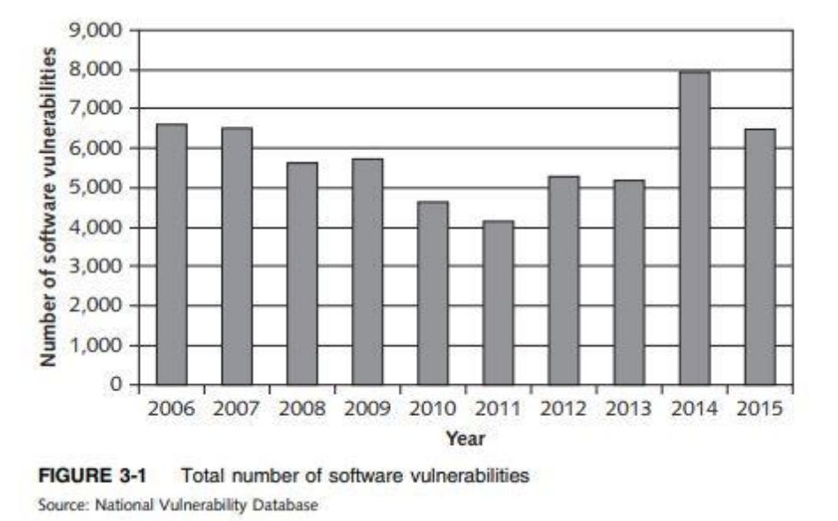
Why Computer Incidents Are So Widespread
Increasing Complexity Increases Vulnerability
Expanding and Changing Systems Introduce New Risks
Increasing Popularity of BYOD Policies
Growing Reliance on Commercial Software with Known Vulnerabilities
Increasing Sophistication of Those Who Would Do Harm

Slide 5
Increasing Complexity Increases Vulnerability:
Complexity in computing environment is increased due to interconnections of cloud computing, networks, computers, mobile devices, OS, websites
With the expansion of the numbers of possible entry point to networks, possibility of security breaches also increases

Slide 6
Expanding and Changing Systems Introduce New Risks:
Business has moved from an era of stand-alone computers to an era of e-commers, mobile computing, global business
To keep up with the technological change, tackle new security risks with effective approaches has increasingly became difficult for IT organizations

Slide 7
Increasing Popularity of BYOD Policies:
The practice of BYOD (Bring Your Own Device) to workspace increased security issues
Accessing internet for non-work activity ( browsing websites, shopping, visiting social networks) exposes them to malware

Slide 8
Growing Reliance on Commercial Software with Known Vulnerabilities
Poor system design or implementation leads exploits to take advantage of a particular system vulnerability
Any delay in installing a patch to deal with vulnerability leads to potential security breach

Slide 9
Increasing Sophistication of Those Who Would Do Harm
Knowledges and expertise group of cyber attackers with ample resources: funds, tools exploits computer and network security
Today’s computer threat is much better organized and may be part of an organized group such as:
Anonymous
Chaos Computer Club (Europe's largest association of hackers with 7700 registered members)
Lizard Squad (black hat hacking group, mainly known for their claims of distributed denial-of-service attacks primarily to disrupt gaming-related services)
TeslaTeam (TeslaTeam is currently the only virtual army in Serbia to openly launch cyber-attacks.)
Hacker teams sponsored by national governments
Some of the perpetrators/culprit
Black Hat Hacker
Cracker
Malicious Insider
Industrial Spy
Cybercriminals
Cyberterrorist
Notes:
2. Cracker: An individual who causes problems, steals data, and corrupts systems.
3. Malicious Insider: An employee or contractor who attempts to gain financially and/or disrupt a company’s information systems and business operations.
4. Industrial spy: An individual who captures trade secrets and attempts to gain an unfair competitive advantage.
5. Cybercriminal: Someone who attacks a computer system or network for financial gain.
7. Cyberterrorist: Someone who attempts to destroy the infrastructure components of governments, financial institutions, and other corporations, utilities, and emergency response units.

Slide 10
Types Of Exploits
Some of the more common attacks include
Rootkits
Advanced Persistent Threats
Phishing and spear phishing
Smishing and vishing
Ransome ware
Viruses
Worms
Trojan Horses
Blended Threats
Spam
Distributed Denial Of Services
Notes:
Ransome Ware:-It is malware that stops you from using your computer/system or accessing your data until you meet certain demands, such as paying a ransom or sending photos to the attacker.
In early February 2016, Hollywood Presbyterian Medical Center was forced to shut down its computer network after hackers encrypted some of its data and demanded a ransom be paid before the data would be unlocked. Initially, the hospital refused to pay the ransom, and hospital employees were forced to resort to paper, pencil, phones, and fax machines to carry out many of their tasks, including accessing patient data. The hospital sought help from the FBI, the Los Angeles Police Department, and cybersecurity consultants, but it was unable to access the data. After a week, the hospital paid the ransom of $12,000. By February 15, access to the data was fully restored, and according to a hospital spokesperson, there was no evidence that any patient or employee data had been accessed.
A blended:- threat is a sophisticated threat that combines the features of a virus, worm, Trojan horse, and other malicious code into a single payload.
Rootkits:- Super user access to systems
Some of the symptoms of rootkit infections are:
• The computer locks up or fails to respond to input from the keyboard or mouse.
• The screen saver changes without any action on the part of the user.
• The taskbar disappears.
• Network activities function extremely slowly.
Advanced Persistent Threats: An APT attack advances through the following five phases:
Inspection
Attack
Discovery
Capture
Export
Spear phishing:- is a variation of phishing in which the phisher sends fraudulent emails to a certain organization’s employees. It is known as spear phishing because the attack is much more precise and narrow, like the tip of a spear.
Smishing and Vishing: Smishing is another variation of phishing that involves the use of texting. In a smishing scam, people receive a legitimate-looking text message telling them to call a specific phone number or log on to a website.
Vishing is similar to smishing except that the victims receive a voice-mail message telling them to call a phone number or access a website

Slide 11
2.2 CIA Security Triad- Confidentiality, Integrity Availability
IT security practices of organizations worldwide are focused on ensuring
1) Confidentiality
2) Maintaining integrity, and
3) Guaranteeing the availability of systems and data

Slide 12
Confidentiality ensures only those with proper authority can access sensitive data
Integrity ensures that data can only be changed by authorized individuals to guarantee accuracy, consistency and trustworthiness of data
Availability ensures that data can be accessed when and where needed during both normal and disaster recovery operations

Slide 13
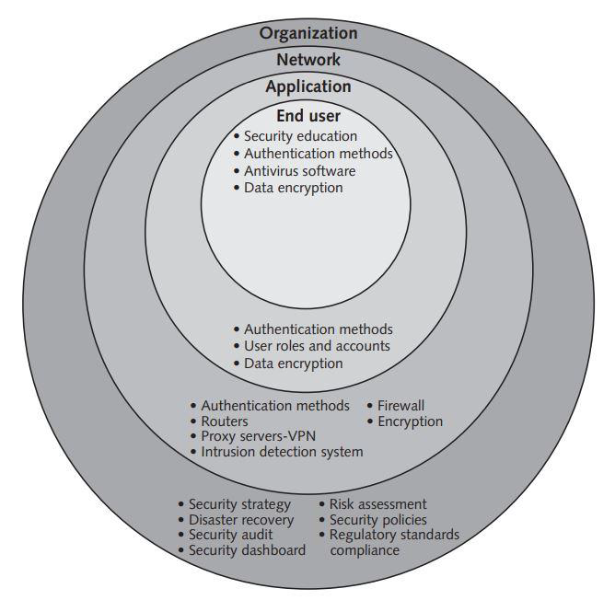
Implementing CIA
At organization level
Network level
Application level
End-user Level

Slide 14
Implementing CIA at the Organization Level
Definition of an overall security strategy
Performance of a risk assessment
Laying out plans for disaster recovery
Setting security policies
Conducting security audits
Ensuring regulatory standards compliances and
Creating a security dashboard
Completion of these tasks at organizational level sets foundation and clear direction for CIA action

Slide 15
Security Strategy:
To minimize the potential impact of any security incident and to ensure business continuity in the event of a cyberattack, a risk-based security strategy with an active governance is needed
Creating such a strategy typically begins with
Identify and rank organizational threats.
Create a plan to recover crucial data and IT assets in case of a disaster.
Set security policies for employees to follow recommended processes.
Regularly audit security to ensure policies are followed and adapt to changes.
Follow internal policies and external standards from regulatory agencies.
Use a security dashboard to track key performance indicators.

Slide 16
Risk Assessment:
To identify which investments of time and resources will best protect the organization from its most likely and serious threats, risk assessment is needed.
The steps in a general security risk assessment process are as follows:
Step 1: Identify critical IT assets aligned with organizational goals.
Step 2: Identify potential risks, such as DDoS attacks or insider fraud.
Step 3: Assess the likelihood of each risk occurring.
Step 4: Evaluate the impact of each potential threat.
Step 5: Mitigate high-probability, high-impact threats first.
Step 6: Assess the feasibility of implementing mitigations.
Step 7: Conduct a cost-benefit analysis for effectiveness.
Step 8: Decide on implementing countermeasures; reassess if needed.
Notes:
Assess: मूल्याङ्कन गर्नु

Slide 17
Disaster Recovery:
Focuses on technology recovery and identifies the people or teams responsible to take action in the event of a disaster, what exactly these people will do when a disaster strikes

Slide 18
Security Policies:
Defines an organization's security requirements, as well as the controls and sanctions needed to meet those requirement
Security policy typically includes:
Acceptable use policy,
Email policy,
Password protection policy,
Remote access policy, and
Software installation policy.

Slide 19
Security Audits:
Another prevention tool, that evaluates whether an organization has a well-considered policy in place and if it is being followed
Also review who access to particular systems and data and what level of authority each user has
For example, if a policy says that all users must change their passwords every 30 days, the audit must check how well that policy is being implemented.

Slide 20
Regulatory Standards Compliance:
Standards developed by the government authorities and industry regulators
Organizations requires to comply with one or more standards in addition to their own security program

Slide 21
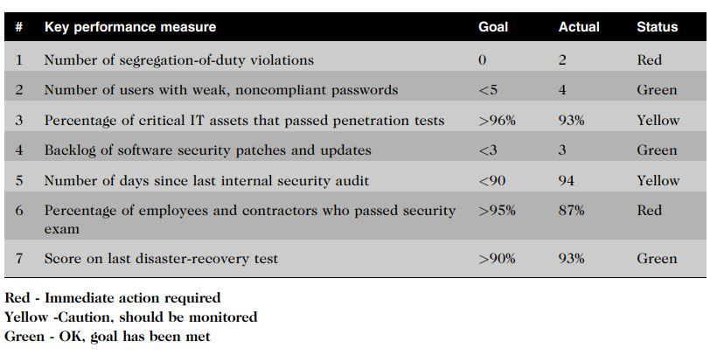
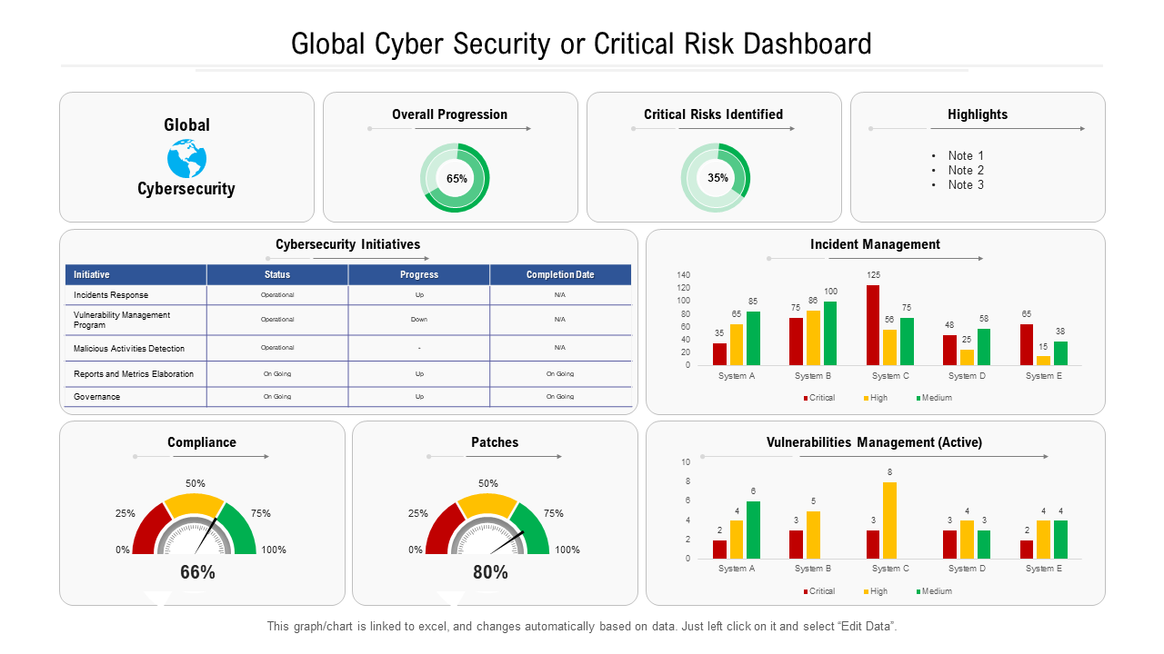
Security Dashboard:
Provides a comprehensive display of all key performance indicators related to an organization's security defenses, including threats, exposers, policy compliance, and incident alerts
It reduces the effort required to monitor and identify threats in time to take action

Slide 22
Implementing CIA at the Network Level
CIA can be implemented in network level by using tools/ techniques like:
Authentication methods
Firewall
Routers
Encryption
Proxy servers and virtual private networks
Intrusion detection system

Slide 23
Authentication methods:
To maintain a secure network, an organization must authenticate users attempting to access the network by requiring them to
Enter username and password
Insert a smart card and enter associate PIN
Provide a fingerprint, voice pattern sample, or retina scan
Use of multifactor authentication: biometrics, one-time passwords, hardware tokens

Slide 24
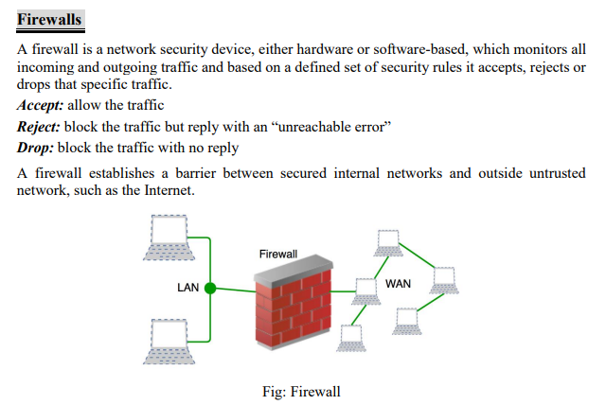

Slide 25
The firewall rule set is based on factors like
Source and destination IP addresses
Network protocols (TCP, UDP, ICMP, etc.)
Port numbers
Applications
User identity
Geographic location
Time of day

Slide 26
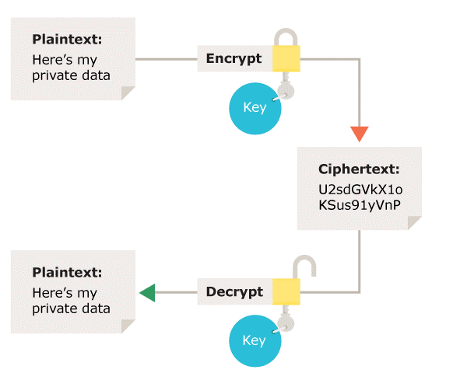
Encryption
Encryption is the process of scrambling messages or data in such a way that only authorized parties can read it.
It is used to protect billions of online transactions each day, enabling consumers to order more than $300 billion in merchandise online and banks to route some $40 trillion in financial transactions each year.
It enables organizations to share sensitive sales data, promotion plans, new product designs, and project status data among employees, suppliers, contractors, and others with a need to know.
Encryption enables physicians and patients to share sensitive healthcare data with labs, hospitals, and other health treatment facilities as well as insurance carriers.

Slide 27
Some of the common encryption methods used are:
Advanced Encryption Standard (AES) – 128, 192, 256 bits - Symmetric encryption
Rivest-Shamir-Adleman (RSA) – Asymmetric encryption
Triple Data Encryption Standard (TripleDES) – Symmetric encryption – advanced form of DES
Elliptic Curve Cryptography (ECC) – Asymmetric encryption

Slide 28
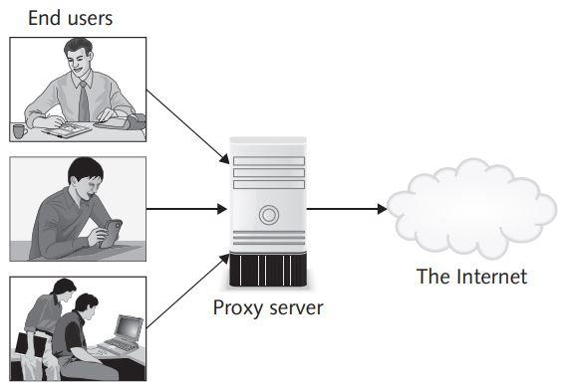
Proxy Servers and Virtual Private Networks:
A proxy server serves as an intermediary between a web browser and another server on the Internet that makes requests to websites, servers, and services on the Internet for you.
Remote users accessing sensitive company data on unsecured networks face security risks. VPNs securely enable remote access by authenticating users, exchanging encryption keys, and ensuring all internet communications are protected from eavesdropping.

Slide 29
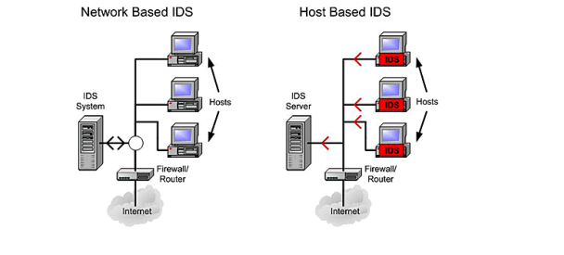
Intrusion Detection System
Monitors system, network resources, activities and notifies network security personnel when it detects network traffic that attempts to avoid the security measures of a networked computer environment

Slide 30
Intrusion detection has two approaches
Knowledge-based IDSs: contains information about specific attacks and system vulnerabilities and watch out for those
Behavior-based IDSs: models normal behavior of a system and its users from reference information collected by various means

Slide 31
Implementing CIA at the Application Level
CIA can be implemented in Application level by using tools/ techniques like:
Authentication methods
User roles and Accounts
Data encryption

Slide 32
Authentication Methods:
Methods like Single-factor authentication, two-factor authentication used to authenticate the users
User Roles and Accounts:
Creation of user's - roles and accounts so they have authority to perform only their responsibilities
Data Encryption:
Used within applications to ensure that the sensitive data are protected from unauthorized access

Slide 33
Implementing CIA at the End-User Level
CIA can be implemented at End-User Level by applying tools/ techniques like:
Security Education
Authentication Methods
Anti-virus Software and
Data Encryption

Slide 34
Security Education:
Creating and enhancing user awareness of security policies, educating them about importance of security to motivate them
Guarding their passwords
Applying strict access controls
Reporting all unusual activity
Authentication Methods:
End users are required to implement a security passcode that must be entered to accept further input

Slide 35
Antivirus Software:
Installed on each user's personal computer to scan computer's memory and disk drives regularly for virus
Anti-virus informs user and it may clean, delete, or quarantine any files, directories when virus is discovered
Data Encryption:

Slide 36
Response to Cyberattack
A response plan should be developed well in advance of any incident
Primary goal is to regain control and limit damage
Some of the activities performed in case of cyberattack are:
Incident notification
Protection of evidence and activity logs
Incident containment
Eradication
Incident follow-up
Using an MSSP (Managed Security Service Provider)
Computer Forensics

Slide 37
Incident Notification
Key element is to define who to notify and who not to notify in the event of a computer security incident
Questions like
Who needs to be notified,
Under what condition should the company contact major customers
How does company inform them

Slide 38
Protection of Evidence and Activity logs:
All details of a security incident are documented to be used as valuable evidence for future prosecution
It captures all system events, specific action (what, when, who)
Might be used in court evidence

Slide 39
Incident Containment
It's necessary to act quickly to contain an attack and to keep a bad situation from becoming worse
Elements for effective response plan :
how such decisions are made
how fast they are made
who makes them

Slide 40
Eradication
Before fixing computer issues, gather evidence and check backups. Save forensic images for study.
01
After removing viruses, make a new backup and keep a log for future reference.
02
Regularly back up important data and test the process to ensure a quick recovery after any problems.
03

Slide 41

Incident Follow-up
Assessing the security incident involves understanding how the organization's defenses were breached and addressing the root cause, often resolved with a simple software patch from the vendor.
Post-incident, a comprehensive review is crucial, including a formal incident report detailing the sequence of events and their impact, allowing identification and prevention of mistakes in the future.
The incident experience should inform updates to the security incident response plan, ensuring continuous improvement.
The key elements of a formal incident report should include the following:
The date and time when the incident was discovered
How the incident was discovered
The method used to gain access to the host computer
A detailed discussion of vulnerabilities that were exploited
Notes:
Lado lado

Slide 42
Using a MSSP (Managed Security Service Provider)
Cybersecurity Challenges:
Organizations face ongoing threats and legal obligations, making security upkeep daunting.
Outsourcing Security:
Many turn to Managed Security Service Providers (MSSPs) like AT&T and IBM for expert help.
Relieving IT Burden:
MSSPs handle security tasks, easing the load on internal teams and providing essential services.
Notes:
release--> Relieving
Load→ Burden
difficult to deal with in prospect →daunting

Slide 43
Computer forensics
Computer forensics is a discipline that combines elements of law and computer science to identify, collect, examine, and preserve data from computer systems, networks, and storage devices in a manner that preserves the integrity of the data gathered so that it is admissible as evidence in a court of law.
Computer forensics investigators work as a team to investigate an incident and conduct forensic analysis by using various methodologies and tools to ensure the computer network system is secure in an organization.

Slide 44
Cyber law
Definition of Cyber Law:
Cyber law, or cybercrime law, pertains to legislation governing the responsible use of technology, encompassing computer hardware, software, the internet, and networks.
Scope and Application:
Applicable to individuals, groups, government, private organizations, and the public, cyber law addresses legal issues in cyberspace. It covers diverse aspects such as freedom of expression, internet access, and online privacy.
Protection for Users:
Cyber law serves to protect users by enabling the investigation of online criminal activities, ensuring a safer digital environment.
Business Safeguards:
In the business landscape, cyber law plays a vital role in shielding companies from unauthorized access and theft, safeguarding intellectual property and ensuring a secure online presence.
Notes:
Legislation → the process of making or enacting laws.

Slide 45
Importance of Cyber Law:
It give orders to all actions and reactions in Cyberspace.
All online transactions are ensured to be safe and protected
All online activities are under watch by the Cyber law officials.
Security for all data and property of individuals, organizations, and Government
All actions and reactions implemented on any cyberspace has some legal angle associated with it
Keeps track of all electronic records
Helps to establish electronic governance

Slide 46

Types of Cyber Law:
Copyright
Fraud
Harassment and stalking
Freedom of Speech
Trade Secret
Contracts and Employment Laws

Slide 47

Categories of Cyber Law:
Individual
Property
Government

Slide 48
Cyber Law as per countries
US
India
Nepal

Slide 49
Provision of Electronic Transaction Act of Nepal
Electronic Transaction Act, 2063
Preamble
Chapter 1: Preliminary
Chapter 2: Provisions relating to Electronic Record and Digital Signature
Chapter 3: Provisions relating to Dispatch, Receipt and Acknowledgement of Electronic Records
Chapter 4: Provisions relating to Controller and Certifying Authority
Chapter 5: Provisions relating to Digital Signatures and Certificates

Slide 50
Chapter 6: Functions, Duties and Rights of Subscribers
Chapter 7: Electronic Record and Government use of Digital Signatures
Chapter 8: Provisions relating to Network Services
Chapter 9: Provisions relating to Offence Relating to Computer
Chapter 10: Provisions relating to Information Technology Tribunal
Chapter 11: Provisions relating to Information Technology Appellate Tribunal
Chapter 12: Miscellaneous

Slide 51
Thank You

