Slide 1
Cyber law and Professional ethics
Nabin Thapa

Slide 2
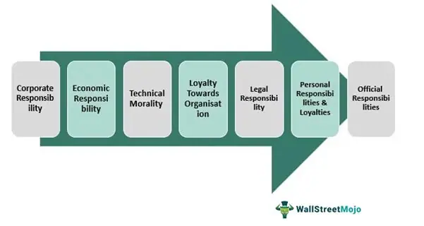
Types of Business Ethics

Slide 3
Corporate Responsibility: The organization works as a separate legal entity with certain moral and ethical obligations. Such ethics safeguard the interest of all the internal and external parties associated with the firm. This includes the employees, customers, and shareholders.
Social Responsibility: Making profits should not be at the cost of society. Therefore, corporate social responsibilities (CSR) have been a common practice where businesses work towards environmental protection, social causes, and spreading awareness.

Slide 4
Personal Responsibility: Employees are expected to act responsibly with honesty, diligence, punctuality, and willingness to perform excepted duties. Individuals should settle dues in time and avoid criminal acts.
Technology Ethics: In the 21st century, companies have adopted e-commerce practices. Technology ethics includes customer-privacy, personal information, and intellectual property fair practices.

Slide 5
Fairness: Favoritism is highly unethical. Every individual possesses certain personal bias. But at the workplace, personal beliefs and biases should not affect decision-making. The firm has to ensure fair chances of growth and promotion for all.
Trustworthiness and Transparency: Businesses should maintain transparency in business practices and financial reports.

Slide 6
Corporate Social Responsibility
Corporate social responsibility (CSR) refers to strategies that companies put into action as part of corporate governance that are designed to ensure the company’s operations are ethical and beneficial for society.
Generally, corporate social responsibility initiatives are categorized as follow:
Environmental responsibility: Environmental responsibility initiatives aim to reduce pollution and greenhouse gas emissions and the sustainable use of natural resources.

Slide 7
Human Right Responsibility: Human right responsibility initiatives involve providing fair labour practices (e.g, equal pay for equal work) and fair trade practice and disavowing child labor.
Philanthropic responsibility: Philanthropic responsibility can include things such as funding educational programs, supporting health initiatives, donating to causes and supporting community beautification projects.

Slide 8
Economic Responsibility: Economic responsibility initiative involve improving the firm’s business operating while participating in sustainable practies- for example, using a new manufacturing process to minimize wastage

Slide 9
Fostering Corporate Social Responsibility and Good Business Ethics
Benefits
Strong Brand Image, Recognition and reputation
CSR adds value to firms by establishing and maintaining a good corporate reputation and brand equity.
Increase Customer Loyalty and sales
Customer of a firm that practices CSR feel that they are helping the firm support good causes.
Operational cost saving
Investing in oprational efficiencies result in operational cost saving as well as reducing environmental impact.
Retaining key and talented employees
Employee often stay longer and are more committed to their firm knowing that they are working for a business that practices CSR.
Easier access to funding
Many investors are more willing to support a business that practices CSR.
Reduce regulatory burden/ load
Strong relationships with regulatory bodies can help reduce a firm’s regulatory burden

Slide 10
Improving Business Ethics
Research by the Ethics Resource Center(ERC) found that 86 percent of the employees in companies with a well-implemented ethics and compliance program are likely to perceive a strong ethical culture within the company, while less than 25 percent of employee in companies with little to no program are likely to perceive a culture that promotes integrity in the workplace.
Business ethics is a form of professional ethics. Business ethics are the rights, responsibilities and duties between a company and its employee, suppliers, customes and neighbors.
In place of work, the law requires one to observe an acceptable code of conduct at all times.
It’s important to foster good business ethics is in order to gain goodwill of the community because according to marshall field.
“goodwill is the one and only asset that competition cannot undersell or destroy”.

Slide 11
The Ethics Resource Center has defined the following characteristics of a successful ethics program:
Employees are willing to seek advice about ethics-related issues
Employees feel prepared to handle situations that could lead to misconduct
Employees are rewarded for ethical behavior
The organization does not reward success obtained through questionable means
Employees feel positively about their company

Slide 12
Some of the action's corporations can take to improve business ethics
Appoint a corporate ethics officer:
He/she provides an organization with vision and leadership in the area of business conduct, aligns the practices of a workplace with the stated ethics and beliefs of that workplace
Require the Board of Directors to Set and Model High Ethical Standards:
The Board of Directors is responsible for management of an organizations, they are expected to conduct themselves according to the highest standards while setting the standard companywide
Establish Corporate Code of Ethics:
A code of ethics is a statement that highlights an organization's key ethical issues and identifies the primary values and principles that are important to the organization and decision making.

Slide 13
Conduct Social Audits:
In a social audit, an organization reviews how well it is meeting its ethical and social responsibility goals and communicates its new goals for the upcoming year to the employees, shareholders, investors, market
Require employees to take ethics training
Employees must be given comprehensive ethics education program that encourages employees to act responsibility

Slide 14
Include ethical criteria in employee appraisals
Managers can help employees to meet performance expectations by monitoring employee behavior and providing feedback; increasingly, managers are including ethical conduct as part of an employee's performance appraisal
Create an ethical work environment
Employees may be encouraged to do "whatever it takes" to get the job done, some employee may feel pressure to engage in unethical conduct to meet management's expectations if the organization has no corporate code of ethics and no strong examples of senior management practicing ethical behavior.

Slide 15
Steps to improve business ethics
Employees must understand that expectations for ethical behavior begin at the top and that senior management expects all employees to act accordingly.
Managers and other must be trained to consider the ethical implications of all business decisions.
An ethical office must be set up with which employee can communicate anonymously.
Outsider such as supplier, distributors, and customers must be told about ethics program.
The ethics code must be enforce with timely action if any rules are break. That is the must forceful way to communicate to all employees that the code is serious.

Slide 16
Ethical consideration in decision making
Ethics is concerned with what is right and wrong , fair and unfair in decision and actions that affect others.
Our ethical framework is found on the values we hold and belives to be important.
Values are a set of moral principles we embrace about what is good, desirable and of value in human actions.
We use this principle to evaluate choice and actions.

Slide 17
Ethical decision are almost always complex for several reasons. Most ethical decisions have.
Multiple alternatives
Uncertain consequences
Outcomes that mix various economic, legal, and social benefits and cost and personal implications.

Slide 18
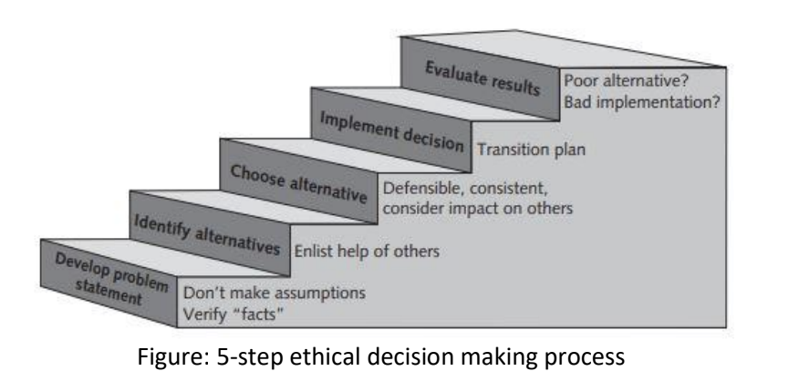
Steps involved in ethical decision making process are:
Develop problem statements
Identify alternatives
Choose alternatives
Implement decision
Evaluate results

Slide 19
Develop problem statements:
A problem of statements is a clear, concise description of the issue that needs to be addressed. We must gather and analyze facts, seek information and opinions from the variety of people to develop a good problem statement
Identify alternatives
During the decision-making process, it is better to enlist all the possible alternatives(solutions). Brainstorming discussion with the stakeholders can help to enlist them

Slide 20
Choose alternatives
Once a set of alternatives has been identified the group must evaluate them based on numerous criteria such as:
Effectiveness of addressing the issue
The extent of risk associated with each alternative
Cost and time to implement
Implement the decision
Once an alternative is selected, it should be implemented in an effective, efficient and timely manner. A transition plan must be defined to explain to people how they will move from the old way of doing things in new way.

Slide 21
Evaluate results:
After the solution to the problem has been implemented, monitor the results to see if the desired effect was achieved and observe its impact on the organization and the various stakeholders. If refinement are needed return to the problem development step, refine the problem statement as necessary and work through the process again.

Slide 22
Ethics in Information Technology (IT)
The growth of the internet and social networks; the ability to capture, store and analyze vast amounts of personal data, and a greater reliance on information systems in all aspects of life have increased the risk that information technology will be used unethically
Here are some examples that raise public concern about the ethical use of information technology:
Government around the world have implemented various systems that enable the surveillance of their citizens and are struggling to achieve the proper balance between privacy and security

Slide 23
Many employees have their email and internet access monitored while at work as employers struggle to balance their need to manage important company assets and work time with employee's desire for privacy and self-direction.
Millions of people have downloaded music and movies at no charge and in apparent violation of copyright laws at tremendous expense to the owners of those copyright.
Organizations contact millions of people worldwide through unwanted email and text messages in an extremely low cost but intrusive marketing approach.

Slide 24
Ethics in IT has two aspects:
The general public needs to develop a better understanding of the critical importance of ethics as it applies to IT; currently too much emphasis is places on technical issues. IT has a deep effect on society and IT professionals and end users need to recognize this fact when they implement technology and formulate policies that will have legal consequences and affect the wellbeing of millions of concerns.
Important business-technology decisions with strong ethical implications are too often left to the technical experts to decide . General business managers must assume greater responsibility for such decisions, but to do so they must be able to make broadminded, objective decisions based on technical knowledge, business know-how, and high ethical standard,. They must also try to create a working environment in which ethical dilemmas can be discussed openly, objectively and constructively.

Slide 25
The goals of Ethics in IT are:
To educated people about the tremendous impact of ethical issues in the successful and secure use of information technology
To motivate people to recognize these issues when making business decisions; and
To provide tools, approaches, and useful insights for making ethical decisions

Slide 26
Managing IT worker relationship
Relationships between IT workers and Employers
Relationships between IT Workers and Clients
Relationship between IT workers and suppliers
Relationship between IT workers and Other Professionals
Relationship between IT workers and IT Users
Relationship Between IT workers and Society

Slide 27
Relationships between IT workers and Employers:
IT workers and employees have a critical, complicated relationship that requires ongoing effort by both parties to keep it strong
Many aspects of this relationship may be addressed in a company's policy and procedures manual or company's code of conduct
Software piracy, Trade secrets, whistleblowing are the area in which IT workers may be tempted to violate laws and policies

Slide 28
Relationship between IT workers and clients:
In relationships between IT workers and clients, each party agrees to provide something of value to the other.
IT workers provide hardware, software, or services at a certain cost and within a given time frame to clients.
The clients trusts IT worker to use his/ her expertise and to act in the client's best interests whereas IT worker trust the client will provide relevant information to make wise decisions.

Slide 29
Relationships between IT workers and suppliers:
Good working relationship between IT workers and suppliers encourages the flow of useful information, ideas to make innovative and cost-effective use of product and services.
Suppliers might use bribery to maintain positive relationships with their customers which is considered unethical action.

Slide 30
Relationships between IT workers and other Professionals:
Professionals often feel a degree of loyalty to other members of their profession in result helping each other in obtaining new positions.
Ethical problems as resume inflation may arise such as over exaggeration of his/her qualifications
Another ethical issue that can arise in relationships between IT workers and other professionals is inappropriate sharing of corporate information.

Slide 31
Relationships between IT workers and IT users:
IT workers have a duty to understand a user's needs and capabilities and to deliver products and services that best meets those needs- subjects of course, to budget and time constraints.
Establishment of environment that supports ethical behaviors by users discourages software piracy, minimizes the inappropriate use of corporate computing resources and inappropriate sharing of information.

Slide 32
Relationship between IT workers and Society:
Regulatory laws establish safety standards for products and services to protect the public.
Society expects members of a profession to provide benefits and to not cause harm through their actions by establishing and maintaining professional standards that protect the public.

Slide 33
Encouraging Professionalism of IT workers
A professional is one who possesses the skill, good judgement and work habits expected from a person who has training and experiences to do a job well.
IT organizations seeks workers having following characteristics of professionals
They are an expert in the tools and skills needed to do their job
They produce high quality results
They meet their commitments
They communicate effectively
They train and develop others who are less skilled or experienced

Slide 34
IT workers of all types can improve their profession's reputation for professionalism by
Subscribing to a professional code of ethics
Joining and participating in professional organizations,
Obtaining appropriate certifications and
Supporting government licensing where available.

Slide 35
Professional Codes of Ethics
These are a set of guidelines that outline the principles and values that professional are expected to follow in their work
They provides a framework for ethical decision-making and behavior, and help to ensure that professionals act in the best interests of their clients, colleagues and society as a whole

Slide 36
Benefits of professional code of ethics:
Ethical decision-making:
Practitioners use a common set of core values and beliefs as a guideline for ethical decision making.
High standards of practice and ethical behavior:
The codes defines acceptable and unacceptable behaviors to guide professionals in their interaction with others.
Trust and respect from the general public:
Adherence to a code of ethics enhances trust and respect for professional and their profession.
Evaluation benchmark:
A code of ethics provides an evaluation benchmark that a professional can use as a means of self-assessment.

Slide 37
Professional Organizations
In order to stay on the top of the many new developments in their fields, IT workers need to network with others, seek out new ideas, and continually build on their personal skills and expertise.
These organizations disseminate information through email, periodicals, websites, social media, meeting and conferences.
Four of the most prominent IT- related professional organizations are highlighted below:
Association for Computing Machinery (ACM)
Institute of Electrical and Electronics Engineers Computer Society (IEEE-CS)
Association of Information Technology Professionals (ATP)
SysAdmin, Audit, Network, And Security (SANS) Institute

Slide 38
Certification
Certification indicated that a professional possesses a particular set of skills, knowledge or abilities, in the opinion of the certify
IT – related certifications may or may not include a requirement to adhere to a code of ethics whereas such a requirement is standard with licensing
Numerous companies and professional organizations offer certifications, and opinions are divided on their value
Many employers view them as a benchmark
Some hiring managers are rather cynical about the value of certifications
Certifications provides a structured way to employees to motivate to learn new skills

Slide 39
Vendor certifications
Many IT vendors- such as Cisco, IBM, Microsoft, SAP and Oracle- offer certification programs for those who use their products.
Workers with vendor certification can represent themselves as a certified user of the manufacturer products.
This might substantially improve an IT workers's salary and career prospects.

Slide 40
Licensing of IT Professionals
Licensing is a form of regulation that is typically required by the government, and is mandatory for certain professions, for example, doctors, nurses, accountants.
It is a legal authorization to practice a profession.
Certification and licensing are often used as a way for individuals to demonstrate their qualifications, and for employers and clients to ensure that professionals are qualified to perform their work.

Slide 41
IT professionals Malpractice
For an IT worker to become licensed raises some potential legal issues as:
Negligence : not doing something that a reasonable person would do or doing something that a reasonable person would not do
A breach of the duty of care: failure to act as a reasonable person would act.

Slide 42
Encouraging ethical use of IT resources among users
Some of the common ethical issues with IT users are:
Software piracy
Inappropriate use of computing resources
Inappropriate sharing of information
Here are some steps that can be taken to encourage ethical use of IT resources among users:
Developing a code of conduct that clearly outlines the acceptable use of IT resources and the consequences for violations
Providing training and educations to users on the ethical use of IT resources, including topics such as security, data privacy and intellectual property
Establishing security measures such as firewalls, antivirus software and user authentication to protect IT resources from unauthorized access and misuse

Slide 43
Encouraging reporting of any suspicious and unethical activity related to the use of IT resources
Monitoring and auditing of IT resources to detect and prevent any unauthorized access or misuse
Holding users accountable for their actions and take appropriate action such as disciplinary measures, if violations of the code of conduct occur
Continuously review and access the use of IT resources, taking into account feedback from users and make adjustments as needed
Creating a culture of ethics in the organization by promoting ethical behavior and decision-making

Slide 44
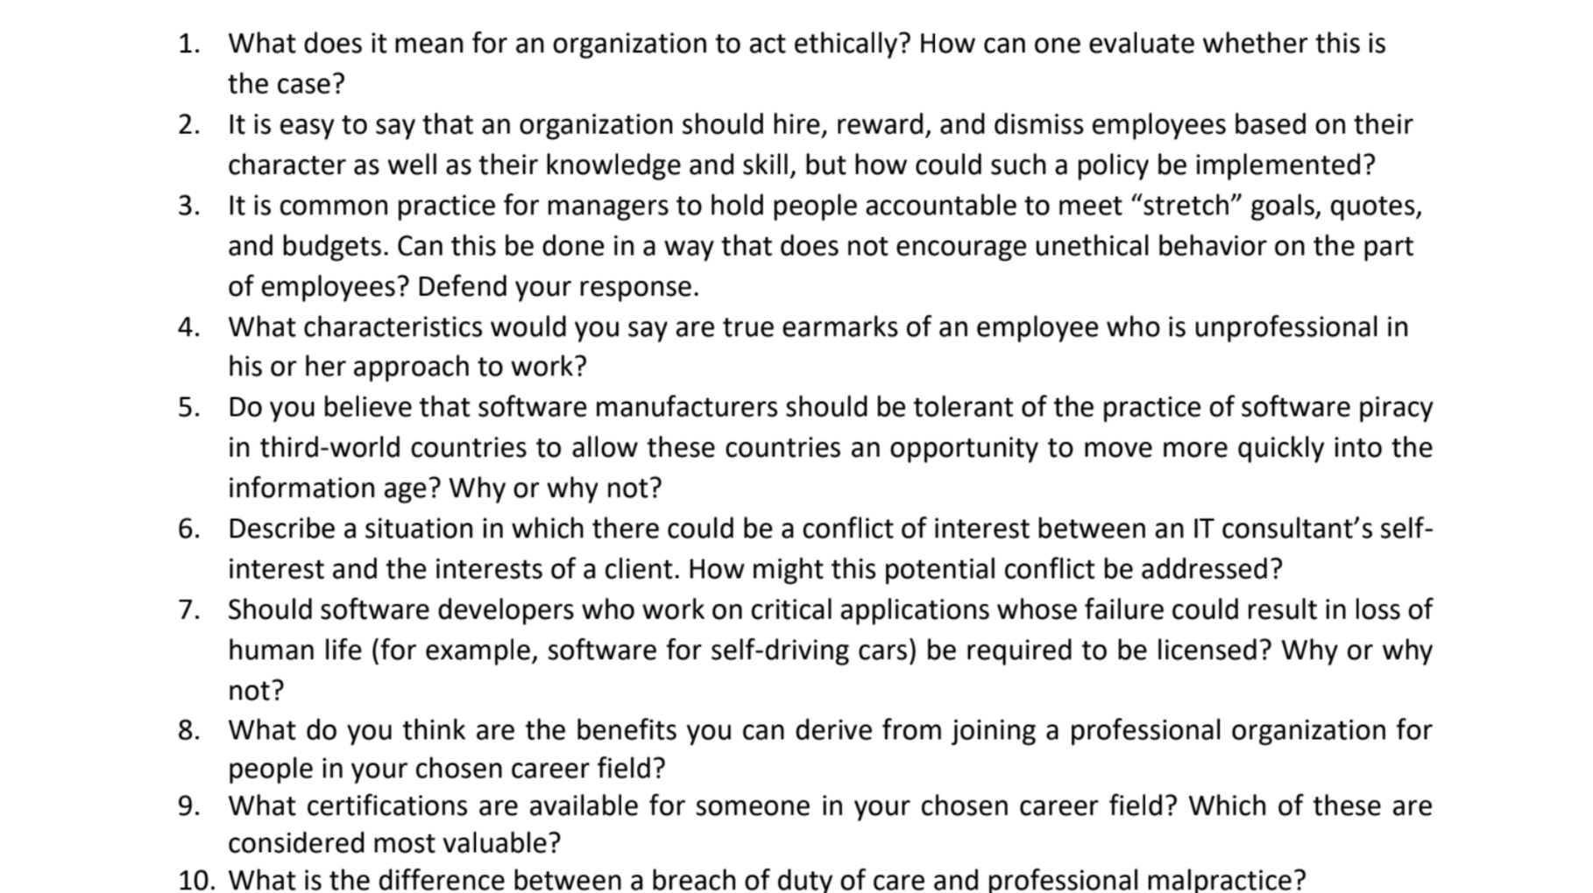
Notes:
;

Slide 45

Thank You

