Slide 1
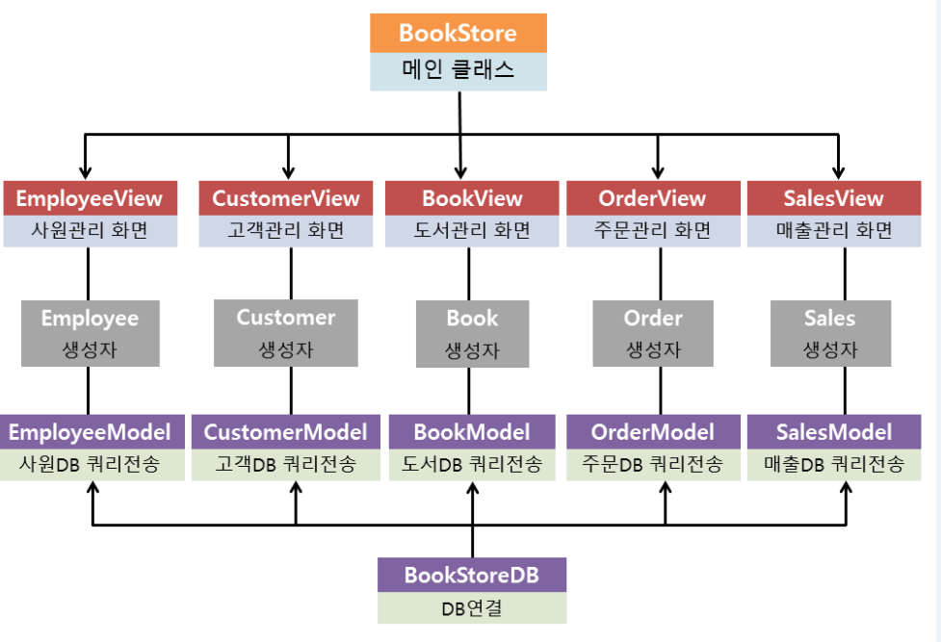

Slide 2
Studyroom Pos
메인 클래스
로그인화면
CustomerView
고객관리 화면
mainPosView
메인포스 화면
studyroomView
스터디룸 화면
reservationView
예약 화면
OrderView
결제 화면
Customer
생성자
reservation
생성자
order
생성자
CustomerModel
고객DB 전송
reservationModel
예약DB 전송
OrderModel
결제DB 전송
Studyroom DB
DB 연결

Slide 3
CustomerModel
StudyroomView
StudyroomPos
+StudyroomPos()
+main(String[]):void
+eventProc():void
+connectDB():void
+addLayout():void
+login():void
ReservationView
OrderModel
OrderView
ReservationModel
CustomerView
+CustomerView():void
+eventProc():void
+connectDB():void
+addLayout():void
+insertCustomer():void
+deleteCustomer():void
+modifyCustomer():void
MainPosView
+MainPosView():void
+eventProc():void
+connectDB():void
+addLayout():void
+customerBt():void
+reservationBt():void
+orderBt():void
ChatClientMain
ChatServerMain
ChatClientProtocol
ChatServerProtocol
ChatService

Slide 4
StudyroomDB
CustomerModel
ReservationModel
OrderModel

