Slide 1

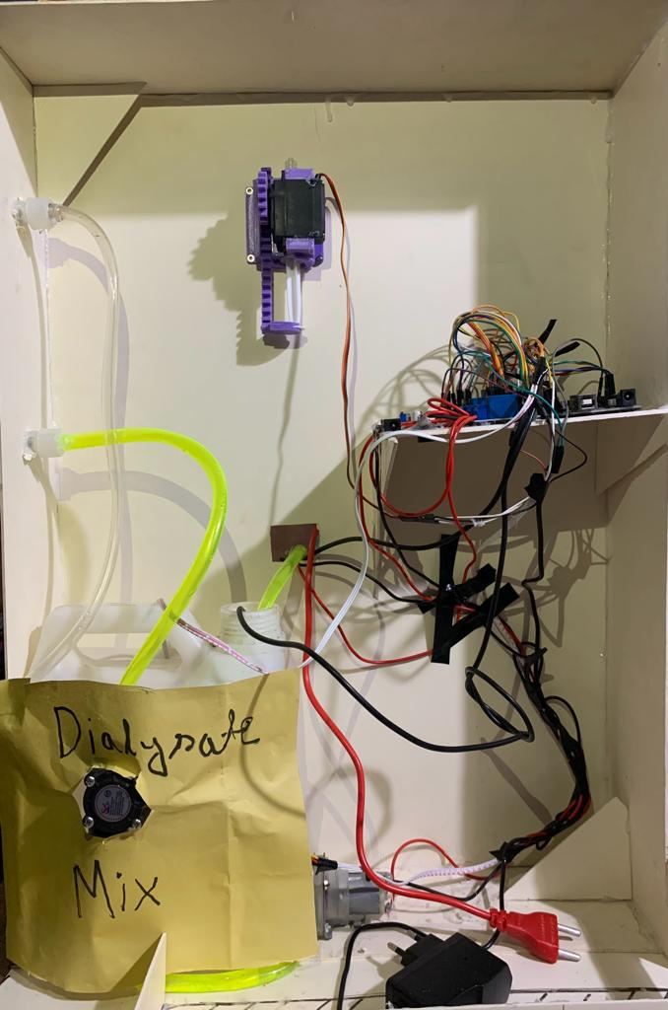
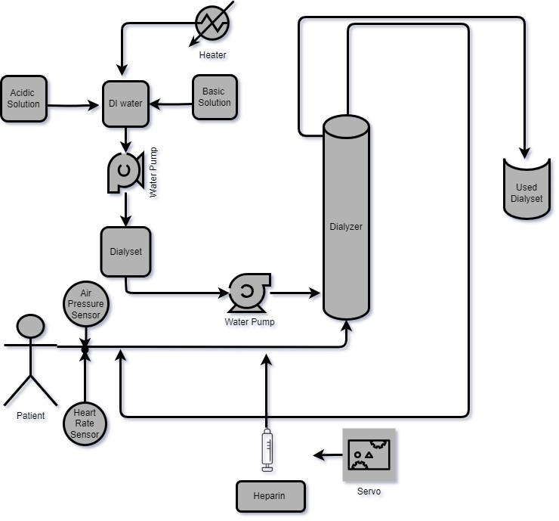
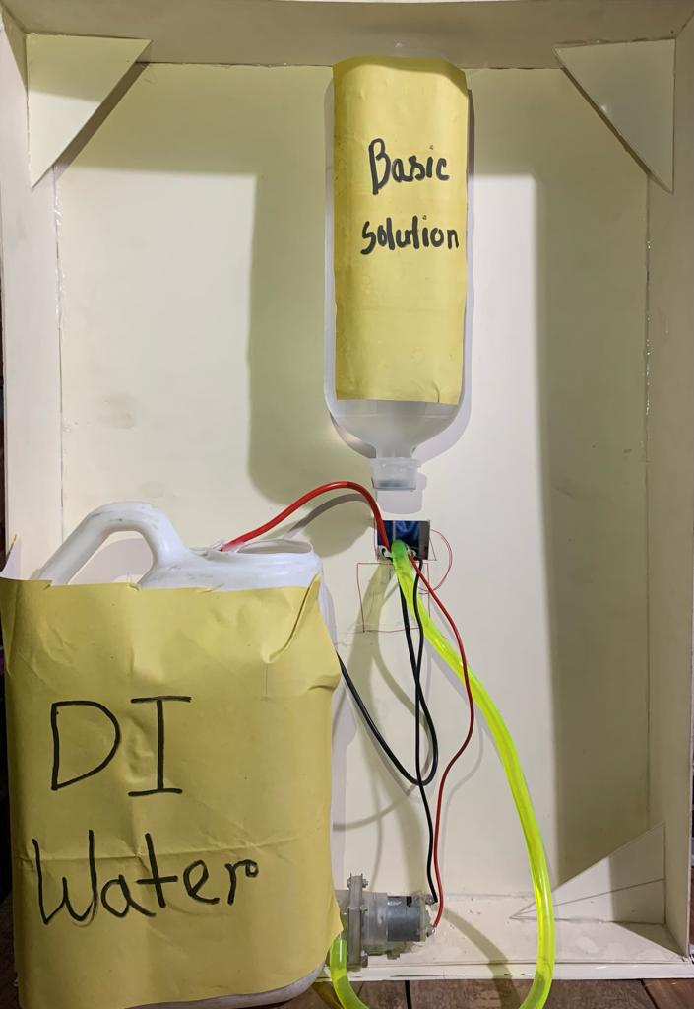
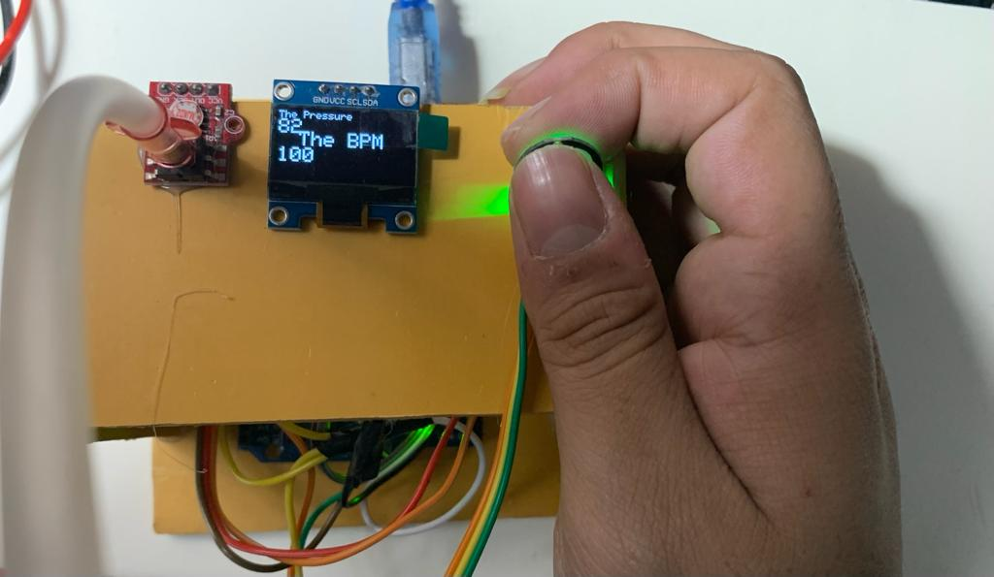
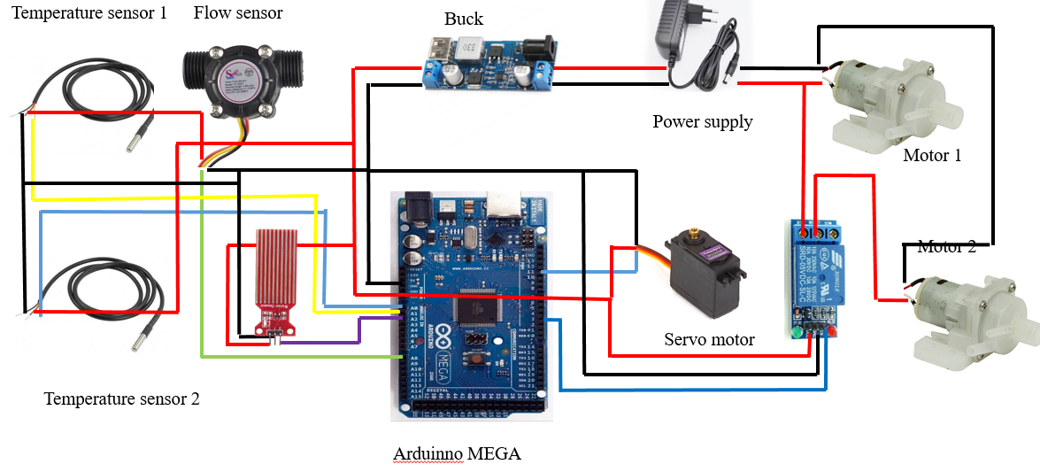
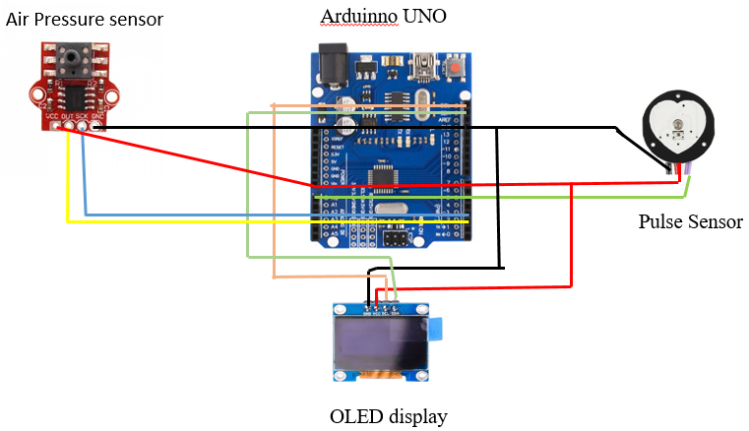
1915026
Automated Heparin Administration and Dialysate Control System with Real-time Monitoring of Patient Vital Indicator in Hemodialysis
Name: Husain Hamid Chowdhury Ruddro
Supervisor: Jeba Fairooz Rahman
Department of Biomedical Engeering
KUET, Khulna-9203, Bangladesh
Introduction & Motivation
Results & Analysis
Hemodialysis treats kidney failure by filtering blood when the kidneys can't.
The goal is to provide low cost and easily accessible dialysis treatment for the kidney failure patient.
What: This machine cleanses the blood by removing toxins and excess fluids when the kidneys fail to do so adequately
Who: Crucial for patients, medical professionals, engineers, regulators, investors, and community health advocates.
How : Extracting the wastages from the blood using dialysate solution by the osmosis process .
Why: This hemodialysis machine is less expensive and very easy to carry compare to the existing hemodialysis machine.
Project Description
1. Two temperature sensors are connected to A0 and A1 pin of Arduino Mega
2. Water level senor connected to the A2 pin that used for turning on the motor using relay
3. Water flow sensor connected to A8 pin that to the dialyzer
5. The extended section used Arduino Uno where the Heart Rate Sensor connected to A0 and pressure sensor’s OUT and SKT pin connected to 2 and 3 pin
4. Servo connected to the pin 11 and also powered by a 5v external power source
Materials & Methods
SL No | Component Name | Description | Quantity
1 | Arduino Mega | Microcontroller | 1
2 | Arduino Nano | Microcontroller | 1
3 | Power Supply | 12V-2A,9V-2A,5V-2A | 3
4 | OLED display | .96’’ Inch 12c OLED Display | 1
5 | Dialyzer | ---- | 1
6 | Heater | 500W | 1
7 | Temperature Sensor | DS18B20 | 1
8 | Water Flow Sensor | G1/2" Water Flow Hall Sensor | 1
9 | Water level Sensor | DC3-5V | 1
10 | Pulse Sensor | ---- | 1
11 | Air Pressure Sensor | HX710B | 1
12 | Pump | 12v Dc | 2
13 | Relay | ---- | 3
14 | Servo Motor | MG996R | 1
15 | Jumper Wire | ---- | As required
16 | Hemodialysis Blood Tubing Set | ---- | 1
Conclusion
The process performed at a very low cost and was a compact machine for carrying anywhere.
It can be a demo machine for the educational purpose.
Accuracy level is comparatively low and painful maintenance.
Rechargeable power supply will make it be able to operate anywhere and also make this fully automatic.
Acknowledgements
Supervisor: Jeba Fairooz Rahman Mam
Special thanks to :Md Abu Shahid Chowdhury Sir
Department of Biomedical Engineering Khulna University of Engineering &Technology (KUET), Khulna-9203, Bangladesh

