Slide 1

Experiment No. 05
Course code : EE 3214
Sessional on
Microprocessors, Micro-controllers and Peripherals
Presented By
Amit Kumer Podder
Department of Electrical and Electronic Engineering
Khulna University of Engineering & Technology
Khulna-9203

Slide 2
Experiment Name
(a) Introduction to 8086 Microprocessor Internal Architecture, Addressing modes and Hex code
(b) Constructing the Machine code for 8086 instruction
(c) Familiarization with MDA-Win 8086 Microprocessor Trainer Kit

Slide 3
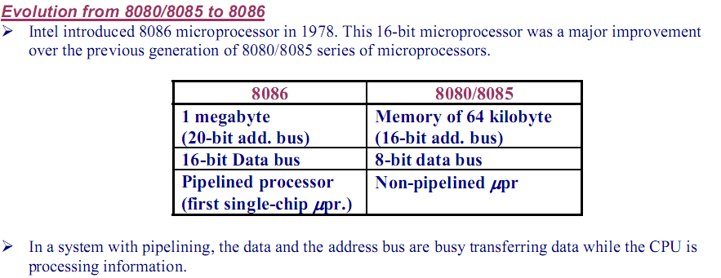
Intel 8086 Microprocessor

Slide 4
Intel 8086 Microprocessor
Key Features:
Released by Intel in 1978
Produced from 1978 to 1990s
A 16-bit microprocessor chip.
Max. CPU clock rate :
5 MHz to 10 MHz
Instruction set: x86-16
Package: 40 pin DIP
The 8086 gave rise to
the x86 architecture of Intel's future processors.
Common manufacturer(s): Intel, AMD, NEC, Fujitsu, Harris (Intersil), OKI, Siemens AG, Texas Instruments, Mitsubishi.
Notes:
4

Slide 5
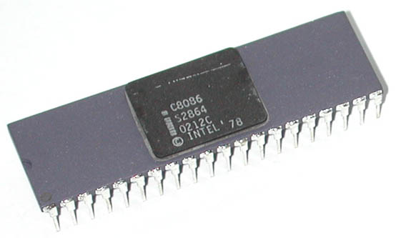
Intel 8086 Microprocessor
It is available in three versions:
8086 (5 MHz)
8086-2 (8 MHz)
8086-1 (10 MHz)
It consists of 29,000 transistors.

Slide 6
Intel 8086 Microprocessor
It has a 16 line data bus.
And 20 line address bus.
It could address up to 1 MB of memory.
It has more than 20,000 instructions.
It supports multiplication and division.

Slide 7
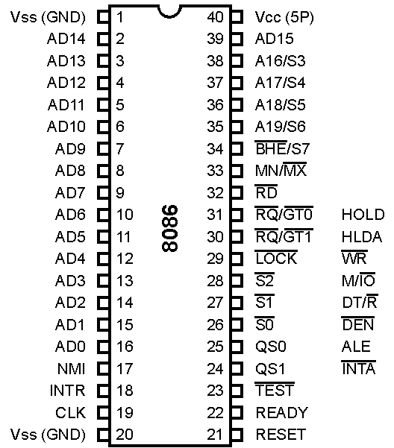
Pin diagram 8086 Microprocessor

Slide 8

These lines are multiplexed bi-directional address/data bus.
During T₁, they carry lower order 16-bit address.
In the remaining clock cycles, they carry 16-bit data.
AD₀-AD₇ carry lower order byte of data.
AD₈-AD₁₅ carry higher order byte of data.

Slide 9
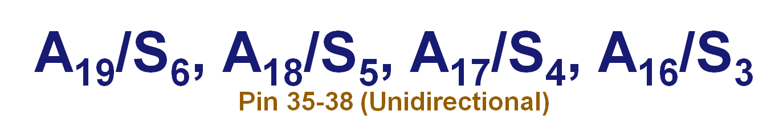
These lines are multiplexed unidirectional address and status bus.
During T₁, they carry higher order 4-bit address.
In the remaining clock cycles, they carry status signals.

Slide 10

BHE stands for Bus High Enable.
BHE signal is used to indicate the transfer of data over higher order data bus (D₈ – D₁₅).
8-bit I/O devices use this signal.
It is multiplexed with status pin S₇.

Slide 11

It is a read signal used for read operation.
It is an output signal.
It is an active low signal.

Slide 12

This is an acknowledgement signal from slower I/O devices or memory.
It is an active high signal.
When high, it indicates that the device is ready to transfer data.
When low, then microprocessor is in wait state.

Slide 13
RESET Pin 21 (Input)
It is a system reset.
It is an active high signal.
When high, microprocessor enters into reset state and terminates the current activity.
It must be active for at least four clock cycles to reset the microprocessor.

Slide 14
INTR Pin 18 (Input)
It is an interrupt request signal.
It is active high.
It is level triggered.

Slide 15
NMI Pin 17 (Input)
It is a non-maskable interrupt signal.
It is an active high.
It is an edge triggered interrupt.

Slide 16
TEST Pin 23 (Input)
It is used to test the status of math co-processor 8087.
The BUSY pin of 8087 is connected to this pin of 8086.
If low, execution continues else microprocessor is in wait state.

Slide 17
CLK Pin 19 (Input)
This clock input provides the basic timing for processor operation.
It is symmetric square wave with 33% duty cycle.
The range of frequency of different versions is 5 MHz, 8 MHz and 10 MHz.

Slide 18
V_{CC} and V_{SS} Pin 40 and Pin 20 (Input)
V_{CC} is power supply signal.
+5V DC is supplied through this pin.
V_{SS} is ground signal.

Slide 19
MN / MX Pin 33 (Input)
8086 works in two modes:
Minimum Mode
Maximum Mode
If MN/MX is high, it works in minimum mode.
If MN/MX is low, it works in maximum mode.

Slide 20
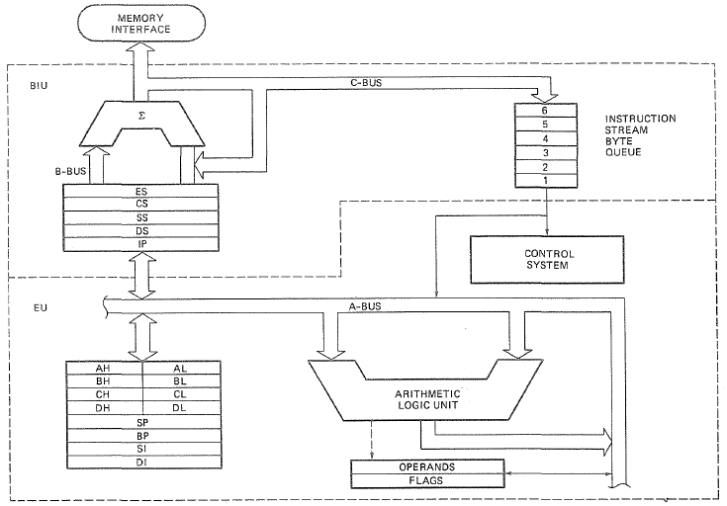
8086 INTERNAL ARCHITECTURE
Fig: 8086 Internal block diagram .

Slide 21
8086 microprocessor
Address Bus – 20 lines – A₁₉ – A₀
Add
Bus
Data Bus – 16 lines – D₁₅ – D₀
Data
Bus
Microprocessor
8086
16 bit- microprocessor
16-bits data bus
Control
signals

Slide 22
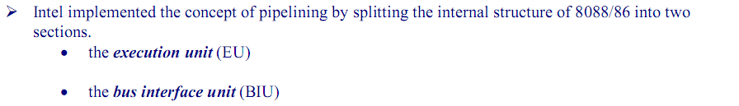
BIU and EU
BIU (bus interface unit) sends out addresses, fetches instructions from memory, reads data from ports and memory, and writes data to ports and memory. In other words, the BIU handles all transfers of data and addresses on the buses for the execution unit.
EU (execution unit) of the 8086 tells the BIU where to fetch instructions or data from, decodes instructions, and executes instructions.

Slide 23
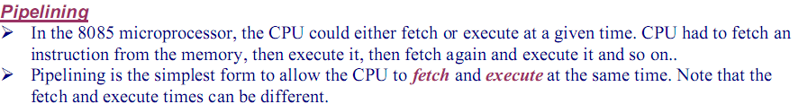
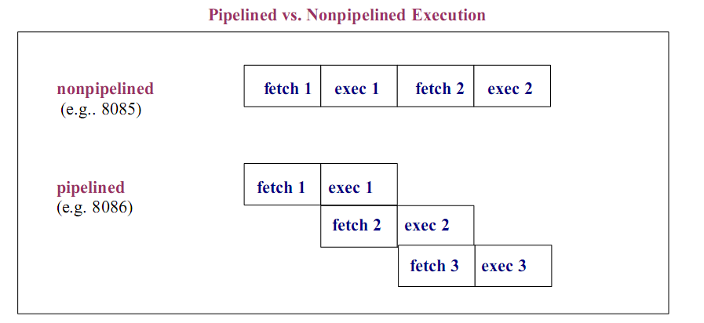

Slide 24
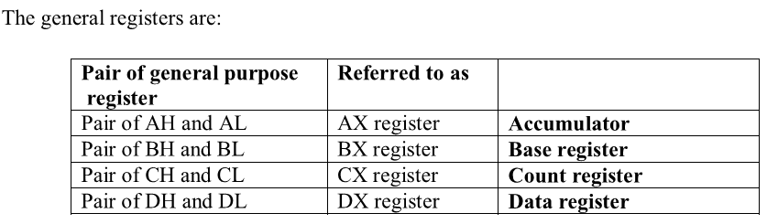
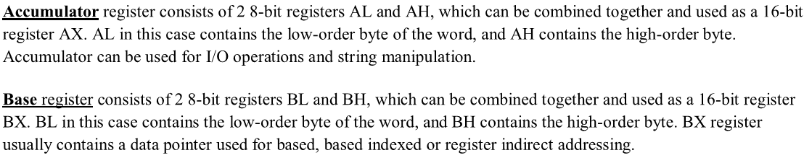

Slide 25
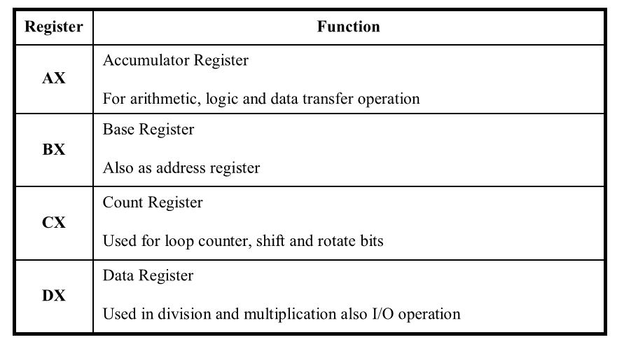

Slide 26
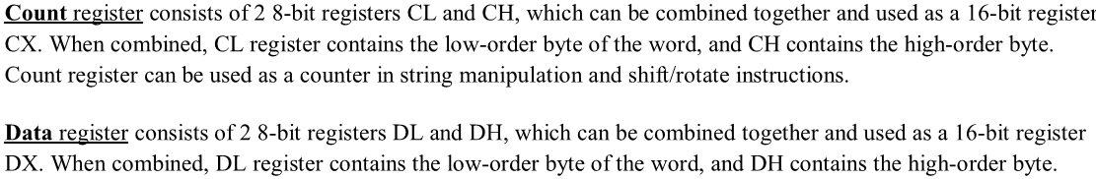
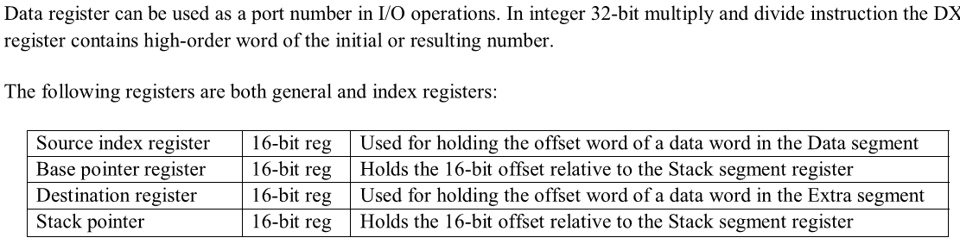

Slide 27
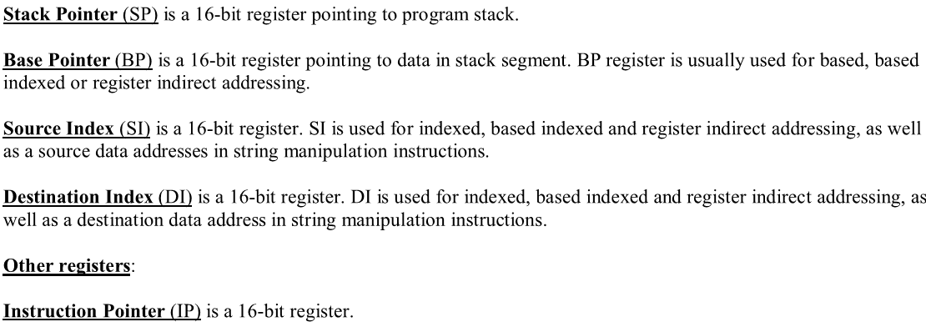

Slide 28
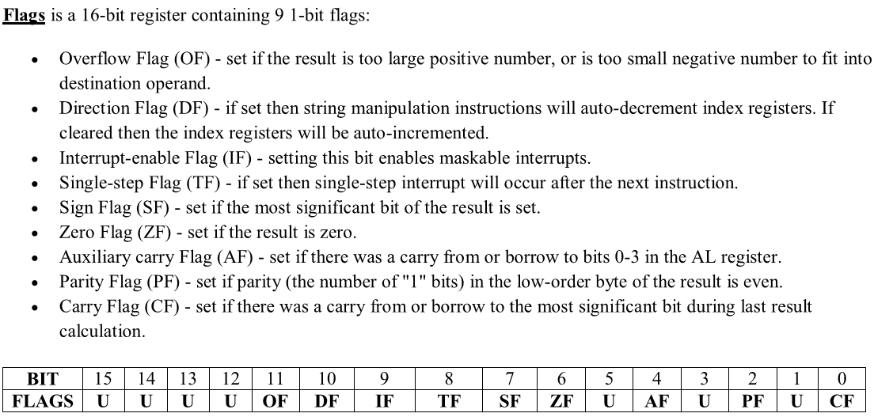

Slide 29
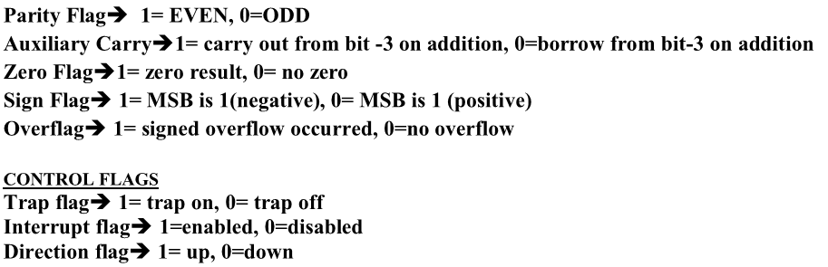

Slide 30
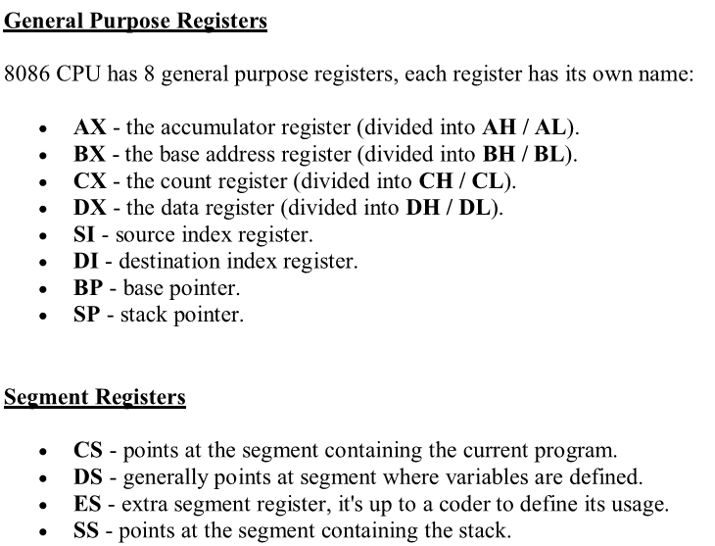
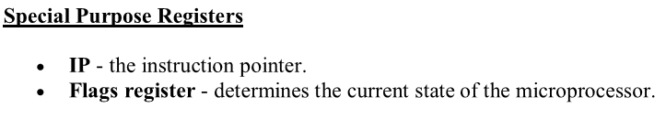

Slide 31
Addressing Modes of 8086
Addressing modes refer to the different methods of addressing the operands. Addressing modes of 8086 are as follows:
Immediate addressing mode-
In this mode, the operand is specified in the instruction itself. Instructions are longer but the operands are easily identified.
Example:
MOV CL, 12H
This instruction moves 12 immediately into CL register. CL ← 12H
Register addressing mode-
In this mode, operands are specified using registers. This addressing mode is normally preferred because the instructions are compact and fastest executing of all instruction forms.
Registers may be used as source operands, destination operands or both.
Example:
MOV AX, BX
This instruction copies the contents of BX register into AX register. AX ← BX

Slide 32
Addressing Modes of 8086
Direct memory addressing mode-
In this mode, address of the operand is directly specified in the instruction. Here only the offset address is specified, the segment being indicated by the instruction.
Example:
MOV CL, [4321H]
This instruction moves data from location 4321H in the data segment into CL.
The physical address is calculated as
DS * 10H + 4321
Assume DS = 5000H
∴PA = 50000 + 4321 = 54321H
∴CL ← [54321H]

Slide 33
Addressing Modes of 8086
Register based indirect addressing mode-
In this mode, the effective address of the memory may be taken directly from one of the base register or index register specified by instruction. If register is SI, DI and BX then DS is by default segment register.
If BP is used, then SS is by default segment register.
Example:
MOV CX, [BX]
This instruction moves a word from the address pointed by BX and BX + 1 in data segment into CL and CH respectively.
CL ← DS: [BX] and CH ← DS: [BX + 1]
Physical address can be calculated as DS * 10H + BX.
Register relative addressing mode-
In this mode, the operand address is calculated using one of the base registers and an 8 bit or a 16 bit displacement.
Example:
MOV CL, [BX + 04H]
This instruction moves a byte from the address pointed by BX + 4 in data segment to CL.
CL ← DS: [BX + 04H]
Physical address can be calculated as DS * 10H + BX + 4H.

Slide 34
Addressing Modes of 8086
Base indexed addressing mode-
Here, operand address is calculated as base register plus an index register.
Example:
MOV CL, [BX + SI]
This instruction moves a byte from the address pointed by BX + SI in data segment to CL.
CL ← DS: [BX + SI]
Physical address can be calculated as DS * 10H + BX + SI.
Relative based indexed addressing mode-
In this mode, the address of the operand is calculated as the sum of base register, index register and 8 bit or 16 bit displacement.
Example:
MOV CL, [BX + DI + 20]
This instruction moves a byte from the address pointed by BX + DI + 20H in data segment to CL.
CL ← DS: [BX + DI + 20H]
Physical address can be calculated as DS * 10H + BX + DI + 20H.

Slide 35
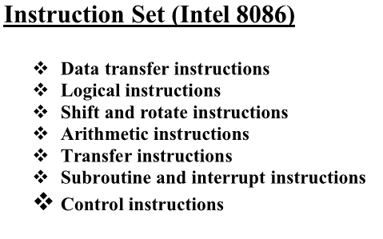

Slide 36
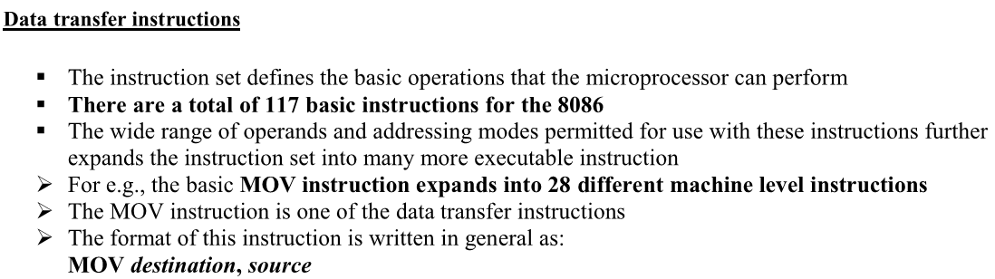
Instruction Set 8086

Slide 37
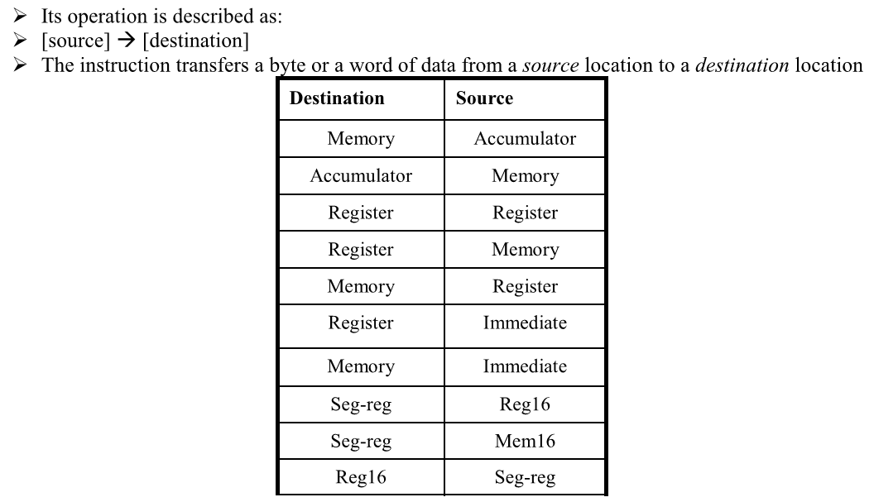
Instruction Set 8086

Slide 38
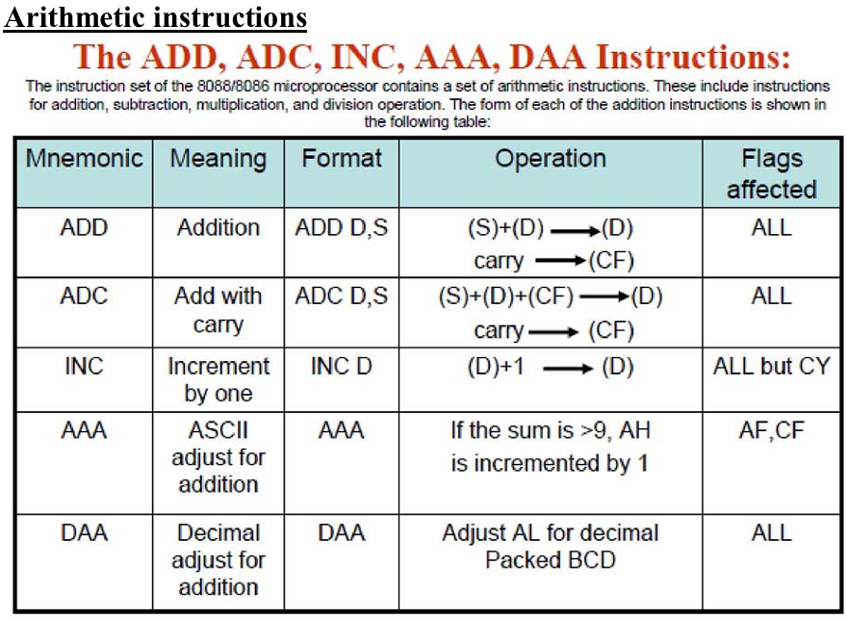
Instruction Set 8086

Slide 39
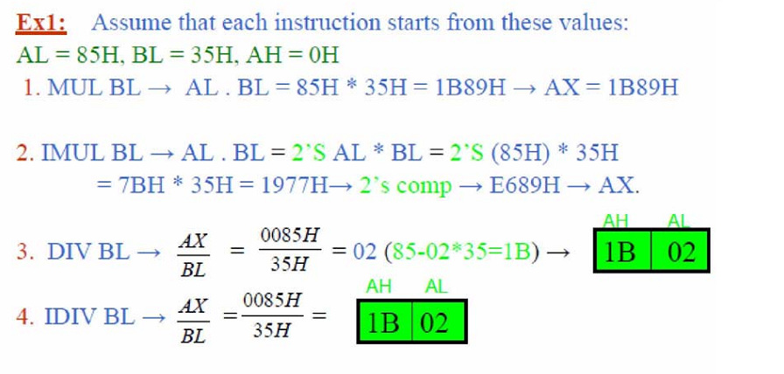
Instruction Set 8086

Slide 40
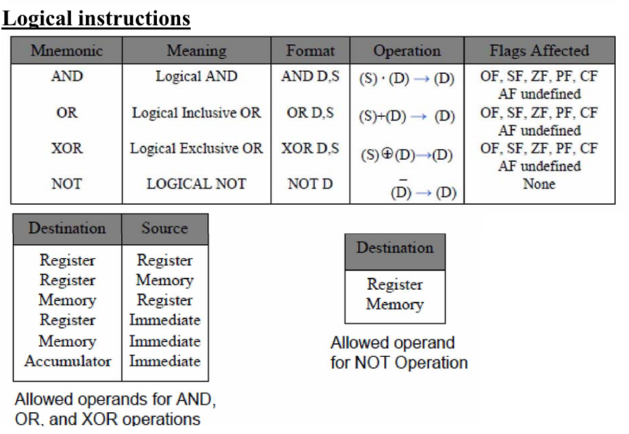
Instruction Set 8086

Slide 41
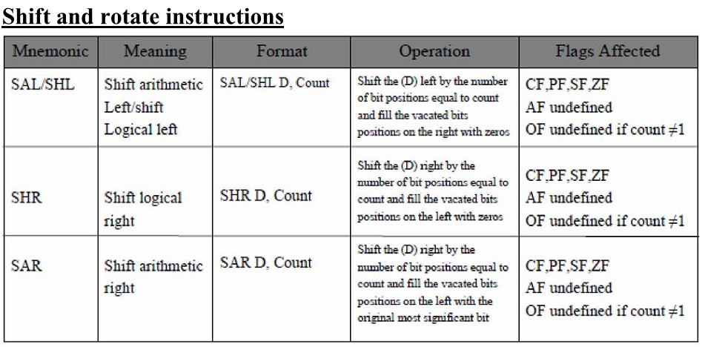
Instruction Set 8086

Slide 42
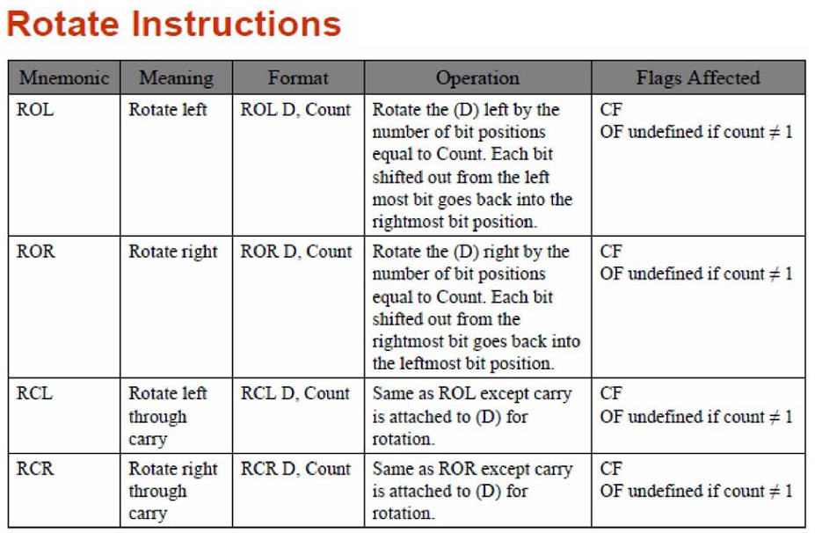
Instruction Set 8086

Slide 43
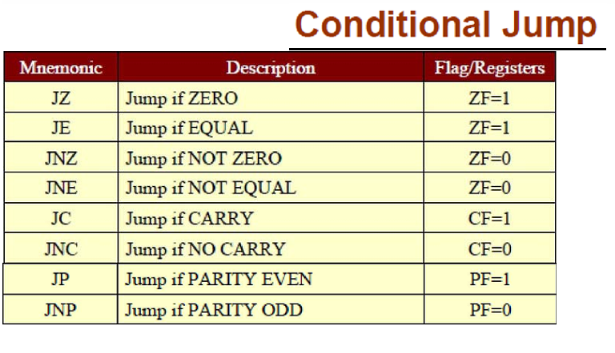
Instruction Set 8086

Slide 44
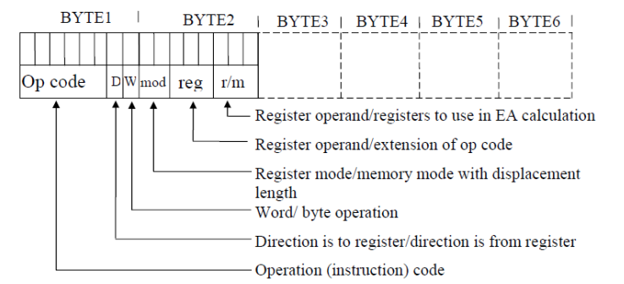
Converting Assembly Language to Machine Code

Slide 45
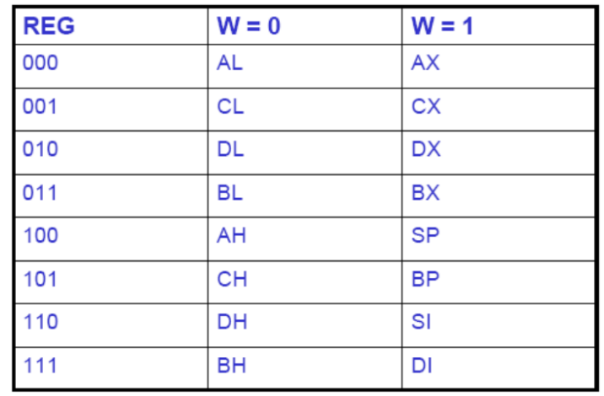
Converting Assembly Language to Machine Code

Slide 46
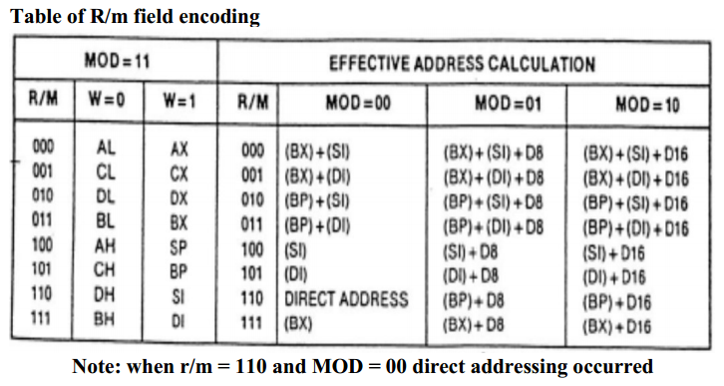
Converting Assembly Language to Machine Code

Slide 47
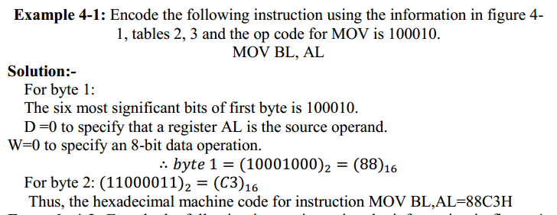
Example

Slide 48
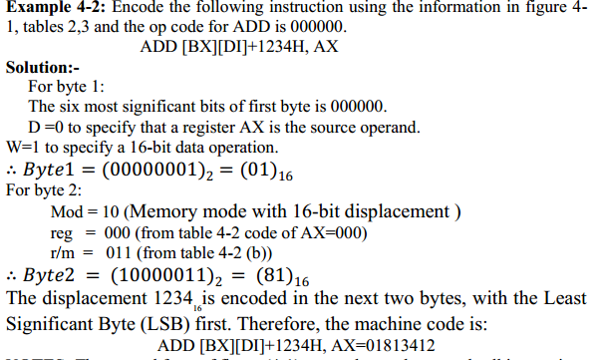
Example

Slide 49
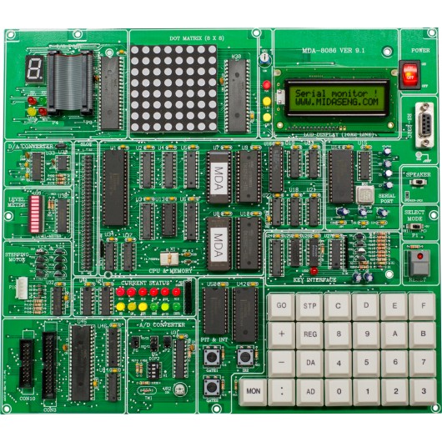
Introduction to MDA-Win 8086 Trainer Kit

Slide 50
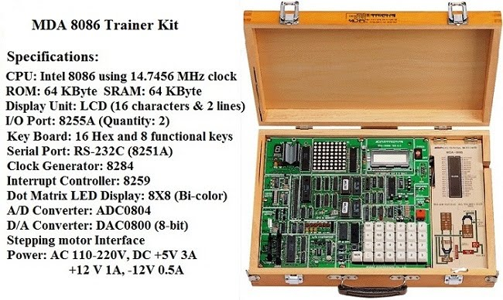
Introduction to MDA-Win 8086 Trainer Kit

Slide 51
Executing a program in MTS-86C
Label | Mnemonic | Hex code | Memory address | Remarks
CODE | SEGMENT |  | 0040: | Higher order
 | ASSUME CS: CODE & DS: CODE |  |  | result will be
 | MOV AX, 1234H | B8, 34, 12 | 00, 01, 02 | stored in DX
 | MOV CX, 0034H | B9, 34, 00 | 03, 04, 05 | & lower order
 | MUL CX | F7, E1 | 06, 07 | in AX
 | HLT | F4 | 08
CODE | ENDS
 | END
51

Slide 52
Do the program in the trainer Kit for Sum and subtraction of two 16 bit number

