Slide 1


Slide 2
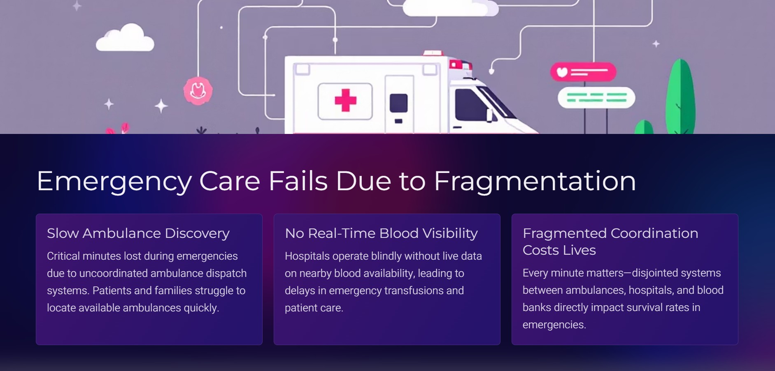

Slide 3


Slide 4


Slide 5
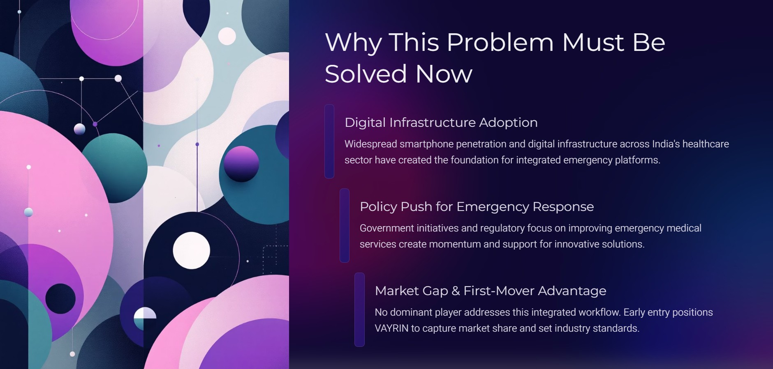

Slide 6


Slide 7
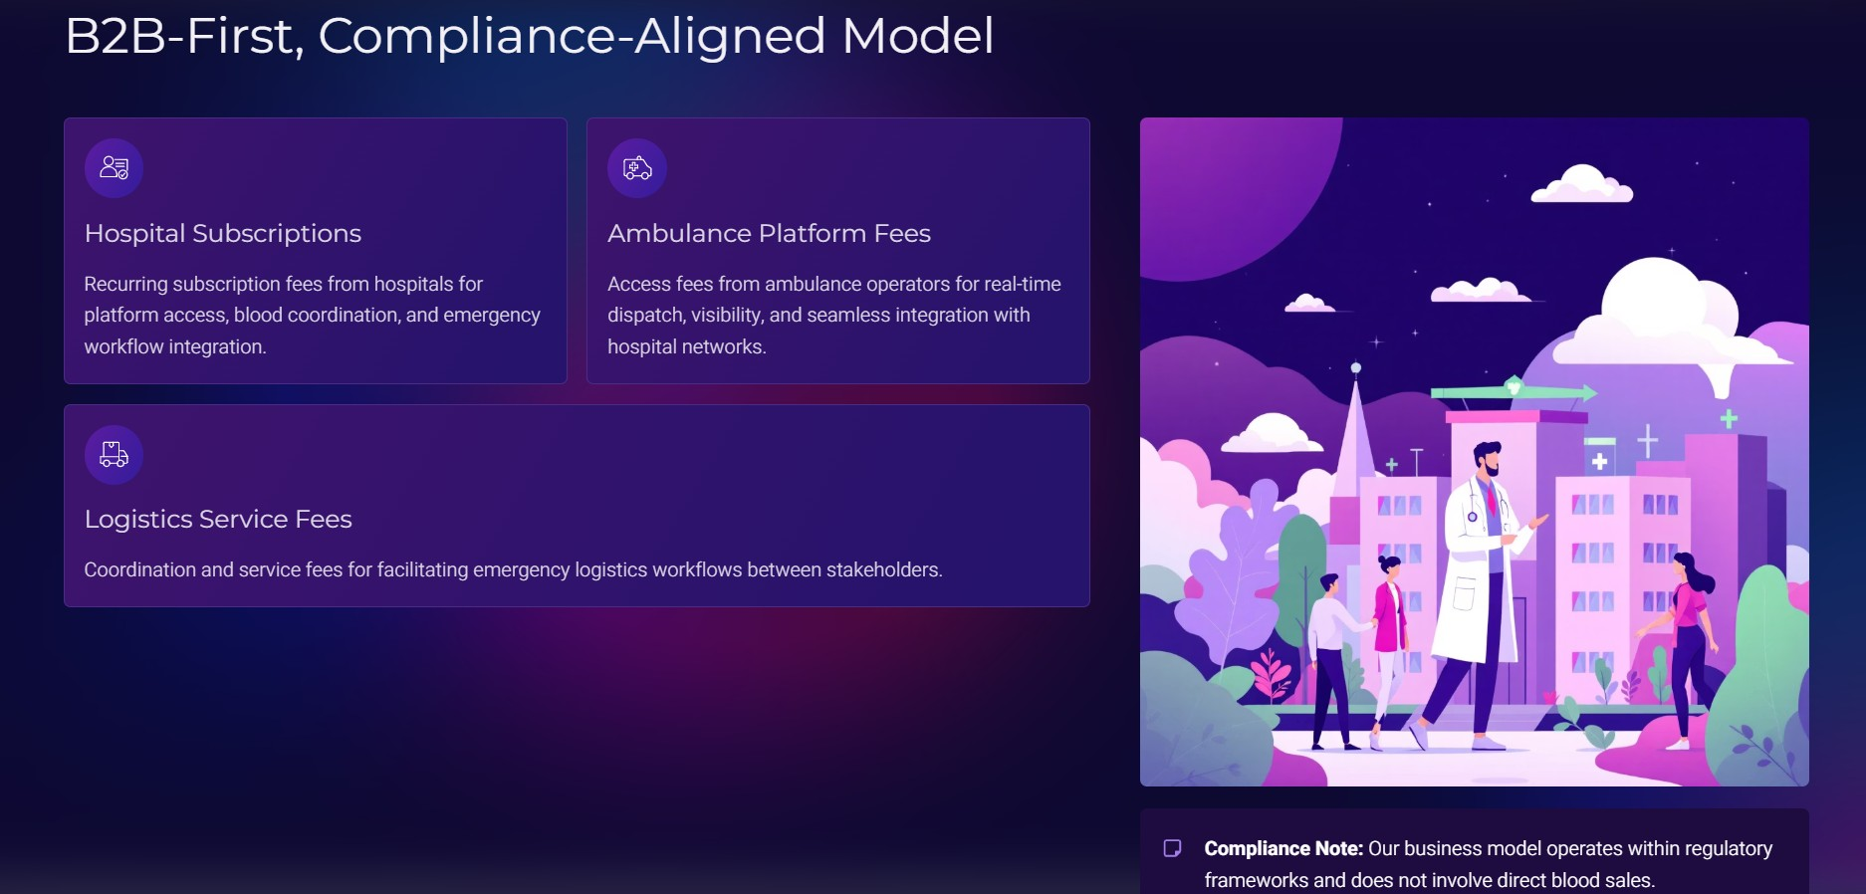

Slide 8
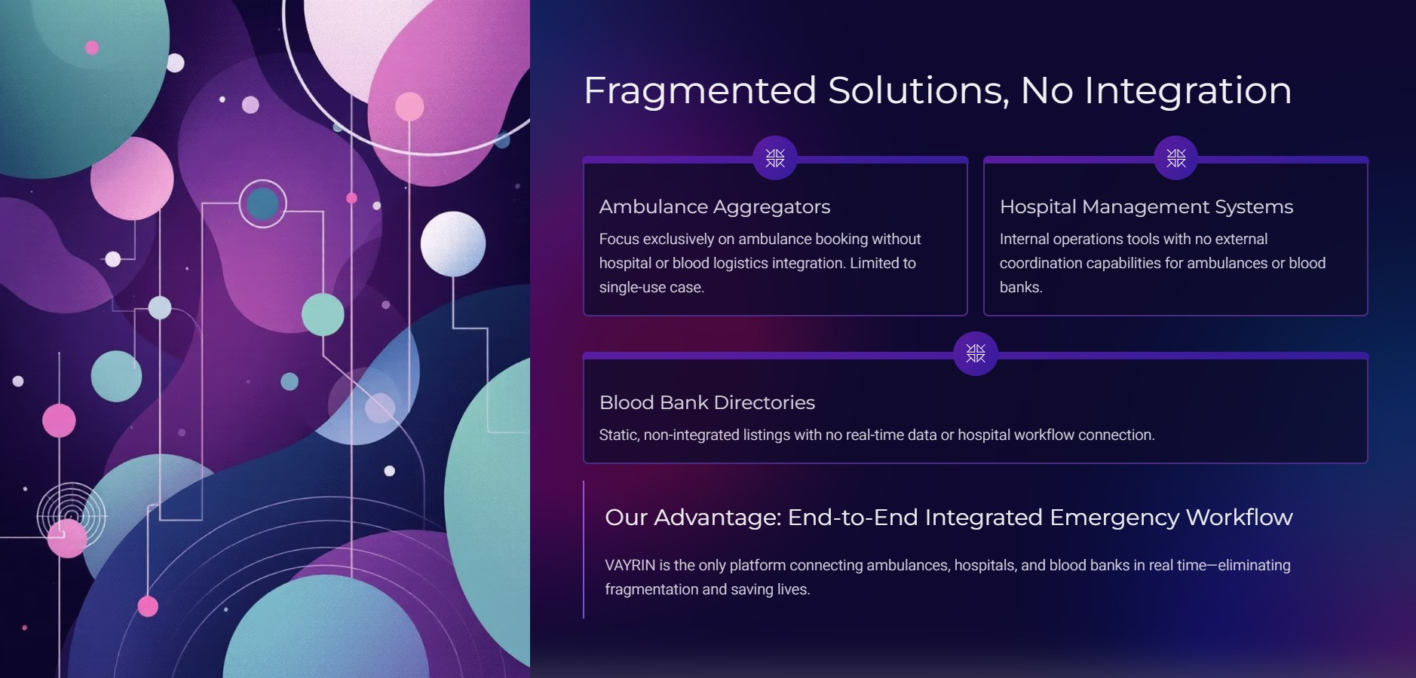

Slide 9

•
2OO'J<. (NAln • tAitl
rharore ti.rte \1>1 or
an 4 ovl It H""-' 11
•

Slide 10
