Slide 1
Show Don’t Tell:
https://github.com/rudeboybert/live-data

Slide 2




Field
GitHub
triggers
Action Files:
workflow.yalm
Observes and records
runs
Any sorts of files:
Report.md
Map.png
…
Data file:
data.csv
R files:
Generate_report.R
Generate_map.R
…
generates
pushes
Lab
creates
downloads
Pulls and reads
Checks/corrects

Slide 3
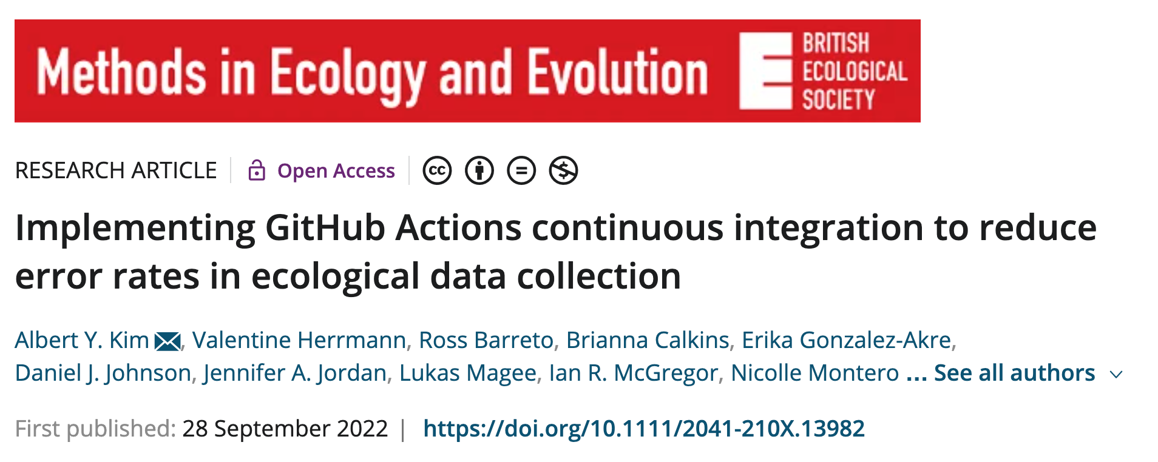
https://doi.org/10.1111/2041-210X.13982

Slide 4
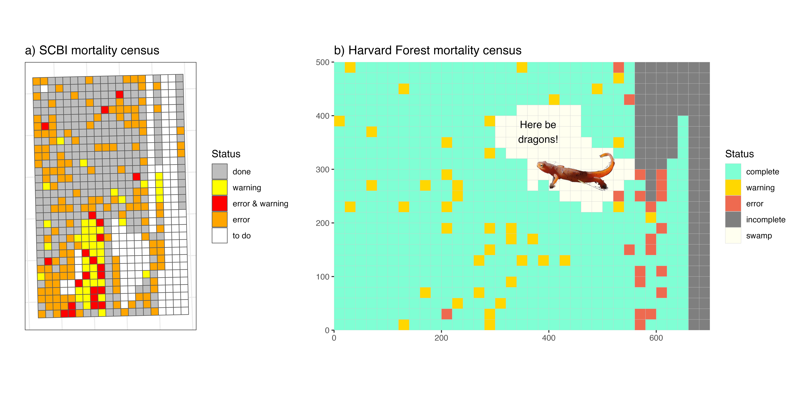
Mortality Completion Status Dashboards

Slide 5
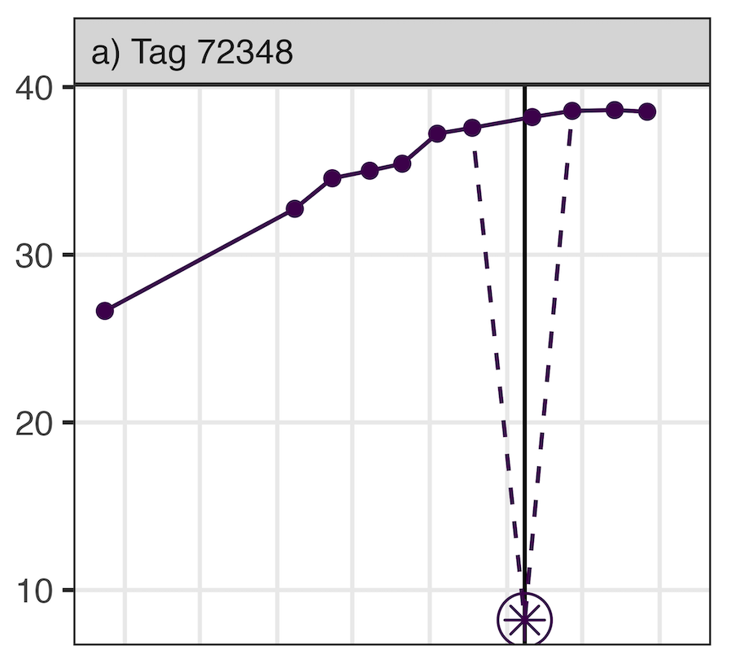
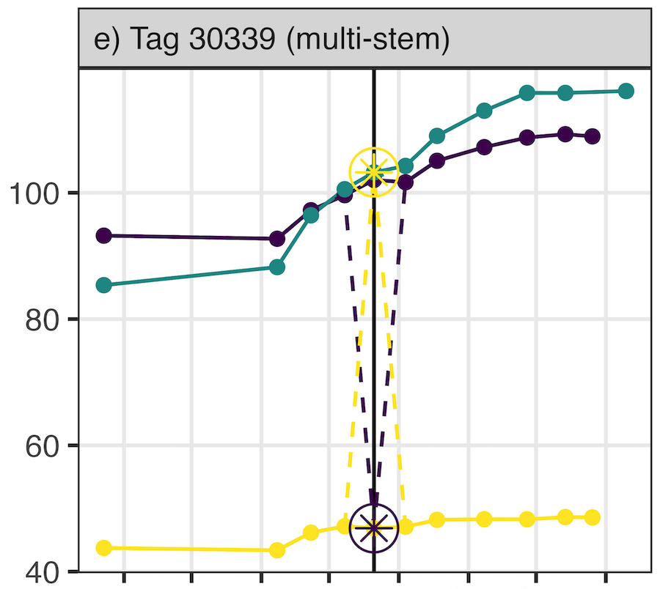
Dendroband Measurement Errors

Slide 6
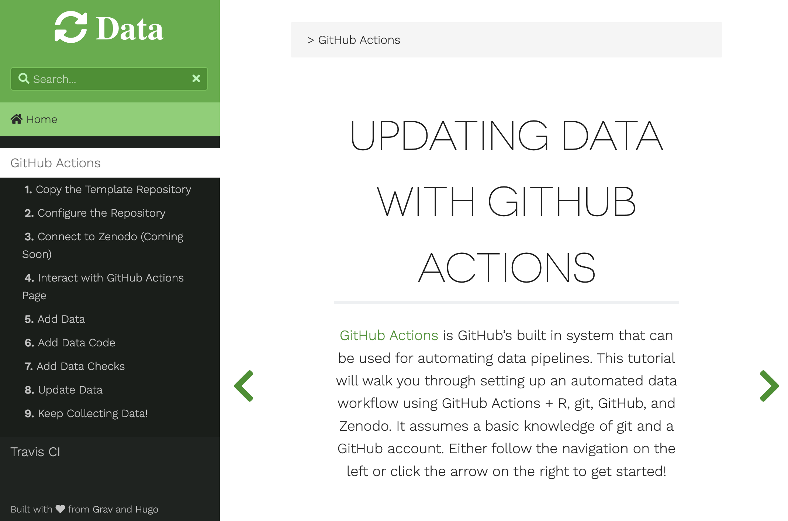
Getting Started: www.updatingdata.org Assumes you’ve used GitHub and R

Slide 7
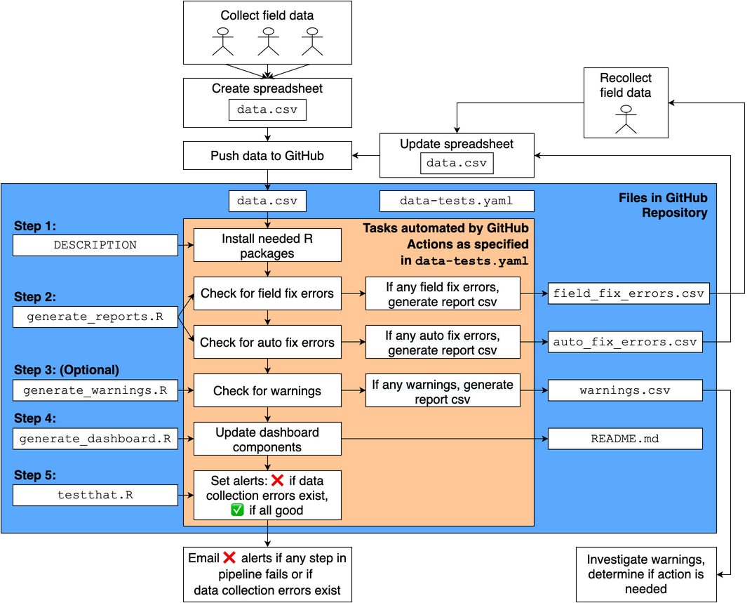
Engine file: https://github.com/SCBI-ForestGEO/SCBImortality/blob/main/.github/workflows/data-tests.yaml
YouTube tutorial: https://www.youtube.com/watch?v=JKF6aXtdLHs&feature=youtu.be

