Slide 1
ZTIS lab 3
Krzysztof Rudek
University Relations IBM

Slide 2
Cloud computing models
IaaS

Slide 3
Cloud computing models
IaaS
PaaS

Slide 4
Cloud computing models
IaaS
provides the infrastructure such as virtual machines and other resources like virtual-machine disk image library, block and file-based storage, firewalls, load balancers, IP addresses, virtual local area networks etc.
PaaS
SaaS

Slide 5
Cloud computing models
IaaS
provides the infrastructure such as virtual machines and other resources like virtual-machine disk image library, block and file-based storage, firewalls, load balancers, IP addresses, virtual local area networks etc.
PaaS
provides computing platforms which typically includes operating system, programming language execution environment, database, web server. technically It is a layer on top of IaaS as the second thing you demand after Infrastructure is platform.
SaaS

Slide 6
Cloud computing models
IaaS
provides the infrastructure such as virtual machines and other resources like virtual-machine disk image library, block and file-based storage, firewalls, load balancers, IP addresses, virtual local area networks etc.
PaaS
provides computing platforms which typically includes operating system, programming language execution environment, database, web server. technically It is a layer on top of IaaS as the second thing you demand after Infrastructure is platform.
SaaS
provides access to application services installed at a server

Slide 7
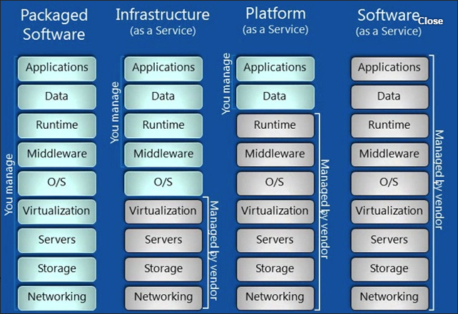
Cloud computing models

Slide 8
IBM Bluemix tutorial
Create a translation application by using Watson services, Eclipse, and Bluemix [1]
https://github.com/rudek-agh/ZTIS
https://www.ibm.com/developerworks/library/cc-translation-app-eclipse-watson-bluemix-trs/cc-translation-app-eclipse-watson-bluemix-trs-pdf.pdf
https://www.ibm.com/developerworks/library/cc-translation-app-eclipse-watson-bluemix-part2-trs/cc-translation-app-eclipse-watson-bluemix-part2-trs-pdf.pdf

Slide 9
References
[1] Big thanks to John J. Andersen for sharing documentation describing todays excercise

