Slide 1
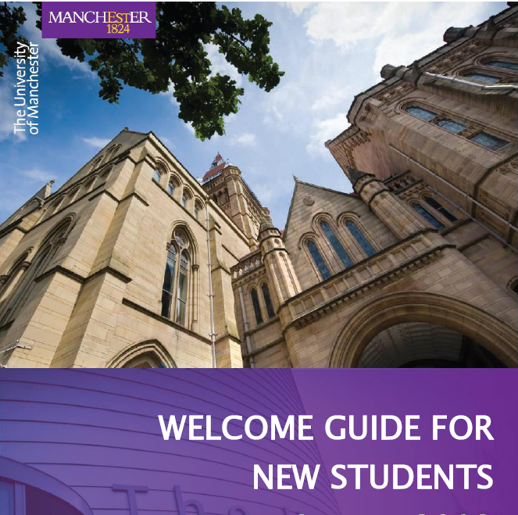
“Effectiveness of Islamic spirituality-based business networks in the international business development of Turkish SMEs”
Yusuf Kurt
Alliance Manchester Business School, UK

Slide 2
Background, problem and motivation, empirical setting

Slide 3
Empirical setting - Anatolian Tigers
Focuses on specific network context among the Anatolian Tigers,
young, export-oriented Turkish SMEs
mostly located in the economically underdeveloped periphery of Turkey
have registered remarkable success in their international business activities.
Success commonly associated with their effective network mechanisms
Connected via “trust and solidarity, the primacy of community over the individual, the discourse of the just-self over the self-interested actor”.
Business associations carrying an ‘Islamic identity’ and providing representation within the country’s economic scene.

Slide 4
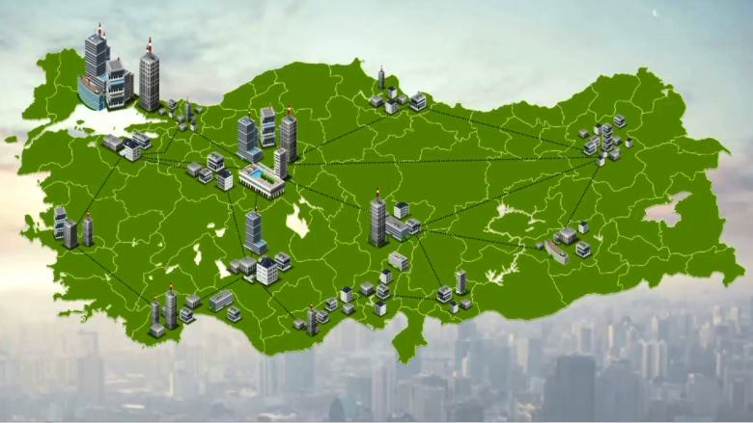

Anatolian Tigers

Slide 5
Background and problem- Internationalization&Networks
Previous studies have not provided a sufficiently comprehensive understanding of how specific network attributes influence network outcomes and in turn internationalization outcomes (Musteen, Datta, & Butts, 2014; Musteen, Francis, & Datta, 2010; Tang, 2011).
“There is still limited research on understanding networking behaviors that precede and precondition network outcomes” (Tang, 2011, p. 375).
Whether certain network attributes and characteristics are more beneficial than others or whether certain types of networks contribute differently to firm internationalization? (Musteen et al., 2014).

Slide 6
Background and problem- Networks behavior/commitment
Network research concerned with networking behavior has mostly employed utilitarian and economic perspectives such as resource interdependence, expected future benefits and instrumental returns as the key motivational determinants of network formation and commitment (Blankenburg, Eriksson, & Johanson, 1999).
However, humans, who are the core actors in network relationships, are not only rational but also spiritual and emotional beings. Their motivation to develop and commit to network relationships could also be profoundly driven by higher-order dimensions of human life such as religion and spirituality (Rego & Cunha, 2008).

Slide 7
Background-III
Business networks are embedded in a wider business context,
However, the presence of higher-order dimensions as significant underlying motivational factors for membership/commitment may alter a network’s characteristics in such an idiosyncratic way that it becomes distinct from traditional business networks where non-economic dimensions play no or only a minor role.

Slide 8
Motivation
Paper sets out to investigate how the distinctive features of Islamic spirituality-based business networks influence the internationalization the performance of Turkish SMEs, also known as the Anatolian Tigers.
These SMEs are members of religiously homophilous networks developed under voluntary business association membership. The study builds on the homophily principle, the core assumption of which is that “similarity breeds connections” (McPherson, Smith-Lovin, & Cook, 2001, p. 414).
The paper proposes that value-based conditions as the antecedents of network membership lead to network homophily, which in turn shapes the nature of the network and consequently the outcomes of network membership that contribute to the member firms’ international business development.

Slide 9
Conceptual Model and Hypotheses

Slide 10
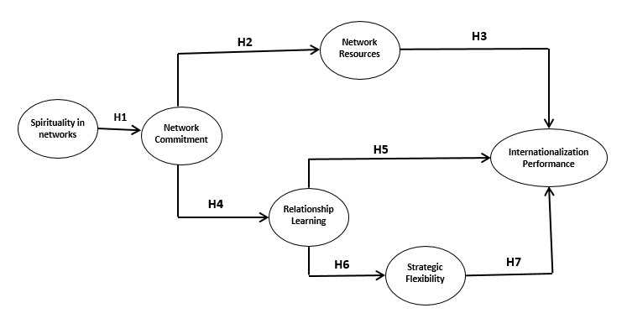
Model

Slide 11
Spirituality and network commitment
Selected Hypotheses
Homophily fosters trust and employees’ organizational commitment (Carmon et al., 2010).
Shared values can create homophily and social bonds that can act as an antecedent of network commitment (McPherson et al., 2001; Smith, 1998; Wilson, 1995).
The research focusing on spirituality-commitment relationships finds that shared spiritual values motivate individuals to feel a bond with their organizations and others, which in turn increases their commitment (Milliman, Czaplewski, & Ferguson, 2003; Rego & Cunha, 2008; Vandenberghe, 2011).
H1: The greater the experience of spirituality among the network members, the greater their commitment to the network.

Slide 12
Network commitment and relationship learning
Selected Hypotheses
Nature and characteristics of network relationships affect the networks’ potential to foster or hinder relationship learning (Newig et al., 2010).
Effective network mechanisms based on trust and commitment can create an effective learning environment (Selnes & Sallis, 2003)
As discussed in the homophily literature, social homogeneity fosters the distribution of information and tacit knowledge more effectively, and it functions as a better source of learning for the actors (Newig et al., 2010).
Spirituality, which creates value-based homophily, is likely to foster trust, increase commitment and fosters effective networks for learning.
H4: The greater the experience of spirituality among the network members, the greater the relationship learning from the network.

Slide 13
Methodology

Slide 14
Methodology & research design
Design
Primary Data: 12 preliminary case interviews (Qualitative, semi-structured) to feed into questionnaire design
Questionnaire Survey (Quantitative)
Sampling & data
Sample: 120 Companies (SMEs (<250), Members of BAs, involving international business activities)
Data: Survey-based
Face-to-face surveys with owners/managers of SMEs in 3 different cities
Data analysis
PLS-SEM (Ringle, Wende & Becker 2015)

Slide 15
Descriptive statistics
Our sample firms;
Spend between two to twenty-five years in going abroad with an average of 10 years.
The average rate of foreign sales to total sales is %35.
The number of foreign countries in which firms operate range from two to seventy-two countries with an average of 16 counties.
Regarding market entry destinations; %47 of the sample firms started their first foreign operations in the Middle East and North Africa (MENA) region, followed by %37 that first entered in the European countries and %13 in the Central Asia and Caucasus region.
Firms have an average international experience of 11 years ranging from one year and maximum 31 years.

Slide 16
Table 2. Discriminant validity

Slide 17
Structural model results

Slide 18
Supportive qualitative statements from the respondents
“Doing business, trade, and commerce are not the main reasons that make me a MUSIAD member. I want to be part of a group, which shares the same values, belief, and goals with me. That makes me feel better in terms of moral satisfaction…So being together with these kinds of people makes it easier for me to follow the purpose of my life.” (KNY2)
“It [to access resources] is not our motivation for being here. I know they provide support and resources for the members. I also know that, if we requested any resource and support, they would provide [it to] us.” (KYS2)
“The reason for me becoming a member here was not accessing certain benefits and resources. I would rather aim to contribute/add something to this community.” (BRS3).
“I personally prefer not to benefit from the resources the association networks provide us. I do not find it ethical in my moral value system. I am here for service to my community and I see this membership as a way of serving my values and goals. We never see our membership as a business.” (INEGOL 3)

Slide 19
Conclusion
Integration of the spirituality dimension into the context of business networks. The inclusion of spirituality has the potential to lead to a more comprehensive understanding of the ‘human’ aspect of network relationships.
More nuanced understanding on the role of a specific type of network in internationalization through establishing a link between network behavior and outcomes.
As opposed to predominant understanding that SMEs benefit from networks by mainly exploiting network resources, our findings suggest that resources are not the main benefit for SMEs in our network context.
The length of network membership positively affects internationalization performance. This can be explained through the process of relationship learning.

Slide 20
Thank You
Questions?

