Slide 1
CareQueue:
Clinic Appointments & Patient Queue
DevOps capstone: from code to cloud
Rudhar Bajaj
github.com/rudhar07/carequeue-clinic
Docker
GitHub Actions
Trivy
Terraform + AWS EKS
Kubernetes + Helm
Argo CD
Prometheus + Grafana
CareQueue · DevOps capstone
1 / 14
Notes:
Introduce CareQueue and the goal: take a real clinic app from code to cloud with a full DevOps pipeline.

Slide 2
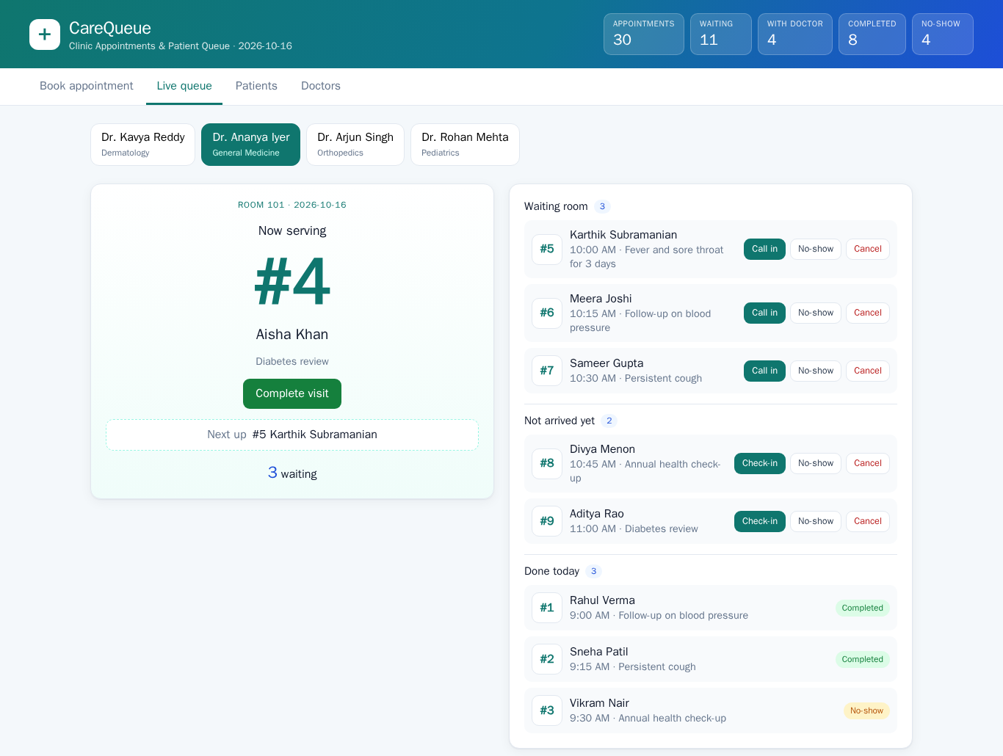
The problem and what CareQueue does
Problem: a small outpatient clinic's front desk needs bookings and a waiting room that stay in order
Booking: patients go into a doctor's time-slot grid
Tokens: every booking gets a per-day token number
Live queue: check in → call in → complete; now serving and next up
No double booking: 409, backed by a partial unique index; past or off-grid slots: 422
One patient per doctor in consultation; status changes validated
CareQueue · DevOps capstone
2 / 14
Notes:
A small clinic's front desk: bookings, tokens and a live waiting-room queue, with the rules enforced by the API and the database.

Slide 3
Tech stack
Application
Containers
CI/CD & security
IaC & cloud
React 18 + Vite
FastAPI · Python 3.13
SQLAlchemy 2 · Alembic
PostgreSQL 17
Docker, non-root images
Multi-stage frontend
Docker Compose (:3000)
GitHub Actions, 7 jobs
GHCR, commit-SHA tags
Trivy · Gitleaks · Bandit
pip-audit · npm audit
Terraform
AWS VPC + EKS 1.36
terraform-aws-modules
Region ap-south-1
Kubernetes
GitOps
Observability
Helm chart helm/carequeue
ingress-nginx · HPA
metrics-server
kind (local + CI) / EKS
Argo CD Application
Git as source of truth
Auto-sync + self-heal
kube-prometheus-stack
Prometheus + Alertmanager
Grafana, 15-panel dashboard
CareQueue · DevOps capstone
3 / 14
Notes:
Walk through the stack layer by layer, from the app to observability.

Slide 4
Architecture
Developer
git push
GitHub
code + Helm chart
GitHub Actions
7 jobs: tests, scans, Trivy
GHCR
images tagged by commit SHA
watches Git
image:<sha> pulled
Kubernetes · namespace carequeue · kind (local, CI) / EKS
Argo CD
auto-sync + self-heal
frontend ×2
nginx + React
/
syncs helm/carequeue
Ingress
nginx
backend ×2–6
FastAPI
Prometheus
ServiceMonitor → /metrics
/api
scrapes
Terraform
VPC + EKS, ap-south-1
HPA
backend 2→6
PostgreSQL
StatefulSet + PVC
Grafana
15-panel dashboard
CareQueue · DevOps capstone
4 / 14
Notes:
Left to right: developer pushes to GitHub, Actions tests/scans/builds, images go to GHCR by SHA. Argo CD watches the repo and syncs the Helm chart into the cluster. Terraform provisions VPC + EKS. Prometheus scrapes the backend, Grafana visualises it.

Slide 5
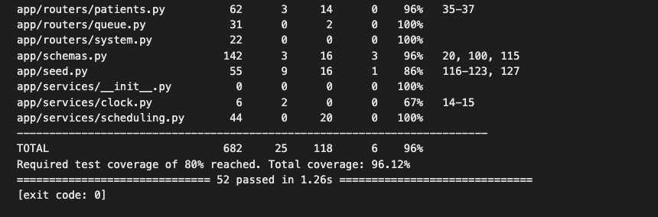
Application and testing
52
96%
11
pytest tests,
all passing
backend coverage
(80% gate)
Vitest frontend
tests
Resource | Main endpoints
Doctors | /api/doctors · /{id} · /{id}/slots
Patients | /api/patients (?q= search) · /{id}
Appointments | /api/appointments · PATCH /{id}/status
Queue & stats | /api/queue · /api/stats/today
Ops | /health · /ready · /metrics · /api/info
pytest -v: 52 passed, total coverage 96.12%
Tests run on in-memory SQLite, never the real database
Business rules covered: 409 double booking, 422 past or off-grid slots, status machine
A failing test or coverage under 80% fails the CI build
CareQueue · DevOps capstone
5 / 14
Notes:
REST API under /api plus health, readiness and metrics endpoints. 52 backend tests at 96% coverage, 11 frontend tests.

Slide 6
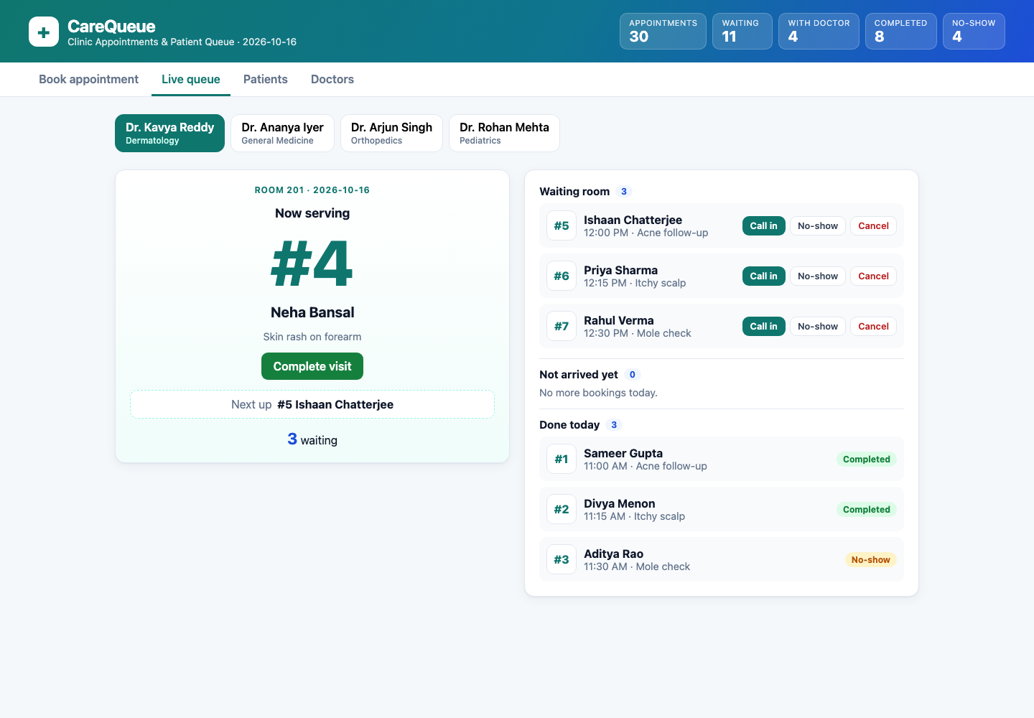
Docker
Backend: python:3.13-slim pinned by digest, runs as uid 10001
Frontend: multi-stage, node:24-alpine build → nginx-unprivileged (uid 101)
nginx serves the React app and proxies /api to the backend
Healthchecks; GIT_SHA baked in at build time → /api/info
docker compose up --build → UI on localhost:3000
PostgreSQL 17
healthy
backend
migrate + seed
frontend
:3000
docker compose: live queue at http://localhost:3000
CareQueue · DevOps capstone
6 / 14
Notes:
Two non-root images; frontend is multi-stage; compose brings the full stack up on localhost:3000.

Slide 7
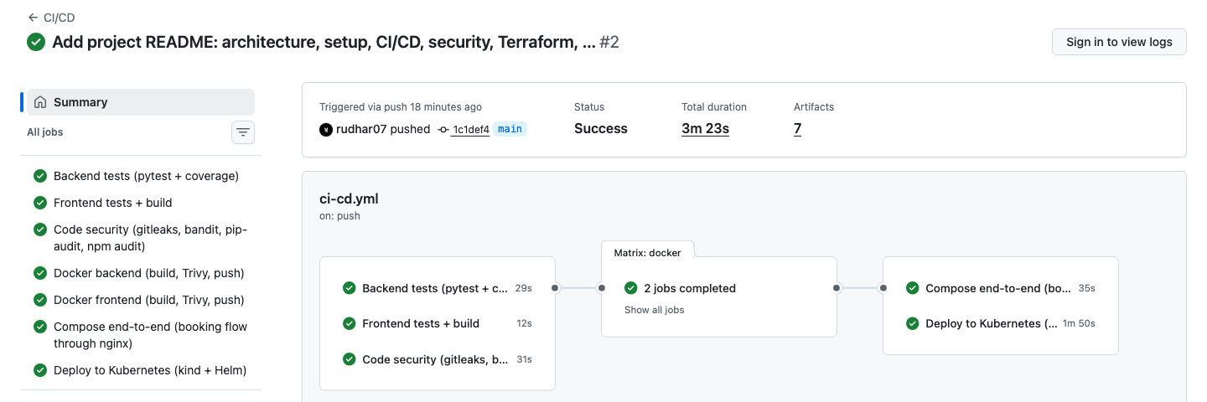
CI/CD pipeline: GitHub Actions
Backend tests
pytest, coverage ≥ 80%
matrix: docker
Docker backend
build → Trivy gate → push :sha
Compose end-to-end
booking flow through nginx :3000
Frontend tests + build
vitest, vite build
Docker frontend
build → Trivy gate → push :sha
Deploy to Kubernetes
kind + Helm, helm test, SHA check
Code security
gitleaks, bandit, pip-audit, npm audit
Runs on every push and PR to main, plus manual dispatch
Any failing test or scan stops it: no push, no deploy
Images tagged only with the full commit SHA, never latest
Deploy checks /api/info commit == GITHUB_SHA
Run on 1c1def4: all 7 jobs green in 3m 23s
Green run in GitHub Actions (7 jobs, matrix: docker)
CareQueue · DevOps capstone
7 / 14
Notes:
Seven jobs. Three parallel quality gates, then a docker matrix that builds, scans with Trivy and pushes by SHA, then a compose end-to-end test and a deploy to kind with Helm that checks the running SHA.

Slide 8
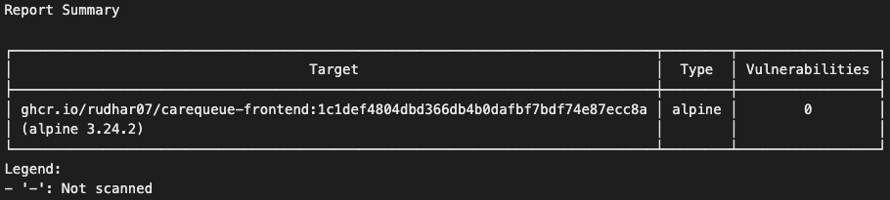
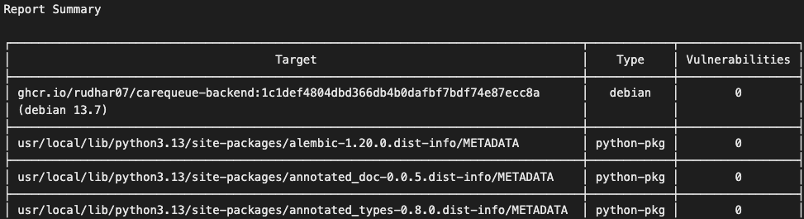
DevSecOps: security gates
Tool | Gate
Trivy (image) | fixable HIGH/CRITICAL fails, both images
Gitleaks | any secret in files or git history
Bandit | MEDIUM+ severity and confidence
pip-audit | any known-vulnerable dependency
npm audit | high/critical in production deps
Pipeline Trivy gate: frontend image (alpine), 0 vulnerabilities
Pipeline Trivy gate: backend image (debian), 0 fixable HIGH/CRITICAL
What Trivy found
0 HIGH/CRITICAL findings with a fix in either image, so the gate passed. The backend's Debian base has HIGH CVEs with no fix yet: reported, not blocking. An old nginx image made the gate exit 1.
The gate step
trivy image --severity HIGH,CRITICAL --ignore-unfixed --exit-code 1
The pushed image is the exact image that was scanned.
CareQueue · DevOps capstone
8 / 14
Notes:
Trivy gates both images on fixable HIGH/CRITICAL; gitleaks scans tree and history; bandit, pip-audit and npm audit check code and dependencies.

Slide 9
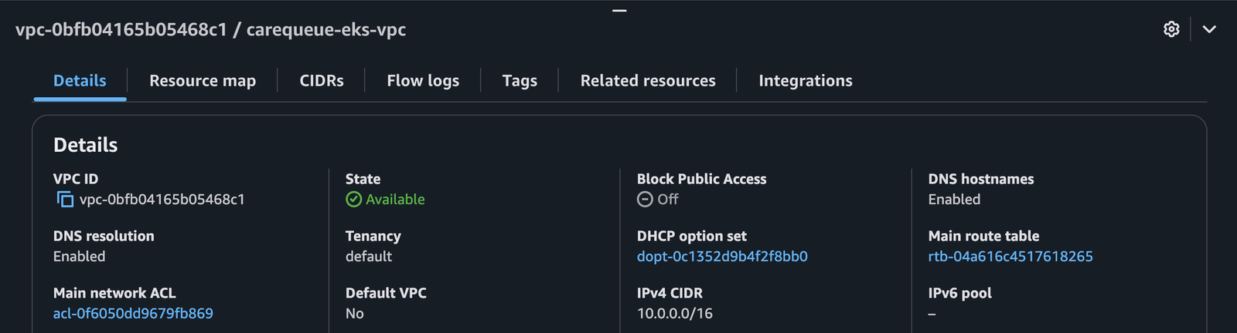
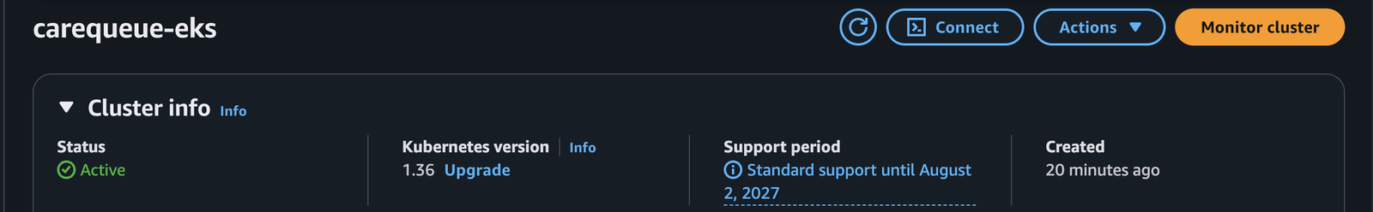
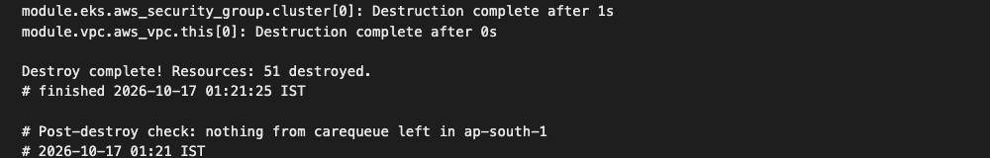
Infrastructure: Terraform on AWS
1 plan
51 to add
2 apply
2 nodes Ready
3 destroy
51 destroyed
VPC 10.0.0.0/16, 2 public subnets in 2 AZs, internet gateway
EKS 1.36 with 1 managed node group (min 1, max 3)
Real AWS run in ap-south-1 on 2026-10-17
Free plan rejected t3.medium, so the run used m7i-flex.large
fmt, validate, tflint and Trivy config scan all clean
AWS Console: carequeue-eks-vpc, 10.0.0.0/16, Available
EKS cluster carequeue-eks: Active, Kubernetes 1.36
terraform destroy: 51 destroyed, nothing left in ap-south-1
CareQueue · DevOps capstone
9 / 14
Notes:
Terraform VPC with two public subnets plus EKS 1.36 and a managed node group in ap-south-1. Applied for real, verified, then destroyed.

Slide 10
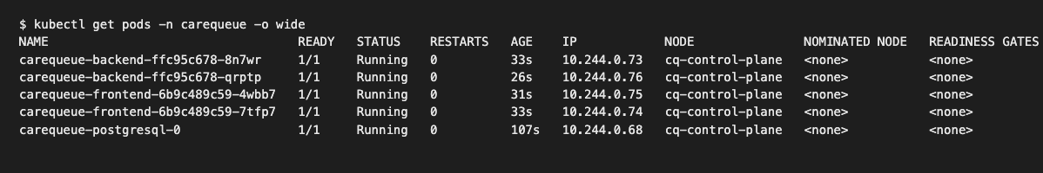
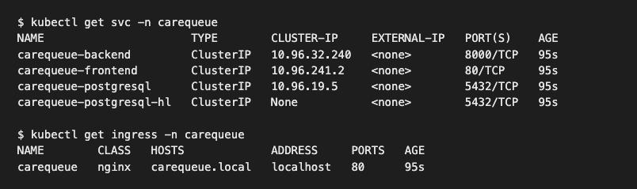
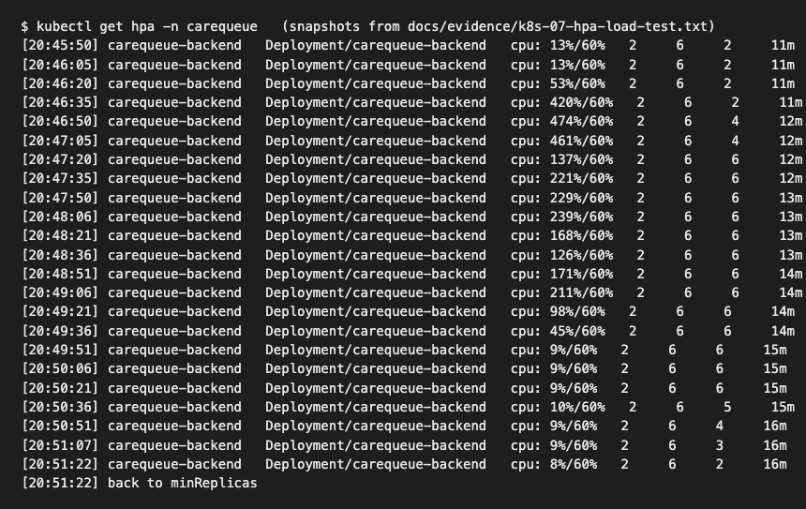
Kubernetes setup: Helm
Helm chart helm/carequeue: 16 templates, dev + prod values
Backend + frontend Deployments, 2 replicas each, non-root, read-only filesystem
Ingress: / → frontend, /api → backend
HPA: backend 2→6, frontend 2→4; load test scaled 2 → 4 → 6 → 2
Probes: startup + liveness /health, readiness /ready (checks DB)
PostgreSQL StatefulSet + PVC, migrate/seed Jobs, PDBs, helm test
kubectl get pods
5/5 Running
svc + ingress
ClusterIP, host carequeue.local
HPA
scale up and back down
CareQueue · DevOps capstone
10 / 14
Notes:
One Helm chart deploys everything: two replicas each, ingress routing, autoscaling, probes and Postgres as a StatefulSet.

Slide 11
GitOps with Argo CD
GitHub repo
helm/carequeue (desired state)
Argo CD
Application: carequeue
auto-sync
Kubernetes
namespace carequeue (live state)
pull
self-heal
Manifest: gitops/argocd-application.yaml
Git is the source of truth: Argo CD tracks main with values-dev.yaml
Automated sync + prune: chart changes applied, removed resources deleted
Self-heal: manual kubectl edits are reverted to the Git state
Release: set the image tags to the new commit SHA in Git and push; Argo CD rolls it out
kind: Application
spec:
source:
repoURL: .../carequeue-clinic.git
targetRevision: main
path: helm/carequeue
destination:
namespace: carequeue
syncPolicy:
automated:
prune: true
selfHeal: true
excerpt
CareQueue · DevOps capstone
11 / 14
Notes:
Argo CD watches the GitHub repo and keeps namespace carequeue in sync with the Helm chart. Automated sync and self-heal.

Slide 12
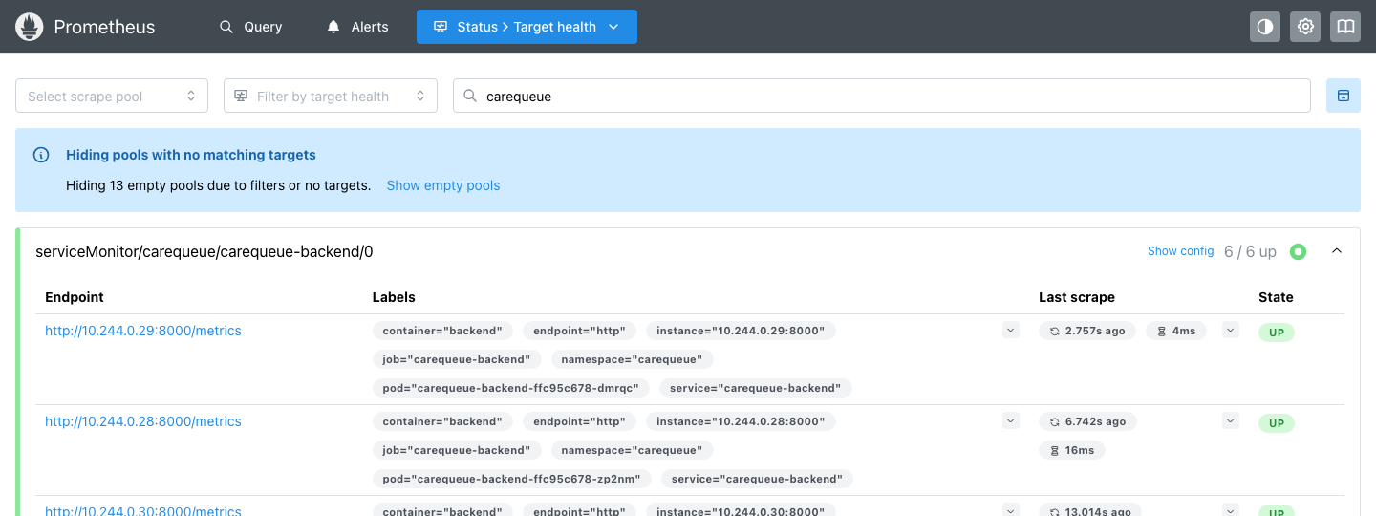
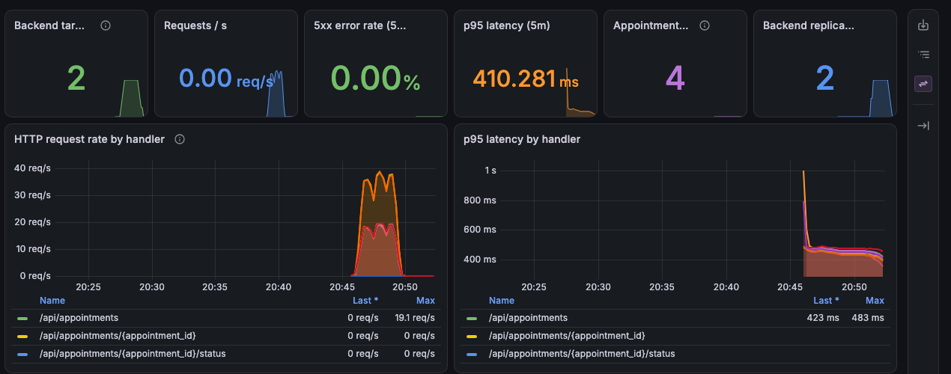
Observability: Prometheus + Grafana
/metrics: request rate, latency, status codes + clinic metrics
e.g. carequeue_queue_waiting{doctor}
ServiceMonitor → Prometheus scrapes every backend pod: 6/6 UP
3 alert rules: backend down, high 5xx rate, long queue
Grafana: 15 panels: rate, p95, errors, bookings, queue, CPU/memory, HPA
Installed with kube-prometheus-stack
Prometheus targets: serviceMonitor carequeue-backend, 6/6 up
Grafana: CareQueue Clinic API dashboard
CareQueue · DevOps capstone
12 / 14
Notes:
Backend exposes /metrics; a ServiceMonitor makes Prometheus scrape every backend pod; 3 alert rules; Grafana dashboard with 15 panels.

Slide 13
Troubleshooting lab: 6 faults, broken on purpose
Each case: symptom → investigate → root cause → fix → verify, on a real cluster
1
Wrong image tag
2
Wrong DATABASE_URL
3
Service selector mismatch
Symptom: ImagePullBackOff
Fix: use a tag that exists
Symptom: Running but 0/1 Ready, /ready 503
Fix: correct the host name typo
Symptom: no endpoints, 503 at Ingress
Fix: restore the selector labels
4
Ingress → missing Service
5
No CPU requests
6
Wrong liveness path
Symptom: 503 from the Ingress
Fix: point at the real Service
Symptom: HPA targets <unknown>
Fix: add requests and limits
Symptom: restart loop
Fix: helm rollback to last good
CareQueue · DevOps capstone
13 / 14
Notes:
Six faults broken on purpose on a real cluster, each with symptom, investigation, root cause, fix and verification.

Slide 14
Key learnings and known limitations
Key learnings
Known limitations
SHA tags: one image per commit, easy rollback, /api/info proves what runs
Scan the exact image you push; gate only on fixable HIGH/CRITICAL
Readiness must check the DB; HPA needs CPU requests
Read cloud errors closely: the Free plan blocked t3.medium
Always terraform destroy, then verify nothing is left
No NAT gateway, nodes in public subnets to save cost (enable_private_subnets for production)
Free-tier node type m7i-flex.large on the AWS run
EKS destroyed after the proof; the always-on demo runs on local kind
Backend base image has unfixed Debian HIGH CVEs (reported, not blocking)
5 Trivy config trade-offs suppressed inline, with reasons
CareQueue · DevOps capstone
14 / 14
Notes:
What worked and what I learned, plus honest limitations of the lab setup.

