Slide 1
Music Analyzer

Slide 2
Problem Statement
Data analysis of data available on lastfm
    As many people are interested in listening songs. And last fm is one of the biggest platforms where people listen songs online. And hence we can find various interesting patterns using this data.

Slide 3
Proposal
As from the huge data we can derive various patterns from last fm api as well as from other sources like youtube.
With the help of which this app is able to give the
  Popularity Visualization
  Sentiment Score on the basis of comments
  Sentiment Score on the basis of lyrics available

Slide 4
App Description
Features:
  Popularity Graph on the basis of views,like_ratio,repeat_ratio
  Sentiment Analysis of the artist tracks on the basis of comments
  Sentiment Analysis of the artist tracks on the basis of lyrics

Slide 5
App Description
Api Used:
    last fm
    Heroku
Languages:
    pyhton
    angular
Libraries:
Nltk
urllib
requests
json
d3.js
numpy
matplotlib

Slide 6
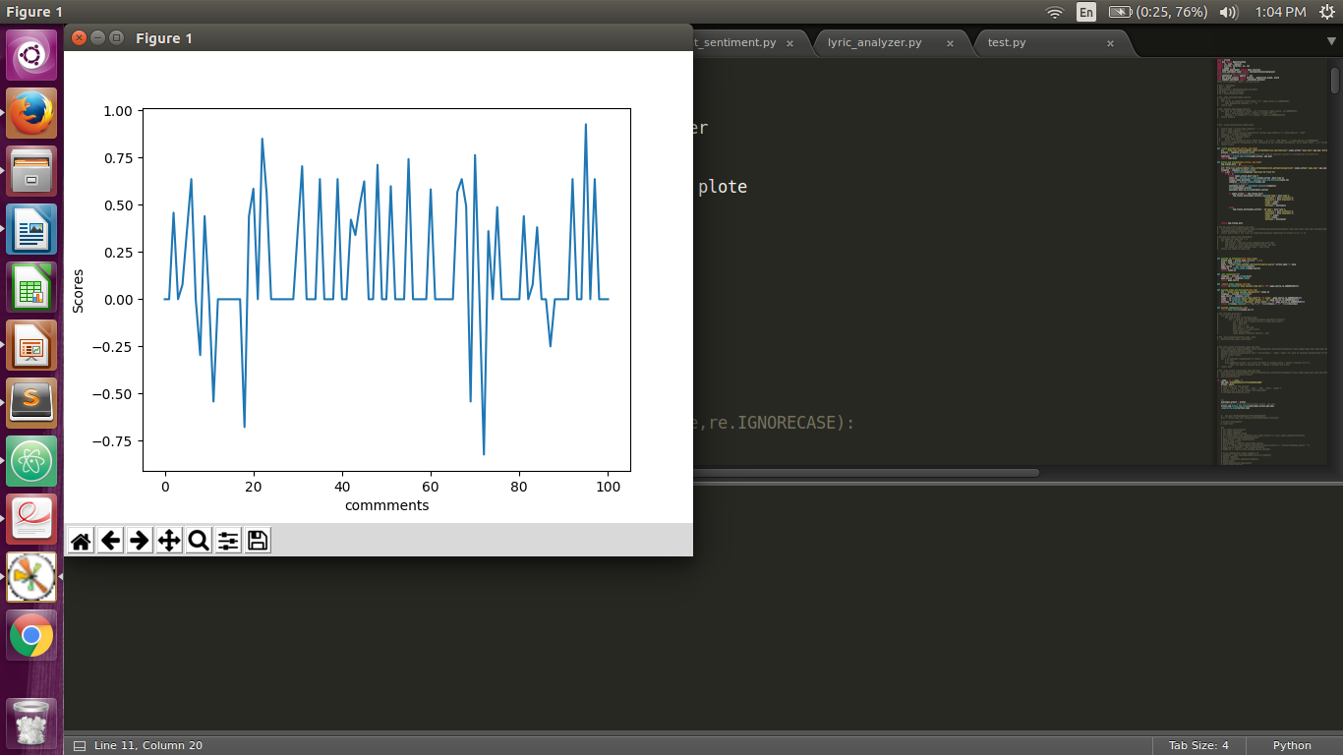
Track Comment Sentiments

Slide 7
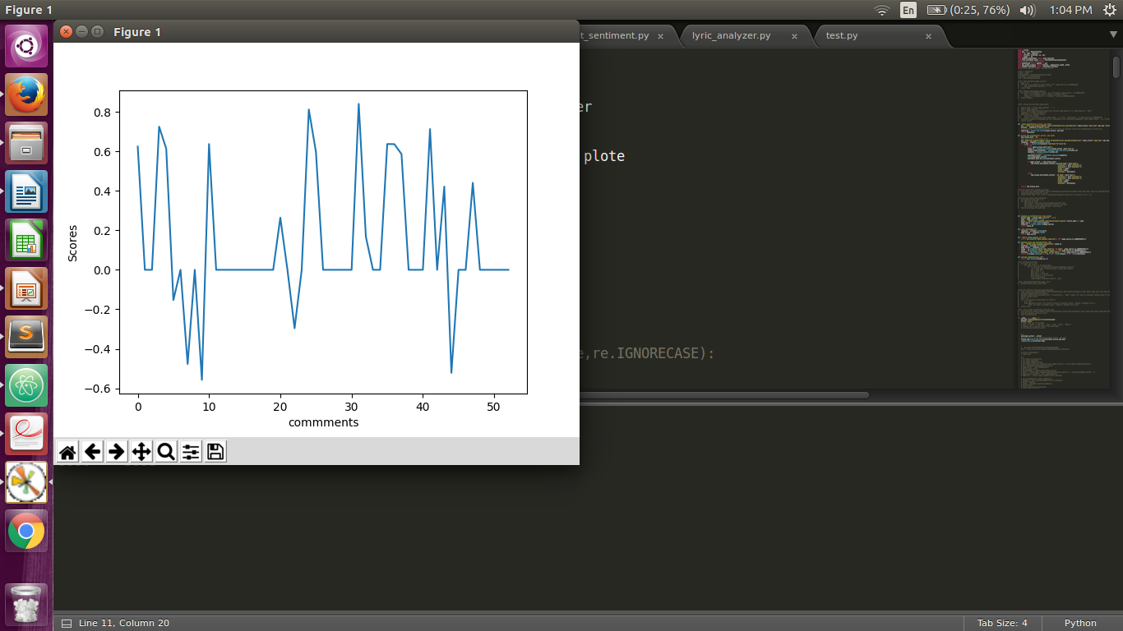
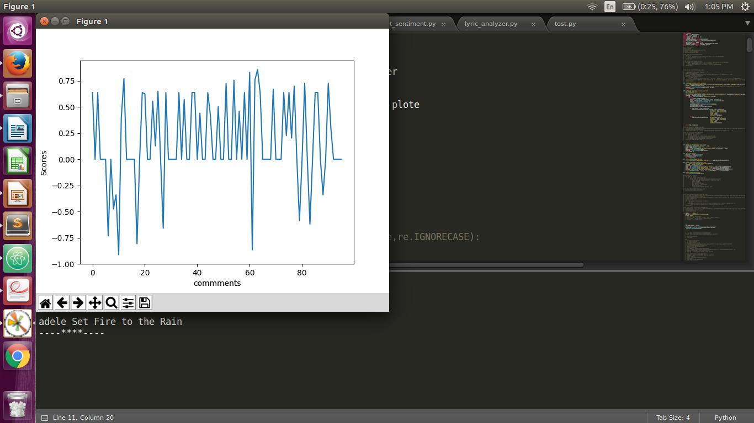
Track Comment Sentiments

Slide 8
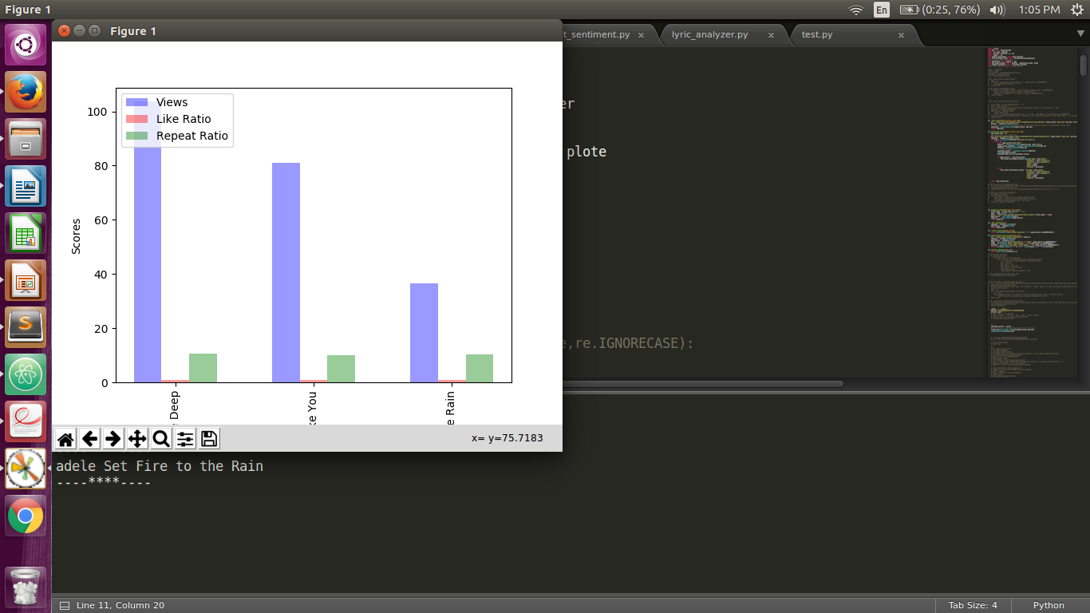
Popularity Graph

Slide 9
Thankyou

