Slide 1
Css
By: Rudhra Koul

Slide 2
Section -1 -:Introduction and Initial Setup

Slide 3
What is CSS
CSS stands for Cascading Style Sheets.
The core idea behind css is that it makes the webpage look good
Usually a webpage contains HTML which is the structure of a webpage and essentially required.
CSS on the other hand is used to add color , font , borders etc. i.e. it is used for Styling the page

Slide 4
CSS History, Present & Future
CSS1 was released in 1996
CSS2 was released in 1998
CSS3 the latest version of CSS that we use is still in development
There will never be CSS4 because with CSS3 they split it up in modules like modules for color , border , shadow etc.We have different versions of these modules and modules and module versions are continuously being added

Slide 5
Important Links
W3C CSS Working Group

Slide 6
Section -2 -:Diving Into the Basics of CSS

Slide 7
Basic Setup
To make the development easier I have initialized this project with node and added a development server lite-server to it
I am using yarn as my package manager
To setup this project just go to branch BasicsOfCSS and to commit with message Basic Setup and run yarn on the terminal
To start the project type npm start
It will open the browser window on http://localhost:3000 and will by default open index.html from Section2 folder in this project
We can use vscode or any other ide for development

Slide 8
Adding CSS to our Project with Inline Styles
There are three ways to add CSS
The First way is inline styling
Lets say we want to add style to the section element in our index.html
We can add a style attribute to it.A style attribute is an html attribute that can be added to pretty much any html element
We can now add a css style by adding a so called css decleration as a value to the style attribute
The decleration means we define what we want to style and how we want to style it
The what here is the property to set for example we want to set the background of our section,but how do I know there is a background property?Firstly there is a set of commonly used properties and also by going through reference docs we can know what all properties are available.The background property as the name suggests sets the background of our section

Slide 9
Adding CSS to our Project with Inline Styles
The next question was how to style we assign such a value by adding a colon after the property and then the value that we want to set to the property.
The value that we can set depends on the property being referenced for example for the background property we can set a color
So we can either assign a color by giving its name like red or we can also use the hex code for a color by using #followed by hex code of color for example the hex code for a particular shade of red is #ff1b68
Lets add this style <section style=“background:#ff1b68”>.After adding this we will notice that we have a red background to our text.
This is the first CSS code we wrote for this training
This was achieved using in line css .It is called inline css because we added the style element directly on the element we wanted to add it to.
If we have multiple style we can separate the declerations with semi colons(;)
This approach is typically not recommended because as and when the code increases it becomes difficult to understand and hard to manage and reuse

Slide 10
Understanding the <style> Tag & Internal CSS
Since we know the inline styles are bad lets use an alternative so first just remove the inline style
The second option is called Internal CSS it uses the head section of html
Inside the head section we can add a <style></style> tag and add our css inside it.
This also uses the same property value assignment we used in the inline css
We just need one additional thing here that is something called as a selector to signify to which element in our dom we want to apply the style to.
We add a selector simply by writing the tag name without the angle brackets followed by curly braces and add our style decleration inside the curly braces
Lets add such a style to our section <style> section { background:#ff1b668;}</style>
This way we are telling CSS to look for all section elements on our page and apply background red to them.
If we now open the browser we will again see the style applied

Slide 11
Understanding the <style> Tag & Internal CSS
Now lets add another section to our page with an h1 tag and some text we will see that the style is applied to it also.This is another advantage of internal style if we used inline style we would need to add this style manually to second section also and if we wanted to change the color we would need to do that at all different places but now we can change it at one place.

Slide 12
External StyleSheet adding a .css file
The third way of including styles is using an external file.
First remove the style tag from head section and add a new file main.css.The file can be named anything it should just end with a .css extension
Open the main.css file in this file we add our css rules rule is a combination of selector ,property and value.so as we added a rule in <style> tag add the same rule here for giving red color to background of section but without the style tags
In our index.html file we need to specify that we want to use the main.css file for styling for doing so we use a <link>tag with rel attribute set to stylesheet and href set to our css file along with its relative path
Now we have our styles back.
This is the recommended way to add styles as it gives a clear separation between out html and css code .It is more manageable and also prevents bloating of our head section as styles increase
Also if we use the same file for multiple pages the browser can cache it and doesn’t need to redownload it for all pages whereas if we add styles to head section it increases our file size and browser needs to redownload it as it is a part of html page.

Slide 13
Applying Additional Styles & Importing Google Fonts
Lets focus on two things now:
Adding additional styles like position , font etc.
Adding different styles to different sections
Lets change the font family and the color of the h1 tag inside our first section
Now to do that we add a selector for h1 to our main.css
Inside the curly braces lets add color to the text using color property add the color property and give it a value of white.Now if we save it we will notice the color of both h1 tags in both sections changed to white
Lets change the font to do this we add a property font-family now we have a couple of different options for the value if we set it to sans-serif it uses the default font of our browser which can be changed from preferences>customised fonts
We will notice we have a standard font ,serif font ,sans-serif font and fized width font.To use standard font just don’t set any font in css, to use serif font set font-family to serif to use sans-serif set it to sans-serif to use fixed with set it to monospace.This is a great way to set font as we will be using fonts set by browser and thus are sure of there availability
We can also set a custom font but we are not sure if it will be installed on the browser of our users

Slide 14
Applying Additional Styles & Importing Google Fonts
If we want to use a font not installed on our pc we can use google fonts search for google fonts and we will see a bunch of fonts that we can include and use
To add any such font to our project we click on plus sign on that font which would open a popup and gives us an import link that we need to add to our html file and also gives us instructions on how to add it to our css .
Lets try and add anton font to our project for h1 tags
Copy the import link and add it to head section in our index.html above the link for our css file so we can use it in our css file
Also copy the value for the font family and paste it as a value for font-family property in our h1 selector in main.css file
Since we are dynamically loading that font we are sure that it will be available for all users on all machines

Slide 15

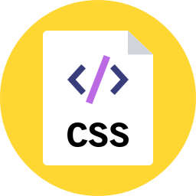
Theory Time - Selectors
Now lets focus on applying different styles to different h1 or section elemenets. To do this we need to use other type of selectors. So lets first get to know the available type of selectors
Selector
Element
<h1>Our Header </h1>
<p>The blog post</p>
<div>More Info</div>
h1 {
Color: red;
}
Classes
<h1 class=“blog”>Our Header </h1>
<p class=“blog”>The blog post</p>
<div class =“blog”>More Info</div>
.blog {
Color: red;
}
Universal
<h1”>Our Header </h1>
<p class=“blog”>The blog post</p>
<div class =“blog”>More Info</div>
* {
Color: red;
}
Rarely Used
Notes:
The element selector is used to select an html tag .It is specified simply by writing the tag name without <>.Any style applied to it will apply to all such tags in the dom.
Class selector is used to set style for elements within the same class .A class is added to any html tag by adding the class attribute.It is specified in css by adding a dot(.) followed by a classs name and { }.The specified styles will apply to all elements having that particular class.We can add any class to any element as classes are user defined .
Universal selector is used when we want to add same style to all elements of our dom.It is specified by a * followed by { }.It is rarely used

Slide 16
Theory Time - Selectors
Selector
ID
<h1 id=“main- title”>Our Header </h1>
#main-title {
Color: red;
}
Attribute
<button disabled> Click </button>
[disabled] {
Color: red;
}
Notes:
The id selector is used to apply style to a tag having a specific id.An id is unique to any element so this style is applied to one element.It is specified by using # followed by the id followed by { }.Id are user specified so any value can be added.Ids can also be added to url’s with a # sign and the page will scroll to that element but ids can also be used for styling
In attribute selector we select html element by the attribute they have.This can thereby select multiple elements.It is specified by [attribute] { }.

Slide 17
Theory Time - Selectors
Now lets add is’s to our sections add an id product-overview to first section
Add an id plans to second section
So now using an id selector set background red for only first section
For second section lets just apply style to the h1 tag so lets add a class section-title to h1 tag in second section CSS classes are by convention written in small case with individual words separated by – and as a note remember css classes are case insensitive
Classes are reusable
Lets leave the h1 element selector there and add a class selector for section-title class and add color green to it.
Now we see that the first section has a red background because of the id selector.The h1 in the first section has white color and Anton font because of the h1 element selector.The second section has no styles applied but the h1 tag in second section has a green color because of the class selector and anton font inherited from the h1 element selector.

Slide 18
Understanding the "Cascading" Style & Specificity
We had an element selector for h1 and also a class selector for h1 in second section .So both our selectors match the second h1 tag.
If we notice closely we will see the h1 tag gets the font property and colour from element selector but the color property seems to be overridden by the class selector.
It appears that css is parsed from top to bottom so the last tag takes preference and overrides.It is not totally wrong css is parsed from top to bottom but even if we switch the order the styling still applies the same i.e class selector still overrides the h1 tag style.
Now if we add one more h1 selector and change font we will notice that the font changes so the order does matter but only if we use the same selector as although the font changed class still overrides the color.Also we will notice that since we don’t set the font in class selector it does not override it .
So we can infer two things:
Multiple rules same to affect the same element
Different selectors seem to have different priorities

Slide 19
Understanding the "Cascading" Style & Specificity
To understand what's going on lets move to the developer tools
Open the ui right click on the text displayed by the h1 tag in section 2 and click inspect and focus on the styles column.
Here we can see the list of applied styles and the list has to be read from top to bottom with the topmost taking the highest priority.
We see a couple of styles are applied topmost is the element style this would be the inline style if any was applied, because inline styles have the highest priority.
This priority concept is called specificity
Then we will notice a class selector(.section-title) so it has a higher specificity than the element selector but lower than the inline selector
Then we see two element selectors in the order they are added to the main.css file.so element selectors have a lower specificity than class and inline but if there are more than one selector of same type the order takes precedence ie the one added last has more precedence or specificity.
Even below that we will notice some browser default styles that have the lowest priority and can be easily overridden

Slide 20
Understanding the "Cascading" Style & Specificity
The fact that we have multiple rules affecting the same paret is the cascading part of the name cascading style sheets.
So Cascading simply means that multiple styles or multiple rules can be applied to the same element.
Cascading or multiple rules may lead to conflicts and css has a concept called specificity which defines clear rules how such conflicts are resolved and which type of selector has a higher specificity.
Lets get an overview of these rules on next slide

Slide 21
"Cascading" Style & Specificity
Cascading
Specificity
Multiple rules can apply to the same element
Resolve conflicts arising from multiple rules
Inline styles
#ID selector
.class , :pseudo-class and [attribute] selectors
<Tag> and ::pseudo-element selectors
Notes:
<Tag> and ::pseudo-element selectors have the lowest priority or lowest specificity.we will study about pseudo-element selectors in upcoming slides
.class , :pseudo-class and [attribute] selectors have higher priorityWe will also study about pseudo-classes later
#Id selectors have higher specificity
There are more rules in specificity like ones concerning inheritance which we will study later
Inline styles have the highest specificity

Slide 22
Understanding Inheritance
Lest now get rid of that extra h1 selector from main.css.
The concept of inheritance means that every element inherits some styles from its parent element
Lets add some inheritance to our project by setting a global default font we can do this by either using the universal selector but it is very in efficient another way is to style the body tag as body tag engulfs all other tags of our html
So create an element selctor for body and set a font-family from google fonts I will be using Montserrat
We wont be able to see any visual c hange as it will be overridden by higher specificity h1 tag as h1 tag is placed at the last so it overrides it but in devtools if we scroll to end you will see a font with message inherited from body
So some styles are inherited from the parents and not necessary the direct parents but inheritance has a very low specificity even less than the browser defaults
Now if we add a <p> tag with some text to second section and since there is no overriding of fonts for <p> we will notice it has a font inherited form parent body.
So inheritance is a great way to set styles globally but if any direct selector is encountered it will be overridden
Inheritance is useful for setting default font size weight etc. to keep the look and feel constant

Slide 23
Adding Combinators
Now we notice that the h1 in the first section has an anton font because it is inherited from the h1 element selector.
Suppose we don’t want it to have the anton font there are multiple ways to do it:
We can add an id or class selector and set the font to it
We can add a font-family property to the section above it and use the value inherit which is used to tell css to inherit the value for this property so It will inherit from parent body
Oor instead we can change the css in suh a way that the font family anton is specifically applied to only the h1 tag inside the second section for that we can use combinators ie we combine two selctors we will first selct the section by id #product-overview and then after a space write h1 and then specify the styles
This tells browser to apply style only on the h1 tag insdie the section it is not necessary that h1 is directly under section it will work even if it is a sub child for example if it is in a div inside the section
Also using combinators increases specificity now if we add a normal h1 selector the style will not apply to the h1 in section 2 as it’s a specificity rule that a selector with more information has higher specificity than the one with less information

Slide 24
Theory Time - Combinators
Combinators allow us to be more clear about our rules and select elements by passing more information about the selector . We can combine multiple selectors not just two in combinators.
There are 4 very important type of combinators:
+
Adjacent Siblings
~
General Siblings
div + p {
}
div ~ p {
}
>
Child
Descendant
div > p {
}
div p {
}
Notes:
Adjacent siblings that use a + sign between selectors
General siblings that use a tilde ~ sign between selectors
Child that use a > sign between selectors
Descendant that use a whitespace between selectors

Slide 25
Adjacent Siblings
+
Adjacent Siblings
<div>
<h2>Not Applied</h2>
<p> CSS Applied </p>
<h2>Not applied</h2>
<h3>Not applied</h3>
<p>Not applied</p>
<h2>Not applied</h2>
<p> CSS Applied </p>
</div>
h2 + p {
color: red;
}
Elements share the same parent (<h2> and <p> both have same parent <div>)
Second element comes immediately after first element (style is applied only to those <p> tags that come just after <h2> tags)

Slide 26
General Siblings
~
General Siblings
<div>
<h2>Not Applied</h2>
<p> CSS Applied </p>
<h2>Not applied</h2>
<h3>Not applied</h3>
<p>CSS Applied</p>
<h2>Not applied</h2>
<p> CSS Applied </p>
</div>
h2 ~ p {
color: red;
}
Elements share the same parent (<h2> and <p> both have same parent <div>)
Second element comes after first element (style is applied to all those <p> tags that come after any <h2> tags not necessary immediately after <h2>)

Slide 27
Child combinator
>
Child
<div>
<div>Not Applied</div>
<p> CSS Applied </p>
<div>Not applied</div>
<article>
<p>Not applied</p>
</article>
<p>CSS Applied</p>
</div>
div > p {
color: red;
}
Second element is a direct child of first element

Slide 28
Descendant combinator
Descendant
<div>
<div>Not Applied</div>
<p> CSS Applied </p>
<div>Not applied</div>
<article>
<p>CSS Applied </p>
</article>
<p>CSS Applied</p>
</div>
div p {
color: red;
}
Second element is a descendant child of first element

Slide 29
Practice
The instructions are:
1. Style the <h1> tag to use any color of your choice and a sans-serif font. 2. Style all <code> tags to use the monospace font-family and have red text. 3. Use a class selector to ensure that the <code> elements in the second <li> element have a different color (e.g. green). 4. Switch the order of the rules you created and use the dev tools of your browser to understand how specifity resolves conflicts (for the <code> elements). 5. Set a default font (e.g. sans-serif) for the entire content of your page and use "Inheritance" to change the font of the <li> items, too. 6. Use a combinator to give all <li> elements but the first one (!) a black background and white text color (don't worry if the numbers disappear). 7. Use another combinator to now give all <li> inside an <ol> element a black background and white text color.

Slide 30
Useful resources
Complete MDN CSS Reference : https://developer.mozilla.org/en-US/docs/Web/CSS/Reference
Written CSS docs on MDN: https://developer.mozilla.org/en-US/docs/Web/CSS
Common CSS Properties Reference: https://developer.mozilla.org/en-US/docs/Web/CSS/CSS_Properties_Reference
CSS Combinators: https://developer.mozilla.org/en-US/docs/Learn/CSS/Introduction_to_CSS/Combinators_and_multiple_selectors
More details on CSS Specifity: https://developer.mozilla.org/en-US/docs/Web/CSS/Specificity

Slide 31
Section -3 -:Diving deeper into css

Slide 32
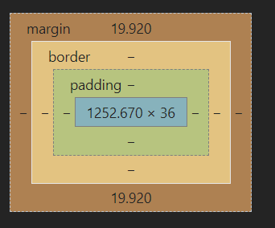
Introducing the CSS Box Model
If we consider the red box around our first element.
It would look better if it was bigger ,the text had more space around it and till we add a navigation bar it would be better if it did not have white space around it.
We can achieve all this by understanding and working with the box model
Every element in html is interpreted as a box in css we can see such a box by opening the developer tools and navigating to the bottom of the page in the styles section.

Slide 33
Introducing the CSS Box Model Cont…
Every element has a content represented by the innermost blue area i.e actually what is inside it for our <section> tag the content is the <h1> tag and for the <h1> tag the content is the text inside it .
The next part is the padding which in case of our <section> is zero . padding is the internal space between the content and the border . Padding is highlighted in green.
The next part is a border we don’t have one in our case yet . The border surrounds the element , comes directly after the padding which in turn comes directly after the content . The border is highlighted in yellow.
We also may want to have a spacing around the element and that is called the margin . It is not a part of the core element which ends at the border but it comes after that . It is the distance between the element and its next sibling . The <h1> element has a margin which is default browser margin we can see this by scrolling up and we will notice the margin-block-start and margin-block-end browser defaults . The margin is highlighted in light brown colour.
You will notice that the margin goes outside the surrounding section as it is not the part of the element

Slide 34
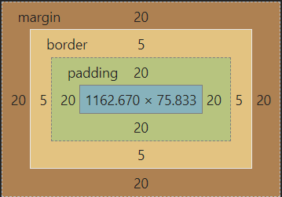
Understanding the Box Model
Lets add some spacing around the text in section 1 by adding a padding of 20px to the id selector
Now in our devtools we will notice we have a padding and the padding is even around the margin of h1 tag . This is because whenever a padding is added it is added after the child element’s content and margin so that margin and padding don’t overlap.
Now after the padding lets add a border that should be solid,black and 5px wide so we can either add three properties:
border-style: solid;
border-color: black;
border-width: 5px;
Or we can add all three together using a special shorthand notation which we will explore more in upcoming slides :
Border : solid black 5px;
To complete the box model lets add a margin of 20px

Slide 35
Understanding Margin Collapsing and Removing Default Margins
If we inspect our section we will notice some whitespace to the left and right before and after the margin this is coming from the body actually we can see that the body has a default margin of 8px.
To prevent this we can set the margin of body to 0 and we will notice that the margin for our section tag is from edge to edge now.
So remember body be default has a margin
Also if we inspect the h1 tag in the second section we will notice it has a default margin coming from browser defaults but from the top it overlaps the margin from section 1.This behaviour is called Margin collapsing.
Margin collapsing means if we have two block elements next to each other the margins between them are actually collapsed to one single margin and the bigger margin wins.
This is not a bug this is enforced by css so that we don’t get big distances between elements.
To get around this we can specifically use margin-top or margin-bottom so set the appropriate spacing between elements

Slide 36
Understanding Margin Collapsing
Three cases arise in Margin collapsing:-
Adjacent siblings which both have margins
A parent which holds one or more child elements where the first and/ or last (or the only) child has margins
An element without content, padding, border and height
1. Adjacent Siblings
In this case, the first element might have a margin of 10px (on all sides let's say) and the second one has 5px (or 20px - the values don't matter).
CSS will collapse the margins and only add the bigger one between the elements. So if we got margins of 10px and 5px , a 10px margin would be added between the elements?
2. A parent with children that have a margin
To be precise, the first and/ or last or the only child has to have margins (top and/ or bottom). In that case, the parent elements margin will collapse with the child element(s)' margins. Again, the bigger margin wins and will be applied to the parent element.
If the parent element has padding, inline content (other than the child elements) or a border, this behavior should not occur, the child margin will instead be added to the content of the wrapping parent element.
3. An empty element with margins
This case probably doesn't occur that often but if you got an element with no content, no padding, no border and no height, then the top and bottom margin will be merged into one single margin. Again, the bigger one wins.

Slide 37
Working with Shorthand Properties
Shorthand properties help us to combine values of multiple properties in a single property .
border-width:2px
border-style :solid
border-color: orange
border : 2px solid orange
margin : 5px 10px 5px 10px
Top
Right
Bottom
Left
margin-top:5px
margin-right:10px
margin-bottom:5px
Margin-left :10px
margin : 5px 10px
Top & Bottom
Left & Right
margin : 10px
Left & Right
Top & Bottom
Notes:
The sequence of indivisual properties does not matter if they have different type of values.
If they have similar type of values special handling is needed that we will study in upcoming slides
We can use shorthand to set only maybe just one property like border color and all other properties take default values

Slide 38
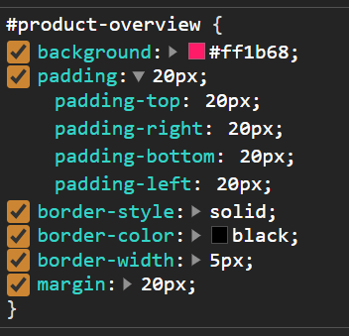
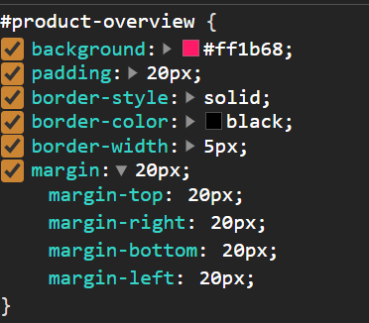
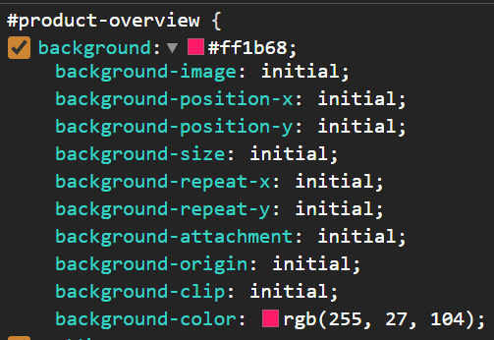
Working with Shorthand Properties
The sequence of individual properties does not matter if they have different type of values.
If they have similar type of values special handling is needed that we will study in upcoming slides
We can use shorthand to set only maybe just one property like border color and all other properties take default values
If we go to developer tools we will notice an arrow after all the shorthands we used and if we click on that we can see all the individual long form properties that were set implicitly

Slide 39
Diving Into the Height & Width Properties
Now we have a fair understanding of margin and border now lets remove the margin border and padding of #product-overview selector . Now we only have one change that we don’t have the margin applied by the body.
Now if we set the width of section to 100% we don’t see any change because section div etc are block elements and by default take 100% of the screen width.
If we now set the width to 50% we will see the box shrinks to 50% of page width.It actually shrinks to 50% of the width taken by surrounding container i.e. the <main> tag which is again a block element and takes whole page width so 50% of width of main which in turn is 50% of width of the page.
So width can either be set relatively with % or with absolute values like px or rem etc
Now if we set the height of our section to 100% we will see only a small change it wont span to the end of the page.
The reason is 100% refers to the available height of surrounding element i.e <main> and the height of main grows dynamically it grows based on the content it has.
So if we set the height of main to 100% we still don’t see a change because it’s parent is <Body> which has dynamic height too and its parent is <html> which has dynamic height too so to see a change we need to set height 100% on all of them to creating a chain and passing the height of 100% down to our section element.
For now just remove all these heights and set the height of section to 528px;

Slide 40
Understanding Box Sizing
Lets add a padding of 10px, solid black 5px border and a margin of 10px to our section
Now if we examine our section element we will notice that the actual dimensions of our section have 528px height + (10+10) padding + (5+5) border making the total height 558px
So the height that we set is set on the content and border and padding is added to it this is because by default all elements have a certain way to calculate width and height known as content-box.
This behaviour is controlled by the box-sizing css property which by default is content-box which means if we set width and height we set the width and height of the content border and padding are applied afterwards
We can although set it to border-box now width and height will include border and padding but not margin so now if we set height to 528 the height of the content will be 498px only as 528 now includes (10+10) padding and (5+5) border.
This is actually a common practice and so we usually set it using universal selector * to set the default box-sizing to border-box for all elements.
Now lets remove the margin as we want our element to span from edge to edge

Slide 41
Adding the Header to our Project
Now lets remove the border too from the section.
Also I have added some code to our index.html to add an ugly looking navigation bar to the code.
Now lets try to make the header look a bit better so first since we might use the header tag again in our code so lets add a class main-header to our header tag and use the class selector to add css to it
So now we want to have a navigation bar that spans the whole screen width ,has a green background color, and also it should have some padding so that the content of the header doesn’t sit on the edges
So now add width:100% , background:#2ddf5c,padding:8px 16px to achieve the full width,background color and padding.

Slide 42
Understanding the Display Property
Now if we notice in our header the list elements don’t look so good it would have been better if we could change their placement.
So now first of all to access them in css lets add a class to them ,lets use a specific naming convention called bem(block element modifier) to name our classes we will study bem later in our trainingso the name will be main-nav__item this signifies that it is an item in the main-nav
Use this class on all list items
To our ul tag add a class “main-nav__items”
To our nav tag add the class “main-nav”
So now we kind of have an hierarchy main-nav contains main-nav__items which contain multiple main-nav__item
In html we have inline elements which are rendered in a same line like <a> tags if we have multiple <a> tags simultaneously the are rendered in the same line, we also have block elements which are rendered one after the other like div, section ,h1 etc these elements take the full available width of the container

Slide 43
Understanding the Display Property Cont…
Now since inline elements are usually adjacent to other inline elements therefore setting the margin ,padding etc is not plainly possible as multiple elements in one single line cant have different margin(top , bottom) ,padding etc.
But for block elements since they span the whole width of the container these properties can be set.
Using display property we can although change the default behaviour of elements we can set the display property to block to make an element behave like a block element, to inline to make it behave like inline, change it to none to hide it from visible flow although it will still be part of the dom but hidden from display.
We can also set it to inline-block such elements will continue to behave like inline but the block properties like margin padding etc can also be set.
So lets set the display property for our list items to inline block using the class selector for main-nav__items

Slide 44
display: none vs visibility: hidden
We had a look at display: none; - this value removes the element to which you apply it from the document flow. This means that the element is not visible and it also doesn't "block its position". Other elements can (and will) take its place instead.
There is an alternative to that though.
If you only want to hide an element but you want to keep its place (i.e. other elements don't fill the empty spot), you can use visibility: hidden;
The element is only invisible, it's not removed from the document flow and of course also not from the DOM.

Slide 45
Applying the Display Property & Styling our Navigation Bar
Now if we notice that our brand link uhost and other links are in separate lines.
Lets move them to same line we will notice that the brand link is a div and the other links are in a <nav> tag and both of them are block elements.
So we need to set display to inline-block for both ,we can either add a class to the div or use a combinator to select it, lets use a direct child combinator and also for the nav we already have a class lets select that too and add the display:inline-block to them.
We now have the brand link and other links on the same line.Now lets move the links(elements in the nav element) to the right side.
Now to do that we can add text-align :right to the main-nav element and all the elements are treated as text .
We will notice that it did not have any effect although if we check in our devtools the text-align right is inherited from the nav to ul this is because ul sits under nav which is inline-bloack element so does not take full available width it only takes width as needed so text align :right does not have an effect
So we need to set a width and the width should be the complete width of the header – the width of the div also we will notice that the ul has a default padding to the left and margin to top and bottom which we need to remove
So lets set margin and padding to zero for the ul by selecting it using its class selector we should also set list-style: none to just remove any bullet points although padding:0 will automatically remove the bullet points

Slide 46
Applying the Display Property & Styling our Navigation Bar
Now lets change the width of main-nav calss(<nav>) we will set the width to 100% initially and we will notice the content is right aligned but also now its on a separate line.This is because the nav now takes full 100% width and thus doesn’t fit on the same line anymore
So we need to actually take 100% - width of the div we can check the width of div from the devtools for time being which is 48.135 in my case lets take it as 49px
We will use a special calc function given by css to set the width as calc(100% - 49px).We will notice it does become narrower but still in next line.This is because of a behaviour of inline block that we need to understand
If we check out html there is a whitespace between the </div> and <nav> tags and we usually structure our code in such a way and it doesn’t cause a problem but using display:inline-block this whitespace is treated as a character and has a width which it occupies on the screen if we remove this whitespace the links will be on the same line
But keeping the elements on same line is not good as we want to structure and format our code so actually we need to subtract not only the width of div but also the width of the whitespace that is hard to measure because its not even visible from dev tools.So we just subtract a bit more from the width like subtract 54 instead of 49.
It is more of a hack and we will look into a cleaner solution in upcoming slides

Slide 47
Working with "text-decoration" & "vertical-align"
So now lets style our brand (<a> inside the header).So to do this first we need to select it lets add a class to it lets follow bem and name it main-header__brand.
Select it in our css file using the class selector
So we will apply following styling
Remove the default underlining
Lets change the color
Make the text bold
Increase the font size
So lets remove the underline by setting text-decoration:none which is by default set by browser to underline.Change the color to darker green by adding color:#0e4f1f and lets make it bold by adding font-weight:bold and set the font size by setting font-size:22px
This would now cause the size to increase and thus split into two line so we need to fix our hack again by subtracting a bit more from the width maybe decduct 74px
Now we will notice that the brand is styled well but the links are now aligned to the botton of the brand as the brand has a higher font size so links don’t appear aligned center and are aligned more towards the bottom of the brand.
To fix this we need to set the vertical-align:middle to both the brand and the nav holding the links

Slide 48
Styling Anchor Tags
So now lets style the links
We need to make the <a> tags have a little bit distance from each other
Have the same green color as brand by default
Also remove the underline
To add spacing between list items lets add a right-left margin of 16px to the main-nav__item selector we will use the shorthand we learned to only set left and right not top-bottom by setting margin:0px16px
Now we need to remove the underline to do this we can use text-decoration:none but it wont work on the main-nav-item as the text decoration is et on <a> tag not on <li>.it would have been inherited by since the browser defaults use a direct-selector it will override the inheritance so its better to st the property on <a> tag to do this we can either add a new class or use a combinator.
Performance wise a class is a little bit faster than the combinator but since we are using a combinator for a direct child with parent already having a class it is also a high performance combinator and we can also skip adding a new class.
So lets add a direcxt child combinator on main-nav__item a and add color:#0e4f1f and text-decoration:none to it.

Slide 49
Adding Pseudo Classes
Lets style the links further:
The links should change color if we hover over them lets say white color
Also the links should change colour if we keep them clicked like a touch event on a mobile device lets say white color
We can achieve this by using pseudo classes.Lets add such a css and then understand it further in theory
We add a combinator like .main-nav__item a but now we add a pseudo class to anchor tag as Main-nav__item a:hover for hover and main-nav__item a:active.Active and hover are just a few examples of pseudo classes that we can add
Inside these selectors just add the color:white rule
Now if we hover over our links or keep them pressed the colour changes to white
Lets study about pseudo classes in depth on next slide

Slide 50
Pseudo Classes & Pseudo Elements
Pseudo classes define a style or allow us to define a style for a special state of an element like the hover or active state
Pseudo classes are defined by a :class name
A list of pseudo classes can be found on mdn(Mozilla developers network) a link to which is added to the last slide of this section
Examples of Pseudo classes are hover,active,first-child,first-of-type etc
Pseudo element allows us to define a style for a specific part of an element
Pseudo elements are defined by :: element name
A list of pseudo elements can be found on mdn(Mozilla developers network) a link to which is added to the last slide of this section
Examples of pseudo elements are first-letter,first-line,after etc
Lets quickly dive into some of them
For example if we want to set color :red and font size 20px to first letter of the <p> tag in the section 2 we can do that by selecting it using pseudo element as p::first-letter and add our styles to it as:
p::first-letter {
color: #ff1b68;
font-size: 20px;
}

Slide 51
Pseudo Classes & Pseudo Elements
Now lets see an example of after and before pseudo elements that allow us to render content with css but such content should only add to the design and should not be crucial or page content that should always go to html mainly for accessibility reasons
We can use after to maybe style the links better
Lets first select it using .main-nav__item a::after
In this selector we can set a special property that is available only with after and before i.e. content
Lets set the content to something like content:” (Link)”; also lets add a color:red to it.
This kind of styling is used to add a link to open in new tab or an icon etc
We will now notice a red coloured word (Link) after each nav item and this word is a part of the content and thus is clickable.

Slide 52
Grouping Rules
Now lets first remove the after and first-letter pseudo elements selectors
Now if we notice that the hover and active pseudo class selectors that we used have exactly the same css rules i.e. color:white and they are applied to same element just the pseudo class differs
In such a case we can group them
To do so after the first selector i.e. main-nav__items a:hover we can add a comma and then either in the same line or next line we can add another class to group them
So lets remove the old rules and create a new group rule to achieve the same effect
The css will look like :
.main-nav__item a:hover,
.main-nav__item a:active {
color: white;
}

Slide 53
Working with "font-weight" & "border"
Lets add some more styles to the links
The links by default should be bold
They should have a border at the bottom not an underline as underline is too close to the text like a border with a padding.This border should be visible only when we hover over it
To make the links bold just add font-weight:bold to main-nav__item a
So in the pseudo element selector for hover add a border-bottom: 5px solid white to add a border
To give space between text and border add a padding top and bottom of 3px to the selector for <a> tag

Slide 54
Adding & Styling a CTA-Button
The start hosting link that we have is actually the main link for our web hosting portal its kind of a CTA(call to action) button and must therefore stand out of the rest.
To style this link separately lets add another class to it.So here it is worth remembering that we can add multiple classes to an element we will name the class main-nav__item—cta.
This name is again following bem –cta specifies it has a special state called cta
To give multiple classes to an element we just separate them with a whitespace
Add a class selector for this class to our main.css file and using combinator target the <a> tag in this class
Now since the selector .main-nav__item a ans .main-nav__item—cta a both have same specificity as they both start with a class and then have a descendant child to override styles in our new selector we need to add it after the first selector to override rules in it.
So now lets add a color:white,background:#ffib68,padding 8px 16px and we will also add a new rule border-radius:8px this will give a round edge to the border
Also we need to change the hover and active effects so we will add a selector eith pseudo classes .main-nav__item—cta a:hover, .main-nav__item—cta a:active and add color :#ff1b68, background :white ie we swap the background and text color on hover we will also remove the border by setting border:none so that we don’t get that white border effect in this.

Slide 55
Adding a Background Image to our Project
So lets add an image as a background for the large pink area
I have already added the image to section3 folder with the name freedom.jpg
Lets add this image as abackground in our #product-overview selector
To do this remove the color and use a url() helper method
This allows us to reference an image and use it as a background thereafter
url takes in a string as a parameter i.e the path of the image we can give a local path or an http path
For local path if it is in same folder just give the name if it is in sub folder we need to pass the folder name as well
So in our case just give freedom.jpg

Slide 56
Assignment
Build a nice box (div) with some content (e.g. "I'm a box!"), padding, a border (style it as you want) and some margin.
If you didn't do it already: Set different padding and margin for the four different sides of the box.
Add the same box below the first box and note if you can identify any strange behavior.
Give the first box a height of 100% of the window height.
Set the first box back to a more reasonable height of 300px and set its width to 50%.
Set same height and width for second box also and Position the two boxes next to each other.
"Hide" box number 1 and see how that changes the page.
Add a hover effect to the the LAST div element. Use pseudo-classes for that.

Slide 57
Useful Links
CSS Box Model: https://developer.mozilla.org/en-US/docs/Learn/CSS/Introduction_to_CSS/Box_model
box-sizing : https://developer.mozilla.org/en-US/docs/Web/CSS/box-sizing
More on height & width: https://www.w3schools.com/css/css_dimension.asp
The display Property: https://developer.mozilla.org/en-US/docs/Web/CSS/display
Pseudo Classes on the MDN: https://developer.mozilla.org/en-US/docs/Web/CSS/Pseudo-classes
Dive deeper into Pseudo Elements: https://developer.mozilla.org/en-US/docs/Web/CSS/Pseudo-elements

Slide 58
Section -4 -:More on Selectors & CSS Features

Slide 59
Using Multiple CSS Classes & Combined Selectors
We can use Multiple classes on one element
So the two rules here will be applied on the element and in case of a conflicting rule normal specificity and ordering rules will hold.
In the second selector we will notice that there is no space between the tag(a) and class(active) in css they are separated by a dot(.).This is not a combinator it is used to target an anchor tag which has the active class.This concept is not limited to tag.class selector we can combine class.class or tag.class.class , class.id etc this concept is called selector chaining.here the difference to combinator is that the different parts of the selctor are not nested they are essentially pointing to same element
.class1 {…}
.class2 {…}
<div class=“class1 class2” >
<a href=“#” class=“active” >
a.active {…}
Notes:
Branch :MoreOnSelectorsAndCssFeatures
Commit : MultipleCssClassesAndCombinedSelector

Slide 60
Using Multiple CSS Classes & Combined Selectors Cont..
We will find some html and css code in this commit in the repository,we have a nav with two links and then two sections with p tags in our index.html
In our main.css some basic styling is applied using tag and class selectors like margin background font padding border test-decoration etc.
We don’t have an element with two classes yet lets create this by adding a class highlighted to section1
The two classes here are separated just by a whitespace and they are independent of each other both of them can be reused anywhere
If two classes define a conflicting rule the normal specificity and ordering rule will apply and therefore whichever class is selected last in our main.css will override the property
To show this lets create a selector for our highlighted class below the .main-section class selector and override the border property to set it to 2px solid orange.
We will see that both classes are applied and highlighted class will override the border property as it comes last in the main.css file if we switch the order main-section will override the border property
Lets now have a look at the combined selector the first <a> tag in our nav has a class active lets use that to create a combined selector and add a purple color to it we will see that the first link has a purple color now
Notes:
Branch :MoreOnSelectorsAndCssFeatures
Commit : MultipleCssClassesAndCombinedSelector

Slide 61
Classes or IDs?
Css Classes are re-usable. Classes allow us to name and mark things for styling purposes only . Although they can be used in conjunction with js to interact with the dom but that interaction is usually styling related. Classes are something really connected to css and therefore using a class to style something is rarely wrong and thus usually they should be the first pick for styling an element.
Using tag selectors it is easy to mess up things like for example you styled an h1 tag using a tag selector and the same style got applied to another h1 tag that you didn’t want to style . So try to use tag selectors for only some generic styles that should apply to every tag of that type.
Id selectors are also a decent choice if we want to style a unique element using an id it is a decent choice , but id’s also have a non css meaning they are not used only for styling purposes ,therefore using an id just to apply a style is not recommended and we should use a class instead even though such a class might not be reused.
Notes:
Branch :MoreOnSelectorsAndCssFeatures
Commit : ClassesOrIds

Slide 62
(Not) using !important
If we add !important to the value of a rule in css after the value and before the ; it is called important it is used to override all specificity and other selectors.
In general don’t use !important ,use specificity and rules to style you website according to your needs and to write better CSS code in the end.
It leads to bad code. It should be used only in very rare some edge cases like badly written third party css etc
Lets see this in action in our main.css file the border defined in highlighted class selector overrides the one defined in main-section selector but if we add !important to it we will see that the border defined with !important always takes precedence. If we have some other overridden rule like height in highlighted they would still override
Notes:
Branch :MoreOnSelectorsAndCssFeatures
Commit : Important

Slide 63
Selecting the Opposite with :not()
In the last section we had a look at pseudo classes.
Lets take a look at one such class not
Not is an interesting pseudo class as it allows us to reverse a certain rule or exclude a certain selector
The syntax used is :not(selector) this will select everything that is not the selector passed in the parenthesis
Some browsers support more complex selectors inside the parenthesis but most browsers don’t.
As per mdn reference “The ability to list more than one selector in not is experimental and not yet widely supported”
Lets see it in action
Lets select all anchor tags that don’t have the active class so we will write the selector as
a:not(.active)
Lets give this selector a color blue and we will notice that the second anchor tag that does not have the active class is blue in color
It can be really handy in some cases but often you can find a positive way to write such a rule.
Like in this case we can set a blue color for all anchor tags and override it for a.active and since this selector offers more information it will override the default rule as it will have higher specificity.
From a performance prespective writing a positive rule is better than writing a not rule
Notes:
Branch :MoreOnSelectorsAndCssFeatures
Commit : notPseudoClass

Slide 64
CSS & Browser Support
In CSS whenever we use a certain type of selector or a certain property or a certain style you have to check if the browser of the target audience supports that feature otherwise we can’t use it.
We can always find workarounds for implementing features that are not supported ,but checking the browser support is till important.
On mdn reference we can see the browser support section on end of every page
There we will see a split for desktop and mobile browsers, and the major browsers and how well they support a certain feature
For some features you might also notice two lines in the table one for basic support and one for more advanced version of that feature
You can also see since which version a specific browser supports a specific feature
In addition to mdn we can also use www.caniuse.com
This website gives a lot of information about what is supported by which browser and also things like what percentage of market can use your website if we use a certain feature.It gives support for both css and js
Checking these and more such resources is always a good idea when building a real world project.
Notes:
Branch :MoreOnSelectorsAndCssFeatures
Commit : BrowserSupport

Slide 65
Useful Links
A discussion on "classes vs IDs": https://stackoverflow.com/questions/12889362/difference-between-id-and-class-in-css-and-when-to-use-it
When is using !important okay? => https://css-tricks.com/when-using-important-is-the-right-choice/
The :not() pseudo class: https://developer.mozilla.org/en-US/docs/Web/CSS/:not
Can I Use: https://caniuse.com/
Notes:
Branch :MoreOnSelectorsAndCssFeatures
Commit : UsefulLinks

Slide 66
Section -5 -:Practicing The Basics
Notes:
Branch :PracticingTheBasics
Commit : InitialCommit

Slide 67
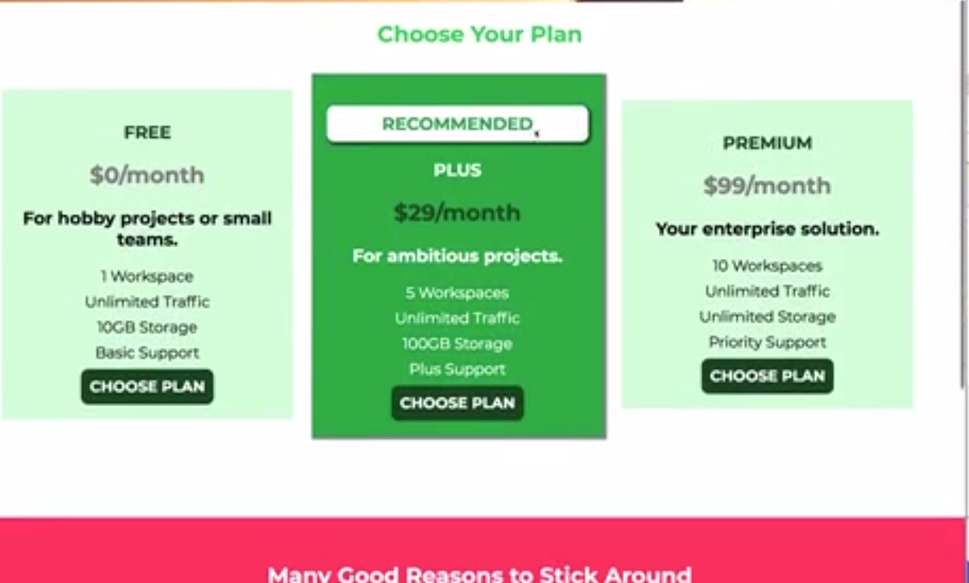
Adding Style to our Plans
Here I have added some html to the plans section of our page To describe the different hosting plans we have In our fictional hosting company.
Each plan is present in an <article> tag with some information like name of the plan , price ,description and some plan details as an unordered list.
It also has a choose plan button to select a particular plan
Now lets style the plans section and make it look a bit beautiful
At the end we want the plans to look like :
Notes:
Branch :PracticingTheBasics
Commit : StylingPlans

Slide 68
Adding Style to our Plans
Now if we see our main.css file we already have the .section-title selector and it is still there in our html we have actually added our new code below that.
So as per the image of expected result we kind of need to style all plans in a similar way but just have to highlight the middle one.
So to achieve this we can assign a class to all article elements representing our plans lets name the class plan.Lets add this plan class to all the articles in our html
Lets add a class selector for plan in our main.css file below the #product-overview h1 selector
Lets give our plans a light green background using background:#d5ffdc
Lets align all text in the plan to centre by using text-align:center
To have some distance between the edges and text lets add some padding using padding:16px;
Lets also add some margin to give them space from the other content using margin:8px
All plans should now sit in the same line so lets change the display to display:inline-block but since there width is more than what can fit in a single line we need to adjust there width too
Lets add a width of 30% using width:30% we will notice the <article> tag we are styling is under a <div> which is under a <section> which is under a <main> and we haven’t restricted width on any of them so it will take full page width and consequently each of our <article> will take 30% of full page width
We also want the three plans to align properly with each other so we will add vertical-align:middle
Also the choose your plan text should be center aligned using text-align:center in section-title class selector
Notes:
Branch :PracticingTheBasics
Commit : StylingPlans

Slide 69
Working on the Recommended Plan
Now we want to ensure that the plan in the middle looks different from other plans i.e it stands out of the rest
We will change its background ,highlight the “Recommended” badge
Now to control the “Recommended” badge contained in a <h1> tag we need to give it a class like plan__annotation.We should also add a second class to our recomeneded plan to override the background color etc we can add plan—highlighted class to the <article> tag containing our recommended plan
Create a class selector in our main.css for plan—highlighted and override the background set it to a darker green (#19b84c).We can also change the text color to white to make it easier to read
Lets add a small drop shadow behind the plan for that we can use the box-shadow property
Box-shadow property allows us to set a box-shadow or an inset(shadow inside the box) shadow by using the keyword inset before the values
Lets add a box shadow first and then study it in detail in next slide so lets add box-shadow: 2px 2px 2px 2px rgba(0,0,0,0.5);
This will add a black 50% transparent shadow 2px to the right and 2px to the bottom of the box with 2px spread and blurriness.
Notes:
https://css-tricks.com/almanac/properties/b/box-shadow/
Branch :PracticingTheBasics
Commit : RecomendedPlan

Slide 70
Box-shadow
The box shadow takes following values :
Horizontal offset
Vertical offset
Blur radius
Spread radius
Color
So the syntax is box-shadow: [horizontal offset] [vertical offset] [blur radius] [optional spread radius] [color];
The horizontal offset (required) of the shadow, positive means the shadow will be on the right of the box, a negative offset will put the shadow on the left of the box.This defines the positioning of the shadow on the X axis
The vertical offset (required) of the shadow, a negative one means the box-shadow will be above the box, a positive one means the shadow will be below the box. box.This defines the positioning of the shadow on the Y axis
The blur radius , if set to 0 the shadow will be sharp, the higher the number, the more blurred it will be, and the further out the shadow will extend. For instance a shadow with 5px of horizontal offset that also has a 5px blur radius will be 10px of total shadow.
The spread radius , positive values increase the size of the shadow, negative values decrease the size. Default is 0 (the shadow is same size as blur).It defines how much the shadow should spread beyond the values for x and y axis
If we omit the blur and spread we will get a very sharp shadow that ends just after the values defined for x and y axis
Color (required) – takes any color value, like hex, named, rgb or rgba. If the color value is omitted, box shadows are drawn in the foreground color (text color). But be aware, older WebKit browsers (pre Chrome 20 and Safari 6) ignore the rule when color is omitted.Using a semi-transparent color like rgba(0, 0, 0, 0.4) is most common, and a nice effect, as it doesn’t completely/opaquely cover what it’s over, but allows what’s underneath to show through a bit, like a real shadow.
For example
box-shadow: 3px 3px 5px 6px #ccc; The shadow will be placed 3px right and bottom of the original shape will have a 5px blur and 6px spread
box-shadow: inset 0 0 10px #000000;
Notes:
https://css-tricks.com/almanac/properties/b/box-shadow/
Branch :PracticingTheBasics
Commit : RecomendedPlan

Slide 71
Color function
There are many ways to defiune a color like using its name,hex value etc
We can also use a color function we can write rgb() then define values for red green and blue inside the parenthesis to get the desired shade the allowed values like between 0-255 for all R b and g. a value of rbg(255,255,255) represents white and rgb(0,0,0) represents black
There is an alternative to rgb i.e rgba which defines a fourth parameter the alpha channel representing the transparency of the color the value lies between 0 and 1 where 0 means fully transparent and 1 means opaque
Notes:
https://css-tricks.com/almanac/properties/b/box-shadow/
Branch :PracticingTheBasics
Commit : RecomendedPlan

Slide 72
Styling the Badge with "border-radius"
Lets now style the recommended badge.
Add a selector for the <h1> tag containing the recommended badge we can use a class selector referring to the class plan__annotation
We want to make it sit in a white box and therefore have a non white(green) text and also have a tiny drop shadow also maybe add a padding and rounded corners
To make the box white add a background:white;
To make the text color green add color:#19b84c;
To add a drop shadow add box-shadow: 2px 2px 2px 2px rgba(0, 0, 0, 0.5);
To add a padding use padding:8px;
To make the corners rounded use border-radius:8px;
Notes:
Branch :PracticingTheBasics
Commit : StylingTheBadge

Slide 73
Styling our List
Lets style the bullet points in our plans.
Add a class plan__features on all <ul> tags in all plans and add a class selector for this class in our main.css file
Now lets remove the bullet points by setting list-style:none
Also lets get rid of all margin and padding set by the ul by setting margin:0 and padding:0
We can now set some space between the individual list item by setting the top and bottom margin to 8px and 0 to right and left .
We can set this style either by using a combinator like .plan__features li{ margin:8px 0px} or by assigning a class plan__feature to all li items I will be using a class to be in sync with the coding style followed in this project but using a combinator is absolutely fine
Notes:
Branch :PracticingTheBasics
Commit : StylingTheList

Slide 74
Working on the Title and the Price of our Packages
Lets work on the title and price of our packages
Lets add a class plan__title and plan__price respectively to the title and price of all plans i.e add these classes to the <h1> and <h2> tags representing title and plan respectively
Add class selectors for these classes to our main.css .plan__title {} and .plan__price{}
Lets change the color of our title to dark green color:#0e4f1f;
Lets change the color of our price to grey color:#858585;
Although these colours look good but they don’t look so good on our recommended plan because of the background so lets override it for the recommended plan using combinators
So add a combinator for title of our recommended plan as .plan--highlighted .plan__title{} override the color to white color:white
So add a combinator for price of our recommended plan as .plan--highlighted .plan__price{} override the color to dark green again color: :#0e4f1f;
Notes:
Branch :PracticingTheBasics
Commit : TitleAndPrice

Slide 75
Improving our Action Button
Lets now style the action button on bottom of each plan
Lets add a class button to all the button on our plans and create a class selector .button{} for the same in our main.css
Lets add a dark green background using backgroung:#0e4f1f; and a white text color using color:white;
Now if we notice in our dev tools we have a lot of defaults like padding border text styles etc applied to it by the browser also we will notice that the font looks different than the rest of our page
Although it inherits the font from body but it is overridden by the direct font assignment by the browser so to correct the font we will use font:inherit; inherit is a keyword which forces the inherited styles to be applied and note we are using font not font-family this is a shortcut to set multiple font related styles together.
Now lets override the border and set it to 1.5px solid and dark green using border:1.5px solid #0e4f1f;
Similarly lets override the padding and set it to 8px from all sides using padding 8px;
Lets add rounded corners using border-radius:8px
One thing that we will notice is that when we hover over the button we get no indication that it is a button,we don’t get a hand shaped cursor and no different hover style lets add them and also set the font-weight :bold;
Notes:
Branch :PracticingTheBasics
Commit : ImprovingActionButton

Slide 76
Improving our Action Button
To change the cursor to hand use cursor:pointer; cursor can have more options too pointer and default are the most commonly used
To add a hover effect we can use the hover pseudo class we will also use the active pseudo class for situations when we keep mouse pressed on the button and change the background :white; and color:#0e4f1f;
Notes:
Branch :PracticingTheBasics
Commit : ImprovingActionButton

Slide 77
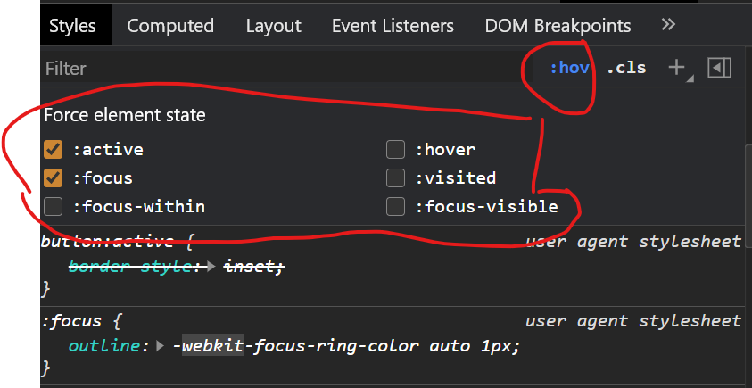
Understanding Outlines
If we want to check the applied styles on a button in a particular state like active or focus etc in devtools we can select the :hov pseudo class and then select the checkbox for whwichever state we want to view styles for
We will notice that in focussed state the button has a slight blueish border like thing called outline
Outline is something comparable to a border but it is not part of the box model ,outline is actually a border like thing that is applied before the margin and after the border
We can set a different style for outline or remove it as per requirement for now on lets remove it by creating a pseudo selector for focus and setting outline to none. .button:focus{ outline:none;}
Notes:
Branch :PracticingTheBasics
Commit : UnderstandingOutlines

Slide 78
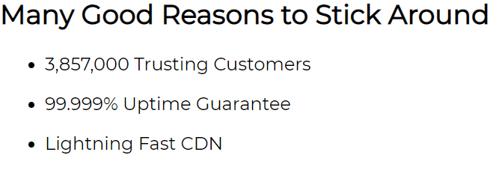

Presenting the Core Features to the User
Now lets add a new section to our page and present some core features to the user these are like highlights as to why uhost is good for them in short self praise or advertising.
I have added a new section below our plans in index.html which has a heading(<h1>) and a list(<ul>) with list items(<li>) having an empty div(<div>) where we can add something and a paragraph(<p>) representing the core features or the advertisement text.
Currently it will look like :
And the idea is to turn it into something like
Notes:
Branch :PracticingTheBasics
Commit : CoreFeatureSetup

Slide 79
Styling the Headline of the Core Features Section
Lets first style the heading for our core features section
We already have a class that applies some styles to headline text used for plans section “section-title“ class use this class on the <h1> tag representing the headline for our section.we will notice it now has a green color and is center aligned
Lets now style the list in our section.First lets add a strong reddish color to the background d of the section to achieve this lets first assign an id to this section key-features
Add a id selector for the above id to our main.css as #key-features and add background:#ff1b68 to give it a strong reddish background
Now if we notice since we have a red background the green color of our heading does not look so good so lets change that to change it we will use a descendant combinator like #key-features .section-title{ }
Set the color:white.Also lets add a little bit more margin maybe margin:32px;
Also lets add a margin-top:80px to our #key-features to give a space between the two sections for plans and key features also lets add some padding so that the content doesn’t stick to the edges of the section maybe padding:16px;
Notes:
Branch :PracticingTheBasics
Commit : StylingHeadline

Slide 80
Preparing the Content of the Key Feature Area
Lets style our list .
Lets add a class key-feature__list to the <ul> list and class key-feature to the individual list items<li> and assign a class key-feature__description to the <P> tags inside the list items<li>
Add a class selector for the list .key-feature__list to our main.css.First lets get rid of the bullet points by using list-style:none; also lets remove the margin and padding by using margin:0; padding:0;
Add a class selector for list items using .key-feature{} and lets make the list items inline using display:inline-block; Also lets give a width :30%; we are not using 33% because as we saw in previous sections we will have some width taken by the whitespace between the <li> so using 30% we will take in account that width too and avoid having the last element in next line.
Now as we will notice we have the elements in a single line with no bullet point but they are not center aligned lets fix them by adding text-align:center; to the list class selector
Lets now style the plan description add a class selector .key-feature__description{}.Use text-align:center to center the text inside its box just to make sure everything is perfectly centered.Add a font-weight:bold; and color:white; and increase font-size:20px;
Right now we will see that on smaller screens each text or <P> tag breaks into two lines we will fix that later but at least they should be vertically aligned with the top line of each text using vaertical-align:top to key-feature
Notes:
Branch :PracticingTheBasics
Commit : KeyFeatureArea

Slide 81
Preparing the Content of the Key Feature Area
In future sections we will add an image above the texts but for time being lets just add a circular container for the images which for now just has a background color
To add such acircle we will notice we have a <div> above the <p> in each <li> add a class key-feature__image to all such <div> tags and add a selector for the same .key-feature__image in our main.css file
Add a backgroung:#ffcede add a width:128px a border:2px solid #424242; this creates a box now to turn it into a circle we will add border-radius:50% this will round everything such that we get a circle
If we save it we will notice although we have a circle but since it has no height it doesn’t look so good to have a perfect circle we will need to match the height and the width to make asquare and then because of our border radius it will become a circle
Now lets center the circles horizontally to center then we need to add some margin to right and left but how do we know how much margin.we can use a trick by setting margin: 0 auto ; or just margin :auto; since we don’t care about the top and bottom margin we can skip setting that to 0.Using auto it automatically adjusts the margin according to the available space and set equal margins to center the element horizontally .It does not work with vertically though;
Notes:
Branch :PracticingTheBasics
Commit : KeyFeatureArea

Slide 82
Adding the Footer
Now lets add a footer to the site
I have added a <footer> element with a <nav> which contains a <ul> and each list item<li> represents a link in the navigational footer.
Now lets style the footer to do so lets add a class main-footer to the <footer> tag.
Add a class selector for this footer .main-footer { } to the end of our main.css
Lets add a background:black; and a color:white;
We will notice that a black background is added but the text color is still blue because the text is actually in <a> tags which although inherit the white color but it is overridden by the browser defaults.Also we will notice that there is a margin because of the <u>l element and because of the concept of margin collapsing it is merged with the bottom margin of section above it.
So since color:white does not work lets remove it from the footer and add a padding:32px; and a margin-top:48px;
Lets add a class main-footer__links to the <ul> and main-footer__link to each <li> element and also add class selectors for the same in our main.css file .main-footer__links { } and .main-footer__link { }.
Add list-style:none; margin:0; padding:0; and text-align:center; to the .main—footer__links selector
Add display:inline-block; to align the links in same line and margin:0 16px; to remove top and bottom margin and add a 16px space between the links to .main-footer_link selector
Select the <a> tag using a descendant combinator .main-footer__link a { } and add color:white tos et text color to white and text-decoration:none to remove the links
Also using the pseudo classes for hover and active set color:#cccccc to it .
Notes:
Branch :PracticingTheBasics
Commit : AddingFooter

Slide 83
Adding the Packages Page
Now lets add a new page for the offered packages.
To do this add a new folder named packages inside our Section5 folder and copy our index,html file to this folder.
Open this file and remove all content between <main> and </main> tags.
We will leave the header footer and fonts as it is as we will need the same on this page too.
We would need to adjust the links in our header for packages link since we are already in packages folder we need to change <a href="packages/index.html">Packages</a> to <a href=“index.html">Packages</a>
For other two links since we need to move out from packages folder to access these files just add a ../ in front of the links to move out of packages folder we also need to do the same for the link to the main page add ../ to move out.
Also just remove the import for anton font as we will not be using it on this page
For our main.css it does not make sense to copy it as is to packages folder because the only thing that is common is the header and footer style so lets split it up smartly .
Add a new file share.css to Section5 folder
cut out and move all the header footer and navigation css from main.css to shared.css
Also move the button related css to shared.css as it is also shared across files
Notes:
Branch :PracticingTheBasics
Commit : AddingPackagesPage

Slide 84
Adding the Packages Page
Add an import for the shared.css file to the index.html before the import for main.css because if we need to override a style from shared.css we can do so in our main.css and since it is parsed top to bottom it will first load the styles from shared,css and them when it imports main.css it will override and styles overridden in main.css.
In the index.html in our packages folder add an import for the shared.css but we need to add ../shared.css as the file is present one directory up
Add a new file packages.css to the packages folder and add its import to the index file in packages below the import for shared.css any styles for packages will be added to this file
Also we need to move th * universal selctor and .body selector from main.csss toshared.css too
Now for the bosy of the packages page I have added some html to the <main> and </main> tags.
It has three section representing the three offered packages and each <section> contains an <a> tag and each <a> conatins a <h1>,<h2> and <p> tag representing the package details
So our initial goal is to make the section look like the screenshot on next slide .
Notes:
Branch :PracticingTheBasics
Commit : AddingPackagesPage

Slide 85

Adding the Packages Page
Notes:
Branch :PracticingTheBasics
Commit : AddingPackagesPage

Slide 86
Styling the package links
Lets add a space to the top of our <main> we can directly target it using element selector as the page will have only one main so add an element selector for main in packages.css
Add a padding-top:32px;
Now to select the packages add a class packages to all the <section> tags representing our packages and add a class selector for the same to our packages.css
Limit the width of the section to 80% so that they don’t take the entire width of the page using width:80%;
Add some spacing between the packages by adding a margin of 16px to top and bottom but 0 to right and left as I want to place them on the edge of the page
Add a solid 4px thick dark green border using border:4px solid #0e4f1f;
Remove the left border to give a look like they are emerging from the edge of the screen using border-left:none;
Now lets target the text to do this select the <a> tag using a descendant selector .package a {}
Set the text-decoration:none; color:inherit to use the page default.set display:block to ensure that the <a> tag takes the full available width of the surrounding section so that the whole box representing the package can be clickable
Also add a padding of 32px using poadding:32px;
Notes:
Branch :PracticingTheBasics
Commit : StylingPackageLinks

Slide 87
Styling our Package Boxes
Add classes package__title , package__subtitle and package__info to the <h1>,<h2>and <p> tags respectively in all <section> tags representing our packages
Add class selectors for all these in packages.css .package__title{ } , .package__subtitle{ } and .package__info{ }
Add a dark gray color to the subtitle using color:#979797;
Add a padding:16px; add a 1px solid dark green border using border:1px solid #0e4f1f; font-size:20px; and color:0e4f1f; to the package__info
Now lets add different backgrounds to different plans and for that lets add id’s to the <section> representing the plans add id plus,free and premium to the plans and create id selectors for the same in packages.css #plus{}, #free{} #premium{}
Add a slightly transparent light green color to the plus plan using background:rgba(213,255,220,0.95)
Add a slightly different transparent green background to free plan using background:rgba(234,252,237,0.95) to free plan
Add a darker green background to premium plan using background:rgba(14,79,31,0.95) to free plan
Lets assign a white background to package__info by adding background:white;
Lets style the premium package a bit differently
Notes:
Branch :PracticingTheBasics
Commit : StylingPackageBoxes

Slide 88
Styling our Package Boxes
Select the title of premium package using a combinator #premium .package__title{} Add a color:white; to it.
Select the sub-title of premium package using a combinator #premium .package__subtitle{} Add a color:#bbb; to it.
Add a hover and active effect to all packages using pseudo classes hover and active on the package class selector and add a box-shadow:2px 2px 4px rgba(0,0,0,0.5) and border-color:#ff5454;
Notes:
Branch :PracticingTheBasics
Commit : StylingPackageBoxes

Slide 89
Adding "float" to our Package
Our task here is that the middle plan should be positioned to the right of the page.
We cant do it with text-align:right; as it is not an inline element ,if we turn it into one we might mess up the other styles inline-block also doesn’t look so promising.
What we can use is float .float is not so widely used now it was used widely in past now there are better ways to do it like flex which we will study in upcoming slides
Float means to override the default positioning and tell the browser to push an element to left or right of the page . With float the element is automatically taken out of the document flow, this is one of the major reasons float is not used so often.
Lets try it out add float:right; to the free id selector.We will notice that the free section is now aligned to the right but the bottom section is moved up and itsa text is flowing around the free section .
This is how float behaves and is thus sometimes used to position image with text allowing the text to float around the image but block level elements don’t float around.
So what we need to do it is firstly keep the space covered by free section reserved and tell all the block elements after it that they should not respect any previous floatings.
To do this add a <div> in html right after the free section and assign a class clearfix to it
In our css file add a class selector for clearfix and add a property clear:both; this property tells css to clear any floatings on both right and left side this means any element coming after that will not respect previous floatings.This is not a good way we have better ways now but ya floats are available.
Now since the element is right aligned the border should be removed from right not left so we will add border-right:none and border-left:4px solid #0e4f1f also text-align:right to free id selector
Notes:
Branch :PracticingTheBasics
Commit : AddingFloatToPackages

Slide 90
Fixing the Hover Effect
We will notice that the left border stays green when we hover over the free package.This isbecause we have added a border-left property in our id selector and since id selectors have a higher specificity than the class and pseudo selectors the hover is overridden this can be confirmed by inspecting the element and selecting the :hov filter
A cleaner fix with some redundant code will be to add a selector like #free:hov,#free:active{ } and add the red border css to it
An alternative which we should use in very very rare scenarios us adding an exclamation !important To the border css in the .package:hover,.package:active{} selector
!important is used to override specificity and such a declaration always wins if we encounter the !important again for the same element then the specificity is gain taken into account
Using important is a bad practice because you break specificity and should be used in very rare scenarios like where you need to override a style from some library etc.
Notes:
Branch :PracticingTheBasics
Commit : FixingHoverEffect

Slide 91
Adding the Final Touches
We will notice that the plans on our main page are not centered horizontally.
to fix this by add a class plan__list to the div that contains our plans and add a class selector for the same in our main.css
Add a style width:80%; and margin:auto; this will centre the whole div containing our plans horizontally .
But we will notice that although all the plans are now centered as a whole but the text above the plans “choose your plan” is not centred above the middle plan this is because the blocks themselves inside the div are not centered so to center them we can add text-align:center
Notes:
Branch :PracticingTheBasics
Commit : FinalTouches

Slide 92
Section -6 -:Positioning
Notes:
Branch :Positioning
Commit : PositioningTheory

Slide 93
Why Positioning will Improve our website
We will notice that when we scroll down our navigation bar is not visible and user has to scroll up to use the navigation bar . It should ideally be fixed and displayed always.
The text “Risk hai to Ishq hai” on our image is also not positioned best way the position should be changed kind of inside the image.
If we go to the packages page we will notice we don’t have a background image
Also the plus package is our recommended package but it is not emphasised properly to do that we can add a badge to the right upper part of the plus package.
All this we will achieve using positioning
Notes:
Branch :Positioning
Commit : PositioningTheory

Slide 94
Understanding Positioning - The Theory
<html>
<body>
Position:
<div>
static
Default
Document Flow
<div>
absolute
relative
<div>
fixed
sticky
Notes:
Branch :Positioning
Commit : PositioningTheory
1-Consider the html doc given on the slide we have an <html> which contains a <body> which further contains three block level elements(<div>).
1-The general behaviour of these block level elements is the one specified here i.e they occupy the entire space in the row that they are positioned in and thus they are displayed one after the another
2- This is because they are block level elements and are following the general document flow i.e the flow of a normal html document
3- Now the question here is is there some default style which forces this behaviour or makes sure that this behaviour will be followed by the elements the property is called position
4- The default value for the position property is static.If we don’t specify anything static position will be applied and the behaviour we noticed will apply.
5.There might situations where we want to change the normal document flow for example maybe we want to move the first div to right upper corner of our html or maybe we want to move the second div to left upper corner of body element . All this is possible but not with default value of position the other possible values are
6.Absolute
7- relative
8-fixed
9-sticky -:This is relatively new value and thus the browser support is not so great yet
So In general we need the value of position property different than static to be able to change the position of elements

Slide 95
Understanding Positioning - The Theory
<html>
Top
<body>
Right
Left
<div>
<div>
<div>
<div>
viewport
Bottom
<div>
<Body>
<…>
Document Flow
Positioning Context
Notes:
Branch :Positioning
Commit : PositioningTheory
With all these values of position we just specify that we want to change the position but how we want to change it or where actually the element moves still needs to be specified and for that we need some additional concepts.
1-Lets take an example of an html
2. Lets focus on the first div and lets assume we have specified the position property to not be static.Now with that we told the element to move to another position and now the element asks where should I move?
3,4,5,6,7-For that we have four different options top bottom Left and right. These can also be used in combination. Using these properties we change the position of the element in document flow
There is one more important concept that we need to understand for example we apply top:20px what does that mean there are different options
8-The first option is it might refer to element itself i.e take the current position of the element and move it up 20 px.
9. Another option might be that the 20px refers to a distance maybe maybe move the element 20px from our viewport.Viewport simply refers to the viewable area of our browser we can translate it to browser window for simplicity
10-It may also mean that move it from top 20 px from out <html>,<body> or more or less any element
11-All these options refer to the so called positioning context

Slide 96
Working with the "fixed" Value
For this demo I have temporarily changed the code for our index.html and main.css file.
The index.html contains 3<div> tags representing a navigation bar,background image and Features inside a parent <div>
In our css I have just added a few basic styles like margin ,padding,border background , color etc to all the elements.You will notice that I have a height also for the html element that is only to get a scroll bar on the page .Also notice I also have a margin around my html element too
Nothing in the css right now has anything to do with the position property lets change that.
We will focus on the three child <div> tags .Keep in mind right now we have the default position i.e static.
Before focussing on position lets just add a new selector to select the first child <div> using a combinator .parent .child-1{ } lets add top:100px; to it.We will see there is no change as we know all this works if position is not static
Lets remove top and add position:fixed; We will notice that firstly the width of the element decreased significantlt it almost looks like an inline element now.Secondly the second div took its place and it is kind of overlapping as we already studied changing value of position removes it from the document flow this simply means that for all the other elements the navigation bar div doesn’t exist.
Now what about the width that decreased did we create an inline element here?.We learned earlier that for inline elements changing the width doesn’t have an effect but if we add width:400px; to the selector created above we will notice it increases in width
Notes:
Branch :Positioning
Commit : WorkingWithFixedValue

Slide 97
Working with the "fixed" Value
So we actually didn’t create an inline element we basically have an elemnt that behaves like an inline block element.
Ok now lets get back to the fact that this div actually represents a navigation bar so how can we create a navigation bar with position:fixed;
Lets add top:100px; we will notice the element moves a bit down but sill it is not clear as to what it refers to in the positioning context ie 100px from top from what element.
Lets change to top:0; we will see the element is now stuck to kind of the border of html element but it doesn’t exactly fit now lets remove the margin from our element using marin:0; we will notice now it sticks to the top of the page even if we scroll down it is stuck to the top of viewport i.e 0px from the top of viewport.
If we change top to bottom or left or right it will stick to that part of the viewport
If we use this knowledge now and add left0; and top 0; both the navigation bar is now fixed at top left of the viewport.
If we now increase the width :100% as we would like the.span to the whole width we will see a nice fixed navigation bar.Although we will notice that the right border is located out of our viewport we already know this can be solved by box-sizing:border-box;
We will also notice that even if we change the div(block level element) to a span(inline element) it still retains its position so positioning can be applied on all kind of elements.
Notes:
Branch :Positioning
Commit : WorkingWithFixedValue

Slide 98
Creating a Fixed Navigation Bar
Lets now move back to our uhost website and create a fixed navigation bar for it.
The nav bar is in a <header> tag that has a class main-header.we already have a selector for this in our shared.css
Open shared.css and add position:fixed; to it .
We will notice that with just this we have a working fixed navigation bar.We did not have to set top:0,left:0; because here we don’t have any margin on any of the parent of our header so it is already on top left.
We will although notice that the nav bar now hides some portion of our background image as now the nav bar is removed from the document flow and our background image moves up to take its place we will deal with this later
Notes:
Branch :Positioning
Commit : FixedNavBar

Slide 99
Using "position" to Add a Background Image
Now lets add a background image to our packages page.
Open the index.html file inside the packages folder.To add a background image we will first need an html tag that will hold the image.so just below the hearder just add a simple <div> with a class background.
Now add a folder images inside our Section6 folder and add the file plans-background.jpg to this folder
Open packages.css file and add a selector for the .background{}
In this selector add a background property and the value would be url(“../images/plans-background.jpg”);
Now if we save and visit our packages page we will notice nothing changed.lets add a width:100% and height:100% to the background selector.We will still notice nothing changes.
If we change the width and height to 500px each we will notice that an image is displayed but we have issues with percentage values and the image is not displayed completely. And it has pushed our plans down
To fix this lets add a position:fixed; by doing this it is moved out of document flow and other elements come back to its original position and image is displayed above it but still small
Now if we change width and height again to 100% we will see that the image is now displayed covering the whole page.
So why does the % not work without position fixed and how did it work later.This is because earlier it was taking 100% of the height and width of the container i.e div but since div had no content the width was 0 but after position fixed it takes 100% of height and width of view port.
Now we just have one issue the image is above the content not in the background we will fix that in upcoming slides
Notes:
Branch :Positioning
Commit : AddBackgroundImage

Slide 100
Understanding the Z-Index
So The question here is why is our background image not really a background image?
This is because till now we just positioned our elements along the x-axis or the y-axis but we also need a way to position them along z-axis.We can actually do that in css using a property called z-index.
Z-index represents the position of an element along the z-axis.its default value is auto for understanding purposes lets assume auto means 0.
So to place an element above any other the z index should be greater than 0 like 1,2,3, 100 etc
To place an element below another the z index should be lower than 0 ie -1,-2, -44 etc
Z-index only works for elements that have the value of position different from static.so to change the z-index we have to apply a position property.
So now we know that all our elements on the packages page have a z-index value 0 by default so to move our background image below other elements lets add z-index:-1; to the .background{ } selector.
Now if we change the z-index to 1 for our background we will notice it is above our packages as well as above the nav bar but if we add a z-index of 1 to main-header{} selector in our shared.css we will notice that the the nav bar is still at the top of our background
Actually when we have two elements with same z-index the order in which the elements occur in the html takes precedence and since our header comes after the background image it is displayed above it when both have same z-index value.
Remove z-index from main-header{} and change the value of z-index back to -1 in .background and we have a working background image and nav bar again.
Notes:
Branch :Positioning
Commit : UnderstandingZIndex

Slide 101
Adding a Recommended Badge to our Plus Package
Now lets add a recommended badge to our plus package to do that add an <h2> tag to the <a> tag in the section representing the plus package right after the <h1> tag .Add a class package-badge to it.And add a text RECOMMENDED to the <h2> tag
Add a class selector . package__badge{ } for this badge to our packages.css file.Add a position:fixed; to it.Now the badge is removed from the document flow we can add top,left etc properties to position it according to the view port but now it will be fixed and when we scroll it wont move with our package.
Lets try it out add top:0,left:0 the badge sticks to the top of our html.Lets change the value to maybe top:100 left:500px we are almost at the position we want our badge to be but this is a bad ,cumbersome and error prone way. Also since it is removed from document flow it does not scroll with the page.
Lets try another value for the position .Change it to position:absolute;.We will notice the element is no longer stuck to the viewport but what is it stuck to now?
For position absolute the positioning context is defined based on 2 cases:
If none of the ancestors have the position property applied the positioning context refers to the html element
If we have the second case that we have a positioned ancestor that ancestor is the positioning context.
So in our case it is the <html> element we can verify that by adding top:0 and we will notice that the badge is stuck to html element.
If we try to change it and add position:absolute to the .packages{} selector our badge will stick to the package but the package itself will stick to <html> and also the elements are removed from the document flow breaking our website
Notes:
Branch :Positioning
Commit : AddingRecomendedBadge

Slide 102
Adding a Recommended Badge to our Plus Package
Lets try another value for position:relative for packages
We will notice that now our website doesn’t crash .Package class is not taken out of document flow and now since the badge has position:absolute and it has a positioned ancestor the positioning context now is packages for the badge.
So till now we learnt that fixed and absolute are quiet comparable both take the elements out of document flow.
For fixed the positioning context is always the viewport and for absolute it is either <html> if there is not positioned ancestor or the positioned ancestor is one exists.
The relative position doesn’t take the element out of document flow.We will dive deeper into relative positioning in upcoming slides.
Now our badge is inside the plus package box lets first style its appearance then work on its position .
Lets change the font-size:12px,color:white ,background:#ff5454; padding:8px;
Now we know that the positioning context is the package so lets position the badge inside it we need to move it to top right but not stick it to the edge so lets change top:0;,remove left and add right:0; but to keep it a bit away from edges lets add a mergin:20px;
We now have the badge positioned correctly but we will notice that when we scroll the packages are above the navigation bar now to fix that we move the navigation bar up in the z-axis by adding z-index:1 to .main-header{} selector in shared.css
Notes:
Branch :Positioning
Commit : AddingRecomendedBadge

Slide 103
Diving Deeper into Relative Positioning
For a better understanding of relative positioning I have again changed the code to the same simple page we used to study the fixed value.
Just for a recap about what the code was , the index.html contains 3<div> tags representing a navigation bar , a background image and a Features inside a parent <div>
In our css I have just added a few basic styles like margin ,padding , border background , colour etc. to all the elements. You will notice that I have a height also for the html element that is only to get a scroll bar on the page .Also notice I also have a margin around my html element too
So lets start by adding a position:relative to our navigation bar i.e .parent .child-1{} class selector
We will notice that nothing changes but now we can change the positioning context of other elements i.e children of this element but since this has no children here nothing much can be done.
Lets add top:50px and left:50px to it.we will notice that the element moved but what is the positioning context for this element ? For relative positioning the element itself acts as a positioning context so it moved relative to its original position.So we pushed the element 50px from top and 50px from the left from its initial position.
Now lets change the top:300px.We will notice that the element moved out of the surrounding <div> i.e we moved the navigation bar out of its parent.sometimes we might want this behaviour but sometimes we wont,we might want that although we are able to move it but it should not leave its parent element or it should not be visible if it leaves its parent element.
We will study about how this is solved and also about a problem that might occur depending upon the type of the parent element in upcoming slides
Notes:
Branch :Positioning
Commit : RelativePositioning

Slide 104
Working with "overflow" and Relative Positioning
Now if we want to avoid the behaviour that the child element is moving out of the parent element we can go top the selector for parent i.e .parent{ } and add overflow:hidden;
The value hidden fore overflow hides the element as soon as it goes out of the parent.
Now lets remove the selector for nav bar and also the overflow property from the parent selector and add a position :relative to the parent.
So now our parent is the relatively positioned element lets add a top:500px to it we will notice it moves out of the parent i.e <body> in this case but we know how to fix that we go to the selector for body and add overflow:hidden;
We will notice that nothing changes this is the problem I reffered to on previous slide this isbecause of a default behaviour of css if we add overflow :hidden to the body it simply passes it on to the <html> element and removed from body so the situation we have is that actually <html> has overflow:hidden but body doesn’t although we added it to body but due to css default behaviour it was passed on to <html>.
We although do have a trick to fix that simply add overflow:hidden to both body as well as html so now it wont be passed to html as that already has a overflow:hidden and things would work again
So if the parent is not <body> this issue wont occur and if it is it can be solved with the tric k given above.
Notes:
Branch :Positioning
Commit : Overflow

Slide 105
Introducing "sticky" Positioning
To understand sticky positioning we will use a new sample code .The index.html has three parent<div> with a class parent and each parent<div> contains three child <div> with classes country,cities,cities
The main.css also has some basic styles applied
Lets ass position:sticky; to .parent .country{ } selector .We will notice no apparent change in the website.Now just add top:20px;
We will notice that all the country elements don’t move at the start but as soon as we scroll to a certain limit it behaves like a fixed element and then stops behaving as fixed after a certain limit.
So sticky is actually a hybrid of relative and fixed.The element behaves as relative initially but as soon as we reach the distance tahat we specify with top right,left,bottom the element starts behaving like fixed.The element stops being fixed as soon as it reaches the end of the content of its parent element.
Now lets uncomment all the commented css to have separate colours etc for body html etc to have a better understanding.
We will notice that the element behaves like a normal element till body is in viewport when we reach 10px from the border of parent the element starts behaving like fixed and when we have completed scrolling till the content of parent the element stops being fixed.
Sticky is relatively new and doesn’t have good browser support yet.
Notes:
Branch :Positioning
Commit : Sticky

Slide 106
Stacking Context
To understand stacking context we have another sample code it has a <div> with class navigation .Another <div> with class headline which internally contains three child <div> each representing an image with classes image-1, image-2, image-2 respectively.Then we have another <div> with class contact-us
The css part has some basic styles .All parent elements have position:fixed.That is why we have navigation at bottom then headlines and the contact us since all of them by default have z-index 0 so the sequence of these elements in html decide which element will be on top.
Now if we add z-index:1 to our .headline{} it will be on top.
Stacking context comes in picture when we play with the z-index of the children i.e the images in our case.
Lets add a z-index:100 to our .contact-us{}.It will now again be on the top
Lets add a position fixed to our .image-1{} ,image-2 and image-3 and also add a z-index more than 100 to image-2
We will see that image -2 is above image-3 and image -1 but even though the z-index is far bigger than the one for contact-us ,The contact-us is still on top this is because of the stacking context.
This means that the z-index for the child elements will have an impact only within the parent and the general order of contact-us above the headline element depends on the z-index of the headline element.
In simple words the images are a part of the stacking context of headline
Whenever we apply position fixed to our element a new stacking context is created automatically but for position relative and absolute a new stacking context is created only when we add a z-index
Notes:
Branch :Positioning
Commit : StackingContext

Slide 107
Assignment Questions
Go to our landing page in the course project and add a “margin-top” to our image (“#product-overview”) to ensure, that both the image and the slogan („Risk hai to Ishq hai“) are no longer hidden below the navigation bar.
Find a way to position the slogan in the left lower corner of the image using “px”. The slogan should have some space to the left and to the bottom but do NOT add a margin to it.
Change the positioning context of the slogan (challenge: What was the positioning context so far? What is the new positioning context?). Remember how we created the badge on the “Packages” page…
Adjust the position of the slogan using “%” values.
Switch to the “Packages” page.
Add a “z-index” of 10 to the badge (“.package__badge”). Scroll down on the webpage, what happens to the badge and what causes this issue?
Fix the issue encountered using the “z-index”. Make sure that the highest “z-index” on the entire page is the “z-index” of the badge (hint: Maybe the Stacking Context is a helpful concept in this situation, so you might have to add the “position” property again).
Notes:
Branch :Positioning
Commit : AssignmentQuestions

Slide 108
Assignment Solution
Notes:
Branch :Positioning
Commit : AssignmentSolution

Slide 109
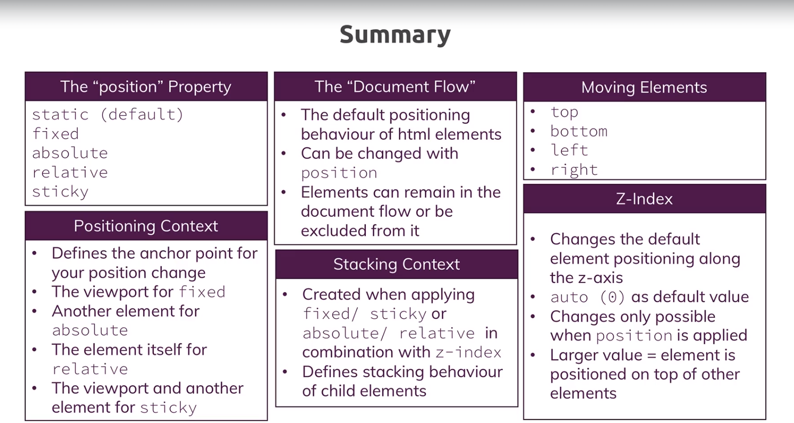
Notes:
Branch :Positioning
Commit : Summary

Slide 110
Useful Links
https://youtu.be/1OKZOV-iLj4
https://medium.com/@dte/understanding-css-selector-specificity-a02238a02a59
https://www.w3schools.com/cssref/pr_class_position.asp
https://developer.mozilla.org/en-US/docs/Web/CSS/position
Positioning theory: https://developer.mozilla.org/en-US/docs/Learn/CSS/CSS_layout/Positioning
More about the "position" property: https://developer.mozilla.org/en-US/docs/Web/CSS/position
The z-index: https://developer.mozilla.org/en-US/docs/Web/CSS/z-index
The Stacking Context: https://developer.mozilla.org/en-US/docs/Web/CSS/CSS_Positioning/Understanding_z_index/The_stacking_context
The "sticky" value and current browser support: https://caniuse.com/#search=sticky
Notes:
Branch :Positioning
Commit : Summary

Slide 111
Section -7 -:Background Images & Images
Notes:
Branch :BackgroundImageAndImages
Commit :InitialCommit

Slide 112
Understanding "background-size"
If you open the image freedom.jpg in an image viewer we would notice the image has a lot of things that are not displayed on our website this is due to the size of our container not matching the image size.
So to fix this we need to position and size it both can be done using the background property.
Till now we used a background either with an image or with a solid color , but this is actually a shortcut notation.
In our main.css #product-overview{} we could replace the background with background-image: url(“freedom.jpg”);To use a solid color we can use background-color:red;.Usually you would expect the color to override the image as it was defined after image but that does not happen because it turns out we can define multiple backgrounds only one solid color though we will study more about this in upcoming slides but for time being to view the color just de select the image from the dev tools.
Here we don’t need a color so lets remove it . Lets now understand how we can size and position the image.
For sizing we can use background-size property . It can take a couple of different values as input
We can give input in pixels for example if we try background-size:100px;We will notice that we get multiple images of 100px width each.This is because if we give only one value to background-size it is taken as width and the image is repeated to fill the entire available space in the container.
The repeating behavior can be controlled by using background-repeat.It can also take multiple values one of them is no-repeat which means not to repeat the image and thus we get only one small image
Notes:
Branch :BackgroundImageAndImages
Commit :BackgroundSize

Slide 113
Understanding "background-size"
It can also take repeat-x to repeat only on x-axis(one row) or repeat-y to repeat only on y axis(one column).Lets et it back to no-repeat.
Lets change the size to 300px it still does not fit lets add nother value to it like background-size:300px 100px; .This is used to set both width and height.Usually if we specify only width the height is automatically adjusted to maintain the aspect ratio but if we do set width and height the image is forced into these dimensions which may distort the image.
We can also set the size using percentage values if we set it to 50% it will take up 50% of the container space.If we set it to 100% it will occupy full width of the cointainer.
We can also set both width and height in % but again the aspect ratio will not be maintained and the image may be distorted.If we don’t want to distort it we can set width to auto now width will be set automatically and aspect ratio maintained like background-size:auto 100%; .In this case though image will not occupy full container as in our case the container has a different aspect ratio.
In case where we set the width to 100% and don’t set the height the image takes full container space but to maintain aspect ratio the image is cropped we can control the cropping behavior we will study that in upcoming slides.
Besides manually setting the width and height we can also use some predefined keywords one of them is cover.It will fill the entire container but before that it will take into account if our image is a landscape or portrait .If it is landscape it will set width100% and vice versa.It will occasionally zoom in the image to fit it to container.
Notes:
Branch :BackgroundImageAndImages
Commit :BackgroundSize

Slide 114
Understanding "background-size"
Another alternative is contain it will ensure that the image is displayed completely even if it leaves some whitespace in the container.
So in our case we might want to stick with cover but we need to position our image in such a way that we see less of the sky at top and more of the rocks at the bottom.We will look at this in next slide
Notes:
Branch :BackgroundImageAndImages
Commit :BackgroundSize

Slide 115
Working with "background-position"
Lets position the image now using the propert background-position it can also take multiple values.
The simplest is by setting a pixel value for example background-position:20px;We will see that the image moves to the right by 20 pixels.Thed first value defines the x-axis it defines how the left edge of the image should be positioned relative to the left edge of the container. We can also set a second value say 50 px this relates to y-axis that is how the top edge of the image is placed with reference to the top edge f the container
We can also use perecentage values for example set it to background-position: 10% but now we notice nothing changed because percentage values work differently.Using percentage values we define how the excess space i.e the part of image that is not a part of container how that is defined or divided .In this case sice the image takes full container width and is not cropped either from left or right so any value for this wont make any difference.
We can also set a second value which defines the y-axis if we set only one value the default for second is 50 % which means if the image does not fit the container out of the part that does not fit 50% will be cropped at the top and 50% at the bottom.If we set it to 10% only 10% will be cropped at the top rest will be cropped at the bottom.If we set it to 100% all the content will be cropped at the top and nothing at the bottom this results in bottom edge of the image to be perfectly lined up with bottom edge of the container.
We can also use some predefined values like center it is same as setting 50% 50% it means crop 50% at top bottom left and right if parts don’t fit effectively the center of container overlaps with center of image.
Notes:
Branch :BackgroundImageAndImages
Commit :BackgroundPosition

Slide 116
Working with "background-position"
We can also set it to left top which means that the left edge of image is placed on left edge of container and top edge at the top edge of container so effectively all cropping happens at right and bottom.This can be translated to 0% 0%.
We can set it to left bottom to say left and bottom edges should be aligned
We can also combine it with % values like background-position: left 10% bottom 20%;which means to the left we want to crop10% and to the bottom we want to crop 20%.
For our page this setting seems nice so lets stick to that.
Notes:
Branch :BackgroundImageAndImages
Commit :BackgroundPosition

Slide 117
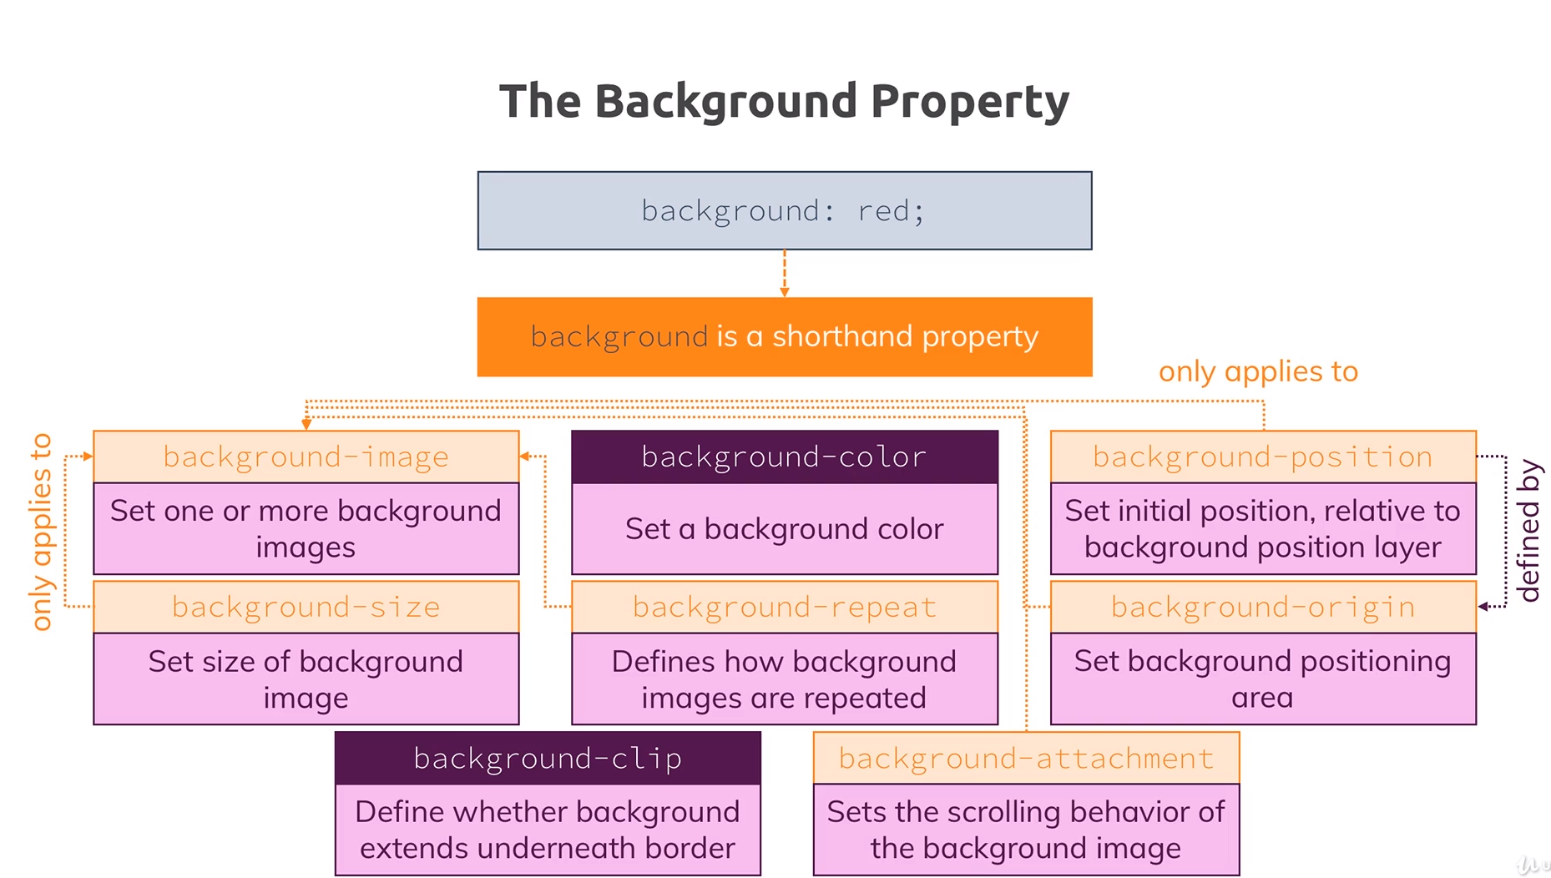
Notes:
Branch :BackgroundImageAndImages
Commit :ClipOriginAndAttachment

Slide 118
Applying "background" Origin, Clip & Attachment
Lets add a border to our image temporarily as this will help us to better understand some of the background properties so add border:5px dashed red; to the #product-overview{ } element selector.
We will notice that on left and right there is white space beneath the border and on top and bottom there is the image beneath the border. The reason being that on left and right the image fits the container and the b order is not a part of the container ,but on the top and bottom we have excess image so we crop it but that in turn seems to happen after the border just a note the border even in this case is also not a part of the container. This is exactly what we can control with background-origin.
If we set the background-origin:border-box we will notice that the border is above the image even on left and right because now we basically define what the container is for our background property, by default it is not border-box .
If we set it to content-box we will notice some padding on all sides because content-box means the container is without the padding and border.
The default actually is padding-box which mean the container including content and padding but not the border.
Lets change it to border-box to ensure that the image goes beneath the border even though we will remove the border later.
However what we might have noticed is that no matter what we set the image always was beneath the border from top and bottom because there we were not talking about setting the height of the container we simply had excess image and we cropped it and cropping is affected by background-origin this instead is set by background-clip.
Notes:
Branch :BackgroundImageAndImages
Commit :ClipOriginAndAttachment

Slide 119
Applying "background" Origin, Clip & Attachment
Lets set the background-clip:border-box; we get the same behavior as before
If we change it to padding-box we will notice that the border is outside the image on all sides so with background-clip we define where the image should be clipped if necessary and now it is clipped after the padding, we can also set it to content-box to clip before the padding and thus we will notice some white space around the image this also now affects the width of the image.So we can say that clip kind of overrides the origin.
Background attachment is a property that is rarely used it actually defines how scrolling will work in a container that has a background image but that is not fixed itself, we cant see its effect in this example as for our main page although the container is relative but we cant scroll inside it and on packages page we have scroll but the container is fixed
Background attachment will allow us to set fixed , scroll or local as its values which define whether the image scrolls with the other content of the container i.e local , with scroll the image will stay at its place and content will scroll over it and for fixed the image will be fixed to the viewport and not to the container i.e even if you scroll down a lot the image will still be visible as it is fixed to the viewport
Notes:
Branch :BackgroundImageAndImages
Commit :ClipOriginAndAttachment

Slide 120
Using the "background" Shorthand on our Project
Now lets put all the background properties we used into a shorthand.
We will start with background:url(“freedom.jpg”);
Now lets add the positioning and size but both can use pixels and percentage values so how will we define what is what.Actually the position comes first then it is separated from the size by a slash(/) so our property becomes background:url(“freedom.jpg”) left 10% bottom 20%/cover; Use this and comment out size and position and we will see the same result as before.
Now lets add repeat background:url(“freedom.jpg”) left 10% bottom 20%/cover no-repeat; and comment out background-repeat and we will see same result
For origin and clip we also have same values and here simply the order wins if we only include one value it will be set for both like background:url(“freedom.jpg”) left 10% bottom 20%/cover no-repeat border-box; if we define two values the first one will set the origin and second one will set the clip since we have same values we can use a single value.
Also if we have an attachment we can add its value at the end.
Now remove the origin and clip and we will have the same effect now
Now lets also remove the border as it was only for demo purposes
Notes:
Branch :BackgroundImageAndImages
Commit :BackgroundShortcut

Slide 121
Styling Images
Now lets start by using an image as a logo .Right now we have only text lets just remove it and use an image.
Go to the index.html file and where we have uhost in our anchor tag we will remove uhost and add an <img> tag.
You will find an image for the uhost icon in images folder in this commit use it as an image source so our <img> tag will be <img src="../images/uhost-icon.png" alt="Uhost - Your favourite Hosting Company" />
We can infact also move our freedom.jpg to images folder and adjust its link in the main.css file.
Now we will notice that the image is too big for our logo so we need to style it.
We will style it in our shared.css file as it is a part of our shared header
We will notice that we had earlier styled our text logo in .main-header__brand selector we can leave that styling as is for our alt text if somehow our image is not displayed,
If we try to set the height to 22px here we will notice nothing changes because the selector is actually for the container ie the <a> tag and if we have an <img> tag in our dom the surrounding container takes the dimensions of the image no matter what height we set on the container.
To fix this we need to use a selector to select the <img> we can either add a class to it or use a descendant selector as .main-header__brand img { } to select all images in .main-header__brand
Notes:
Branch :BackgroundImageAndImages
Commit :StylingImages

Slide 122
Styling Images Cont …
Now inside our .main-header__brand img { } selector lets add height:22px.Now we see the image is actually smaller.
Now instead if we set the height to 100% we would assume it to have same effect and take 100% height of surrounding container but this does not happen percentage values for images don’t respect the surrounding container instead they take %age of the dimensions of the image.
But this happens actually because our container is an inline element if we set it to inline-block or block we will notice that our image starts respecting the container dimensions if we use percentage values for image height and width.
So if we use %ages for image dimensions in a inline container it will take image height width and if we use it in a block or inline-block it will take %age of container dimensions.
For normal images we can not do much of a styling for positioning and sizing as we were able to do with background images
Notes:
Branch :BackgroundImageAndImages
Commit :StylingImages

Slide 123
Adding the Customers Page to our Website
Now lets add a customers page to our website create a folder customers and create a file index.html and customers.css in it.
Copy the code for index.html from this commit.
Now go to main Index.html and copy the entire<Header> to customers/index.html
Fix the images path in customers/index.html
Also copy the img tag to packages/index.html replace the text logo
Inside our customers/index.html we will find two img imports copy these two images to the images folder from this commit.
Adjust the header links in the customers/index.html also the link inside <a> tag for our logo.
Now we got everything setup we will notice that the two images on our customers page don’t look so good we will fix them in upcoming slides.
Notes:
Branch :BackgroundImageAndImages
Commit :AddingCustomers

Slide 124
Basic Setup for image styling
Customers.css contains some basic css code already added to it,which styles everything except the images
Also copy the footer section from the main index.html and replace in customers/index.html
If we open the customers page now we will notice nothing changed with respect to the images but the text is now styled properly , and the footer looks good.
We will notice that the container for the image already has a class testimonial__image-container and the image has a class testimonial__image, Both the images have this setup.
This completes the basic setup required now we can start styling the images.
Notes:
Branch :BackgroundImageAndImages
Commit :ImageStylingBasicSetup

Slide 125
Working on the Image Layout
Now open customers.css and add a class selector .testimonial__image-container{ } below the .testimonial:first-of-type selector
Also add .testimonial__image{} class selector below it
We will style it in a way that the image and the info about the image are side by side so Set the width:80% for the container and width:100% for the image and display:inline-block for the container.
We will now notice that the image size did reduce but the image and text is still not in one line.We will also notice that the text is inline-block element by looking at css in .testimonial__info{ } selector
so we can theoretically set both the image and text in one line,to do so we can reduce the width of text to 20% in .testimonial__info{ } selector but since we are aware that we need to set the total width to a little less so we can reduce the image container width to 75 %.
Now we will notice that the text is next to the image but not in the center,The reason for this positioning is that our info container .testimonial__info{ } has vertical-align:middle but our .testimonial__image-container{ } which is adjacent to it does not have it,so add vertical-align:middle to it.
Now the text and image are perfectly aligned.
Now to make it look a bit more nicer lets just adjust the width again make the image container 65 % and the text 30% in width
Notes:
Branch :BackgroundImageAndImages
Commit :imageLayout

Slide 126
Working on the Image Layout
To make it look even better lets add a shadow behind the images by adding box-shadow: 3px 3px 3px 3px rgba(0,0,0,0.4).
We will now notice we have a nice shadow on the image but we have a white space below the image.
It is an inline element bug we can get rid of it by going to the image selector and setting vertical-align to top or bottom or by making the element as display:block.
Notes:
Branch :BackgroundImageAndImages
Commit :imageLayout

Slide 127
Understanding Linear Gradients
Gradients are CSS elements of the image data type that show a transition between two or more colors.
These transitions are shown as either linear or radial.
Lets open our main.css file and to the background image that we have there lets say we want to add a linear gradient instead of the image.
The first thing that we should understand is that gradients both linear and radial are treated as images,so if we were to use the sub properties not the shorthand for background we will target the gradient by using background-image property.
Now for time being just comment out the background property and add a linear gradient by using the background-image property
We add a linear gradient by using the linear-gradient() function css ships with.
The function essentially has two parts we can although have more than two arguments but that is because we can specify the multiple colours of the transition.
The first part is the direction of transition which can be omitted in which case the parameters will be two colours like linear-gradient(red,blue); which gives a transition from red to blue and default direction vertical so it will be a perfect line which transitions from red to blue smoothly.
Notes:
Branch :BackgroundImageAndImages
Commit :linearGradient

Slide 128
Understanding Linear Gradients
The first argument is usually a direction which can be specified in a special syntax like to bottom ex background-image: linear-gradient(to bottom,red,blue); which simply mans from top to bottom transition from red to blue so we will essentially see the same result
We can also write something like to left bottom ex background-image: linear-gradient(to left bottom red,blue); now it will be a diagonal from top right corner to left bottom corner
We can also specify direction in degrees like background-image: linear-gradient(0deg, red, blue);
The starting point for degrees i.e the straight line is 180 deg and we can set any angle we want 180 deg would mean straight vertical transition from red to blue 0 degree would therefore mean a reverse vertical transition from blue to red.
We can of course add more colours.
We can specify colours by name hex code,rgb,hsl values
Another way is to add transparency for example we can transition from red to transparent using background-image: linear-gradient(red, transparent);
We can also transition to a rgba value with transparency like background-image: linear-gradient(red, rgba(0,0,0,0.4)); transitioning from red to transparent black
We can also set upto what percentage space which color is shown like background-image: linear-gradient(red 70%, blue 80%,black 75% ); This means upto 70 % red should be there upto 80% blue should be there but since red is already covering 70 % we will see a transition of red to blue after 70% red black will be covering 75% but since when black starts being visible it is still in blue zone son we will see a straight line between blue and black no transition
Notes:
Branch :BackgroundImageAndImages
Commit :linearGradient

Slide 129
Applying Radial Gradients
A radial gradient starts at a certain shape and then transitions to all the areas around it.
It is defined by the radial-gradient() function of css
Lets start with a simple gradient again background-image: radial-gradient(red,blue); it starts in the middle and the shape is an ellipse it starts with red and then transitions to blue.
We can add multiple colours like background-image: radial-gradient(red,blue,green); so now we will have a red ellipse transitioning into a blue ellipse transitioning into a green ellipse.
We can change the shape from ellipse to circle using background-image: radial-gradient(circle , red,blue,green); circle is the only alternative to ellipse
We can also add the position example background-image: radial-gradient(circle at top, red,blue,green); or percentage values background-image: radial-gradient(circle at 20% 50 %, red,blue,green); i.e the innermost circle will start 20% from left and 50% from top
we can also add the size as background-image: radial-gradient(circle 20px at 20% 50%, red,blue,green); which means except the outermost circle i.e the green circle the other circles(red and blue) will have a combined diameter of 20 px this works only for circle for elipse we have to specify two values background-image: radial-gradient(ellipse 20px 30px at 20% 50%, red,blue,green);
we also have some shortcuts like background-image: radial-gradient(circle farthest-side at 20% 50%, red, blue, green); this means the edge of the second last shape i.e blue circle touches the farthest side from the center of the innermost circle other possible values are closest-side,closest-corner ,farthest-corner etc
Rest is similar to linear gradient.
Notes:
Branch :BackgroundImageAndImages
Commit :radialGradient

Slide 130
Stacking Multiple Backgrounds
We can set multiple backgrounds for the same element.
This of course only makes sense when backgrounds have some kind of transparency to it like transparent images or a gradient with transparent colors else we will only see the topmost background.
We can use multiple backgrounds and they can be a combination of images , solid colors and gradients but we can use multiple images but only one solid color and gradients count as images in this context.
Open main.css and comment the background gradient and uncomment the background property with image url.
We can add a solid red color as a fallback ie in case image is not loaded.add it after url("images/freedom.jpg") like background: url("images/freedom.jpg") #ff1b68 left 10% bottom 20%/cover no-repeat border-box;
This will be displayed if image is not loaded i.e it is read left to right.
Each background should be separated by a comma also we have a bunch of properties which are related to background-url so our solid color should be added at the end like background: url("images/freedom.jpg") left 10% bottom 20%/cover no-repeat border-box , #ff1b68;
We can also add other background related properties to all elements of the comma separated list of backgrounds.
Notes:
Branch :BackgroundImageAndImages
Commit :StackingMultipleBackgrounds

Slide 131
Stacking Multiple Backgrounds cont..
Now lets add a linear gradient at the starting making it the topmost layer of the background we will add a gradient starting at bottom transitioning to top with a golden brown color and 60% opacity transitioning to a full transparency, we will also add a color stop of 10% so that we don’t have an even transition but leave our color relatively early. linear-gradient(to top, rgba(80, 68, 10, 0.6) 10%, transparent)
We will notice that our botom of image now has a golden hue to it.
Notes:
Branch :BackgroundImageAndImages
Commit :StackingMultipleBackgrounds

Slide 132
Filters
Filters allow us to change the visual appearance of an element by applying various effects like blur, greyscale or changing the contrast etc .
Open packages.css and add a center/cover position to the background image so more image is visible. background: url("../images/plans-background.jpg") center/cover;
Lets add a grayscale filter to it using filter: grayscale(40%). This is how easily a filter can be applied.
There are a lot of built in filters available .The full list is available on mdn website.
We will also notice that ie does not support filters.
Notes:
Branch :BackgroundImageAndImages
Commit :Filters

Slide 133
Adding & Styling SVGs - The Basics
Svg is a very popular type of image format.
SVG stands for scalable vector graphics.
SVG is a very vast topic and in this slide we will just look at a few basics.We will notice I have added three svg images to the key-features section in index.html.
It displays three icons in the key features section of our main page .
We will notice that the icons are a little big lets style it.Open main.css and go to the .key-feature__image selector and add a padding:20px to it we will notice that the images are now smaller
We will also notice that if we inspect the image in browser dev tools we can select each indivisual part of the image .
We can also style each such part but that is more related to svg than css.
Notes:
Branch :BackgroundImageAndImages
Commit :SVG

Slide 134
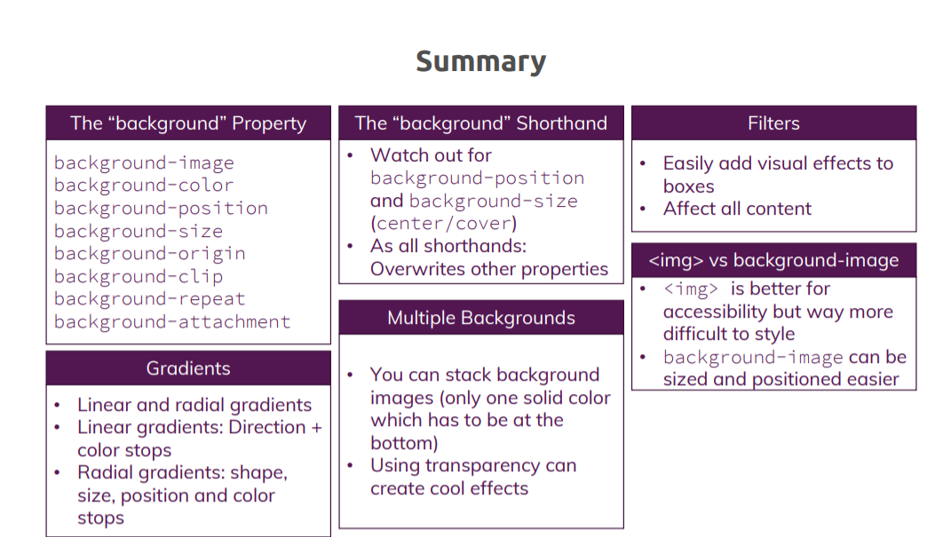
Summary
Notes:
Branch :BackgroundImageAndImages
Commit :SVG

Slide 135
Useful Links
The background Property: https://developer.mozilla.org/en-US/docs/Web/CSS/background
Styling Images: https://www.w3schools.com/css/css3_images.asp
Filters: https://developer.mozilla.org/en-US/docs/Web/CSS/filter
Styling SVG: https://developer.mozilla.org/en-US/docs/Web/SVG/Tutorial/SVG_and_CSS
Notes:
Branch :BackgroundImageAndImages
Commit :SVG

Slide 136
Section -8 -:Size And Units
Notes:
Branch :sizeAndUnits
Commit :InitialCommit

Slide 137
Pixels Percentages & More
Units
How is the size calculated?
pixels
px
Percentages
%
?
What’s the right unit to choose?
root em
rem
em
em
Viewport Height
vh
Which properties can I use in connection with these units?
Viewport Width
vw
Notes:
2.Pixels refer to the no of pixels on our screen and varies according to the screen resolution
3. Percentage refers to the available space in terms of percentage
4,5. Root em and em both are relative to font size
6,7.Viewport height and viewport width are in reference to the viewport
8. Now we have 3 things that we need to answer in order to understand the use of these units
Branch :sizeAndUnits
Commit :Overview

Slide 138
Pixels Percentages & More Cont…
Which Properties can I use or where units matter?
Lets consider the box Model
Margin
Which properties can I use?
Padding
font-size
Content
padding
border
Margin
width
height
Border
top
bottom
left
right
Notes:
Branch :sizeAndUnits
Commit :Overview
2.So in our box model first we have the content which has a background color but we don’t need units for that
3.But we need units for font-size
4.The next step in box model is the Padding which specifies the distance between content and the border Padding itself needs units
5.Next part of box model is the border which again needs units
6.The same is true for the next part of the box model Margin.
7.We also have units for width
8.Similarly for Height .Here I have shown height and width with respect to border-box
9.Now there are four more properties where units matter the top and bottom after we specify the position
10 .Also we have left and right

Slide 139
Pixels Percentages & More Cont…
How is the Size Calculated?
Absolute Lengths
Viewport Lengths
Font-Relative Lengths
Mostly ignore user settings
Adjust to current viewport
Adjust to default font size
px
vh
rem
cm
vw
em
mm
vmin
…
…
vmax
Special Case
%
Notes:
Branch :sizeAndUnits
Commit :Overview
1,2.These length ususally ignore user settings
3.Like if we set font size in pixels and then change font size of browser we wont see much change as user settings are ignored
4 Other possible options are centimeter,millimeter etc not used now in development because different screen sizes hold different pixel values
5,6. Adjust according to viewport length i.e the visible area of our site on the screen .
7. Viewport height
8. Viewport width ,viewport min,viewport max
9,10 adjust to default font size
11,12 rem and em are usually used but others also exist
13,14.% values are usually a special case as we need to understand how the box size for % units is calculated

Slide 140
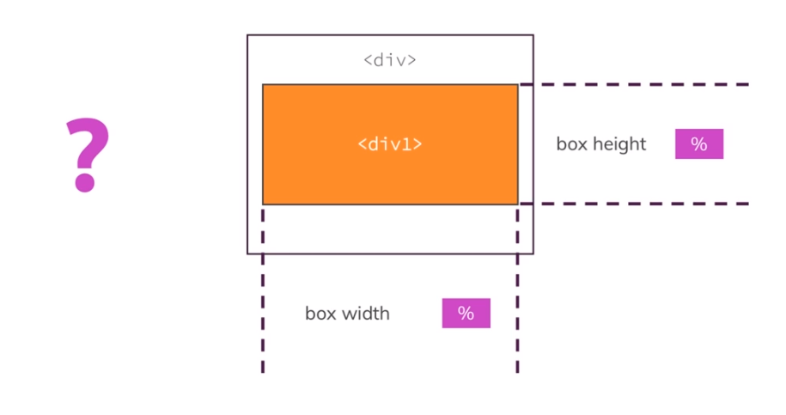
Pixels Percentages & More Cont…
How is the box size for % Units calculated?
Notes:
Branch :sizeAndUnits
Commit :Overview
Consider a div inside another div so if we give % values for height and width for inner div .we need to understand what is this % referring to.Is it % of outer div,%of body % of viewport etc .
For understanding it we need to understand the concept of container unit .We will dive deeper into it in upcoming slides.

Slide 141
Three Rules To Remember
The position property has an impact on the way % unit behaves.
So accordingly we have three rules:
Rule 1: Fixed Positioning and % :
If we have an element with position:fixed ; The reference point for such an element wrt % unit is called the containing block.This containing block can be a parent elemet etc we will see how to identify the containing block in a while for now lets take an example if a parent element or containing block has a width of 100 px the the width of child element is 10px if it is specified as 10%.So % is in reference to the % of containing block
The containing block depends on the position property applied in case the position is fixed then the containing block is not an element it is the viewport
If we inspect the css for our navigation bar at the top of our pace we will notice it has a class selector .main-header with position:fixed; and width:100%; and we will notice it takes 100% of our screen width no matter how much we increase or decrease the size of the screen if we change width to 50% it will always take half of the width of screen irrespective of screen size i.e the containing block here is viewport as position is fixed.
Notes:
Branch :sizeAndUnits
Commit :ThreeRulesToRemember

Slide 142
Three Rules To Remember
Rule 2: Absolute Positioning and % :
If we have an element with position:absolute ; The reference point for such an element wrt % unit is i.e the containing block is an ancestor and which ancestor it is we will see in a few moments but the important thing here is the % refers to the ancestors content+padding
The containing block depends on the position property applied in case the position is absolute then the containing block is an element which is an ancestor with position either absolute,relative,fixed or sticky ,In simple words the containing block in this case is the closest ancestor with position that is not static.
If we inspect the css for our slogan “Ishq hai to risk hai” on our main page we will hotice it is styled with a selector #product-overview h1{} and has a position absolute in main.css file we will also notice we have two properties left and bottom with % units and the closest ancestor is the section with id product-overview which as a position relative using the id selector #product-overview{} so this is the containing block in this case but the containing block is to be used as content+padding .
Now if we add a width 100% to the #product-overview h1 we will notice that the h1 tag now has a width of 100 % of the section .Lets change the width of the section to 50 % inside the #product-overview{} selector now our h1 tag again takes 100% width of the containing section even though the section in now only displayed over 50%
Notes:
Branch :sizeAndUnits
Commit :ThreeRulesToRemember

Slide 143
Three Rules To Remember
Rule 3: static/relative Positioning and % :
If we have an element with position: static/relative ; The reference point for such an element wrt % unit is i.e the containing block is an ancestor and which ancestor it is we will see in a few moments but the important thing here is the % refers to the ancestors content only
The containing block depends on the position property applied in case the position is static/relative then the containing block is an element which is an ancestor which is a block level element ,In simple words the containing block in this case is the closest ancestor with position that is not static.
If we inspect the css for our image container which is a div on our customers page we will notice that it has a selector .testimonial__image-container wihich has not position property i.e static positioning and a width of 65% in customers.css.The div has an ancestor which has a class testimonial and since div is a block level element it becomes the containing block for our image container.
If we add a apdding 0 top/bottom and 10px left/right using padding: 0 10px; to our .testimonial{} and change width of our image container to 50% in .testimonial__image-container{} we will notice it will take 50% of width of .testimonial - padding(20px).If we change the position to relative for our .testimonial__image-container{} we will still have same image
Notes:
Branch :sizeAndUnits
Commit :ThreeRulesToRemember

Slide 144
Fixing the Height 100% Issue
Consider a scenario where we have an element with position:static/relative and a height property with % units applied to it . This means that according to our Rule 3 the containing block is an ancestor which is a block level element.Now a special case here is that the ancestor also has position:static/relative applied.
Now with this starting scenario in mind lets go to our website and add some code to see why this scenario can lead to some unexpected behavior
So lets go to our customers page and add a new element The element is supposed to be a backdrop which should be over the entire website so it should be on top of all the other elements we have because soon in the next module we are going to add a popup window which should be on top once we click a button . Below this popup we want to have this slightly transparent backdrop and behind the backdrop all the rest of the website should be there.
So for now we need to create an element which has a height of 100% and width of 100%.
To do this we go to the customers index.html and add a <div class=“backdrop”></div> with no content.
As we need this backdrop in all our html files we style it in our shared.css file.We will add a .backdrop{} class selector just below the body selector.
For now to replicate the issue we will set the position:relative to the .backdrop{} selector,We are not using position selective as we need the backdrop to be above all other elements so we need to add a z-index which wont be possible with position:static.so we add a z-index:100; and a width:100% and height:100% so that backdrop covers the whole website we also add a black color with slight transparency by adding background:rgba(0,0,0,0.5); so that we can still see the other elements but the focus will be on the popup that we will add later
Notes:
Branch :sizeAndUnits
Commit :ThreeRulesToRemember

Slide 145
Fixing the Height 100% Issue
Now if we save the file and revisit our customers page we wont see any changes but if we inspect it we will notice that the backdrop is present in the dom and since we applied position relative the containg element should be the nearest ancestor which is a block level element which is <body> in our case so it should ideally take 100% height and width of body but it we will notice it has the full 100% width but height is 0 which is the unexpected behavior.
Now what caused this issue we will notice that we haven’t defined a height and width of the body so it should ideally have an issue with both height and width but it works for width as it takes whatever width the body has but the height is dependent on the content and the information does not suffice to calculate the height at this point.
Now we have multiple ways to solve this issue which we will study going forward with the course but if we want to solve it with percentages only we can use a workaround
We will go to the shared css file and add a html{} selector and add a height:100% and aso add the same to the body{} selector
We will now see that the backdrop is working apparently it moved the other elemnts down as it has position:relative and thus stays in the document flow. We will also notice the backdrop doesn’t cover the elements below it we will see the reason for this in a while but we can now see that the height is calculated according to body element now.
Regarding the issue that it does not cover all elements that can be solved easily by removing the html selector and height from body selector and changing the position to absolute in the .backdrop selector
Notes:
Branch :sizeAndUnits
Commit :ThreeRulesToRemember

Slide 146
Fixing the Height 100% Issue
We will now notice that the backdrop now covers the visible elements but it has two issues we have a space at the top not covered by backdrop and also the backdrop doesn’t stick to viewport i.e if we scroll down the backdrop doesn’t still cover the elements below it.
Regarding the gap at the top it is because of margin collapsing if we inspect the main element go to the div inside and click on the first div with class testimonial we will notice that we applied a margin top of 96px to the first-of-type testimonial and a margin top 48px to all elements with class testimonial if we remove them both from the inspect element we will see the gap at the top is removed.
However for time being we do want these margins so we will not remove them but lets think about why this is working now.It works because now we have position absolute so the containing block in this case is the closest ancestor with position that is not static but that is not the case for us as neither body nor html has any position applied and if this is the case absolute behaves like position:fixed and the containing block is considered to be the viewport but if we scroll down we will notice it wont stick to the viewport and behave like an absolutely positioned element but takes % values with reference to viewport.
If we therefore change position tof ixed we will see that the backdrop sticks to the viewport now but we still have the margin collapsing issue which can be solved quickly by adding top:0; and left:0; to the .backdrop{} as positions we will see that the backdrop is working perfectly now
In upcoming slides we will see how this issue can also be solved with vh and vw units.We now just have two issues firstly the backdrop is not on all pages so we will add the <div class=“backdrop”> to all index.html files below the <body> elements
Notes:
Branch :sizeAndUnits
Commit :ThreeRulesToRemember

Slide 147
Fixing the Height 100% Issue
Also we will notice that we cant click anywhere on our website as the backdrop covers it so for time being lets add a display:none to the .backdrop{} selector.
We will later use js to modify the css to show/hide the backdrop.
Notes:
Branch :sizeAndUnits
Commit :ThreeRulesToRemember

Slide 148
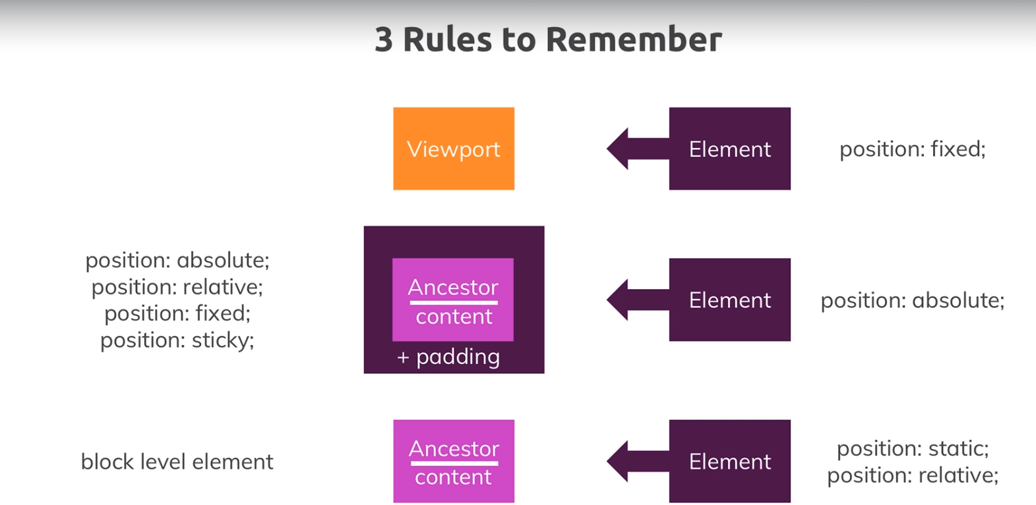
Notes:
Branch :sizeAndUnits
Commit :ThreeRulesToRemember

Slide 149
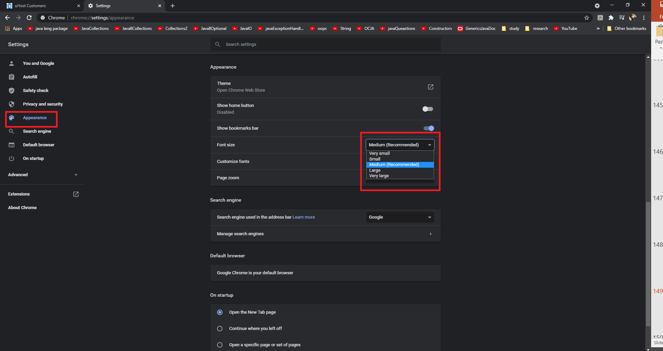
Defining the Font Size in the Root Element
We already know that we can change the font size from our browser setting just like shown below in the image :
Notes:
Branch :sizeAndUnits
Commit :FontSizeInRoot

Slide 150
Defining the Font Size in the Root Element
If we change the font size in our browser setting all the font sizes that we did not explicitly specify in css files will be changed this is the normal behavior and probably there is no reason to change that.
But if we want we can set the font size for the entire website in reference to a %age of the font size in the browser settings.
To do this we add an html{} selector to our shared.css file and add font-size:75%; to it now our font sizes will be 75% of the browser settings.
We can try this out and then remove this code as we don’t really need it in our website.
html {
font-size: 75%;
}
Notes:
Branch :sizeAndUnits
Commit :FontSizeInRoot

Slide 151
Using "min-width/height" & "max-width/height"
Although we have a separate section about responsive design in upcoming slides lets still take a few steps to work on responsiveness thereby learning a concept which includes a mix of percentage and pixel units.
We will notice that if we change the size of our browser window on the customers page the image size also increases or decreases which is good but after a certain level the image size is too big what if we want this responsiveness but still want to limit the max or min of the image..
To do so lets first have a quick recap of how our images are styled.The images have a class of .testimonial__image with height:100% it does not have any position property so it is statically positioned and the containing element is thus the nearest ancestor which is block level element and in this case it is a div with class testimonial__image-container it has a width of65%.
So it would be good if we could limit the size of our container as the image has a 100% width of the container so if the container doesn’t get bigger and bigger our image will also stay smaller.
To do so we go to our customers css file and add a max-width:580px to our . testimonial__image-container{} so we will still have container to be 65% of our page width but when we increase the page width the container will increase until it reaches the width 580px after that the container wont increase further.
A similar thing we can do with min-width to restrict the minimum width that our image container will take.
Notes:
Branch :sizeAndUnits
Commit :minMaxWidthHeight

Slide 152
Thanks!!!!!

