Slide 1
Java Generics
By: Rudhra Koul

Slide 2
Section -1 -:Introduction

Slide 3
Why use Generics
There are two main types of exceptions
Compile Time :
Can be easily detected.
Compiler/Ide error messages can help us detect the issue and fix it.
Run time:
These are more problematic.
They don’t always surface immediately and it may surface at a point in the program that is far from the actual cause of the problem.
So why are generics important:
It adds stability to our code by making more of bugs detectable at compile time.
It helps us to re-use same code with different type of parameters.
It provides stronger type checks at compile time.
We can eliminate the need for type casting.
We can implement generic algorithms and reuse them.

Slide 4
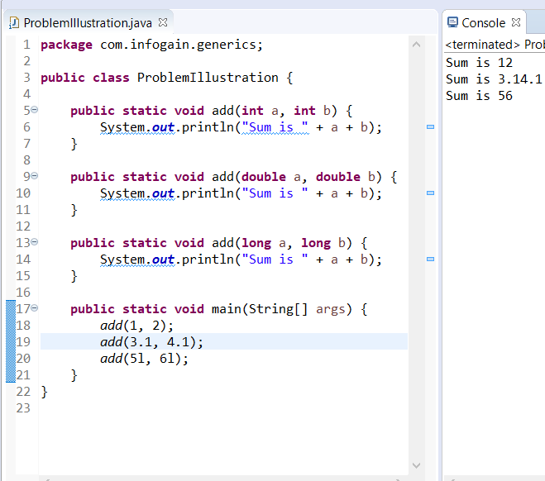
Problem Illustration
Consider the code above.
I have created an overloaded method to add two numbers.
The method effectively has the same code,but I still have to make multiple methods because of different parameter types.
To add capability of adding other number types like floats, I would need to create more methods but the implementation logic remains same.
It is not possible to create methods for all the possible types, even if we do write it for all possible types the code will be a bunch of clutter.
We need a better way to reuse code with same logic but different input types.

Slide 5
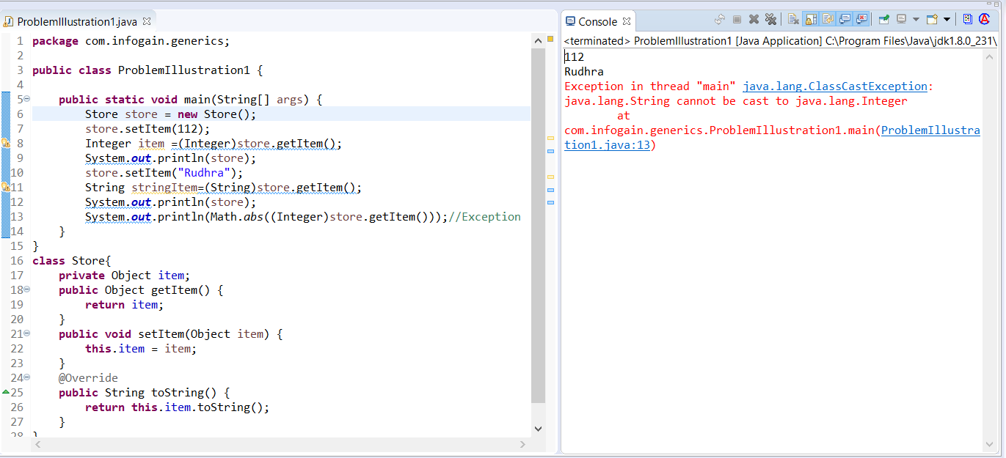
Problem Illustration -2
Consider the code above Store class does offer the capability to store any type of data in item as it is of Object Type which is parent of every class in java.
We although need to cast item back to the type we want whenever we retrieve it.
Secondly this is an unchecked case and can result in ClassCastException which is a runtime Exception so cannot be detected at runtime. So there is no type safety.

Slide 6
Thanks!!!!!

