Slide 1
Java Generics
By: Rudhra Koul

Slide 2
Section -1 -:Problem Illustration

Slide 3
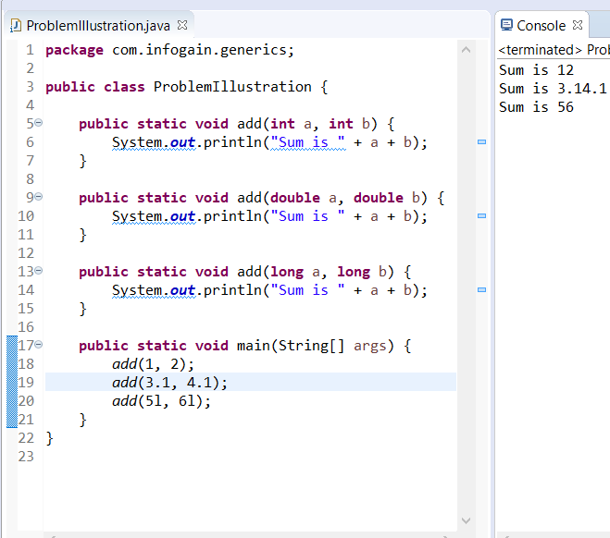
Problem Illustration
Consider the code on the right.
I have created an overloaded method to add two numbers.
The methods effectively have the same code, but I still have to make multiple methods because of different parameter types.
To add capability of adding other number types like floats, I would need to create more methods but the implementation logic remains same.
It is not possible to create methods for all the possible types, even if we do write it for all possible types the code will be a bunch of clutter.
We need a better way to reuse code with same logic but different input types.

Slide 4
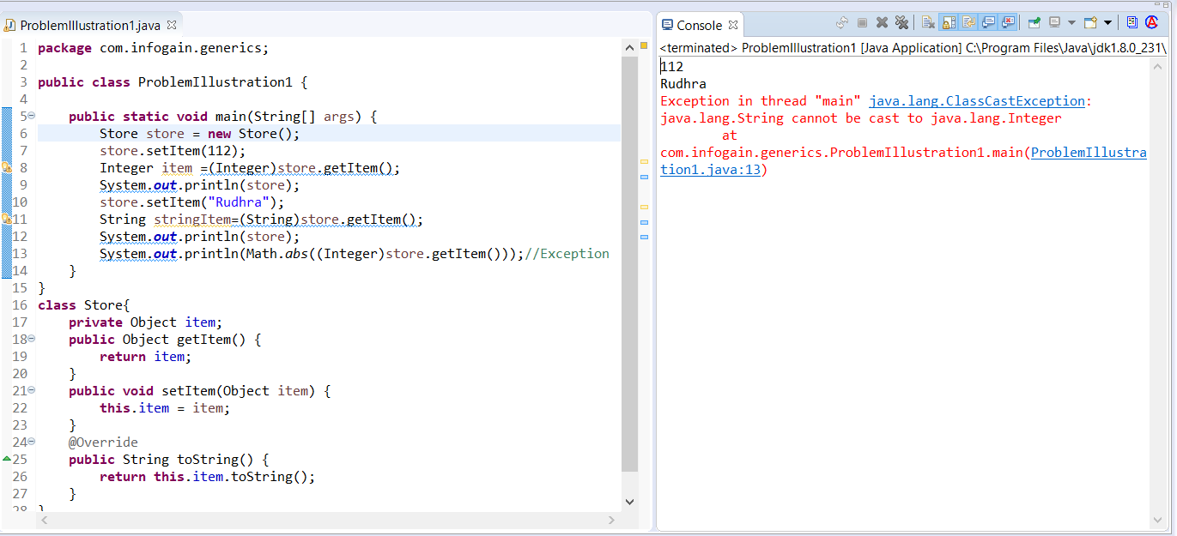
Problem Illustration -2
Consider the code above. Store class offers the capability to store any type of data in item as it is of Object Type which is parent of every class in java.
Although we need to cast item back to the type we want whenever we retrieve it.
Secondly this is an unchecked cast and can result in ClassCastException which is a runtime Exception so cannot be detected at compile time. So there is no type checking/type safety.

Slide 5
Why use Generics
There are two main types of exceptions
Compile Time :
Can be easily detected.
Compiler/Ide error messages can help us detect the issue and fix it.
Run time:
These are more problematic.
They don’t always surface immediately and it may surface at a point in the program that is far from the actual cause of the problem.
So why are generics important:
It adds stability to our code by making more bugs detectable at compile time.
It helps us to re-use same code with different type of parameters.
It provides stronger type checks at compile time.
We can eliminate the need for type casting.
We can implement generic algorithms and reuse them.

Slide 6
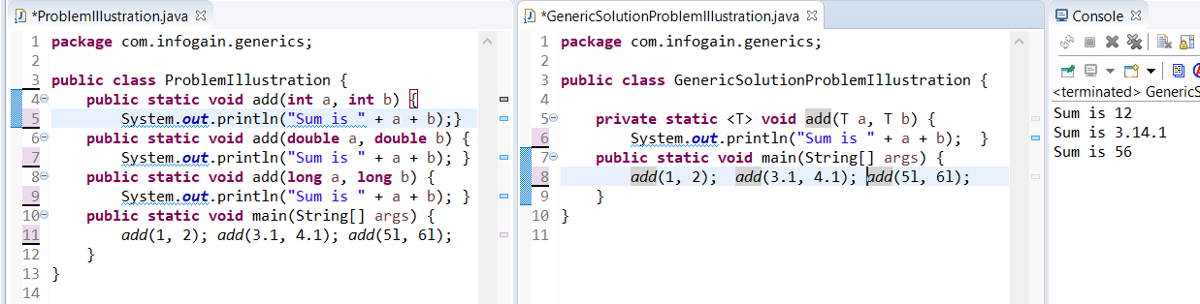
Generic Types
We can solve the problems faced in previous slides using generics.
To make a generic add method that can take multiple types of parameters, we can replace the data type of the parameters to add method by any valid java Identifier by convention we use T.
Although we need to declare this just before the return type in <> to let the compiler know that we are using generic types in this method.
This T will be replaced by compiler into a real data type based on the data this method is called with.

Slide 7
Generic Classes
Generics was introduced in java 1.5 version.
After Generics came into picture, we can provide a type parameter to the class and then use that type parameter as data type for method parameters /return values /instance variables.
For example consider the code snippet for java 1.4 (pre-generics) version of ArrayList class :
Class ArrayList implements List {
Object get(int index){….};
boolean add(Object o) {…};
}
In java 1.5 it was changed to
Class ArrayList<T> implements List {
T get(int index){….};
boolean add(T o) {…};
}
This <T> here is called Type parameter.
Based on the runtime requirement T will be replaced with provided type.
Such type of parameterized classes are called Generic classes or template classes

Slide 8
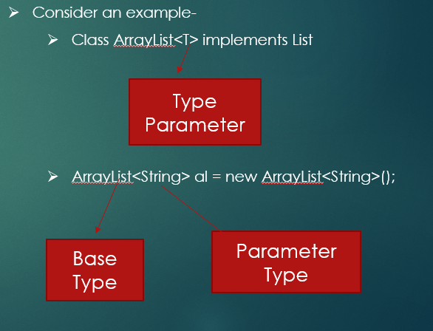
Generic Classes
Type Parameter and Type Argument Terminology
Many developers use the terms "type parameter" and "type argument" interchangeably, but these terms are not the same. When coding, one provides type arguments in order to create a parameterized type. Therefore, the T in Foo<T> is a type parameter and the String in Foo<String> is a type argument.
An invocation of a generic type is generally known as a parameterized type.
To instantiate this class, use the new keyword, as usual, but place <Integer> between the class name and the parenthesis:
Box<Integer> integerBox = new Box<Integer>();
Notes:
GenericClassExample.java

Slide 9
Generic Classes Cont…
Purpose of generics is to provide type safety and resolve type conversion problems.
Generics helps us to add type safety to collections like an ArrayList
Generics helps us to remove the need for type casting.
PolyMorphism concept : parent reference can hold child object is applicable for only Base Type not Parameter type so
ArrayList<Object> all= new ArrayList<String>(); is not valid even though String is a child of Object
List<String> all= new ArrayList<String>(); is valid.
Generics can be used only with reference types not with primitive types so:
ArrayList<int> al = new ArrayList<int>(); is not valid but
ArrayList<Integer> al = new ArrayList<Integer>(); is valid
Generics helps us to add type safety to collections like an ArrayList
We can solve the problems faced in store class in previous slides using generics.
Instead of Using Object as data type for item we can make the class generic
We can declare a type parameter at class level USING <>(Diamond Operator)
At runtime java will replace it with an actual type .
We need to specify the type while creating an object of this class.
It adds a restricting on what can be handled by the store class thus making it type safe and avoiding casting.
Notes:
GenericsWithCollectionsExample.java

Slide 10
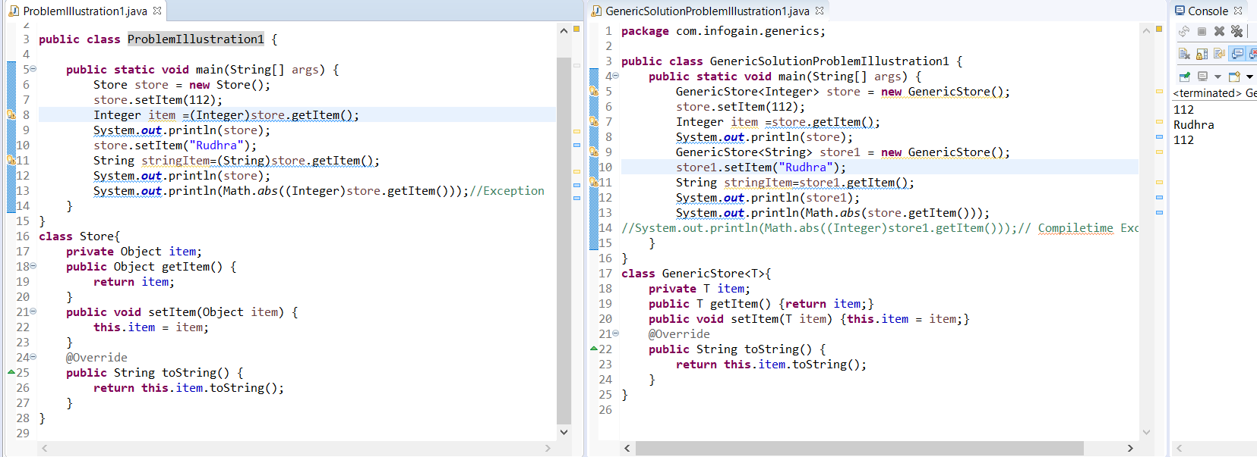
Generic Classes Cont…

Slide 11
Generic Classes Cont…
We can use any valid java identifier as type parameter but it is convention to use T.
So class Test<T>, So class Test<X>So class Test<Rudhra> all are valid.
We can take any number of Type parameters So class Test<T>, So class Test<T,R>, So class Test<T,R,S> is valid
We can declare and use multiple type parameters in the same way we do for a single type parameter we just have to make sure we use different identifiers for the different Type parameters for ex <K,V>.
Type Parameter Naming Conventions
By convention, type parameter names are single, uppercase letters. This stands in sharp contrast to the variable naming conventions that you already know about, and with good reason: Without this convention, it would be difficult to tell the difference between a type variable and an ordinary class or interface name.
The most commonly used type parameter names are:
E - Element (used extensively by the Java Collections Framework)
K - Key
N - Number
T - Type
V - Value
S,U,V etc. - 2nd, 3rd, 4th types
You'll see these names used throughout the Java SE API
Notes:
TypeParameterNamingConventionExample.java

Slide 12
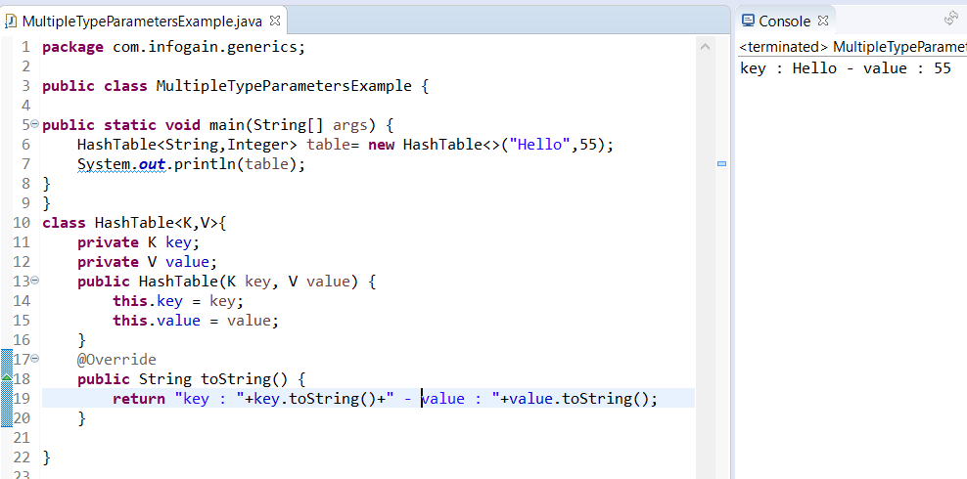
Generic Classes Cont…

Slide 13
Generic Classes Cont…
Invoking and Instantiating a Generic Type
To reference the generic Box class from within your code, you must perform a generic type invocation,
which replaces T with some concrete value, such as Integer:
Box<Integer> integerBox;
You can think of a generic type invocation as being similar to an ordinary method invocation, but instead of passing an argument to a method, you are passing a type argument — Integer in this case — to the Box class itself.
The Diamond
In Java SE 7 and later, you can replace the type arguments required to invoke the constructor of a generic class with an empty set of type arguments (<>) as long as the compiler can determine, or infer, the type arguments from the context. This pair of angle brackets, <>, is informally called the diamond. For example, you can create an instance of Box<Integer> with the following statement
Box<Integer> integerBox = new Box<>();
Because a Java compiler can infer the types from the declaration Box<Integer> , the instantiation statements can be shortened using diamond notation and we do not need to specify type in new Box<>();
You can also substitute a type parameter (i.e., K or V) with a parameterized type (i.e., List<String>). For example, using the OrderedPair<K, V> example
OrderedPair<String, Box<Integer>> p = new OrderedPair<>("primes", new Box<Integer>(...));

Slide 14
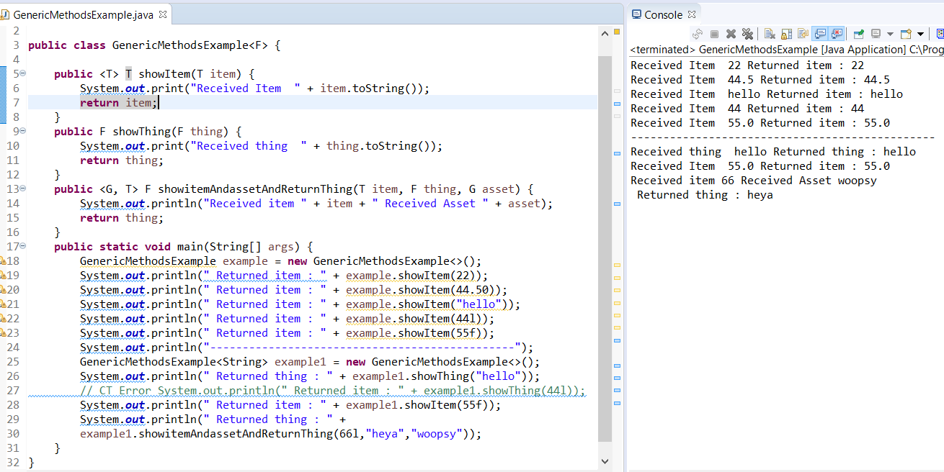
Generic Classes Cont…

Slide 15
Generic Methods
We can declare Type parameter at class level or method level
If we declare it at class level we have to declare it after class name
For example Class Test<T>
Now we can use this anywhere in the class.
If we declare it at method level we have to declare it just before the return type
For example public <T>void m1(T t)
Now we can use this anywhere within the method.
We can use Generic Types for return Types/Instance Variables as well as parameters.

Slide 16
Generic Methods
Generic methods are methods that introduce their own type parameters. This is similar to declaring a generic type, but the type parameter's scope is limited to the method where it is declared. Static and non-static generic methods are allowed, as well as generic class constructors.
The syntax for a generic method includes a list of type parameters, inside angle brackets, which appears before the method's return type. For static generic methods, the type parameter section must appear before the method's return type.
The Util class includes a generic method, compare, which compares two Pair objects:
public class Util {
public static <K, V> boolean compare(Pair<K, V> p1, Pair<K, V> p2) {
return p1.getKey().equals(p2.getKey()) && p1.getValue().equals(p2.getValue()); } }
public class Pair<K, V> {
private K key; private V value;
public Pair(K key, V value) {
this.key = key; this.value = value; }
public void setKey(K key) { this.key = key; }
public void setValue(V value) { this.value = value; }
public K getKey() { return key; }
public V getValue() { return value; } }

Slide 17
Generic Methods
The complete syntax for invoking this method would be:
Pair<Integer, String> p1 = new Pair<>(1, "apple");
Pair<Integer, String> p2 = new Pair<>(2, "pear");
boolean same = Util.<Integer, String>compare(p1, p2);
The type has been explicitly provided, as shown in bold. Generally, this can be left out and the compiler will infer the type that is needed:
Pair<Integer, String> p1 = new Pair<>(1, "apple");
Pair<Integer, String> p2 = new Pair<>(2, "pear");
boolean same = Util.compare(p1, p2);
This feature, known as type inference, allows you to invoke a generic method as an ordinary method, without specifying a type between angle brackets.
Notes:
GenericMethodsExample1.java , GenericStaticMethodsExample1.java

Slide 18
Raw Types
A raw type is the name of a generic class or interface without any type arguments. For example, given the generic Box class:
public class Box<T> {
public void set(T t) { /* ... */ }
}
To create a parameterized type of Box<T>, you supply an actual type argument for the formal type parameter T:
Box<Integer> intBox = new Box<>();
If the actual type argument is omitted, you create a raw type of Box<T>:
Box rawBox = new Box();
Therefore, Box is the raw type of the generic type Box<T>. However, a non-generic class or interface type is not a raw type.
Raw types show up in legacy code because lots of API classes (such as the Collections classes) were not generic prior to JDK 5.0. When using
raw types, you essentially get pre-generics behavior — a Box gives you Objects.
For backward compatibility, assigning a parameterized type to its raw type is allowed:
Box<String> stringBox = new Box<>();
Box rawBox = stringBox; // OK
But if you assign a raw type to a parameterized type, you get a warning:
Box rawBox = new Box(); // rawBox is a raw type of Box<T>
Box<Integer> intBox = rawBox; // warning: unchecked conversion

Slide 19
Raw Types Cont..
You also get a warning if you use a raw type to invoke generic methods defined in the corresponding generic type:
Box<String> stringBox = new Box<>();
Box rawBox = stringBox;
rawBox.set(8); // warning: unchecked invocation to set(T)
The warning shows that raw types bypass generic type checks, deferring the catch of unsafe code to runtime. Therefore, you should avoid using raw types.
Notes:
RawTypesExample.java

Slide 20
Raw Types – Unchecked Error Messages
Unchecked Error Messages
When mixing legacy code with generic code, you may encounter warning messages similar to the following:
Note: Example.java uses unchecked or unsafe operations.
Note: Recompile with -Xlint:unchecked for details.
This can happen when using an older API that operates on raw types, as shown in the following example:
public class WarningDemo {
public static void main(String[] args){
Box<Integer> bi;
bi = createBox(); }
static Box createBox(){
return new Box(); } }
The term "unchecked" means that the compiler does not have enough type information to perform all type checks necessary to ensure type safety. The "unchecked" warning is disabled, by default, though the compiler gives a hint. To see all "unchecked" warnings, recompile with -Xlint:unchecked.
Recompiling the previous example with -Xlint:unchecked reveals the following additional information:
WarningDemo.java:4: warning: [unchecked] unchecked conversion found : Box required: Box<java.lang.Integer> bi = createBox();
To completely disable unchecked warnings, use the -Xlint:-unchecked flag. The @SuppressWarnings("unchecked") annotation suppresses unchecked warnings

Slide 21
Bounded Type Parameters
We may want to restrict the types that can be used as type arguments in a parameterized type. For example a method that operates on numbers should only accept Number or its subclasses.
If we define a Generic class and specify operations in its methods which are applicable only on particular type of data we need to restrict the type parameter to be either of that type or its subclass using extends keyword.
This is the concept of bounded type parameters .
To declare a bounded type parameter, list the type parameter's name, followed by the extends keyword, followed by its upper bound, which for example is Number. Note that, in this context, extends is used in a general sense to mean either "extends" (as in classes) or "implements" (as in interfaces).
Syntax is <T extends SuperClassName>. This specifies that T can only be replaced by superClassName, or subclasses of superClassName. Thus, superclass defines an inclusive, upper limit.
For example class Test<T extends Number> we can create class Test with either Number or its child classes as Type arguments.
We can apply extends keyword for interfaces also
Example class Test<T extends Runnable>
Notes:
BoundedTypeParametersExample1.java

Slide 22
Bounded Type Parameters
The type parameter can have single or multiple bounds ie we can use a combination as bounded type parameter
Syntax : <T extends B1 & B2 & B3>
For example:
Class Test<T extends Number & Runnable & Comparable>
Class Test<T extends Number & Runnable>
A type variable with multiple bounds is a subtype of all the types listed in the bound. If one of the bounds is a class, it must be specified first.
Class Test<T extends Runnable & Number> is invalid because whenever we use class and interface we have to specify class first so Class Test<T extends Number & Runnable > is valid
Class Test<T extends Number and Thread> is invalid as a class cant extend two classes in java.
Notes:
BoundedTypeParametersExample2.java

Slide 23
Generic Methods and Bounded Type Parameters
Bounded type parameters are key to the implementation of generic algorithms. Consider the following method that counts the number of elements in an array T[] that are greater than a specified element .
public static <T> int countGreaterThan(T[] anArray, T elem) {
int count = 0;
for (T e : anArray)
if (e > elem) // compiler error
++count;
return count; }
The implementation of the method is straightforward, but it does not compile because the greater than operator (>) applies only to primitive types such as short, int, double, long, float, byte, and char. You cannot use the > operator to compare objects. To fix the problem, use a type parameter bounded by the Comparable<T> interface:
The resulting code will be:
public static <T extends Comparable<T>> int countGreaterThan(T[] anArray, T elem) {
int count = 0;
for (T e : anArray)
if (e.compareTo(elem) > 0)
++count;
return count;
}

Slide 24
Generic Methods and Bounded Type Parameters Cont…
Consider a method with following signature public <T extends Number >void test(List<T > all){…}
We can call this method with a list of Integers,Numbers,Doubles etc.
T here is upper bounded by Number i.e we cant go higher than number we have to stay with number or its child classes we cant go with Object as it is higher than number.
We cant add anything except null to this list inside this method. Because we don’t know at compile time whether this list will be of Type Number,Integer,Double.so what if we add a Integer to it but at runtime a list of Double type was passed to it.
Still if you want to be able to add any type of Number to it we can add a parameter of Type T to the method for example public <T extends Number >void test(List<T > all,T obj) { all.add(obj); };
Notes:
GenericMethodsWithBoundedTypes.java

Slide 25
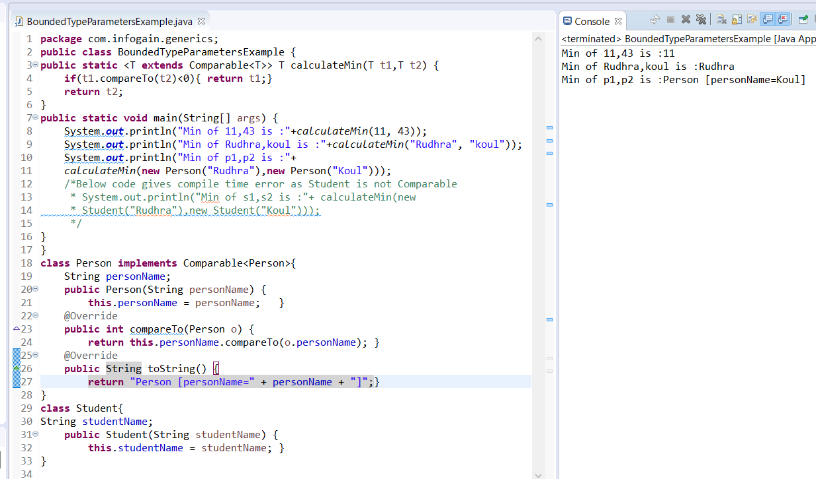
Bounded Type Parameters Cont …

Slide 26
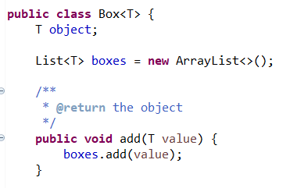
Generics, Inheritance, and Subtypes
It is possible to assign an object of one type to an object of another type provided that the types are compatible. For example, you can assign an Integer to an Object, since Object is one of Integer's supertypes:
Object someObject = new Object();
Integer someInteger = new Integer(10);
someObject = someInteger; // OK
In object-oriented terminology, this is called an "is a" relationship. Since an Integer is a kind of Object, the assignment is allowed. But Integer is also a kind of Number, so the following code is valid as well:
public void someMethod(Number n) { /* ... */ }
someMethod(new Integer(10)); // OK
someMethod(new Double(10.1)); // OK
The same is also true with generics. You can perform a generic type invocation, passing Number as its type argument, and any subsequent invocation of add will be allowed if the argument is compatible with Number:
Box<Number> box = new Box<Number>();
box.add(new Integer(10)); // OK
box.add(new Double(10.1)); // OK
Notes:
InheritanceAndSubtypesExample1.java, InheritanceAndSubtypesExample2.java

Slide 27
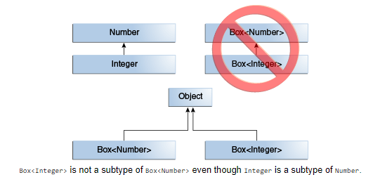
Generics, Inheritance, and Subtypes
Now consider the following method:
public void boxTest(Box<Number> n) { /* ... */ }
What type of argument does it accept? By looking at its signature, you can see that it accepts a single argument whose type is Box<Number>. But what does that mean? Are you allowed to pass in Box<Integer> or Box<Double>, as you might expect? The answer is "no", because Box<Integer> and Box<Double> are not subtypes of Box<Number>.
This is a common misunderstanding when it comes to programming with generics, but it is an important concept to learn.
Given two concrete types A and B (for example, Number and Integer), MyClass<A> has no relationship to MyClass<B>, regardless of whether or not A and B are related. The common parent of MyClass<A> and MyClass<B> is Object.

Slide 28
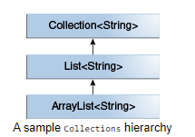
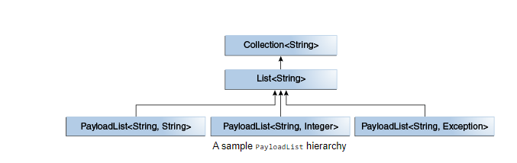
Generic Classes and Subtyping
You can subtype a generic class or interface by extending or implementing it. The relationship between the type parameters of one class or interface and the type parameters of another are determined by the extends and implements clauses.
Using the Collections classes as an example, ArrayList<E> implements List<E>, and List<E> extends Collection<E>. So ArrayList<String> is a subtype of List<String>, which is a subtype of Collection<String>. So long as you do not vary the type argument, the subtyping relationship is preserved between the types
Now imagine we want to define our own list interface, PayloadList, that associates an optional value of generic type P with each element. Its declaration might look like:
interface PayloadList<E,P> extends List<E> {
void setPayload(int index, P val); ... }
The following parameterizations of PayloadList are subtypes of List<String>:
PayloadList<String,String>
PayloadList<String,Integer>
PayloadList<String,Exception>
Notes:
InheritanceAndSubtypesExample3.java

Slide 29
Type Inference
Type inference is a Java compiler's ability to look at each method invocation and corresponding declaration to determine the type argument (or arguments) that make the invocation applicable.
The inference algorithm determines the types of the arguments and, if available, the type that the result is being assigned, or returned. Finally, the inference algorithm tries to find the most specific type that works with all of the arguments.
To illustrate this last point, in the following example, inference determines that the second argument being passed to the pick method is of type Serializable:
static <T> T pick(T a1, T a2) { return a2; }
Serializable s = pick("d", new ArrayList<String>());
Notes:
TypeInferenceExample1.java

Slide 30
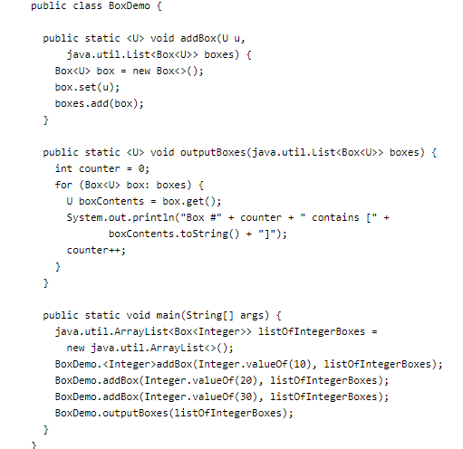
Type Inference & Generic Methods
Type inference, enables you to invoke a generic method as you would invoke an ordinary method, without specifying a type between angle brackets.
The following is the output from this example:
Box #0 contains [10]
Box #1 contains [20]
Box #2 contains [30]
The generic method addBox defines one type parameter named U.
Generally, a Java compiler can infer the type parameters of a generic method call.
Consequently, in most cases, you do not have to specify them.
Type Witness
To invoke the generic method addBox, you can specify the
type parameter with something called a type witness as follows:
BoxDemo.<Integer>addBox(Integer.valueOf(10), listOfIntegerBoxes);
Alternatively, if you omit the type witness,
A Java compiler automatically infers (from the method's arguments) that the type parameter
is Integer:
BoxDemo.addBox(Integer.valueOf(20), listOfIntegerBoxes);
Notes:
TypeInferenceExample2.java

Slide 31
Type Inference and Instantiation of Generic Classes
You can replace the type arguments required to invoke the constructor of a generic class with an empty set of type parameters (<>) as long as the compiler can infer the type arguments from the context.
This pair of angle brackets is informally called the diamond.
For example, consider the following variable declaration:
Map<String, List<String>> myMap = new HashMap<String, List<String>>();
You can substitute the parameterized type of the constructor with an empty set of type parameters (<>):
Map<String, List<String>> myMap = new HashMap<>();
Note that to take advantage of type inference during generic class instantiation, you must use the diamond.
In the following example, the compiler generates an unchecked conversion warning because the HashMap() constructor refers to the HashMap raw type, not the Map<String, List<String>> type:
Map<String, List<String>> myMap = new HashMap(); // unchecked conversion warning
Notes:
DiamondOperatorExample1.java

Slide 32
Type Inference and Generic Constructors of Generic and Non-Generic Classes
constructors can be generic (in other words, declare their own formal type parameters) in both generic and non-generic classes. Consider the following example:
class MyClass<X> {
<T> MyClass(T t) {
// ...
}
}
Consider the following instantiation of the class MyClass:
new MyClass<Integer>("")
This statement creates an instance of the parameterized type MyClass<Integer>; the statement explicitly specifies the type Integer for the formal type parameter, X, of the generic class MyClass<X>. Note that the constructor for this generic class contains a formal type parameter, T. The compiler infers the type String for the formal type parameter, T, of the constructor of this generic class (because the actual parameter of this constructor is a String object).
Compilers from releases prior to Java SE 7 are able to infer the actual type parameters of generic constructors, similar to generic methods. However, compilers in Java SE 7 and later can infer the actual type parameters of the generic class being instantiated if you use the diamond (<>). Consider the following example:
MyClass<Integer> myObject = new MyClass<>("");
In this example, the compiler infers the type Integer for the formal type parameter, X, of the generic class MyClass<X>. It infers the type String for the formal type parameter, T, of the constructor of this generic class.
It is important to note that the inference algorithm uses only invocation arguments, target types, and possibly an obvious expected return type to infer types. The inference algorithm does not use results from later in the program.
Notes:
TypeInferenceExample3.java

Slide 33
Target Types
The Java compiler takes advantage of target typing to infer the type parameters of a generic method invocation. The target type of an expression is the data type that the Java compiler expects depending on where the expression appears. Consider the method Collections.emptyList, which is declared as follows:
static <T> List<T> emptyList();
Consider the following assignment statement:
List<String> listOne = Collections.emptyList();
This statement is expecting an instance of List<String>; this data type is the target type. Because the method emptyList returns a value of type List<T>, the compiler infers that the type argument T must be the value String. This works in both Java SE 7 and 8. Alternatively, you could use a type witness and specify the value of T as follows:
List<String> listOne = Collections.<String>emptyList();
However, this is not necessary in this context. It was necessary in other contexts, though. Consider the following method:
void processStringList(List<String> stringList) {
// process stringList
}
Suppose you want to invoke the method processStringList with an empty list. In Java SE 7, the following statement does not compile:
processStringList(Collections.emptyList());
The Java SE 7 compiler generates an error message similar to the following:
List<Object> cannot be converted to List<String>
The compiler requires a value for the type argument T so it starts with the value Object. Consequently, the invocation of Collections.emptyList returns a value of type List<Object>, which is incompatible with the method processStringList. Thus, in Java SE 7, you must specify the value of the value of the type argument as follows:
processStringList(Collections.<String>emptyList());
This is no longer necessary in Java SE 8. The notion of what is a target type has been expanded to include method arguments, such as the argument to the method processStringList. In this case, processStringList requires an argument of type List<String>. The method Collections.emptyList returns a value of List<T>, so using the target type of List<String>, the compiler infers that the type argument T has a value of String. Thus, in Java SE 8, the following statement compiles:
processStringList(Collections.emptyList());
Notes:
TargetTypesExample1.java

Slide 34
Wildcards
In generic code, the question mark (?), called the wildcard, represents an unknown type. The wildcard can be used in a variety of situations: as the type of a parameter, field, or local variable; sometimes as a return type (though it is better programming practice to be more specific). The wildcard is never used as a type argument for a generic method invocation, a generic class instance creation, or a supertype.
If we have a requirement like a method can accept an arrayList of any type we can achieve so by using ? As type argument in the method parameter for example:
Void m1(ArrayList<?> al).
Notes:
WildcardsExample1.java

Slide 35
Upper Bounded Wildcards
You can use an upper bounded wildcard to relax the restrictions on a variable. For example, say you want to write a method that works on List<Integer>, List<Double>, and List<Number>; you can achieve this by using an upper bounded wildcard.
To declare an upper-bounded wildcard, use the wildcard character ('?'), followed by the extends keyword, followed by its upper bound. Note that, in this context, extends is used in a general sense to mean either "extends" (as in classes) or "implements" (as in interfaces).
To write the method that works on lists of Number and the subtypes of Number, such as Integer, Double, and Float, you would specify List<? extends Number>. The term List<Number> is more restrictive than List<? extends Number> because the former matches a list of type Number only, whereas the latter matches a list of type Number or any of its subclasses.
Consider the following process method:
public static void process(List<? extends Foo> list) { /* ... */ }
The upper bounded wildcard, <? extends Foo>, where Foo is any type, matches Foo and any subtype of Foo. The process method can access the list elements as type Foo:
public static void process(List<? extends Foo> list) {
for (Foo elem : list) {
// ...
}
}
In the foreach clause, the elem variable iterates over each element in the list. Any method defined in the Foo class can now be used on elem.
Notes:
UpperBoundedWildcardsExample1.java

Slide 36
Upper Bounded Wildcards Cont…
The sumOfList method returns the sum of the numbers in a list:
public static double sumOfList(List<? extends Number> list) {
double s = 0.0;
for (Number n : list)
s += n.doubleValue();
return s;
}
The following code, using a list of Integer objects, prints sum = 6.0:
List<Integer> li = Arrays.asList(1, 2, 3);
System.out.println("sum = " + sumOfList(li));
A list of Double values can use the same sumOfList method. The following code prints sum = 7.0:
List<Double> ld = Arrays.asList(1.2, 2.3, 3.5);
System.out.println("sum = " + sumOfList(ld));

Slide 37
Upper Bounded Wildcards Cont…
Consider a method with following signature public void test(List<? extends Number > all){…}
We can call this method with a list of Integers,Numbers,Doubles etc.
? here is upper bounded by Number i.e we cant go higher than number we have to stay with number or its child classes we cant go with Object as it is higher than number.
We cant add anything except null to this list inside this method. Because we don’t know at compile time whether this list will be of Type Number,Integer,Double.so what if we add a Integer to it but at runtime a list of Double type was passed to it.

Slide 38
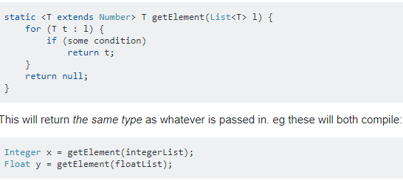
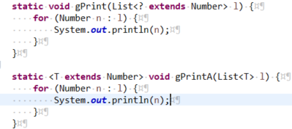
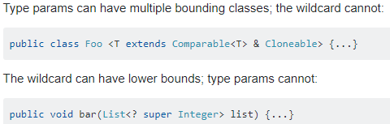
Upper Bounded Wildcards Cont…
Difference between <? extends Number> vs <T extends Number>
The reason for declaring a T is so that you can refer to it again, thus binding two parameter types, or a return type together.

Slide 39
Unbounded WildCards
The unbounded wildcard type is specified using the wildcard character (?), for example, List<?>. This is called a list of unknown type. There are two scenarios where an unbounded wildcard is a useful approach:
If you are writing a method that can be implemented using functionality provided in the Object class.
When the code is using methods in the generic class that don't depend on the type parameter. For example, List.size or List.clear. In fact, Class<?> is so often used because most of the methods in Class<T> do not depend on T.
Consider the following method, printList:
public static void printList(List<Object> list) {
for (Object elem : list)
System.out.println(elem + " ");
System.out.println();
}
The goal of printList is to print a list of any type, but it fails to achieve that goal — it prints only a list of Object instances; it cannot print List<Integer>, List<String>, List<Double>, and so on, because they are not subtypes of List<Object>. To write a generic printList method, use List<?>:
public static void printList(List<?> list) {
for (Object elem: list)
System.out.print(elem + " ");
System.out.println();
}
Because for any concrete type A, List<A> is a subtype of List<?>, you can use printList to print a list of any type:
List<Integer> li = Arrays.asList(1, 2, 3); printList(li);
List<String> ls = Arrays.asList("one", "two", "three"); printList(ls);

Slide 40
Unbounded WildCards
It's important to note that List<Object> and List<?> are not the same. You can insert an Object, or any subtype of Object, into a List<Object>. But you can only insert null into a List<?>.
Consider the following example
Void m1(ArrayList<?> al)
We cant add anything to this arraylist inside the m1() method except null as we don’t know its type exactly. null is allowed as null can be assigned to any type. Although while calling this method we can call it with arrayList of any type.
This kind of methods are best suitable for read only operations.
Consider following example
Void m1(ArrayList<? extends Student> al)
This kind of syntax we can only send an arraylist which is of a type that is a child class of Student or Student type arraylist or if Student is an interface arraylist of its implementation classes ,
We ant add anything to this list inside the method except null as we are not sure which child class or which implementation we are getting .
This is again suitable for Read only operations.
Notes:
UnboundedUpeerBoundedWildcardsExample.java

Slide 41
Lower Bounded Wildcards
An upper bounded wildcard restricts the unknown type to be a specific type or a subtype of that type and is represented using the extends keyword. In a similar way, a lower bounded wildcard restricts the unknown type to be a specific type or a super type of that type.
A lower bounded wildcard is expressed using the wildcard character ('?'), following by the super keyword, followed by its lower bound: <? super A>.
You can specify an upper bound for a wildcard, or you can specify a lower bound, but you cannot specify both.
Say you want to write a method that puts Integer objects into a list. To maximize flexibility, you would like the method to work on List<Integer>, List<Number>, and List<Object> — anything that can hold Integer values.
To write the method that works on lists of Integer and the supertypes of Integer, such as Integer, Number, and Object, you would specify List<? super Integer>. The term List<Integer> is more restrictive than List<? super Integer> because the former matches a list of type Integer only, whereas the latter matches a list of any type that is a supertype of Integer.
The following code adds the numbers 1 through 10 to the end of a list:
public static void addNumbers(List<? super Integer> list) {
for (int i = 1; i <= 10; i++) {
list.add(i);
}
}

Slide 42
Lower Bounded Wildcards Cont…
If we use Void m1(ArrayList<? super Student> al) this kind of syntax .Two cases arise
if Student is a class we can pass an arraylist Student or its parent classes.
If Student is an interface we can access this method by passing an ArrayList of either Student Type or super class of implementation class of Student.
Within this method we can Add Student type of objects and also null to the ArrayList .
We can use ? Only in declaration in the right hand side of an assignment we need to specify an actual class without any boundary for example
ArrayList<?> al = new ArrayList<?>(); and ArrayList<?> al = new ArrayList<? extends Number>(); are both invalid.
ArrayList<? > al = new ArrayList<String>();, ArrayList<String > al = new ArrayList<String>(); ArrayList<? extends Number> al = new ArrayList<Integer>();, ArrayList<? super String> al = new ArrayList<Object>(); are all valid.

Slide 43
Wildcards and Subtyping
regular classes follows this rule of subtyping: class B is a subtype of class A if B extends A. This rule does not apply to generic types:
List<B> lb = new ArrayList<>();
List<A> la = lb; // compile-time error
Given that Integer is a subtype of Number, what is the relationship between List<Integer> and List<Number>?
Although Integer is a subtype of Number, List<Integer> is not a subtype of List<Number> and, in fact, these two types are not related. The common parent of List<Number> and List<Integer> is List<?>.
In order to create a relationship between these classes so that the code can access Number's methods through List<Integer>'s elements, use an upper bounded wildcard:
List<? extends Integer> intList = new ArrayList<>();
List<? extends Number> numList = intList; // OK.
List<? extends Integer> is a subtype of List<? extends Number>
Because Integer is a subtype of Number, and numList is a list of Number objects, a relationship now exists between intList (a list of Integer objects) and numList.

Slide 44
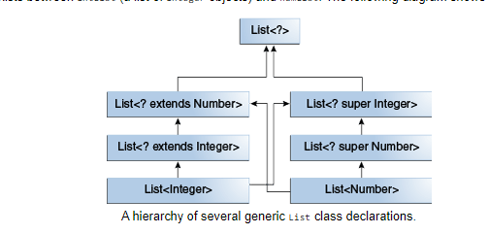
Wildcards and Subtyping
The following diagram shows the relationships between several List classes declared with both upper and lower bounded wildcards.

Slide 45
Wildcard Capture and Helper Methods
In some cases, the compiler infers the type of a wildcard. For example, a list may be defined as List<?> but, when evaluating an expression, the compiler infers a particular type from the code. This scenario is known as wildcard capture.
For the most part, you don't need to worry about wildcard capture, except when you see an error message that contains the phrase "capture of".
The WildcardError example given below produces a capture error when compiled:
public class WildcardError {
void foo(List<?> i) {
i.set(0, i.get(0));
}
}
In this example, the compiler processes the i input parameter as being of type Object. When the foo method invokes List.set(int, E), the compiler is not able to confirm the type of object that is being inserted into the list, and an error is produced. When this type of error occurs it typically means that the compiler believes that you are assigning the wrong type to a variable. Generics were added to the Java language for this reason — to enforce type safety at compile time.
The WildcardError example generates the following error when compiled by Oracle's JDK 7 javac implementation:
WildcardError.java:6: error: method set in interface List<E> cannot be applied to given types;
i.set(0, i.get(0));
^
required: int,CAP#1
found: int,Object
reason: actual argument Object cannot be converted to CAP#1 by method invocation conversion
where E is a type-variable:
E extends Object declared in interface List
where CAP#1 is a fresh type-variable:
CAP#1 extends Object from capture of ?
1 error
In this example, the code is attempting to perform a safe operation, so how can you work around the compiler error? You can fix it by writing a private helper method which captures the wildcard

Slide 46
Wildcard Capture and Helper Methods
In this example, the code is attempting to perform a safe operation, so how can you work around the compiler error? You can fix it by writing a private helper method which captures the wildcard. In this case, you can work around the problem by creating the private helper method, fooHelper, as shown in WildcardFixed:
public class WildcardFixed {
void foo(List<?> i) {
fooHelper(i);
}
// Helper method created so that the wildcard can be captured
// through type inference.
private <T> void fooHelper(List<T> l) {
l.set(0, l.get(0)); } }
Thanks to the helper method, the compiler uses inference to determine that T is CAP#1, the capture variable, in the invocation. The example now compiles successfully.By convention, helper methods are generally named originalMethodNameHelper.
Now consider a more complex example, WildcardErrorBad:
public class WildcardErrorBad {
void swapFirst(List<? extends Number> l1, List<? extends Number> l2) {
Number temp = l1.get(0);
l1.set(0, l2.get(0)); // expected a CAP#1 extends Number,
// got a CAP#2 extends Number;
// same bound, but different types
l2.set(0, temp); // expected a CAP#1 extends Number,
// got a Number } }
In this example, the code is attempting an unsafe operation. For example, consider the following invocation of the swapFirst method:
List<Integer> li = Arrays.asList(1, 2, 3);
List<Double> ld = Arrays.asList(10.10, 20.20, 30.30);
swapFirst(li, ld);
While List<Integer> and List<Double> both fulfill the criteria of List<? extends Number>, it is clearly incorrect to take an item from a list of Integer values and attempt to place it into a list of Double values.

Slide 47
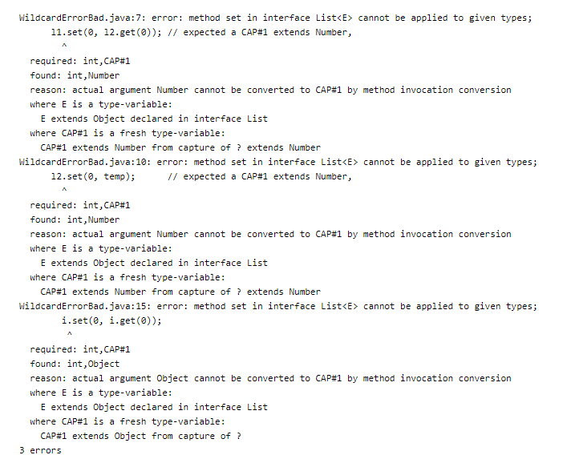
Wildcard Capture and Helper Methods
Compiling the code with Oracle's JDK javac compiler produces the following error:
There is no helper method to work around the problem, because the code is fundamentally wrong.

Slide 48
Guidelines for Wildcard Use
One of the more confusing aspects when learning to program with generics is determining when to use an upper bounded wildcard and when to use a lower bounded wildcard.
For purposes of this discussion, it is helpful to think of variables as providing one of two functions:
An "In" Variable
An "in" variable serves up data to the code. Imagine a copy method with two arguments: copy(src, dest). The src argument provides the data to be copied, so it is the "in" parameter.
An "Out" Variable
An "out" variable holds data for use elsewhere. In the copy example, copy(src, dest), the dest argument accepts data, so it is the "out" parameter.
Of course, some variables are used both for "in" and "out" purposes — this scenario is also addressed in the guidelines.
You can use the "in" and "out" principle when deciding whether to use a wildcard and what type of wildcard is appropriate. The following list provides the guidelines to follow:
Wildcard Guidelines:
An "in" variable is defined with an upper bounded wildcard, using the extends keyword.
An "out" variable is defined with a lower bounded wildcard, using the super keyword.
In the case where the "in" variable can be accessed using methods defined in the Object class, use an unbounded wildcard.
In the case where the code needs to access the variable as both an "in" and an "out" variable, do not use a wildcard.
These guidelines do not apply to a method's return type. Using a wildcard as a return type should be avoided because it forces programmers using the code to deal with wildcards.

Slide 49
Guidelines for Wildcard Use Cont…
A list defined by List<? extends ...> can be informally thought of as read-only, but that is not a strict guarantee. Suppose you have the following two classes:
class NaturalNumber {
private int i;
public NaturalNumber(int i) { this.i = i; }
// ...
}
class EvenNumber extends NaturalNumber {
public EvenNumber(int i) { super(i); }
// ...
}
Consider the following code:
List<EvenNumber> le = new ArrayList<>();
List<? extends NaturalNumber> ln = le;
ln.add(new NaturalNumber(35)); // compile-time error
Because List<EvenNumber> is a subtype of List<? extends NaturalNumber>, you can assign le to ln. But you cannot use ln to add a natural number to a list of even numbers. The following operations on the list are possible:
You can add null.
You can invoke clear.
You can get the iterator and invoke remove.
You can capture the wildcard and write elements that you've read from the list.
You can see that the list defined by List<? extends NaturalNumber> is not read-only in the strictest sense of the word, but you might think of it that way because you cannot store a new element or change an existing element in the list.

Slide 50
Type Erasure
Generics were introduced to the Java language to provide tighter type checks at compile time and to support generic programming. To implement generics, the Java compiler applies type erasure to:
Replace all type parameters in generic types with their bounds or Object if the type parameters are unbounded. The produced bytecode, therefore, contains only ordinary classes, interfaces, and methods.
Insert type casts if necessary to preserve type safety.
Generate bridge methods to preserve polymorphism in extended generic types.
Type erasure ensures that no new classes are created for parameterized types; consequently, generics incur no runtime overhead.

Slide 51
Erasure of Generic Types
During the type erasure process, the Java compiler erases all type parameters and replaces each with its first bound if the type parameter is bounded, or Object if the type parameter is unbounded.
Consider the following generic class that represents a node in a singly linked list:
public class Node<T> {
private T data; private Node<T> next;
public Node(T data, Node<T> next) {
this.data = data; this.next = next;
}
public T getData() { return data; }
// ...
}
Because the type parameter T is unbounded, the Java compiler replaces it with Object:
public class Node {
private Object data; private Node next;
public Node(Object data, Node next) {
this.data = data; this.next = next;
}
public Object getData() { return data; }
// ...
}

Slide 52
Erasure of Generic Types
In the following example, the generic Node class uses a bounded type parameter:
public class Node<T extends Comparable<T>> {
private T data; private Node<T> next;
public Node(T data, Node<T> next) {
this.data = data;
this.next = next;
}
public T getData() { return data; }
// ...
}
The Java compiler replaces the bounded type parameter T with the first bound class, Comparable:
public class Node {
private Comparable data;
private Node next;
public Node(Comparable data, Node next) {
this.data = data;
this.next = next;
}
public Comparable getData() { return data; }
// ...
}

Slide 53
Erasure of Generic Methods
The Java compiler also erases type parameters in generic method arguments. Consider the following generic method: which Counts the number of occurrences of elem in anArray.
public static <T> int count(T[] anArray, T elem) {
int cnt = 0;
for (T e : anArray)
if (e.equals(elem))
++cnt;
return cnt;
}
Because T is unbounded, the Java compiler replaces it with Object:
public static int count(Object[] anArray, Object elem) {
int cnt = 0;
for (Object e : anArray)
if (e.equals(elem))
++cnt;
return cnt;
}
Suppose the following classes are defined:
class Shape { /* ... */ }
class Circle extends Shape { /* ... */ }
class Rectangle extends Shape { /* ... */ }
You can write a generic method to draw different shapes:
public static <T extends Shape> void draw(T shape) { /* ... */ }
The Java compiler replaces T with Shape:
public static void draw(Shape shape) { /* ... */ }

Slide 54
Effects of Type Erasure and Bridge Methods
Sometimes type erasure causes a situation that you may not have anticipated. The following example shows how this can occur. The example (described in Bridge Methods) shows how a compiler sometimes creates a synthetic method, called a bridge method, as part of the type erasure process.
Given the following two classes:
public class Node<T> {
public T data;
public Node(T data) { this.data = data; }
public void setData(T data) {
System.out.println("Node.setData");
this.data = data; } }
public class MyNode extends Node<Integer> {
public MyNode(Integer data) { super(data); }
public void setData(Integer data) {
System.out.println("MyNode.setData");
super.setData(data); } }

Slide 55
Effects of Type Erasure and Bridge Methods Cont…
Consider the following code:
MyNode mn = new MyNode(5);
Node n = mn; // A raw type - compiler throws an unchecked warning
n.setData("Hello");
Integer x = mn.data; // Causes a ClassCastException to be thrown.
After type erasure, this code becomes:
MyNode mn = new MyNode(5);
Node n = (MyNode)mn; // A raw type - compiler throws an unchecked warning
n.setData("Hello");
Integer x = (String)mn.data; // Causes a ClassCastException to be thrown.
Here is what happens as the code is executed:
n.setData("Hello"); causes the method setData(Object) to be executed on the object of class MyNode. (The MyNode class inherited setData(Object) from Node.)
In the body of setData(Object), the data field of the object referenced by n is assigned to a String.
The data field of that same object, referenced via mn, can be accessed and is expected to be an integer (since mn is a MyNode which is a Node<Integer>.
Trying to assign a String to an Integer causes a ClassCastException from a cast inserted at the assignment by a Java compiler.

Slide 56
Bridge Methods
When compiling a class or interface that extends a parameterized class or implements a parameterized interface, the compiler may need to create a synthetic method, called a bridge method, as part of the type erasure process. You normally don't need to worry about bridge methods, but you might be puzzled if one appears in a stack trace.
After type erasure, the Node and MyNode classes become:
public class Node {
public Object data;
public Node(Object data) { this.data = data; }
public void setData(Object data) {
System.out.println("Node.setData");
this.data = data; } }
public class MyNode extends Node {
public MyNode(Integer data) { super(data); }
public void setData(Integer data) {
System.out.println("MyNode.setData");
super.setData(data); } }
After type erasure, the method signatures do not match. The Node method becomes setData(Object) and the MyNode method becomes setData(Integer). Therefore, the MyNode setData method does not override the Node setData method.

Slide 57
Bridge Methods Cont…
To solve this problem and preserve the polymorphism of generic types after type erasure, a Java compiler generates a bridge method to ensure that subtyping works as expected. For the MyNode class, the compiler generates the following bridge method for setData:
class MyNode extends Node {
// Bridge method generated by the compiler
public void setData(Object data) {
setData((Integer) data);
}
public void setData(Integer data) {
System.out.println("MyNode.setData");
super.setData(data);
}
// ...
}
As you can see, the bridge method, which has the same method signature as the Node class's setData method after type erasure, delegates to the original setData method.

Slide 58
Non-Reifiable Types
Type erasure has consequences related to variable arguments (also known as varargs ) methods whose varargs formal parameter has a non-reifiable type. See the section Arbitrary Number of Arguments in Passing Information to a Method or a Constructor for more information about varargs methods.
Non-Reifiable Types
A reifiable type is a type whose type information is fully available at runtime. This includes primitives, non-generic types, raw types, and invocations of unbound wildcards.
Non-reifiable types are types where information has been removed at compile-time by type erasure — invocations of generic types that are not defined as unbounded wildcards. A non-reifiable type does not have all of its information available at runtime. Examples of non-reifiable types are List<String> and List<Number>; the JVM cannot tell the difference between these types at runtime. As shown in Restrictions on Generics, there are certain situations where non-reifiable types cannot be used: in an instanceof expression, for example, or as an element in an array.
Heap Pollution
Heap pollution occurs when a variable of a parameterized type refers to an object that is not of that parameterized type. This situation occurs if the program performed some operation that gives rise to an unchecked warning at compile-time. An unchecked warning is generated if, either at compile-time (within the limits of the compile-time type checking rules) or at runtime, the correctness of an operation involving a parameterized type (for example, a cast or method call) cannot be verified. For example, heap pollution occurs when mixing raw types and parameterized types, or when performing unchecked casts.
In normal situations, when all code is compiled at the same time, the compiler issues an unchecked warning to draw your attention to potential heap pollution. If you compile sections of your code separately, it is difficult to detect the potential risk of heap pollution. If you ensure that your code compiles without warnings, then no heap pollution can occur.

Slide 59
Potential Vulnerabilities of Varargs Methods with Non-Reifiable Formal Parameters
Generic methods that include vararg input parameters can cause heap pollution.Consider the following ArrayBuilder class:
public class ArrayBuilder {
public static <T> void addToList (List<T> listArg, T... elements) {
for (T x : elements) {
listArg.add(x); } }
public static void faultyMethod(List<String>... l) {
Object[] objectArray = l; // Valid
objectArray[0] = Arrays.asList(42);
String s = l[0].get(0); // ClassCastException thrown here } }
The following example, HeapPollutionExample uses the ArrayBuiler class:
public class HeapPollutionExample {
public static void main(String[] args) {
List<String> stringListA = new ArrayList<String>();
List<String> stringListB = new ArrayList<String>();
ArrayBuilder.addToList(stringListA, "Seven", "Eight", "Nine");
ArrayBuilder.addToList(stringListB, "Ten", "Eleven", "Twelve");
List<List<String>> listOfStringLists =
new ArrayList<List<String>>();
ArrayBuilder.addToList(listOfStringLists,
stringListA, stringListB);
ArrayBuilder.faultyMethod(Arrays.asList("Hello!"), Arrays.asList("World!"));
}
}

Slide 60
Potential Vulnerabilities of Varargs Methods with Non-Reifiable Formal Parameters
When compiled, the following warning is produced by the definition of the ArrayBuilder.addToList method:
warning: [varargs] Possible heap pollution from parameterized vararg type T
When the compiler encounters a varargs method, it translates the varargs formal parameter into an array. However, the Java programming language does not permit the creation of arrays of parameterized types. In the method ArrayBuilder.addToList, the compiler translates the varargs formal parameter T... elements to the formal parameter T[] elements, an array. However, because of type erasure, the compiler converts the varargs formal parameter to Object[] elements. Consequently, there is a possibility of heap pollution.
The following statement assigns the varargs formal parameter l to the Object array objectArgs:
Object[] objectArray = l;
This statement can potentially introduce heap pollution. A value that does match the parameterized type of the varargs formal parameter l can be assigned to the variable objectArray, and thus can be assigned to l. However, the compiler does not generate an unchecked warning at this statement. The compiler has already generated a warning when it translated the varargs formal parameter List<String>... l to the formal parameter List[] l. This statement is valid; the variable l has the type List[], which is a subtype of Object[].
Consequently, the compiler does not issue a warning or error if you assign a List object of any type to any array component of the objectArray array as shown by this statement:
objectArray[0] = Arrays.asList(42);
This statement assigns to the first array component of the objectArray array with a List object that contains one object of type Integer.
Suppose you invoke ArrayBuilder.faultyMethod with the following statement:
ArrayBuilder.faultyMethod(Arrays.asList("Hello!"), Arrays.asList("World!"));
At runtime, the JVM throws a ClassCastException at the following statement:
// ClassCastException thrown here
String s = l[0].get(0);
The object stored in the first array component of the variable l has the type List<Integer>, but this statement is expecting an object of type List<String>.

Slide 61
Prevent Warnings from Varargs Methods with Non-Reifiable Formal Parameters
If you declare a varargs method that has parameters of a parameterized type, and you ensure that the body of the method does not throw a ClassCastException or other similar exception due to improper handling of the varargs formal parameter, you can prevent the warning that the compiler generates for these kinds of varargs methods by adding the following annotation to static and non-constructor method declarations:
@SafeVarargs
The @SafeVarargs annotation is a documented part of the method's contract; this annotation asserts that the implementation of the method will not improperly handle the varargs formal parameter.
It is also possible, though less desirable, to suppress such warnings by adding the following to the method declaration:
@SuppressWarnings({"unchecked", "varargs"})
However, this approach does not suppress warnings generated from the method's call site.

Slide 62
Restrictions on Generics
To use Java generics effectively, you must consider the following restrictions:
Cannot Instantiate Generic Types with Primitive Types
Cannot Create Instances of Type Parameters
Cannot Declare Static Fields Whose Types are Type Parameters
Cannot Use Casts or instanceof With Parameterized Types
Cannot Create Arrays of Parameterized Types
Cannot Create, Catch, or Throw Objects of Parameterized Types
Cannot Overload a Method Where the Formal Parameter Types of Each Overload Erase to the Same Raw Type

Slide 63
Cannot Instantiate Generic Types with Primitive Types
class Pair<K, V> {
private K key; private V value;
public Pair(K key, V value) {
this.key = key; this.value = value;
}
}
When creating a Pair object, you cannot substitute a primitive type for the type parameter K or V:
Pair<int, char> p = new Pair<>(8, 'a'); // compile-time error
You can substitute only non-primitive types for the type parameters K and V:
Pair<Integer, Character> p = new Pair<>(8, 'a');
Java compiler autoboxes 8 to Integer.valueOf(8) and 'a' to Character('a'):
Pair<Integer, Character> p = new Pair<>(Integer.valueOf(8), new Character('a'));

Slide 64
Cannot Create Instances of Type Parameters
You cannot create an instance of a type parameter. For example, the following code causes a compile-time error:
public static <E> void append(List<E> list) {
E elem = new E(); // compile-time error
list.add(elem);
}
As a workaround, you can create an object of a type parameter through reflection:
public static <E> void append(List<E> list, Class<E> cls) throws Exception {
E elem = cls.newInstance(); // OK
list.add(elem);
}
You can invoke the append method as follows:
List<String> ls = new ArrayList<>();
append(ls, String.class);

Slide 65
Cannot Declare Static Fields Whose Types are Type Parameters
A class's static field is a class-level variable shared by all non-static objects of the class. Hence, static fields of type parameters are not allowed. Consider the following class:
public class MobileDevice<T> {
private static T os;
// ...
}
If static fields of type parameters were allowed, then the following code would be confused:
MobileDevice<Smartphone> phone = new MobileDevice<>();
MobileDevice<Pager> pager = new MobileDevice<>();
MobileDevice<TabletPC> pc = new MobileDevice<>();
Because the static field os is shared by phone, pager, and pc, what is the actual type of os? It cannot be Smartphone, Pager, and TabletPC at the same time. You cannot, therefore, create static fields of type parameters.

Slide 66
Cannot Use Casts or instanceof with Parameterized Types
Because the Java compiler erases all type parameters in generic code, you cannot verify which parameterized type for a generic type is being used at runtime:
public static <E> void rtti(List<E> list) {
if (list instanceof ArrayList<Integer>) { // compile-time error
// ...
}
}
The set of parameterized types passed to the rtti method is:
S = { ArrayList<Integer>, ArrayList<String> LinkedList<Character>, ... }
The runtime does not keep track of type parameters, so it cannot tell the difference between an ArrayList<Integer> and an ArrayList<String>. The most you can do is to use an unbounded wildcard to verify that the list is an ArrayList:
public static void rtti(List<?> list) {
if (list instanceof ArrayList<?>) { // OK; instanceof requires a reifiable type
// ...
}
}
Typically, you cannot cast to a parameterized type unless it is parameterized by unbounded wildcards. For example:
List<Integer> li = new ArrayList<>();
List<Number> ln = (List<Number>) li; // compile-time error
However, in some cases the compiler knows that a type parameter is always valid and allows the cast. For example:
List<String> l1 = ...;
ArrayList<String> l2 = (ArrayList<String>)l1; // OK

Slide 67
Cannot Create Arrays of Parameterized Types
You cannot create arrays of parameterized types. For example, the following code does not compile:
List<Integer>[] arrayOfLists = new List<Integer>[2]; // compile-time error
The following code illustrates what happens when different types are inserted into an array:
Object[] strings = new String[2];
strings[0] = "hi"; // OK
strings[1] = 100; // An ArrayStoreException is thrown.
If you try the same thing with a generic list, there would be a problem:
Object[] stringLists = new List<String>[]; // compiler error, but pretend it's allowed
stringLists[0] = new ArrayList<String>(); // OK
stringLists[1] = new ArrayList<Integer>(); // An ArrayStoreException should be thrown,
// but the runtime can't detect it.
If arrays of parameterized lists were allowed, the previous code would fail to throw the desired ArrayStoreException.

Slide 68
Cannot Create, Catch, or Throw Objects of Parameterized Types
A generic class cannot extend the Throwable class directly or indirectly. For example, the following classes will not compile:
Extends Throwable indirectly
class MathException<T> extends Exception { /* ... */ } // compile-time error
Extends Throwable directly
class QueueFullException<T> extends Throwable { /* ... */ // compile-time error
A method cannot catch an instance of a type parameter:
public static <T extends Exception, J> void execute(List<J> jobs) {
try {
for (J job : jobs)
// ...
} catch (T e) { // compile-time error
// ...
}
}
You can, however, use a type parameter in a throws clause:
class Parser<T extends Exception> {
public void parse(File file) throws T { // OK
// ...
}
}

Slide 69
Cannot Overload a Method Where the Formal Parameter Types of Each Overload Erase to the Same Raw Type
A class cannot have two overloaded methods that will have the same signature after type erasure.
public class Example {
public void print(Set<String> strSet) { }
public void print(Set<Integer> intSet) { }
}
The overloads would all share the same classfile representation and will generate a compile-time error.

Slide 70
Questions and Exercises: Generics
Q1-Write a generic method to count the number of elements in a collection that have a specific property (for example, odd integers, prime numbers, palindromes).
Q2:-Will the following class compile? If not, why?
public final class Algorithm {
public static <T> T max(T x, T y) {
return x > y ? x : y;
}
}
Q3:-Write a generic method to exchange the positions of two different elements in an array.
Q4:-If the compiler erases all type parameters at compile time, why should you use generics?
5:-What is the following class converted to after type erasure?
public class Pair<K, V> {
public Pair(K key, V value) {
this.key = key;
this.value = value;
}
public K getKey(); { return key; }
public V getValue(); { return value; }
public void setKey(K key) { this.key = key; }
public void setValue(V value) { this.value = value; }
private K key;
private V value;
}
Q6:-What is the following method converted to after type erasure?
public static <T extends Comparable<T>>
int findFirstGreaterThan(T[] at, T elem) {
// ...
}

Slide 71
Questions and Exercises: Generics
Q7:-Will the following method compile? If not, why?
public static void print(List<? extends Number> list) {
for (Number n : list)
System.out.print(n + " ");
System.out.println();
}
Q8:-Write a generic method to find the maximal element in the range [begin, end) of a list.
Q9:-Will the following class compile? If not, why?
public class Singleton<T> {
public static T getInstance() {
if (instance == null)
instance = new Singleton<T>();
return instance;
}
private static T instance = null;
}
Q10:-Given the following classes:
class Shape { /* ... */ }
class Circle extends Shape { /* ... */ }
class Rectangle extends Shape { /* ... */ }
class Node<T> { /* ... */ }
Will the following code compile? If not, why?
Node<Circle> nc = new Node<>();
Node<Shape> ns = nc;

Slide 72
Questions and Exercises: Generics
Q11:-Consider this class:
class Node<T> implements Comparable<T> {
public int compareTo(T obj) { /* ... */ }
// ...
}
Will the following code compile? If not, why?
Node<String> node = new Node<>();
Comparable<String> comp = node;
Q12:-How do you invoke the following method to find the first integer in a list that is relatively prime to a list of specified integers?
public static <T>
int findFirst(List<T> list, int begin, int end, UnaryPredicate<T> p)
Note that two integers a and b are relatively prime if gcd(a, b) = 1, where gcd is short for greatest common divisor.

Slide 73
ANSWERS
https://docs.oracle.com/javase/tutorial/java/generics/QandE/generics-answers.html

Slide 74
Thanks!!!!!

