Slide 1
JavaScript

Slide 2
Section 1 – The Basics

Slide 3
Two ways to use js
Inline
Make use of <script></script> tags and write js code in between.for example <script>console.log(“hello world”);</script>
Imported
Write js code in a separate .js file and import it again make use of <script> tag use the attribute type=“text/javascript” and src=“js/main.js” for example : <script type=“text/javascript” and src=“js/main.js”> </script> and simply write console.log(“hiiiii”) in main.js file and place it in js folder.

Slide 4
JS Variables
Variables can be declared in js using the var keyword.
var Rudhra = ‘Rudhra’; //String
var isTrue = false; //Boolean
var number = 10 ;
var array = [56, ‘Tam Tam’,true, isTrue]; //Array
var object = {
name: ‘Rudhra’,
LastName: ‘Koul’
` } //Array

Slide 5
If Condition
Syntax :
If(//condition to check) {
//Code to execute if condition is true
} else if (//condition to check) {
//Code to execute if condition is true
}
else{
//Code to execute if both the above conditions are false
}
var username=‘Rudhra’;
If(username){
Console.log(‘username has a value’);
}
else{
Console.log(‘username is empty’)
}

Slide 6
Switch
Syntax :
switch (//variable to check) {
case //value to check:
//code to execute
break;
case //value to check:
//code to execute
break;
default:
//code to execute
break;
}

Slide 7
Operators
+ used for addition and String concatenation
- used for subtraction
* used for multiplication
/ used for division
% used for finding remainder
== equality check on the basis of value
=== equality check on the basis of value and type
! Inverting a check
> greater than
>= greater than equalto
< less than
<= less than equal to
&& logical and
|| logical or
? : Ternary operator

Slide 8
For Loop
for(start; end condition; counter incrementer/Decrementer;){
//loop body
}
for(start; end condition; counter incrementer/Decrementer;){
If(//some condition){
//some code
break;
}
//some code
}
for(start; end condition; counter incrementer/Decrementer;){
If(//some condition){
//some code
continue;
}
//some code
}

Slide 9
While Loop
while(//termination condition){
//loop body
//increment/decrement counter to eventually reach termination condition
}

Slide 10
functions
Syntax for declaration
function functionName (//0 or more Parameters) {
//function body
// optional return
}
Syntax for Invoking
functionName(//Arguments);
functionName();
var result=functionName();
var result= functionName(//Arguments);

Slide 11
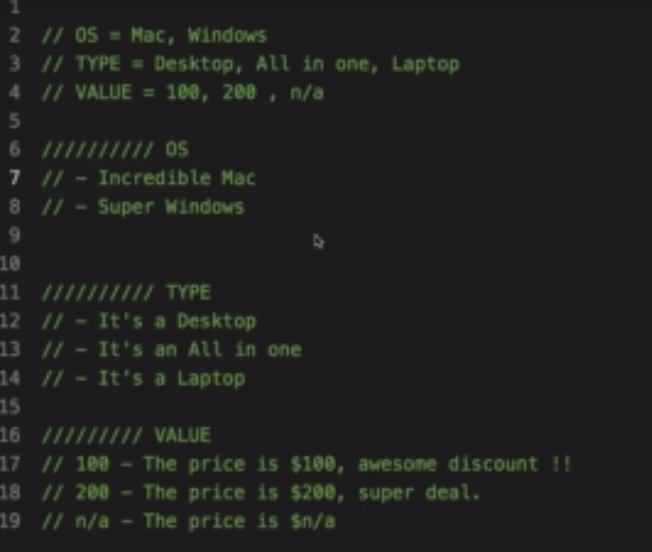
Exercise 1

Slide 12
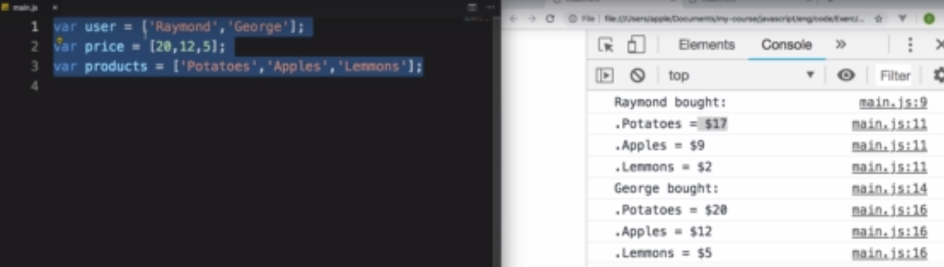
Exercise 2

Slide 13
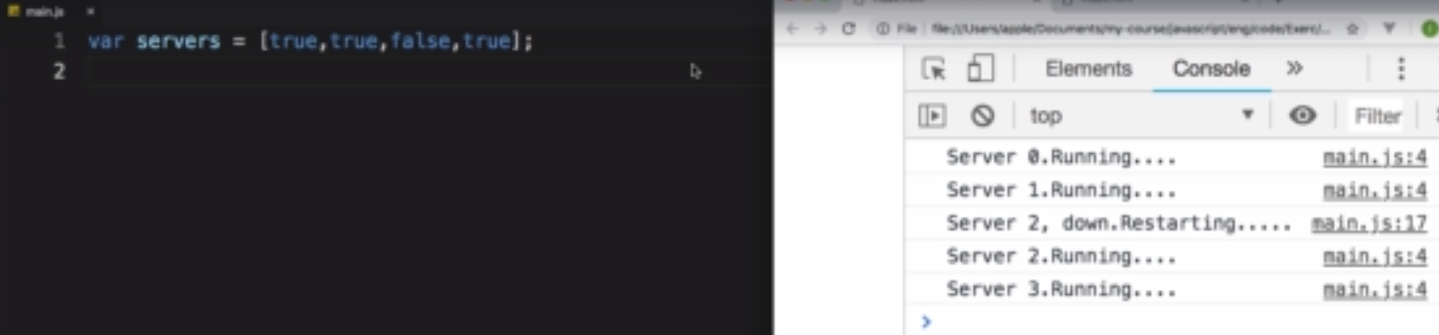
Exercise 3

Slide 14
Section 2 – The DOM

