Slide 1
JavaScript

Slide 2
What is Java Script
JavaScript is a dynamic ,weakly typed programming language which is compiled at runtime.It can be executed as a part of a webpage in a browser or directly on any machine(“host environment”).
javaScript was created to make webpages more dynamic(e.g. change content on a page directly from inside the browser). Originally, it was called LiveScript but due to the popularity of java ,it was renamed to JavaScript.
JavaScript is totally independent from Java and has nothing in common with java.

Slide 3
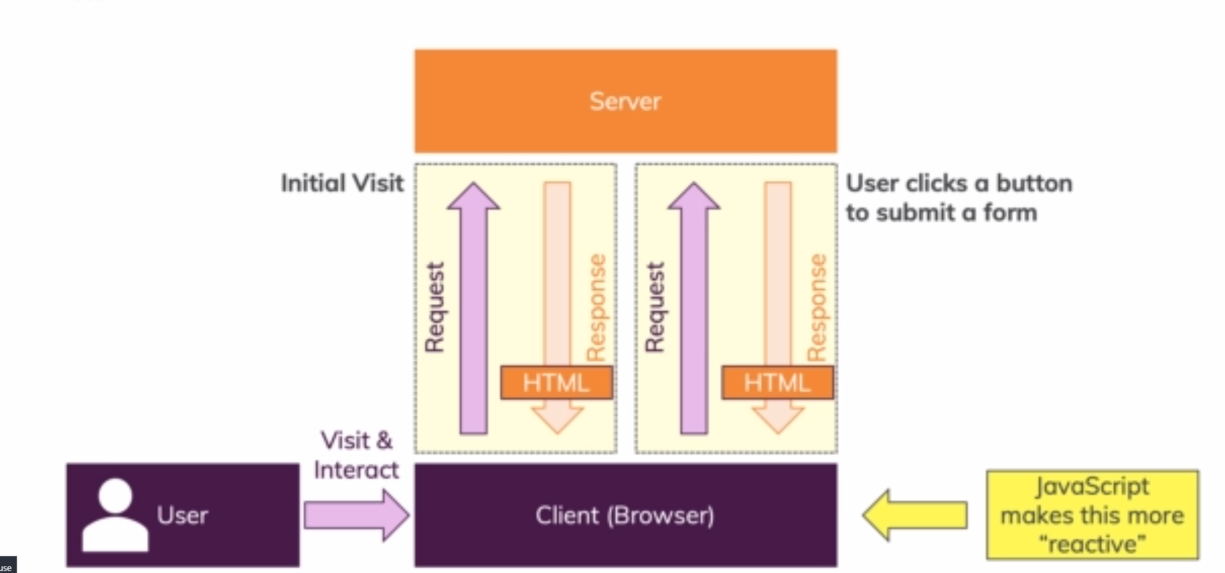
How Do Webpages work?

Slide 4
What is Java Script
JS
Interpreted, on the fly
Dynamic, Weakly Typed Programming language
“Hosted Language” :Runs in different Environments ike in web browser
Most prominent Use Case: Run code in a browser(On a webpage)

Slide 5
How is JavaScript Executed? (Interpreted, on the fly)
<Your Code>
JavaScript Engine
Parse Code
Built into The Browser
Compile To Machine Code
V8 (Chrome)
SpiderMonkey (Firefox)
Execute Machine Code
NashHorn Java 8
On A Single Thread
Effect On A Webpage
Notes:
So How is js code executed in our browser or typically in any environment
Lets say we have a js code and we want it to have an effect on a webpage when we run our script
Then we have an important thing built into any environment capable of running js code ie a js engine
It is built into the browser
For example v8 in chrome
Spidermonkey in Mozilla
And NashHorn in jdk 8 although deprecated in jdk 14 .
Other browsers often re-use these engines or even have there own engines
Now the job of js engine is
To parse the code compile it to machine code which runs faster
Execute the code then we can see an effect on our webpage
Modern Engines have a lot of optimizations they might start running the uncompiled code and then dynamically shift to compiled code and so on.
All of this happens in a single thread .Js code execution runs in one thread only.

Slide 6
Dynamic ? Weakly Typed?
Dynamically Interpreted Programming Language
Weakly Typed Programming Language
Not pre-compiled instead it is parsed and compiled “On the Fly” (e.g. in a browser)
Data Types are assumed or inferred dynamically
Code Evaluated and Executed at Runtime
You don’t have to tell Java script that some variable has to hold a certain value (e.g. a number)
Code can change at Runtime (e.g. type of a variable)
Data Types are not hard bound they can change

Slide 7
Java Script Runs On A Host Environment
Browser-side
“Other” (e.g. Server -side)
JavaScript was invented to create more dynamic websites by executing in the browser
Google’s JavaScript engine (V8) was extracted to run JavaScript anywhere called “Node.Js”
JavaScript can manipulate the HTML code, CSS ,send background Http requests & much more
Node.js can be executed on any machine and is therefore often used to build web backends (server-side -javascripts)
JavaScript cant access the local file system ,interact with Operating system etc.
Nodejs can access file system ,interact with operating system etc. It can’t manipulate HTML or css
Notes:
The capabilities are inverse between js and Node js

Slide 8
A brief Overview of JS History
1995
Netscape Introduces “LiveScript” / “JavaScript”
1996
Microsoft releases its own version for IE
Late 1996
JavaScript submitted to ECMA International to start standardization
1997 - 2005
Standardization efforts<Microsoft didn’t join the Standardization but supported the standardized version in IE.
2006-2011
Huge Progress in JS ecosystem. Microsoft eventually joined forces.

Slide 9
JavaScript and ECMAScript
Implemented By Browser Vendors
ECMAScript
JavaScript
ECMA is a standard organization that evolves the ECMAScript language
The most famous ECMAScript implementation other implementations are “ActionScript” or “JScript”
ECMAScript isint directly used but browser vendors(Gooogle,Mozilla,Opera etc) implement the standards into js engines
Each browser comes with its own JS engine that also defines which features are actually supported
Under Active development
Under Active development year 2015-2016 saw some paradigm shifts in the new versions
Notes:
European Computer Manufacturer's Association
Browsers can choose to support or not support a certain feature or may support a feature even though it might still be under discussion at ECMA.

Slide 10
Section 1 – The Basics

Slide 11
Two ways to use js
Inline
Make use of <script></script> tags and write js code in between.for example <script>console.log(“hello world”);</script>
Imported
Write js code in a separate .js file and import it again make use of <script> tag use the attribute type=“text/javascript” and src=“js/main.js” for example : <script type=“text/javascript” and src=“js/main.js”> </script> and simply write console.log(“hiiiii”) in main.js file and place it in js folder.

Slide 12
JS Variables
Variables can be declared in js using the var keyword.
var Rudhra = ‘Rudhra’; //String
var isTrue = false; //Boolean
var number = 10 ;
var array = [56, ‘Tam Tam’,true, isTrue]; //Array
var object = {
name: ‘Rudhra’,
LastName: ‘Koul’
` } //Array

Slide 13
If Condition
Syntax :
If(//condition to check) {
//Code to execute if condition is true
} else if (//condition to check) {
//Code to execute if condition is true
}
else{
//Code to execute if both the above conditions are false
}
var username=‘Rudhra’;
If(username){
Console.log(‘username has a value’);
}
else{
Console.log(‘username is empty’)
}

Slide 14
Switch
Syntax :
switch (//variable to check) {
case //value to check:
//code to execute
break;
case //value to check:
//code to execute
break;
default:
//code to execute
break;
}

Slide 15
Operators
+ used for addition and String concatenation
- used for subtraction
* used for multiplication
/ used for division
% used for finding remainder
== equality check on the basis of value
=== equality check on the basis of value and type
! Inverting a check
> greater than
>= greater than equalto
< less than
<= less than equal to
&& logical and
|| logical or
? : Ternary operator

Slide 16
For Loop
for(start; end condition; counter incrementer/Decrementer;){
//loop body
}
for(start; end condition; counter incrementer/Decrementer;){
If(//some condition){
//some code
break;
}
//some code
}
for(start; end condition; counter incrementer/Decrementer;){
If(//some condition){
//some code
continue;
}
//some code
}

Slide 17
While Loop
while(//termination condition){
//loop body
//increment/decrement counter to eventually reach termination condition
}

Slide 18
functions
Syntax for declaration
function functionName (//0 or more Parameters) {
//function body
// optional return
}
Syntax for Invoking
functionName(//Arguments);
functionName();
var result=functionName();
var result= functionName(//Arguments);

Slide 19
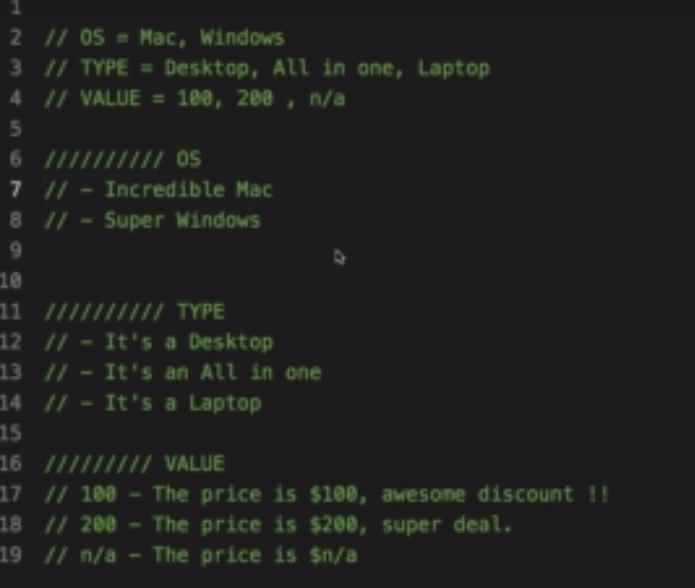
Exercise 1

Slide 20
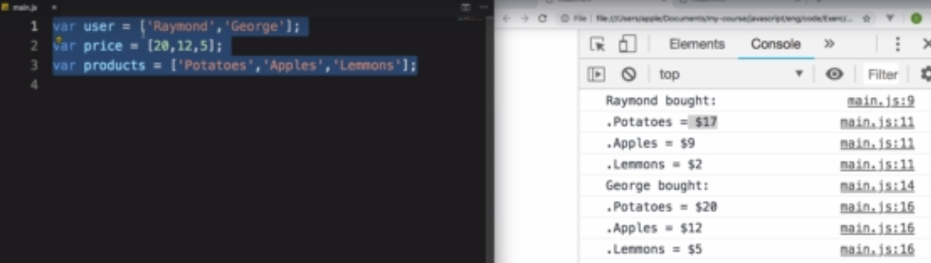
Exercise 2

Slide 21
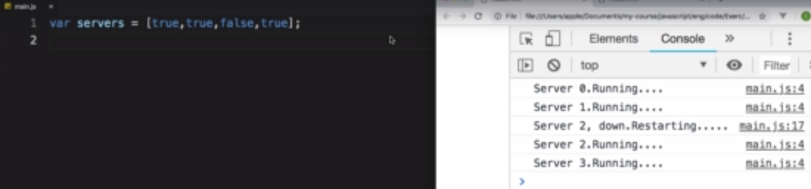
Exercise 3

Slide 22
Section 2 – The DOM

Slide 23
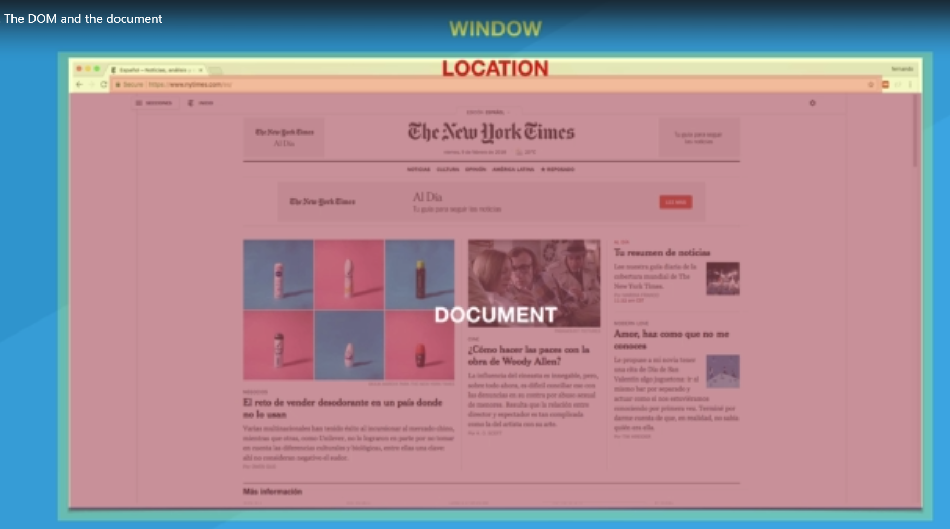
DOM –Document Object Model

Slide 24
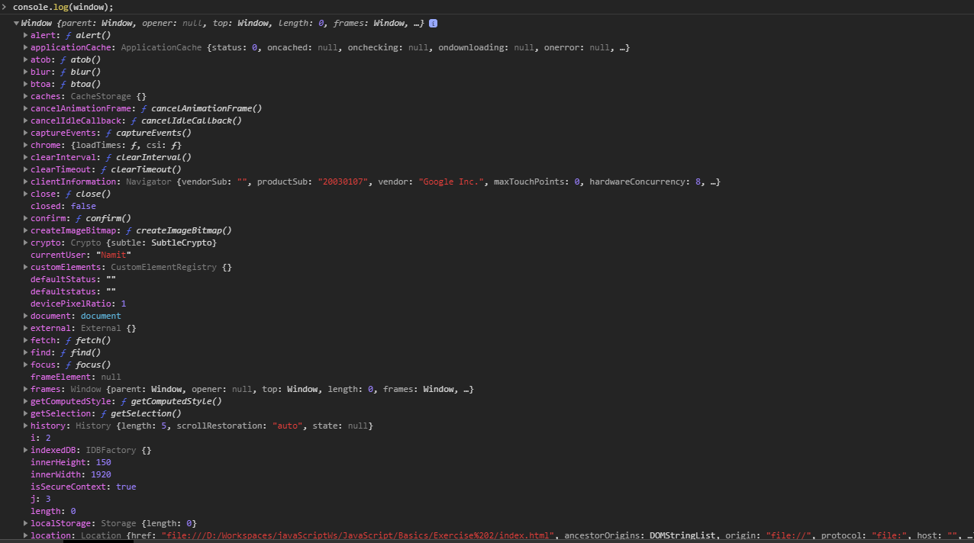
Dom-Window

Slide 25
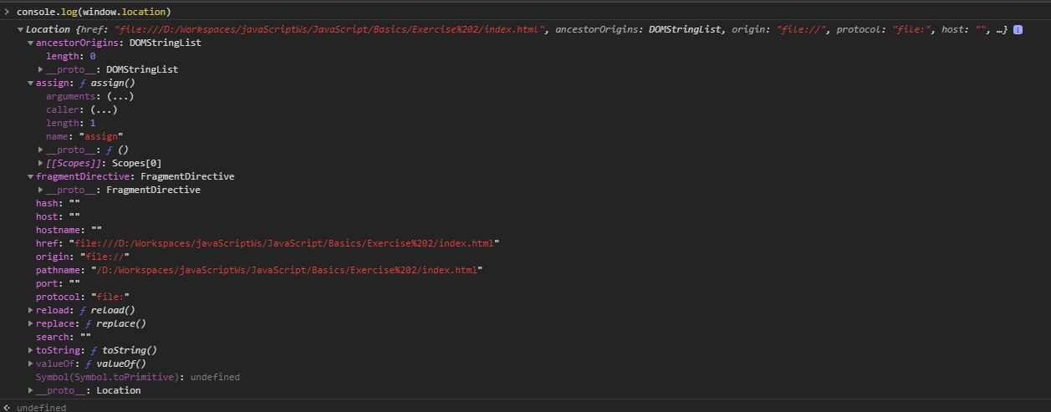
Dom-Location

Slide 26
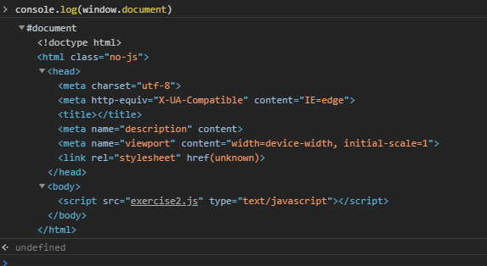
Dom-Document

Slide 27
Dom-Selecting DOM elements
Selecting dom elements by id ,tag name or class name :
Syntax Selecting by Tag Name
document.getElementsByTagName(//Tag Name);
Syntax Selecting by Class Name
document.getElementsByClassName(//Class Name);
Syntax Selecting by Id
document.getElementById(//Id);
Selecting dom elements using querySelector and querySelectorAll
Syntax Selecting using query Selctor by Tag Name
document.getquerySelector(//Tag Name);
document.getquerySelectorAll(//Tag Name);
Syntax Selecting using query Selctor by Class Name
document.getquerySelector(//.ClassName);
document.getquerySelectorAll (//.ClassName);
Syntax Selecting using query Selctor by Id
document.getquerySelector(//#ID);
document.getquerySelectorAll(//#ID);

Slide 28
Dom-Creating and Inserting DOM elements
create dom elements :
To create a new dom element we need to host it in memory by saving it in a var.
Syntax creating a new dom element
var div =document.createElement(‘div’);
We can set attributes styles etc to this element by accesing the required property with.
For example
div.textContent=‘Some content’;
div.style.color=‘red’;

Slide 29
Dom-Document

