Slide 1
JavaScript

Slide 2
Section 1 – The Basics

Slide 3
What is Java Script
JavaScript is a dynamic ,weakly typed programming language which is compiled at runtime.It can be executed as a part of a webpage in a browser or directly on any machine(“host environment”).
javaScript was created to make webpages more dynamic(e.g. change content on a page directly from inside the browser). Originally, it was called LiveScript but due to the popularity of java ,it was renamed to JavaScript.
JavaScript is totally independent from Java and has nothing in common with java.

Slide 4
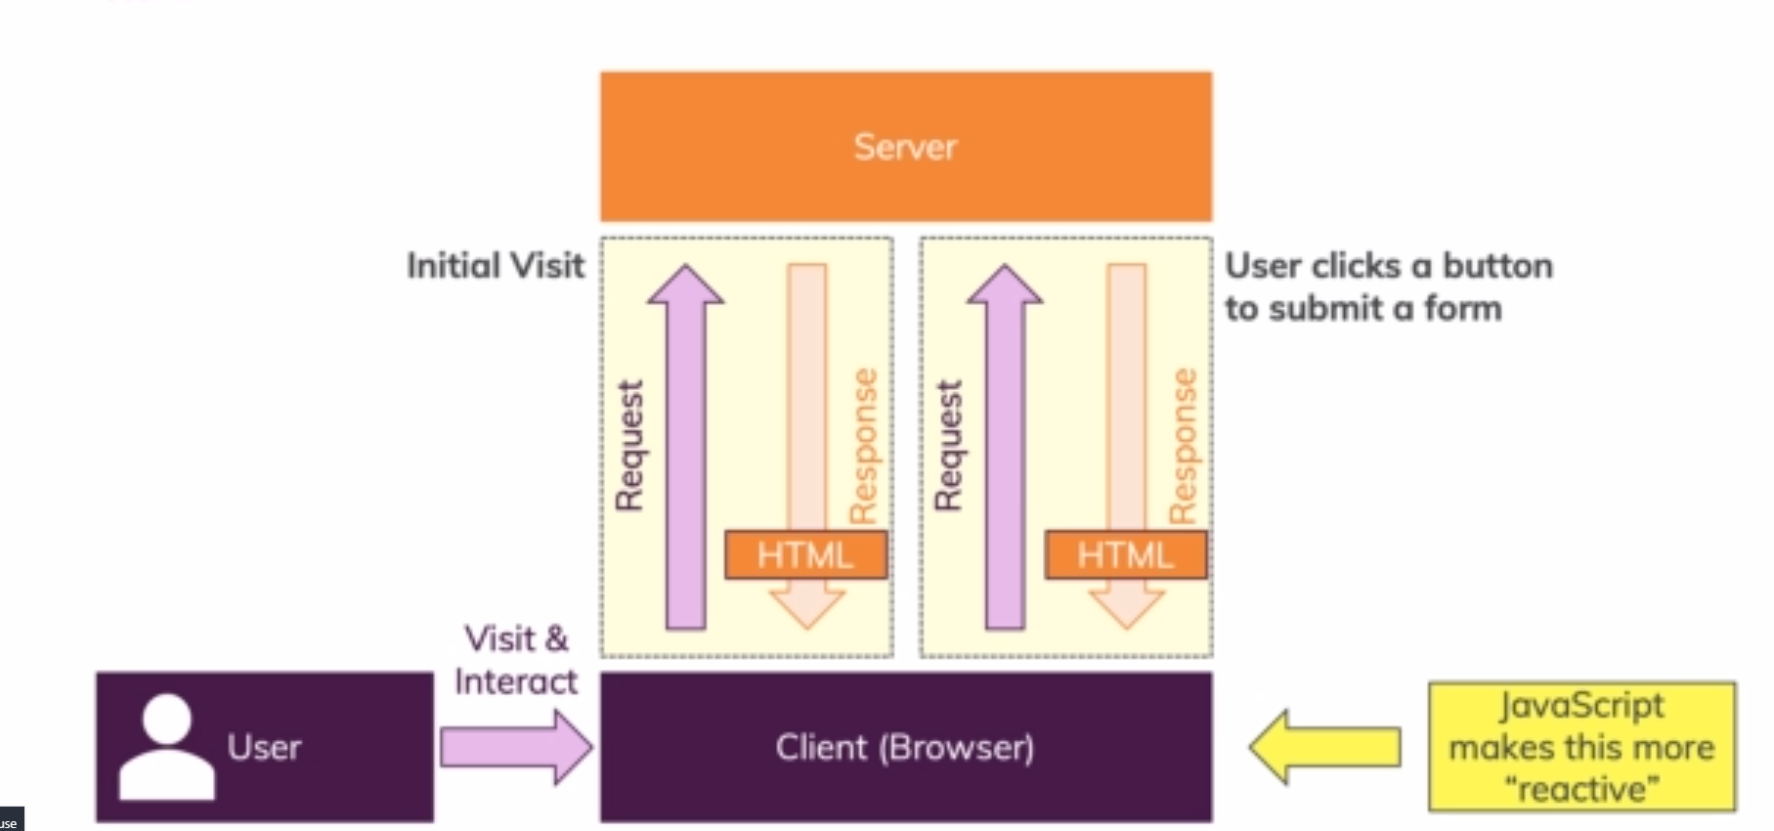
How Do Webpages work?

Slide 5
What is Java Script
JS
Interpreted, on the fly
Dynamic, Weakly Typed Programming language
“Hosted Language” :Runs in different Environments ike in web browser
Most prominent Use Case: Run code in a browser(On a webpage)

Slide 6
How is JavaScript Executed? (Interpreted, on the fly)
<Your Code>
JavaScript Engine
Parse Code
Built into The Browser
Compile To Machine Code
V8 (Chrome)
SpiderMonkey (Firefox)
Execute Machine Code
NashHorn Java 8
On A Single Thread
Effect On A Webpage
Notes:
So How is js code executed in our browser or typically in any environment
Lets say we have a js code and we want it to have an effect on a webpage when we run our script
Then we have an important thing built into any environment capable of running js code ie a js engine
It is built into the browser
For example v8 in chrome
Spidermonkey in Mozilla
And NashHorn in jdk 8 although deprecated in jdk 14 .
Other browsers often re-use these engines or even have there own engines
Now the job of js engine is
To parse the code compile it to machine code which runs faster
Execute the code then we can see an effect on our webpage
Modern Engines have a lot of optimizations they might start running the uncompiled code and then dynamically shift to compiled code and so on.
All of this happens in a single thread .Js code execution runs in one thread only.

Slide 7
Dynamic ? Weakly Typed?
Dynamically Interpreted Programming Language
Weakly Typed Programming Language
Not pre-compiled instead it is parsed and compiled “On the Fly” (e.g. in a browser)
Data Types are assumed or inferred dynamically
Code Evaluated and Executed at Runtime
You don’t have to tell Java script that some variable has to hold a certain value (e.g. a number)
Code can change at Runtime (e.g. type of a variable)
Data Types are not hard bound they can change

Slide 8
Java Script Runs On A Host Environment
Browser-side
“Other” (e.g. Server -side)
JavaScript was invented to create more dynamic websites by executing in the browser
Google’s JavaScript engine (V8) was extracted to run JavaScript anywhere called “Node.Js”
JavaScript can manipulate the HTML code, CSS ,send background Http requests & much more
Node.js can be executed on any machine and is therefore often used to build web backends (server-side -javascripts)
JavaScript cant access the local file system ,interact with Operating system etc.
Nodejs can access file system ,interact with operating system etc. It can’t manipulate HTML or css
Notes:
The capabilities are inverse between js and Node js

Slide 9
A brief Overview of JS History
1995
Netscape Introduces “LiveScript” / “JavaScript”
1996
Microsoft releases its own version for IE
Late 1996
JavaScript submitted to ECMA International to start standardization
1997 - 2005
Standardization efforts<Microsoft didn’t join the Standardization but supported the standardized version in IE.
2006-2011
Huge Progress in JS ecosystem. Microsoft eventually joined forces.

Slide 10
JavaScript and ECMAScript
Implemented By Browser Vendors
ECMAScript
JavaScript
ECMA is a standard organization that evolves the ECMAScript language
The most famous ECMAScript implementation other implementations are “ActionScript” or “JScript”
ECMAScript isint directly used but browser vendors(Gooogle,Mozilla,Opera etc) implement the standards into js engines
Each browser comes with its own JS engine that also defines which features are actually supported
Under Active development
Under Active development year 2015-2016 saw some paradigm shifts in the new versions
Notes:
European Computer Manufacturer's Association
Browsers can choose to support or not support a certain feature or may support a feature even though it might still be under discussion at ECMA.

Slide 11
Section 2 – Basics: Variables, Data Types, Operators & Functions

Slide 12
Two ways to use js
Inline
Make use of <script></script> tags and write js code in between.for example <script>console.log(“hello world”);</script>
Imported
Write js code in a separate .js file and import it again make use of <script> tag use the attribute type=“text/javascript” and src=“js/main.js” for example : <script type=“text/javascript” and src=“js/main.js”> </script> and simply write console.log(“hiiiii”) in main.js file and place it in js folder.

Slide 13
JS Variables
Variable is a data container whose value can change
Variables can be declared in js using the var keyword.
var Rudhra = ‘Rudhra’; //String
var isTrue = false; //Boolean
var number = 10 ;
var array = [56, ‘Tam Tam’,true, isTrue]; //Array
var object = {
name: ‘Rudhra’,
LastName: ‘Koul’
} //Array

Slide 14
JS Variables ES6
Variables can be declared in latest js versons using the let keyword.
let Rudhra = ‘Rudhra’; //String
let isTrue = false; //Boolean
let number = 10 ;
let array = [56, ‘Tam Tam’,true, isTrue]; //Array
let object = {
name: ‘Rudhra’,
LastName: ‘Koul’
` } //Array

Slide 15
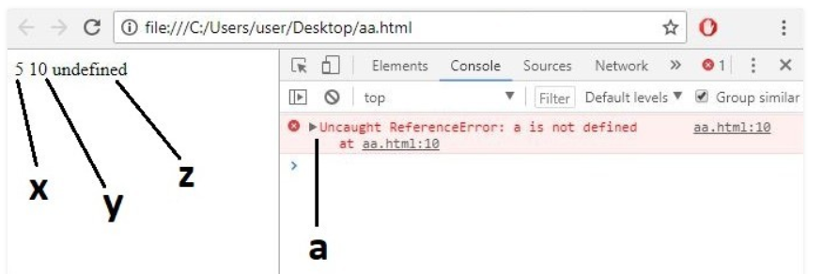
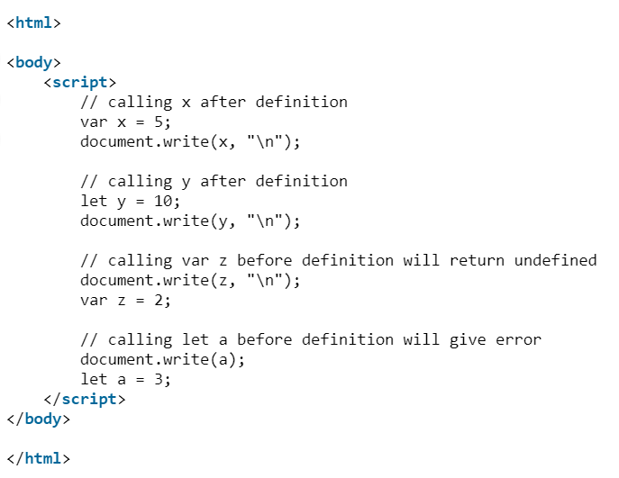
Difference between Let and Var
var and let are both used for variable declaration in javascript but the main difference between them is that var is function scoped and let is block scoped.
It can be said that a variable declared with var is defined throughout the program as compared to let.
ECMAScript 6 introduced let.

Slide 16
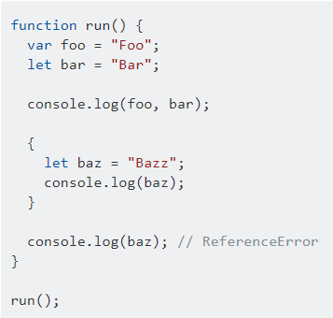
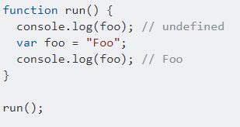
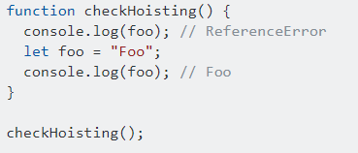
Difference between Let and Var
Scoping rules
Variables declared by var keyword are scoped to the immediate function body (hence the function scope) while let variables are scoped to the immediate enclosing block denoted by { } (hence the block scope).
Hoisting
Variables declared with var keyword are hoisted (initialized with undefined before the code is run) which means they are accessible in their enclosing scope even before they are declared.
let variables are not initialized until their definition is evaluated. Accessing them before the initialization results in a ReferenceError. Variable said to be in "temporal dead zone" from the start of the block until the initialization is processed.

Slide 17
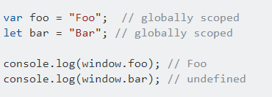
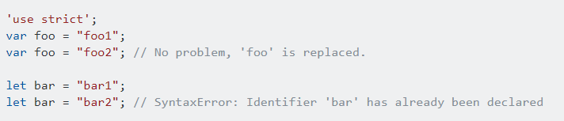
Difference between Let and Var Cont…
Creating global object property
At the top level, let, unlike var, does not create a property on the global object:At the top level, let, unlike var, does not create a property on the global object
Redeclaration
In strict mode, var will let you re-declare the same variable in the same scope while let raises a SyntaxError.

Slide 18
JS Variables ES6 – Variable Naming
Allowed
Not Allowed /Not Recomended
let userName
Best Practice:
camelCase
let user_name
Allowed but Bad Practice:
snake-case
let ageGroup5
Only letters and digits allowed
let 21Players
Starting digits not allowed
let $kindOfSpecial
Starting with $ is also allowed
let user-b
No special characters
let _internalValue
Starting with _ is allowed
let let
Keywords not allowed

Slide 19
Defining constants using Const keyword
Constants are similar to variables i.e. they are used to hold data but the only difference is that the data can’t be changed.
Once declared the value of the constant cant change
Syntax:
const numOfUsers=22;

Slide 20
Data Types :Numbers ,Strings, Boolean
Numbers
2,-2,2.356
Strings (Text)
‘Hi’ , `HI`, “HI”
Boolean
true ,false

Slide 21
Strings
Strings can be declared with either ‘’(single quotes), “”(double quotes) or ``(backticks).
We should stay with one of them and maintain consistency.
We cannot mix them ie we cant open a string with a double quote (”) and try to close it with a single quote (‘).
If we want to output a single quote(‘) we can do so by creating the string with double quotes(“”).
We can also use \ to escape a character so if we use “hiii I am \’ abcd\’ ” this will print the single quotes .
Using backticks gives us access to a special syntax we can print the result of an expression or a variable using ${expression/variable} inside our string.
This syntax ie using `` backticks is called a template literal.
It can be used to create a string with multiple lines or indentation.
We can also achieve this using the escape character \ .To insert a line break we can use \n and so on.
We can use the + operator for string concatenation.

Slide 22
Operators
+
used for addition and String concatenation
!
Inverting a check
-
used for subtraction
>
greater than
*
used for multiplication
>=
greater than equalto
/
used for division
<
less than
%
used for finding remainder
<=
less than equal to
**
exponentiation ex 2**3=8
&&
logical and
=
Assigning a value
||
logical or
==
equality check on the basis of value
? :
Ternary operator
===
equality check on the basis of value and type

Slide 23
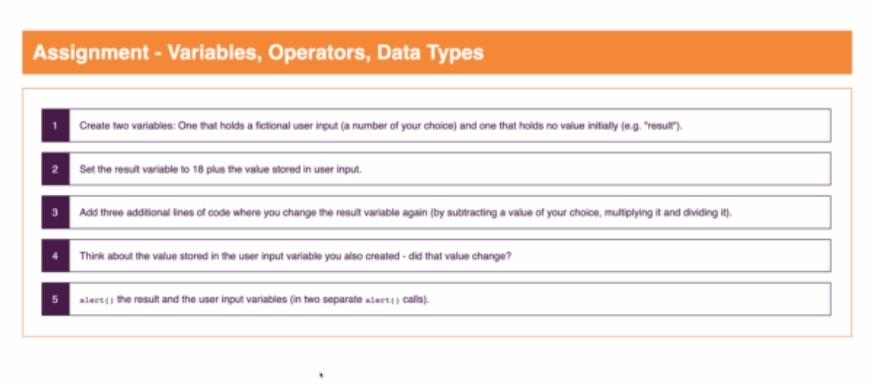
Variables and Data Types Assignment 0

Slide 24
If Condition
Syntax :
If(//condition to check) {
//Code to execute if condition is true
} else if (//condition to check) {
//Code to execute if condition is true
}
else{
//Code to execute if both the above conditions are false
}
var username=‘Rudhra’;
If(username){
Console.log(‘username has a value’);
}
else{
Console.log(‘username is empty’)
}

Slide 25
Switch
Syntax :
switch (//variable to check) {
case //value to check:
//code to execute
break;
case //value to check:
//code to execute
break;
default:
//code to execute
break;
}

Slide 26
For Loop
for(start; end condition; counter incrementer/Decrementer;){
//loop body
}
for(start; end condition; counter incrementer/Decrementer;){
If(//some condition){
//some code
break;
}
//some code
}
for(start; end condition; counter incrementer/Decrementer;){
If(//some condition){
//some code
continue;
}
//some code
}

Slide 27
While Loop
while(//termination condition){
//loop body
//increment/decrement counter to eventually reach termination condition
}

Slide 28
functions
Syntax for declaration
function functionName (//0 or more Parameters) {
//function body
// optional return
}
Syntax for Invoking
functionName(//Arguments);
functionName();
var result=functionName();
var result= functionName(//Arguments);

Slide 29
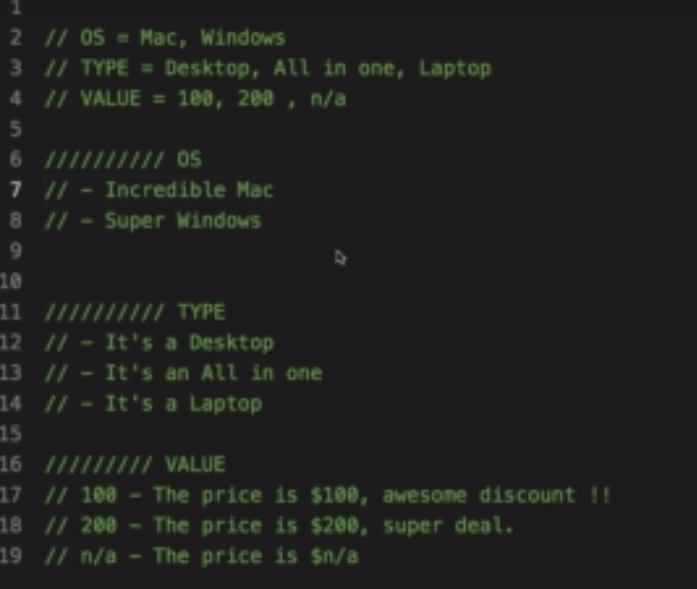
Exercise 1

Slide 30
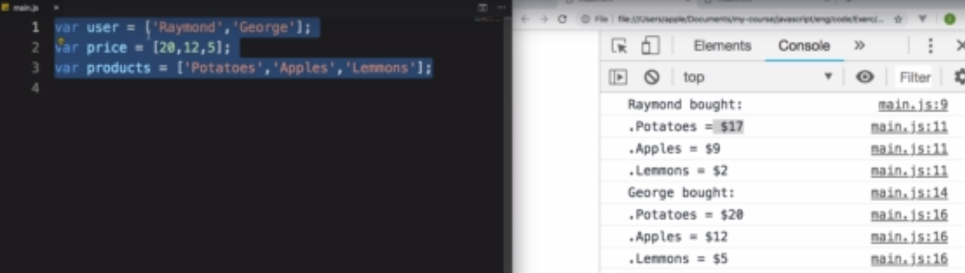
Exercise 2

Slide 31
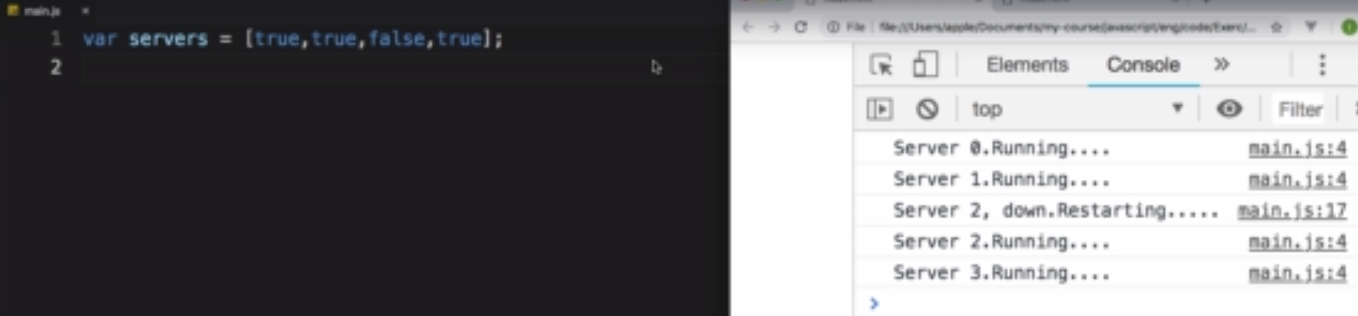
Exercise 3

Slide 32
Section 3 – The DOM

Slide 33
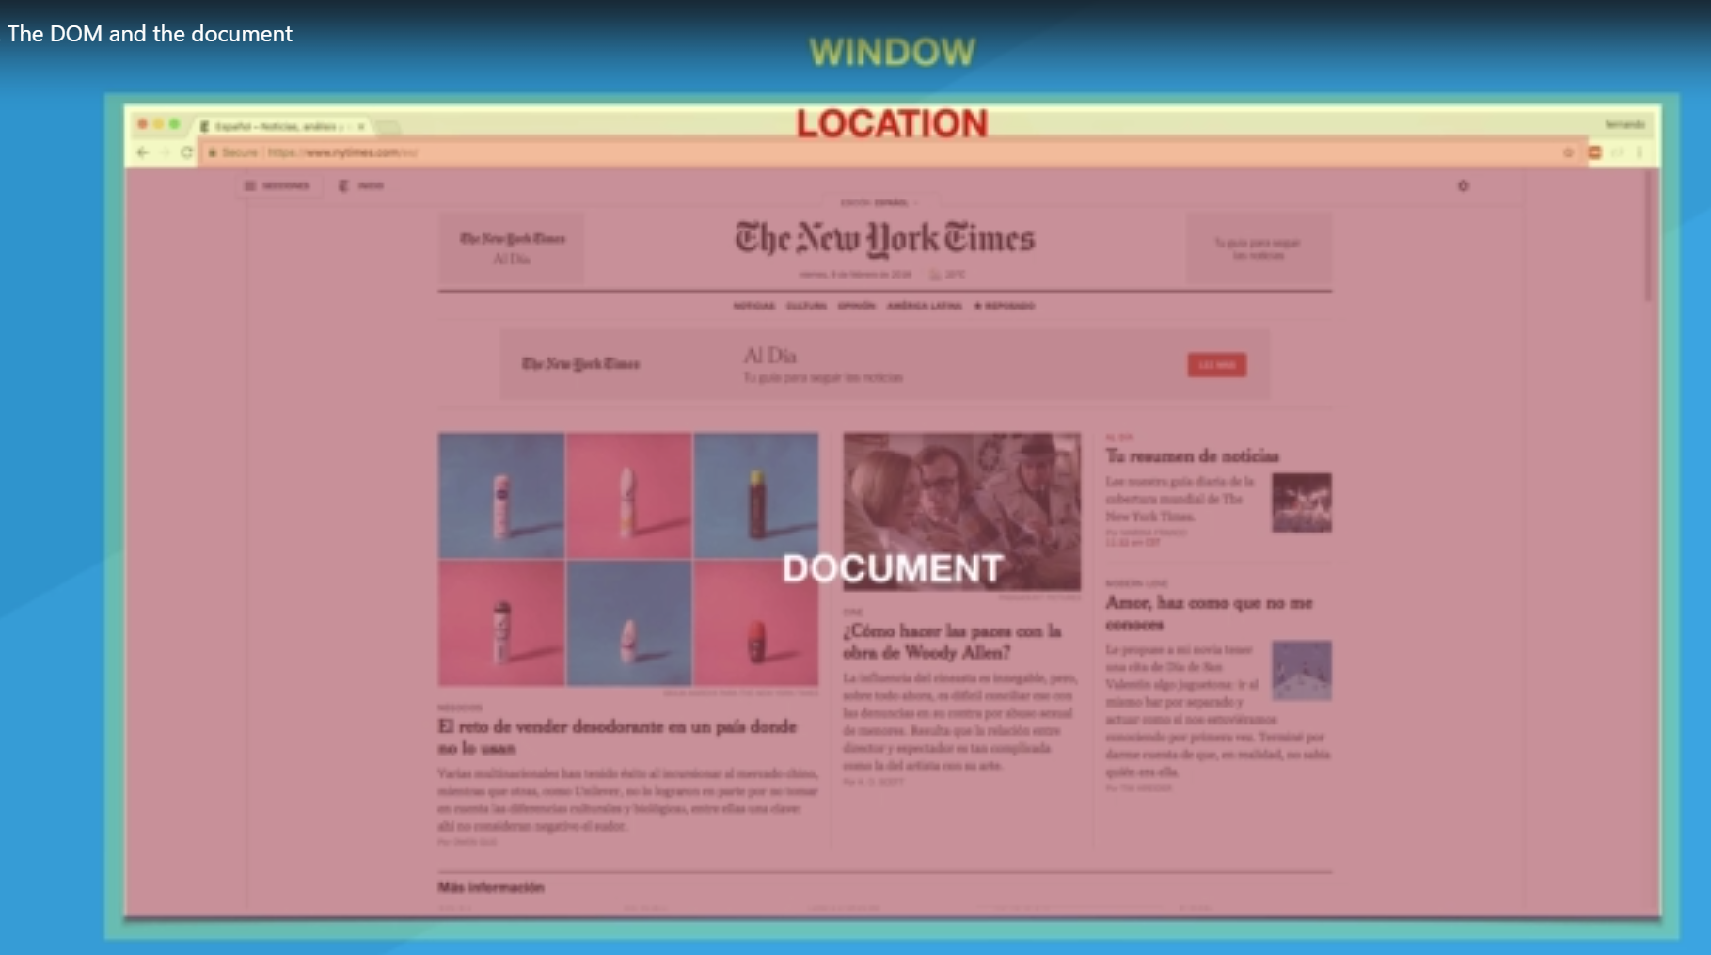
DOM –Document Object Model

Slide 34
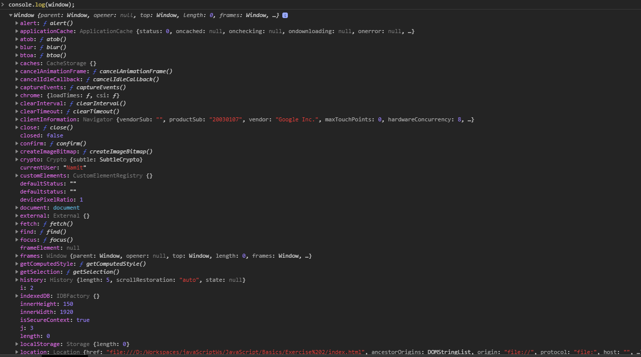
Dom-Window

Slide 35
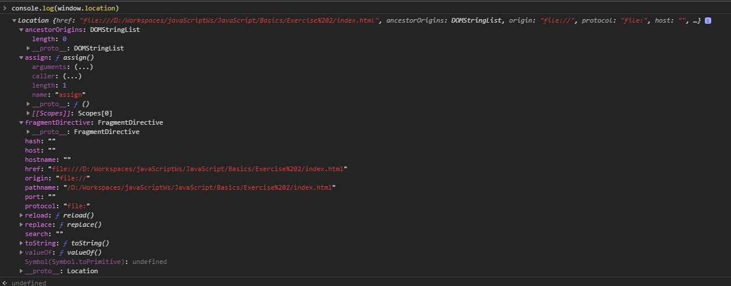
Dom-Location

Slide 36
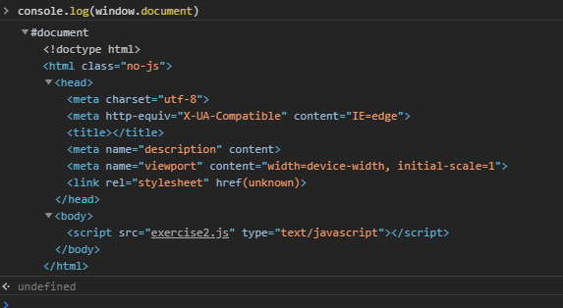
Dom-Document

Slide 37
Dom-Selecting DOM elements
Selecting dom elements by id ,tag name or class name :
Syntax Selecting by Tag Name
document.getElementsByTagName(//Tag Name);
Syntax Selecting by Class Name
document.getElementsByClassName(//Class Name);
Syntax Selecting by Id
document.getElementById(//Id);
Selecting dom elements using querySelector and querySelectorAll
Syntax Selecting using query Selctor by Tag Name
document.getquerySelector(//Tag Name);
document.getquerySelectorAll(//Tag Name);
Syntax Selecting using query Selctor by Class Name
document.getquerySelector(//.ClassName);
document.getquerySelectorAll (//.ClassName);
Syntax Selecting using query Selctor by Id
document.getquerySelector(//#ID);
document.getquerySelectorAll(//#ID);

Slide 38
Dom-Creating and Inserting DOM elements
create dom elements :
To create a new dom element we need to host it in memory by saving it in a var.
Syntax creating a new dom element
var div =document.createElement(‘div’);
We can set attributes styles etc to this element by accesing the required property with.
For example
div.textContent=‘Some content’;
div.style.color=‘red’;

Slide 39
Dom-Document

