Slide 1
Java Collections
By: Rudhra Koul

Slide 2
Arrays VS Collections
An array is an indexed collection of homogeneous data of a fixed length.
Features Of Array:
The main Advantage of arrays is that we can represent multiple values with a single variable.
Arrays are fixed in size :
Arrays can hold only homogeneous data elements ,this can be solved to some extent by using Object[].
Arrays concept is not based on some standard data structure so readymade methods are not available and we need to write a logic for everything like searching , sorting etc.
It is recommended to use arrays as they are faster in performance.
Memory wise arrays are not recommended if we are not sure about how many objects will be there exactly it can cause memory wastage.
Arrays can be created for both primitives as well as Objects

Slide 3
Arrays VS Collections Cont…
Collections
Collections are growable in nature
Collections can store Homogeneous as well as Heterogeneous data.
Collections are implementations of standard data structures and thus have common functionality already available as methods reducing coding effort.
It is recommended to use Collections for better memory management
It is not recommended to use collections with respect to performance.
Collection can be created for only Objects not primitive types.

Slide 4
Collection VS Collections Cont…
Sno | Collection | Collections
1 | It is an Interface | It is a class.
2 | It is used to represent a group of objects. | It is a utility class that has helper methods for use with different type of collections.for example Collections.sort(…);

Slide 5
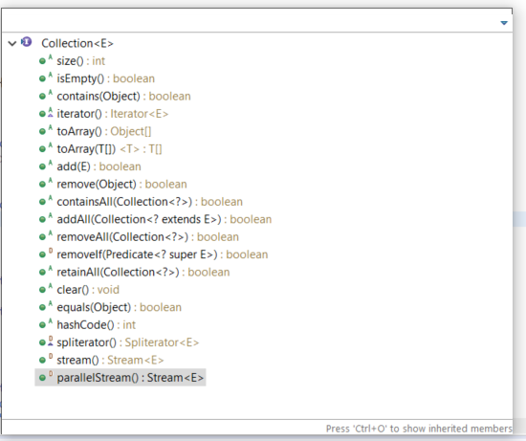
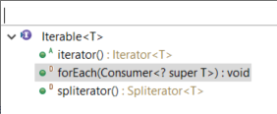
9 key Interfaces of Collections Framework
1. Collection:
Used to represent a group of objects as a single entity.
Contains common methods available in all type of collections.
It is in general considered as root Interface of collections framework(Although it has a parent Iterable which is an interface used to make any class compatible for use with for-each loop.)
There is no Concrete class that directly implements Collection.
Methods in collection interface:
Methods in Iterable:

Slide 6
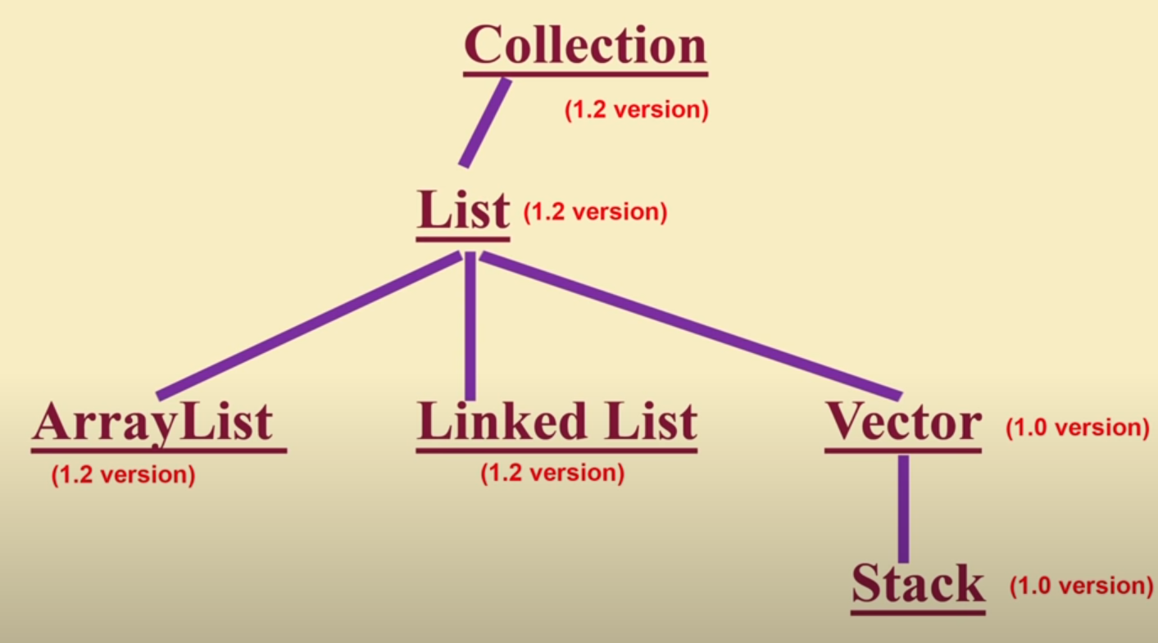
9 key Interfaces of Collections Framework
2. List :
List is a child interface of collection.
If we want to represent a group of indivisual Objects as a single entity where duplicates are allowed and insertion order is maintained we should go for List
Hierarchy of List Interface:
Vector and Stack classes came in jdk1.0 but were re-engineered to implement list interface in jdk1.2 .
ArrayList, LinkedList, Vector and Stack are concrete implementations of List interface.

Slide 7
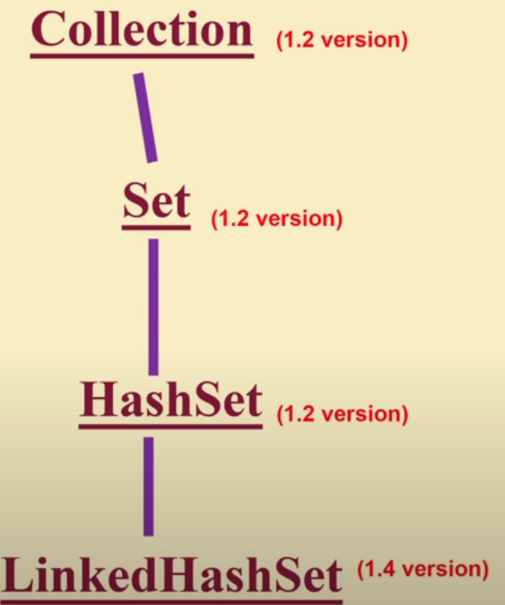
9 key Interfaces of Collections Framework
3. Set :
Set is a child interface of collection.
If we want to represent a group of individual Objects as a single entity where duplicates are not allowed and insertion order is not preserved we should go for Set.
Hierarchy of Set Interface:
Set and HashSet came in jdk1.2 and LinkedHashSet came in jdk 1.4 version
HashSet and LinkedHashSet atr concrete implementations of Set interface.

Slide 8
List VS Set
Sno | List | Set
1 | Duplicates are allowed | Duplicates are not allowed
2 | Insertion order is preserved | Insertion order is not preserved.

Slide 9
9 key Interfaces of Collections Framework
3. SortedSet :
SortedSet is a child interface of Set interface.
If we want to represent a group of individual Objects as a single entity where duplicates are not allowed and elements are inserted as per a sorting order we can go for a SortedSet .
Set and SortedSet came in jdk1.2.
Set and Sorted set both are interfaces.
4. NavigableSet :
NavigableSet is a child interface of SortedSet interface.
It is similar to Sorted set but defines some additional methods helpful in navigating/traversing the set
Set and SortedSet ,Treeset came in jdk1.2
NavigableSet came in jdk 1.6 version and TreeSet class was re-engineered to implement NavigableSet.
Set , SortedSet , NavigableSet are interfaces
TreeSet is a concrete implementation od NavigableSet.

Slide 10
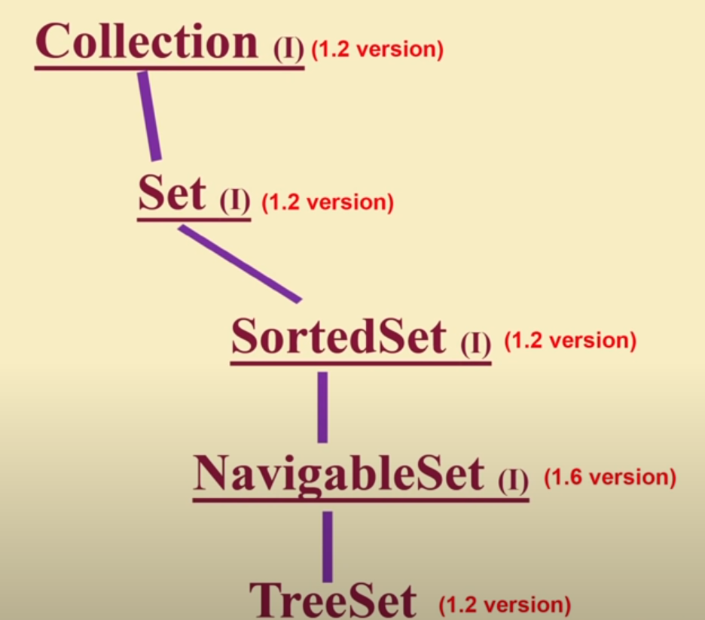
9 key Interfaces of Collections Framework
Hierarchy of SortedSet , NavigabeSet and TreeSet

Slide 11
9 key Interfaces of Collections Framework
6. Queue :
Queue is a child interface of collection.
If we want to represent a group of individual Objects prior to some processing which will be extracted in FIFO order we should go for Queue. For example if we need to store some 1000 mail ids and send emails to them in a particular order we can use a Queue.
Queue is implemented directly by PriorityQueue class and extended directly by BlockingQueue Interface.
BlockingQueue is implemented by LinkedBlockingQueue and PriorityBlockingQueue classes.
All Queue related interfaces and classes were added in jdk 1.5 version.

Slide 12
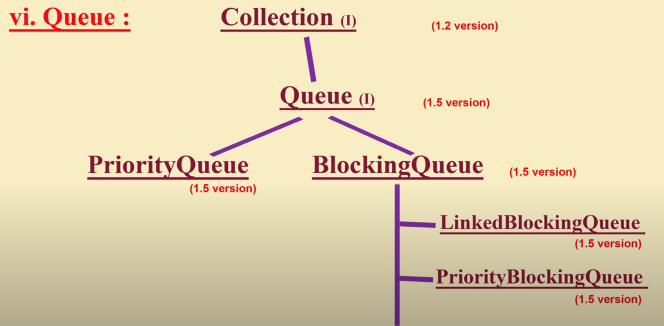
9 key Interfaces of Collections Framework
Hierarchy of Queue

Slide 13
9 key Interfaces of Collections Framework
7. Map :
All the interfaces discussed in previous slides(Collection , List , Set , SortedSet , NavigableSet and Queue) are all meant for representing a group of individual objects.
If we want to represent a group of Objects as key value pairs then we should use Map.
Map is not a child of Collection interface.
Both key and value are Objects.
Duplicate keys are not allowed but duplicate values are allowed.
Map interface is implemented directly by HashMap , WeakHashMap , IdentityHashMap and Hashtable classes.
HashMap is extended by LinkedHashMap class.
Map ,HashMap and WeakHashMap were Introduced in jdk1.2 version.
LinkedHashMap and IdentityHashMap were Introduced in jdk1.4 version.
Hashtable was introduced in jdk1.0 version as an concrete implementation of abstract class Dictionary . Hashtable is extended by Properties class.
HashTable was re-engineered in jdk1.4 version to implement Map interface although it still extends the abstract class Dictionary.

Slide 14
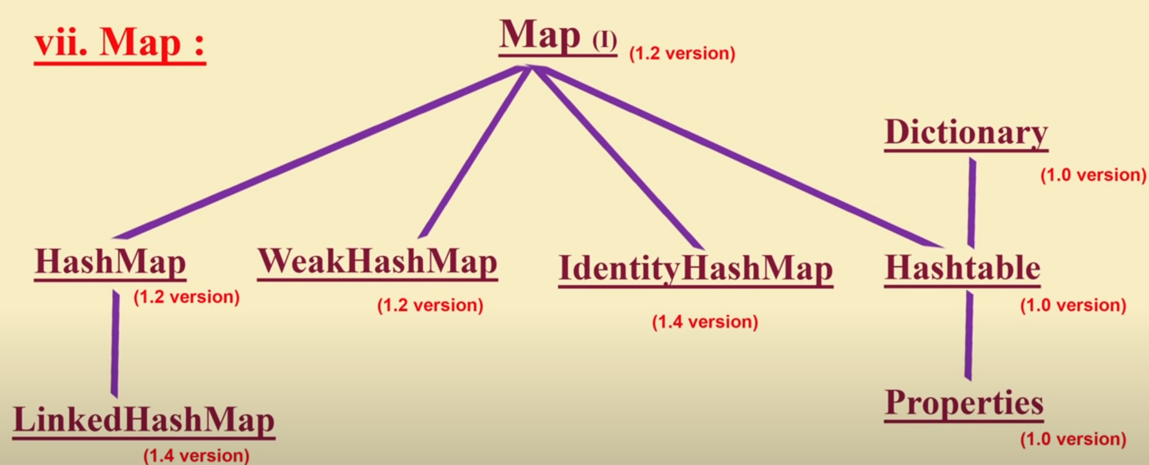
9 key Interfaces of Collections Framework
Hierarchy of Map

Slide 15
9 key Interfaces of Collections Framework
8. SortedMap :
SortedMap is a child interface of Map interface.
If we want to represent a group of Objects as a key value pairs where duplicate keys are not allowed and elements are inserted as per a sorting order on keys we can go for a SortedMap .
Map and SortedMap came in jdk1.2.
Map and SortedMap both are interfaces.
9. NavigableMap :
NavigableMap is a child interface of SortedMap interface.
It is similar to SortedMap but defines some additional methods helpful in navigating/traversing the Map
Map , SortedMap , TreeMap came in jdk1.2
NavigableMap came in jdk 1.6 version and TreeMap class was re-engineered to implement NavigableMap.
Map , SortedMap , NavigableMap are interfaces.
TreeMap is a concrete implementation od NavigableMap.

Slide 16
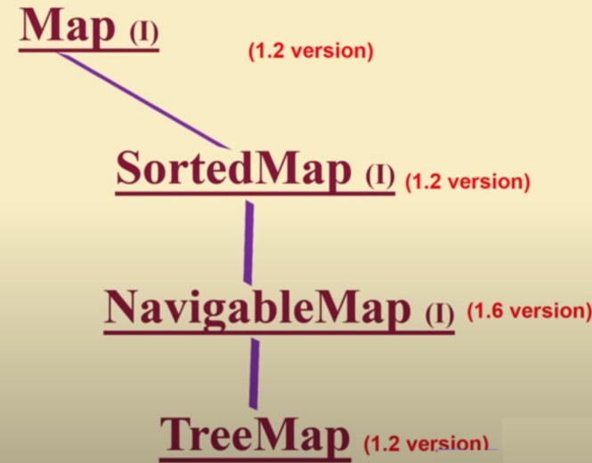
9 key Interfaces of Collections Framework
Hierarchy of SortedMap , NavigabeMap and TreeMap

Slide 17
Collection Framework
Collections framework consists of the 9 interfaces and its corresponding implementation classes and sub interfaces mentioned in previous slides
It also contains two Interfaces which are used for sorting of Collections which are:
Comparable : Provides default Natural sorting order to the classes
Comparator: Used to provide custom Sorting order for Collections.
To navigate the Collections we need to user Cursors java has three cursors which are:
Enumeration
Iterator
ListIterator
Collections framework also Contains two Utility classes which are :
Collections : Contains helper methods for Collections
Arrays: Contains helper methods for Arrays.

Slide 18
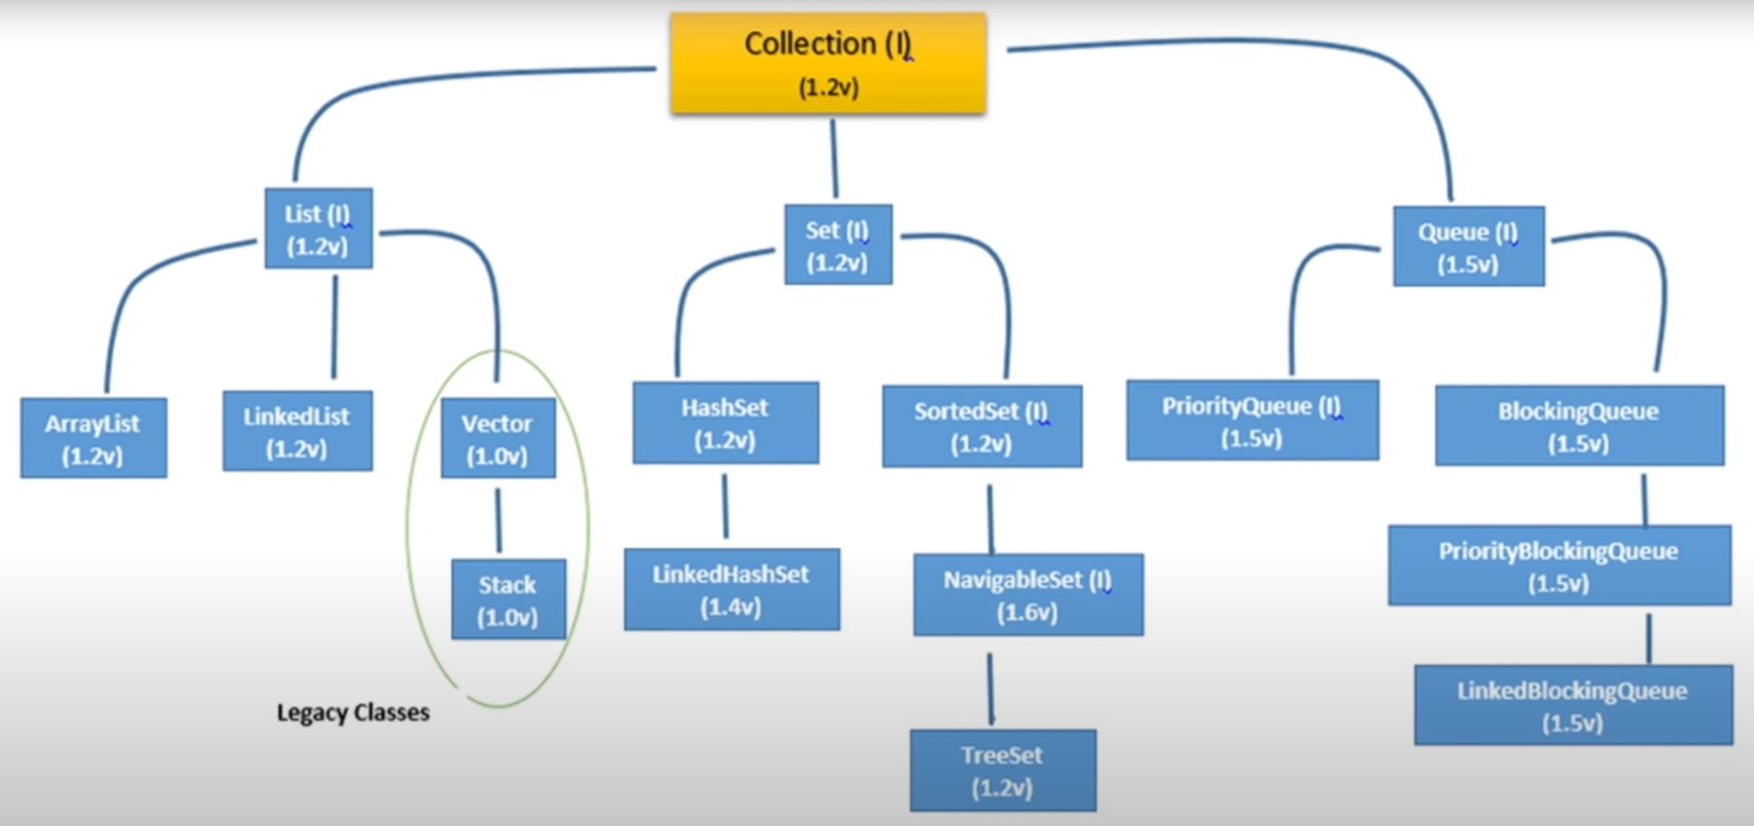
Collection Framework Cont …
Collection Interface Complete Hierarchy

Slide 19
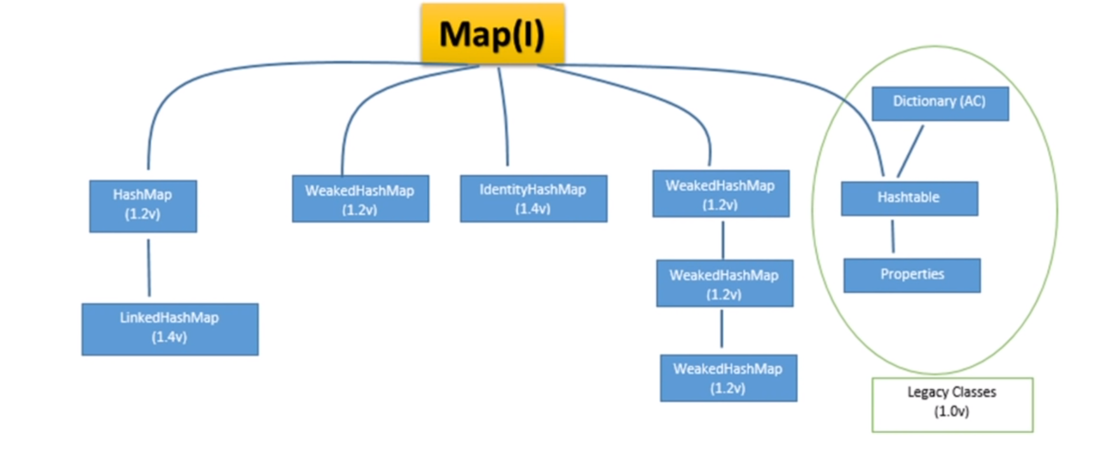
Collection Framework Cont …
Map Interface Complete Hierarchy

Slide 20
Collection Framework Cont …
Sorting , Cursors and Utility classes in Collection Framework
Sorting
Comparable
Comparator
Cursors
Enumeration
Iterator
ListIterator
Utilities
Collections
Arrays

Slide 21
Thanks!!!!!

