Slide 1

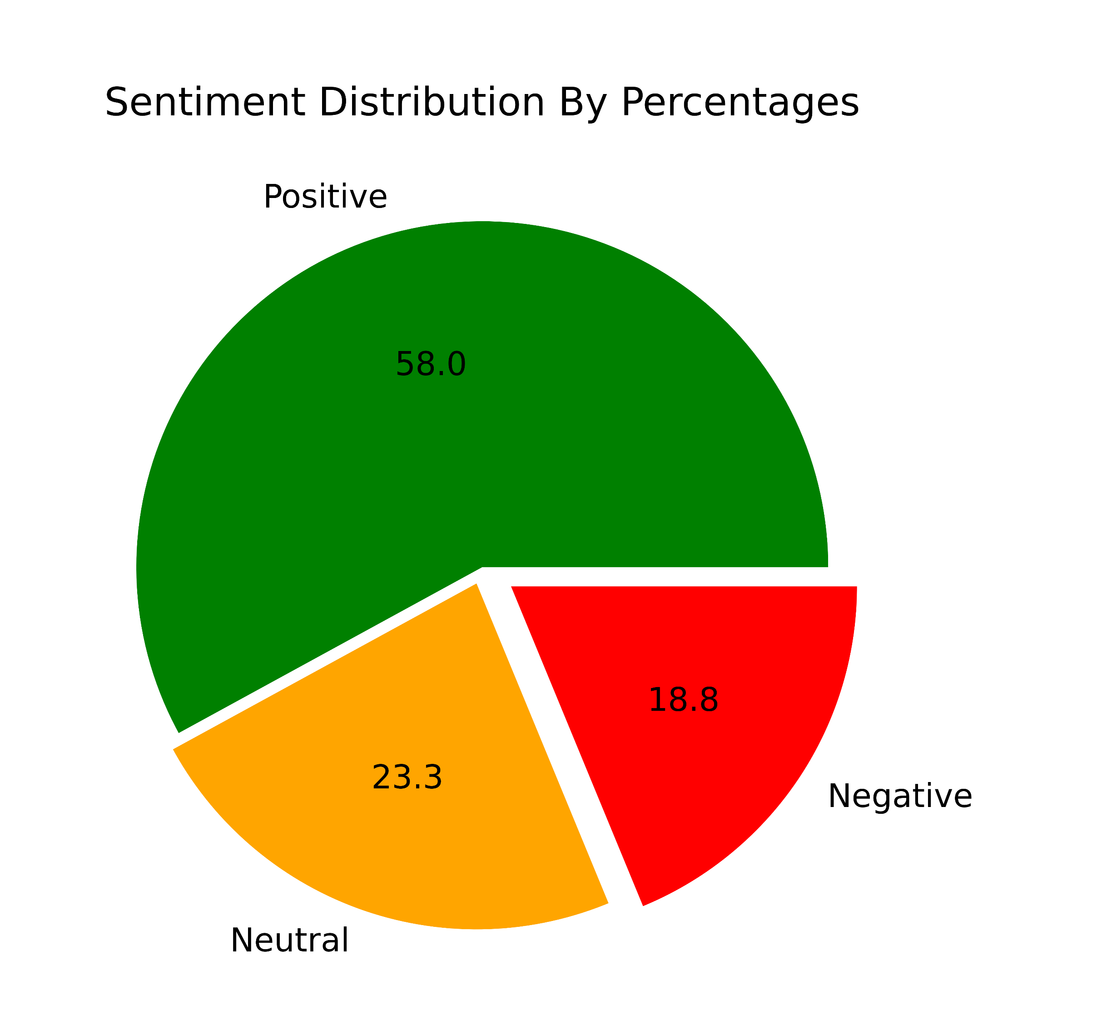
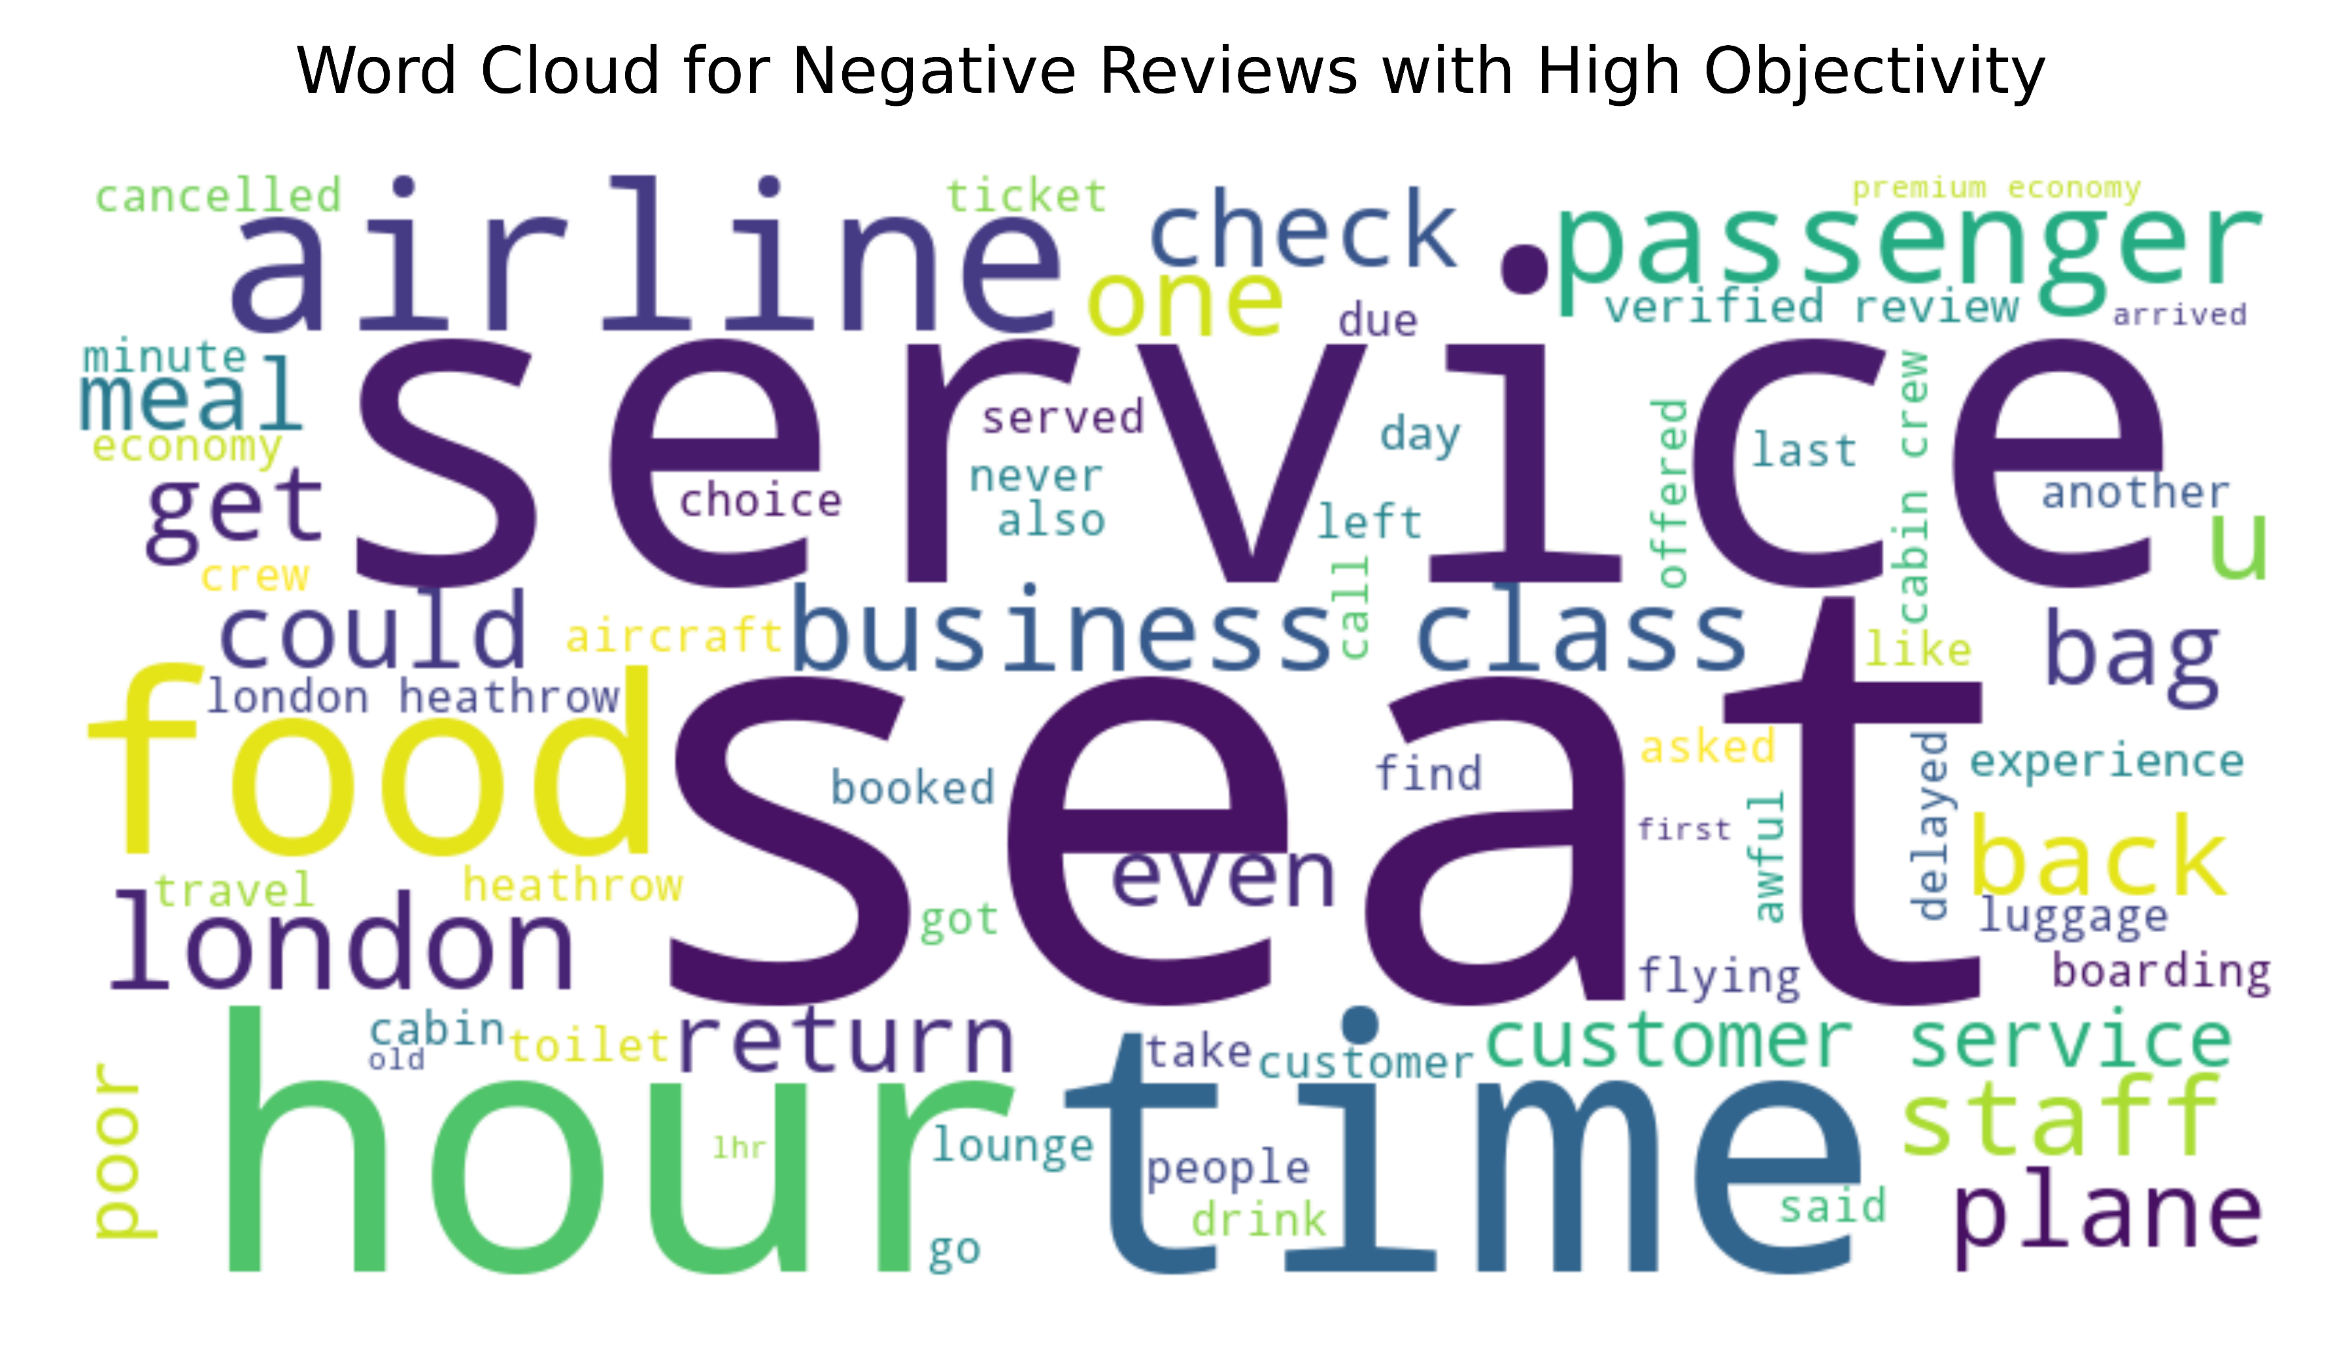
CUSTOMER REVIEW SENTIMENT ANALYSIS & TEXT MINING USING PYTHON NLTK
After scraping the customer review data and analysing the sentiment polarities of those reviews, it has come to light that 27% of those reviews are negative and among those negative reviews, the keyword with highest frequencies and insightfulness are as graphically illustrated below

