Slide 1

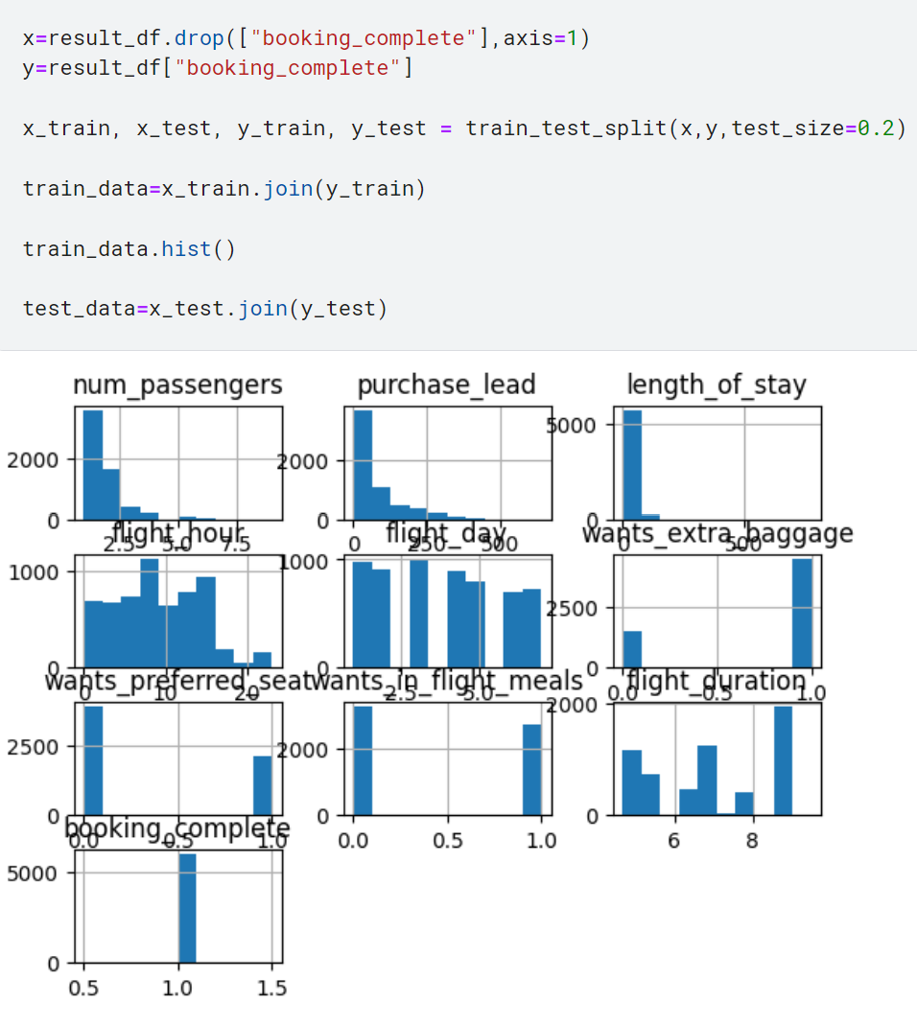
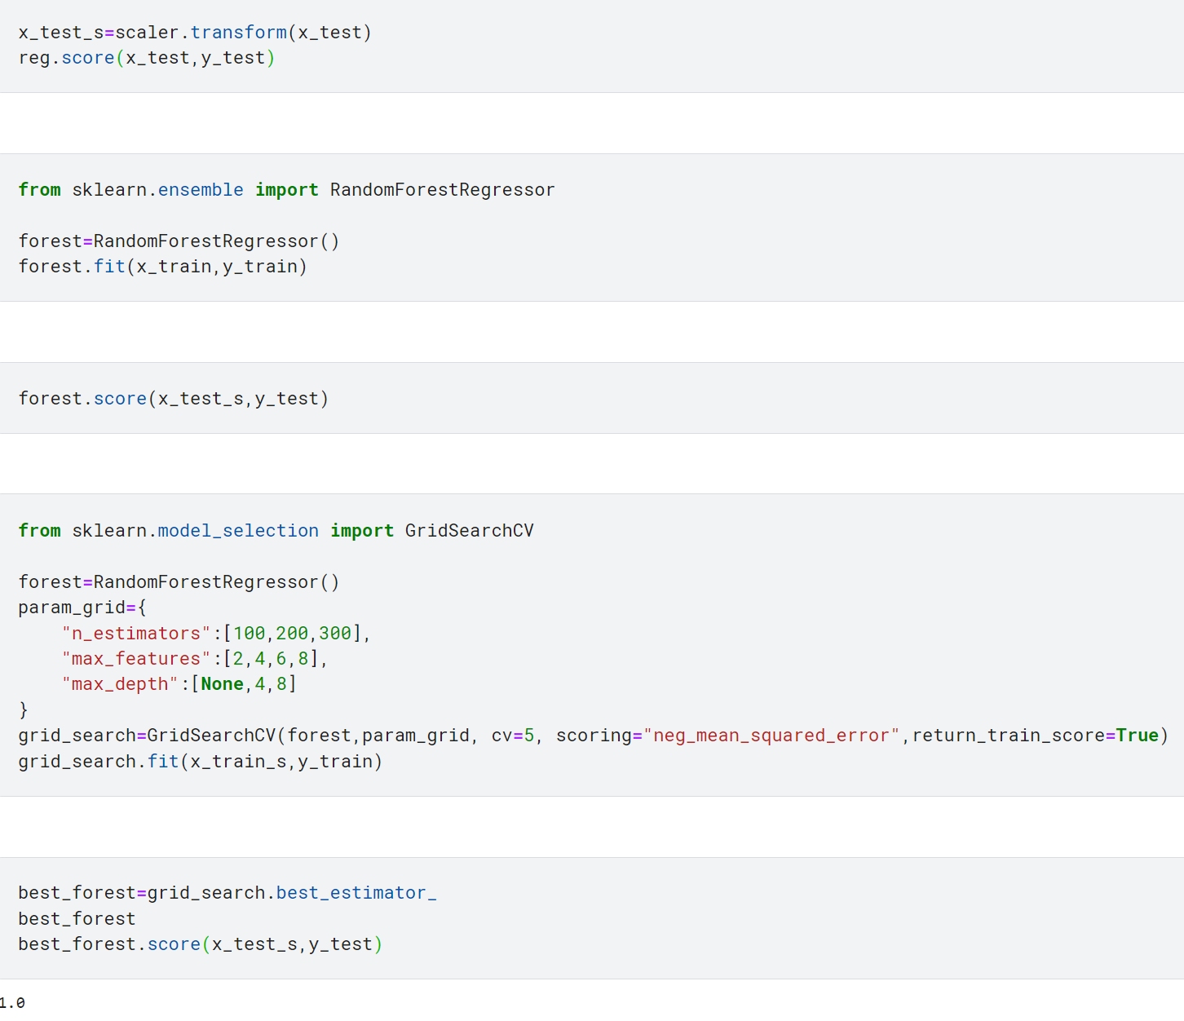
PREDICTIVE MODELLING TRAINING MACHINE LEARNING MODELS WITH SCIKIT LEARN
The machine learning models were trained using SK Learn library and Random Forest Regression

