Slide 1

BUSINESS INTELLIGENCE ANALYSIS
Fukita Corporation
Presented By
RUDI K

Slide 2
CONTENTS
01
02
03
Company Introduction
Aims and Objectives
BI Dashboard
04
05
06
Graphs and Diagrams
Statistics
Conclusion

Slide 3


ABOUT FUKITA CORPORATION
Fukita Corporation was conceived in the year 2002 in the vibrant landscape of China. Our journey is one of innovation, sustainability, and a relentless pursuit of quality that has redefined the bicycle manufacturing landscape globally.
Guided by our esteemed CEO, Ms. Hiroko Tanaka, Fukita Corporation thrives under the leadership of industry veterans. Their dedication to excellence and market intuition has shaped Fukita's success story.
Fukita Corporation proudly holds a commanding 75% market share in China's vibrant bicycle manufacturing sector. Our commitment to anticipating trends and exceeding consumer expectations has solidified our standing as an industry leader.
More than just a bicycle manufacturer, Fukita is the go-to Original Equipment Manufacturer (OEM) for related equipment. Collaborating with strategic partners, we extend our influence across diverse transportation solutions.

Slide 4
Comprehensive Understanding of Fukita Corporation’s Online Sales Performance
AIMS AND OBJECTIVES
Fukita Corporation’s Global Sales Distribution Analysis
Fukita Corporation’s Sales Trends Over Time Analysis
Fukita Corporation’s Customer Demographics Analysis
Fukita Corporation’s Product Performance Analysis

Slide 5
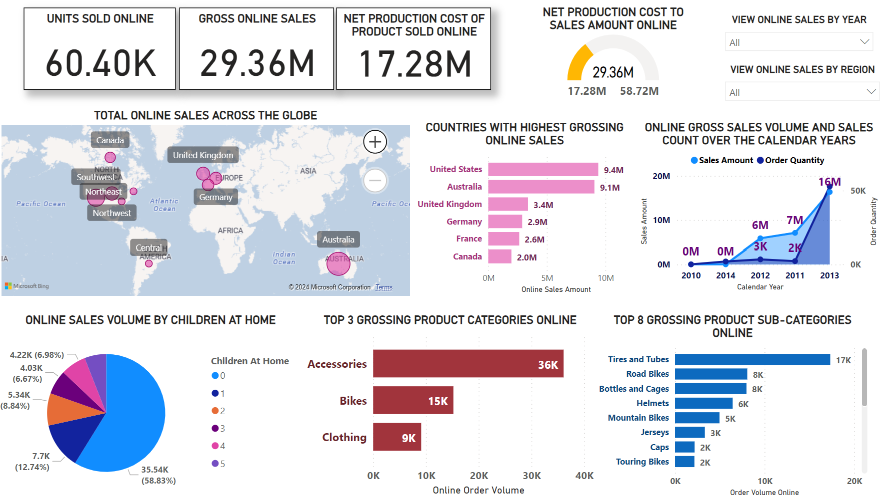
FUKITA CORPORATION ONLINE SALES DASHBOARD

Slide 6
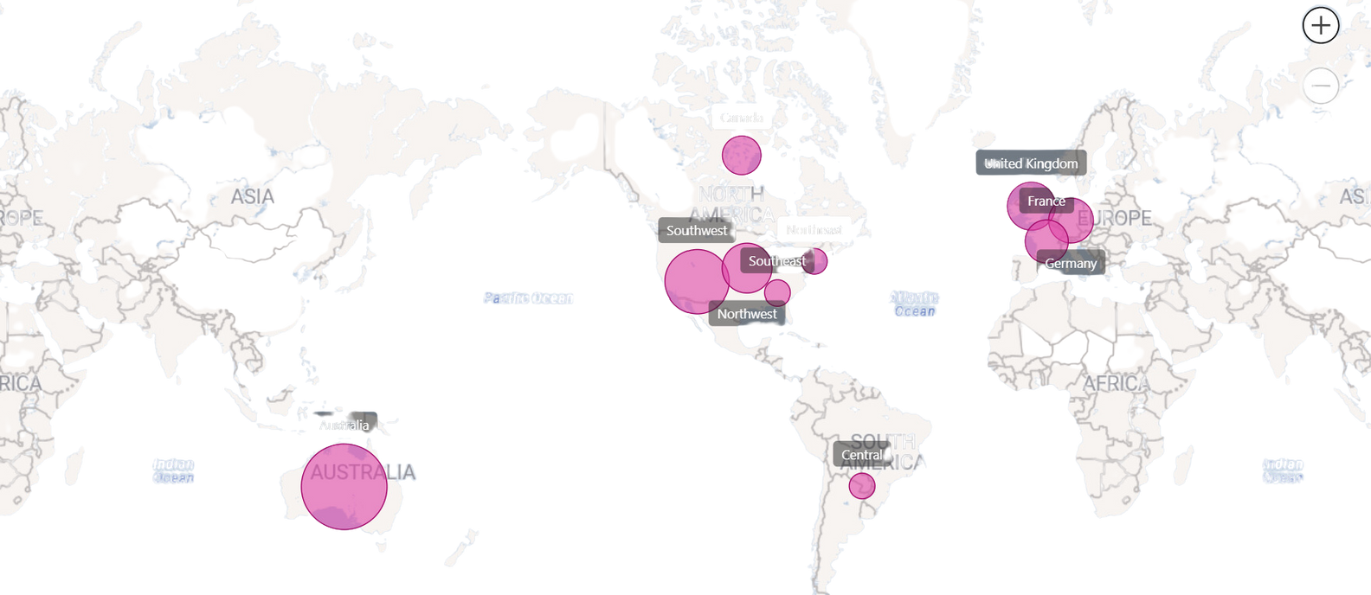
ONLINE SALES ACROSS THE GLOBE

Slide 7
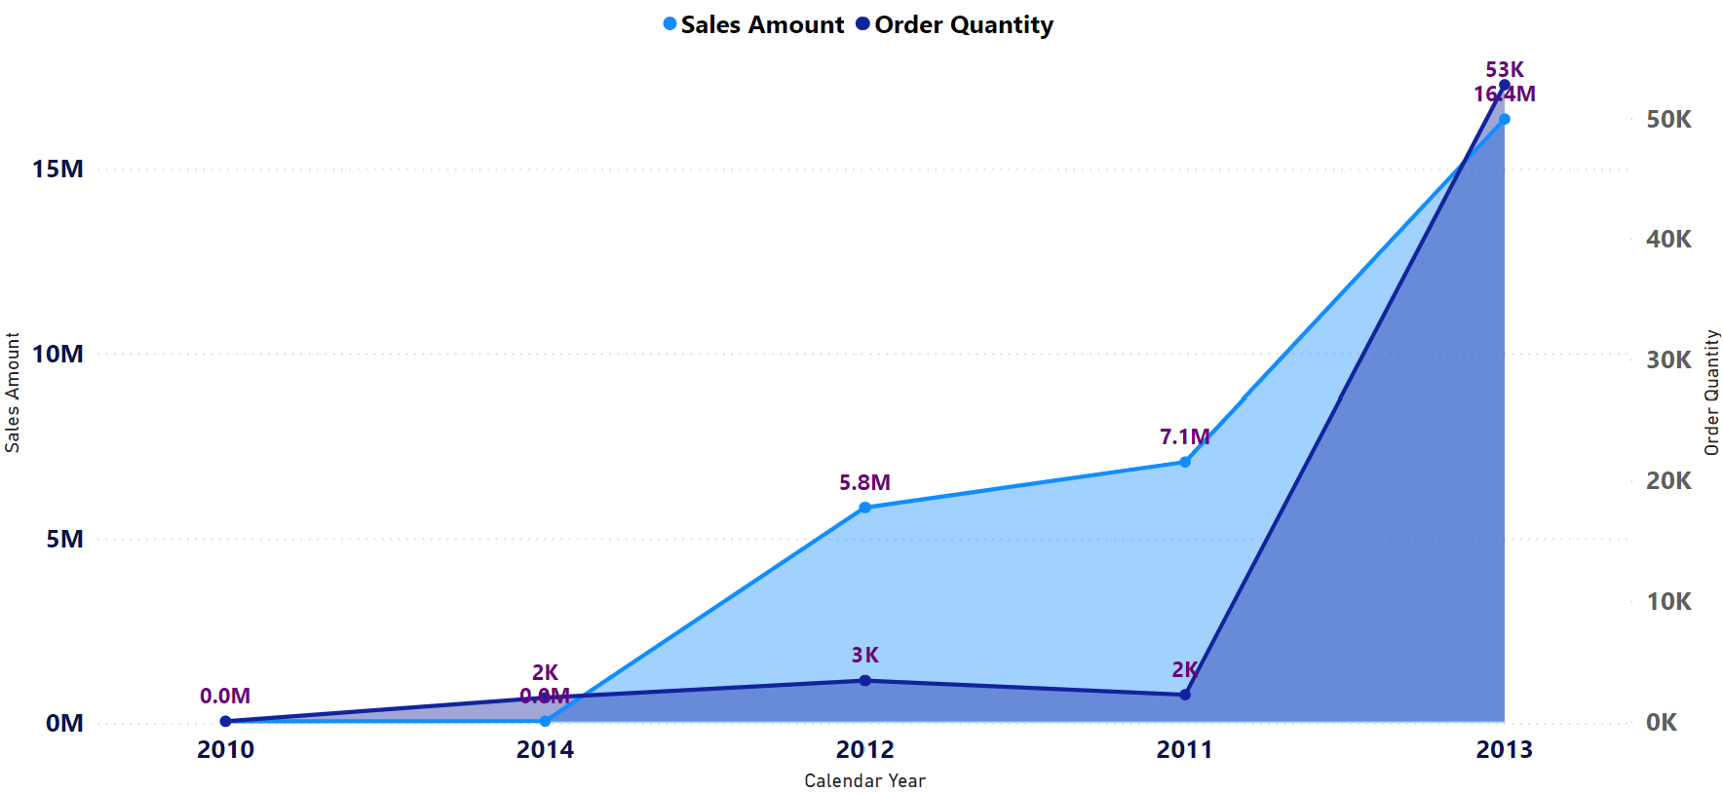
GROSS ONLINE SALES VOLUME AND ORDER QUANTITY OVER THE YEARS

Slide 8
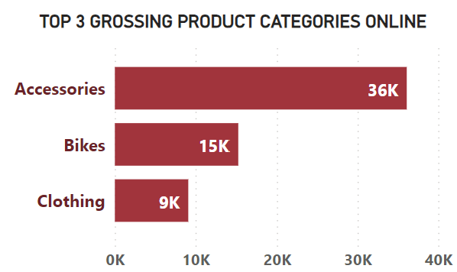
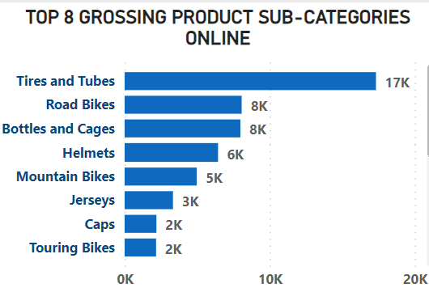
TOP ONLINE GROSSING
PRODUCT CATEGORIES & SUB-CATEGORIES
Aspect Two

Slide 9
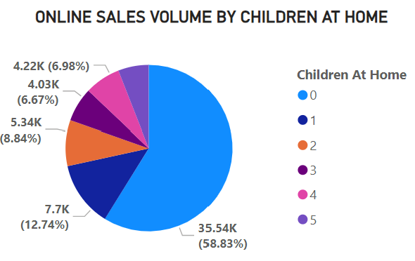
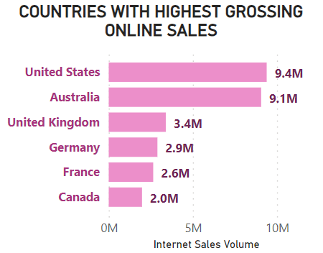
SOME ADDTIONAL METRICS FOR ONLINE SALES

Slide 10
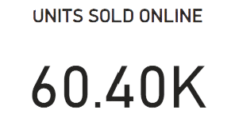
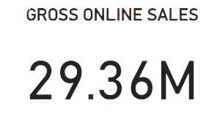
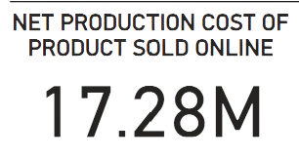
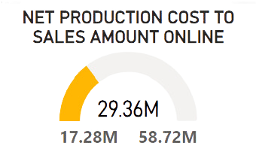
INFORMATION CARDS
Total Online Sales Volume
Fukita Corporation has sold 60.4K products via its online channels
Gross Sales Amount Online
The Gross Amount of sales made online by Fukita Corporation is $29.36M
Production Cost to Sales Amount
The total amount of money spent on promotion compared to the total amount of sales made

Slide 11
CONCLUSION
The Business Intelligence (BI) dashboard developed for Fukita Corporation offers a comprehensive toolset for understanding and optimizing the company’s online sales performance. By providing key metrics such as units sold online, gross online sales, and net production cost of products sold online, the dashboard offers valuable insights into the profitability and effectiveness of Fukita's online sales strategies.
The geographical sales distribution map aids Fukita Corporation in visualizing its global reach and market performance, guiding strategic decisions regarding market expansion and resource allocation. Insights into top-performing markets and sales trends over time inform forecasting, inventory planning, and marketing campaigns, enabling the company to maximize sales performance and capitalize on growth opportunities.
Moreover, customer demographics data and product category insights empower Fukita Corporation to tailor its products and marketing strategies to meet customer needs effectively. By leveraging these insights, Fukita can optimize digital marketing strategies, enhance customer experience, and drive business growth in line with strategic objectives.
In conclusion, the BI dashboard serves as a powerful tool for Fukita Corporation, enabling data-driven decision-making and strategic business planning. The experience gained from this assignment, utilizing industry-standard tools such as MS SQL Server, Visual Studio, and Power BI, has been invaluable, providing practical insights into the world of Business Intelligence and enhancing skills for future endeavors.

Slide 12
END OF PRESENTATION
THANK YOU
FOR YOUR TIME
PRESENTED BY
RUDi K

