Slide 1

TaskForce
A general purpose AI Agent
Capstone Project: AI Solutions Architecture
By Rudolf Dittrich
rudi.dittrich77@gmail.com
github: https://github.com/rudi77/ai_solution_architecture
report: https://github.com/rudi77/ai_solution_architecture/blob/rich_cli/capstone/documents/report.md

Slide 2
Task Force Agent Framework - Motivation
Built to understand how agents really work
Goal: implement an agent which can carry out general purpose tasks
Not just a chatbot wrapper → agent architecture
Clarifies open questions
Plans
Executes Tools
State Management – Kind of a memory
Use the ReAct Pattern (thought -> action -> observation)

Slide 3
High-Level Design Philosophy
Two-Phase Execution Model
Pre-Clarification Phase
Collect all missing inputs upfront
Execution Phase
Deterministic plan, no ambiguity
Design choice: less flexible → more predictable & reliable

Slide 4
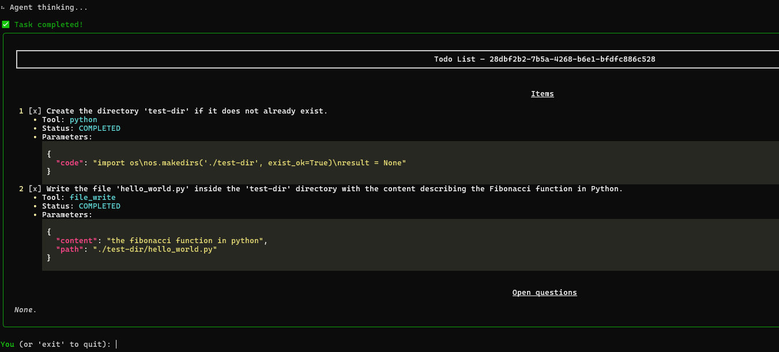
The TodoList Concept
Why a TodoList?
Acts as the explicit plan for the agent
Inspired by “Manus Agent” approach
No hidden reasoning → everything is visible
Two Steps
Clarification Mining
Ask all missing questions first
Final TodoList
Deterministic, executable
ard fail if ambiguity remains

Slide 5
Core Components & Execution Flow
Core Components
Agent Orchestrator (lifecycle & ReAct loop)
TodoListManager (incl. TodoList and TodoItem)
Tool System (Git, File, Python, Shell, Web)
State Manager (session persistence)
Execution Flow
Clarify → Plan → Loop[ Thought → Action → Observation ]
No execution until TodoList complete
Transparency via event streaming

Slide 6
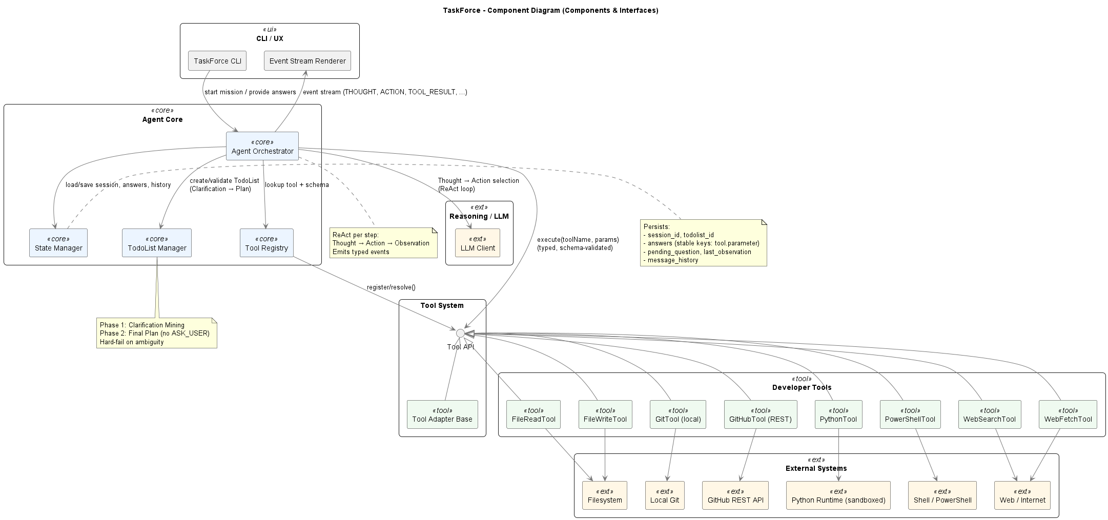
TaskForce – Component Diagram

Slide 7
Learnings
Agents are really hard
Deterministic planning is harder than expected
State persistence makes/breaks reliability
LLMs non-deterministic behavior makes the whole system unstable
Very good prompt or context engineering is needed and necessary.

