Slide 1

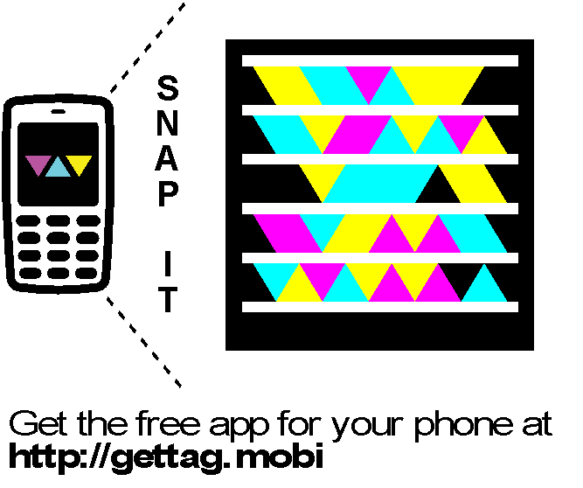


Slide 2
Using the MVVM Design Pattern with the Microsoft Visual Studio 2010 XAML Designer
Developer Tools, Languages, and Frameworks
DTL
3
23
Level 300

Slide 3



Rudi Grobler Barone, Budge & Dominick
Blog
http://www.rudigrobler.net
Twitter
@rudigrobler
DTL323 - Using the MVVM Design Pattern with the Microsoft Visual Studio 2010 XAML Designer
Mon, 18 Oct 2010 (10:45 - 11:45) | Breakout Session | Sessions Room C3 | Level: 300 - Advanced
WTB312 - Powering Rich Internet Applications: Windows Server AppFabric, Web Services, and Microsoft Silverlight
Tue, 19 Oct 2010 (14:30 - 15:30) | White Board | Session Room D2 | Level: 300 - Advanced
WUX310 - Securing Microsoft Silverlight
Tue, 19 Oct 2010 (17:15 - 18:15) | Breakout Session | Session Room A3 | Level: 300 - Advanced
WUX407 - Best Practices: Building a Real-World Microsoft Silverlight Line-of-Business Application
Wed, 20 Oct 2010 (08:30 - 09:30) | Breakout Session | Session Room D4 | Level: 400 - Expert

Slide 4
MVVM
View
Commands
Properties
ViewModel
Methods
Properties
Model (POCO/DTO/Entity)

Slide 5
MVVM (rich model)
View
Commands
Properties
ViewModel
Methods/
Properties
Model (Rich domain objects)

Slide 6
Why MVVM?
Testing of UI code
UI code structure/discipline
Separation of concerns
Design-Developer workflow

Slide 7
N-Layer Architecture
Interface
WPF
Forms
ASP.NET
MVC
Silverlight
Patterns
Interface Control
Object Model
Patterns
Data Access
Patterns
Data Storage and Management

Slide 8
The View
Binding is important
Data binding
Element binding
Commanding (or similar)
RAD designers are important
Visual Studio 2010
Blend
“No code behind”
Not an MVVM goal
Enable better designer <-> developer interaction

Slide 9
The ViewModel
Adds commands/verbs to the model
Possibly even reshapes the model
Enhances the model with data binding support
If the model doesn’t already support data binding
Triggered/invoked by the view
Extends the model with extra properties

Slide 10
The Model
MVVM is primarily a UI pattern
Types of Model
Objects don’t support data binding
Objects encapsulate data, rarely behavior
Rich
Objects support data binding
Objects encapsulate behavior as well as data
Anemic
Focus is on the View and ViewModel
The Model is assumed to already exist

Slide 11
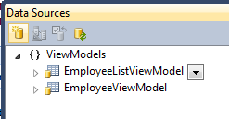
Connecting the Parts
Drag and Drop
View
ViewModel
Model

Slide 12
Resource Generated in View
<UserControl.Resources>
<CollectionViewSource x:Key="employeeViewModelViewSource"
d:DesignSource=
"{d:DesignInstance my:EmployeeViewModel, CreateList=True}" />
</UserControl.Resources>

Slide 13
Code-behind????
private void UserControl_Loaded(object sender, RoutedEventArgs e)
{
// Do not load your data at design time.
// if (!System.ComponentModel.DesignerProperties.GetIsInDesignMode(this))
// {
// //Load your data here and assign the result to the CollectionViewSource.
// System.Windows.Data.CollectionViewSource myCollectionViewSource =
// (System.Windows.Data.CollectionViewSource)this.Resources["Resource Key"];
// myCollectionViewSource.Source = your data
// }
}

Slide 14
Basic XAML Framework (BXF)
Basic Xaml Framework (Bxf) is a simple, streamlined set of UI components designed to demonstrate the minimum framework functionality required to make MVVM work well while leveraging the Visual Studio 2010 XAML designer ("Cider"). Bxf works with Silverlight, WPF and (soon) WP7.
http://bxf.codeplex.com/
Rockford Lhotka

Slide 15
Making MVVM Work
Shell
Data binding &
Command router
View
View
Status
Errors
View factory
ViewModel
ViewModel
ViewModel
ViewModel
ViewModel (or Presenter)

Slide 16
Building an App with MVVM
DEMO

Slide 17
Summary
MVVM is a good pattern
Avoid code-behind
MVVM requires a little “plumbing”
UI shell abstraction
Route View events to ViewModel verbs
View factory concept

Slide 18

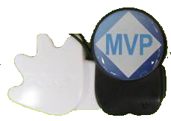
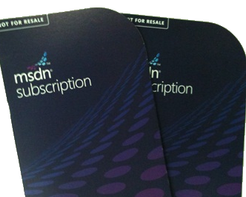

Questions?
Blog
http://www.rudigrobler.net
Twitter
@rudigrobler
And don’t forget
to poken me

Slide 19




Resources
Required Slide
Learning
Sessions On-Demand & Community
Microsoft Certification & Training Resources
www.microsoft.com/teched
www.microsoft.com/learning
Resources for IT Professionals
Resources for Developers
http://microsoft.com/technet
http://microsoft.com/msdn
Need more Information?
SMS [ Your Name ] and the word “Dev” to 41491

Slide 20

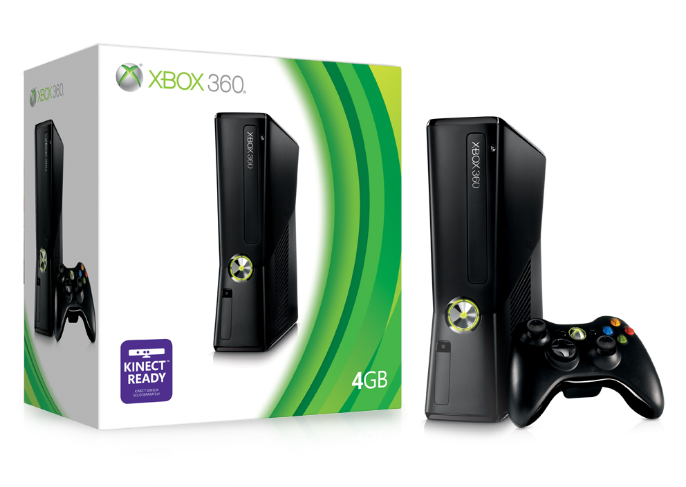
Complete an evaluation via CommNet and Tag to win amazing prizes!

Slide 21

© 2008 Microsoft Corporation. All rights reserved. Microsoft, Windows, Windows Vista and other product names are or may be registered trademarks and/or trademarks in the U.S. and/or other countries.
The information herein is for informational purposes only and represents the current view of Microsoft Corporation as of the date of this presentation. Because Microsoft must respond to changing market conditions, it should not be interpreted to be a commitment on the part of Microsoft, and Microsoft cannot guarantee the accuracy of any information provided after the date of this presentation. MICROSOFT MAKES NO WARRANTIES, EXPRESS, IMPLIED OR STATUTORY, AS TO THE INFORMATION IN THIS PRESENTATION.

