Slide 1

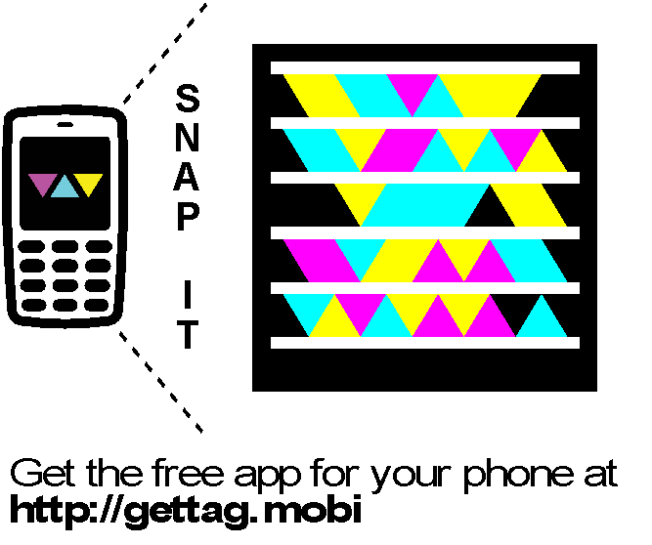


Slide 2
Best Practices: Building a Real-World Microsoft Silverlight Line-Of-Business Application
Web and User Experience
WUX
4
07
Level 400

Slide 3



Rudi Grobler Barone, Budge & Dominick
Blog
http://www.rudigrobler.net
Twitter
@rudigrobler
DTL323 - Using the MVVM Design Pattern with the Microsoft Visual Studio 2010 XAML Designer
Mon, 18 Oct 2010 (10:45 - 11:45) | Breakout Session | Sessions Room C3 | Level: 300 - Advanced
WTB312 - Powering Rich Internet Applications: Windows Server AppFabric, Web Services, and Microsoft Silverlight
Tue, 19 Oct 2010 (14:30 - 15:30) | White Board | Session Room D2 | Level: 300 - Advanced
WUX310 - Securing Microsoft Silverlight
Tue, 19 Oct 2010 (17:15 - 18:15) | Breakout Session | Session Room A3 | Level: 300 - Advanced
WUX407 - Best Practices: Building a Real-World Microsoft Silverlight Line-of-Business Application
Wed, 20 Oct 2010 (08:30 - 09:30) | Breakout Session | Session Room D4 | Level: 400 - Expert

Slide 4
Software development in the “Real” world
How difficult it “really” is
Difficulty
How easy Microsoft demos make it look
Time

Slide 5
Agenda
Best Practices:
Lesson #1: Pick a Pattern and Stick to It
Lesson #2: Data Binding and Nested Controls
Lesson #3: Notify Users of Successes (and failures)
Lesson #4: Get an Agent - A Service Agent
Lesson #5: Extend Existing Controls

Slide 6
Lesson #1: Pick a Pattern and Stick to It
Silverlight Line-of-Business (LOB) applications can grow out of control without proper planning:
Typically has many screens with supporting code
Validation code
Code to call the application's services
Service code
Model code
Data access code

Slide 7
The MVVM Pattern
The Model-View-ViewModel (MVVM) works very well for Silverlight LOB applications:
Provides consistency across code
Allows for better code re-use
Allows for Separation of Concerns (SoC)
Supports Unit Testing
Used as a type of controller for your view
Silverlight 4 provides ICommand support
Code-behind IS NOT evil but minimize the code you add there

Slide 8
MVVM Pattern Enablers
Data Binding
ViewModel
Commanding
Messaging

Slide 9
MVVM Pattern Players
The MVVM pattern has 3 key players:
Model: Business domain (business rules, data access, model classes)
View: User interface (Silverlight screens)
ViewModel: Middle-man between View and Model – similar to a controller
Presentation Layer
Business Domain
View
ViewModel
Model

Slide 10
MVVM
DEMO

Slide 11
What every MVVM framework needs?
ViewModel base class
ICommand implementation
Event bus

Slide 12








MVVM Light Toolkit
MVVM Foundation

Slide 13
Lesson #2: Data Binding in Nested Controls
Binding data in nested control scenarios can be challenging
Data required by controls may be out of scope due to where it's defined. For example:
Items controls nested in a DataGrid or ListBox
Items controls inside of a nested User Control
How do items controls get their data when the target collection is out of scope?

Slide 14
Data Binding in Nested Controls
Nested controls can access data stored in a StaticResource
Defined as a resource in the Page using "ViewModel" key
ViewModel
States Customers
Bind ItemsSource to
StaticResource key
DataContext is now Customers which doesn’t have a States property!
Page
DataContext = ViewModel
DataGrid
ItemsSource = Customers
ComboBox
ItemsSource = States
Row
ComboBox shows States
Row
ComboBox shows States

Slide 15
Data Binding in Nested User Controls
Accessing the DataContext within child User Controls
ViewModel
Defined as a resource in the Page using "ViewModel" key
States Customers
Page
DataContext = ViewModel
DataGrid
ItemsSource = Customers
Child User Control
ComboBox
ItemsSource = {StaticResource ViewModel}
Row
ComboBox shows States
Row
ComboBox shows States
ViewModel key not defined in UserControl’s Resources

Slide 16
Using a DataContextProxy
DataContextProxy class simplifies data binding in nested User Controls:
Exposes the parent's DataContext object (that's defined as a StaticResource) to child User Controls and their children
Provides a DataSource Dependency Property
Modeled after the ScriptManagerProxy from ASP.NET AJAX

Slide 17
DataContextProxy
DEMO

Slide 18
Lesson #3: Notify Users of Successes (and Failures)
Silverlight provides a rich animation engine and media capabilities – Use them!
Animations can be used to provide a visual indication of success or failure without getting in the way
Minimize the number of times a user has to click on a MessageBox or ChildWindow
Take advantage of media to play subtle sounds as operations succeed or fail

Slide 19


Using Animations and Media
Animations can be used to show unobtrusive messages:
MediaElement provides a simple way to play sounds
<Storyboard x:Name="sbOperationCompleted">
<DoubleAnimationUsingKeyFrames Storyboard.TargetName="StatusCanvasTranslateTransform" Storyboard.TargetProperty="Y">
<EasingDoubleKeyFrame KeyTime="00:00:00" Value="-66"/>
<EasingDoubleKeyFrame KeyTime="00:00:00.6" Value="0" />
<EasingDoubleKeyFrame KeyTime="00:00:03" Value="0"/>
<EasingDoubleKeyFrame KeyTime="00:00:03.6" Value="-66"/>
</DoubleAnimationUsingKeyFrames>
</Storyboard>

Slide 20
Failures & Success
DEMO

Slide 21
Lesson #4: Get an Agent – A Service Agent
Make service calls from a Service Agent:
Allows for better code re-use
Allow ViewModel classes to stay focused and clean
Can minimize amount of wrapper code
Service Agent can implement an interface to allow for testing
Presentation Layer
View
ViewModel
Service Agent
Model

Slide 22
Typical WCF Service Calls
.
public void GetJobs(EventHandler<GetJobsCompletedEventArgs> callback)
{
IJobPlanService proxy = GetProxy();
proxy.GetJobsCompleted += callback;
proxy.GetJobsAsync();
}
public void GetEmployees(EventHandler<GetEmployeesCompletedEventArgs> callback)
{
IJobPlanService proxy = GetProxy();
proxy.GetEmployeesCompleted += callback;
proxy.GetEmployeesAsync();
}

Slide 23
Minimize WCF Service Call Code
//Method in ViewModel Class
public void GetAreasByJobID()
{ MyServiceAgent.CallService<GetAreasCompletedEventArgs> (
(s,e) => CurrentTimeSheetView.Areas = e.Result, TimeSheetJob.JobID );
}

Slide 24
The CallService<T> Method
Type _Type = typeof(JobPlanServiceClient);
public void CallService<T>(EventHandler<T> callback, params object[] parameters) where T : EventArgs {
var proxy = new JobPlanServiceClient(_Binding, _EndPointAddress);
string action = typeof(T).Name .Replace(CompletedEventargs, String.Empty);
_Type.GetEvent(action + Completed) .AddEventHandler(proxy, callback);
_Type.InvokeMember(action + Async, BindingFlags.InvokeMethod, null, proxy,parameters);
}

Slide 25
Service Agent
DEMO

Slide 26
Lesson #5: Extend Existing Controls
Extend built-in Silverlight controls and Toolkit controls rather than reinventing the wheel
Examples of extended controls:
TextBox → FilteredTextBox
ComboBox extended to deal with primary keys better
AutoCompleteBox → AutoCompleteComboBox

Slide 27
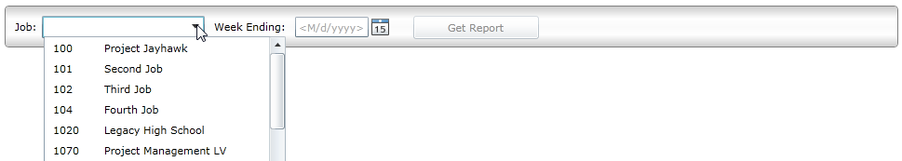
Extending AutoCompleteBox
Customer required filtering combined with ComboBox-like functionality
AutoCompleteBox was extended to create an AutoCompleteComboBox for filtering and/or direct selection:

Slide 28
AutoCompleteComboBox
DEMO

Slide 29
Summary
Best Practices:
Lesson #1: Pick a Pattern and Stick to It
Lesson #2: Data Binding and Nested Controls
Lesson #3: Notify Users of Successes (and failures)
Lesson #4: Get an Agent - A Service Agent
Lesson #5: Extend Existing Controls

Slide 30

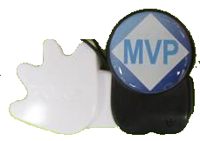
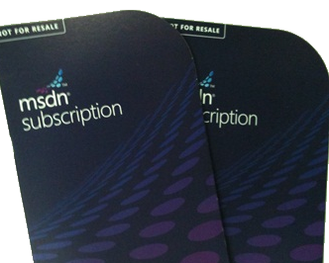

Questions?
Blog
http://www.rudigrobler.net
Twitter
@rudigrobler
And don’t forget
to poken me

Slide 31




Resources
Required Slide
Learning
Sessions On-Demand & Community
Microsoft Certification & Training Resources
www.microsoft.com/teched
www.microsoft.com/learning
Resources for IT Professionals
Resources for Developers
http://microsoft.com/technet
http://microsoft.com/msdn
Need more Information?
SMS [ Your Name ] and the word “Web” to 41491

Slide 32

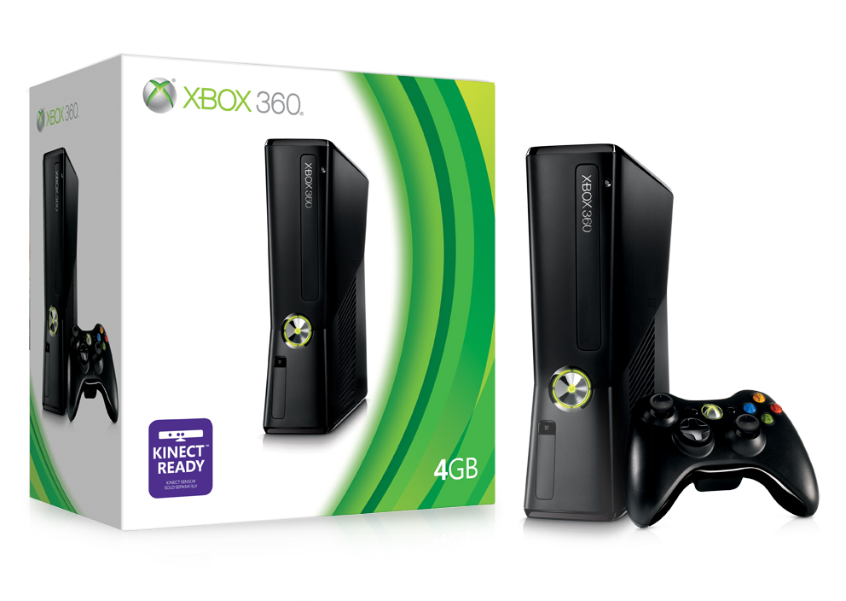
Complete an evaluation via CommNet and Tag to win amazing prizes!

Slide 33

© 2008 Microsoft Corporation. All rights reserved. Microsoft, Windows, Windows Vista and other product names are or may be registered trademarks and/or trademarks in the U.S. and/or other countries.
The information herein is for informational purposes only and represents the current view of Microsoft Corporation as of the date of this presentation. Because Microsoft must respond to changing market conditions, it should not be interpreted to be a commitment on the part of Microsoft, and Microsoft cannot guarantee the accuracy of any information provided after the date of this presentation. MICROSOFT MAKES NO WARRANTIES, EXPRESS, IMPLIED OR STATUTORY, AS TO THE INFORMATION IN THIS PRESENTATION.

