Slide 1
What’s new in WPF and Smart Clients in .NET 4.0
<Presenter Name=“Rudi Grobler”>
<Presenter.ContactDetails>
<Company Source=“Barone, Budge & Dominick” />
<Blog Source=“http://www.rudigrobler.net”/>
<Twitter Source=“@rudigrobler” />
<Email Source=“rudi@bbd.co.za” />
</Presenter.ContactDetails>
</Presenter>

Slide 2
What’s new...
Cached compositions
Text clarity
Layout Rounding
ClickOnce improvements
Multitouch
Windows 7 Taskbar
Ribbon
Focus mgt improvements
Support for UIAccessible2
VSM integration
Full Trust XBaps
PS 3
Client Profile
Data controls
Accessibility Improvements
Chart Controls
Control Themes
Hundreds of good bug fixes…
Plus all the goodness of .NET4!
MEF
Dynamic Language Support
More…

Slide 3
Agenda
Light up Windows 7
Fundamentals
New Controls

Slide 4
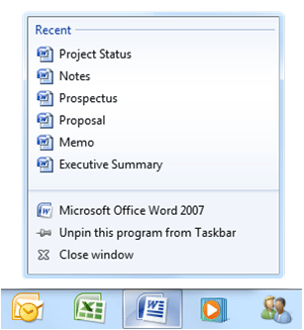
Light up Windows 7
Taskbar
Jumplist
Progress bars
Icon overlays
Multi-touch

Slide 5


<demo/>

Slide 6
Multi-touch
UIElement changes
Manipulation events (tracking and interpreter)
Touch system gesture events (double-tap and rollover)
Raw touch input events (for going to the metal)
Multi-touch support in controls:
ScrollViewer update to accept pan gestures
Base controls updated to be multi-touch aware
Multi-capture support (for more than one contact point at time)
New multi-touch specific controls (e.g. ScatterView)
Compatible with Surface SDK 2.0

Slide 7



Multi-touch In 20 lines of code
<demo/>

Slide 8
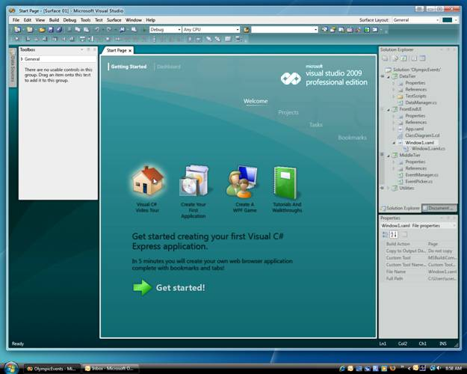
Fundamentals
Framework Deployment
Application Deployment
Improved interop
Text Clarity
Layout Rounding / Snapping
Graphics Performance

Slide 9

Framework Deployment
.NET 4 is a Side by Side release!
Visual Studio and .NET support multi-targeting
Client Profile SKU
Setup improvements
Notes:
Deployment continues to be the #1 issue we need to address for the framework and for client apps in general.
Poll:
How big do you think the full .NET framework is?
The matrix is actually quite complex but no version of the framework is actually 200mb. We’ve done a poor job of educating people about .NET setup and frankly, the setup experience has just plain sucked.
In 3.5 SP1, we made significant investments in improving the setup experience. However, since SP1 was a in-place update and a service pack, we were constrained with the changes we could make. Thus the deployment experience is potentially much better for users on Windows XP without any framework at all but not much better for everyone else (and on Vista, some necessary updates are just now going out).
In .NET4, we’re doing the work in Visual Studio and with the framework to enable true Side by Side of the framework. A 4.0 application is an application that targets version 4 of the .NET Framework. The side-by-side support built into the .NET Framework allows multiple versions of the Framework to be installed on a single system and for 3.x family and 4.x family components to run within the same process.
In Dev10 the CLR is enabling a previously blocked scenario: in-proc SxS. For the purpose of risk assessment “in-proc SxS” refers to scenarios where multiple copies (instances) of your software are loaded into a process SxS.
By far the most common in-proc SxS customer scenarios in Dev10 will be through COM. In particular scenarios where user code calls into a managed COM object that was built with a differing version of the runtime.
The 4.0 Framework is designed to be highly compatible with the 3.x Framework. This includes compatibility at a deeper level than just the public types and APIs. For example, we closely monitor changes in the implementation of APIs that might also affect compatibility. Thus, an API that returns a value that was not returned by its predecessor would still be considered incompatible.
While every effort has been made to retain compatibility, there are certain cases where we might break compatibility. This is only done in the most serious cases after a thorough analysis of the impact of the change. Breaking changes are typically only made as a last resort to address security-related issues or serious flaws in existing functionality. Breaking changes are not made to improve the consistency or appearance of an API or to fix bugs that can be addressed through other reasonable means. Wherever compatibility is affected, Microsoft will publicly document the changes and provide potential workarounds. The complete list of breaking changes for the 1.1 Framework can be found at
With these investments, we’re finally able to offer a much improved setup experience across ALL configurations and versions of Windows (XP, Vista, Win7, etc).
TAGS: WPF Fundamentals Setup Deployment VisualStudio Quality Ubiquity Vista Windows7 ClientProfile

Slide 10
Client Profile SKU
Smaller, Faster NET Framework SKU
.NET Framework Client 26mb
Setup optimizations for ngen, download, etc.
Works across ALL CONFIGURATIONS
Brandable deployment experience
Developers can customize app deployment experience to match brand
Can integrate framework and app installers
Tools and documentation for creating these packages
Easier deployment of applications
Developers may use deployment bootstrapper to manage the installation of their app and pre-reqs
Will install application after the framework and launch it (.msi, .application or .xbap)
Notes:
The Client Profile is a subset of the full framework designed to provide the optimal install and deployment experience for specifically client scenarios. In .NET 4.0, we’re continuing to improve this.
- The package itself in 4.0 is much smaller (faster) than the full framework – just 22mb.
- The setup was re-written including optimizations for ngen and download logic.
- Developers have the option of creating a branded, integrated install experience that includes the framework, the application and pre-req components, etc. - The web installer to be included with the application setup package just 280K. The installer does the heavy work of figuring out what bits the machine requires and downloading those.
- The offline installer is factored as well providing more factored options for offline media-based installs.
We’re committed to continuing to make this faster, easier, more reliable to reduce friction and provide the best possible install experience.

Slide 11
Setup and Size
Notes:
One more quick thing. If the question is asked about why we are SO much better than 3.5, here are the primary reasons
We were carrying the entire Framework twice in 3.5 – Once as MSIs for downlevel and once as MSUs for Vista
We have removed a significant number of large pre-reqs
XPS Essentials Pack
MSXML
VC Redist with MFC
WMI Decoupled Provider
We are being very aggressive with compression (Both using a new compression engine and really being smart about how we pack things to optimize for size)
We carry a single setup engine instead of carrying it multiple nested times
---
I’ve been doing a road show on the new plan for the Client Profile, and I’m not sure which information is the most important to capture on a single slide for Soma. I’ve got it down to a few main issues which I’ll include below. If you can identify which information you’d like to capture, I can take a shot at massaging it down to a single slide. If you take a shot at that, I’d be curious to see your final edits to the slide. You can always include this information in backup notes if you want.
Anyway, here’s the information.
Summary
We’ve recently decided to add content to the Client Profile and deploy the Client on WU to Client OSes instead of the Full Framework. Don’t think of the expanded Client Profile as a SKU suitable for a just 80% of Client apps anymore – With recent additions, our goal is to cover 95-99% of Client apps. We had done well enough with our size goals to allow us to add content and target a much broader set of client apps. In fact, after migrating an additional 4 megs of content into the Client SKU, we do not think that the managed surface area left in full will be needed for any significant percentage of Client Apps. As such, we feel comfortable deploying the Client Profile to client OSes via WU and think that Client App ISVs will almost always be able to use the Client Profile for their media.

Slide 12
Application Deployment
Continuing to make improvements to ClickOnce to enable a more seamless install and upgrade experience
Command-line arguments for CO deployed apps
File associations for CO deployed apps
Background updates and custom install ux
Notes:
The feedback we continue to get on client apps is that application deployment is still too hard and fragile. Technologies like ClickOnce are not widely used in the enterprise and almost never used in public facing consumer applications.
Our long term goals for applications can be summarized this way:
- Make it much easier to get the targeted framework onto the computer with a great user experience
- Make the install and update process for client apps as seamless as a web page. As easy to install an app as clicking on a link.
- Give client apps access to the most important desktop features without adding install complexity
- Make it safe for users to install client apps such that 10’s and even 100’s can be installed with no degradation to the system or user data/security compromises.
- Make it easy for consumers/users to find these apps and for authors to monetize them.
So where are we in terms of making this happen? Here’s a list of the things we’ve been doing over the last couple releases:
3.5 and SP1
- Command-line arguments for ClickOnce deployed apps
File associations for ClickOnce deployed apps
- ClickOnce support for FireFox
Client Profile and setup improvements.
4.0
- Background updates and custom install ux
This enables apps to completely take over the install and update experience. Beyond the UI, it enables applications to use ClickOnce to detect, download and install completely in the background. The user need only restart the app to get the update.
To see where we are / will be in 4.0, install http://photoSuru on a Windows XP machine (with no .NET Framework installed). A pretty nice install experience for the framework + app, file associations, command line args, ClickOnce updates, background sync and offline. You won’t see the custom update Ux just yet because it just got coded up but we should see that soon.
There are more changes we’re making in 4.0 as well and I’ll add more details in the future.
Beyond 4.0, we’re looking at some new deployment technologies that will be all new, lighter weight and enable seamless and safe deployment. We want to look at enabling Mesh style deployment with Client applications as well as partial trust, standalone applications that require no prompt at all to run on the desktop. We also are looking at ways to enable components to be versioned and deployed seamlessly as well.
TAGS: WPF Fundamentals Setup Deployment VisualStudio Quality Ubiquity Vista Windows7 ClientProfile

Slide 13
ClickOnce Background Update
<demo/>

Slide 14
Graphics
Entirely New Text Rendering Stack
Layout Rounding
ClearTypeHint – Clear Type on IRTs
Animation Easing Functions
Pixel Shader 3.0 Support
Cached Composition
VisualScrollableAreaClip

Slide 15
Graphics
Other Stuff
Faster Default Image Resampling
Removal of Legacy BitmapEffect Support
Removal of Fixed-Function Rendering Pipeline

Slide 16
Cached Composition
Motivation:
Vector rasterization is a very expensive operation
Video cards are optimized to render textures
Difficult to cache vector data
Per-primitive AA forces retessellation on scale / translation

Slide 17
Cached Composition
Previously two basic ways:
RenderTargetBitmap
TileBrush caching via the RenderOptions.CachingHint attached property

Slide 18
Cached Composition
New Property on UIElement
UIElement.CacheMode
Currently accepts an instance of BitmapCache
New Brush
BitmapCacheBrush – basically a cached VisualBrush
Interactive
XAML-able
Hardware Accelerated

Slide 19
Cached Compositions
<demo/>

Slide 20
Cached Composition
When expensive content would require rerendering
When IRTs would be repeatedly regenerated
e.g. All inputs to Effects (including ImageBrushes)
Bypasses IRT allocation / deallocaiton cost

Slide 21
Animation Easing Functions
Added an EasingFunction property to all From/To and By animation types
Easing Function modifies animation progress
Allows for custom modification of any animation’s progress
Easy to create custom easing functions (Implement IEasingFunction)

Slide 22
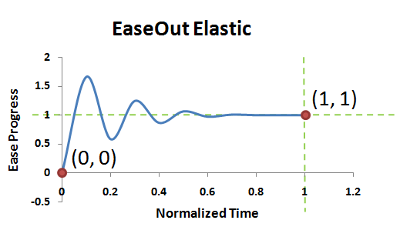
Animation Easing Functions
Normal progress ranges from 0…1
Easing Functions allow progress ranges below 0 and above 1 (e.g. bouncing)

Slide 23
Animation Easing Functions Built-In Easing Functions
 | Class Name | Properties
Circle Easing Function | CircleEase | N/A
Back Easing Function | BackEase | Amplitude
Exponential Easing Function | ExponentialEase | Exponent
Power Easing Function | PowerEase | Power
Quad Easing Function | QuadraticEase | N/A
Cubic Easing Function | CubicEase | N/A
Quart Easing Function | QuarticEase | N/A
Quint Easing Function | QuinticEase | N/A
Elastic Easing Function | ElasticEase | Oscillations Springiness
Bounce Easing Function | BounceEase | Bounces Bounciness
Sine Easing Function | SineEase | N/A

Slide 24
Animation Easing
<demo/>

Slide 25
Why a New Text Stack?
General blurriness of rendered text
Small characters especially blurry
Small East-Asian characters sometimes hard to distinguish
Lack of rendering options

Slide 26



Font Rendering History
Aliased Rendering
Glyphs on pixel boundaries
Sharp horizontal and vertical features
Curved and diagonal portions of text
exhibited substantial aliasing
ClearType Rendering
Tripled horizontal resolution
on LCDs
TrueType fonts
Encoded text as quadratic Beziers
Arbitrary scaling of glyphs
Hinting Language
Embedded Bitmaps

Slide 27
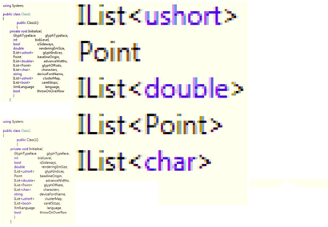
Improved Text Rendering
Notes:
Previously, WPF text was restricted to rendering with Ideal Width Layout, which caused text to look blurry.

Slide 28
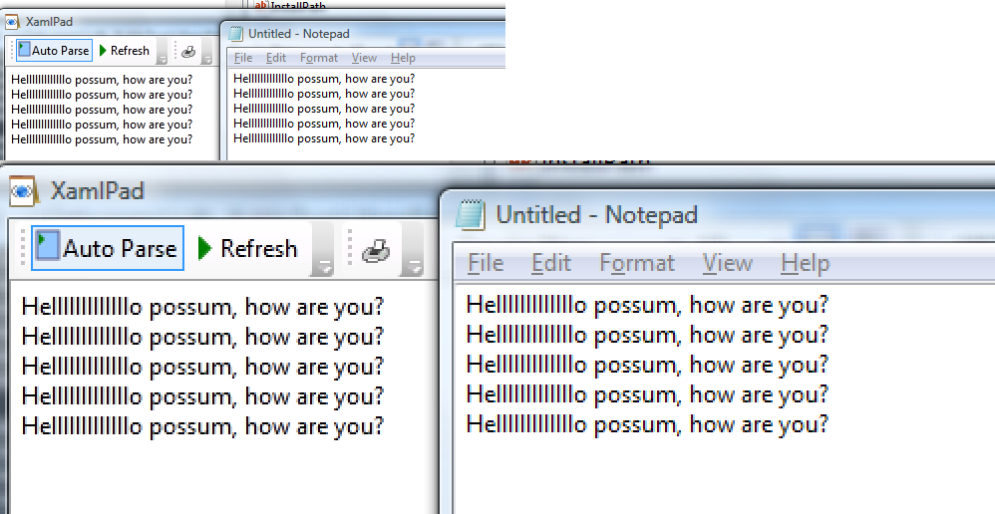
WPF 4.0 <left> vs. GDI <right>
Notes:
Now WPF allows the user to select many different rendering and layout modes.
Importantly, we support Compatible Width Layout, which produces rendering with sharpness comparable to GDI cleartype.
Also, we will now expose the ability for the app to select Aliased Text Rendering and Grayscale Text Antialiasing
In WPF 4, our TextFormatter will have the ability to use CompatibleWidth text metrics for text formatting. This simply means that the TextFormatter will be able to format the text so that the width of each letter is a whole number of pixels.
WPF Text rendering is now comparable to (arguably it even looks better than) GDI’s Compatible Width Cleartype, which to this point has set the standard for text crispness.

Slide 29

Text Rendering API

Slide 30
Text Rendering API
TextFormattingMode
Ideal (default behavior which uses IdealWidth text metrics)
Display (optional new behavior which uses ComptabileWidth text metrics)
TextRenderingMode
Aliased (aliased rendering)
Grayscale (grayscale antialiasing)
ClearType (ClearType always on)
Auto (ClearType unless otherwise specified in the system font smoothing options)

Slide 31
Text Rendering
<demo/>

Slide 32
Text in WPF 4.0
Sharper East-Asian Fonts
WPF Can now render using the embedded font bitmaps in many East Asian Languages
Better foreign language support
New glyph shaping engines provide better international support (e.g. diacritics)

Slide 33
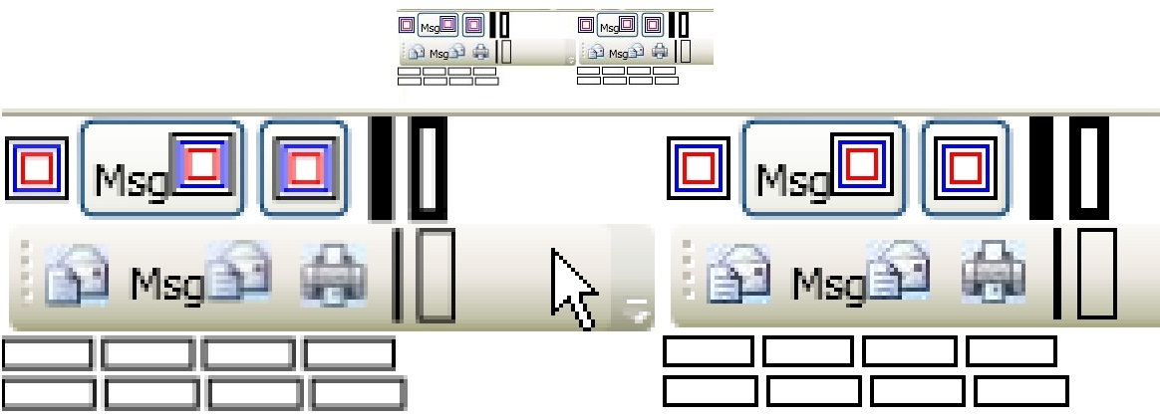
Layout Rounding
Rounds an object’s coordinates on whole pixels.
Notes:
UseLayoutRounding will be a Dependency Property declared on UIElement and inherited down the visual tree. For an entire application to use it, one just has to set the UseLayoutRounding property on the uppermost container (Canvas, Grid, ect…).

Slide 34
Layout Rounding
<demo/>

Slide 35
Layout Rounding
Not a graphics feature – a Layout Feature
How is it different from Pixel Snapping?
Guidelines
Pixel Snapping is difficult to use and often doesn't work
Layout Rounding changes both the position and the size of elements

Slide 36
Pixel Shader 3.0 Support
PS 3.0 is now supported
Max executed instruction: 96 -> 65535
Constant registers: 32 -> 224
Texture indirections: 4 -> unlimited
True flow control (branching, loops, etc…)
NO Software Fallback
Means no PS 3.0 for RTB, printing, RDP / TS, base tile of a tiled TileBrush, or when app is running in SW

Slide 37
Support for Dynamic Objects
WPF4 now has support for data binding with dynamic objects that implement IDynamicMetaObjectProvider (DynamicObject)
Notes:
VS - WPF for the masses – less hand cranking of xaml and code
Blend – tool maturity and improved designer – developer workflow
1. RAD Databinding:
Strong Design Time support for Databinding
- DataSources Window (like Windows Forms)
- Designer UI for generating and intellisense for editing/creating databinding expressions
- Support for ValueConverters
2. Easier Auto Layout
- Design “size to content” driven layouts in the designer surface (doesn’t work well in VS2008 design surface)
- Design containers that don’t naturally want to have a fixed root size (e.g. User Controls, Pages etc)
- Convenience designer features that let you transition your design from fixed layouts to automatic ones
3. Easier Property Editing
Adding convenient property editors for common and harder-to-configure types:
- Brush/Color
- Font
- Image
Smart Tags
- Inline property editing for common properties
4. Easier Style Application
Finding and applying resources made easy with a picking UI accessed from inside the property browser (like Blend)
Managing resources made easier with a visual manager for resources in your app – so you can locate, re-factor/re-scope them quickly and easily
5. Less XAML Editing
All these features will let you spend less time hand-editing your XAML
6. Silverlight Just Works
- Baseline capabilities per the Silverlight add-on for Visual Studio 2008
- Adding a full active design surface
Goal is parity with all WPF designer capabilities, wherever this is technically possible (e.g. platform constraints)
TAGS: WPF VisualStudio Designer XAML Editing Layout Tooling WPFfortheMasses Silverlight Compatibility ClientContinuum

Slide 38
Dynamic objects
<demo/>

Slide 39
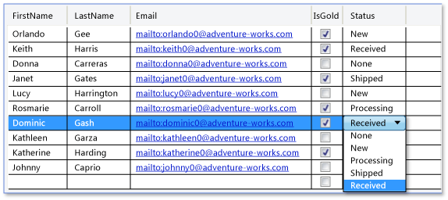
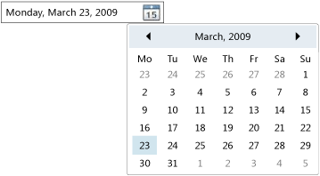
New Controls
DataGrid
DatePicker
Calendar
VSM is also now in WPF 4

Slide 40
Visual State Manager (VSM)

Slide 41
New Controls
<demo/>

Slide 42


Resources
Required Slide
Add your own resources as required.
Resources for Developers msdn.com
Microsoft Certification & Training Resources microsoft.com/learning
Slides are available on my blog @ http://www.rudigrobler.net/speaking

Slide 43



We Want To Hear From You!
Required Slide
Connect with Microsoft South Africa's Developer & Platform Group
blogs.msdn.com/southafrica
twitter.com/msdevsa
Microsoft Devs SA

Slide 44


Slide 45
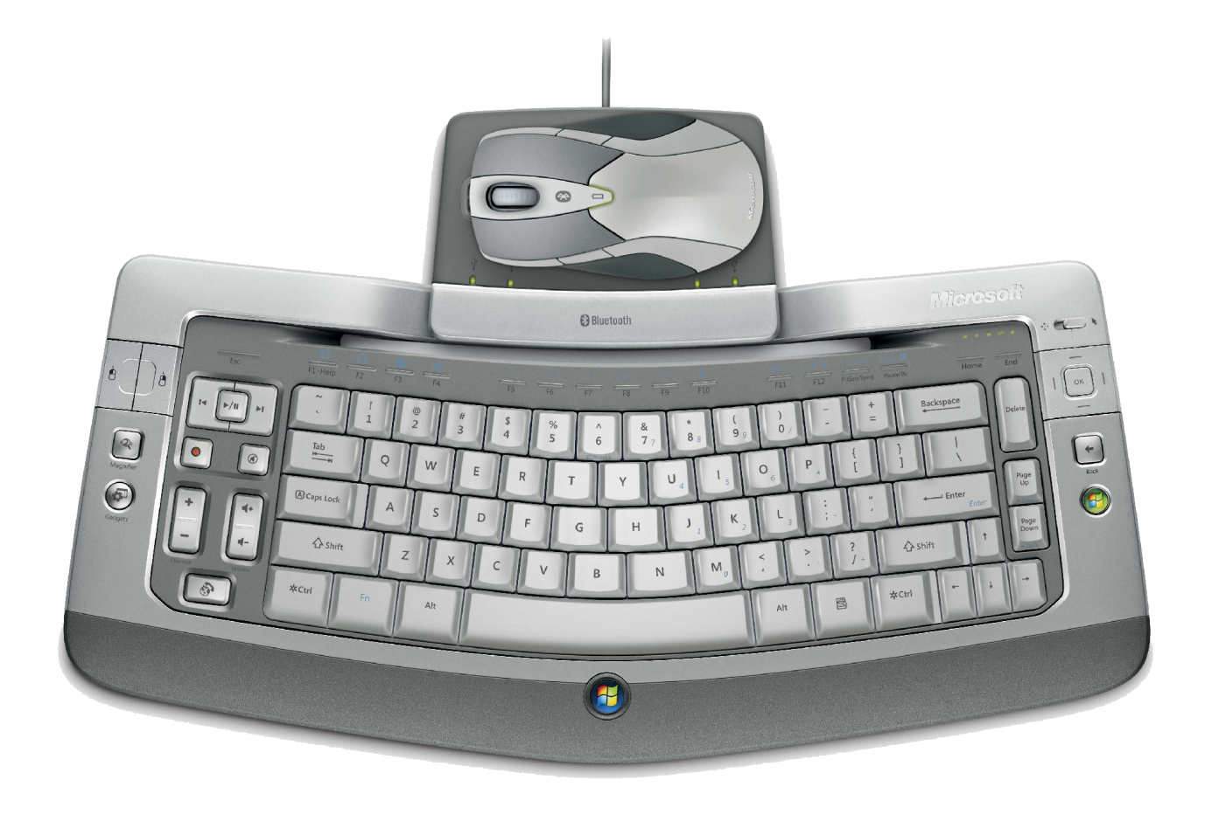
Win a Wireless Entertainment Desktop 8000!
Required Slide
Complete your evaluation and enter to win!

Slide 46



Submit an Entry Form at the BB&D Stand and Win*! A Dell Netbook valued at R4,000
* Terms & conditions apply

Slide 47



Win an Xbox 360 with DVT!
Required Slide
Be a winner with DVT
Enter your details at the DVT stand and you could WIN an XBOX 360 ARCADE!

Slide 48
Questions and Answers
<questions/>
Slides are available on my blog @ http://www.rudigrobler.net/speaking

Slide 49

© 2010 Microsoft Corporation. All rights reserved. Microsoft, Windows, Windows Vista and other product names are or may be registered trademarks and/or trademarks in the U.S. and/or other countries.
The information herein is for informational purposes only and represents the current view of Microsoft Corporation as of the date of this presentation. Because Microsoft must respond to changing market conditions, it should not be interpreted to be a commitment on the part of Microsoft, and Microsoft cannot guarantee the accuracy of any information provided after the date of this presentation. MICROSOFT MAKES NO WARRANTIES, EXPRESS, IMPLIED OR STATUTORY, AS TO THE INFORMATION IN THIS PRESENTATION.

