Slide 1

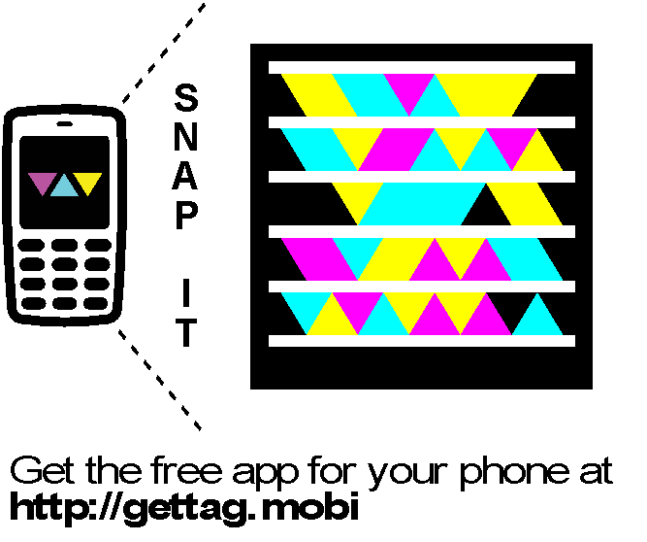


Slide 2
Securing Microsoft Silverlight
Web and User Experience
WUX
3
10
Level 300

Slide 3



Rudi Grobler Barone, Budge & Dominick
Blog
http://www.rudigrobler.net
Twitter
@rudigrobler
DTL323 - Using the MVVM Design Pattern with the Microsoft Visual Studio 2010 XAML Designer
Mon, 18 Oct 2010 (10:45 - 11:45) | Breakout Session | Sessions Room C3 | Level: 300 - Advanced
WTB312 - Powering Rich Internet Applications: Windows Server AppFabric, Web Services, and Microsoft Silverlight
Tue, 19 Oct 2010 (14:30 - 15:30) | White Board | Session Room D2 | Level: 300 - Advanced
WUX310 - Securing Microsoft Silverlight
Tue, 19 Oct 2010 (17:15 - 18:15) | Breakout Session | Session Room A3 | Level: 300 - Advanced
WUX407 - Best Practices: Building a Real-World Microsoft Silverlight Line-of-Business Application
Wed, 20 Oct 2010 (08:30 - 09:30) | Breakout Session | Session Room D4 | Level: 400 - Expert

Slide 4

Know thy
ENEMY

Slide 5
Silverlight Security Vectors
Trust
Boundary
Users/Hackers
(Reflector, Silverlight Spy, Debuggers,
Memory Profilers)
Eavesdroppers
(Packet Sniffers, etc.)
Hackers/Personnel
(Intrusion and Physical Security)

Slide 6

“It's a basic truth of the human condition that everybody lies. The only variable is about what."
House M.D.

Slide 7
Securing the Client
YourApp.xap
Main Assembly
Other.dll
Other Assets
Embedded XAML
Your Libraries
Other Resources
Images
Fonts
SDK Assemblies
Optionally deployed Controls
Code
YourApp.zip
Main Assembly
Other.dll
Other Assets
Embedded XAML
Your Libraries
Other Resources
Images
Fonts
SDK Assemblies
Optionally deployed Controls
Code

Slide 8
Hacking Silverlight
DEMO

Slide 9

Phase 2: Develop & Build
Are you
Scared yet?
Notes:
So we see that Windows Embedded offers you several ways to evaluate our family of embedded operating systems as well as bringing continual innovation to our release cycle
Let’s look at the challenges of the Develop and Build cycle

Slide 10
Securing the Client
Client Security Considerations
Code
XAML
Assets
Secrets
Isolated Storage
Data
Limit the surface area
Only send needed data (Projection)
Obfuscation (Only limited protection)
No protection (Stored as text)
No protection
Obfuscation helps but secrets still needs to be loaded into memory.
Do NOT save your secrets here…
No protection
Consider encryption

Slide 11
Protecting You Intellectual Property
What is worth protecting?
Labor? No…
Unique implementations? Yes…
Sensitive data? Yes…
Silverlight does not protect your Algorithms
Obfuscation only protects against decompilation
Code runs in the client
Client must be able to download assemblies
Hide it on the Server
Generate the XAML on the Server
Send only summary data to the client

Slide 12
Obfuscation
“Obfuscation is the concealment of intended meaning in communication, making communication confusing, intentionally ambiguous, and more difficult to interpret”
dotfuscator
Silverlight XAML Obfuscation
With XAML Obfuscation, developers can protect Intellectual Property and prevent tampering by renaming XAML resources, trim and compress Silverlight assemblies to optimize load time and performance, and automatically re-sign assemblies. Developers can fully obfuscate and instrument Silverlight XAP files resulting in a streamlined automated build process.
CodeFort
.NET & Silverlight Obfuscator
CodeFort is an advanced obfuscator and protection tool for Microsoft .NET and Silverlight applications.

Slide 13
Obfuscation
DEMO

Slide 14




Protecting Your XAP
Silverlight Apps Are Just Files
Protect like any other web file
Forms Authentication
Windows Authentication
Token-based Authentication

Slide 15
Protecting your XAP
DEMO

Slide 16
Protecting Your XAP
Forms Authentication
Cookie based
Windows Authentication
Just Works
Token-based Authentication
Can use expiring tokens
Custom Encrypted Cookies
Never decrypt on client
Expire Cookies Frequently
Assumes NTLM on the Platform
OSX is Problematic
Pass them in on web services
Not foolproof or ‘secure’
Must also expire

Slide 17
Protecting Your XAP
For Apps with Login
XAP needs to be accessed anonymously
Compose at Runtime
Bootstrapper
PRISM
SLExtensions
Tamper detection
Sign your XAPs or check their MD5 checksum

Slide 18
Protecting your XAP
DEMO

Slide 19
ASP.NET Application Services
Using Forms Authentication Service
AuthenticationService (pre-built WCF)
Simple SOAP call to authenticate
<%@ ServiceHost Language="C#"
Service="System.Web.ApplicationServices.AuthenticationService" %>
var proxy = new AuthenticationServiceClient();
proxy.LoginCompleted += (s, args) =>
{
if (args.Result)
{
// Succeeded
}
};
proxy.LoginAsync("Frank", "P2ssw0rd", null, false);

Slide 20
ASP.NET Application Services
DEMO

Slide 21
Isolated Storage
Do NOT save secrets here… and if you do, at least encrypt it
Can be disabled by user
Is limited in size (1MB) but can be increased
Discoverable (not encrypted)
%userprofile%\AppData\LocalLow\Microsoft\Silverlight\is
%userprofile%\Local Settings\Application Data\Microsoft\Silverlight\is
Encryption
Symmetric Encryption: AES
Needs key and initialisation vector, both must be stored somewhere safe
Key can be derived from password or other known value

Slide 22
Isolated Storage
DEMO

Slide 23
Securing Services
Secure service same way you would secure the XAP
Token Based
Cookie Based
NTLM Based
Also consider securing each method
if (HttpContext.Current.User.Identity.IsAuthenticated)
{
}

Slide 24
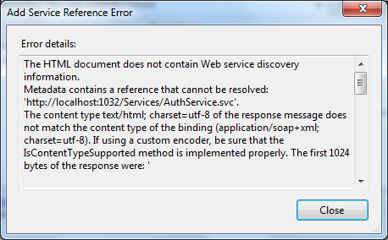
Securing Services
Add Service Reference Problem
Doesn’t play well with security
Must disable security when adding/refreshing
Trouble for building references at build-time

Slide 25
Securing Services
ClientCredentials
MyServiceClient client = new MyServiceClient();
client.ClientCredentials.UserName.UserName = “rudigrobler";
client.ClientCredentials.UserName.Password = “p@ssw0rd";
client.GetNameCompleted += (s, args) =>
{
theText.Text = args.Result;
};
client.GetNameAsync();

Slide 26
Securing Services
http://www.rudigrobler.net/MyCoolApp.xap
https://www.rudigrobler.net/foo.asmx

Slide 27
Securing Services
To enable a Silverlight control to access a service in another domain, the service must explicitly opt-in to allow cross-domain access.
<?xml version=“1.0” encoding=“utf-8” ?>
<access-policy>
<cross-domain-access>
<policy>
<allow-from http-request-headers=“SOAPAction”>
<domain uri=“*” />
</allow-from>
<grant-to>
<resource path=“/” including-subpaths=“true” />
</grant-to>
</policy>
</cross-domain-access>
</access-policy>
clientaccesspolicy.xml

Slide 28
Securing WCF DataService
Entity Set Access Rules
Also supports Query Interceptors
public class QuizDataService : DataService<GiveAQuizEntities>
{
public static void InitializeService(DataServiceConfiguration config)
{
config.SetEntitySetAccessRule("QuestionDefinitions", EntitySetRights.All);
config.SetEntitySetAccessRule("Quizzes", EntitySetRights.ReadSingle);
config.SetEntitySetAccessRule("QuizTakers", EntitySetRights.WriteAppend);
config.SetEntitySetAccessRule("QuizResults", EntitySetRights.WriteAppend);
config.SetEntitySetAccessRule("QuizAnswers", EntitySetRights.WriteAppend);
}
}

Slide 29
WCF DataService
DEMO

Slide 30

http://giveaquiz.codeplex.com/
GiveAQuiz.com is a new web site that allows users to create quizzes and have other users take the quizzes. This is differentiated from polling web sites as this project will allow the creator of a quiz to view the each individual user’s results instead of just summary information (which is especially important for grading contextual results like essay questions). This web site is aimed squarely on users that need to create quizzes and give grades on the results.

Slide 31




Browser HTTP Stack
Browser
Silverlight
App
Browser Stack
Network Call
with Browser State
(cookies, Session ID, NTLM)
Network Call

Slide 32
Browser HTTP Stack
Standard network stack goes through Browser
Good:
Uses cookies and NTLM
Looks and feels like the browser
Bad:
Only GET/POST are supported
Typically limited to two outbound requests
Incomplete status codes

Slide 33
404
DEMO

Slide 34
Client HTTP Stack
Alternative: Client HTTP Stack
For specific scenarios:
Need PUT/DELETE
Need Custom Cookies
Need more control
Status codes, bodies and headers
Only status code 404 (Not Found) and 200 (OK)
Only stack available out-of-browser

Slide 35
Client HTTP Stack
Create New Request
Use WebRequestCreator’s ClientHttp property:
WebRequest req = WebRequestCreator.ClientHttp.Create(new
Uri("http://api.search.live.net/qson.aspx?query=Silverlight",
UriKind.Absolute));

Slide 36
Client HTTP Stack
Specify all Client HTTP Stack
Call WebRequest’s RegisterPrefix to specify:
Then all calls become client, even WebClient:
bool httpResult =
WebRequest.RegisterPrefix("http://",
WebRequestCreator.ClientHttp);
WebClient client = new WebClient();
client.DownloadStringCompleted += new
DownloadStringCompletedEventHandler(OnDlComplete);
client.DownloadStringAsync(new Uri("/template.xaml",
UriKind.Relative));

Slide 37
Client Http Stack
DEMO

Slide 38
Browser Stack vs. Client Stack
Feature | Browser Stack | Client Stack
Authentication | Handled by browser | Not supported
Content caching | Handled by browser | Not supported
Cookies | Handled by browser | Handled by CookieContainer (Cannot be shared with browser)
HTTP methods | GET and POST only | All methods provided by server options in ClientAccessPolicy.xml
Proxy info | Uses browser proxy info | Uses OS proxy info
Request headers | Supported on GET requests | Supported on all requests
Response headers | Not supported | Fully supported in HttpWebResponse
Status codes | 200 and 404 only | All status codes supported

Slide 39

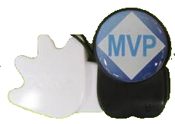
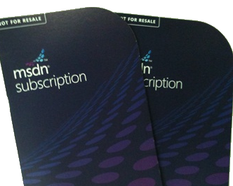

Questions?
Blog
http://www.rudigrobler.net
Twitter
@rudigrobler
And don’t forget
to poken me

Slide 40


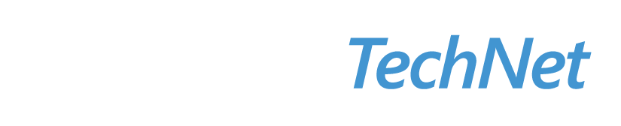

Resources
Required Slide
Learning
Sessions On-Demand & Community
Microsoft Certification & Training Resources
www.microsoft.com/teched
www.microsoft.com/learning
Resources for IT Professionals
Resources for Developers
http://microsoft.com/technet
http://microsoft.com/msdn
Need more Information?
SMS [ Your Name ] and the word “Web” to 41491

Slide 41

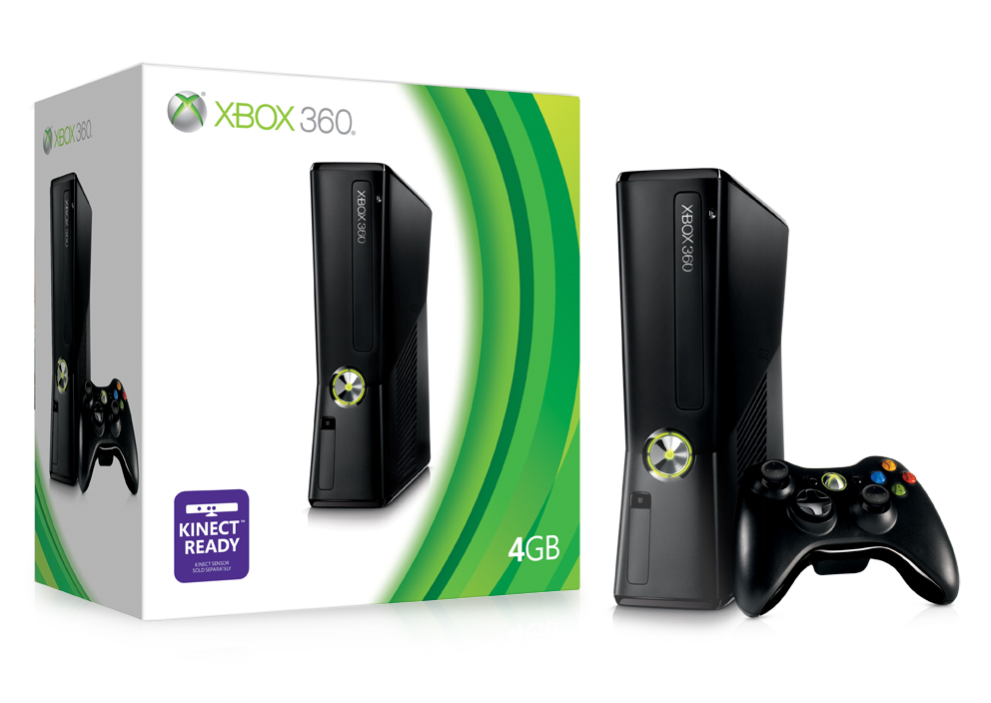
Complete an evaluation via CommNet and Tag to win amazing prizes!

Slide 42

© 2008 Microsoft Corporation. All rights reserved. Microsoft, Windows, Windows Vista and other product names are or may be registered trademarks and/or trademarks in the U.S. and/or other countries.
The information herein is for informational purposes only and represents the current view of Microsoft Corporation as of the date of this presentation. Because Microsoft must respond to changing market conditions, it should not be interpreted to be a commitment on the part of Microsoft, and Microsoft cannot guarantee the accuracy of any information provided after the date of this presentation. MICROSOFT MAKES NO WARRANTIES, EXPRESS, IMPLIED OR STATUTORY, AS TO THE INFORMATION IN THIS PRESENTATION.

