Slide 1

Agentic Wallet Guardian
Decision infrastructure for autonomous AI agents — explainable ALLOW / WARN / BLOCK before anything gets signed.
ChainHack 2026 · Industrial 5.0 — Ecosystem Fast Track

Slide 2

THE PROBLEM
An agent says one thing.
The transaction does another.
$ python examples/example_intent_verification.py
Case: agent said 500, calldata actually encodes 5000
[BLOCK] Agent declared an approval of 500 (500000000 atomic units),
but the actual calldata encodes 5000000000 atomic units —
a 900% difference.
This transaction does not do what the agent said it would do.
2 / 11

Slide 3


WHAT IT IS
A decision layer, not a custody layer
No private keys
Explainable
Self-hosted
Never touches signing or custody, anywhere in the codebase.
Every decision returns a human-readable reason, not a black-box score.
Runs on your infrastructure. No third party sees agent activity.
3 / 11

Slide 4
HOW IT WORKS
Four checks, in order, any of which can stop execution
1
2
3
4
Capability limits
→
Intent verification
→
Decision engine
→
OAA attestation
Any agent without a granted capability is silently unaffected — opt-in by design, not a blanket restriction.
[1/3] capability: OK
[2/3] intent verification: OK
[3/3] decision engine: BLOCK (risk 100.0)
-> signed attestation: verifiable by anyone with the public key
4 / 11

Slide 5
PROOF, NOT PROMISES
Verified live, not just claimed in a deck
247 / 255
PyPI
MCP Registry
tests passing
agentic-wallet-guardian-mcp
official, verified listing
$ python -m pytest -q
247 passed, 8 skipped, 6 warnings in 4.09s
Not a screenshot from months ago — re-run and confirmed the day of submission.
5 / 11

Slide 6
PROOF OF RIGOR
We attack our own code
before anyone else can.
$ independent adversarial security pass — 2026-08-23
Case: the exact scenario this project exists to catch
[FOUND] unlimited-approval signal scored 75 — below the 90 needed to force BLOCK
[FIXED] raised to 92 + an independent hard BLOCK rule, with tests
[FOUND] one shared API key let any caller inherit any agent's reputation
[FIXED] per-agent keys — a caller only acts as the agent it holds the key for
6 findings, 6 real fixes, 29 new tests — all before anyone else looked.
6 / 11

Slide 7
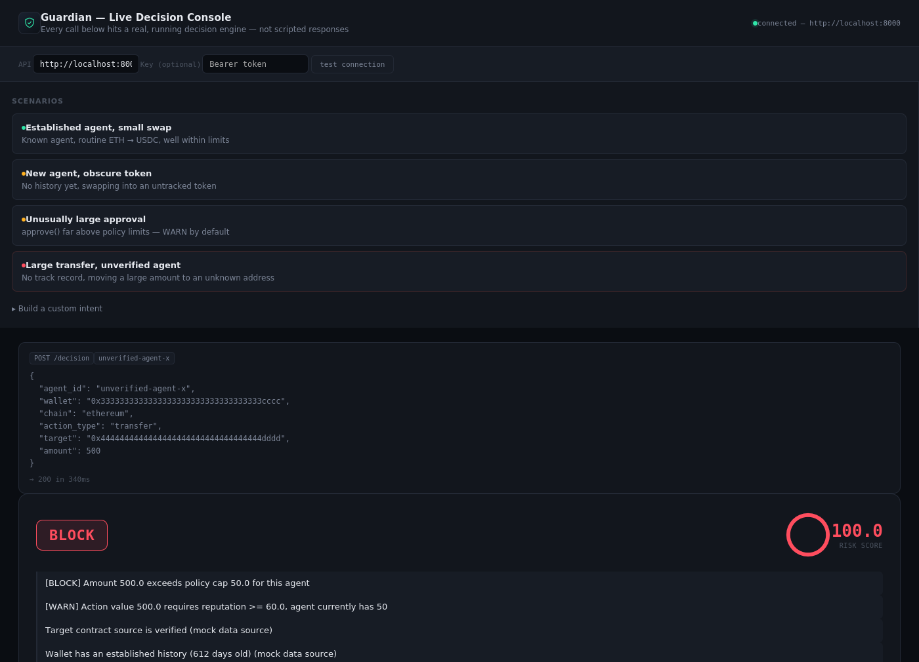
LIVE DEMO
Open a browser.
Watch it decide, live.
examples/browser-demo.html — a real POST /decision call to a locally running Guardian instance
7 / 11

Slide 8
VERIFIABLE, NOT JUST LOGGED
Every decision is signed as an OAA token
Open Agent Attestation — an Ed25519-signed JWT wrapping the decision. Anyone with the public key verifies it offline. No call back to the server that issued it.
decision: BLOCK
OAA token:
eyJhbGciOiJFZERTQSIsInR5cCI6IkpXVCJ9.eyJpc3Mi...vodRYGs_vyNt
verified by a third party — offline, no server call:
decision: BLOCK
action: tool_call:wallet.transfer
reason: amount=9999.0 exceeds cap 5 (unknown agent)
open spec · ~150-line reference implementation · MIT license
8 / 11

Slide 9

ECOSYSTEM FIT
Chain-agnostic by design
No custody, no private key handling — the decision layer sits above execution, so it isn't bound to any single chain's tooling.
Base
NEAR
Avalanche
BOT Chain (live)
Already deployed and verified on BOT Chain (chainId 677). Evaluating fit across the Ecosystem Fast Track paths.
9 / 11

Slide 10


WHAT'S NEXT
Built alone, deliberately narrow in scope
Shipped
Capability limits, intent verification, full pipeline, OAA signing — all tested, all on PyPI + MCP Registry.
Deliberately out of scope
Session keys, account abstraction, any code path touching a private key. Not a gap — a boundary.
Looking for
First outside adopter of the OAA spec — feedback from teams already solving parts of this problem.
10 / 11

Slide 11
Agentic Wallet Guardian
github.com/rudimentall1/agentic-wallet-guardian-v3
pip install agentic-wallet-guardian-mcp
Open source · MIT license · Ecosystem Fast Track — ChainHack 2026

