Slide 1
Computer Architectures Session 2
Pipelined implementation of microprocessor
&
Digital backend flow
TAs :
Jun Yin (jun.yin@kuleuven.be)
Yuanyang Guo (yuanyang.guo@imec.be)
Linyan Mei (linyan.mei@kuleuven.be)
Yunzhu Chen (yunzhu.chen@imec.be)

Slide 2

Objective
Session 1
Session 2
Session 3
Single cycle processor skeleton
Functional single cycle processor
Single cycle processor with multiplication
Pipelined processor
Pipelined processor with data hazard resolution
Advanced acceleration
Simulation
Backend flow (synthesis only)
Backend flow (complete)

Slide 3

Objective
Session 1
Session 2
Session 3
Single cycle processor skeleton
Functional single cycle processor
Single cycle processor with multiplication
Pipelined processor
Pipelined processor with data hazard resolution
Advanced acceleration
Simulation
Backend flow (synthesis only)
Backend flow (complete)

Slide 4
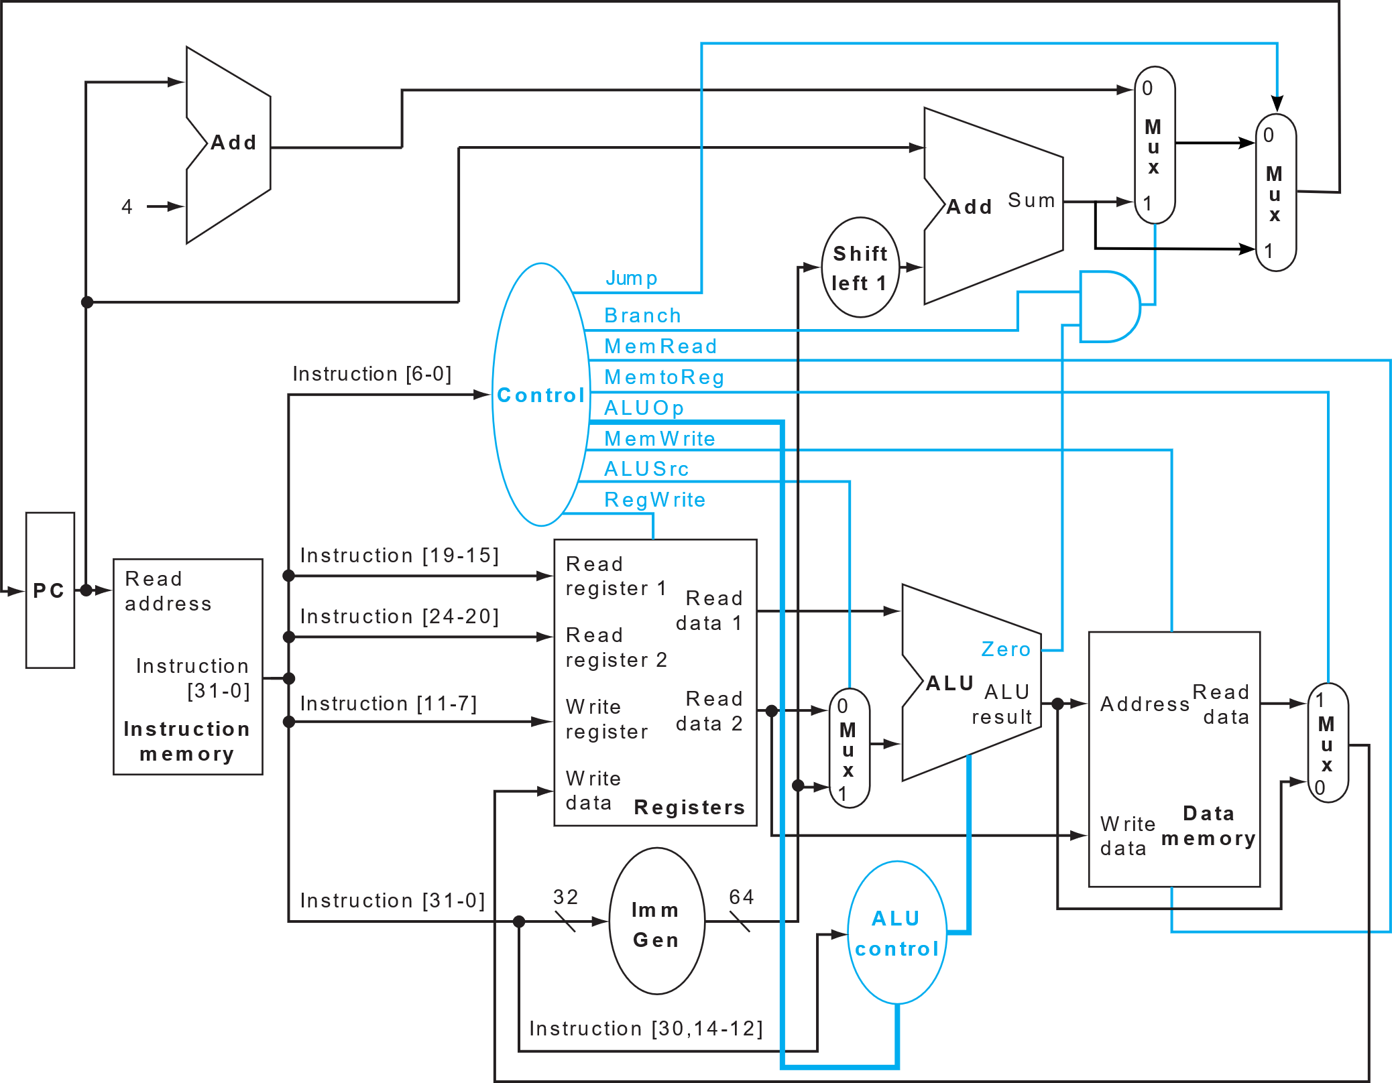
Last session
Single Cycle Processor
Simple_program
Mult1
Mult2
Prerequisite for this session!

Slide 5
This session
Session 1
Session 2
Session 3
Single cycle processor skeleton
Functional single cycle processor
Single cycle processor with multiplication
Pipelined processor
Pipelined processor with data hazard resolution
Advanced acceleration
Simulation
Backend flow (synthesis only)
Backend flow (complete)

Slide 6
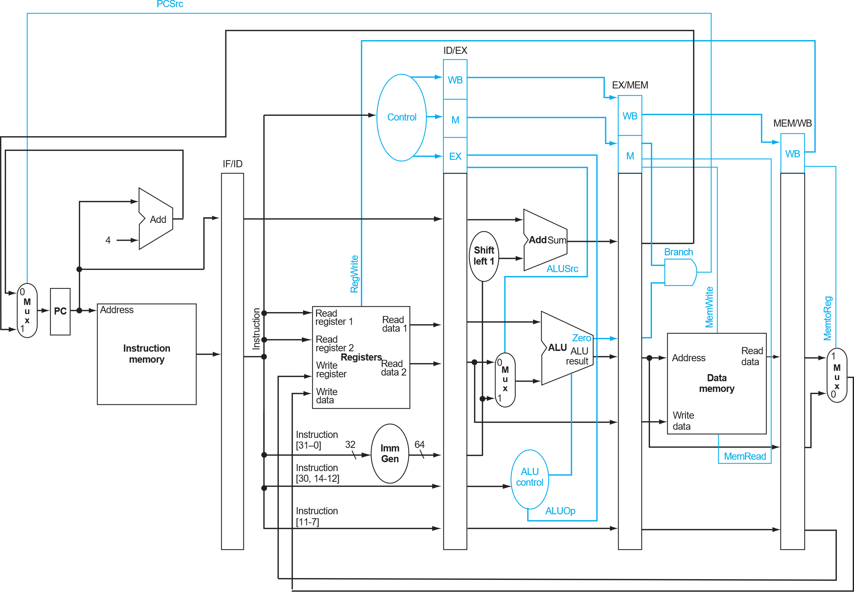
Pipelining
Executing instructions in steps
Fetch
Decode
Execute
Memory
Write Back

Slide 7
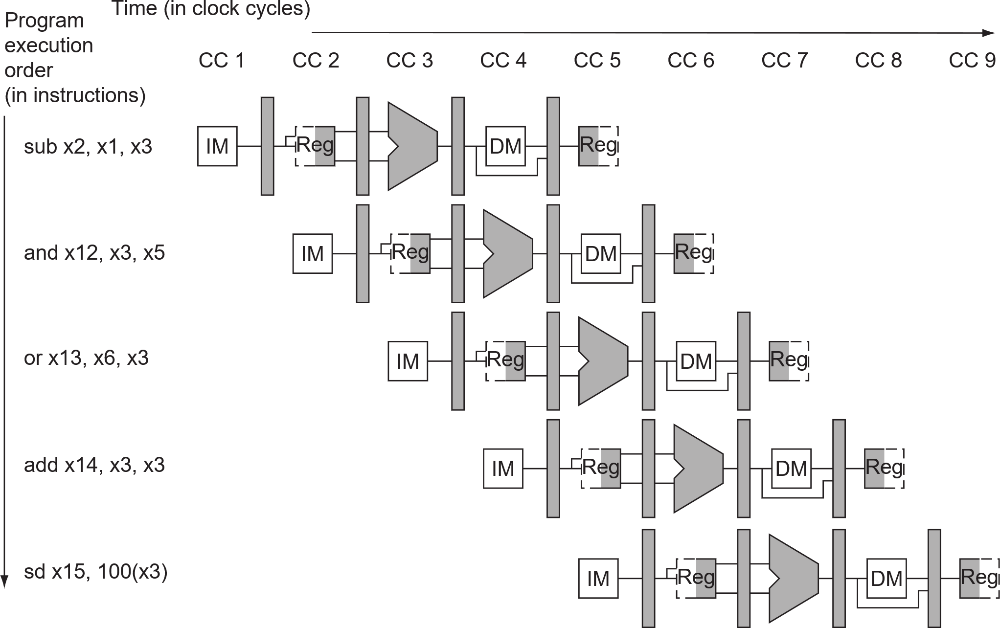
Pipelining
At clock cycle 5:
Inst 1 -> write back
Inst 2 -> data
Inst 3 -> execute
Inst 4 -> decode
Inst 5 -> fetch

Slide 8

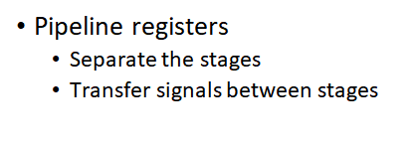
Pipelining
Pipeline registers

Slide 9
Method
Stage | IF | ID | EXE | MEM | WB
Data Path resources | instruction_memory | register_file
Pipe. Reg. | IF/ID | ID/EXE | EXE/MEM | MEM/WB
Signals | instruction
EXAMPLE

Slide 10
Method
// IF STAGE wire [ 31:0] instruction, instruction_IF_ID, instruction_MEM_WB;
sram_BW32 #( .ADDR_W(9 ), .DATA_W(32) ) instruction_memory( .clk (clk ), .addr (current_pc ), .wen (1'b0 ), .ren (1'b1 ), .wdata (32'b0 ), .rdata (instruction ), // Wiring component .addr_ext (addr_ext ), // to appropriate stage .wen_ext (wen_ext ), .ren_ext (ren_ext ), .wdata_ext(wdata_ext ), .rdata_ext(rdata_ext ) );
// IF_ID Pipeline register for instruction signal reg_arstn_en#( .DATA_W(32) // width of the forwarded signal )signal_pipe_IF_ID( .clk (clk ), .arst_n (arst_n ), .din (instruction ), .en (enable ), .dout (instruction_IF_ID) )
// ID STAGE
register_file #( .DATA_W(64) ) register_file( .clk (clk ), .arst_n (arst_n ), .reg_write(reg_write ), .raddr_1 (instruction_IF_ID[19:15]), // Wiring component .raddr_2 (instruction_IF_ID[24:20]), // to appropriate stage .waddr (instruction_MEM_WB[11:7] ),// Reg_write addr .wdata (regfile_wdata ), .rdata_1 (regfile_rdata_1 ), .rdata_2 (regfile_rdata_2 ) );
Sample Code Snippet
Stage | IF | ID | EXE | MEM | WB
Data Path resources | Instruction_memory | register_file
*_ext wires are only for the cpu_tb.v initialization.
Pipe. Reg. | IF/ID | ID/EXE | EXE/MEM | MEM/WB
Signals | Instruction_IF_ID |  |  | Instruction_MEM_WB
The IF_ID Pipeline Register.
Tips:
Be careful with each register’s DATA_WIDTH.
Always put the signal definition before usage.
EXAMPLE

Slide 11
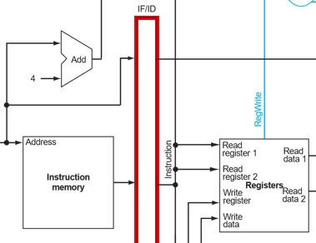
Method
// IF STAGE wire [ 31:0] instruction, instruction_IF_ID, instruction_MEM_WB;
sram_BW32 #( .ADDR_W(9 ), .DATA_W(32) ) instruction_memory( .clk (clk ), .addr (current_pc ), .wen (1'b0 ), .ren (1'b1 ), .wdata (32'b0 ), .rdata (instruction ), // Wiring component .addr_ext (addr_ext ), // to appropriate stage .wen_ext (wen_ext ), .ren_ext (ren_ext ), .wdata_ext(wdata_ext ), .rdata_ext(rdata_ext ) );
// IF_ID Pipeline register for instruction signal reg_arstn_en#( .DATA_W(32) // width of the forwarded signal )signal_pipe_IF_ID( .clk (clk ), .arst_n (arst_n ), .din (instruction ), .en (enable ), .dout (instruction_IF_ID) )
// ID STAGE
register_file #( .DATA_W(64) ) register_file( .clk (clk ), .arst_n (arst_n ), .reg_write(reg_write ), .raddr_1 (instruction_IF_ID[19:15]), // Wiring component .raddr_2 (instruction_IF_ID[24:20]), // to appropriate stage .waddr (instruction_MEM_WB[11:7] ),// Reg_write addr .wdata (regfile_wdata ), .rdata_1 (regfile_rdata_1 ), .rdata_2 (regfile_rdata_2 ) );
Sample Code Snippet
Stage | IF | ID
Data Path resources | Instruction_memory | register_file
①
*_ext wires are only for the cpu_tb.v initialization.
①
②
①
②
The IF_ID Pipeline Register.
Pipe. Reg. | IF/ID
Signals | Instruction_IF_ID
②
Tips:
Be careful with each register’s DATA_WIDTH.
Always put the signal definition before usage.
EXAMPLE

Slide 12
Method
Module instantiation
The Template
The Instance
// reg_arstn_en.v
module reg_arstn_en#(
parameter integer DATA_W = 20,
parameter integer PRESET_VAL = 0
)(
input clk,
input arst_n,
input en,
input [ DATA_W-1:0] din,
output [ DATA_W-1:0] dout
);
// cpu.v
reg_arstn_en#( .DATA_W(32) )signal_pipe_IF_ID( .clk (clk ), .arst_n (arst_n ), .din (instruction ), .en (enable ), .dout (instruction_IF_ID) )
Template Name
Parameterization
Instance Name
Port
Name
Signal
Connection
EXAMPLE

Slide 13
Method
Linting your code.
// IF STAGE BEGIN
... // IF STAGE END
// IF_ID REG BEGIN
... // IF_ID REG END
// ID STAGE BEGIN
... // ID STAGE END
// ID_EX REG BEGIN
... // ID_EX REG END
// EX STAGE BEGIN
... // EX STAGE END
// EX_MEM REG BEGIN
... // EX_MEM REG END
// MEM STAGE BEGIN
... // MEM STAGE END
// MEM_WB REG BEGIN
... // MEM_WB REG END
// WB STAGE BEGIN
... // WB STAGE END
Sample Code Snippet
What should the final table be like?
Stage | IF | ID | EXE | MEM | WB
Data Path resources | IMEM PC | Control Unit Register File … | ALU … | … | …
Pipe. Reg. | IF/ID | ID/EXE | EXE/MEM | MEM/WB
Signals | Instruction_IF_ID Updated_pc_IF_ID | ControlSignals_ID_EX RegFile_data_1_ID_EX … | … | …
Use it as a checklist to avoid coding mistakes!
EXAMPLE

Slide 14
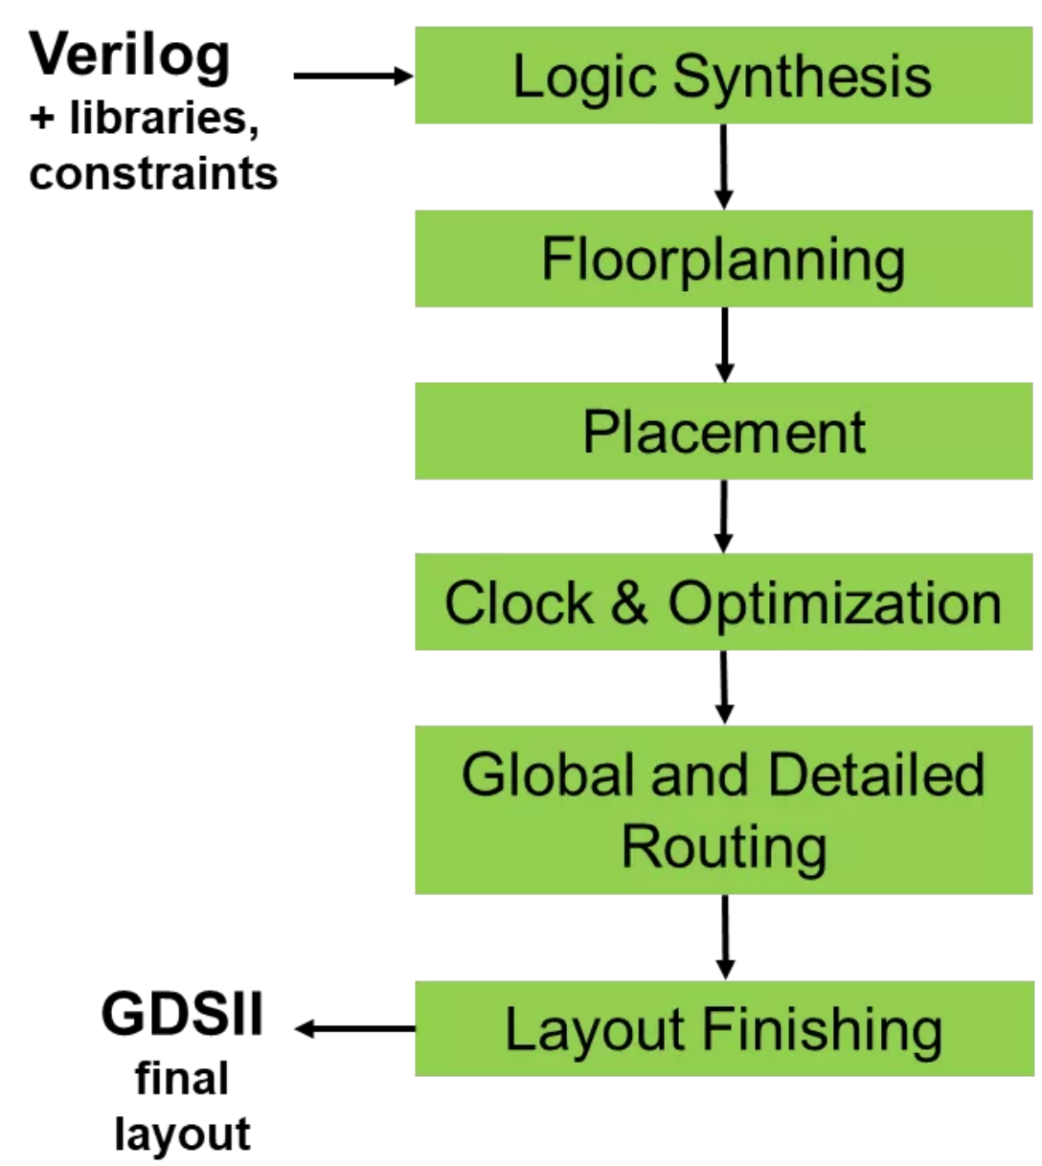
Digital Backend Flow
The RTL design is synthesized into a gate-level netlist.
Decide on the chip area and set memory macros location in the chip.
The synthesized gates are placed in the chip according to the floorplan.
A clock tree is generated to distribute the clock signal throughout the chip, while minimizing skew and ensuring timing requirements are met.
The global routing involves determining the overall routing paths between the blocks and macros; The detailed routing creates the actual metal interconnects between the gates.
Design rule checking: Once the routing is complete, the design is checked against a set of design rules to ensure that it is manufacturable.

Slide 15
Session Objectives
Pipelined processor
MULT2
Pipelined processor
Introduce the relevant pipeline registers to cpu.v to support pipelined execution
Run MULT2
Run backend flow, track the timing and area change along the steps. Also, visualize the chip formation along the steps.
# load operands
ld x8, 0(x0)
ld x9, 8(x0)
ld x10, 16(x0)
ld x11, 24(x0)
ld x12, 32(x0)
ld x13, 40(x0)
ld x14, 48(x0)
ld x15, 56(x0)
ld x16, 64(x0)
ld x17, 72(x0)
# multiplication
mul x18, x8, x9
mul x19, x10, x11
mul x20, x12, x13
mul x21, x14, x15
mul x22, x16, x17
#sums
addi x23, x0, 0
nop
nop
nop
add x23, x23, x18
nop
nop
nop
add x23, x23, x19
nop
nop
nop
add x23, x23, x20
nop
nop
nop
add x23, x23, x21
nop
nop
nop
add x23, x23, x22
nop
nop
nop
nop

