Slide 1
Computer Architectures Session 3
Pipelined microprocessor with control-hazard
Advanced acceleration
TAs :
Jun Yin (jun.yin@kuleuven.be)
Yuanyang Guo (yuanyang.guo@imec.be)
Linyan Mei (linyan.mei@kuleuven.be)
Yunzhu Chen (yunzhu.chen@imec.be)

Slide 2


Last session
Session 1
Session 2
Session 3
Single cycle processor skeleton
Functional single cycle processor
Single cycle processor with multiplication
Pipelined processor
Pipelined processor with data hazard resolution
Advanced acceleration
Simulation
Backend flow (synthesis only)
Backend flow (complete)

Slide 3
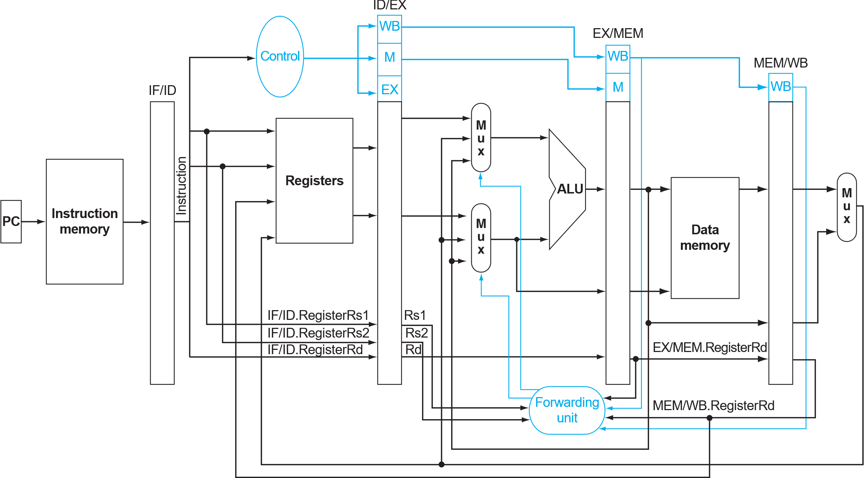
Last session
Pipelined Processor
Mult2
Backend complete
Prerequisite for this session!

Slide 4
This session: Data hazard resolution
Session 1
Session 2
Session 3
Single cycle processor skeleton
Functional single cycle processor
Single cycle processor with multiplication
Pipelined processor
Pipelined processor with data hazard resolution
Advanced acceleration
Simulation
Backend flow (synthesis only)
Backend flow (complete)

Slide 5
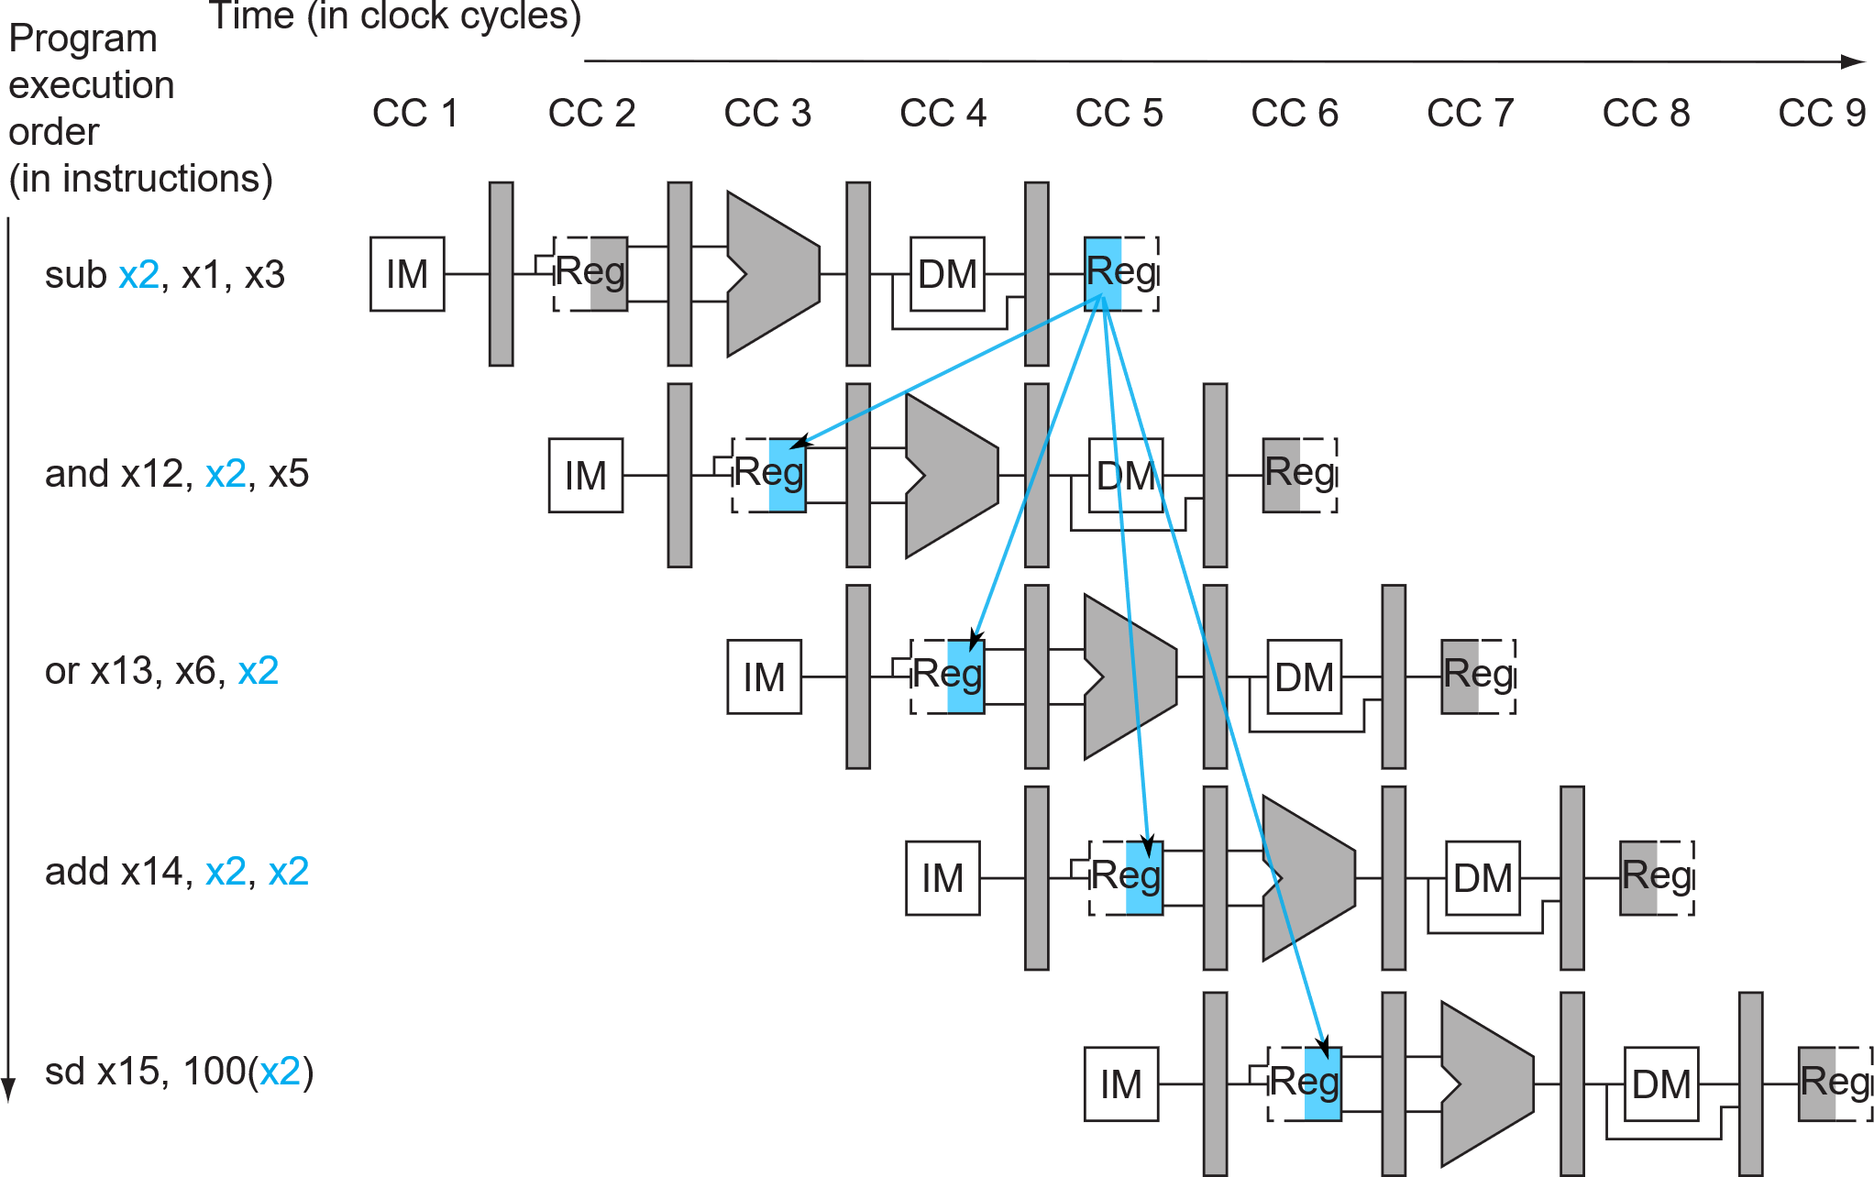
Data Hazard Example
Forwarding already known results
Patterson Book. FIGURE 4.50

Slide 6
Data Hazard Example
Forwarding already known results
Patterson Book. FIGURE 4.51

Slide 7
Data Hazard resolution
MULT2
MULT3
# load operands ld x8, 0(x0) ld x9, 8(x0) ld x10, 16(x0) ld x11, 24(x0) ld x12, 32(x0) ld x13, 40(x0) ld x14, 48(x0) ld x15, 56(x0) ld x16, 64(x0) ld x17, 72(x0) # multiplication mul x18, x8, x9 mul x19, x10, x11 mul x20, x12, x13 mul x21, x14, x15 mul x22, x16, x17 #sums addi x23, x0, 0 nop nop nop add x23, x23, x18
# load operands ld x8, 0(x0) ld x9, 8(x0) ld x10, 16(x0) ld x11, 24(x0) ld x12, 32(x0) ld x13, 40(x0) ld x14, 48(x0) ld x15, 56(x0) ld x16, 64(x0) ld x17, 72(x0)
# multiplication mul x18, x8,x9 mul x19, x10, x11 mul x20, x12, x13 mul x21, x14, x15 mul x22, x16, x17
#sums addi x23, x0, 0 add x23, x23, x18 add x23, x23, x19 add x23, x23, x20 add x23, x23, x21 add x23, x23, x22
Why the nops ?
nop
nop
nop
add x23, x23, x19
nop
nop
nop
add x23, x23, x20
nop
nop
nop
add x23, x23, x21
nop
nop
nop
add x23, x23, x22
nop
nop
nop
nop
nop
nop
nop
nop
Pipeline clean up is still required!
x23 dependency
Pipeline clean up
Data Hazard resolved!

Slide 8
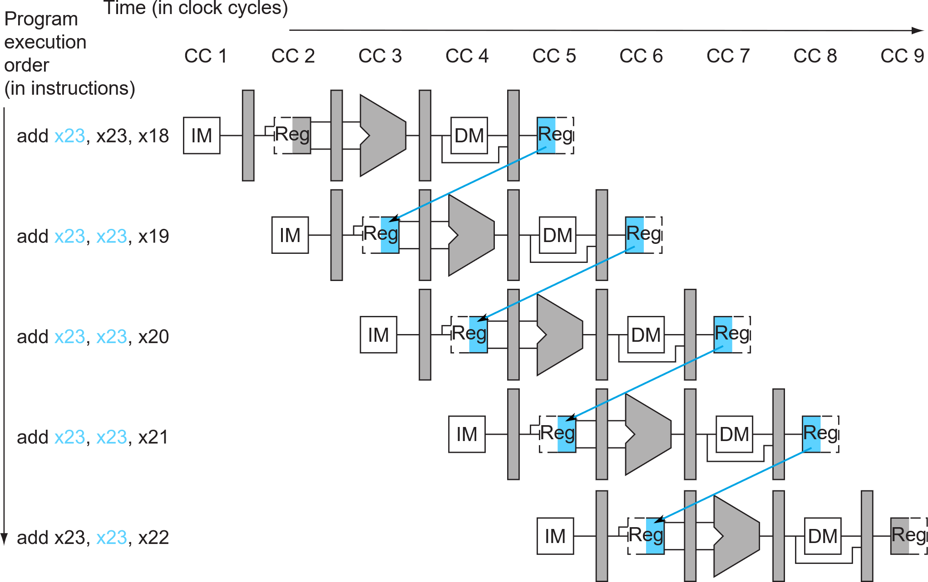
Data Hazard Example – MULT3

Slide 9
Data Hazard Example – MULT3
Forwarding already known add result
Notes:
rs1_ID_EX == rd_EX_MEM ?

Slide 10
Forward unit
Forwards operands to the ALU from wherever they are available

Slide 11
Session Objectives
MULT3
Pipelined processor with data hazard resolution
Introduce a forwarding unit forward_unit.v to cpu.v to support pipelined execution
Run MULT3
Synthesize
# load operands ld x8, 0(x0) ld x9, 8(x0) ld x10, 16(x0) ld x11, 24(x0) ld x12, 32(x0) ld x13, 40(x0) ld x14, 48(x0) ld x15, 56(x0) ld x16, 64(x0) ld x17, 72(x0)
# multiplication mul x18, x8,x9 mul x19, x10, x11 mul x20, x12, x13 mul x21, x14, x15 mul x22, x16, x17
#sums addi x23, x0, 0 add x23, x23, x18 add x23, x23, x19 add x23, x23, x20 add x23, x23, x21 add x23, x23, x22
Tips:
Do not forget to update designlist.tcl and files_Verilog.f, if you add new RTL source file.
Please refer to the mux-2 to customize a mux-3, if needed.
Do not forget to add/modify all the signal wires in the top cpu.v according to your new modules.

Slide 12
This session: Data hazard resolution
Session 1
Session 2
Session 3
Single cycle processor skeleton
Functional single cycle processor
Single cycle processor with multiplication
Pipelined processor
Pipelined processor with data hazard resolution
Advanced acceleration
Simulation
Backend flow (synthesis only)
Backend flow (complete)

Slide 13
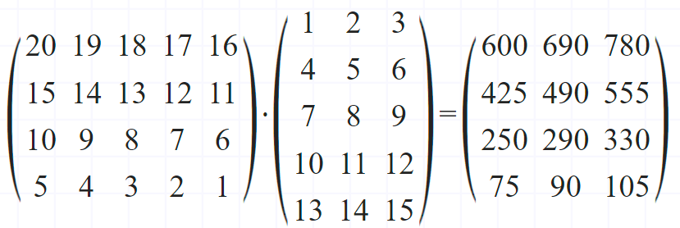
Session Objectives
Testing example:
(B = 4, K = 3, C = 5)
Matrix-matrix multiplication (MULT4)
To calculate the multiplications of the matrices stored in mult4_dmem_content.txt
modifying your RTL design
modifying the mult4_imem
or both …
Run your-version MULT4
Synthesize
I[B][C]
W[K][C]
O[B][K]
mult4_dmem_content data layout:
[Addr/8]
0
19
20
34
35
46
20
19
18
…
1
4
7
…
600
690
780
…
I[B][C]
(given)
Row-major
W[K][C]
(given)
Column-major
O[B][K]
(expected)
Row-major
We check on this part!
Notes:
[Jun-0324]:
+ dmem addr index
+ dmem data layout

Slide 14
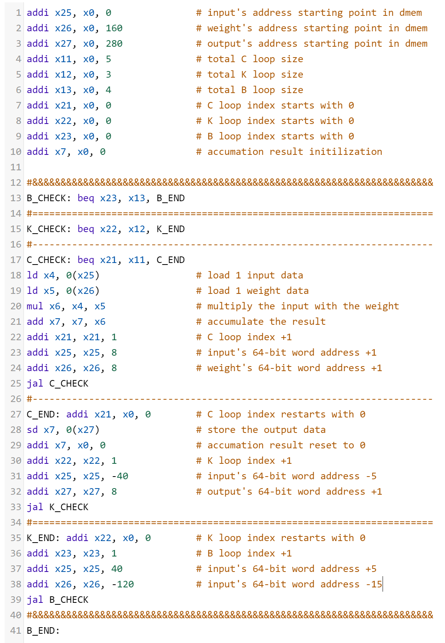
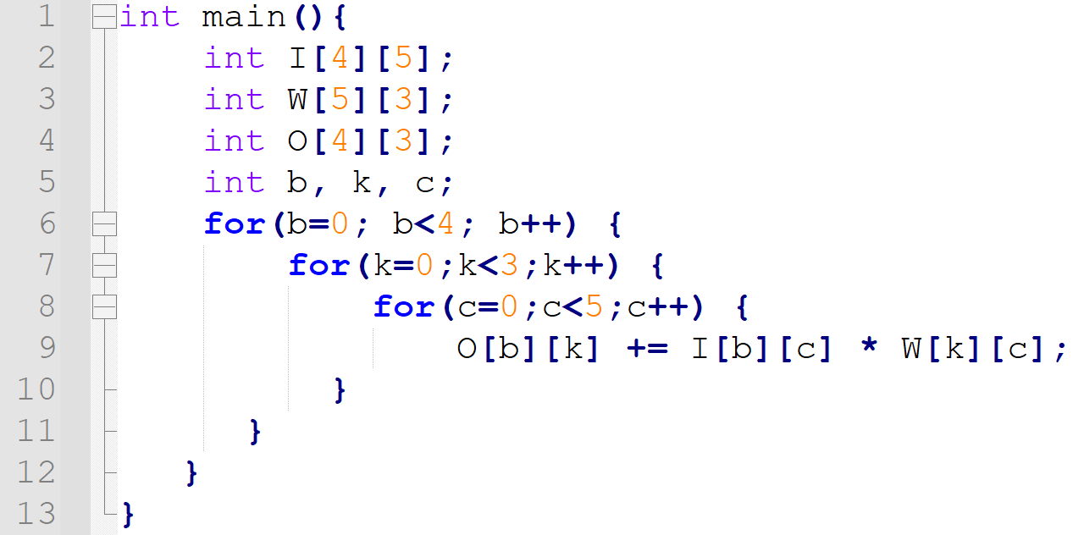
RISC-V assembly code
MULT 4: our baseline solution
C code:
I[B][C]
W[K][C]
O[B][K]
Testing example:
(B = 4, K = 3, C = 5)
I[B][C]
W[K][C]
O[B][K]
Required modifications to the architecture
Full data forwarding logic
Hazard detection unit (control/data hazard)
Notes:
[Jun-0324]:
+ diagram
+ todo list

Slide 15
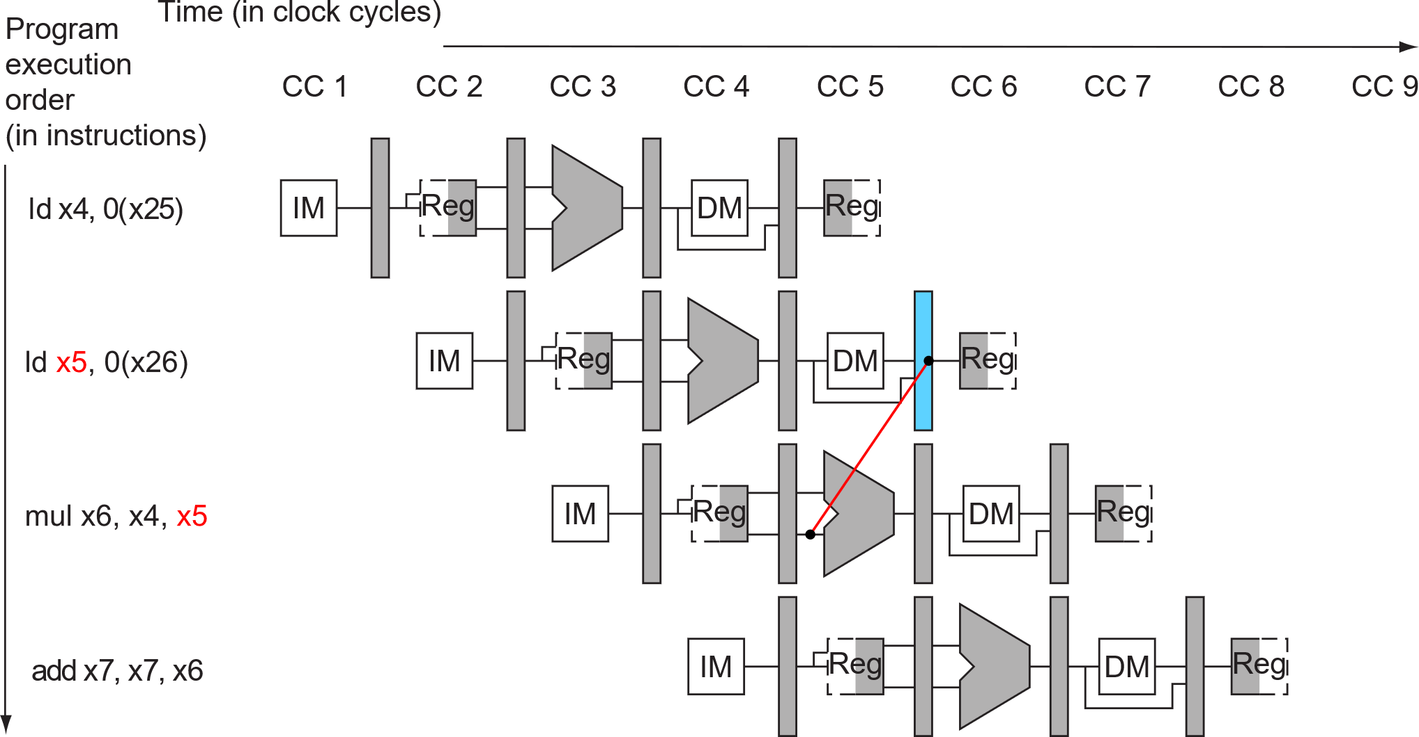
I. Full data forwarding logic (Book §4.7)
MULT4:
addi x25, x0, 0 # input's address starting point in dmem addi x26, x0, 160 # weight's address starting point in dmem addi x27, x0, 280 # output's address starting point in dmem addi x11, x0, 5 # total C loop size addi x12, x0, 3 # total K loop size addi x13, x0, 4 # total B loop size addi x21, x0, 0 # C loop index starts with 0 addi x22, x0, 0 # K loop index starts with 0 addi x23, x0, 0 # B loop index starts with 0 addi x7, x0, 0 # accumulation result initialization B_CHECK: beq x23, x13, B_END K_CHECK: beq x22, x12, K_END C_CHECK: beq x21, x11, C_END ld x4, 0(x25) # load 1 input data ld x5, 0(x26) # load 1 weight data mul x6, x4, x5 # multiply the input with the weight add x7, x7, x6 # accumulate the result addi x21, x21, 1 # C loop index +1 addi x25, x25, 8 # input's 64-bit word address +1 addi x26, x26, 8 # weight's 64-bit word address +1 jal C_CHECK C_END: addi x21, x0, 0 # C loop index restarts with 0 sd x7, 0(x27) # store the output data addi x7, x0, 0 # accumulation result reset to 0 addi x22, x22, 1 # K loop index +1 addi x25, x25, -40 # input's 64-bit word address -5 addi x27, x27, 8 # output's 64-bit word address +1 jal K_CHECK K_END: addi x22, x0, 0 # K loop index restarts with 0 addi x23, x23, 1 # B loop index +1 addi x25, x25, 40 # input's 64-bit word address +5 addi x26, x26, -120 # input's 64-bit word address -15 jal B_CHECK B_END:
Notes:
[Jun-0324]: + slide order change

Slide 16
Previous session’s data Hazard Example
Necessity for MULT3
New register_file.v
(we write it for you, next slide)
Patterson Book. FIGURE 4.51
Notes:
[Jun-0324]:
- replace “Forwarding already known results”
- delete the 2nd arrow: it was not covered/needed previously. Part of this session’s forwarding — the data forwarding after 1-cycle stall.
+ condition explanation

Slide 17
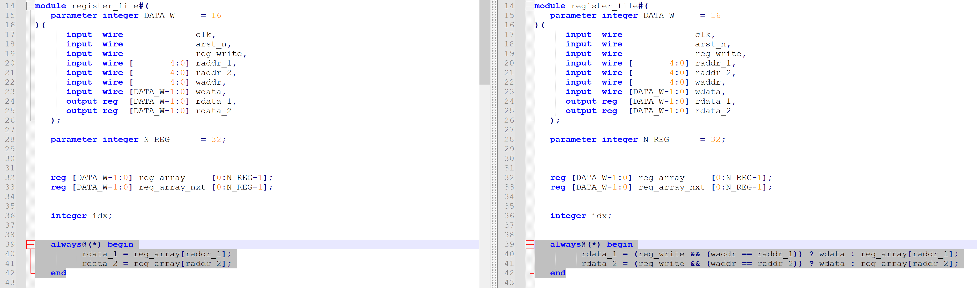
Update the register_file.v
Line 40 and 41
Original
New
To enable data forwarding from WB stage to ID stage

Slide 18
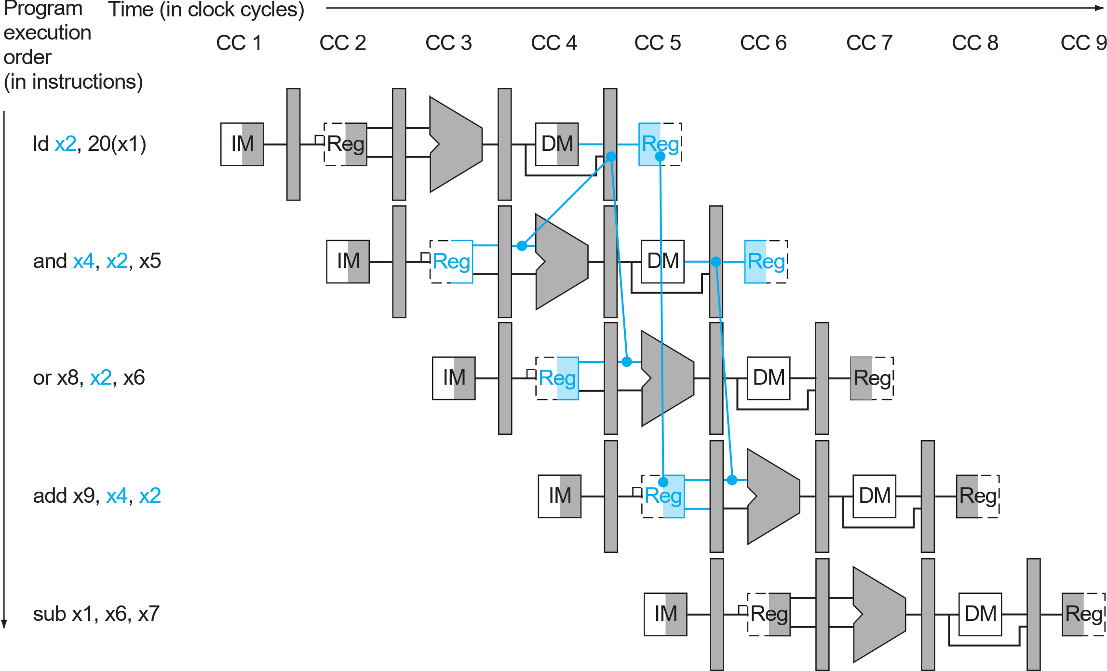
This session’s data Hazard Example
Can’t get data from the future.
We need to stall the “and” instruction.
Load and use
Patterson Book. FIGURE 4.56
Notes:
[Jun-0324]: + explanation

Slide 19
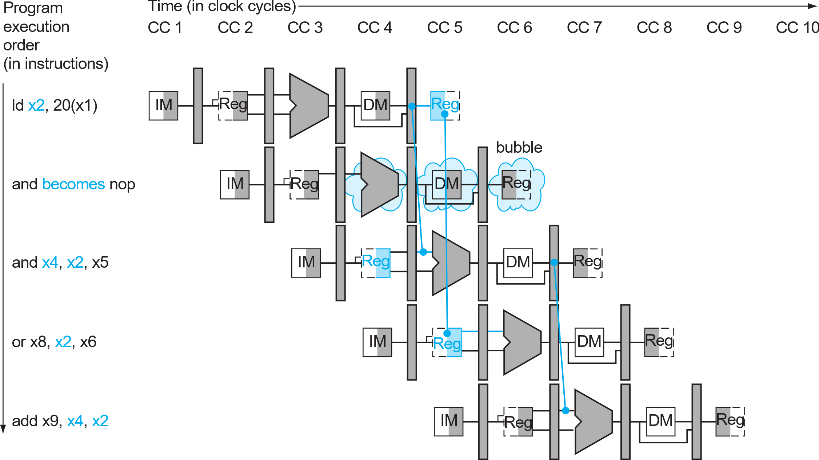
This session’s data Hazard Example
After 1-cycle stall, the hazard between [ld] and [and] becomes a normal WB->EX forwarding.
Load and use
Notes:
[Jun-0324]: + explanation

Slide 20
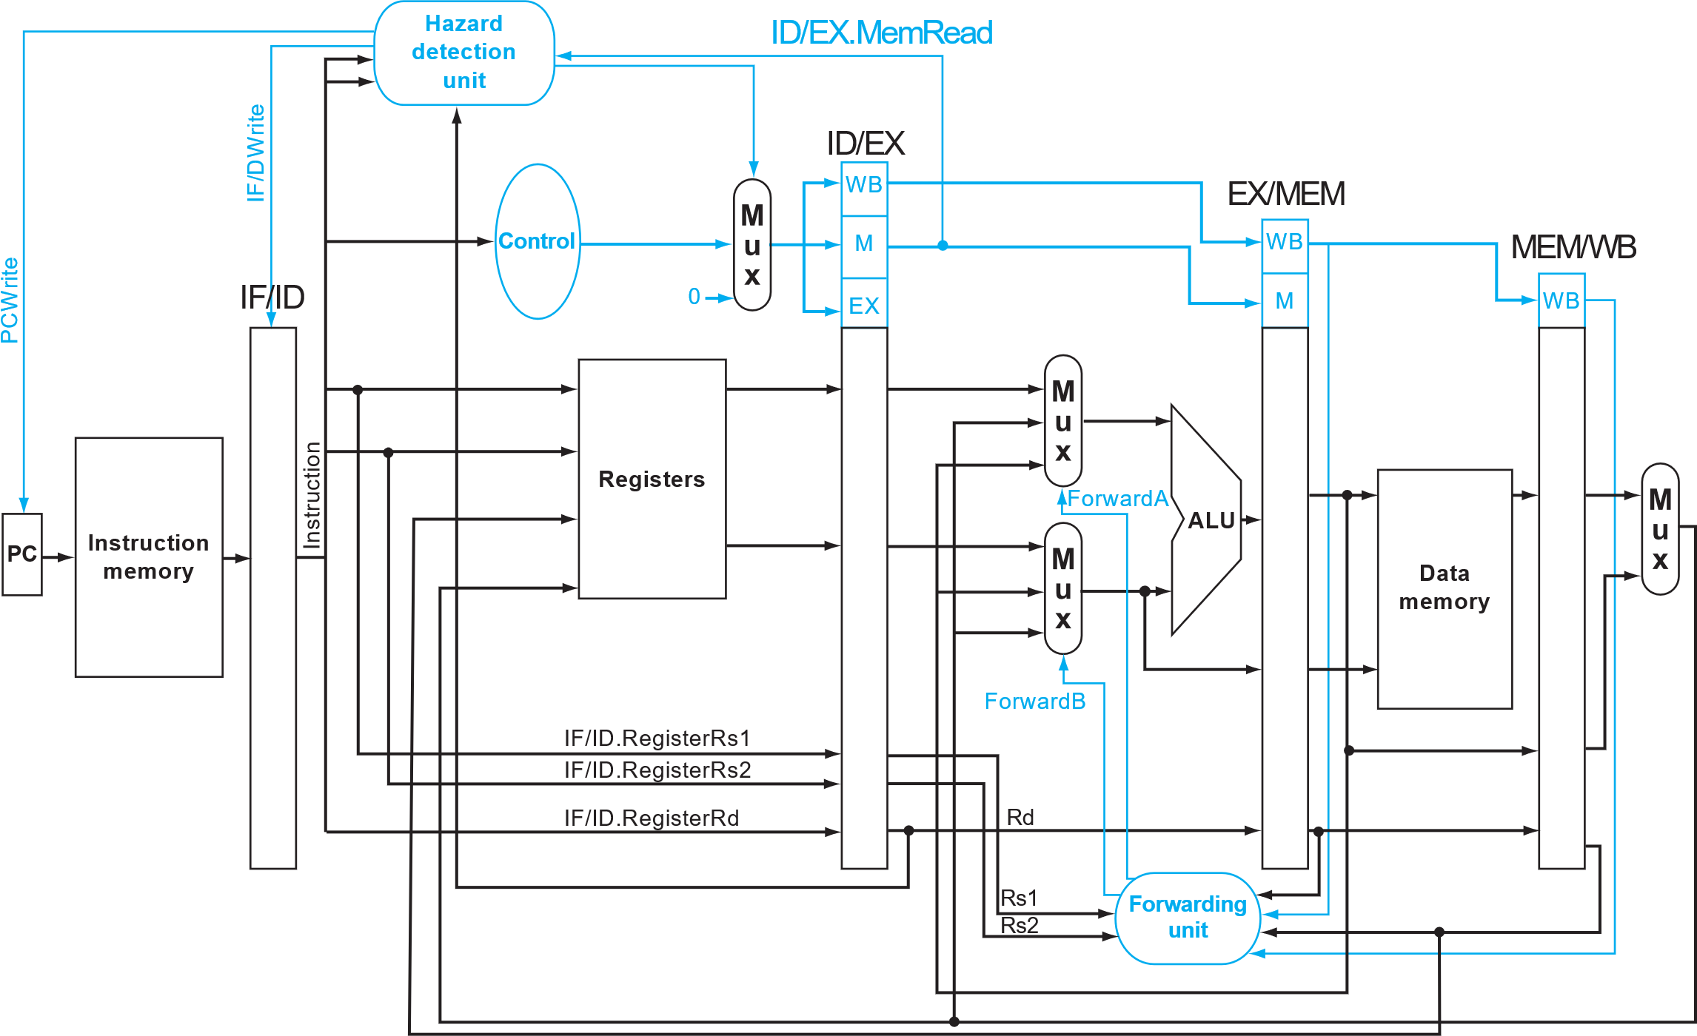
Stalling with Hazard detection unit
1.
Stop control signal propagation if stall
To be implemented:
Stall
WB->EX forwarding
Prevent PC and IF/ID register updates if hazard is detected
2.
Patterson Book. FIGURE 4.58

Slide 21
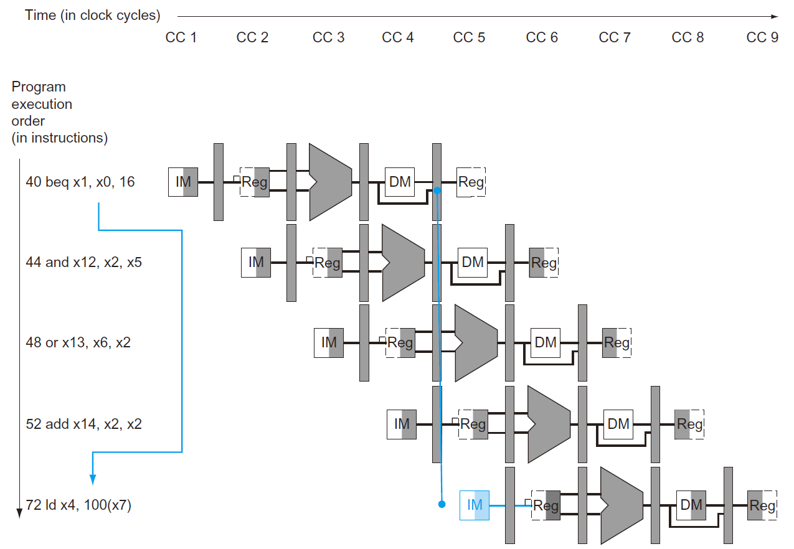
II. Control Hazard solution (Book §4.8)
MULT4:
Control Hazard:
addi x25, x0, 0 # input's address starting point in dmem addi x26, x0, 160 # weight's address starting point in dmem addi x27, x0, 280 # output's address starting point in dmem addi x11, x0, 5 # total C loop size addi x12, x0, 3 # total K loop size addi x13, x0, 4 # total B loop size addi x21, x0, 0 # C loop index starts with 0 addi x22, x0, 0 # K loop index starts with 0 addi x23, x0, 0 # B loop index starts with 0 addi x7, x0, 0 # accumulation result initialization B_CHECK: beq x23, x13, B_END K_CHECK: beq x22, x12, K_END C_CHECK: beq x21, x11, C_END ld x4, 0(x25) # load 1 input data ld x5, 0(x26) # load 1 weight data mul x6, x4, x5 # multiply the input with the weight add x7, x7, x6 # accumulate the result addi x21, x21, 1 # C loop index +1 addi x25, x25, 8 # input's 64-bit word address +1 addi x26, x26, 8 # weight's 64-bit word address +1 jal C_CHECK C_END: addi x21, x0, 0 # C loop index restarts with 0 sd x7, 0(x27) # store the output data addi x7, x0, 0 # accumulation result reset to 0 addi x22, x22, 1 # K loop index +1 addi x25, x25, -40 # input's 64-bit word address -5 addi x27, x27, 8 # output's 64-bit word address +1 jal K_CHECK K_END: addi x22, x0, 0 # K loop index restarts with 0 addi x23, x23, 1 # B loop index +1 addi x25, x25, 40 # input's 64-bit word address +5 addi x26, x26, -120 # input's 64-bit word address -15 jal B_CHECK B_END:

Slide 22
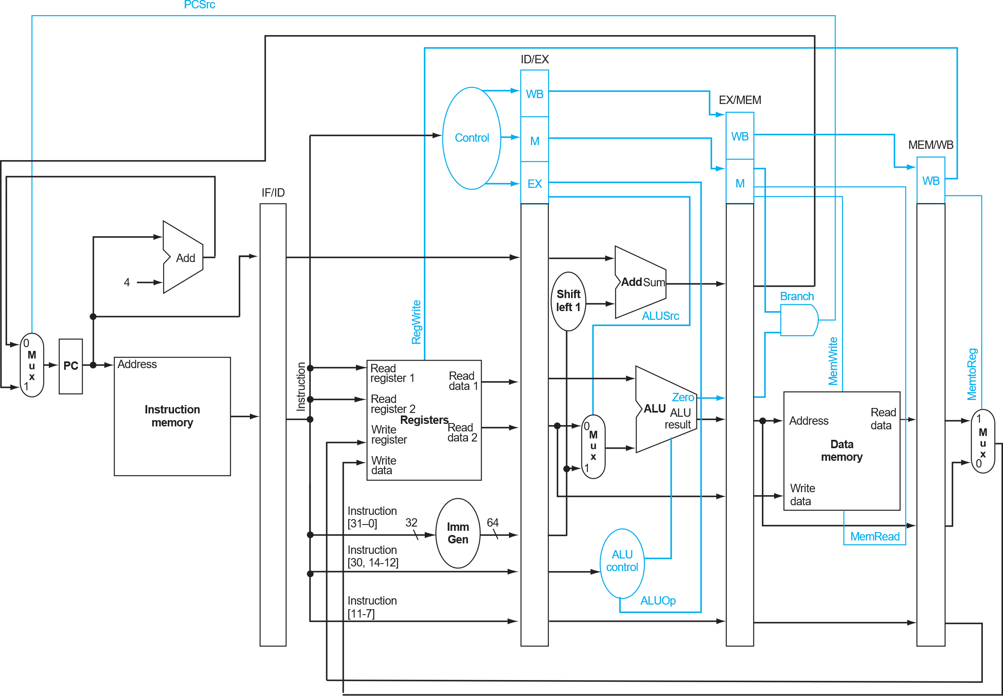
Control Hazard
Recall §4.6:
We know if the branch was taken at the MEM stage.
Patterson Book. FIGURE 4.49

Slide 23
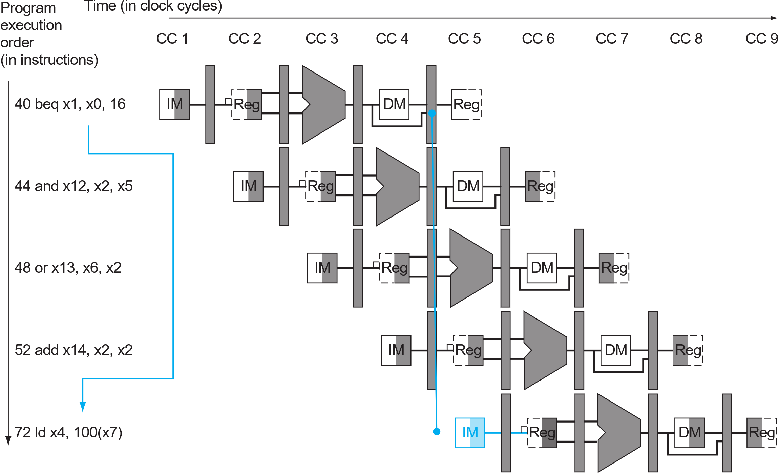
Control Hazard
Recall §4.6:
By that time, 3 instructions are already in the pipeline.
They should be discarded, hence 3 cycles are wasted (§4.8.1).
These should be discarded
Branch was taken

Slide 24
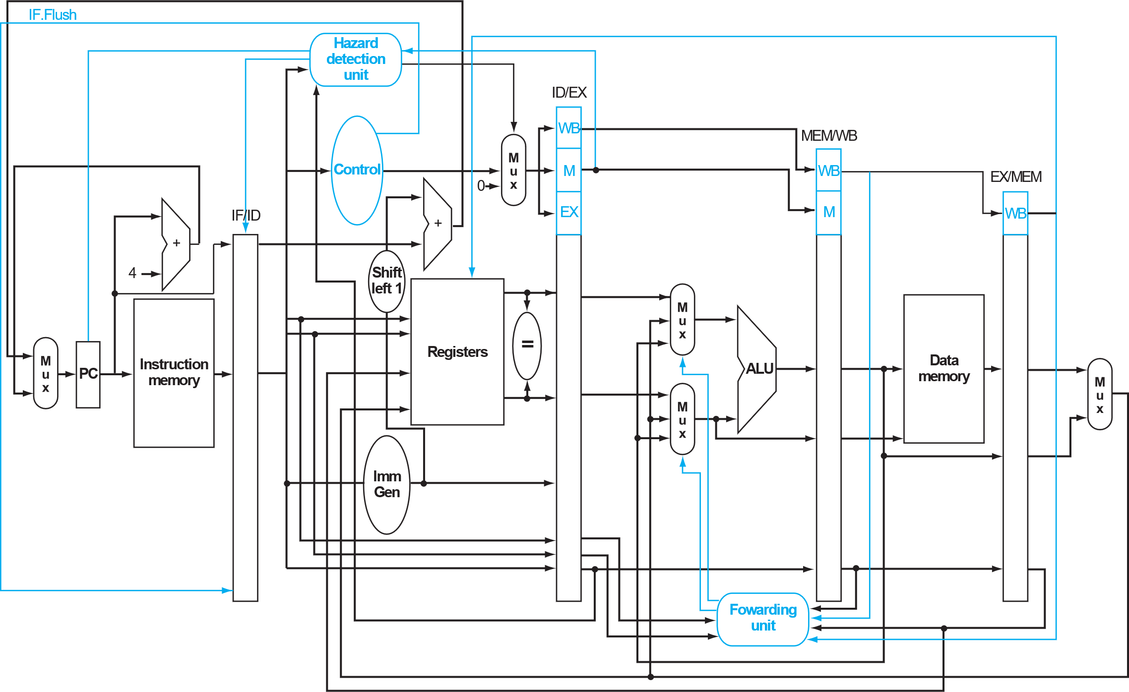
Control Hazard - Our baseline
To save this overhead:
Make branch/jump decision ASAP (at the ID stage, §4.8.2).
This is our baseline architecture for MULT4 （in terms of saving the total cycle amount).
branch_unit (pc value)
We still use the branch-not-taken prediction (in our baseline).
ID judges the branch/jump.
IF basically fetches imem[PC+4].
If branch-taken/jump, next PC is overwritten and the false IF instruction is flushed before next clock edge comes.
Feel free to use different prediction scheme if you find it valuable(§4.8.3).
branch
taken?
Flush instruction if branch is taken (§4.8.2)
Patterson Book. FIGURE 4.62

Slide 25
III. PLAN B – hazards can be solved with nop insertion
[Fail-Safe] If the deadline is right ahead,
at least make your processor functional on MULT4!
Understand the program, locate the hazard, understand your design, upgrade the imem…
addi x25, x0, 0 # input's address starting point in dmem addi x26, x0, 160 # weight's address starting point in dmem addi x27, x0, 280 # output's address starting point in dmem addi x11, x0, 5 # total C loop size addi x12, x0, 3 # total K loop size addi x13, x0, 4 # total B loop size addi x21, x0, 0 # C loop index starts with 0 addi x22, x0, 0 # K loop index starts with 0 addi x23, x0, 0 # B loop index starts with 0 addi x7, x0, 0 # accumulation result initialization B_CHECK: beq x23, x13, B_END nop nop nop K_CHECK: beq x22, x12, K_END nop nop nop C_CHECK: beq x21, x11, C_END nop nop nop
ld x4, 0(x25) # load 1 input data ld x5, 0(x26) # load 1 weight data nop mul x6, x4, x5 # multiply the input with the weight add x7, x7, x6 # accumulate the result addi x21, x21, 1 # C loop index +1 addi x25, x25, 8 # input's 64-bit word address +1 addi x26, x26, 8 # weight's 64-bit word address +1 jal C_CHECK nop nop nop C_END: addi x21, x0, 0 # C loop index restarts with 0 sd x7, 0(x27) # store the output data addi x7, x0, 0 # accumulation result reset to 0 addi x22, x22, 1 # K loop index +1 addi x25, x25, -40 # input's 64-bit word address -5 addi x27, x27, 8 # output's 64-bit word address +1 jal K_CHECK nop nop nop K_END: addi x22, x0, 0 # K loop index restarts with 0 addi x23, x23, 1 # B loop index +1 addi x25, x25, 40 # input's 64-bit word address +5 addi x26, x26, -120 # input's 64-bit word address -15 jal B_CHECK nop nop nop B_END:
Don’t just copy and paste this one!
Understand your architecture and insert the necessary nops.
Hazard control and nop insertion are related
The better hazard control logic you have,
The fewer nops you will need,
The better performance you will achieve.

Slide 26
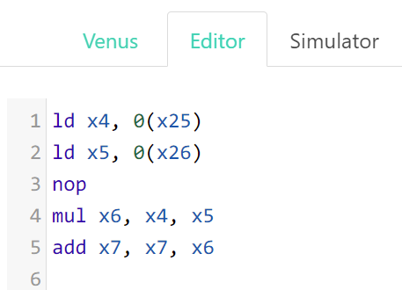
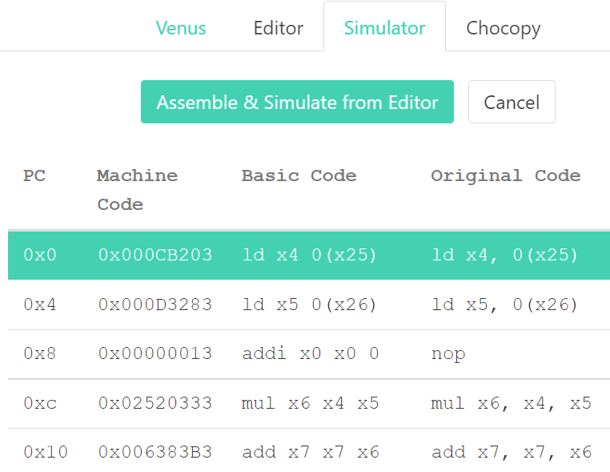
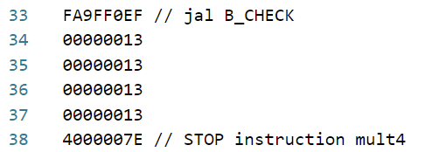
III. PLAN B – hazards can be solved with nop insertion
Whenever you change the program, DO NOT FORGET to regenerate the machine code (imem_content)!
Make use of the online tool we mentioned in session-1 (link-online-converter, link-github).
1. Paste your assembly code in Editor.
2. Go to Simulator and click the Green button.
3. Upgrade the imem_content (remove “0x”!).
4. Never forget to add the finishing line.

Slide 27
Session 3 Summary & Overall Grading Criterion
Grading
Objective
You are competing against our baseline implementation
Rules
Do NOT modify
mult4_dmem_content.txt
cpu_tb.v
Feel free to modify
All other RTL files
mult4_imem_content.txt
ITEM | Points
Functional pipelined MULT2 | 1.0
Functional pipelined MULT3 | 0.5
Functional MULT4 | 0.5
Functional MULT4 #cycles = baseline impl (844 cc) | 0.5
Functional MULT4 #cycles < baseline impl (844 cc) | 0.5
Report | 1.0
Total | 4.0
Project handover
Deadline: May 19th

Slide 28
Remarks
Useful resources to make it go faster!
Patterson Book. End of section 4.8 on branch prediction
Patterson Book. Section 4.10 on instruction parallelism
RISC-V specification. Chapter 17 on the “V” Standard Extension for Vector Operations
Be creative

