Slide 1
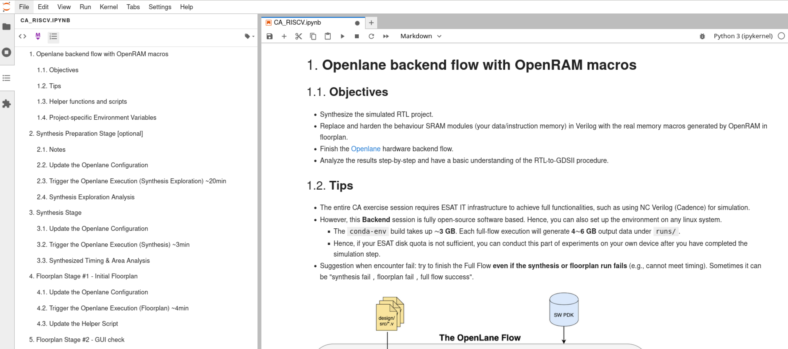
The first thing after you open Jupyter Notebook
Activate the index number

Slide 2
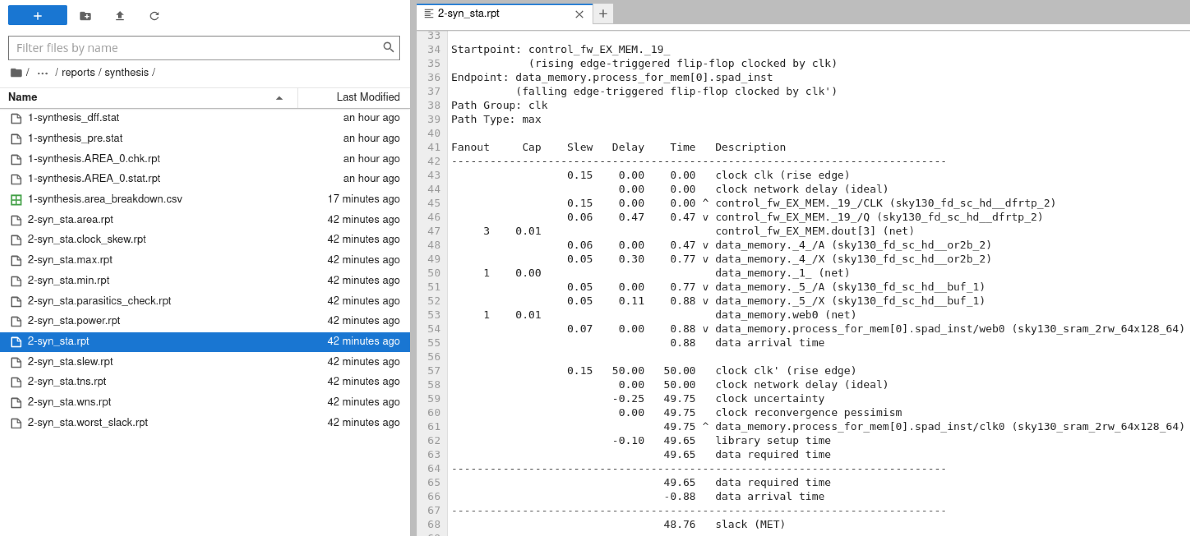
Timing [lots of steps]
Critical path
Clock margin (ns)
in reports/<the step>/x-<step name>_sta.rpt

Slide 3
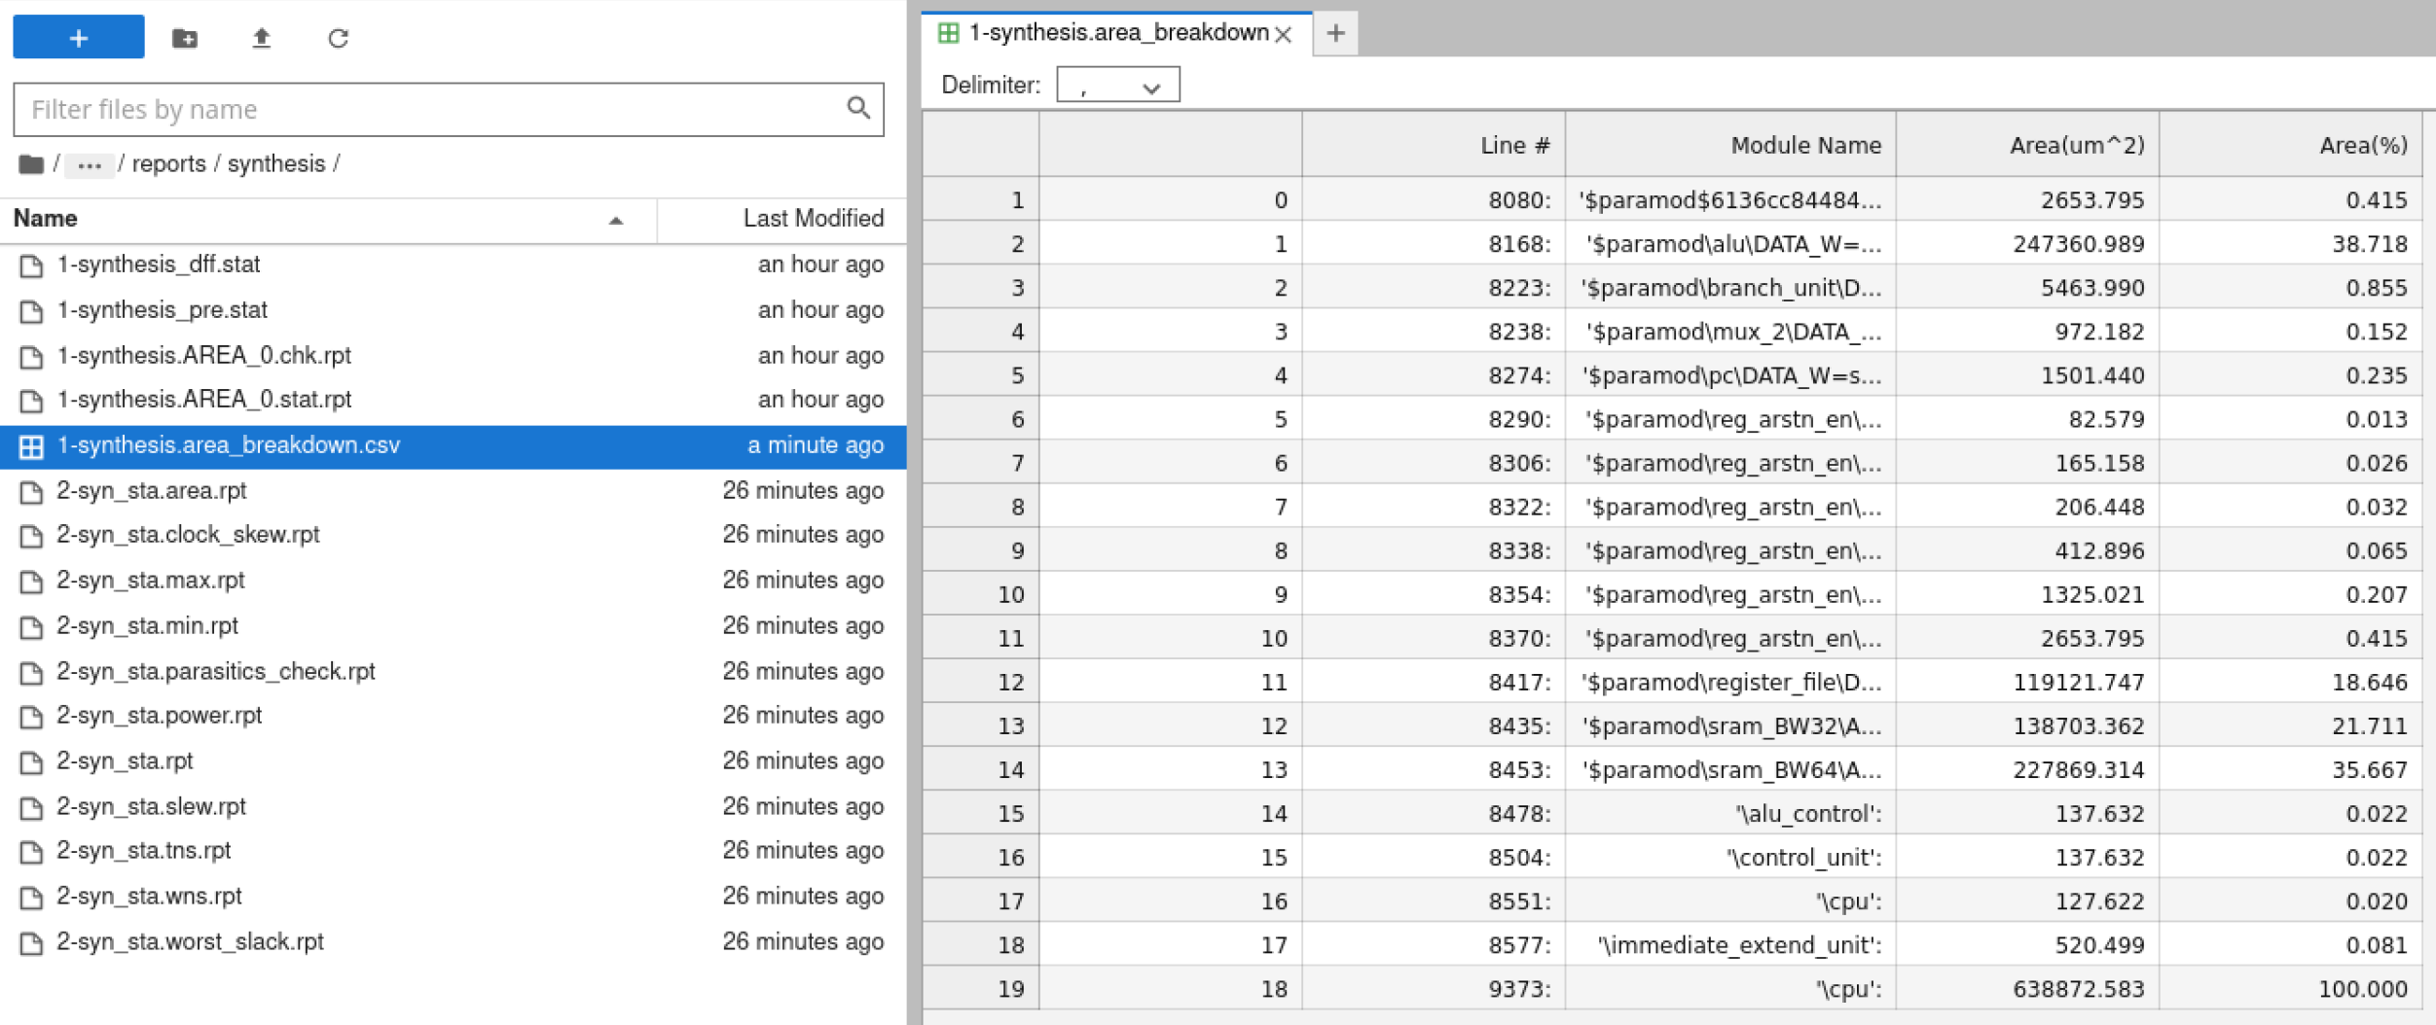
Design Area Break down [Synthesis]
Area breakdown
Total design area (after synthesis)
*You might need to rerun block 3.3 in the notebook to regenerate the table.
in reports/synthesis/1-synthesis.area_breakdown.csv

Slide 4
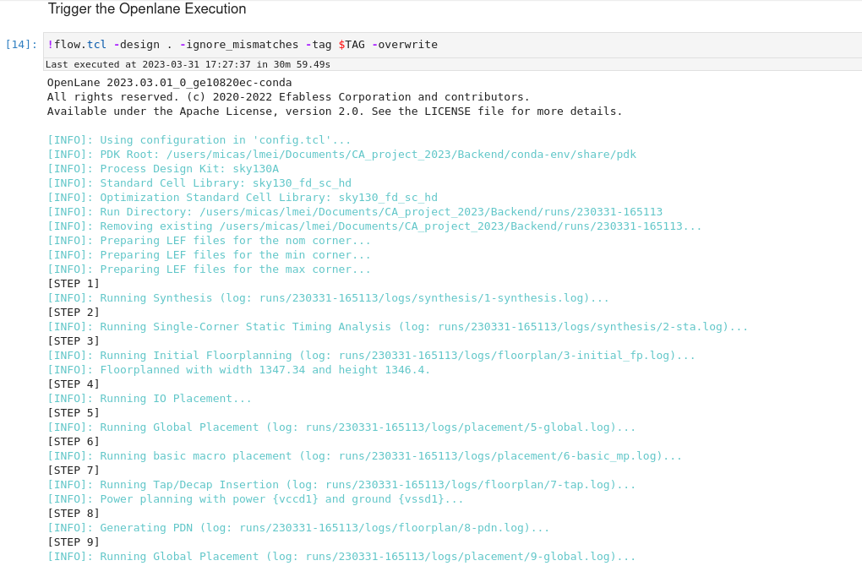
Die Area [Floorplan]
(Floorplan step)
Die area
You can also get it in reports/floorplan/
x-initial_fp_die_area.rpt

Slide 5
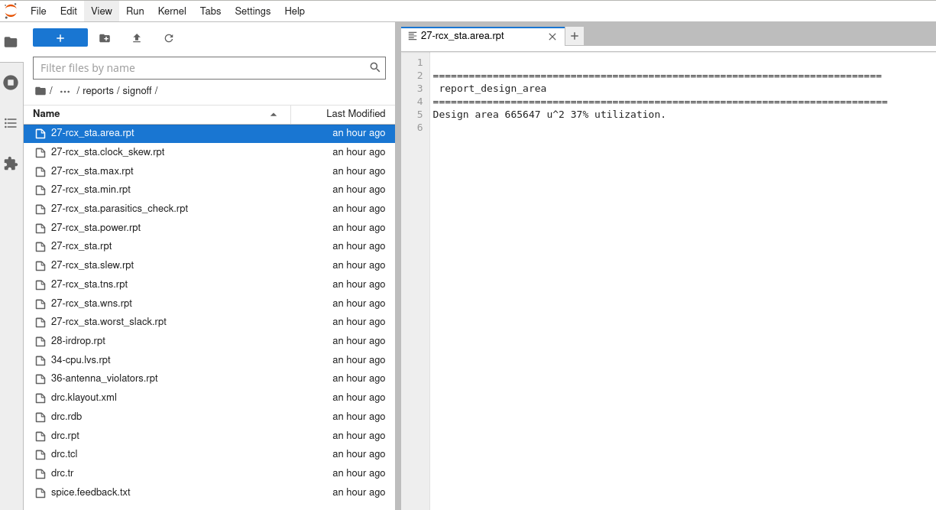
Area Utilization [Sign-off]
Total design area
(after signoff)
Sign-off area utilization
in reports/signoff/x-rcx_sta.area.rpt

