Slide 1
UE18CS390A – Capstone Project Approval
Project Title : Speech to presentation automation
Project ID : PW23_KSS_02
Project Guide : Prof Srinivas K S
Project Team : Medha Koppam - PES1UG20CS251
Rohan Mehta - PES1UG20CS350
Rudransh Kulkarni - PES1UG20CS361
Shruthi Pai - PES1UG20CS416

Slide 2
Outline
Problem Statement
Scope and Feasibility study
Applications/Use cases
Expected Deliverables
Capstone (Phase-I & Phase-II) Project Timeline
Any other information

Slide 3

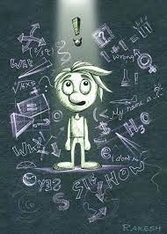
Problem Statement
Students (age 3-15) learn better by visual aids of the topics they’re learning.
Low investment by schools for creating interactive and engaging presentations.
No digital content.
Getting custom engaging graphics/vectors/images made/found can get expensive.
Only text presentations are hardly engaging.
Summaries for topics are hardly available.
Questions on topics are also hand-picked by teachers which consumes plenty of time on their end which could be invested elsewhere.

Slide 4

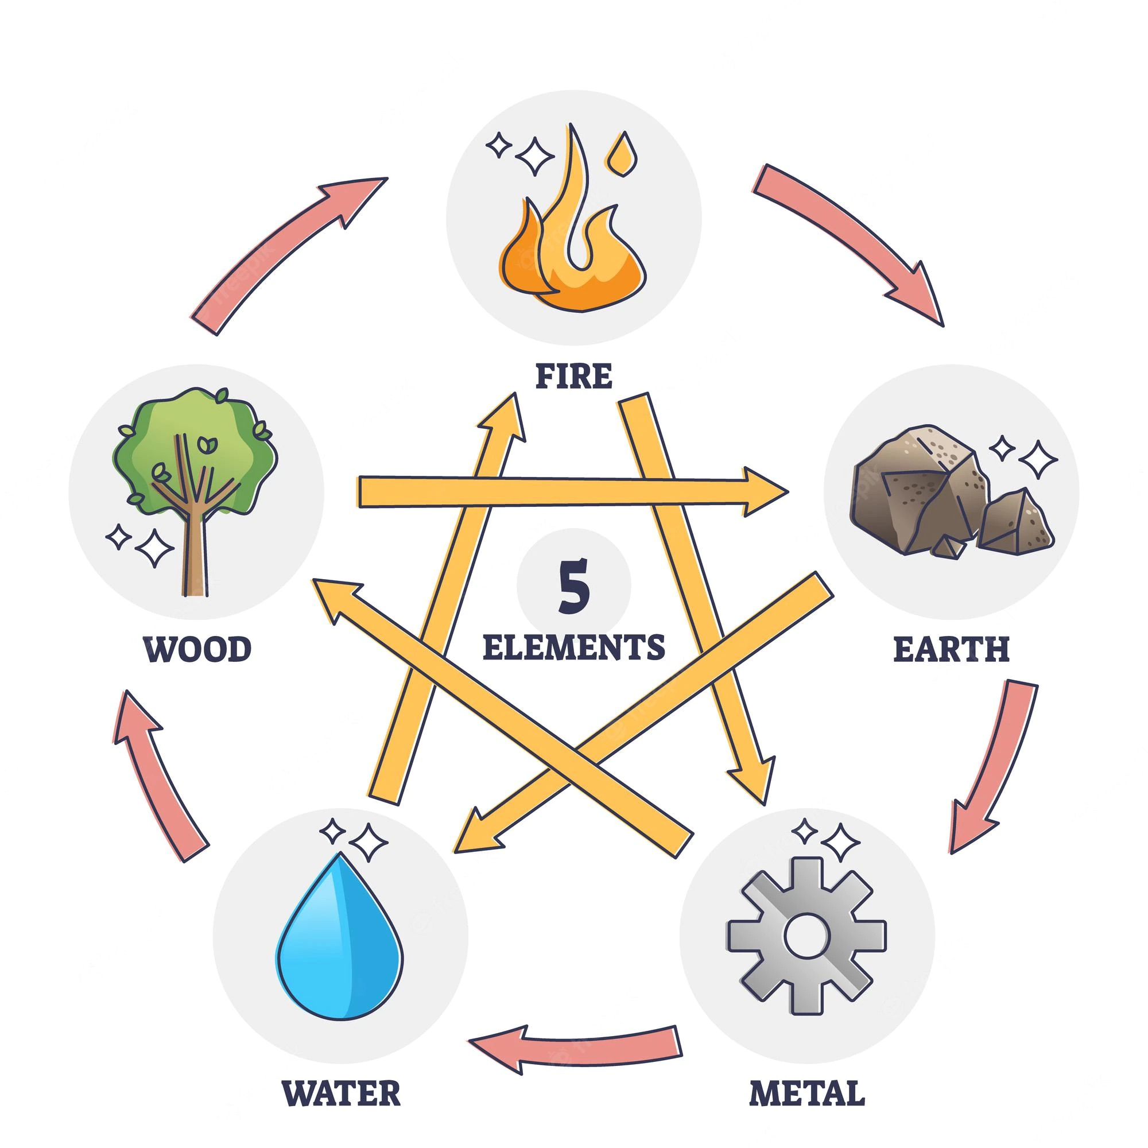
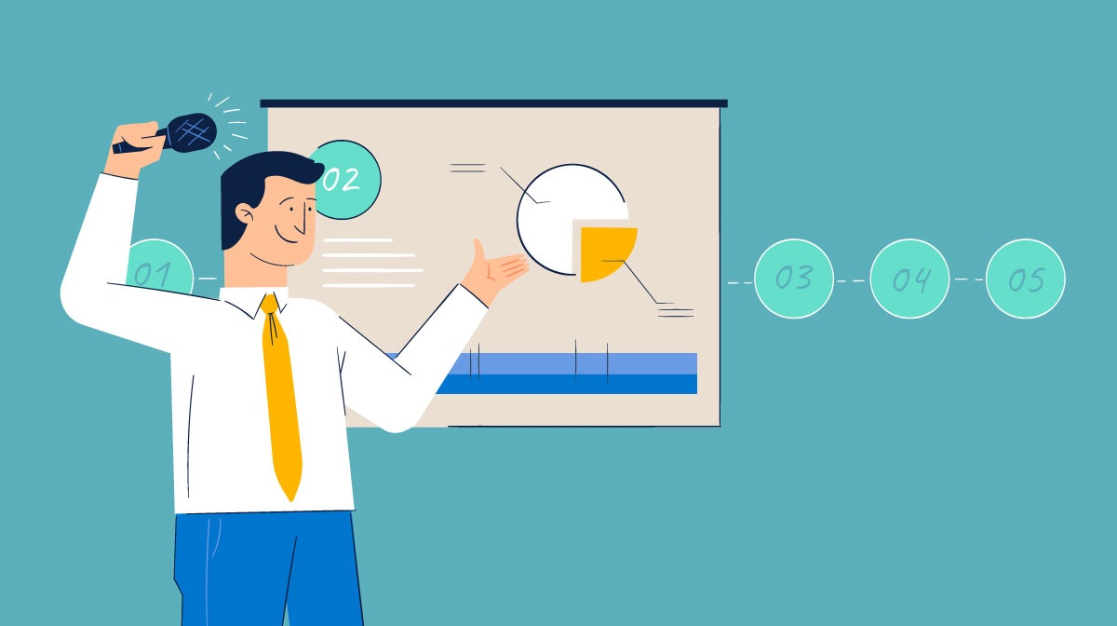
Solution
Input
  speech
  number of slides required
  institution logo (if needed)
From here, our product takes care of everything for you.
Output
  Each slide will have relevant, informative and visually appealing images/graphics/vectors.
  Important points are fetched from the input speech are represented as text on the slides to give a holistic understanding of the topic.
  Automatic module summaries will be generated for each presentation.
  Questions at the end of the module will be automatically generated by the AI using speech analysis to quiz the students.
Text

Slide 5


Scope
Personalisation
Us
Designs.ai
Beautiful.ai
Ease of use

Slide 6
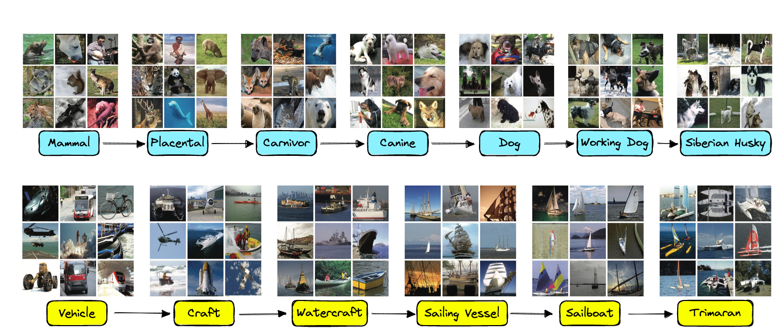
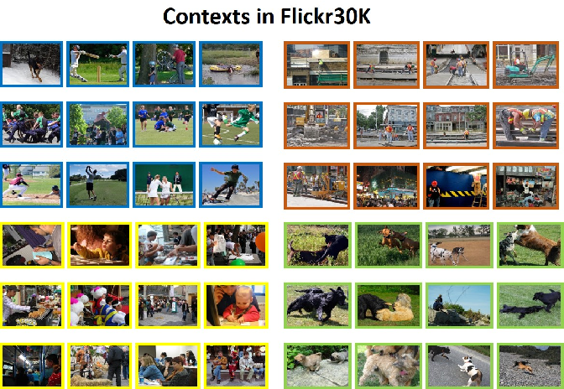
Feasibility study
Datasets
Flickr30k
ImageNet
COCO

Slide 7
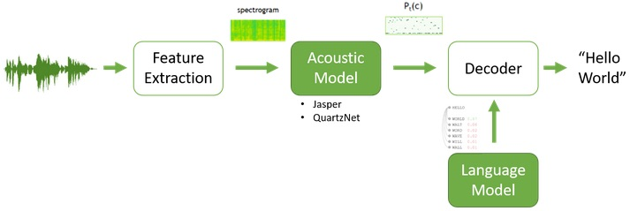
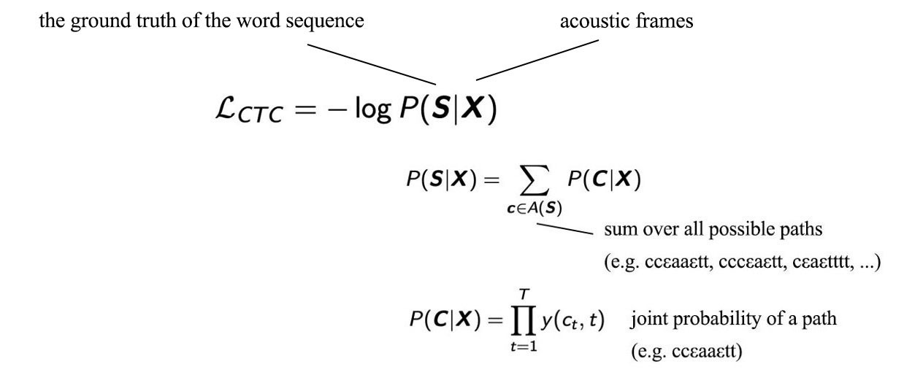
Feasibility study
Logic - speech to text - Acoustic model
Flowchart
Loss function

Slide 8
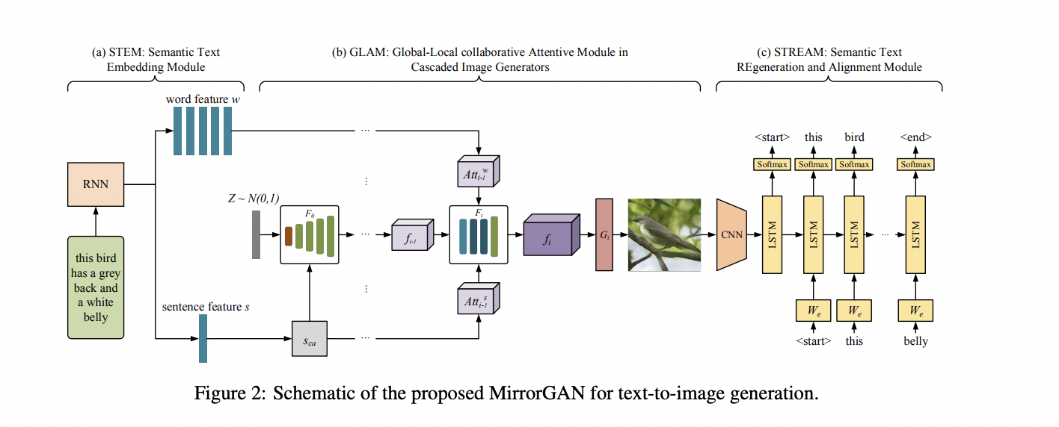
Feasibility study
Logic - Text to 2D image generation - MirrorGAN

Slide 9
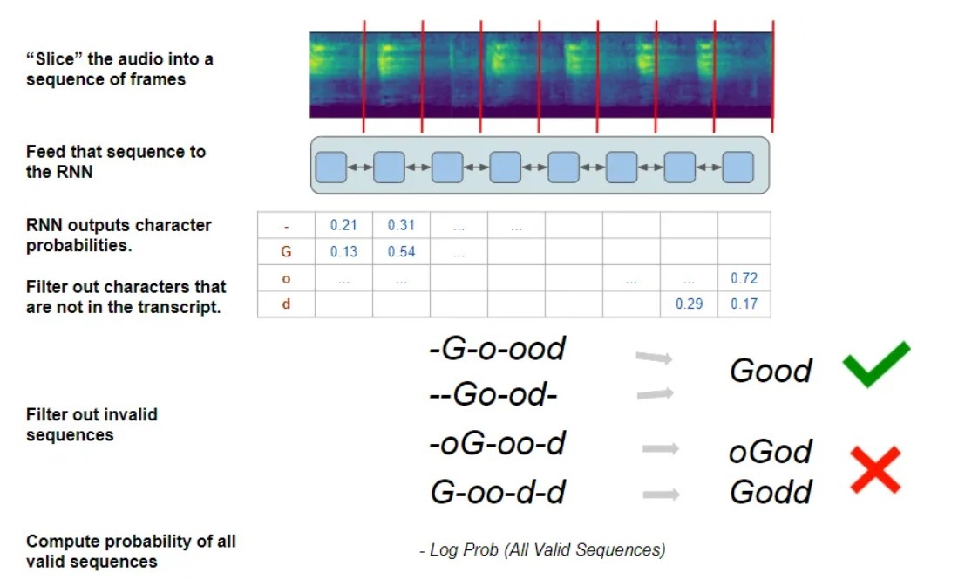
Feasibility study
Logic - Speech Analysis - RNN plus CNN
Loss function - CTC

Slide 10
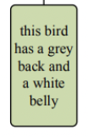

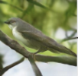
Feasibility study
Example input and output
Acoustic model
MirrorGAN
Text related to the context.
Speech
Text
Image generated
Presentation

Slide 11




Applications/Use cases

Slide 12
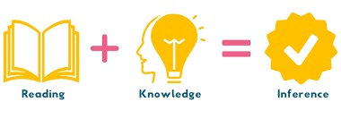
Literature Survey Inferences
Text to 2D using MirrorGAN which has sub modules such as STEM, GLAM and STREAM is a model which converts text to image to text to compare the text which was input
Speech analysis - there are many ways to approach it but a simple RNN and CNN with CTC loss function

Slide 13
Literature Survey Links
https://openaccess.thecvf.com/content_CVPR_2019/html/Qiao_MirrorGAN_Learning_Text-To-Image_Generation_by_Redescription_CVPR_2019_paper.html
https://www.section.io/engineering-education/speech-to-text-transcription-model-using-deep-speech/#:~:text=the%20Language%20model.-,Acoustic%20model,model%20used%20for%20speech%20recognition.
https://proceedings.neurips.cc/paper/2019/file/1d72310edc006dadf2190caad5802983-Paper.pdf
https://towardsdatascience.com/stacking-machine-learning-models-for-speech-sentiment-analysis-adf433488845
https://jonathan-hui.medium.com/speech-recognition-acoustic-lexicon-language-model-aacac0462639
https://towardsdatascience.com/stacking-machine-learning-models-for-speech-sentiment-analysis-adf433488845

Slide 14
Expected Deliverables
Capstone-I deliverables
Capstone-II deliverables

Slide 15
Capstone (Phase-I & Phase-II) Project Timeline
Provide
  The timelines for execution of the project through Gantt chart.
  The plan in terms of efforts by individuals in the team.
  Mention the tasks involved in different stages.

Slide 16
Any other information
Provide any other information you wish to add on.
Note: Changes can be made in the template, with the consent of the guide for inclusion of any other information.

Slide 17
Thank You

