Slide 1
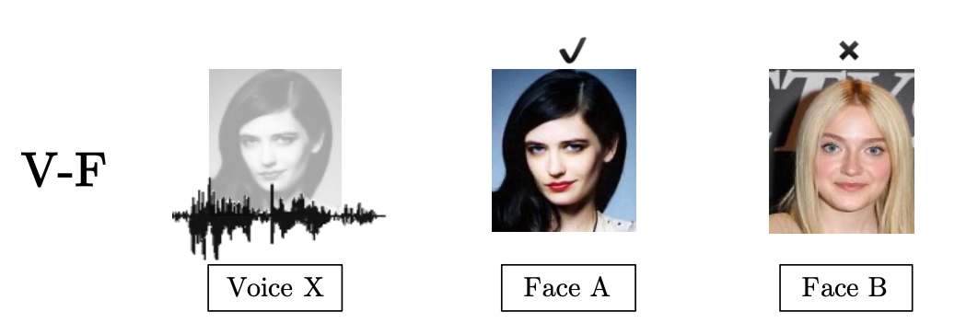
Voice Face Matching system
Submitted by:
Rudman Dmitry

Slide 2
Assignment Overview
Objective:
Develop a system that matches voice embeddings with corresponding face embeddings.
Methodology:
Embedding concatenation (baseline from the paper)
CLIP architecture adaptation (custom approach)
Evaluation Metrics:
Identification accuracy 1:2 - refers to the ability of the system to correctly identify the face associated with a given voice sample from a set of two face images. Since it is a 2-way forced choice, chance performance is 50%.

Slide 3
Dataset Overview
Image Embeddings:
Total 7,129 embeddings
Dimensions – (512,)
Audio Embeddings:
Total 32,090 embeddings
Dimensions – (192,)
After data exploration and cleansing we create triplets for training our models. For each triplet we match “positive” pair (corresponding audio and image indices) with sampled negative image index.
Each triplet consists of:
- The index of the audio embedding.
- The index of the positive image embedding.
- The index of the negative image embedding.
Total triplets: 70930
Training triplets: 57040
Validation triplets: 7160
Test triplets: 6730

Slide 4
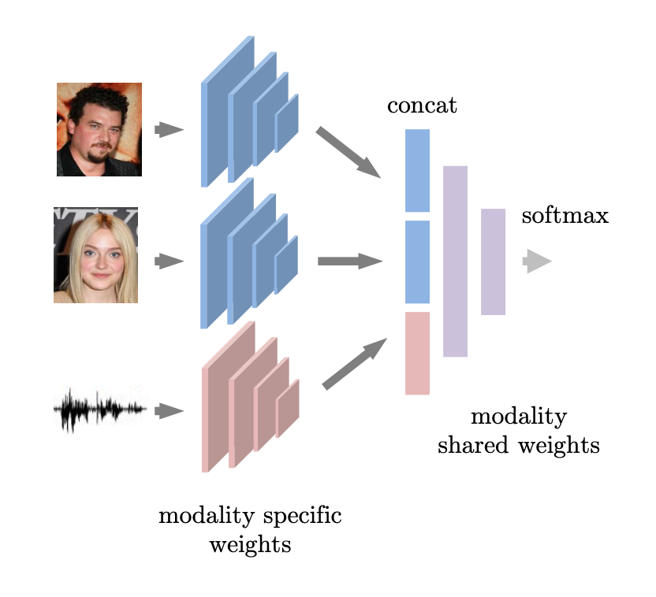
Baseline Model – Voice-Face Triplets Clasifier
Classifies triplets of voice and face embeddings to determine whether a given voice matches one of two faces.
Architecture:
Input: Concatenated embeddings of voice, matching face, and non-matching face.
Fully Connected Layers:
fc1: Expands the concatenated embeddings.
fc2: Reduces dimensionality.
fc3: Outputs classification score.
Max Pooling Layer: Reduces dimensionality between layers.
Dropout Layer: Regularization to prevent overfitting.
Batch Normalization Layer: Standardizes inputs during training for stability.
Training Details:
Swapping and Label Creation: During data preparation, faces in the triplets are randomly swapped to prevent the model from learning trivial solutions. Labels are created to indicate whether the faces were swapped (1 for original, 0 for swapped).
Evaluation Metrics:
Identification accuracy 1:2, accounting for possible random switches of positive and negative faces.
https://arxiv.org/pdf/1804.00326

Slide 5
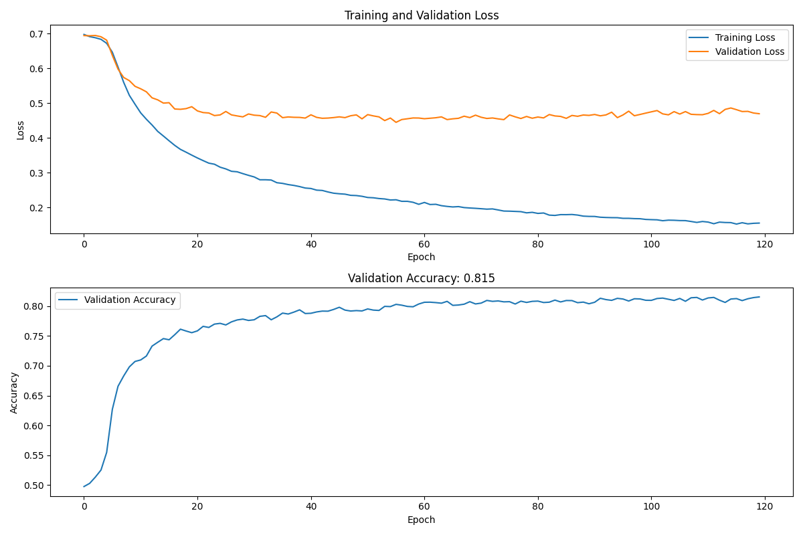
Baseline Performance
Identification accuracy on test 82.2%

Slide 6
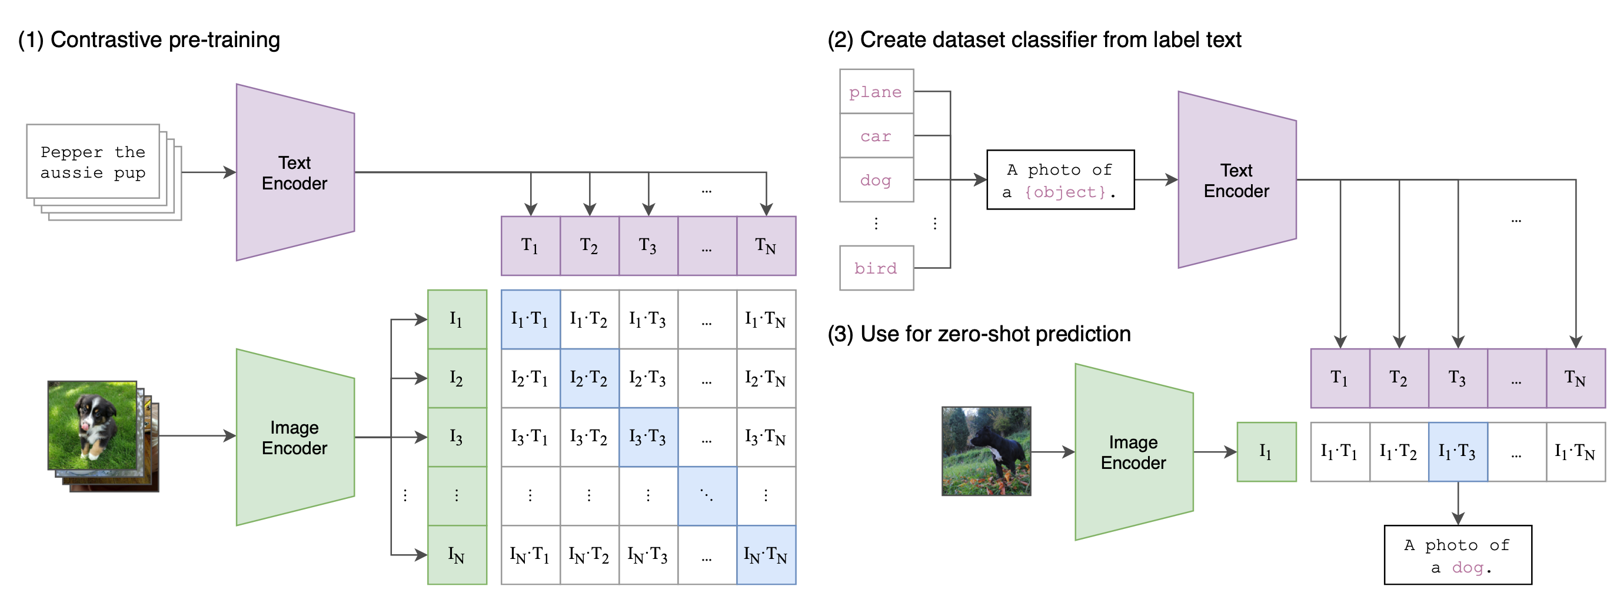
CLIP – Contrastive Language-Image Pretraining
CLIP uses a dual-encoder architecture with two separate encoders - one for images (e.g., a Vision Transformer) and one for text (e.g., a Transformer-based language model)
The objective is to learn representations that bring matching (image, text) pairs closer together in the shared vector space, while pushing non-matching pairs apart.
This is achieved through contrastive learning, where for each (image, text) pair, the model tries to maximize the similarity (e.g., dot product) between the image and text representations for matching pairs, while minimizing the similarity for non-matching pairs.
https://doi.org/10.48550/arXiv.2103.00020

Slide 7
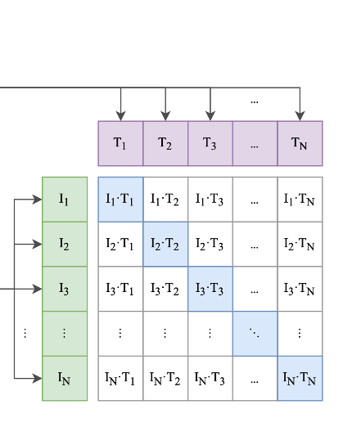
Adapting CLIP for Voice-Face Matching Task
In this task, we adapt the CLIP architecture to use a dual-encoder approach with two separate encoders: one for voice embeddings (using a projection network) and one for face embeddings (using a different projection network).
The goal is to learn representations that bring matching (voice, face) pairs closer together in the shared vector space, while pushing non-matching pairs apart.
For each (voice, face) pair, the model tries to maximize the similarity (e.g., cosine similarity) between representations for matching pairs, while minimizing the similarity for non-matching pairs.
Schematics of the proposed solution:
Projection Head
Voice
Embeddings
Projection Head
Face Image Embeddings

Slide 8

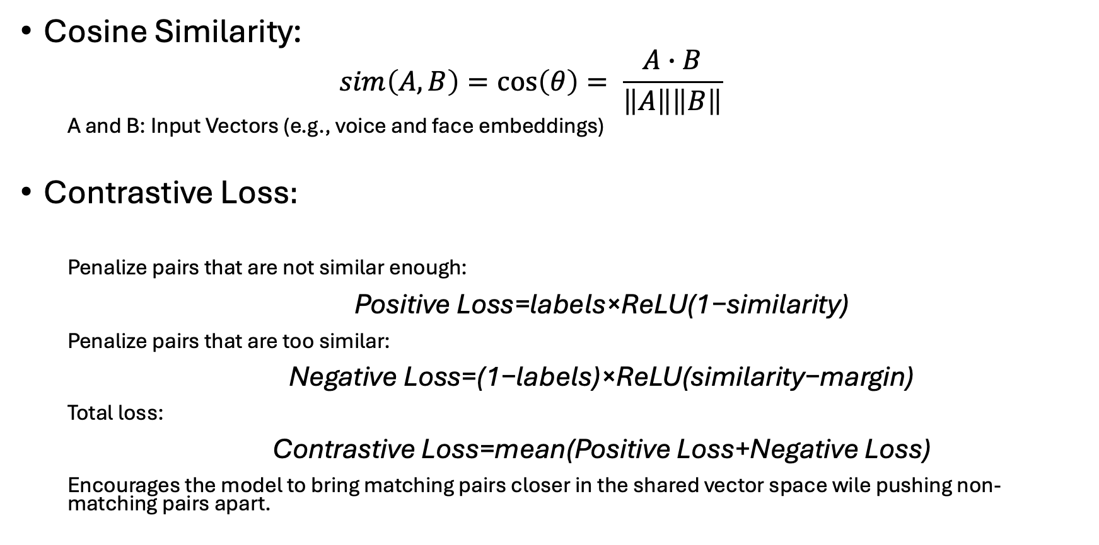
Cosine Similarity and Contrastive Loss
Cosine Similarity:
$$sim\left(A, B\right)=\cos\left(θ\right)= \frac{A∙B}{\left\|A\right\|\left\|B\right\|}$$
A and B: Input Vectors (e.g., voice and face embeddings)
Contrastive Loss$:$
Penalize pairs that are not similar enough:
$\text{Positive} \text{Loss}\text{=}\text{labels}\text{×}\text{ReLU}\text{(1−}\text{similarity}\text{)}$
Penalize pairs that are too similar:
$\text{Negative} \text{Loss}\text{=(1−}\text{labels}\text{)×}\text{ReLU}\text{(}\text{similarity}\text{−}\text{margin}\text{)}$
Total loss:
$\text{Contrastive} \text{Loss}\text{=}\text{mean}\text{(}\text{Positive} \text{Loss}\text{+}\text{Negative} \text{Loss}\text{)}$
Encourages the model to bring matching pairs closer in the shared vector space wile pushing non-matching pairs apart.
B
$$θ$$
A

Slide 9
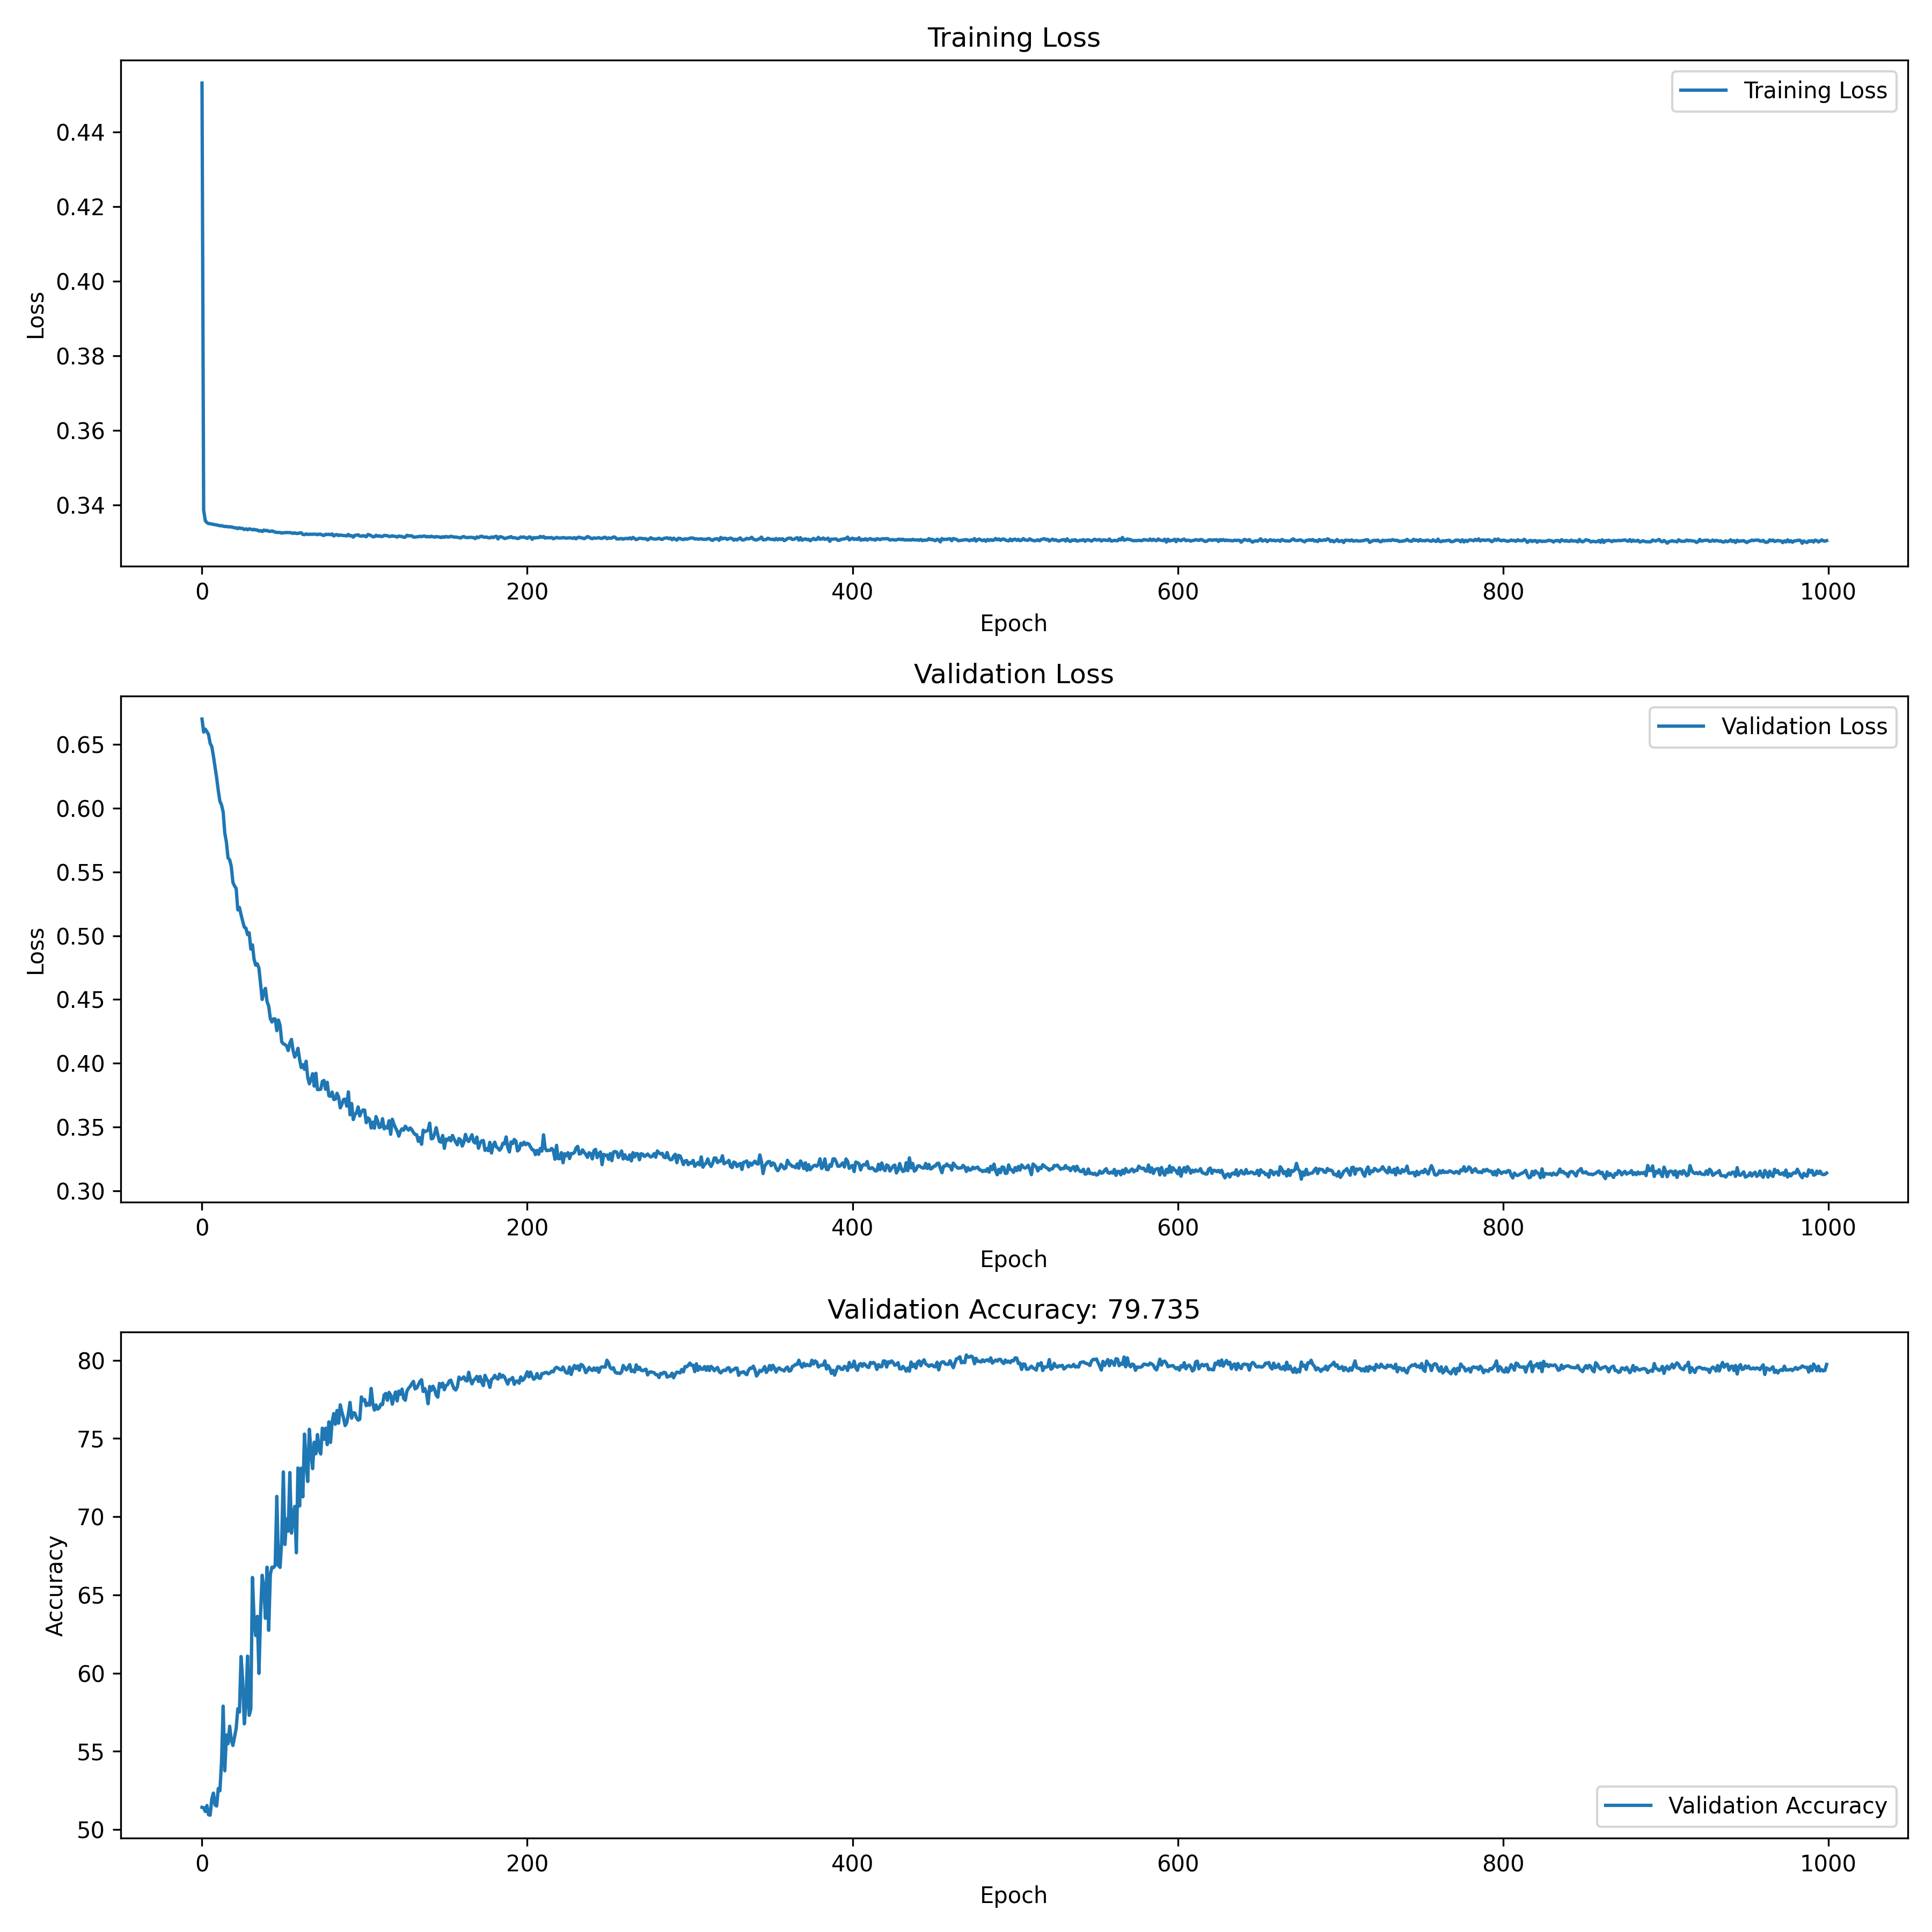
CLIP Adaptation Results
Identification accuracy on test 80.4%

Slide 10
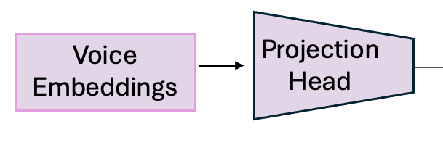
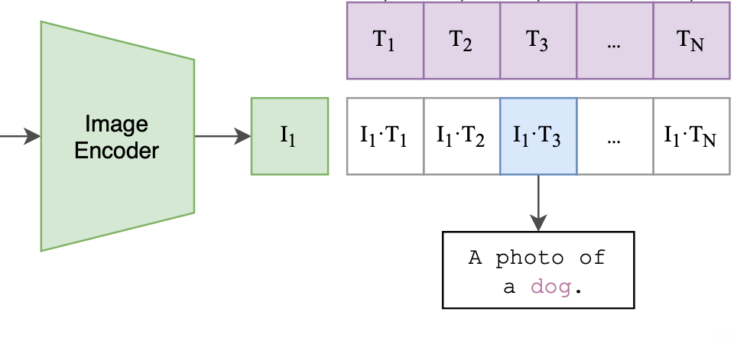
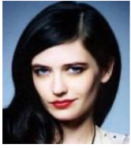
Advantages of CLIP Adaptation over Baseline
Even though performance metrics are comparable, there are benefits to our custom solution, like:
Zero-Shot Learning
Allows rapid generalization to new identities without additional training. By leveraging semantic relationships learned from the training data, zero-shot models can associate a new voice with the correct face image and vice versa, even if that identity was never seen or heard before.
Ability to provide ranked list outputs
Generates a ranked list of possible face matches based on similarity scores. Provide multiple predictions, enhancing flexibility and utility in real-world applications. Useful for scenarios where the top N matches are required.
Match

Slide 11
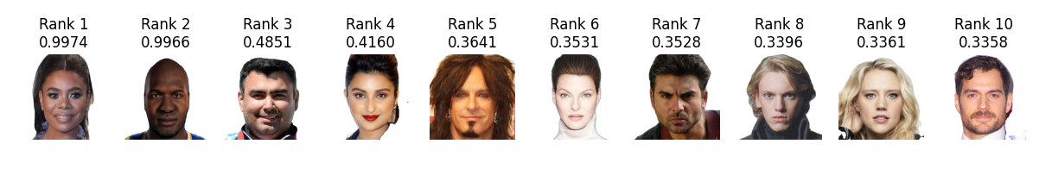

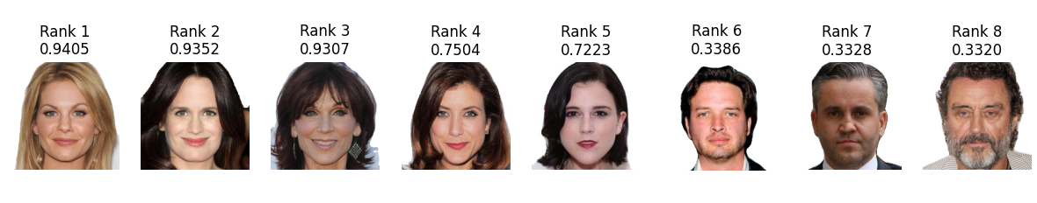
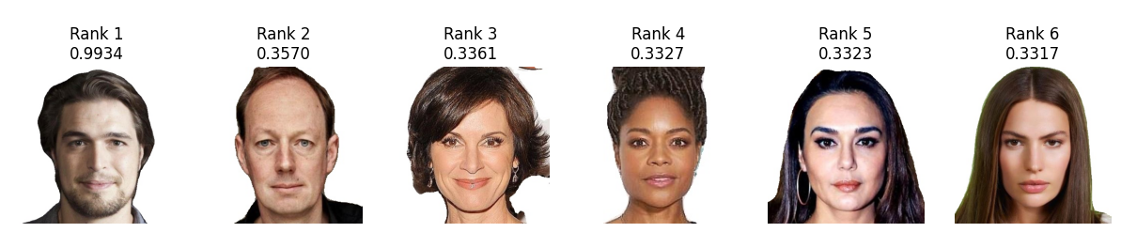
Predicted Ranked Lists
GT
GT
GT

