Slide 1
Final Report of Capstone Project
The Battle of Neighborhoods
Prepared by Tasnim Nahiyan Pervez

Slide 2
1. Introduction
The objective of this Project is to identify better facilities around different neighborhoods which help people exploring these facilities smartly to take effective decision by selecting great neighborhood out of many other neighborhoods in Scarborough, Toronto.
A lot of people are migrating to a various states of Canada who need to know many important factors like housing prices, reputed schools, available entertainment options, shopping location, food shop and hospital etc. This project aims to enable people looking for better neighborhoods considering the above factors.
Here, I have determined the features of the neighborhood and perform a comparative analysis between them. The features include median housing price and better school according to ratings, crime rates of that particular area, road connectivity, weather conditions, good management for emergency, water resources both fresh and waste water and excrement conveyed in sewers and recreational facilities.
This project facilitates people by generating awareness of the surrounding area and the neighborhood before moving to the new place.

Slide 3
2. Data Section
Data source Link: https://en.wikipedia.org/wiki/List_of_postal_codes_of_Canada:_M
I have used Scarborough dataset which we scrapped from wikipedia on Week 3. This Dataset consists of latitude and longitude and zip codes.

Slide 4
Foursquare API Data:
To perform the project work, I collected data about different venues in different neighborhoods of that specific borough. To get this data, I have used "Foursquare" locational information. Foursquare is a location data provider with information including venues and events within an area of interest. The information includes venue names, locations, menus and even photos. Therefore, to obtain all this information, the foursquare location API has been used as the sole data source. After listing the neighborhoods, I have connected to the Foursquare API to gather information about venues inside each and every neighborhood. For each neighborhood, the radius is 100 meter.

Slide 5
Foursquare API Data: (cont.)
The data retrieved from Foursquare contains information as follows:
Neighborhood
Latitude of the Neighborhood
Longitude of the Neighborhood
Venue
Name of the venue (example: store or school name)
Longitude of the Venue
Latitude of the Venue
Venue Category

Slide 6
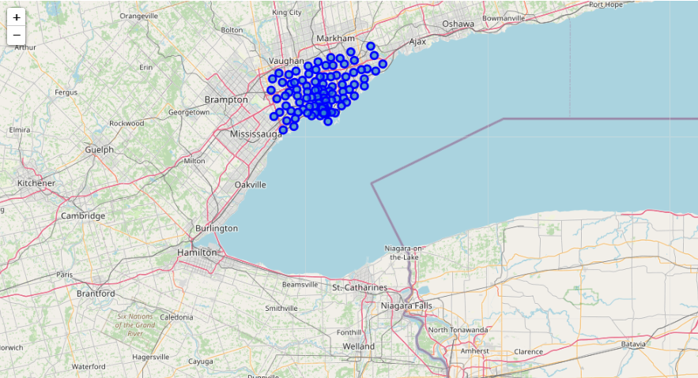
Map of Scarborough

Slide 7
3. Methodology
Clustering Approach
To perform a comparative analysis between two cities, I have decided to explore the neighborhoods and afterwards segment and group them into clusters to find similar neighborhoods in a big city. In order to do that, I have clustered data which is a form of unsupervised machine learning: k-means clustering algorithm.
Workflow
I have used the credentials of Foursquare API features of near-by places of the neighborhoods and mined data. Due to http request limitations, I have set the number of places per neighborhood parameter to 100 and the radius parameter to 500.

Slide 8
4. Result
Location
Scarborough is a popular destination for new immigrants in Canada to reside. It is one of the most diverse and multicultural areas in the Greater Toronto Area in Canada. It is a home to various religious groups and places of worship.
Foursquare API
In this project, I will use Four-square API as a prime data source. Because Foursquare has a database of millions of places, especially the API provides the ability to perform location search, location sharing and details about a business type and business category.

Slide 9
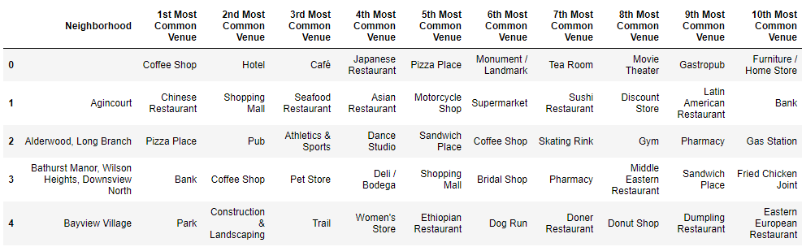
Most Common venues near Neighborhood

Slide 10
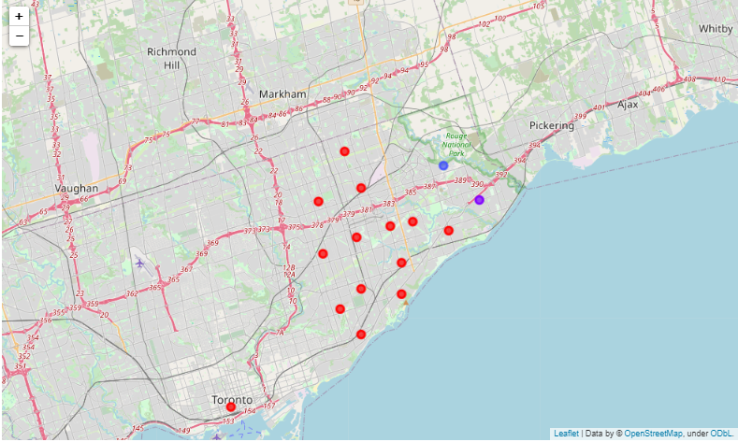
Map of Clusters in Scarborough

Slide 11
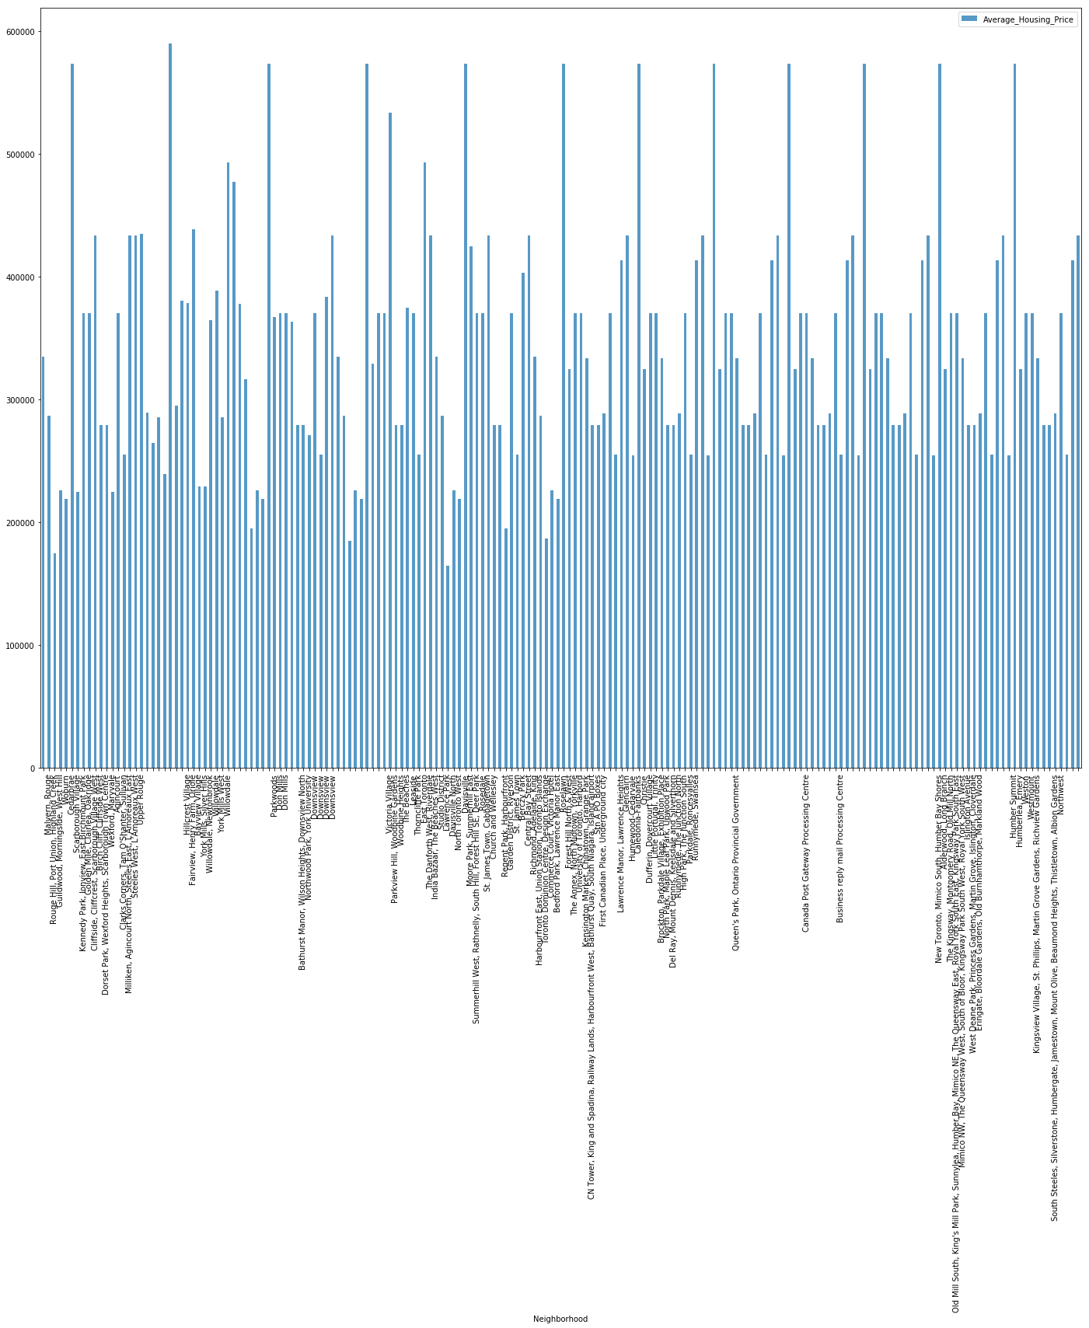
Average Housing Price by Clusters in Scarborough

Slide 12
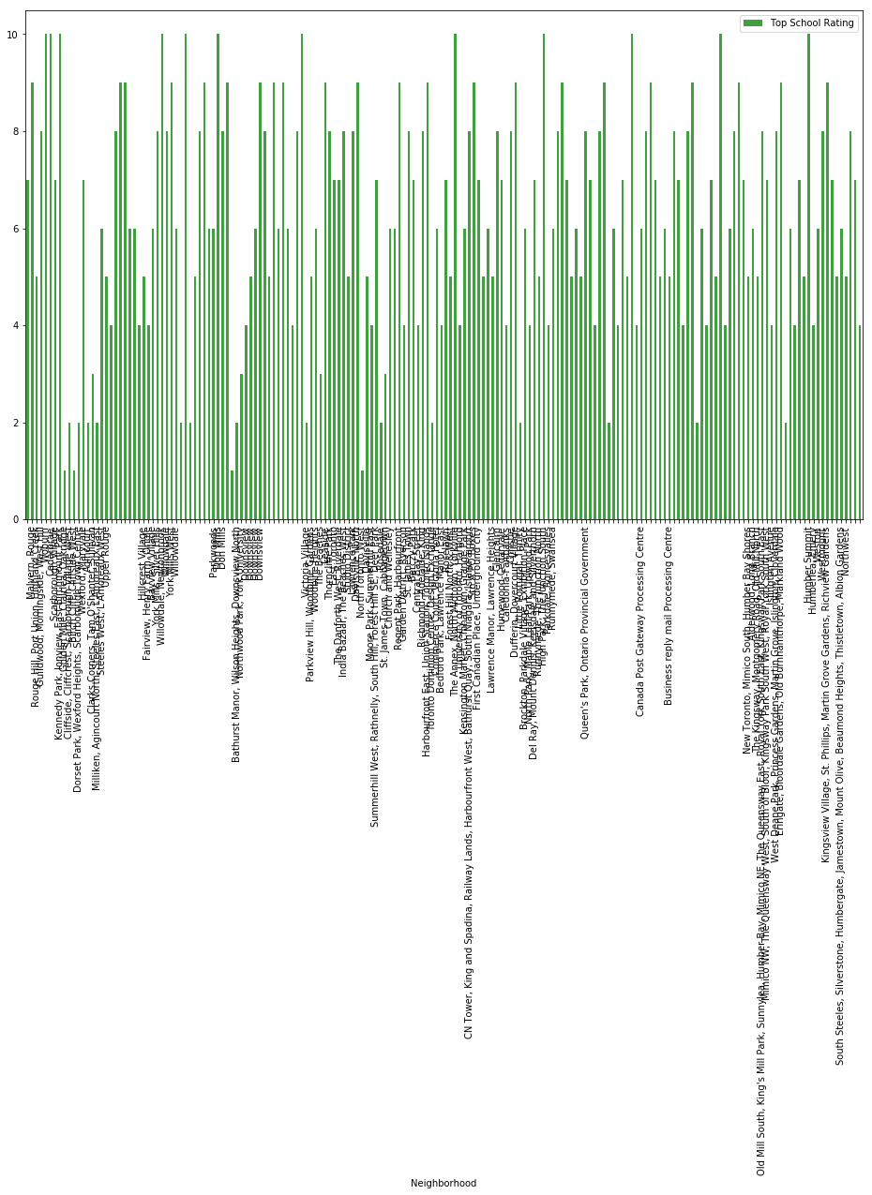
School Ratings by Clusters in Scarborough

Slide 13
5. Discussion
While planning for suggesting a better neighborhood in a new city for the people who are moving I found some challenges: • Identifying the similarity of people’s social presence and culture • Determining Connectivity to the major location or landmark like airport, bus stand, city center, shopping mall • Analyzing the facilities
For this, I will prepare:
List of housing in terms of prices
List of educational institutions in terms of location, fees, rating and reviews

Slide 14
6. Conclusion
In this project, I have used k-means clustering algorithm to segment 103 different latitude and longitude from dataset into 10 different clusters based on their similarities. Average housing price and the school ratings are depicted by the chart included in this report. This project has been completed to provide an impactful solution to the new comers in a big city by helping them identifying the suitable location and neighborhood for their residence.

Slide 15
Thank You

