Slide 1
NETWORK DEVICES
Network devices, or networking hardware,are physical devices that are required for communication and interaction between hardware on a computer network. Example are modem,RJ-45,
NIC(network interface card),ethernetcard,hub,swicth,repeater,brigde,router,
wificard,ect

Slide 2
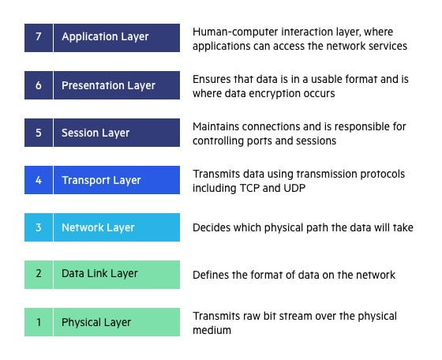
Open Systems Interconnection (OSI) model describes seven layers that computer systems use to communicate over a network

Slide 3
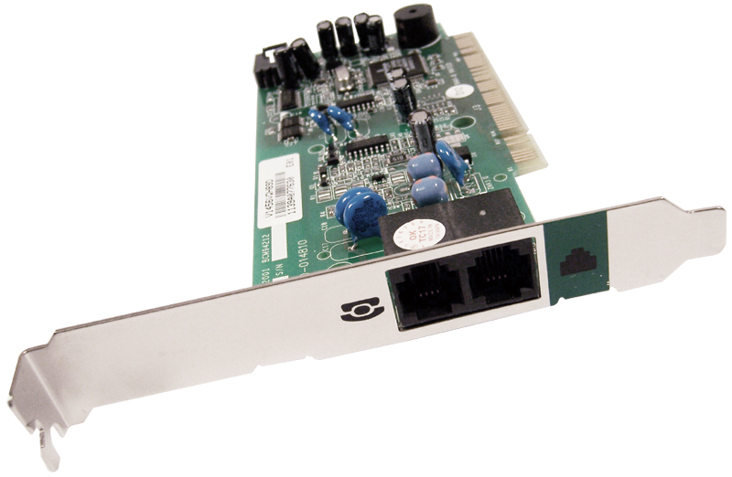
MODEM
modem is a computer hardware device that converts data from a digital format into a format suitable for an analog transmission medium such as telephone or radio.
Modems comes in two varites:
internal modem:
which are fixed with computer

Slide 4
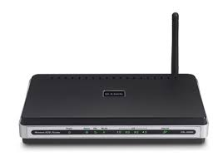
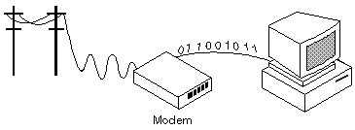
External modem :
Modem that are connected externally to a computer as other devices are connected.

Slide 5
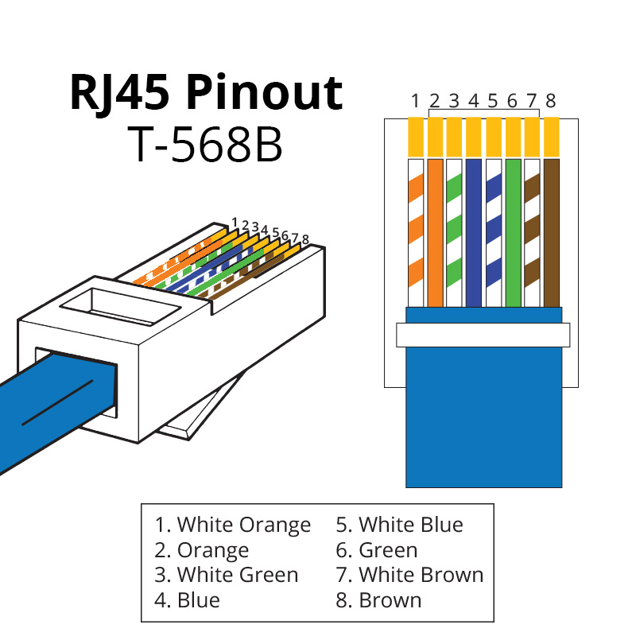
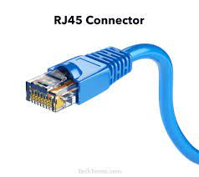
RJ-45
RJ-45(registered jack-5) is an eigth wire connector , which is commonly used to connected local area network ,especially ethernets
RJ-5 connector :

Slide 6
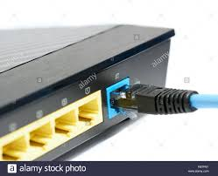
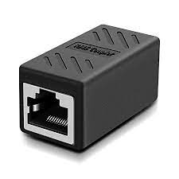
RJ-5 jack :
RJ-5 connector with jack:

Slide 7
NETWORK INTERFACE CARD
A network interface card (NIC) is a hardware component without which a computer cannot be connected over a network. It is a circuit board installed in a computer that provides a dedicated network connection to the computer
Purpose:
NIC allows both wired and wireless communications.
NIC allows communications between computers connected via local area network (LAN) as well as communications over large-scale network through Internet Protocol (IP).

Slide 8
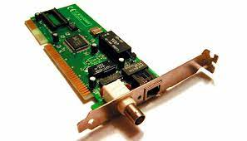
MAC address:
MAC address is a unique identifier assigned to a network interface controller (NIC) for use as a network address in communications within a network segment

Slide 9
ETHERNET CARD
Ethernet card is a type of NIC which enables a computer to access an network
Ethernet is LAN architecture developed by xerox corp in dec and intel.
Ethernet uses star topologies and can support data transfer upto 10 gbps

Slide 10
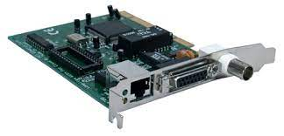
BNC
AUI
RJ-45
BNC connector:(bayone-neill-concelman).it is standard connector used to connect 10base2 coxcial cable
AUI (Attachment unit interface)-a 15 pin connector found on ethernet cards that can
be used for attaching coxcial,fiber optic ,twisted pair cable

Slide 11
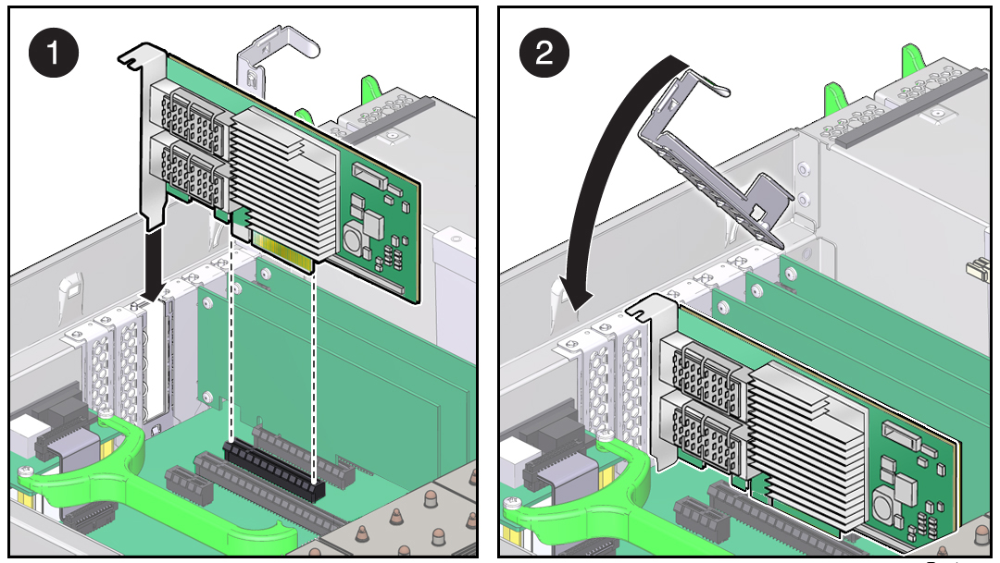
How to insert ethernet card in motherboard
PCI slot:(Peripheral Component Interconnect)

Slide 12
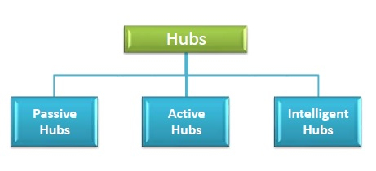
HUB
A hub is network device having multiple ports that are used for connecting multiple computers or segment of lan together.
TYPE OF HUB:

Slide 13
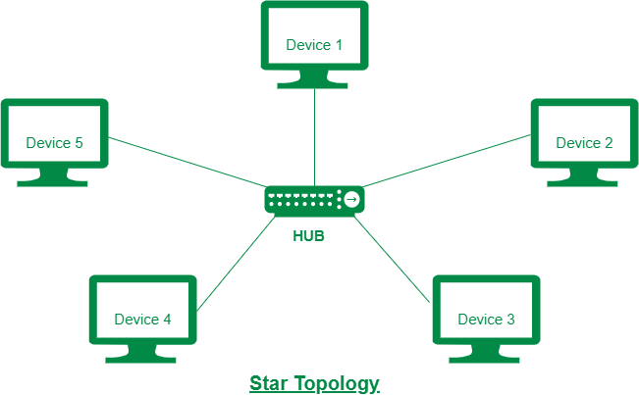
Passive Hubs − Passive hubs connects nodes in a star configuration by collecting wiring from nodes. They broadcast signals onto the network without amplifying or regenerating them. As they cannot extend the distance between nodes, they limit the size of the LAN.

Slide 14
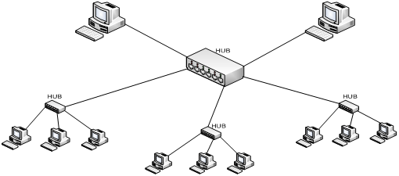
Active Hubs − Active hubs amplify and regenerate the incoming electrical signals before broadcasting them. They have their own power supply and serves both as a repeater as well as connecting centre. Due to their regenerating capabilities, they can extend the maximum distance between nodes, thus increasing the size of LAN

Slide 15
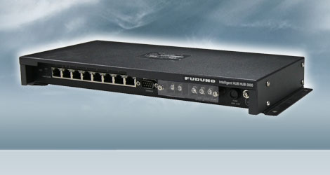
Intelligent Hubs − Intelligent hubs are active hubs that provide additional network management facilities. They can perform a variety of functions of more intelligent network devices like network management, switching, providing flexible data rates etc

Slide 16
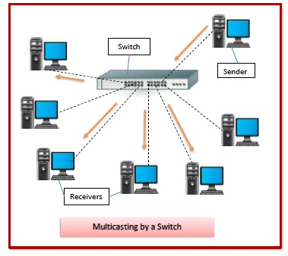
SWICTH
Switches are networking devices operating at layer 2 or a data link layer of the OSI model(Open Systems Interconnection model describes seven layers that computer systems use to communicate over a network). They connect devices in a network and use packet switching to send, receive or forward data packets or data frames over the network.

Slide 17
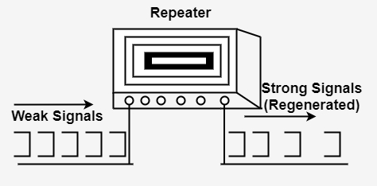
REPEATER
A repeater is a dynamic network device used to reproduce the signals when they transmit over a greater distance so that the signal’s strength remains equal

Slide 18
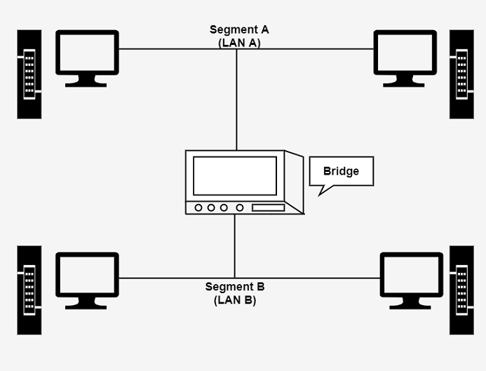
BRIDGE
Bridges are used to connect two subnetworks that use interchangeable protocols. It combines two LANs to form an extended LAN. The main difference between the bridge and repeater is that the bridge has a penetrating efficiency.

Slide 19
Uses of Bridges
The main uses of bridges are −
Bridges are used to divide large busy networks into multiple smaller and interconnected networks to improve performance.
Bridges also can increase the physical size of a network.
Bridges are also used to connect a LAN segment through a synchronous modem relation to another LAN segment at a remote area.

Slide 20
ROUTER
Routers are networking devices operating at layer 3 or a network layer of the OSI model. They are responsible for receiving, analysing, and forwarding data packets among the connected computer networks. When a data packet arrives, the router inspects the destination address, consults its routing tables to decide the optimal route and then transfers the packet along this route.router is like bridge but brigde cannot handle different protocal

Slide 21
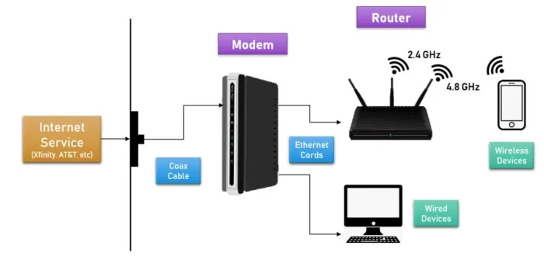
What's the Difference Between a Router and a Modem?
A Modem converts the signal coming into your house from the Internet company to a hard-line data connection (so you can use an Ethernet cord to connect to the Internet).
A Router converts that hard-line connection to a 2.4 GHz or 4.8 GHz Wi-Fi connection that your wireless device (like laptop, cell phone) can connect to for Internet

Slide 22
GATEWAY
A gateway is a network node that forms a passage between two networks operating with different transmission protocols. The most common type of gateways, the network gateway operates at layer 3, i.e. network layer of the OSI (open systems interconnection) model. However, depending upon the functionality, a gateway can operate at any of the seven layers of OSI model
It acts as the entry – exit point for a network since all traffic that flows across the networks should pass through the gateway. Only the internal traffic between the nodes of a LAN does not pass through the gateway
Gateway is located at the boundary of a network and manages all data that inflows or outflows from that network..

Slide 23
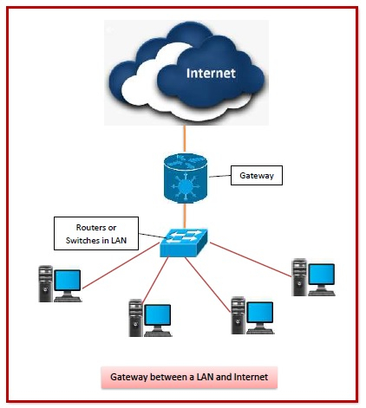

Slide 24
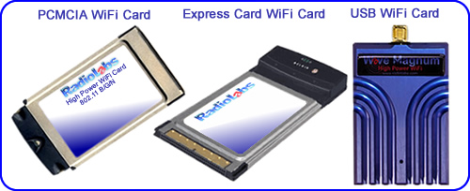
WIFI CARD
The wireless network card is a wireless terminal device, which is used to connect to the Internet through a wireless connection within the wireless coverage of a wireless local area network
TYPE OF WIFI CARD:

