Slide 1





Eco-Label Vision (BinIQ)
AI-Powered Circular Economy Smart Waste Assistant
"Snap. Classify. Guide. Reward. Transform Waste into Value."

Slide 2




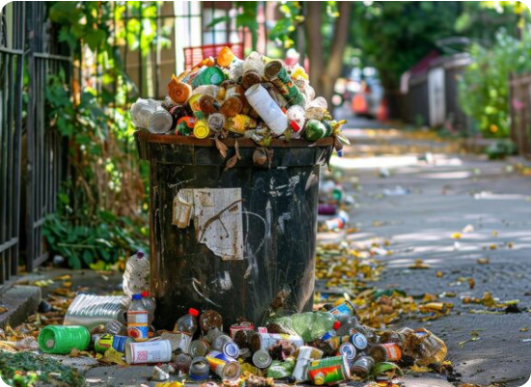
Crisis of Wish-Cycling
3.4B
>25%
$100M+
TONNES WASTE
CONTAMINATION
SORTING LOSS
▹
The 'Wish-Cycling' Trap: Citizens toss questionable items into blue bins hoping they're recyclable, ruining massive high-purity bales.
▹
Resin Code Blindspot: All clear plastics look visually identical. Tiny stamped RIC codes are overlooked, allowing toxic PVC to mix with circular PET.
▹
Municipal & Climate Cost: Lack of real-time visibility leads to massive manual sorting costs and destroyed embodied carbon.

Slide 3






Circular Intelligence Solution
Real-Time AI Scanner
OCR Resin Analysis
Municipal Portal
Webcam & mobile live image analysis. The MobileNetV3-Small classifier predicts waste categories in ~24 ms, providing instant feedback and a visual confidence meter.
EasyOCR decodes stamped RIC 1-7 plastic codes. Effectively differentiates high-value recyclable PET/HDPE from toxic PVC/PS contaminants before they enter the bin.
Live city-wide dashboard displaying recycling purity & diversion KPIs. Includes interactive OpenStreetMap locators and localized waste composition breakdowns.

Slide 4






System Architecture
React 18 + Vite, Tailwind CSS dark UI, Framer Motion
High-performance Python 3.11 REST API via FastAPI
PyTorch 2.x, MobileNetV3-Small, EasyOCR (CRAFT+CRNN)
Rule-based logic synthesizing AI categorization & carbon savings
SQLite / SQLAlchemy for scan history and municipal aggregates

Slide 5

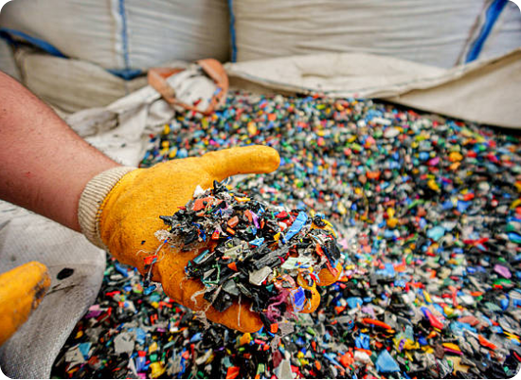
AI & OCR Detection Engine
▹
MobileNetV3 Performance: Achieves an impressive 80.39% Test Set Accuracy with ultra-low 23.6 ms inference latency on standard CPUs.
▹
Strategic Class Balancing: WeightedRandomSampler ensures high detection sensitivity across 9 stratified classes, preventing rare waste misclassification.
▹
Resin Code Extraction: EasyOCR pipeline automatically locates and decodes tiny stamped plastic polymer numbers (RIC 1-7).
▹
Critical Filtration: Instantly sorts Highly Recyclable PET (#1) and HDPE (#2) away from Landfill-bound PVC (#3) and PS (#6).

Slide 6
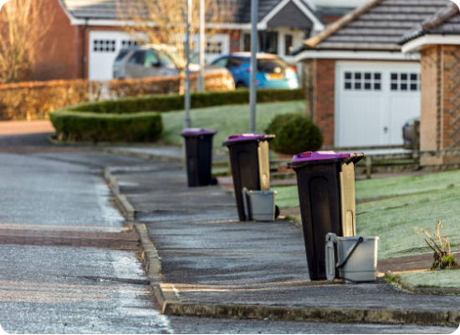
Instant Citizen Experience
▹
Cross-Device Accessibility: Runs instantly directly in any mobile or desktop browser via webcam—zero app store installation required.
▹
Voice Synthesis Guidance: Web Speech API provides step-by-step audio instructions (e.g., 'Rinse bottle and toss into Blue Bin') for a hands-free experience.
▹
Carbon Impact Tag: Displays a computed CO2 offset per scanned item (e.g., Metal +0.12 kg), directly linking citizen actions to broader climate goals.
▹
Transparent Confidence: Exposes top-3 probability breakdown metrics, maintaining trust and educating the user on uncertain classifications.

Slide 7

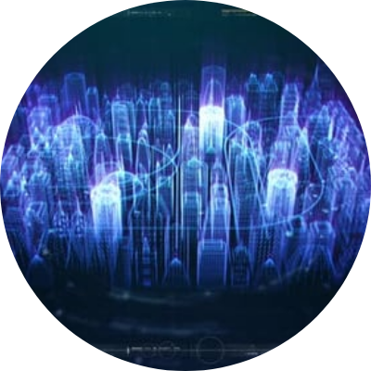
Community & AI Assistant
▹
Smart Recycling Locator: OpenStreetMap & Overpass API integration locates the nearest recycling depots and e-waste facilities using real-time GPS routing.
▹
Citizen Incident Reporting: Users can upload geotagged photos to seamlessly report overflowing bins or illegal dumping directly to local municipal response teams.
▹
Google Gemini AI Chat: Integrated AI assistant provides immediate natural language advice for tricky edge cases, upcycling ideas, and home composting instructions.

Slide 8
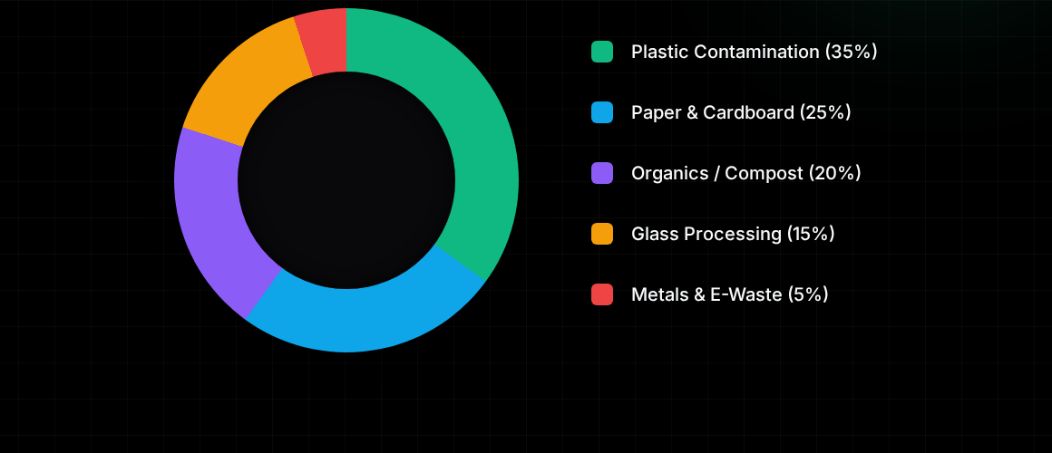
Municipal Intelligence
Live city-wide analytics track recycling purity rates, total waste diverted, and temporal disposal peaks. This targeted operational data optimizes truck routing and saves millions in landfill tipping fees.

Slide 9

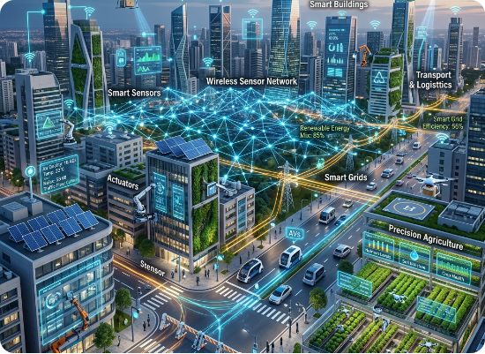
Impact & Future Roadmap
Measurable Environmental Impact
▹
UN SDGs Achieved: Directly advances SDG 11 (Sustainable Cities), SDG 12 (Responsible Consumption), and SDG 13 (Climate Action).
▹
Carbon Offset Metrics: Safely prevents virgin petroleum extraction by saving ~0.08 kg CO2 per plastic and ~0.12 kg CO2 per metal item.
Phase 2 & 3 Innovation Roadmap
▹
IoT Smart Bin Hardware: Edge AI (Jetson Nano) integration with automated sorting servos.
▹
Advanced Segmentation: YOLOv11 upgrades for multi-item clutter detection.
▹
Enterprise Auditing: Deploying watsonx.ai (IBM Granite) for automated commercial compliance reports.

