Slide 1
FLIGHTRADAR67
The live sky, on a real globe —
built for enthusiasts who outgrew flat maps.
Real-time ADS-B · Cesium 3D globe · Routes, trails & RadarAI
5-minute business pitch
Hackathon · Product & GTM

Slide 2
THE PROBLEM
Aviation curiosity is huge. The tools feel stuck in 2012.
Flat & opaque
Enthusiast gap
Dev / data friction
Legacy trackers bury the globe under ads, paywalls, and 2D tiles that break immersion.
Spotters, students & travelers want live context — routes, altitude story, AI answers — not just dots.
Building on live ADS-B is hard: rate limits, antipodal clutter, laggy markers, incomplete routes.
FlightRadar67 · Confidential · 2/12

Slide 3
THE SOLUTION
FlightRadar67 — premium live flight tracking on a true 3D Earth.
• Live ADS-B (adsb.lol) with viewport-chunked loading — fast, not whole-planet spam
• CesiumJS globe with altitude-coloured aircraft, smooth motion, horizon occlusion
• Click → real flown path (turns & curves), dep/arr airports, progress & favourites
• RadarAI assistant + analytics for density, airlines, and busy airports
• Auth.js accounts, Prisma/Postgres, Redis, Docker — production-shaped MVP
FlightRadar67 · Confidential · 3/12

Slide 4
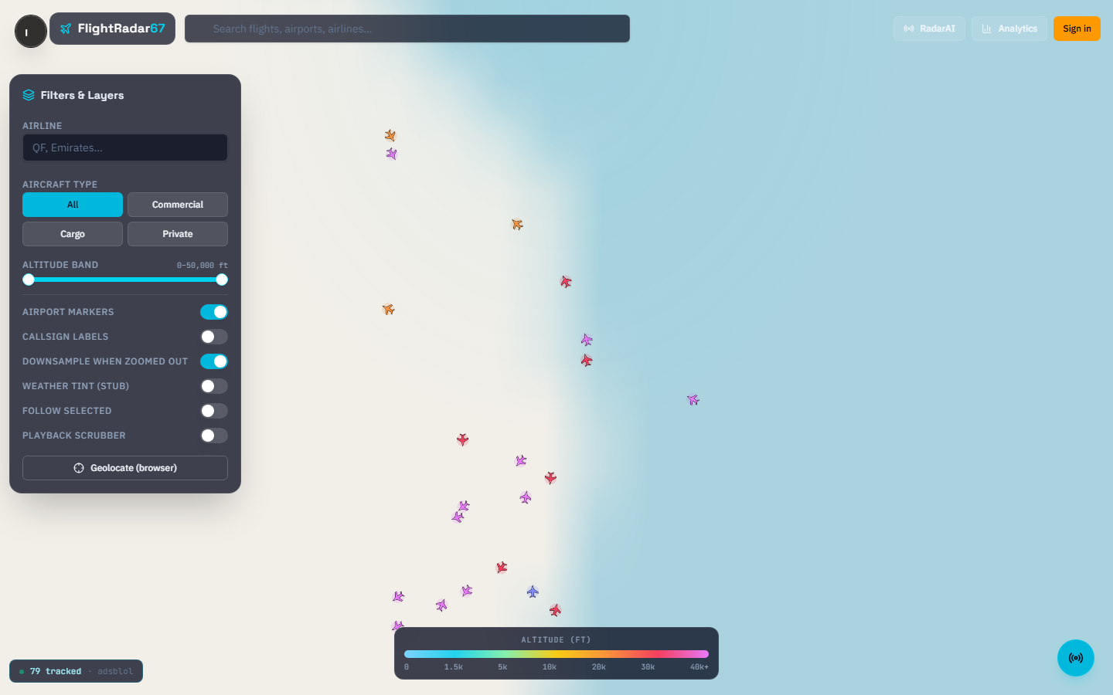
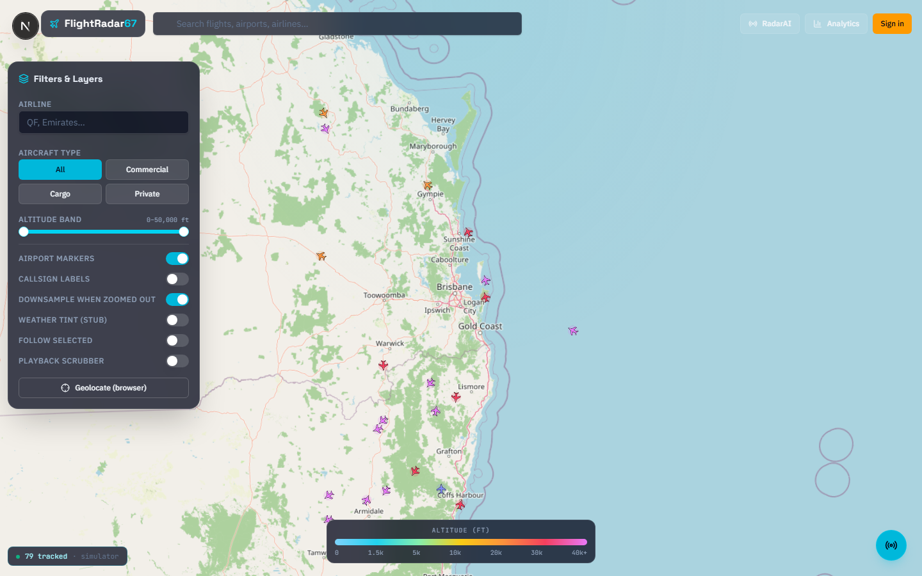
PRODUCT IN ACTION
Live globe · select a flight · see the real track
Also in pitch/assets: demo-walkthrough.webm / .mp4 — play fullscreen during the 75s demo beat.
Judges respond better to a live click-through; keep this clip as backup.
FlightRadar67 · Confidential · 4/12

Slide 5
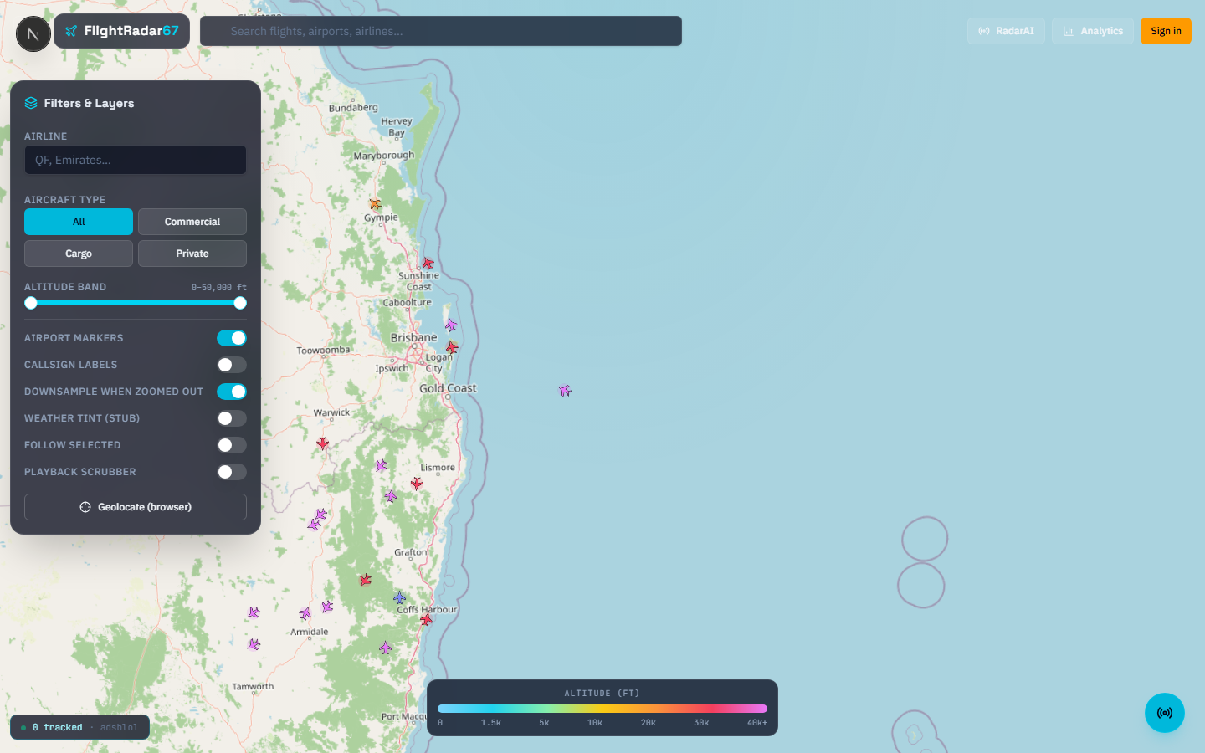
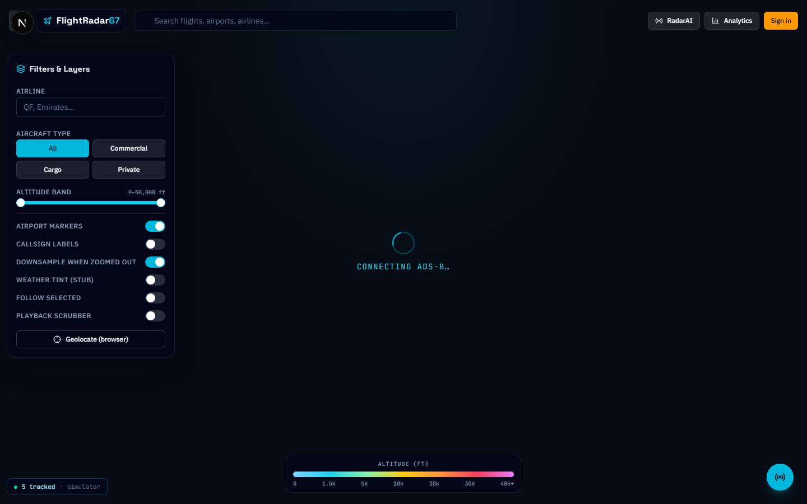
DEMO MEDIA
Recorded walkthrough + extra frames
01
Open the globe over Brisbane — live traffic streams in chunks.
02
Click a jet — altitude colour, info card, dep → arr route.
03
Show the solid ADS-B trail with real turns (not a straight line).
04
Pan the camera — far-side aircraft stay hidden behind Earth.
05
Optional: RadarAI / analytics — ask “busiest airports near me.”
FlightRadar67 · Confidential · 5/12
FlightRadar67 · Confidential · 6/12

Slide 6
MARKET — TAM · SAM · SOM
A wedge inside a multi-billion aviation data & attention market.
TAM
$12–18B
Global aviation software, flight data, travel tools & digital aviation media (consumer + B2B).
SAM
$1.5–2.5B
Live flight tracking, ADS-B platforms, aviation enthusiast apps & APIs in English-speaking + EU/AU markets.
SOM
$25–60M
5-year reachable: freemium consumers + prosumer/API in AU/NZ/SEA → expand to US/EU enthusiasts.
Sources: industry analyst ranges (aviation IT / travel tech) + FlightRadar24-class comps — directional for pitch, not audited.
FlightRadar67 · Confidential · 7/12

Slide 7
PRODUCT–MARKET FIT
Who loves this on day one — and why they pay.
Plane spotters & aviation nerds
Students & STEM clubs
Immersive globe + real trails = shareable wow. High engagement, low CAC via communities.
Live data + RadarAI for learning. School/uni licenses and workshops.
Travel power users
Indie builders / media
Where is my inbound? Beautiful context beats opaque airline apps.
Future API & embeds — creators need gorgeous live clips.
FlightRadar67 · Confidential · 8/12

Slide 8
BUSINESS MODEL
Freemium consumer wedge → pro & data revenue.
Free
Plus
Pro / Edu
API later
$0
$6–9/mo
$19–49/mo
usage
Live map, basic filters, limited history — growth engine.
Full trails, alerts, favourites sync, ad-light experience.
Analytics, RadarAI priority, classroom seats, export.
B2B widgets & historical traces for media/apps.
FlightRadar67 · Confidential · 9/12

Slide 9
GO-TO-MARKET
Community-led growth, then partnerships.
Phase 1 — Seed
AU/NZ aviation Discords, Reddit r/flighttracking, airport spotting groups. Shareable globe clips.
Phase 2 — Content
TikTok/YouTube Shorts of dramatic trails & landings. Creator affiliate Plus codes.
Phase 3 — Edu & B2B
Pilot STEM kits with schools; approach small airlines/MRO for branded embeds.
Phase 4 — Platform
Public API + white-label widget once retention > 30-day D30 target.
FlightRadar67 · Confidential · 10/12

Slide 10
COMPETITION & DIFFERENTIATION
We don’t out-ads FlightRadar24 — we out-experience the free tier.
Player
Their strength
Our angle
FlightRadar24 / FR24 apps
Scale & brand
We win on 3D immersion, open-data ethos, AI layer for learners
ADS-B Exchange / dump1090 UIs
Raw data power users
We win on polish, storytelling routes, consumer UX
Airline apps
My booking only
We win on the whole sky & discovery
Early moat: product craft (occlusion, chunked ADS-B, real traces) + community brand in AU/SEA before clones catch up.
FlightRadar67 · Confidential · 11/12

Slide 11
THE ASK
Validate with judges & mentors — then ship Plus to spotters.
→ Feedback on pricing & ICP priority (spotters vs edu)
→ Intros to aviation clubs / STEM teachers in AU
→ Design partners for 30-day retention experiment
FlightRadar67 — see the sky the way it actually moves.
FlightRadar67 · Confidential · 12/12

