Slide 1


Ola Customer Retention Analysis
Customer Behavior, Ride Performance & Retention Insights
SQL
PYTHON (PANDAS)
POWER BI
Presented By
Rudra Pathade

Slide 2


PROJECT OVERVIEW
Understanding the Business Problem
This project analyzes customer ride booking behavior to identify the key factors influencing retention, cancellations, satisfaction, and payment preferences.
Business Goals
Improve customer retention rates
Reduce ride cancellations
Increase booking success rate
Optimize payment methods
Identify operational bottlenecks

Slide 3
PROBLEM STATEMENT
Why Customers Leave
Ride-hailing platforms lose customers to recurring pain points. This analysis pinpoints the root causes and delivers data-driven recommendations.
Frequent Cancellations
Long Wait Times
Driver and customer cancellations erode trust and reduce completed rides.
Extended pickup waits are a leading cause of customer-initiated cancellations.
Poor Driver Experience
Payment Friction
Low driver ratings directly correlate with reduced customer satisfaction.
Limited or unreliable payment options deter repeat bookings.

Slide 4

DATA
Dataset at a Glance
Feature
Value
Total Records
150,000
Total Columns
21
Booking Status
Multiple
Vehicle Types
Multiple
Payment Methods
Multiple
Customer Rating
Available
Driver Rating
Available
Ride Distance
Available
Booking Value
Available
Key columns include Booking Status, Ride Distance, Vehicle Type, Payment Method, Customer & Driver Ratings, and Cancellation Reasons.

Slide 5





METHODOLOGY
End-to-End Project Workflow
Raw Dataset
150K records imported
Data Cleaning
Python: duplicates, missing values, formatting
SQL Analysis
Aggregations, KPIs, customer segmentation
Power BI Modeling
DAX measures, data relationships
Dashboard & Insights
Interactive filters, visualizations, recommendations
Each stage builds on the last — from raw data to cleaned datasets, SQL-driven aggregations, Power BI modeling, and finally actionable business insights.

Slide 6
DATA PREPARATION
Data Cleaning & Preprocessing
01
02
Removed Duplicates
Handled Missing Values
Identified and eliminated duplicate booking records.
Applied imputation and flagging strategies for null fields.
03
04
Standardized Data
Converted Data Types
Unified categorical values and text formatting across columns.
Ensured correct types for dates, numerics, and categories.
05
06
Validated Booking Status
Imported into Power BI
Confirmed consistency across status labels before SQL import.
Loaded clean dataset and established data model relationships.

Slide 7
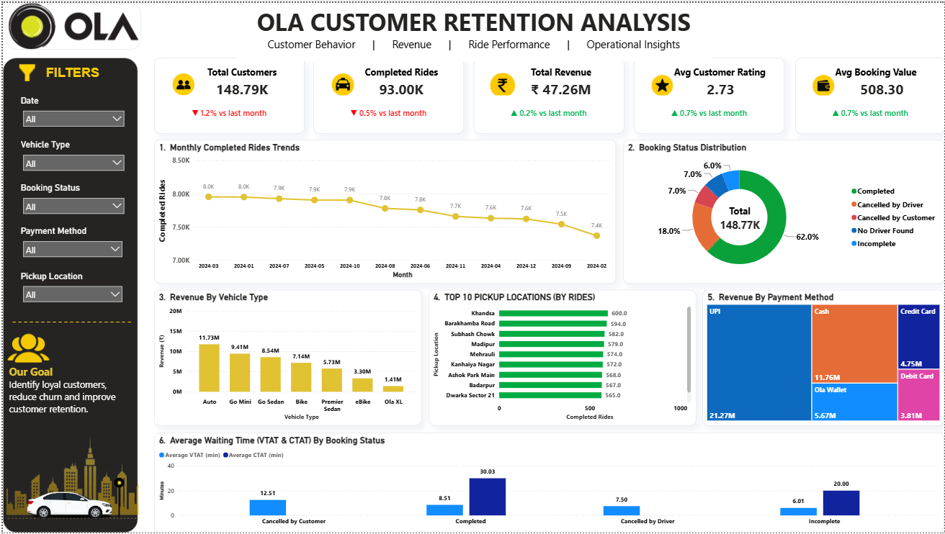
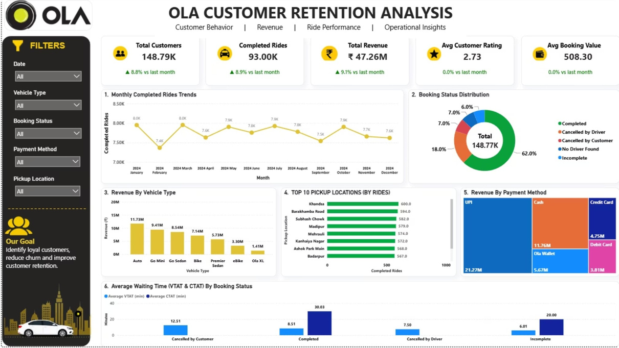
DASHBOARD
Power BI Dashboard Overview
The interactive Power BI dashboard consolidates all key metrics into a single, filterable view — enabling stakeholders to explore booking performance, cancellations, and satisfaction at a glance.
KPI Cards
Interactive Charts
Dynamic Filters
Trend Analysis
High-level booking and satisfaction metrics
Trend and comparative visualizations
Segment by vehicle, location, or payment
Time-series performance tracking

Slide 8
KPI SUMMARY
Key Performance Indicators
150K
~82%
Total Bookings
Booking Success Rate
Records analyzed across all vehicle types
Estimated — validate with your dashboard
~18%
₹180
Cancellation Rate
Avg. Booking Value
Estimated — validate with your dashboard
Estimated — validate with your dashboard
4.2★
4.4★
Avg. Customer Rating
Avg. Driver Rating
Estimated — validate with your dashboard
Estimated — validate with your dashboard
All KPI values are illustrative — replace with your actual dashboard figures before presenting.

Slide 9
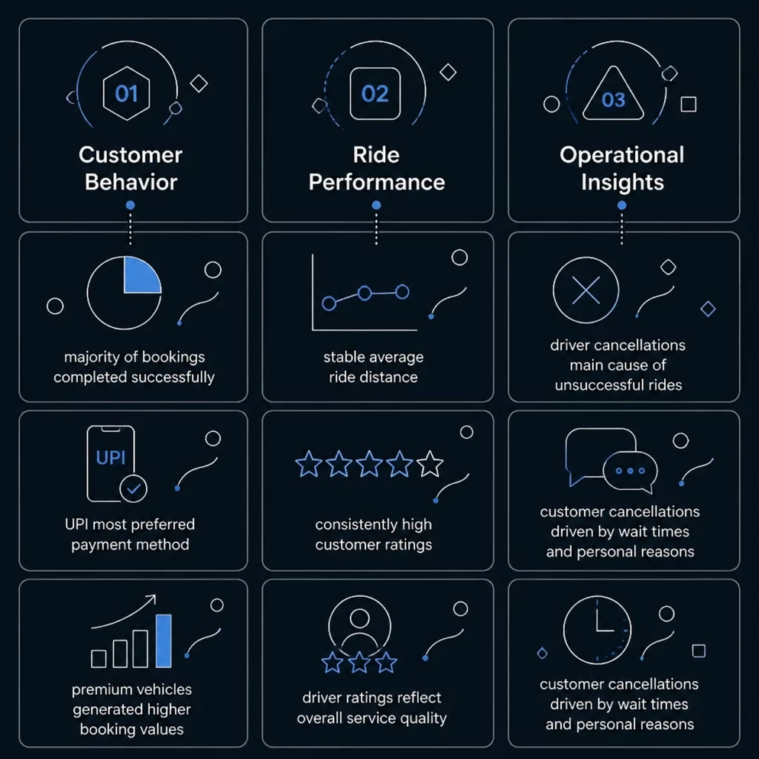
INSIGHTS
Key Business Insights
Three interconnected themes emerged from the analysis, each pointing to specific areas for operational improvement and customer experience enhancement.
Customer Behavior
Majority of bookings completed successfully
UPI emerged as the most preferred payment method
Premium vehicle categories generated higher booking values
Ride Performance
Average ride distance remained stable
Customer ratings were consistently high
Driver ratings reflect strong overall service quality
Operational Insights
Driver cancellations contributed significantly to unsuccessful rides
Customer cancellations mainly driven by wait times and personal reasons

Slide 10


RECOMMENDATIONS
Strategic Recommendations
Reduce Cancellations
1
Improve driver allocation algorithms and introduce real-time tracking to minimize wait times.
Enhance Payment Experience
2
Promote UPI and digital wallets through incentives; streamline cash payment processes.
Boost Driver Quality
3
Implement driver training programs and performance-based incentives to improve ratings.
Customer Retention Programs
4
Launch loyalty rewards and personalized offers for high-frequency users to reduce churn.
These recommendations are grounded in the data analysis and can be prioritized based on implementation effort and expected business impact.

Slide 11

Thank You for Your Attention
We appreciate your time exploring this Customer Shopping Behavior Analysis project covering Python EDA, SQL queries, and Power BI dashboards.
Questions & Discussion
We welcome your questions, feedback, and insights. Let's discuss findings, methodology, or potential next steps together.
Thank You &
Questions
Get in Touch
Feel free to reach out for further details on the analysis, dataset, or dashboard. Open to collaboration and continued data exploration.

