Slide 1
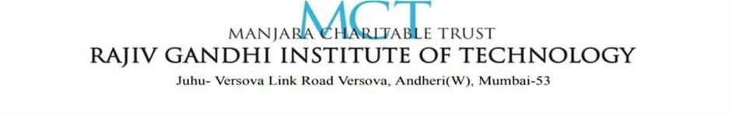
DEPARTMENT OF ARITIFICAL INTELLIGENCE & DATA SCIENCE
Title: ClauseIQ: An NLP-Based Contract Clause Risk Classification System
Under the Guidance of Prof. Naresh Shende
Group No. 8
Student | Roll No.
Atharv Patil | 728
Rudra Pawar | 730
Domain: Natural Language Processing (NLP)

Slide 2
DEPARTMENT OF ARITIFICAL INTELLIGENCE & DATA SCIENCE
1. Abstract
The Contract Clause Risk Classifier is an AI-based system designed to automatically analyze legal contract clauses and identify potential risks. The system uses Natural Language Processing (NLP) and Machine Learning techniques to classify contract clauses into relevant categories and assess their risk levels. By reducing the need for completely manual contract review, the proposed system aims to make the analysis process faster, more consistent, and easier to understand. It can assist users in identifying potentially risky clauses and supporting better decision-making during contract review.
ClauseIQ — Contract Clause Risk Classifier
1

Slide 3
DEPARTMENT OF ARITIFICAL INTELLIGENCE & DATA SCIENCE
2. Introduction
ClauseIQ is an NLP-based system that automatically classifies contract clauses into legal categories and flags their risk level. The system is built on the Contract Understanding Atticus Dataset (CUAD) and combines a trained multi-label text classifier with rule-based risk analysis. Given a full contract or a single pasted clause, ClauseIQ segments the text into individual clauses, classifies each clause into one or more of six legal categories (Termination, Renewal Term, Renewal Notice Period, Liability Cap, Uncapped Liability, and Non-Compete), and assigns a Low, Medium, or High risk rating based on specific red-flag wording such as missing notice periods, uncapped liability language, broad non-compete scope, and one-sided termination rights.
Two classification models are supported: a fast TF-IDF with Logistic Regression baseline that is always available, and an optional fine-tuned transformer (Legal-BERT / DistilBERT) that can be enabled for improved accuracy. Every prediction is accompanied by an explainability view showing the key terms that drove the classification, a confidence score, and — for high-risk clauses — a rule-based suggested rewrite. The baseline model achieves a Macro F1 of 0.853 and a Micro F1 of 0.892 on held-out CUAD data. ClauseIQ is delivered as an interactive Streamlit web application that highlights flagged sections directly within the contract and allows results to be exported as CSV or PDF reports, making contract review faster and more consistent for non-legal-expert users.
ClauseIQ — Contract Clause Risk Classifier
1

Slide 4
DEPARTMENT OF ARITIFICAL INTELLIGENCE & DATA SCIENCE
3. Literature Survey
Ref. | Authors / Work | What it does | Limitation/ Gaps | What your project adds
[1] | Hendrycks et al. — CUAD | Provides a large expert-labeled dataset for identifying 41 types of contractual clauses. | Primarily focuses on clause identification/extraction, not an end-to-end risk-level classification system.. | Uses contract data to perform risk classification (Low/Medium/High) and highlight clauses requiring attention.
[2] | Devlin et al. — BERT | Introduces transformer-based contextual language understanding for text classification. | General-purpose model; it is not specifically designed for contract-risk analysis. | Applies NLP specifically to contract clause risk assessment, rather than generic text classification.
[3] | Chalkidis et al. — LEGAL-BERT | Adapts BERT to the legal domain for better understanding of legal language. | Focuses on legal NLP tasks broadly, rather than providing a complete clause-level risk assessment and explanation workflow.. | Combines clause classification with risk assessment and user-oriented risk interpretation.
ClauseIQ — Contract Clause Risk Classifier
3

Slide 5
DEPARTMENT OF ARITIFICAL INTELLIGENCE & DATA SCIENCE
4. Existing System
Current Approaches
Contract risk review today is handled primarily through three approaches: (i) manual review by lawyers or paralegals, which is accurate but slow, expensive, and does not scale; (ii) generic keyword or clause-library search tools embedded in document management software, which locate clause types but provide no risk judgment; and (iii) commercial contract-review platforms (e.g. enterprise CLM tools) that offer clause extraction but are costly, closed-source, and typically trained on narrow proprietary datasets not adapted for lightweight or academic use.
Limitations
Existing tools generally classify clause type without quantifying risk severity; offer little to no explainability for why a clause was flagged; lack a transparent, rule-based reasoning layer that a non-expert can verify; and are rarely open, affordable, or extensible for individual or small-business use. There is a clear gap for a system that combines accurate clause classification with interpretable, rule-based risk scoring and explainability in one accessible tool.
ClauseIQ — Contract Clause Risk Classifier
4

Slide 6
DEPARTMENT OF ARITIFICAL INTELLIGENCE & DATA SCIENCE
5. Problem Statement and Objective
Problem Statement
Existing contract-review workflows rely on manual reading by legal experts or on generic clause-search tools that identify clause type but do not assess risk. This makes review slow, costly, and inconsistent, and leaves individuals and small businesses without an accessible way to detect risky wording — such as uncapped liability, missing renewal notice periods, or one-sided termination rights — before signing a contract. There is a need for an automated, interpretable system that not only classifies contract clauses but also quantifies their risk and explains its reasoning in plain language.
Objective
To design and build ClauseIQ, an NLP-based system that: (i) classifies contract clauses into legally significant categories using a model trained on the CUAD dataset; (ii) applies transparent, rule-based checks to assign each clause a Low, Medium, or High risk rating; (iii) explains every prediction with the key terms behind it and a confidence score, and suggests stronger wording for high-risk clauses; and (iv) delivers all of this through an accessible web application with exportable reports, reducing the time and expertise needed for reliable contract review.
ClauseIQ — Contract Clause Risk Classifier
5

Slide 7
DEPARTMENT OF ARITIFICAL INTELLIGENCE & DATA SCIENCE
6. Proposed System
Overview
ClauseIQ addresses these gaps by combining a CUAD-trained multi-label classifier with a transparent, rule-based risk-scoring layer and built-in explainability, delivered through an accessible web application.
Key Features
• Document analysis: upload a full contract (PDF, DOCX, TXT); it is automatically split into clauses, classified, and risk-scored.
• Single clause analysis: paste an individual clause for a quick, on-demand check.
• Risk scoring: clauses flagged Low, Medium, or High based on specific wording patterns.
• Explainability: every result shows the key terms driving the classification, plus a confidence score.
• Suggested rewrites: high-risk clauses receive a rule-based suggestion for stronger wording.
• Dual models: a fast TF-IDF + Logistic Regression baseline, and an optional fine-tuned transformer.
• Exportable, highlighted reports: document view with colour-coded risk, downloadable as CSV or PDF.
ClauseIQ — Contract Clause Risk Classifier
6

Slide 8
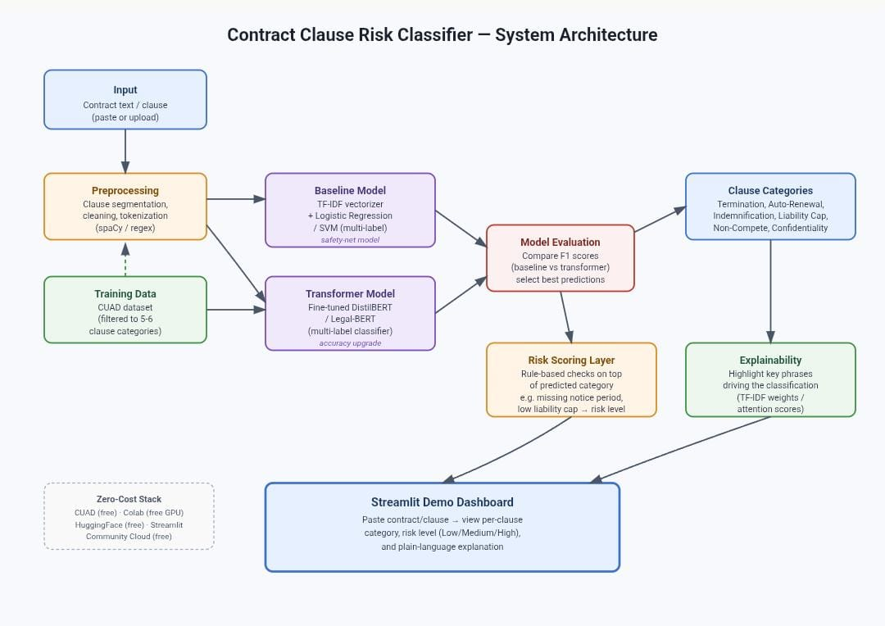
7. System Architecture
ClauseIQ — Contract Clause Risk Classifier
7

Slide 9
DEPARTMENT OF ARITIFICAL INTELLIGENCE & DATA SCIENCE
8. Implementation Details
Pipeline
Raw contracts are parsed from PDF, DOCX, or TXT and segmented into clause-level sections using regex-based header detection (numbered clauses, lettered sub-clauses, "Section N" headers). The CUAD dataset is filtered to six target categories and converted into a multi-label training set during preprocessing.
Models
The baseline model uses a TF-IDF vectorizer (5,000 features, unigrams and bigrams, English stop-words removed) with a One-vs-Rest Logistic Regression classifier, trained on an 80/20 split. The optional transformer model fine-tunes Legal-BERT / DistilBERT on the same data in Google Colab and is loaded with eager attention so per-token attention weights can be exposed for explainability.
Risk Scoring, Explainability & Deployment
Risk scoring applies hand-authored regular-expression rules per category — e.g. detecting auto-renewal language without a matching notice-period pattern, or explicit "uncapped liability" phrasing versus protective damages-exclusion language. Explainability surfaces the key terms behind each prediction, and the report generator produces CSV and PDF exports. The application is deployed as a Streamlit web app; 18 automated tests (pytest) cover risk-scoring rules and clause-splitting logic, including regression tests for two bugs found against a real external contract.
ClauseIQ — Contract Clause Risk Classifier

Slide 10
DEPARTMENT OF ARITIFICAL INTELLIGENCE & DATA SCIENCE
9. References
[1] D. Hendrycks, C. Burns, A. Chen, and S. Ball, "CUAD: An Expert-Annotated NLP Dataset for Legal Contract Review," in Proc. 35th Conf. Neural Information Processing Systems (NeurIPS) Track on Datasets and Benchmarks, 2021.
[2] J. Devlin, M.-W. Chang, K. Lee, and K. Toutanova, "BERT: Pre-training of Deep Bidirectional Transformers for Language Understanding," in Proc. Conf. North American Chapter of the Association for Computational Linguistics (NAACL-HLT), 2019, pp. 4171-4186.
[3] I. Chalkidis, M. Fergadiotis, P. Malakasiotis, N. Aletras, and I. Androutsopoulos, "LEGAL-BERT: The Muppets straight out of Law School," in Findings of the Association for Computational Linguistics: EMNLP, 2020, pp. 2898-2904.
ClauseIQ — Contract Clause Risk Classifier
9

Slide 11
DEPARTMENT OF ARITIFICAL INTELLIGENCE & DATA SCIENCE
Thank You
Questions & Discussion
ClauseIQ — Contract Clause Risk Classifier (NLP)

