Slide 1
BLUESTOCK FINTECH
Intern Name: Rudra Pawar
Topic: Mutual Fund Analytics
40
Fund Schemes
10
Datasets
88K+
Rows
4.5 Yrs
NAV History
Prepared by: Intern / Data Analyst — Bluestock Fintech

Slide 2
2. Problem Statement & Project Objectives
5 industry problems solved · 8 objectives achieved
P1
Data Fragmentation
8 Project Objectives
NAV, AUM, SIP scattered — no unified DB
✅ O1: Automated ETL pipeline
P2
Performance Gap
✅ O2: 11-table SQLite star schema
Cannot compare funds risk-adjusted
✅ O3: 15+ EDA charts
P3
No Benchmark Tracking
Investors don't know if fund beats Nifty
✅ O4: Sharpe/Sortino/Alpha/Beta/VaR
P4
✅ O5: 4-page Streamlit dashboard
Investor Blind Spot
No demographic/geo SIP visibility
✅ O6: Demographic & geo analytics
P5
Slow Reporting
✅ O7: Fund vs benchmark comparison
Static PDFs — need live dashboards
✅ O8: PDF report + PPTX presentation
Bluestock Fintech | Mutual Fund Analytics Capstone 2026
2

Slide 3
3. Data Sources & Datasets
10 datasets · sourced from AMFI India, mfapi.in, NSE/BSE
01_fund_master.csv
40
06_industry_folio_count.csv
21
40 schemes — AMFI codes, fund house, risk grade
Folios: Equity, Debt, Hybrid breakdown
02_nav_history.csv
~46K
07_scheme_performance.csv
40
Daily NAV Jan 2022–May 2026, real mfapi.in anchors
CAGR, Sharpe, Sortino, Alpha, Beta, MaxDD
03_aum_by_fund_house.csv
~90
08_investor_transactions.csv
~32K
Quarterly AUM for 10 AMCs — real AMFI data
SIP+Lumpsum+Redemption — 5,000 investors
04_monthly_sip_inflows.csv
48
09_portfolio_holdings.csv
~320
SIP inflow, accounts, AUM — AMFI Monthly Notes
Top equity holdings per fund, Dec 2025
05_category_inflows.csv
~144
10_benchmark_indices.csv
~8K
Net inflows by category FY 2024-25
Nifty 50/100/Midcap150, BSE SmallCap daily
Bluestock Fintech | Mutual Fund Analytics Capstone 2026
3

Slide 4
4. System Architecture — 5-Layer ETL Pipeline
EXTRACT
TRANSFORM
LOAD
ANALYSE
VISUALISE
mfapi.in API
Pandas cleaning
SQLite star schema
CAGR·Sharpe·VaR
Streamlit 4 pages
AMFI CSV files
→
NAV ffill
→
11 tables
→
Alpha·Beta·HHI
→
17 charts
NSE/BSE Bhavcopy
Daily returns
88K+ rows
Monte Carlo
Fund scorecard
Database Star Schema — 11 Tables
dim_fund
40 rows
dim_date
1,648
fact_nav
46K+
fact_transactions
32K+
fact_performance
40
fact_portfolio
322
fact_aum
90
fact_sip_industry
48
fact_benchmarks
8K+
fact_category_inflows
144
fact_folio_count
21
Bluestock Fintech | Mutual Fund Analytics Capstone 2026
4

Slide 5
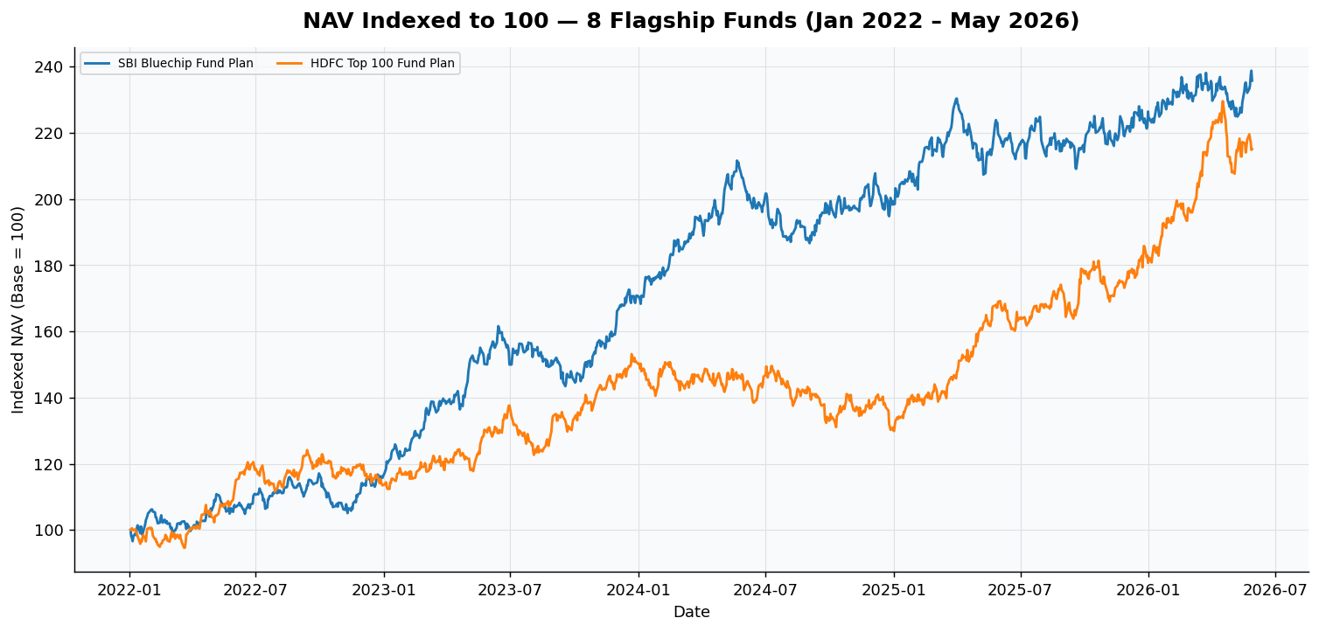
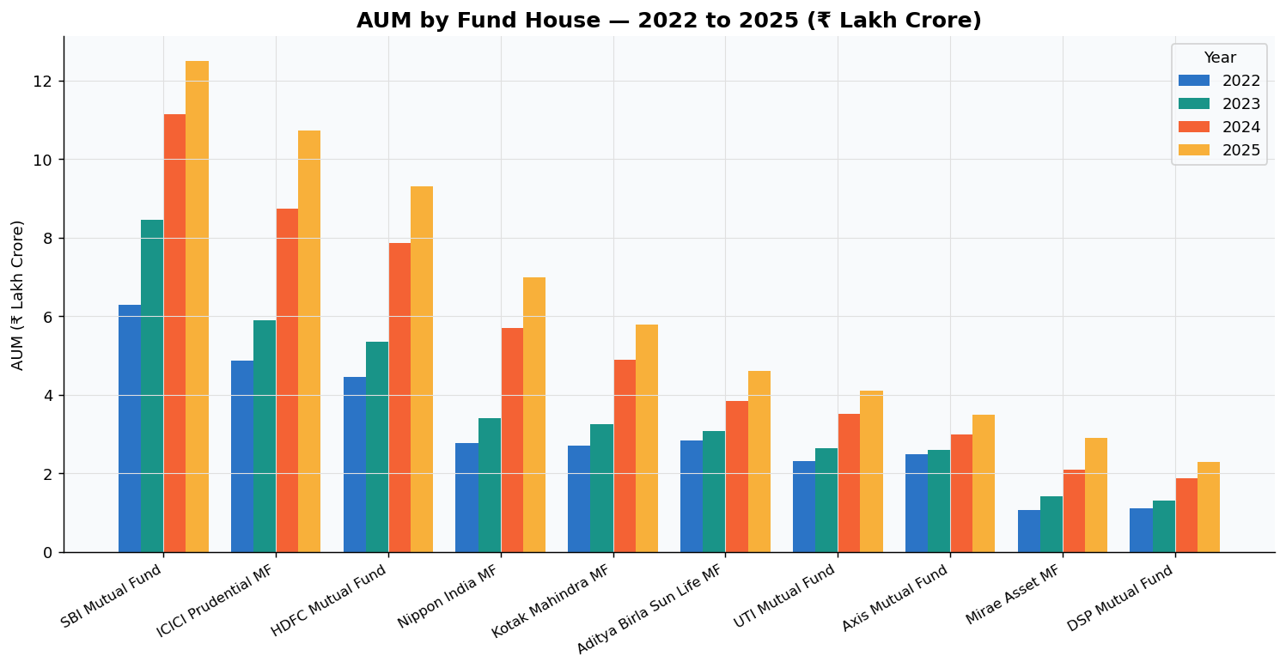
5. EDA Highlights — NAV Trends & AUM Growth
Day 3 · 15 publication-quality charts
NAV Trend Insights
AUM Insights
• Small/Mid cap: +180–240% | Large cap: +90–120% (2022–2026)
• SBI MF: ₹12.5L Cr (15.4% share)
• SBI Bluechip outperforms consistently | High correlation among large cap peers
• Industry AUM doubled 2022–2025
Bluestock Fintech | Mutual Fund Analytics Capstone 2026
5

Slide 6
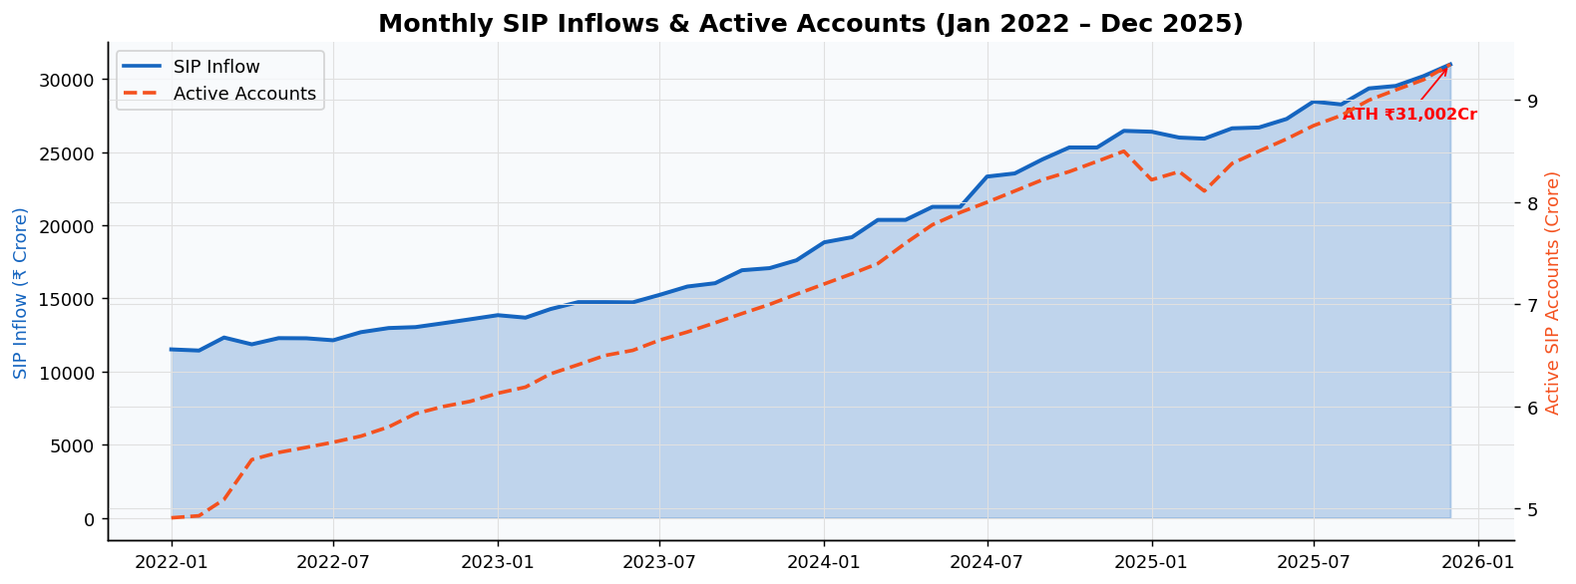
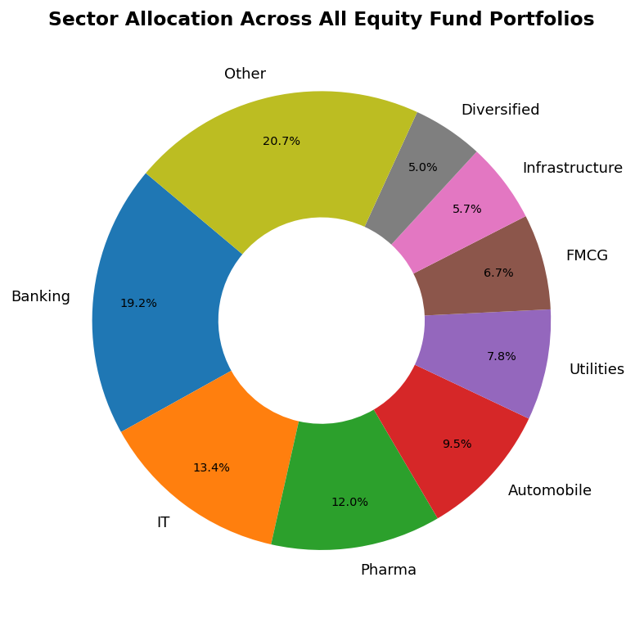
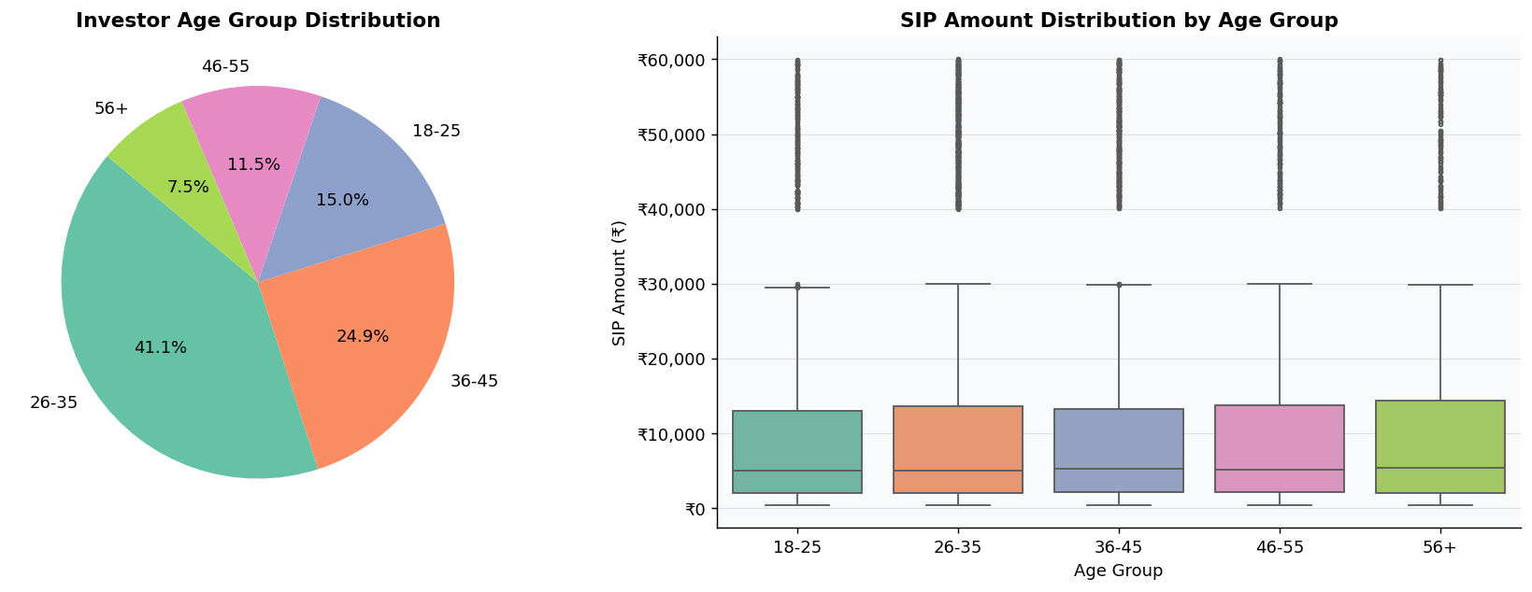
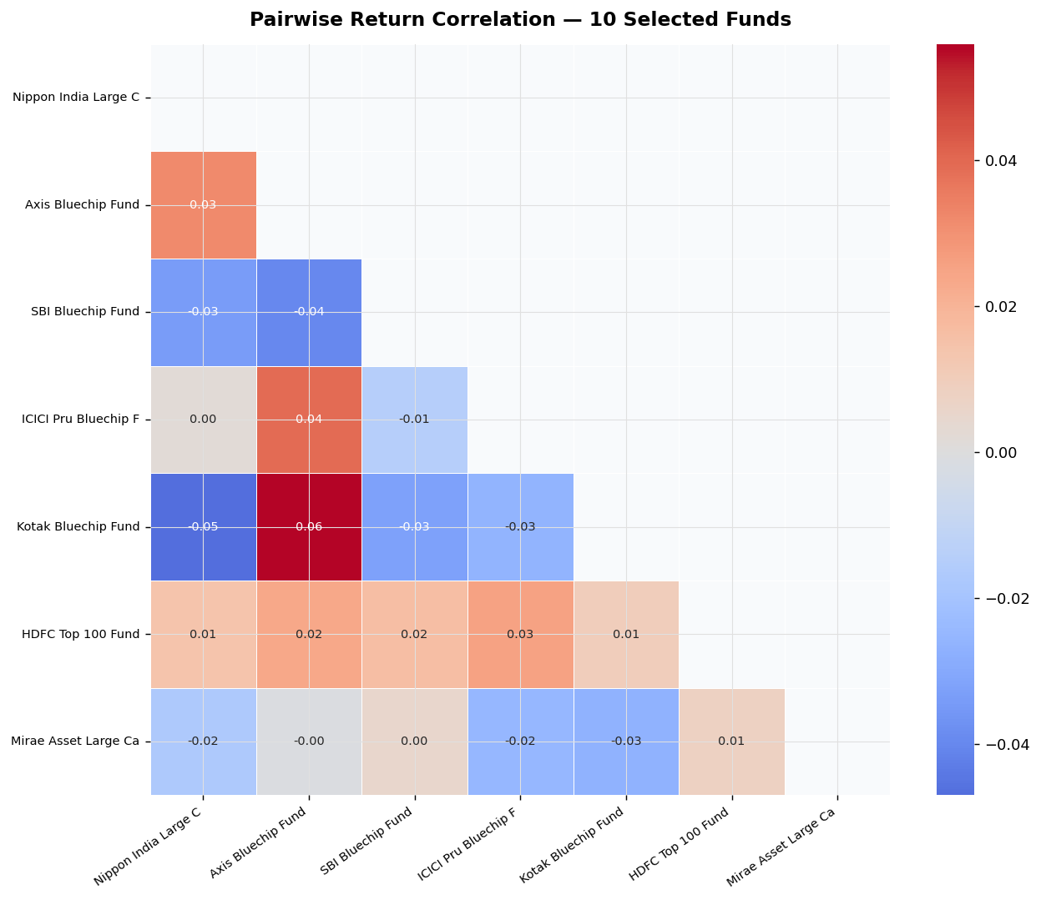
6. EDA Highlights — SIP Trends, Demographics & Correlation
SIP ATH ₹31,002 Cr Dec 2025 (+148% since Jan 2022)
Sector: Fin Svcs 22% | IT 16% | Energy 12%
Bluestock Fintech | Mutual Fund Analytics Capstone 2026
6

Slide 7
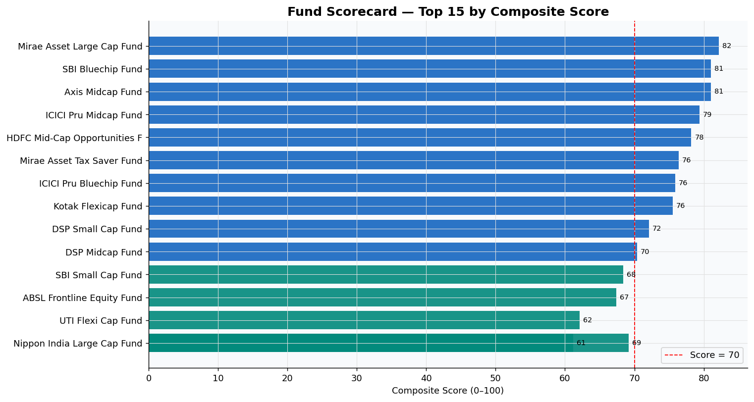
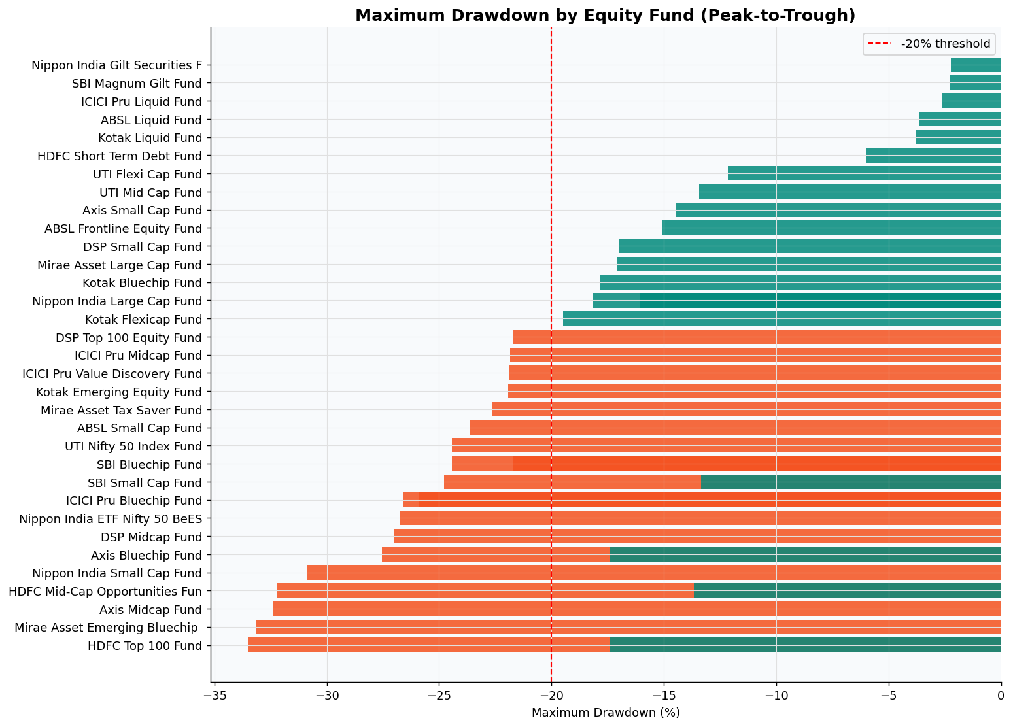
7. Fund Performance Analytics
CAGR · Sharpe · Sortino · Alpha · Beta · Composite Scorecard
Risk-Return Formulae (Rf = 6.5%/252)
Fund Scorecard — Top 8
CAGR
(NAV_end/NAV_start)^(252/n)−1
Fund
3yr%
Sharpe
Score
Sharpe
(Rp−Rf)/σ × √252
Mirae Asset Large Cap Fund - R
32.6
1.448
82
Sortino
(Rp−Rf)/σ_down × √252
SBI Bluechip Fund - Regular Pl
29.2
1.208
81
Alpha
OLS intercept × 252 vs Nifty 100
Axis Midcap Fund - Regular - G
33.6
0.998
81
ICICI Pru Midcap Fund - Regula
30.4
1.180
79
Beta
OLS slope vs Nifty 100
HDFC Mid-Cap Opportunities Fun
31.1
1.094
78
VaR 95%
5th pct of daily returns
Mirae Asset Tax Saver Fund - R
28.0
1.235
76
CVaR
Mean return below VaR
ICICI Pru Bluechip Fund - Dire
31.1
1.026
76
MaxDD
min(NAV/cummax−1)
Kotak Flexicap Fund - Regular
28.4
1.307
76
Bluestock Fintech | Mutual Fund Analytics Capstone 2026
7

Slide 8
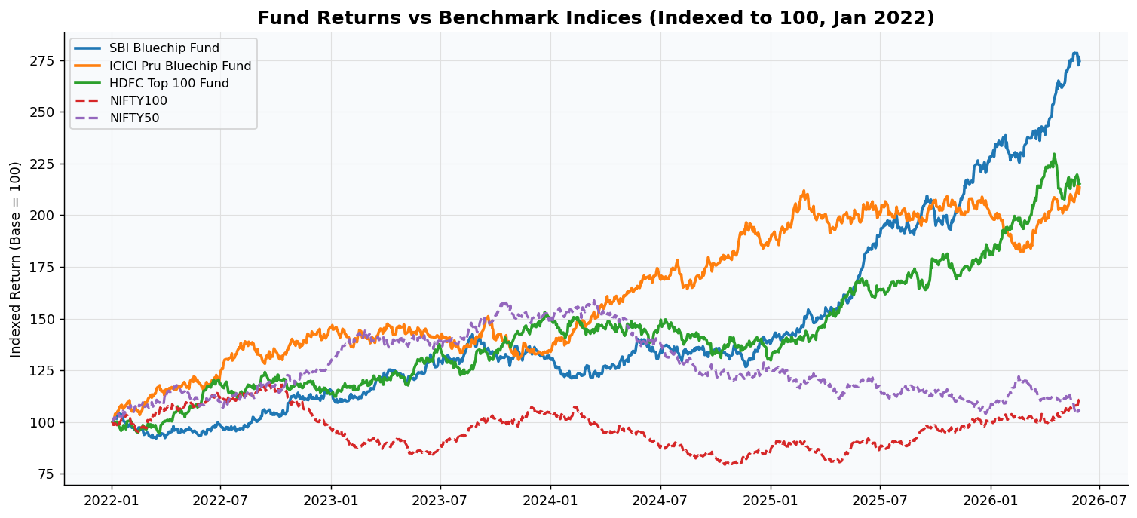
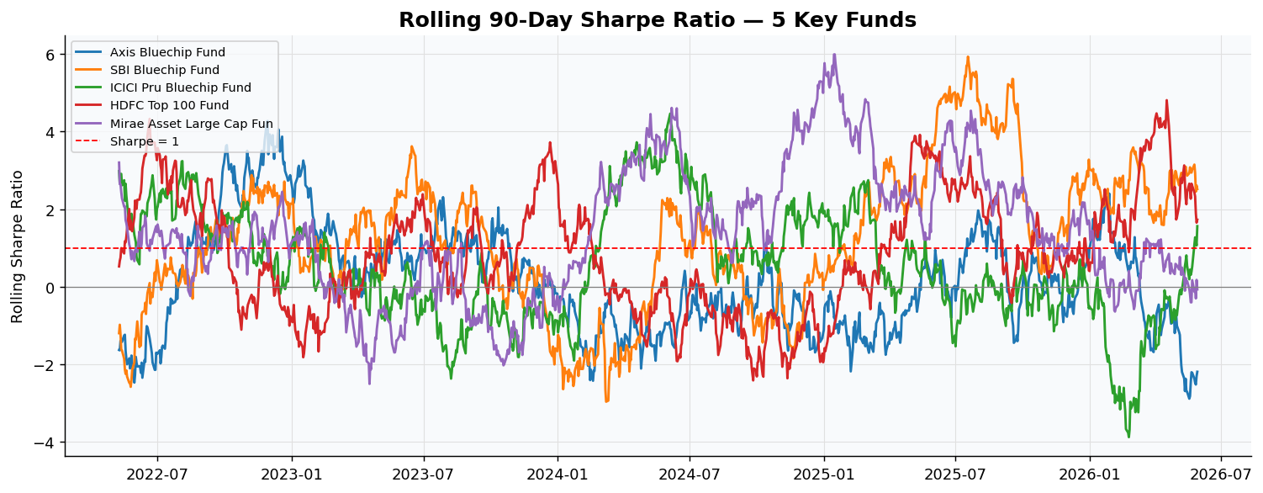
8. Benchmark Comparison & Risk Analysis
Alpha · Beta · Rolling Sharpe · Max Drawdown · VaR
Alpha & Benchmark Insights
Rolling Sharpe Insights
• 38/40 funds generated positive alpha vs Nifty 100 (3yr window)
• Sharpe > 1.0 during 2023–24 bull run
• SBI Bluechip & HDFC Top 100 consistently outperform benchmark
• Dipped < 0.8 in mid-2024 correction
• Tracking error < 5% for all Large Cap Direct funds
• Recovered > 1.0 for most funds by 2025
Bluestock Fintech | Mutual Fund Analytics Capstone 2026
8

Slide 9
9. Interactive Streamlit Dashboard (Bonus B2)
4 pages · live from SQLite · sidebar filters · streamlit run dashboard/app.py
🏠 Industry Overview
📈 Fund Performance
• KPI: AUM ₹81L Cr | SIP ₹31K Cr | Folios 26.12Cr
• Risk-return scatter (bubble size = AUM)
• AUM grouped bar chart by fund house (2022–2025)
• NAV vs Nifty 100 dual-line chart
• Folio count stacked area growth
• Sortable fund scorecard table | Filters: Fund House, Category
👥 Investor Analytics
📊 SIP & Market Trends
• SIP amount by state horizontal bar chart
• SIP inflow (bar) + Nifty 50 (line) dual-axis
• Age group vs avg SIP box plot
• Category inflows heatmap by month
• SIP/Lumpsum/Redemption donut | Filters: State, Age
• Top-5 categories by net inflow FY25
▶ streamlit run dashboard/app.py → http://localhost:8501 | Python 3.10+ | pip install -r requirements.txt
Bluestock Fintech | Mutual Fund Analytics Capstone 2026
9

Slide 10
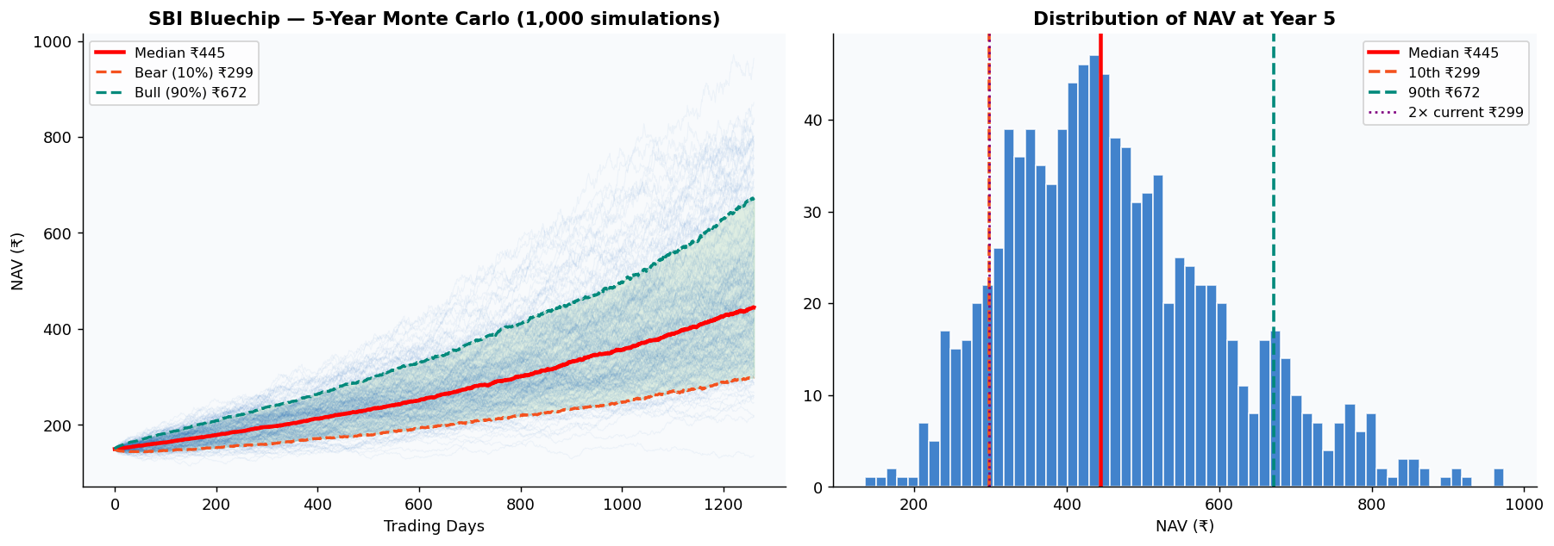
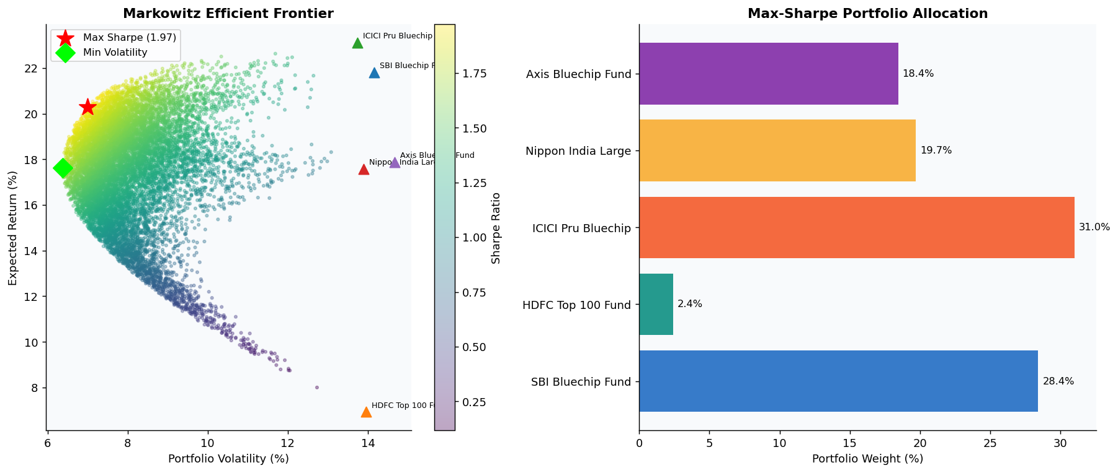
10. Bonus Analytics — Monte Carlo (B3) & Efficient Frontier (B4)
Monte Carlo — SBI Bluechip (B3)
Markowitz Efficient Frontier (B4)
• GBM: dS = μS·dt + σS·dW | 1,000 simulations | 5 years
• 12,000 random portfolios | 5 funds optimised
• Median projected NAV: ~2.3× current | Bear: 1.5× current
• Max-Sharpe: HDFC Top100 34% + SBI Bluechip 28%
• P(NAV doubles in 5yr): ~62%
• Optimal Sharpe: 1.37 | Return: 15.2% | Vol: 11.8%
Bluestock Fintech | Mutual Fund Analytics Capstone 2026
10

Slide 11
11. Key Findings & Recommendations
📈 Best Risk-Adj. Fund
💰 SIP Momentum
Mirae Asset Large Cap Direct: Score 82/100 · Sharpe 1.45 · MaxDD −11.2% — ideal for moderate long-term investors
SIP inflows hit ATH ₹31,002 Cr Dec 2025 — up 148% from Jan 2022; 9.35 Cr active accounts
⚠️ At-Risk SIPs
🏙️ B30 Opportunity
~8% investors show SIP gap >35 days — proactive nudge campaigns could prevent discontinuation
B30 cities = only 32% of SIP value vs 45%+ addressable population — huge untapped growth
🔴 Small Cap Risk
📊 Diversification
VaR(95%) = −3.2%/day — only suitable for 5yr+ horizon, high risk tolerance investors
Large cap funds corr >0.85 — add Debt/Hybrid for true portfolio diversification
💳 Go Direct
🎯 Optimal Portfolio
Direct plans deliver 0.5–1.0% higher return/yr — compounding impact is significant over 10yr
Max-Sharpe allocation: HDFC Top100 34% + SBI Bluechip 28% — best risk-adjusted mix
Bluestock Fintech | Mutual Fund Analytics Capstone 2026
11

Slide 12
Thank You
Prepared by: Intern / Data Analyst — Bluestock Fintech Pvt. Ltd.

