Slide 1
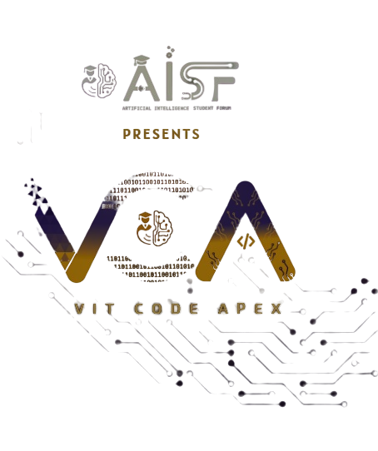

Slide 2


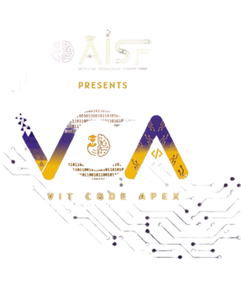
CODE VERSE HACKATHON 2025
Marine-Foul-Detect
Leveraging Artificial Intelligence for Enhanced Naval Operations
Team Swanay
Rudrapratap Paghal, SY
Shiva Pachade, SY
Sandesh Nakade, SY
Sanskruti Dhakar, SY

Slide 3

Chapter 1
Marine-Foul-Detect
1. Real-world Issue
Solution
Marine fouling (biofouling) — the accumulation of algae, barnacles, and other organisms on ship hulls and underwater structures — causes serious operational and economic problems.
Marine-Foul-Detect is an AI-powered image analysis system that automatically detects, classifies, and measures marine biofouling on ship hulls and underwater structures.Unlike manual inspection, it is faster, accurate even in murky water, and fully automated.
2. Why It’s Important
Increases drag, reducing vessel speed and efficiency.
Leads to higher fuel consumption and operating costs.
Poses biosecurity risks by spreading invasive species.
3. Key Facts
Biofouling can increase a ship’s fuel consumption by up to 40%.
The global shipping industry loses billions annually due to fouling-related costs.
Indian Navy and commercial fleets spend huge resources on manual inspections and cleaning.
What It Provides Feature
Detection & Classification → Finds fouling type (barnacles, algae, mussels).Feature
Density Estimation → Calculates % coverage, maps to LoF risk levels.
Feature Automated Reporting → Gives inspection overlays + downloadable report
Target Audience:
1. Indian Navy. 2. commercial shipping operators.
3. offshore platform maintainers.
Impact
Cuts inspection time and reduces fuel-cost estimation errors by up to 40%
This innovation provides a critical advancement in addressing significant challenges faced by the Indian Navy.

Slide 4
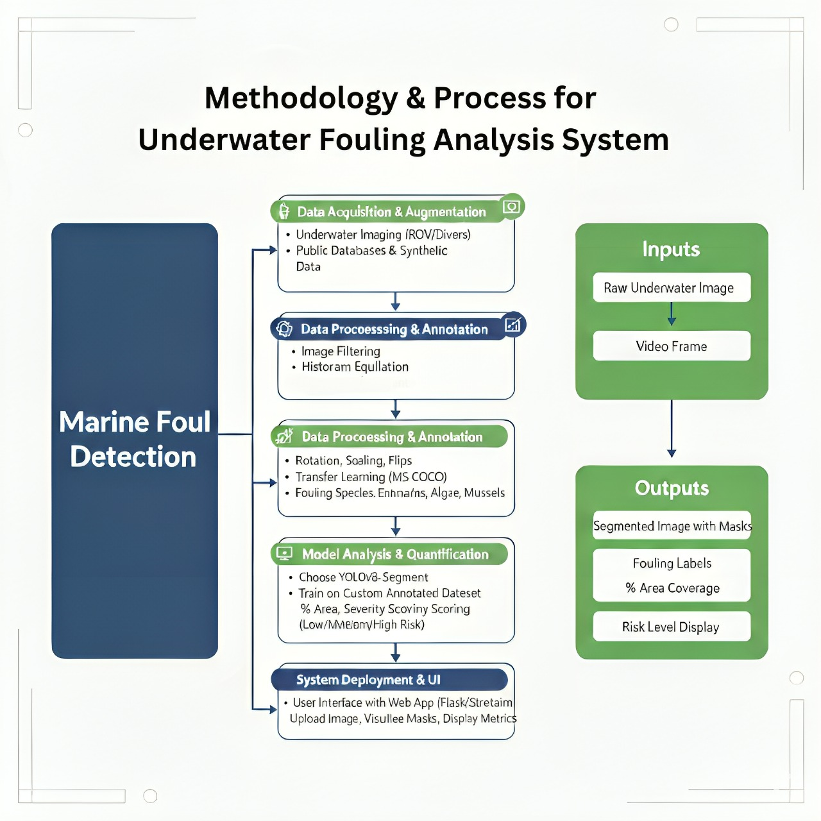
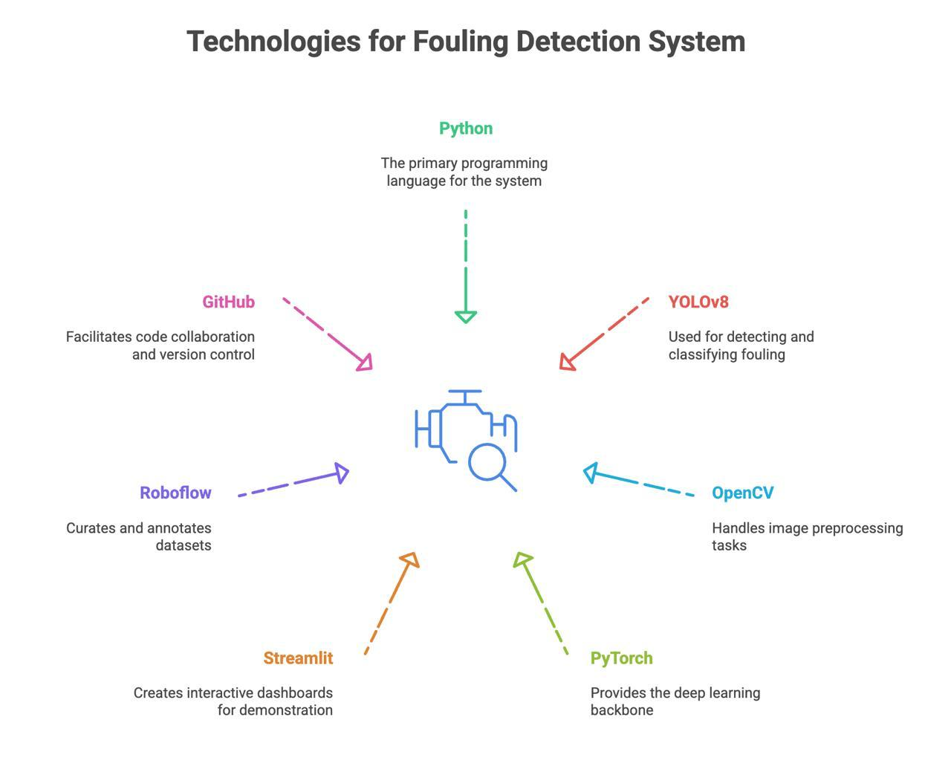
TECHNICAL APPROACH
Technology Used

Slide 5
Chapter 3
Feasibility And Viability
The development of this AI prototype is highly feasible, even within hackathon constraints, due to several key factors:
Technical Feasibility
YOLOv8 + OpenCV can detect and segment fouling on ship hulls.
Pretrained models can be fine-tuned for barnacles, algae, and mussels quickly.
Streamlit UI allows easy demo of annotated images.
Economic Feasibility
Fully open-source tools: Python, PyTorch, YOLOv8, OpenCV, Streamlit.
No licensing cost, only free compute (Colab/Kaggle).
Can scale later using cloud with minimal cost.
Potential Challenges & Risks
Data Limitations: Few labeled underwater images → may affect accuracy.
Image Quality: Murky water, low light, occlusion can reduce detection.
Scalability: Large datasets / real-time use may need more compute.
Trust: Navy/industry may doubt AI accuracy vs manual checks.
Strategies to Overcome
Use data augmentation and pretrained YOLOv8 to handle limited data.
Apply OpenCV preprocessing (denoise, color correction) for murky images.
Operational Feasibility
⚙Simple pipeline: Image → AI → Dashboard.Generates automatic inspection reports, reducing human bias.
Can integrate with existing Navy or shipping inspections.

Slide 6


Chapter 6
IMPACT & BENIFITS
Benefits of the Solution Efficiency
Automated detection reduces inspection time from days → minutes.
Cost-effectiveness: Open-source AI → low deployment cost.
Scalability: Modular pipeline → usable for Navy, shipping, and offshore platforms.
Long-term Value: Reduces maintenance frequency, fuel bills, and emissions.
Reduced Fuel Costs
Up to 20% savings through optimized hull cleaning, directly impacting operational budgets.
Environmental Protection
Lower fuel use = reduced CO₂ emissions, contributing to greener shipping.
⚙
Analogy:
“Just like a thin layer of mud on a bicycle wheel makes pedaling harder, a thin layer of marine fouling on a ship’s hull drastically increases drag and fuel usage. Our solution acts like a self-cleaning inspection system for ships.”
Social/National Security
Improves Indian Navy efficiency, reduces downtime, and prevents spread of invasive species.
This AI solution represents a significant step towards a more intelligent, efficient, and environmentally responsible Indian Navy.

Slide 7
References
References for Marine Fouling Detection Project
[1] Y. Cao, H. Zhou, J. Zhang, and Y. Zhang, “Marine biofouling detection and recognition based on deep learning,” IEEE Access, vol. 8, pp. 150489–150499, 2020.
[2] P. F. Sammarco, M. J. Risk, and A. C. Brown, “Marine fouling and its prevention: An overview,” Oceanography, vol. 30, no. 1, pp. 54–63, 2017.
[3] Z. Zhang, Y. Liu, and X. Wang, “Deep convolutional neural networks for underwater image classification,” in Proc. IEEE Int. Conf. Image Processing (ICIP), Beijing, China, 2017, pp. 1230–1234.
[4] J. Oliveira, M. Almeida, and P. F. Silva, “Biofouling detection in underwater surfaces using computer vision techniques,” in Proc. OCEANS 2019 – Marseille, Marseille, France, 2019, pp. 1–6.
[5] M. S. Couceiro, F. M. L. Martins, and R. P. Rocha, “Vision-based biofouling detection for autonomous underwater vehicles,” in Proc. IEEE Oceans 2016 – Shanghai, Shanghai, China, 2016, pp. 1–7.
[6] A. Krizhevsky, I. Sutskever, and G. E. Hinton, “ImageNet classification with deep convolutional neural networks,” in Proc. Advances in Neural Information Processing Systems (NIPS), Lake Tahoe, NV, USA, 2012, pp. 1097–1105.

Slide 8
Thank You
We appreciate your attention and interest in our innovative marine fouling AI solution. We look forward to advancing naval capabilities together.

