Slide 1
COMPOUND HEAT–DROUGHT STRESS OVER INDIA
Are ecosystems hit harder when heat and drought strike together?
Mid-Evaluation, EVS Project
Arnav Deshmukh · Ayush Brajesh Roy · Saksham Chitkara
Gracy Garg · Rudra Choudhary
IIIT Hyderabad · October 9, 2026

Slide 2
OUTLINE
01
PROBLEM STATEMENT & MOTIVATION
02
OUR HYPOTHESES
03
METHODOLOGY
04
PRELIMINARY ANALYSIS (H1, H2)
05
THINGS LEFT TO DO
2

Slide 3
PROBLEM STATEMENT & MOTIVATION
01

Slide 4
HEAT AND DROUGHT RARELY COME ALONE
Drought: too little water (little rain, dry soil)
Heat: high temperature, “thirsty” air
They feed each other: dry soil heats up, heat dries soil
Plants get hit from both sides
Heat
(high temperature)
Thirsty air
(high VPD)
more
evaporation
less
cooling
Dry soil
(drought)
Plants close stomata
⇒ less photosynthesis
4
slidesmania.com

Slide 5
KEY IDEA: GPP AND THE LAND CARBON SINK
Gross primary productivity (GPP) is the total amount of carbon that plants take out of the air by photosynthesis, per area and time (we use grams of carbon per m² per month). It is the starting point of plant growth, crop yield and the land carbon sink.
NORMAL YEAR
HEAT + DROUGHT
CO₂ in the air
CO₂ in the air
photosynthesis
(GPP)
respiration
(plants + soil)
photosynthesis
(GPP)
respiration
(plants + soil)
Uptake > release ⇒ carbon SINK
(land removes CO₂ from the air)
Uptake < release ⇒ carbon SOURCE
(land adds CO₂ to the air)
Heat + drought can flip land from sink to source: Europe in 2003 [1].
5
slidesmania.com

Slide 6
WHY IT MATTERS
Europe 2003: a summer of heat + drought cut productivity by about 30% and turned Europe’s land into a temporary carbon source [1].
Worldwide: across flux-tower sites, combined heat + drought reduced the carbon sink more than either extreme alone [2].
India: droughts and heatwaves that happen at the same time have become more frequent and widespread [3].
As the climate warms, more droughts will happen during hot spells, so we need to know how much worse the combination is.
6

Slide 7
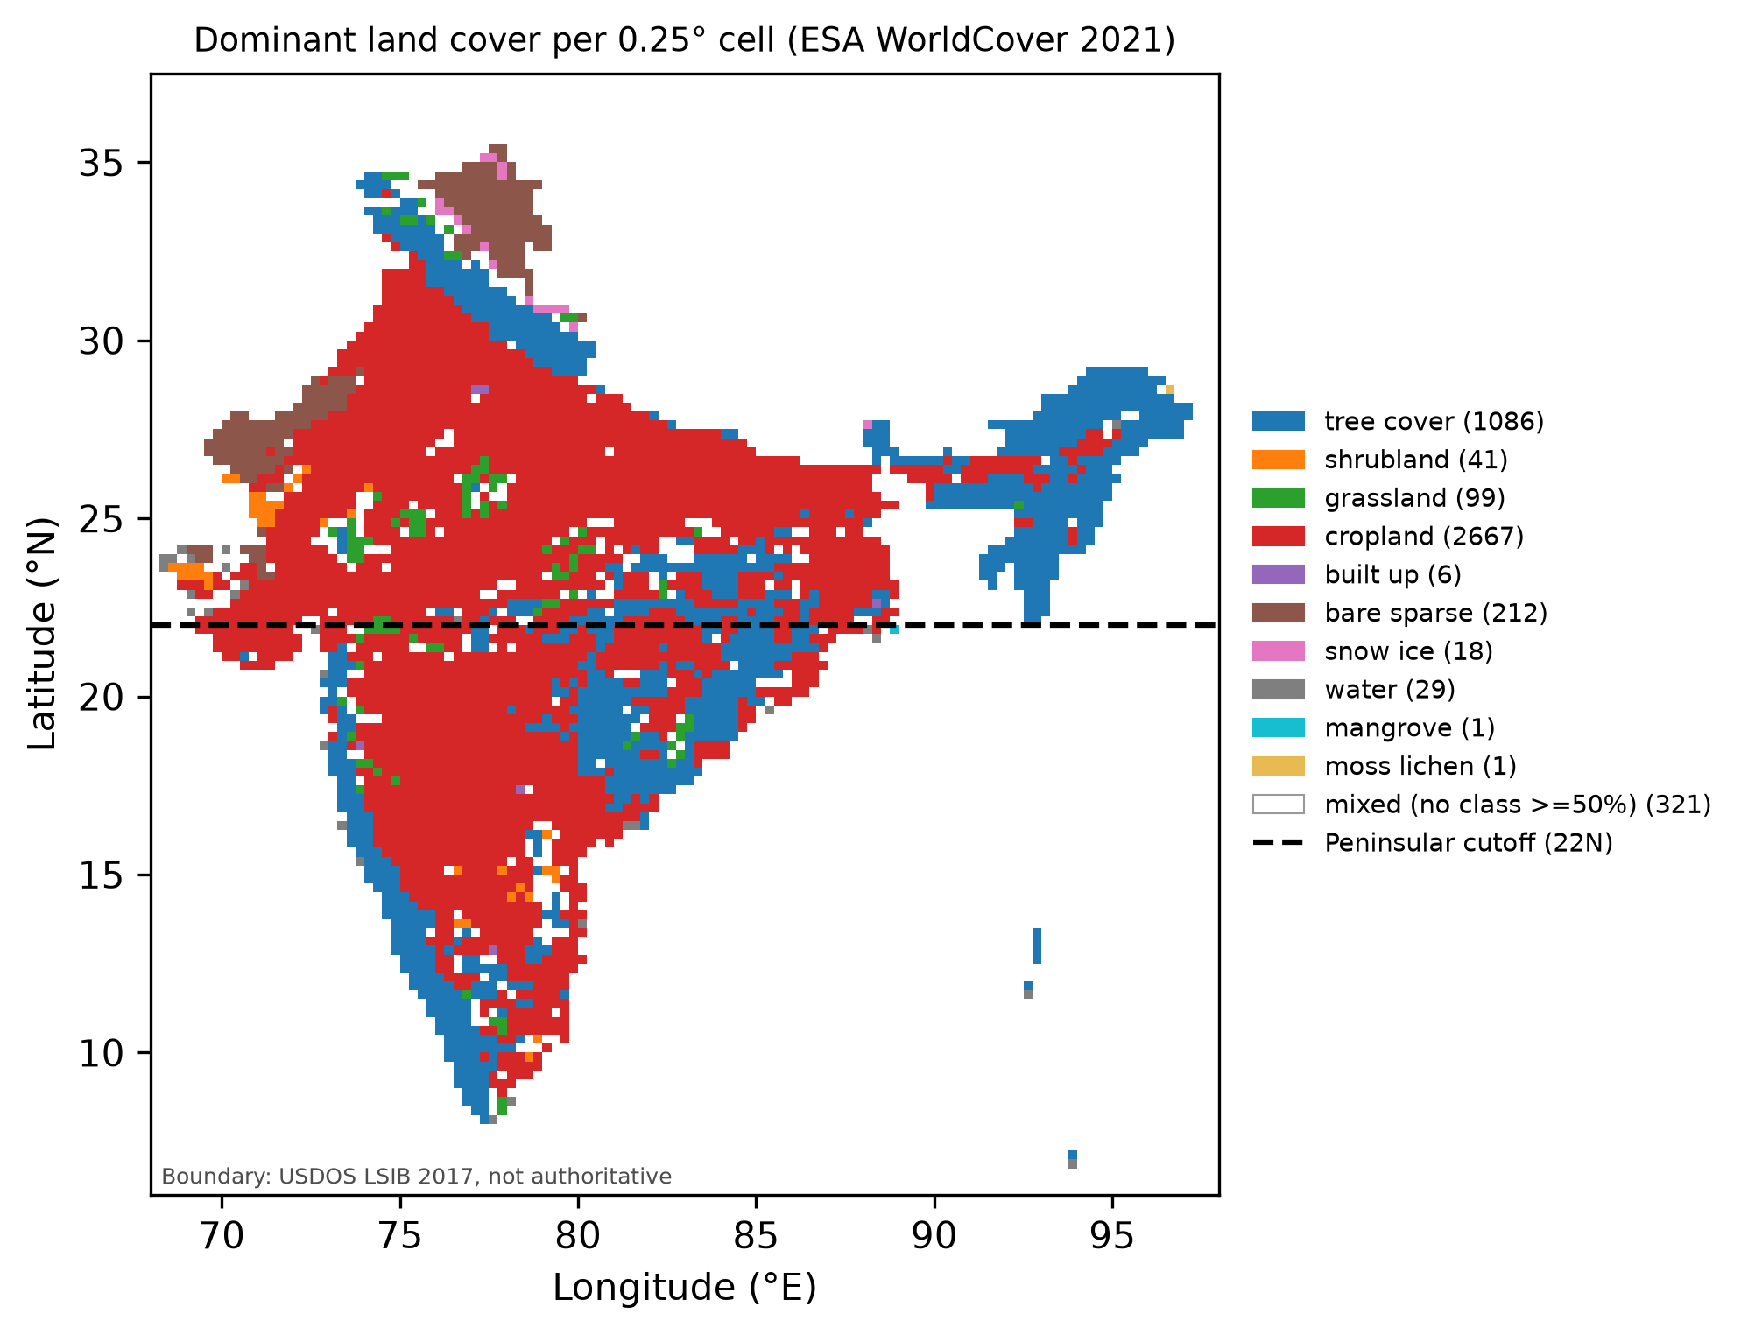
WHY INDIA?
Monsoon-dependent: most rain falls in Jun–Sep; a weak monsoon means drought (2002, 2009).
Hot pre-monsoon: Mar–May is the hottest season; extreme heat in 2010 and 2022.
Mostly cropland (~60% of cells): lost productivity means lost food and income.
Under-studied: most work covers Europe, China or the globe; India-wide studies are new [4, 5].
7
slidesmania.com

Slide 8
PROBLEM STATEMENT
TOPIC: COMPOUND HEAT–DROUGHT STRESS
Are ecosystems experiencing stronger combined impacts?
Does simultaneous heat and drought produce greater ecosystem stress than either disturbance alone?
WHY THIS MATTERS
If heat and drought damage simply add up, we can predict compound impacts from single-stress studies. If they amplify each other, compound events are a separate, bigger risk.
8

Slide 9
OUR QUESTIONS (FOR INDIA)
Is vegetation hit harder in compound (hot and dry) months than in hot-only or dry-only months?
Is the compound hit bigger than the heat damage plus the drought damage added together?
Do ecosystems take longer to recover after compound events?
Does the answer differ between forests, croplands, grasslands, and between Peninsular and North India?
9

Slide 10
WHAT IS KNOWN, AND WHAT IS STILL OPEN
KNOWN
OPEN
Heat + drought together cut the carbon uptake of ecosystems more than either extreme alone (flux towers worldwide [2]; Europe 2003 [1]).
In India, hot and dry conditions together raise the chance that vegetation goes into drought [4].
In Peninsular India’s forests, compound hot–dry extremes raise the risk of large GPP losses [5].
Is the damage to average productivity more than heat damage + drought damage (synergy), or just the sum? Few studies test this directly, with uncertainty.
The answer depends on how “drought” is defined: soil-based and air-based definitions give different impacts [6].
Do ecosystems recover more slowly after compound events? Global studies disagree [7, 8, 9], and we found no India-specific comparison.
10
slidesmania.com

Slide 11
OUR HYPOTHESES
02

Slide 12
OUR HYPOTHESES
Our aim: an India-wide, honest test of additivity on two satellite measures, with uncertainty and a drought-index check, then recovery and regional differences. This is a regional synthesis with extensions, not a first-of-its-kind study.
 | Hypothesis | Current status
H1 | Vegetation (GPP, NDVI) is lower in compound months than in hot-only or dry-only months. | Tested
H2 | The compound effect is synergistic: larger than the heat effect + the drought effect. | Tested
H3 | Ecosystems recover more slowly after compound events than after droughts. | In progress
H4 | The response differs by land cover and by region (Peninsular vs North India). | In progress
Throughout, we check that conclusions do not depend on the choice of drought index (SPEI-3 vs SPI-3).
12
slidesmania.com

Slide 13
METHODOLOGY
03

Slide 14
WORKFLOW
STEP 1
Download & aggregate data (Earth Engine)
STEP 2
Monthly anomalies (z-scores)
STEP 3
Sort each grid-month: normal / hot / dry / compound
STEP 4
Compare GPP & NDVI across boxes (H1, H2)
Everything is scripted in Python (xarray, scipy, statsmodels) and checked by 68 automated tests. The analysis reruns from cached data in minutes.
Events & recovery (H3),
land cover & region (H4)
in progress
14

Slide 15
STEP 1: DATA
Dataset | What we use | Period | Role
ERA5-Land [10] | daily max temperature; soil moisture 0–100 cm; VPD | 1991–2024 | defines “hot”; mechanism
SPEI v2.11 [11] | SPEI-3 (rain minus evaporative demand) | 1991–2024 | defines “dry”
CHIRPS v2 [12] | rainfall → SPI-3 | 1991–2024 | temperature-free drought check
MODIS MOD17A2H [13, 14] | GPP (photosynthesis) | 2001–2022 | main response
MODIS MOD13A3 [15] | NDVI (greenness), quality-masked | 2001–2022 | second response
ESA WorldCover [16] | land-cover fractions | 2021 | vegetation mask; land-cover groups
All five suggested datasets, processed in Google Earth Engine [17] onto one common grid: 0.25° (≈27 km), monthly, all of India (4,481 grid cells).
GPP and NDVI both come from the MODIS Terra satellite: two different products, but not independent sensors.
15
slidesmania.com

Slide 16
METRICS AT A GLANCE
Metric | What it measures | How to read it
Ecosystem response
GPP | Carbon taken up by plants through photosynthesis (gC/m²/month) | higher = more productive
NDVI | Canopy greenness from red and near-infrared reflectance (0–1) | higher = greener
Stress
Tmax z | Anomaly of the monthly mean daily maximum temperature | ≥ 1: “hot” month
SPEI-3 | 3-month water balance: rain minus evaporative demand | ≤ −1: “dry” month
SPI-3 | 3-month rainfall only (no temperature in it) | ≤ −1: dry (robustness)
Soil moisture | Water in the top 1 m of soil | lower = drier soil
VPD | Vapour-pressure deficit: how “thirsty” the air is | higher = more water stress
Statistics
z-score | Distance from normal for that place and calendar month (in SDs) | 0 = normal; −1 = clearly low
Amplification | Compound effect − (heat effect + drought effect) | < 0 synergy; ≈ 0 additive
95% CI | Year-block bootstrap: 1,000 resamples of whole years | excludes 0 = significant
16
slidesmania.com

Slide 17
STEP 2: MONTHLY ANOMALIES (COMPARING LIKE WITH LIKE)
Raw values are not comparable: May is always hotter than January, and a desert always has less GPP than a forest.
So for every grid cell and every calendar month, we convert a value into a z-score:
this month’s value − normal for this cell in this month
z =
typical year-to-year spread
z = −1 means “one standard deviation below what is normal here at this time of year”.
Temperature: normal = 1991–2020. Not detrended, so long-term warming counts as heat.
GPP, NDVI: a linear trend is removed first, so the long-term greening of India (CO₂, irrigation) is not mistaken for an anomaly.
Only growing-season months count: the cell is in India, at least 50% vegetated, and GPP in that month is normally at least 30% of its peak. This removes deserts and dormant seasons (824,598 grid-months remain).
17
slidesmania.com

Slide 18
STEP 3: SORTING EVERY GRID-MONTH INTO FOUR BOXES
SPEI-3 (dryness)
Hot: the month’s average daily maximum temperature is at least 1 standard deviation above normal.
Dry: SPEI-3 ≤ −1, i.e. the last 3 months had clearly less water than usual (rain minus evaporative demand).
SPEI’s demand term depends on temperature, so “dry” is partly driven by heat. We therefore repeat everything with SPI-3, which uses rainfall only.
Left: number of growing-season grid-months in each box, India, 2001–2022.
> −1
≤ −1
< 1
Normal
Dry-only
Tmax z
≥ 1
Hot-only
Compound
Normal | 573,543
Hot-only | 79,717
Dry-only | 109,073
Compound | 62,265 (7.6%)
18
slidesmania.com

Slide 19
STEP 4: HOW WE TEST H1 AND H2
H1: average GPP z (and NDVI z) in each box, and the differences between boxes.
H2: compare the compound effect with the sum of the single effects. Each effect is measured relative to normal months:
Amplification = Δ_{compound} − (Δ_{hot} + Δ_{dry})
< 0: compound is worse than the sum ⇒ synergy;
≈ 0: additive;
> 0: less than the sum (sub-additive).
Uncertainty: 95% confidence intervals from a year-block bootstrap. We resample whole years (1,000 times), because neighbouring cells in the same year are not independent. A result is called significant when its interval excludes zero.
19
slidesmania.com

Slide 20
PRELIMINARY ANALYSIS (H1, H2)
04

Slide 21
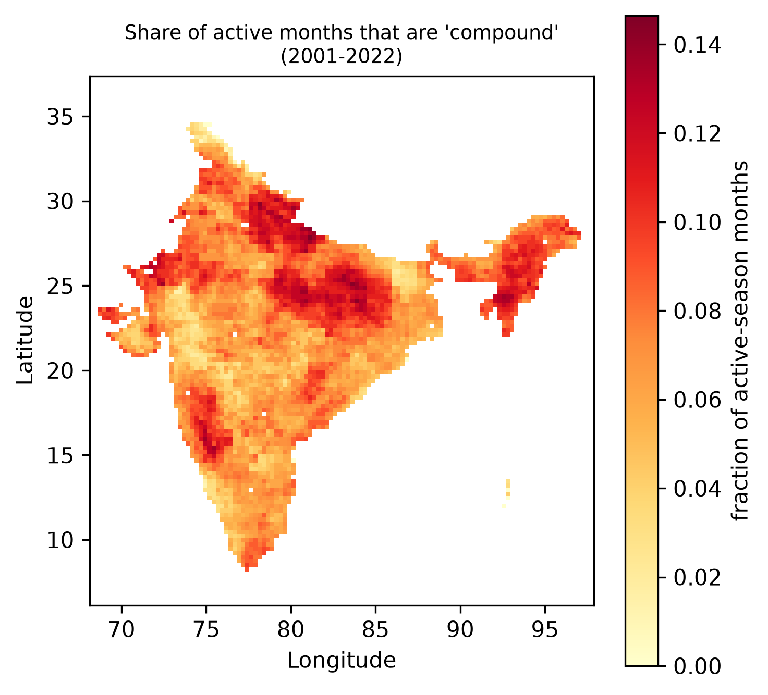
WHERE COMPOUND MONTHS HAPPEN
Share of each cell’s growing-season months that were compound, 2001–2022.
Overall, 7.6% of growing-season grid-months are compound.
Hotspots: the northern plains, east-central India, the North-East, and a belt in the western Deccan (around 15–18°N).
Both North and Peninsular India have more than 20,000 compound grid-months, enough for a reliable comparison.
21
slidesmania.com

Slide 22
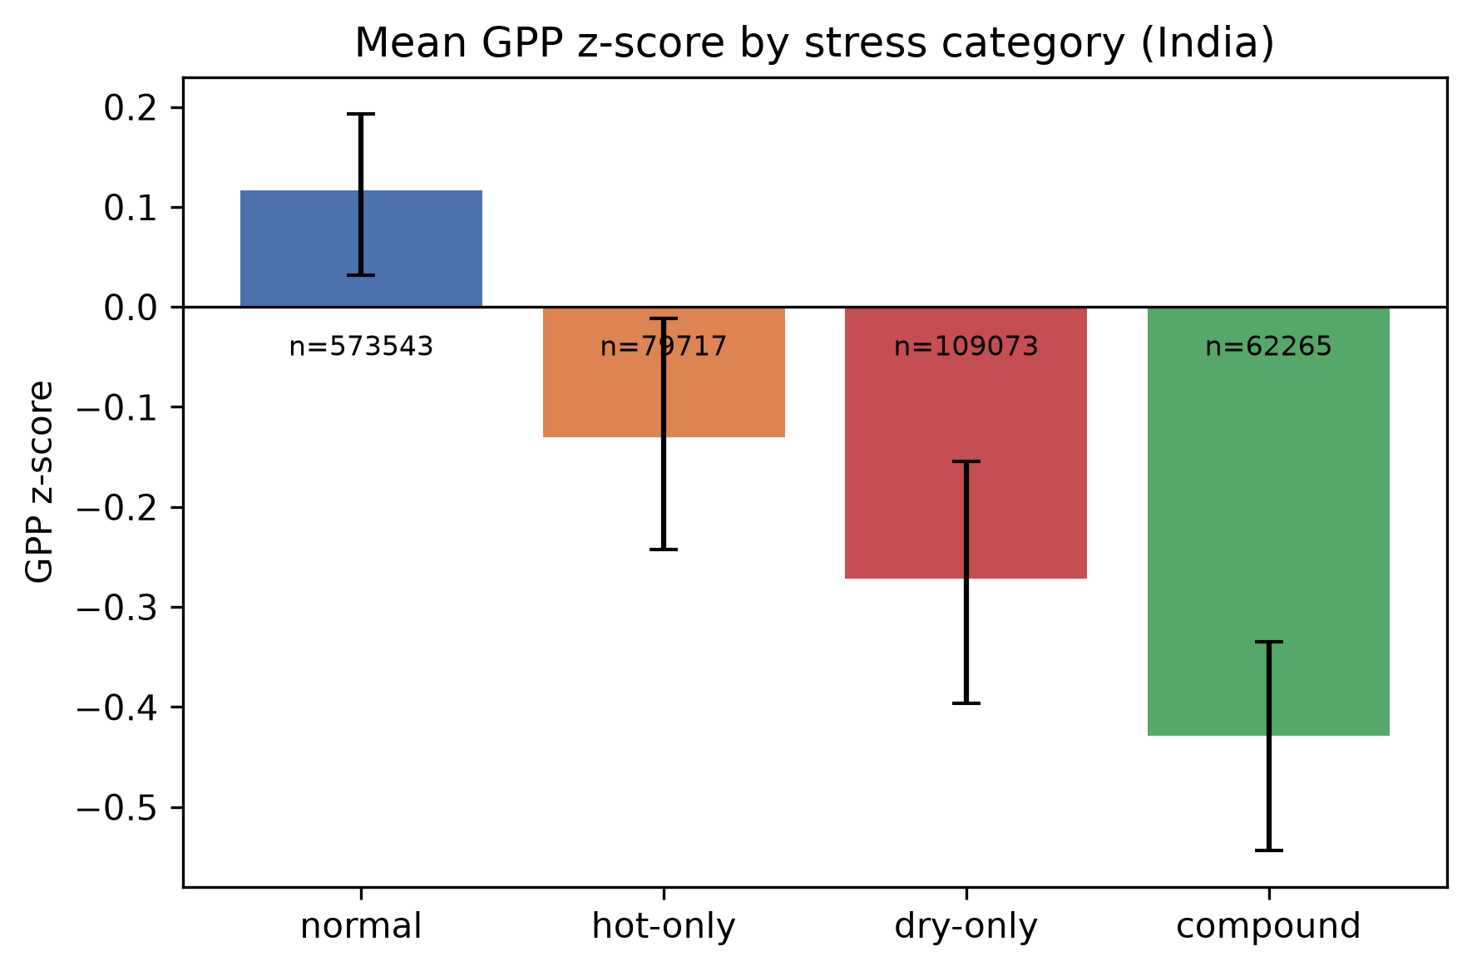
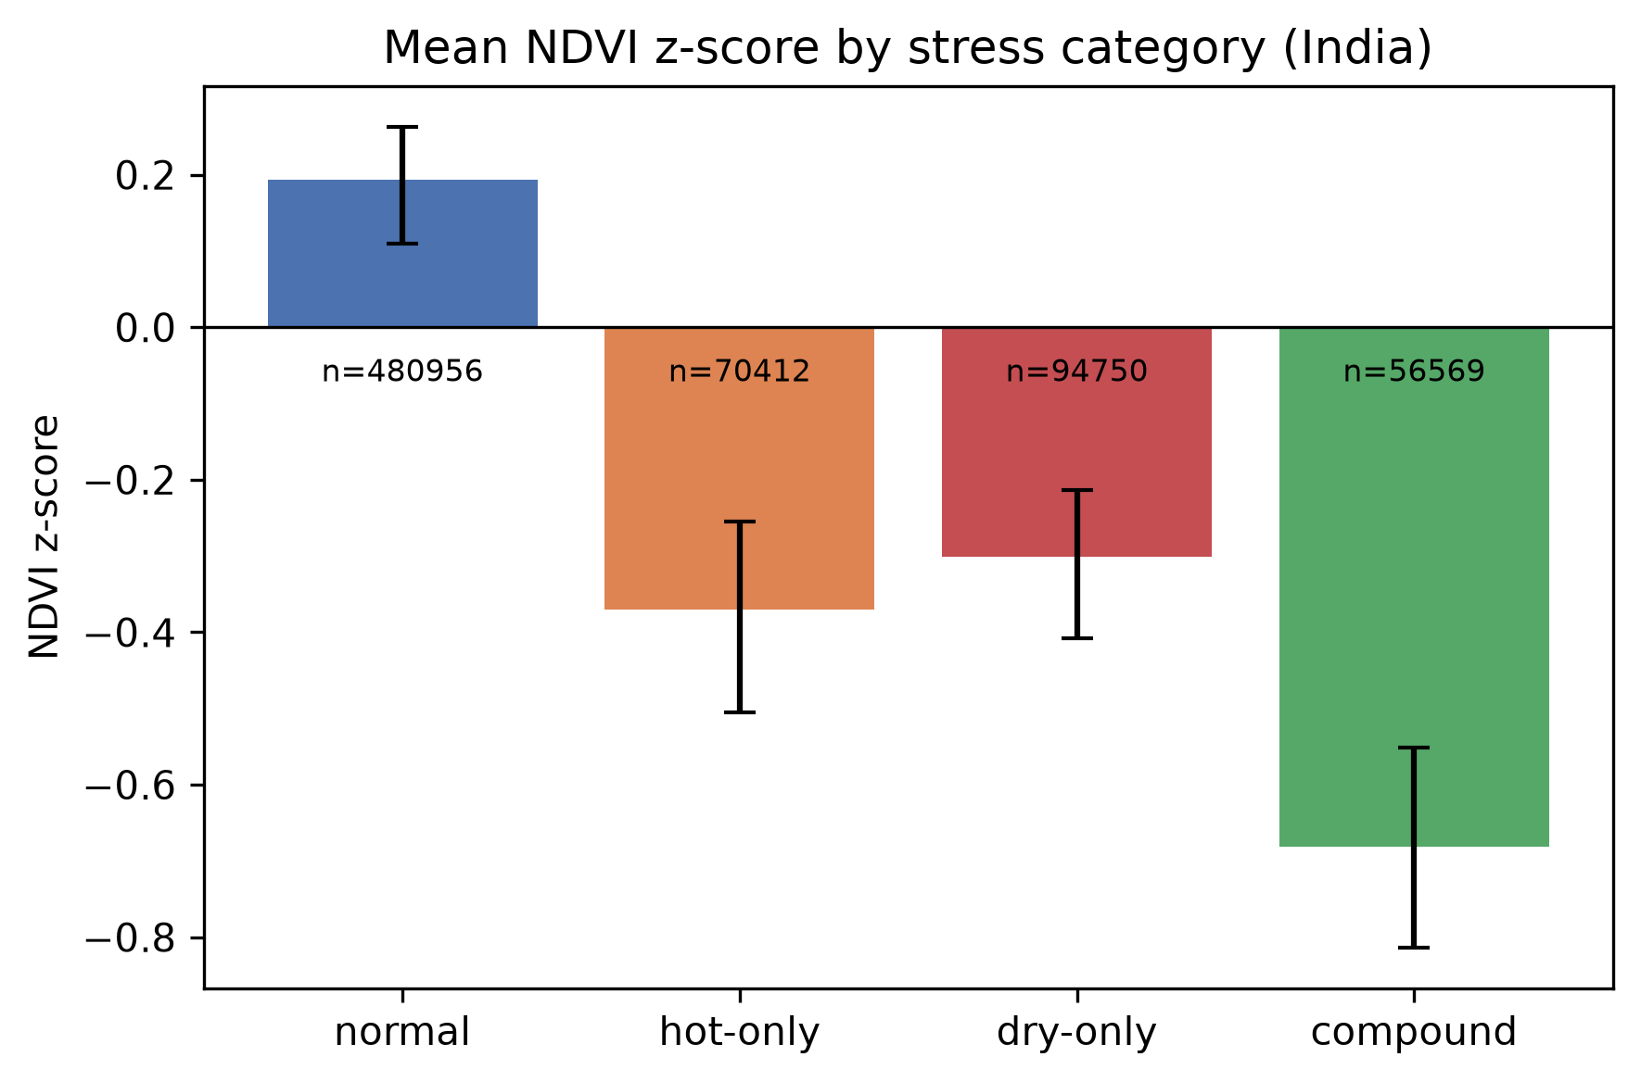
H1: IS VEGETATION HIT HARDER IN COMPOUND MONTHS?
Mean z [95% CI] | Normal | Hot-only | Dry-only | Compound
GPP | +0.12 | −0.13 [−0.24, −0.01] | −0.27 [−0.40, −0.15] | −0.43 [−0.54, −0.33]
NDVI | +0.19 | −0.37 [−0.50, −0.26] | −0.30 [−0.41, −0.21] | −0.68 [−0.81, −0.55]
22
slidesmania.com

Slide 23
H1: RESULT
All three stress types lower productivity and greenness significantly compared with normal months.
Compound months are the worst, and significantly worse than either single stress:
compound minus dry-only: GPP −0.16 [−0.26, −0.04], NDVI −0.38 [−0.49, −0.28];
compound minus hot-only: GPP −0.30 [−0.40, −0.21], NDVI −0.31 [−0.43, −0.21].
Robust to the drought index. With rainfall-only SPI-3, compound minus dry-only is GPP −0.26 [−0.37, −0.13] and NDVI −0.48 [−0.61, −0.35].
Why? Compound months combine the driest soils and the thirstiest air:
 | Normal | Hot-only | Dry-only | Compound
Root-zone soil moisture z | +0.29 | −0.75 | −0.38 | −1.04
Air dryness (VPD) z | −0.38 | +1.11 | +0.18 | +1.43
H1 SUPPORTED.
23
slidesmania.com

Slide 24
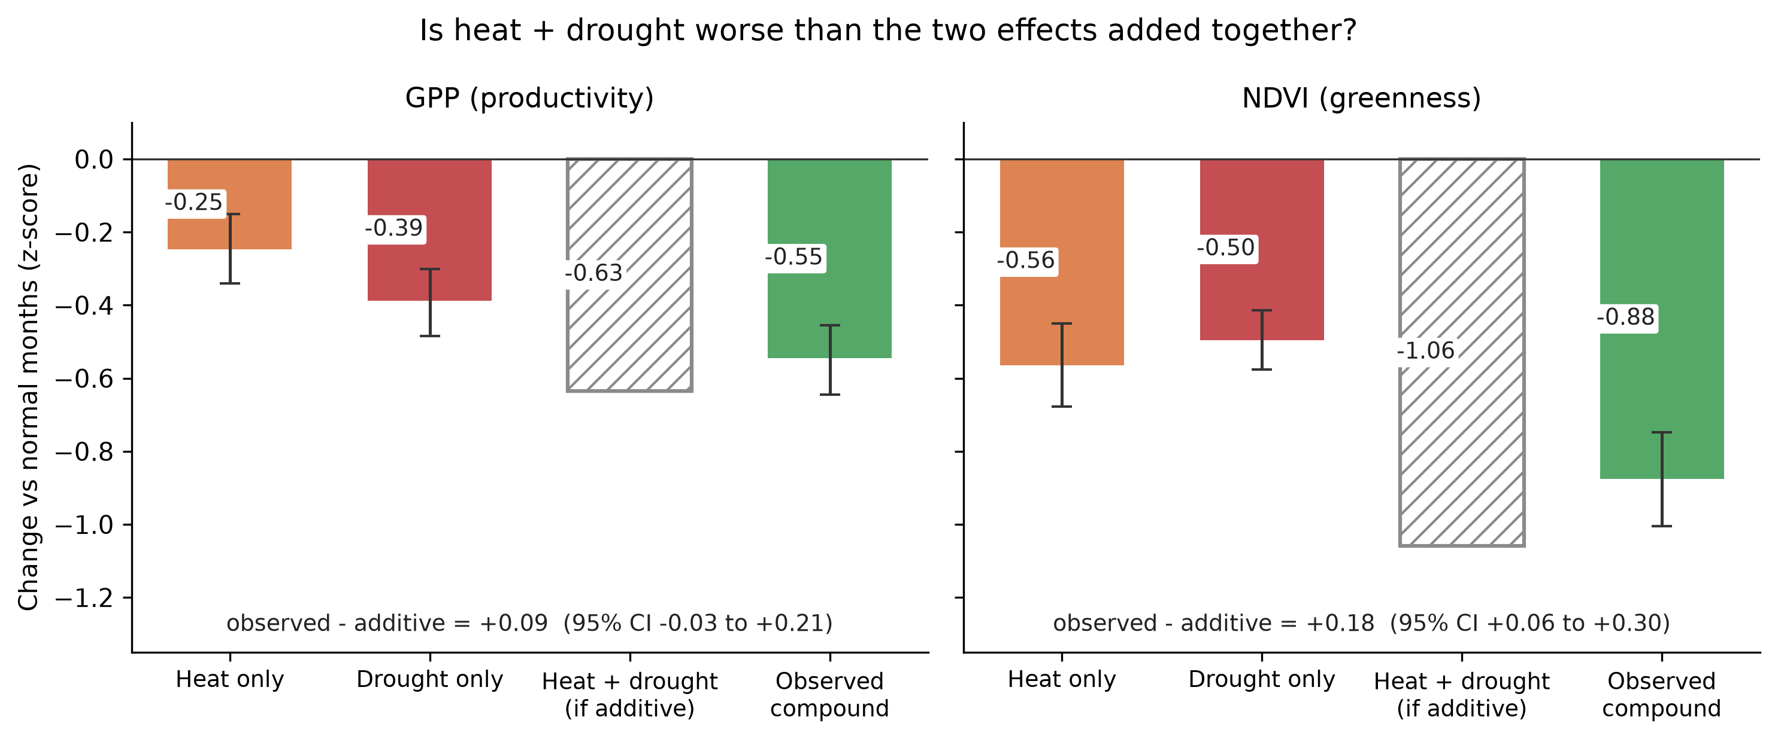
H2: IS THE COMBINATION WORSE THAN THE SUM?
Hatched bar: what we would expect if the two damages simply added up. Green bar: what actually happened in compound months.
24
slidesmania.com

Slide 25
H2: RESULT
Amplification = Δ_{compound} − (Δ_{hot} + Δ_{dry}); < 0 would mean synergy.
No synergy: the amplification is never significantly negative.
Heat and drought damages roughly add up. Compound months are worse than either alone, but not worse than both together.
With SPEI-3, NDVI is even slightly less than additive, but this disappears with SPI-3. The drought definition matters.
 | with SPEI-3 | with SPI-3
GPP | +0.09 | −0.00
 | [−0.03, +0.21] | [−0.12, +0.13]
NDVI | +0.18 | +0.06
 | [+0.06, +0.30] | [−0.05, +0.18]
H2 not supported (for average productivity, India-wide).
25
slidesmania.com

Slide 26
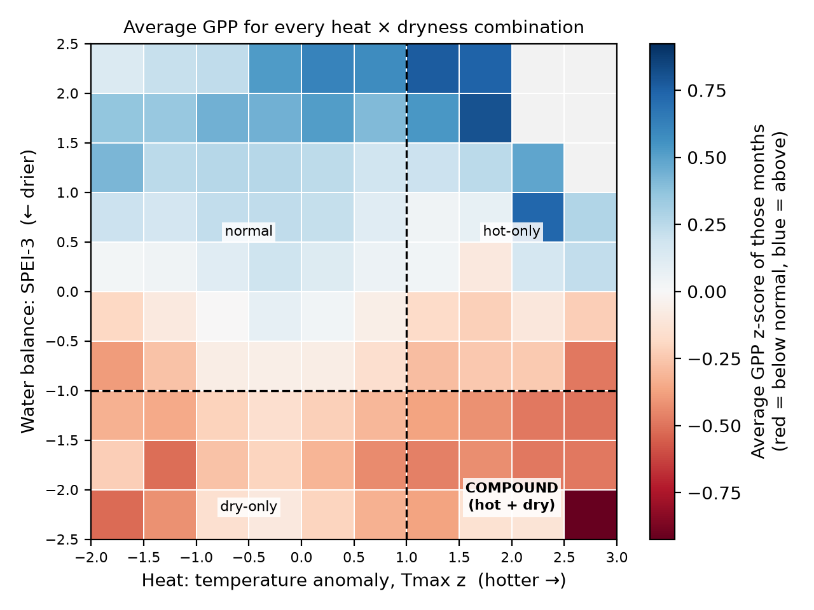
H2: RESPONSE SURFACE (A CHECK WITHOUT BOXES)
WHAT YOU ARE LOOKING AT
x = heat (Tmax z); y = water balance (SPEI-3, lower = drier).
Each square: average GPP z of all months in that range (red = below normal; grey = fewer than 30 months).
Dashed lines = our cut-offs; bottom-right = the compound box.
WHAT WE SEE
GPP falls as it gets drier: about +0.5 in the wettest rows, −0.35 in the driest.
Worst square: hottest + driest corner (−0.92). Hot but wet months are not below normal.
⇒ Dryness is the main driver and heat adds to it, consistent with additive effects.
26
slidesmania.com

Slide 27
OBSERVATIONS SO FAR
H1 supported. Compound heat–drought months reduce productivity (GPP) and greenness (NDVI) significantly more than heat alone or drought alone. This holds for both drought indices.
H2 not supported. The compound effect is about the sum of the heat and drought effects, not more.
Mechanism. Compound months have the driest soils and the thirstiest air at the same time.
Drought definition matters. SPEI vs SPI changes the H2 details. Hot-only months also have dry soils (soil moisture z = −0.75), which rainfall-based indices miss.
How this fits the literature. Meena et al. [4] report “nonlinear amplification” for India using probabilities of vegetation drought. Our test on average anomalies finds additivity. The two ask different questions; comparing them directly is planned.
Caveats. MOD17 GPP is partly modelled (it uses air dryness and temperature, and has no soil-moisture input). NDVI is from the same satellite. Monthly 0.25° data blur short heatwaves.
27
slidesmania.com

Slide 28
THINGS LEFT TO DO
05

Slide 29
IMPROVING H2: REGRESSION INSTEAD OF FOUR BOXES
WHY AND WHAT
The four boxes use fixed cut-offs (±1) and ignore how strong each anomaly is. So, by the final submission, we will move from four boxes to a regression fitted to every month’s actual heat and dryness values.
GPP = a × heat + b × dryness + c × (heat × dryness)
a, b: how much GPP drops per unit of heat or dryness on its own
c < 0 ⇒ heat hurts more when it is also dry (synergy)
One direct test with a confidence interval, and no arbitrary cut-offs
29

Slide 30
FURTHER WORK
H3: RECOVERY
H4: LAND COVER & REGION
BEYOND INDIA
Time for vegetation to recover after each event
Compound vs drought-only at the same drought severity
Forests, croplands, grasslands
Peninsular vs North India
Repeat the analysis for another country
Does India’s “additive” result hold elsewhere?
All our datasets cover the globe (CHIRPS: 50°S–50°N), so the same pipeline can be pointed at a new region.
30

Slide 31
REFERENCES (1/3)
[1] Philippe Ciais, Markus Reichstein, Nicolas Viovy, André Granier, Jérôme Ogée, Vincent Allard, Marc Aubinet, Nina Buchmann, Christian Bernhofer, Arnaud Carrara, Frédéric Chevallier, Nathalie De Noblet, A. D. Friend, Pierre Friedlingstein, Thomas Grünwald, Bernard Heinesch, P. Keronen, Alexander Knohl, Gerhard Krinner, and Riccardo Valentini. Europe-wide reduction in primary productivity caused by the heat and drought in 2003. Nature, 437(7058):529–533, 2005. doi: 10.1038/nature03972.
[2] Jannis von Buttlar, Jakob Zscheischler, Anja Rammig, Sebastian Sippel, Markus Reichstein, Alexander Knohl, Martin Jung, Olaf Menzer, M. Altaf Arain, Nina Buchmann, Alessandro Cescatti, David Ehrhart, Lutz Merbold, Leonardo Montagnani, Dario Papale, Georg Wohlfahrt, Sonia Wolf, and Miguel D. Mahecha. Impacts of droughts and extreme-temperature events on gross primary production and ecosystem respiration: a systematic assessment across ecosystems and climate zones. Biogeosciences, 15(5):1293–1318, 2018. doi: 10.5194/bg-15-1293-2018.
[3] S. Sharma and P. Mujumdar. Increasing frequency and spatial extent of concurrent meteorological droughts and heatwaves in India. Scientific Reports, 7:15582, 2017. doi: 10.1038/s41598-017-15896-3.
[4] A. Meena, S. Swarnkar, S. Dash, and V. Peepliwal. Nonlinear amplification of vegetation drought under compound dry–hot extremes across India. Ecological Indicators, 191:115617, 2026. doi: 10.1016/j.ecolind.2026.115617.
[5] D. Sen, D. Barua, and J. Monteiro. Quantile-based sensitivity and risk thresholds reveal asymmetric responses of tropical forest productivity to individual and compound hot–dry extremes. Environmental Research Communications, 2026. doi: 10.1088/2515-7620/aea1e9.
[6] Y. Liang, J. Wang, Z. Hao, H. Wang, H. Cui, and Q. Ge. Anthropogenically-driven escalating impact of soil-based compound dry-hot extremes on vegetation productivity. Nature Communications, 17:2303, 2026. doi: 10.1038/s41467-026-68878-3.
31
slidesmania.com

Slide 32
REFERENCES (2/3)
[7] Y. Yao et al. Compound hot-dry events greatly prolong the recovery time of dryland ecosystems. National Science Review, 11(10):nwae274, 2024. doi: 10.1093/nsr/nwae274.
[8] M. Huang and P. Zhai. Protracted vegetation recovery after compound drought and hot extreme compared to general drought. Environmental Research Letters, 20(2):024001, 2025. doi: 10.1088/1748-9326/ada4c3.
[9] X. Feng et al. Divergent vegetation recovery shaped by drought, heat and compound extremes. Communications Earth & Environment, 7:688, 2026. doi: 10.1038/s43247-026-03927-9.
[10] Joaquín Muñoz-Sabater, Emanuel Dutra, Anna Agustí-Panareda, Clément Albergel, Gabriele Arduini, Gianpaolo Balsamo, Souhail Boussetta, Margarita Choulga, Shaun Harrigan, Hans Hersbach, Mikel Martínez-Sánchez, Luca Minola, et al. ERA5-Land: a state-of-the-art global reanalysis dataset for land applications. Earth System Science Data, 13(9):4349–4383, 2021. doi: 10.5194/essd-13-4349-2021.
[11] Sergio M. Vicente-Serrano, Santiago Beguería, and Juan I. López-Moreno. A multiscalar drought index sensitive to global warming: the standardized precipitation evapotranspiration index. Journal of Climate, 23(7):1696–1718, 2010. doi: 10.1175/2009JCLI2909.1.
[12] Chris Funk, Pete Peterson, Martin Landsfeld, Diego Pedreros, James Verdin, Shraddhanand Shukla, Gregory Husak, James Rowland, Laura Harrison, Andrew Hoell, and Joel Michaelsen. The climate hazards infrared precipitation with stations – a new environmental record for monitoring extremes. Scientific Data, 2:150066, 2015. doi: 10.1038/sdata.2015.66.
32
slidesmania.com

Slide 33
REFERENCES (3/3)
[13] S. Running, Q. Mu, and M. Zhao. MOD17A2H MODIS/Terra gross primary productivity 8-day L4 global 500m SIN grid V006. NASA EOSDIS Land Processes DAAC, 2015.
[14] Steven W. Running, Ramakrishna R. Nemani, Faith Ann Heinsch, Maosheng Zhao, Matthew Reeves, and Hirofumi Hashimoto. A continuous satellite-derived measure of global terrestrial primary production. BioScience, 54(6):547–560, 2004. doi: 10.1641/0006-3568(2004)054[0547:ACSMOG]2.0.CO;2.
[15] K. Didan. MODIS/Terra vegetation indices monthly L3 global 1km SIN grid V061 (MOD13A3). NASA EOSDIS Land Processes DAAC, 2021.
[16] Daniele Zanaga, Ruben Van De Kerchove, Dirk Daems, Wanda De Keersmaecker, Carsten Brockmann, Grit Kirches, Jan Wevers, Oliver Cartus, Maurizio Santoro, Steffen Fritz, et al. ESA WorldCover 10 m 2021 v200. Zenodo, 2022. doi: 10.5281/zenodo.7254221.
[17] Noel Gorelick, Matt Hancher, Mike Dixon, Simon Ilyushchenko, David Thau, and Rebecca Moore. Google Earth Engine: Planetary-scale geospatial analysis for everyone. Remote Sensing of Environment, 202:18–27, 2017. doi: 10.1016/j.rse.2017.06.031.
33
slidesmania.com

Slide 34
THANK YOU!
Questions?
Presentation template: SlidesMania (Africa Viva)

