Slide 1

EVENT CONNECTORS
Akhila Baddam Reddy
Puneet Kolathaya
Ramya Ajjavara
Rudra Narayan Banjara
Upasana Parida
Wani Sharma

Slide 2


Introduction
New breath of air in the event planning market.
For Indian community (now only focused in Mumbai).
Combining old fashioned values.
Cutting edge event-planning techniques.
Event Connectors – lead the market.
Quality results.

Slide 3

Intent Statement
Everyone wants to make a special day enjoyable and memorable in their own way. However, planning and management of an event is a tedious task.
We have event planners and event managers to resolve this. However, we would have to compromise in a lot of areas when we go to these organizations, especially the budget. This is our area of focus.
We’re trying to build a system where there is a scope for customization of resources for an event at a reasonable budget.

Slide 4
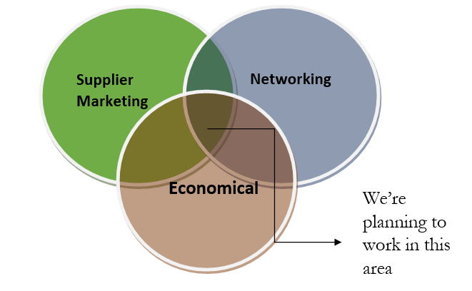
Terrains

Slide 5

Business Model
Executive summary
Market need
Our Solution
Target market
Profit Model
Implementation Chronogram

Slide 6

Executive Summary
Equal opportunities.
Expertise and products.
Event connectors make Interactive event planning.
Quality results.

Slide 7
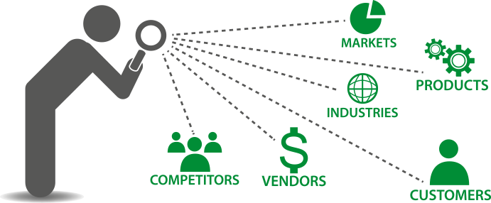
Market Need
Pay more for less flexible services.
Less time-frame.
Platform for startups and freelancers.

Slide 8

Our Solution
Interactive website.
Best deals available.
Planning events in one click.
Pay less for better services.
Quality results.

Slide 9

Target Market
Our BeachHead includes:
* Customers planning small events.
* Middle class society.

Slide 10

Profit Model
Free sign up upto 20 events.
Charging vendors to registers.
Crack a deal- take the cut.
Subscription charge.

Slide 11
Prototype

Slide 12

Implementation Chronogram
Progress
Time →

Slide 13
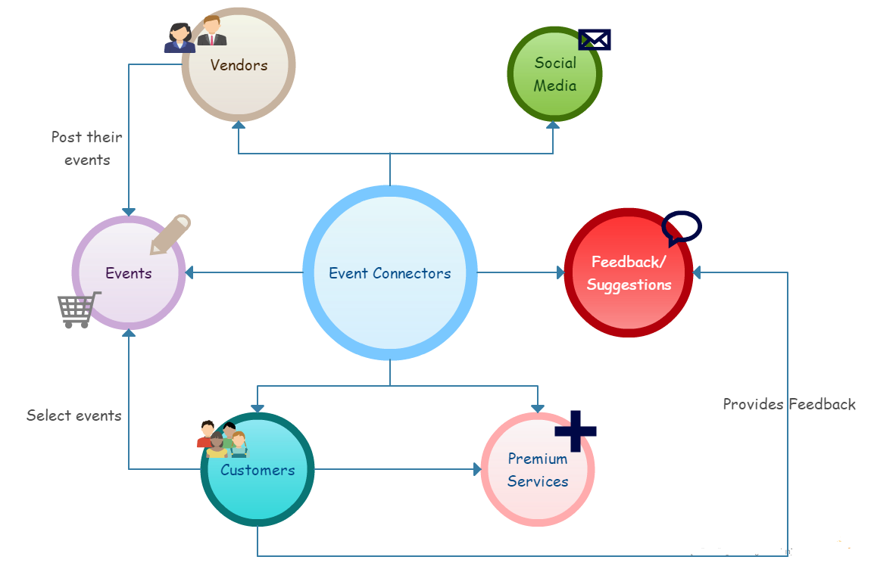

Value Webs

Slide 14
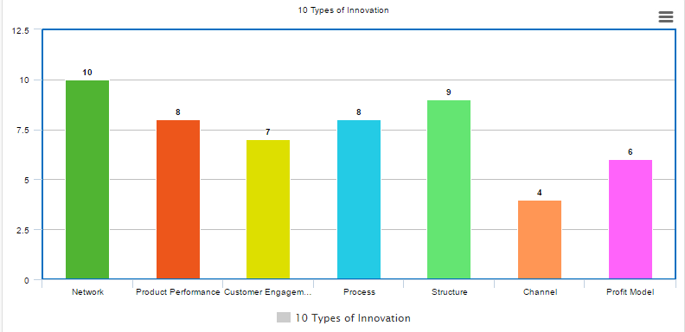
10 Types of Innovation

Slide 15





Competitors

Slide 16
Financial Projection

Slide 17
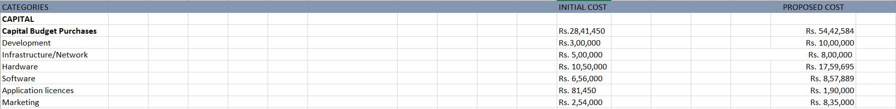
Financial Projection

Slide 18
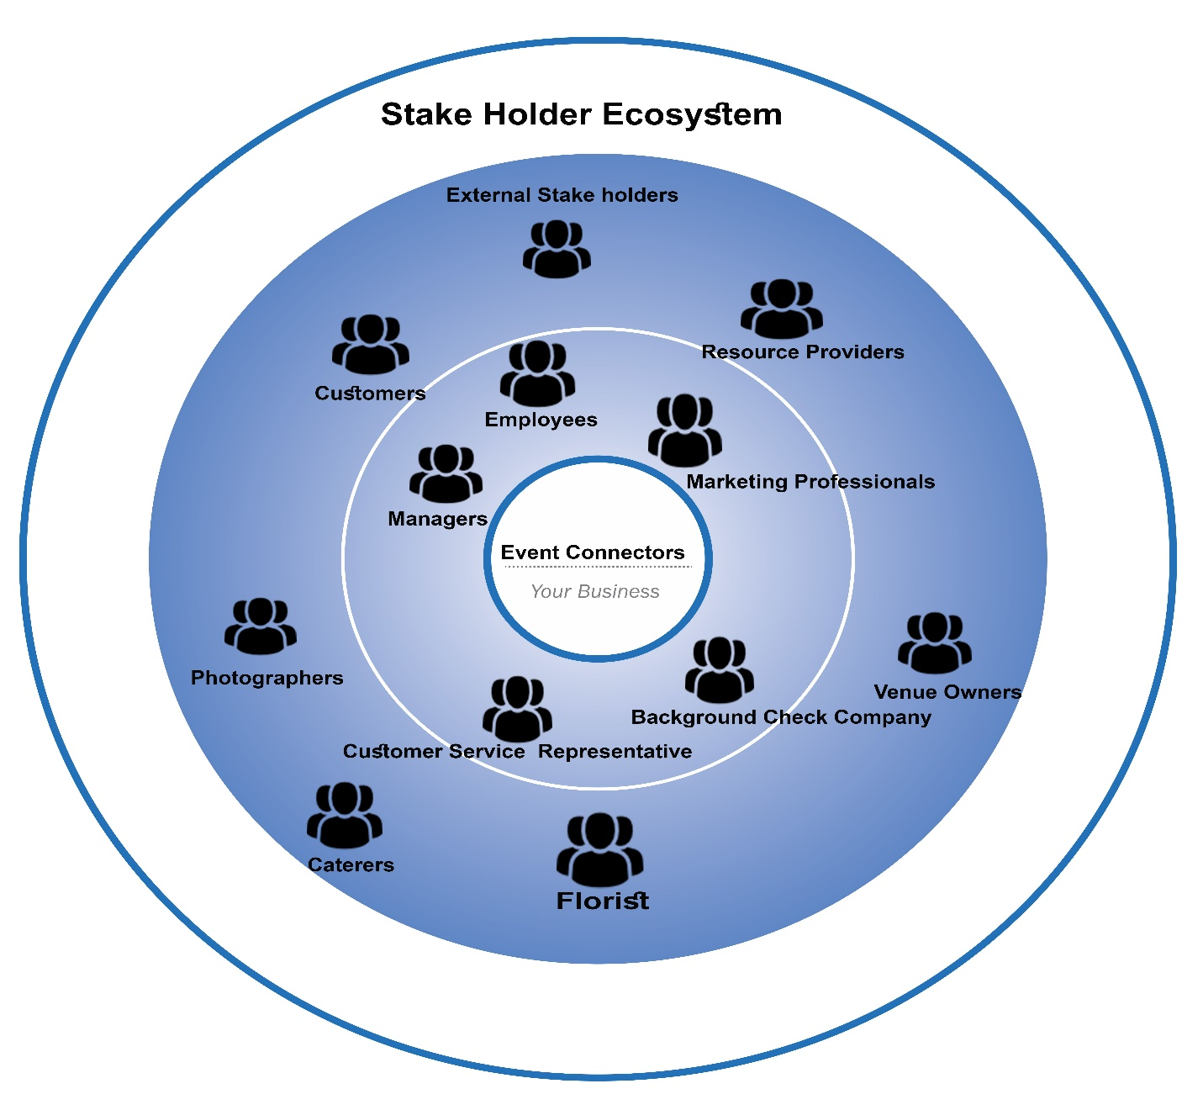
Stakeholder ecosystem
Internal Stakeholder
External Stakeholder

Slide 19
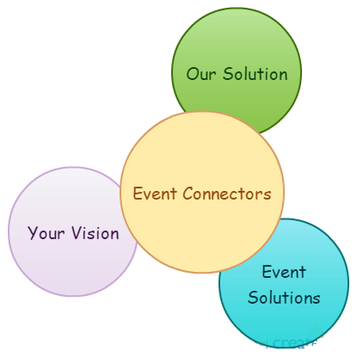
Value Proposition
For The people who want to plan their events on their own.
Who Want to explore the available options in the market and get the best deal.
Our Product Is an interactive platform that makes event planning exciting.
That connects our customers to reliable and paramount vendors.
Unlike Other event planning firms that are very expensive and follow the monotonous process.
Our Product Is transparent giving full control to the customers to select the products they want.

Slide 20
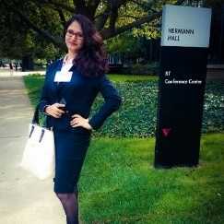
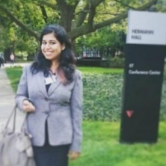
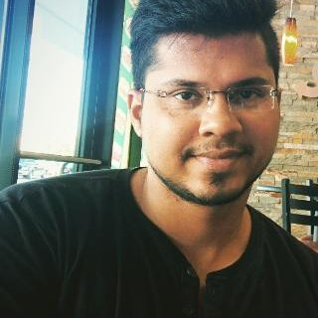
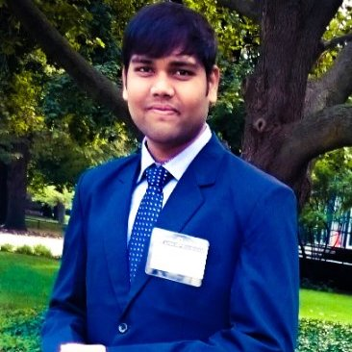
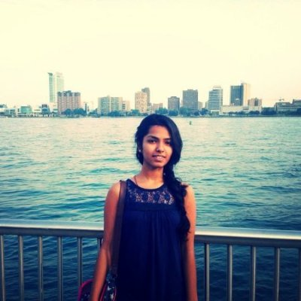
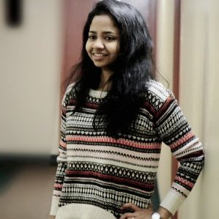
Teams
Wani Sharma
Business Development
Upasana Parida
Marketing Manager
Puneet Kolathaya
Technology Development
Rudra Narayan Banjara
Customer Service Head
Ramya Ajjavara Ramesh
Product Management
Akhila Baddam
Creative Head

Slide 21
THANKYOU!

