Slide 1
Innominds Engineering Partnership for Next-Generation Connected Fitness Platforms
Android Console | Embedded Systems | Edge AI | Connected Devices | Cloud Analytics
Mar 2026

Slide 2



Understanding Precor Product Architecture
Precor Connected Fitness Console
Android based touchscreen console
Embedded compute module
Sensor integration from fitness equipment
Connectivity (WiFi / Bluetooth / Cloud platform)
User interface for workout programs and entertainment
Data collection for performance analytics and personalization
Engineering opportunities
Android platform optimization
Sensor and device integration
AI based workout personalization
Cloud telemetry and analytics
Next-generation console innovation

Slide 3

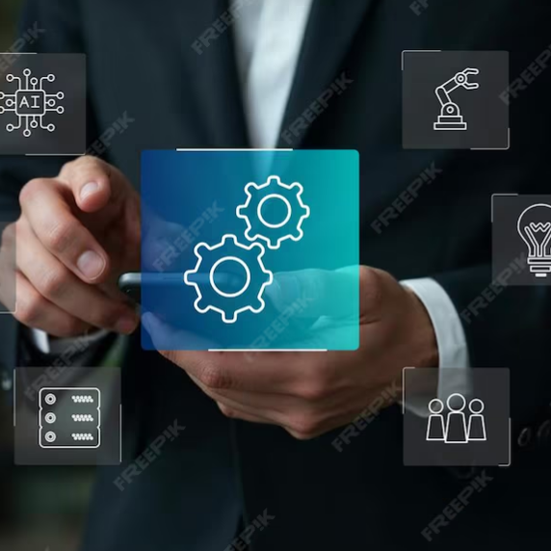




Innominds Engineering Capabilities for Precor Connected Fitness Platforms
We enable connected fitness product companies to design, sustain, and innovate Android-based equipment consoles, embedded platforms, and intelligent fitness experiences through integrated hardware, software, AI, and cloud engineering.
From existing product sustenance to next-generation fitness innovation, Innominds helps accelerate feature development, improve device intelligence, and enable data-driven fitness ecosystems across connected equipment platforms.
Connected Fitness Engineering Lifecycle
Sustain & Optimize
(Android Platform Engineering)
Prototype & Validate
(POC Engineering)
Intelligent Fitness Experiences
(Edge AI & Personalization)
Connected Data & Insights
(Cloud, Data & AI Platforms)
Flexible Engineering Engagement
Android OS optimization, upgrades, and performance tuning
Platform stability, testing automation, and OTA lifecycle support
Rapid POC development for new device capabilities
Feature validation, feasibility testing, and device integration
Edge AI for workout analysis and activity recognition
Personalized coaching with real-time performance insights
Cloud telemetry and fitness data collection
Analytics dashboards and AI-driven equipment insights
Dedicated cross-domain engineering PODs
Scalable offshore delivery for ongoing and new initiatives

Slide 4










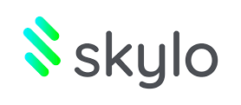












Why Innominds
End-to-end engineering expertise across hardware, embedded systems, Android platforms, Edge AI, and cloud-connected devices.
Strong experience in Android-based device platforms, including tablets, kiosks, and touchscreen console systems.
Proven capabilities in sensor integration, device connectivity, and real-time data processing.
Expertise in Edge AI enablement for intelligent device experiences and personalization.
Ability to support the full product lifecycle from PoC and engineering to production and sustaining support.
Innominds:
Delivering Value Across Connected Device and Platform Engineering
Proven Expertise
Rapid Ramp-Up
Delivery & Governance
Scalable Engagement
Extensive experience delivering connected device platforms across hardware, embedded, and Android ecosystems
Cross-functional PODs covering device engineering, platform development, QA, and DevOps
Ready engineering teams for Android, embedded systems, Edge AI, and connected devices
Structured onboarding enabling pods to become productive within 30 days
Agile delivery aligned with product development cadence and release cycles
Transparent reporting on velocity, quality, and platform stability
Ability to scale engineering PODs based on product roadmap needs
Flexible offshore, hybrid, and onsite engagement models

Slide 5

Application Capabilities
Innominds designs and builds applications across cloud, on‑premise, and hybrid environments, covering mobile, web, desktop, and edge solutions end‑to‑end.
From UX and frontend to backend, analytics, AI, and FinOps‑driven operations, we deliver full‑stack application capabilities aligned to business outcomes.
Plan & Design
Build & Integrate
Operate & Optimize
Deploy
Program Management, Change Management and Communication
Application
Cloud Applications
On‑Premise Applications
Hybrid Applications
Mobile Apps
Web Applications
Desktop & Thick‑Client Apps
Edge & Device Applications
Experience, Logic & Analytics
UX Research & UI Design
Frontend Engineering
Backend & API Services
Edge Analytics
Platform & Product Analytics
Dashboard & BI Analytics
AI & Intelligent Features
Monitoring, Observability & FinOps
Project Management, Release Management
Governance Framework
Migration Elements
Application (Programming Language)
Version Upgrades
Database
Platform (OS, Middleware)

Slide 6






Innominds Capabilities
Android Platform Engineering
End-to-End Android Stack Ownership
Qualcomm and MTK Platform Expertise
BSP, Kernel, Drivers, HAL (HIDL → AIDL), Framework, SystemUI/Launcher, Apps
Proven Android upgrades from android 12 onwards to
android 16 (A12–A16) on Qualcomm IoT platforms
Hands-on experience with Qualcomm chipsets: MSM8909, QCM6125, QCS2290/4490, QCM8550, QCS8250, MDM9x07
Expertise in Qualcomm LA Android environments and MTK Android/kernel bring-up (MT6765, MT6769, NTN)
Strong understanding of QSSI, vendor, and firmware alignment
HAL & Framework Migration
OTA & Platform Stability
OEM HAL redesign and migration from HIDL to AIDL
Framework services, overlays, adaptation for Android 16
Treble and Mainline compliance readiness
OTA enablement for Android 12- Android 14 - Android 16
Performance tuning, boot stability, regression handling
CTS / VTS / STS subset execution and analysis
Kernel & Driver Expertise
Quality & Delivery Excellence
Linux kernel upgrades 3.x → 6.x
Driver development & integration for:
Display, Touch and Camera
Wifi, BT and Sesnors
Audio amplifiers (internal & external), Fuel gauge and Charger ICs
Other custom peripherals
SLA compliance, defect triage, and RCA (5-Why)
CI/CD, Gerrit-based development, structured release management
GMS Testing and Certification,
System and Integration Testing

Slide 7







Our Approach to bring-up Android on New device / Upgrades
Baseline Ingestion & Delta Analysis
BSP, Non-HLOS & Kernel Migration
HAL Migration (HIDL → AIDL)
Framework, SystemUI, Apps
Platform QA & Verification
Certification Support
Governance & Quality
Fetch Qualcomm Android baseline for targeted Android version.
Confirm vendor API level 32 (per Customer) and vendor image model with QSSI
Analyse Customer Android deltas (Peripherals, HAL overlays, patches, apps)
Identify mandatory deltas for Android/Treble compliance
Integrate Qualcomm-provided Non-HLOS
Peripheral driver development/porting for:
Displays
Camera
Internal & external amplifiers
Other Peripherals
Bring-up & hardware verification
Redesign OEM HALs to AIDL
Adapt Android-provided HALs to Android APIs
Treble compliance and Mainline considerations
HAL migration within existing architecture
Rebase framework services, patches, overlays
Migrate SystemUI, Launcher, custom apps
Maintain functional parity with Android
Ensure startup stability + regression cycles
Validate Android basic use cases(system testing)
Validate inter-domain communication
CTS/VTS/STS subset testing
Sanity test report along with every build release
Preparation for GMS/Operator certification/ any specific certification requested by OEM.
Extectuing Tests suite.
Reporting to dev team as well re run for some of test cases.
Weekly progress reports
Bug tracking
Compliance (Severity SLAs + 5-Why RCA)
Our approach ensures a production-ready, stable, compliant Android platform

Slide 8








Embedded Systems & Sensor Integration
Video / Audio Input
Cameras: surround, rear.
Tuners: AM/FM, digital radio.
Microphones: voice recognition, hands-free.
Camera Integration
Interfaces -MIPI-CSI, GMSL, USB. Camera enablement for workout monitoring, posture analysis, and video-based training experiences
Audio Integration
Interfaces – I2S, Audio codecs, speakers, microphones Audio optimization for guided workouts, media streaming, and voice interaction
Video / Audio Output
Displays: main, sub, touch panels.
Amplifiers & Speakers: multi-channel audio.
Peripherals
Display integration
Interfaces – MIPI-DSI, HDMI, eDP - High-resolution touchscreen integration for interactive fitness consoles and media experiences
Data Communication
External: Wi-Fi, Bluetooth, USB, NFC.
Internal: CAN, LIN, Ethernet, IVI-specific networks.
Sensors
Motion sensors, heart rate monitors, cadence sensors, resistance/load sensorsReal-time acquisition and processing of workout and equipment telemetry
Connectivity & I/O Integration
Bluetooth, Wi-Fi, USB, and peripheral integrationsIntegration with wearables, accessories, and external fitness devices
Other Devices
Human input: touch panels, steering switches, controllers.
Navigation: GPS, gyroscope, accelerometers.
Storage: USB/SD media playback.

Slide 9

Functional Coverage & Code Coverage Testing Strategies
FC Milestone Test Strategy
CS Milestone Test Strategy
Sanity Checks: Release Sanity (RS), AU Sanity
Stability Testing: Back2Back (adb reboot, alpaca reset, LPM, S2D – 1000 iterations each)
Stress Testing: APStress (ACF_LPM & ACF_S2D – 250 hrs each)
Feature Validation:
L1 Testing across Audio, Video, Platform, Camera, Display, GFX
L2 Testing for concurrency use cases
Test Suites (TS): CTS, ATS, VTS, CTS-on-GSI, STS
Performance: Standard benchmarks
Monkey Testing: 50 hrs
Sanity Checks: Release Sanity (RS), AU Sanity
Stability Testing: Back2Back (adb reboot, alpaca reset, LPM, S2D – 1000 iterations each)
Stress Testing: APStress (ACF_LPM & ACF_S2D – 250 hrs each)
Feature Validation:
L1 Testing across Audio, Video, Platform, Camera, Display, GFX
L4 Testing with 100 iterations per use case
Test Suites (TS): CTS, ATS, VTS, CTS-on-GSI, STS
Performance: Standard benchmarks
Monkey Testing: 50 hrs

Slide 10




Hardware Capabilities – New Product Initiative (NPI)
Development
Hardware (in-house): Design - PAD, Schematics, Board Design – multi-layer/HDI, Sourcing, BoM & Costing, Fab & Assembly, Bring-up, FCT, EVT, DVT & Pre-compliance, Manufacturing & QA.
Industrial/Mech Design (in-house & partners): Form factor concepts, Detailed ME – 3D, Rapid Prototypes, DFMEA, 2D details, Tooling, T0-thru-MP.
Antenna Design (w partners): COTS / Custom, Cellular/WiFi/BT/BLE/RFID/NFC, Chip/Flex/LDS technologies, Robust process (simulate, prototype, verify, manufacture)
Software (in-house): Linux/Win-IoT/Android/RTOS, Embedded system/kernel level, Applications, Cloud Orchestration - OTA Authentication/Provisioning/Management/Updates, Cybersecurity
Edge Computing: Data Science, Model identification / design, Data preparation, ML-Ops (Training/ Deployment / Performance / Model Update)
Prototyping &
Testing
Compliance &
Certification
Manufacturing & Fulfillment
Eco-system of PCB fab houses & EMS in India, Indonesia, China
Design Testing covering FCT, EVT, DVT & Pre-compliance.
System Testing covering Functionality, Performance, Stability, Reliability & Pre-Compliance.
Eco-system of accredited labs in India & China
Environmental: Temp, Humidity, Drop, Shock, Vibration, Input Protection & Chemical.
Certification: CE/CB, FCC/IC, UL, TEC
Partnership with SIIX, Japan, EMS with global footprint – Japan, SGP/Indo, Thailand, Philippines, Mexico, EU.
Specializing in Automotive, Industrial, Medtech
In-house:
Sourcing, Purchasing & Inventory.
SMT, Box Build, QC/QA.
Shipment Logistics, Servicing, Repair, RMA.
ISO certified for different domains.

Slide 11
New Product (NPI) Development Process
Requirements
Architecture / PoC
Detailed Design (Sch/BoM)
Layout/ Simulation / Reviews / Gerber
Performance / Pre-compliance / Parametric Verification Tests
Bring up & Functional Tests
SMT/Box Build
Fab / Procurement
Pilot Build
Field Tests / Certification
Production Enablement
Ensures Quality by Design & Quality by Testing
Reduces errors and accelerates time-to-market
Improves product durability & reliability

Slide 12


Our Connected Device Eco-system
Shenzhen STS Test Service
On Premise
Compute & Connectivity
Manufacturing & Fulfillment
Lab, Compliance & Certification
Cloud & AI
MPU, uC, SoCs, SOMs
ARM Cortex series & Intel Atom x86
Well supported by Sales & FAEs
WiFi, BT/BLE, UWB, NBIoT, LTE-M, DECT
Chip down & pre-certified modules (Quectel).
Development & Commercialization
SIIX is our Partner EMS with Global footprint
Sourcing, Inventory, Manufacturing (SMT & Box Build), Logistics, Support, Servicing & Repair, ID, Tooling & Molding.
Subsidiaries in Robotics & Energy
TUV-Rheinland, Blr
STS Lab, SZ
Microsoft Solution Partner for Data & AI (Azure),
Digital & App Innovation, Infrastructure (Azure)​
AWS integration – Device & Cloud – capability.

Slide 13













Fitness Equipment System Architecture
Sensors & Inputs
Smart Console & Edge AI
Cloud & Connectivity
Heart Rate
Sensors
Wi-Fi & Bluetooth
Cloud Services
Motion &
Load Sensors
Data Sync
& Analytics
OTA Updates
User Input
Controls
Wearables & Apps
Camera Module
Fitness Trackers
AI/ML Inference
Media & Workouts
Local Storage
& Processing
Mobile Apps
Equipment Data & Inputs
Android OS
Data Sync & Analytics

Slide 14


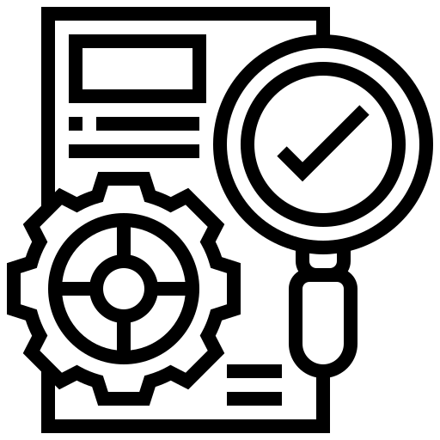
Proof-of-Concept Development Framework
Innominds follows a structured Proof-of-Concept framework to rapidly validate ideas, technologies, and business value before full-scale product development.
Situational Awareness
PoC Activation
Concept Proving
Understanding the Opportunity
Turning the Idea into a Working Prototype
Validating Value and Business Potential
Need & Market Awareness
Problem identification and validation
Market research and opportunity analysis
Technology Awareness
Evaluate emerging technologies
Identify concept gaps and adoption feasibility
Value Exploration
Customer validation of the problem
Prioritize business value and impact
Outcome:
Clear understanding of problem, market need, and technology feasibility
Action Planning
Define PoC scope and objectives
Establish success metrics and validation criteria
Rapid Prototyping
Build high-fidelity prototype
Perform rapid development iterations
Outcome:
A functional prototype demonstrating the core concept
Testing & Validation
Functional PoC testing
Validate business value and technical feasibility
Customer Demonstrations
Stakeholder demos
Collect iterative customer feedback
Outcome:
Validated concept ready for product development or scaling
Business Need Insight | Market Intelligence | Technology Landscape | Engineering Expertise

Slide 15





Design Thinking based AI/ML Development Approach
Design thinking and Agile based, incremental and adaptive development approach
EMPATHIZE
DEFINE
IDEATE
PROTOTYPE
TEST
Understand the user thoroughly
Identify the right problem & define the use case
Come up with as many ideas as possible to solve the problem statement.
Build a sample model to Learn Fast, Cheap and Early
Collect feedback from users to refine
Design Thinking Workshop
Agile delivery model with two weeks sprints
Daily stand-ups
Weekly show & tells
End of sprint retrospective
Use cases identification
Prioritization for implementation
Requirements elaboration
Continued throughout the engagement.
Sprint 0 |  | Sprint 1 |  | Sprint 2
Wk1 | Wk2 | Wk3 | Wk4 | Wk5 | Wk6
Analysis
Design
Model Development & Testing
Model Deployment & UAT
Key Activities
Data Preparation
EDA and Model Analysis
Model Training and Evaluation
Model Selection
Model Fine-Tuning
Model Testing
Feedback Collection
Model Refinement
Model Deployment
UAT

Slide 16
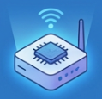




Innominds Edge AI capabilities
Innominds delivers end‑to‑end Edge AI, combining on‑device intelligence, edge–cloud integration, and MLOps to power secure, real‑time experiences across devices and industries.
Edge AI Platforms & Devices
On-Device Intelligence
Edge-to-Cloud Architecture
MLOps & Model Lifecycle
Industry Use Cases
iDhi Edge AI platform
Qualcomm / NVIDIA Jetson
5G / Wi-Fi 6 connectivity
Pose & activity recognition
Vision / video analytics
Sensor fusion models
Secure device onboarding
Streaming & APIs
Hybrid edge / cloud workflows
Data pipelines & retraining
Model monitoring
OTA model updates
Smart fitness consoles
Industrial vision & safety
MedTech & patient monitoring
From chip to cloud to cognition – engineering edge AI solutions for real-time experiences

Slide 17







Edge AI–Driven Personalized Fitness System Features
This architecture shows how edge AI and cloud services work together to deliver a fully personalized fitness experience, from user profiles and sensor data to adaptive training plans.
It enables real-time on-device guidance while continuously learning from workout history and performance analytics to refine recommendations over time.
User Profile & Goals
Devices & Sensors
Edge AI Engine
Personalization Service (Cloud)
Real-Time Guidance UI
Analytics & History Store
Continuous Learning Loop
Fitness goals
Age
Workout history
Motion
Heart rate
Cadence
Camera
Activity recognition
Pose estimation
Workout pattern analysis
Training plan generator
Exercise recommender
Adaptive difficulty
Instructions
Form feedback
Rep counting
History
Calories
Progress
Model updates
Tuning
Enabling Precor to deliver real‑time, edge‑powered workout personalization that keeps every user on the optimal path to their fitness goals.

Slide 18


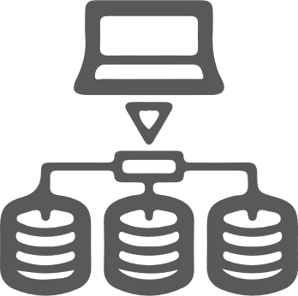













Innominds Cloud services
Cloud Transformation Services
Cloud Managed services
End-to-end cloud operations with AI-driven automation & proactive incident management.
DevOps & Automation
Ecosystem expertise: GitHub, GitLab, ArgoCD, etc. Define, provision, and manage infrastructure with Terraform, Pulumi etc.
SecOps
Implement robust Continuous Integration & Continuous Deployment pipelines.
Cloud-native application development
Build & deploy scalable, resilient, and secure cloud-native applications.
Cloud migration & modernization
Seamless migration strategies: Re-host, Re-platform, Refactor, Retire, Retain, or Replace.
FinOps & cloud cost optimization
Cost visibility, chargeback models, Intelligent rightsizing, policy enforcement for cost controls
CloudOps – SRE & Observability
Implement SRE principles for reliability, scalability, and high availability.
Customers
Technology Partners

Slide 19









Data & BI Offerings
25+
Architects &
Consultants
300+
Developers & Validators
50+
Administrators
100+
Certified Associates
15+
Ongoing Engagements
Implementation Partner for Azure & Tableau
Advisory Services
Data Foundation
Enterprise Intelligence Services
Managed Data Platform
Current Landscape Evaluation
Modern Data Architecture
Analytics & Migration Strategy
Platform Recommendation
PoC / MVP / Pilot Setup
Modern Data Platforms
Data Marts / Warehouse / Lakehouse
Data Governance – Quality / Security
Enterprise Reporting
Self-Service Analytics
Auto Data Discovery
App & Automation
Enterprise Portals
Process Automation
Data Operations
Data Observability
Pipeline Processing Observability
Infra Operations
Data Platform Observability
Customer References

Slide 20



















AI/ML Capabilities
NLP, Text Analytics & ChatGPT/LLM
Speech to Text Conversion
Entity Recognition, Data Extraction & Summarization
Action Items, Questions & Follow-ups
Conversation Analytics
Document Classification
Sentiment Analysis
Predictive Analytics
Demand Forecasting
Fraud Detection
Fault Prediction
Anomaly Detection
Computer Vision Services
Face Recognition
Object Detection & Tracking
Shape & Surface based Matching
Deep Learning
Image Processing & Blob Analysis
OCR & Barcode Extraction
Data Science & Engineering Team
Over 50+ professionals with deep expertise in Machine Learning, AI, Deep Learning and Analytics
Dedicated AI Labs in the USA and India
Platforms
Technologies

Slide 21
















Cloud Data & AI Platform for Precor Consoles
Experience Layer – Dashboards & Apps
Operator Dashboard
User apps
Insights & alerts
Cloud Layer – IoT, Data Platform & AI
IoT Ingestion
telemetry lake
AI models
Edge Layer – Android Console Processing
Realtime analytics
Edge AI inference
Even filtering
Device Layer – Fitness Equipment & Sensors
Treadmill
Bike
Elliptical
Heart rate
Motion
Resistance
Camera

Slide 22
NPI Device Manufacturing Model
Connected Device design, development and manufacturing process
Specifications
High Level Architecture
HDLC
Industrial Design
Hardware
Manufacturing
Concepts
Hardware Architecture
Identity EMS / ODM
Schematics
Detailed Design
DFx
Layout
Bill of Material
Prototype**
Rapid Prototype**
Platform Software
Prototype**
Prototype Quantity
Pilot I**
Toolup**
Customize Firmware / OS
Revision 0**
Pilot Quantity
Pilot II
T0 Sample**
Reference Code / Image
Revision 1
T1 Sample
Production
* *verify, valid, correct

Slide 23
Our Engagement Models
1. Staff Augmentation
2. POD-Based Delivery (Client-Led POD)
3. Managed Delivery POD Model (Innominds-Led)
What We Deliver
Skilled individual resources integrated into Client teams
Support for development, enhancements, and platform operations
Resources operate under Client delivery management and governance
Flexible ramp-up based on immediate skill or capacity needs
Cross-functional POD with Data Engineers, QA, and platform specialists
Dedicated team aligned to a specific domain or platform scope
Sprint-based execution within Client-managed Agile processes
Shared collaboration between Client and Innominds teams
End-to-end POD ownership including delivery, governance, and reporting
Vendor-managed execution aligned to defined KPIs and SLAs
Continuous platform optimization and operational oversight
Architecture guidance and delivery management through Innominds leadership
Hybrid onsite–offshore delivery ensuring scalability and collaboration
Benefits to Daikin
Quick onboarding to address short-term skill gaps
High flexibility in scaling resources
Suitable for tactical or temporary workload support
Client retains full operational control
Improved delivery velocity through a stable team structure
Reduced coordination overhead compared to individual resources
Better collaboration and accountability at the POD level
Supports domain-based analytics and platform initiatives
Single-point ownership and accountability for delivery outcomes
Reduced operational and coordination overhead for the Client
Predictable delivery aligned to business priorities
Faster onboarding of new use cases and data domains
Improved platform stability, documentation, and governance maturity

Slide 24










Proposed Business Models
Traditional Models
Time and Material
Fixed Bid
Hybrid [ Fixed Bid + Time & Material ]
HIGH
PPOD Models
Outcome Based Models
Ddelivery ownership and risk - Vendor
Fixed priced Projects
Outcome Based Models
Time and material Projects
Transaction Based [ No of tickets / Test Cases / transactions processed etc.]
Service Catalog based [ Based on the type of the service to be delivered ]
Low
HIGH
Delivery ownership and risk - Client
POD Models
Delivery Models
Based on Business impact
Autonomous Cross-Functional PODs
Sustainable Growth with Improved Stakeholder Partnerships
Accelerated Time-to-Market
Higher ROI on Technology Investments
Complete Onsite
Hybrid
Complete Offshore
Global ODC
Strategic Partnership

Slide 25
Innominds | Team Augmentation & Staffing Experiance
Nasdaq
Qualcomm
Informatica
Trimble
Automotive / Deloitte
Market Data Compliance
Telecom & Semiconductor R&D
Data & Cloud Engineering
Industry & Technology Solutions
Workforce Scaling — Auto OEM
ENGAGEMENT OVERVIEW
ENGAGEMENT OVERVIEW
ENGAGEMENT OVERVIEW
ENGAGEMENT OVERVIEW
ENGAGEMENT OVERVIEW
Duration:
Duration:
Duration:
Duration:
Duration:
Multi-Year
17+ Years (Since 2008)
6 Years (2021–2027)
11 Years (Since 2013)
Ongoing
Delivery Model:
Delivery Model:
Delivery Model:
Delivery Model:
Delivery Model:
Offshore-Led Agile
Hybrid Onsite + Offshore
Hybrid — India/US/EU
Hybrid — US & Europe
Flexible Workforce Model
Team Scale:
Team Scale:
Team Scale:
Team Scale:
Team Scale:
Cross-functional pod
Peak: 400 Engineers
50 Members, 25+ in <30 Days
Peak: 60, 25 in <4 Weeks
Currently 50 across 2 Projects
TECH STACK
TECH STACK
TECH STACK
TECH STACK
TECH STACK
Python · FastAPI · Node.js
React · AWS · PostgreSQL
C/C++ · Python · Golang
Kubernetes · 3GPP · IMS
Java · Python · ReactJS
Postgres · Spark · Kubernetes
Java · .NET · AWS · Azure
Kubernetes · CI/CD · TDD/BDD
Mobility · QE · DevOps
Backend · Telecom Domain
KEY METRICS
KEY METRICS
KEY METRICS
KEY METRICS
KEY METRICS
100%
30%-40%
Auto
$500K+
39%
5–15%
100%
8+
50+
120
80%
11
30
50
4 Wks
Cloud-Native
Cost Reduced
Compliance
Annual Savings
Quality Uplift
Faster TTM
SLA Compliance
Products Supported
Team Members
Cloud Migrations
Code Coverage
Projects Delivered
Resources in 2 Wks
Active Resources
Phase 1 Ramp
KEY IMPACT
KEY IMPACT
KEY IMPACT
KEY IMPACT
KEY IMPACT
First dedicated Market Data Compliance app replacing manual web search & spreadsheets. AWS-based scalable platform.
Scaled 200 engineers in <6 months. 85% utilization, <2% defect density. ML-driven resource forecasting.
Supporting DA, ATBGSS, EDC & 5 more data products. GitHub Copilot AI integration, Java tech-debt elimination.
Factory Model → 120 Azure migrations. Single-click deployment, 80% QA automation, 4-week release cadences.
3-phase scaling: 25→10→30+. Aligned to Deloitte Flexible Workforce Model. Ramp-up/down as core strength.

Slide 26


Android Expertise

Slide 27
Innominds Capabilities
Android Platform Engineering
End-to-End Android Stack Ownership
Qualcomm and MTK Platform Expertise
Hands-on experience with various QC Chipsets MSM8909, QCM6125, QCS2290/4490, QCM8550, QCS8250, MDM9x07.
Qualcomm LA-based Android environments.
Android and kernel bring-up handed for MTK chipsets e.g. MT6765, MT6769 and NTN chipset.
Strong familiarity with QSSI, Vendor, firmware alignment
BSP, Kernel, Drivers, HAL (HIDL → AIDL), Framework, SystemUI/Launcher, Apps
Proven Android upgrades from android 12 onwards to
android 16 (A12–A16) on Qualcomm IoT platforms
HAL & Framework Migration
OTA & Platform Stability
OEM HAL redesign and migration from HIDL to AIDL
Framework services, overlays, adaptation for Android 16
Treble and Mainline compliance readiness
OTA enablement for Android 12- Android 14 - Android 16
Performance tuning, boot stability, regression handling
CTS / VTS / STS subset execution and analysis
Kernel & Driver Expertise
Quality & Delivery Excellence
Linux kernel upgrades 3.x → 6.x
Driver development & integration for:
Display, Touch and Camera
Wi-Fi, BT and Sensors
Audio amplifiers (internal & external), Fuel gauge and Charger ICs
Other custom peripherals
SLA compliance, defect triage, and RCA (5-Why)
CI/CD, Gerrit-based development, structured release management
GMS Testing and Certification,
System and Integration Testing

Slide 28
Our Approach to bring-up Android on New device / Upgrades
Baseline Ingestion & Delta Analysis
BSP, Non-HLOS & Kernel Migration
HAL Migration (HIDL → AIDL)
Framework, SystemUI, Apps
Platform QA & Verification
Certification Support
Governance & Quality
Fetch Qualcomm Android baseline for targeted Android version.
Confirm vendor API level 32 (per Customer) and vendor image model with QSSI
Analyse Customer Android deltas (Peripherals, HAL overlays, patches, apps)
Identify mandatory deltas for Android/Treble compliance
Integrate Qualcomm-provided Non-HLOS
Peripheral driver development/porting for:
Displays
Camera
Internal & external amplifiers
Other Peripherals
Bring-up & hardware verification
Redesign OEM HALs to AIDL
Adapt Android-provided HALs to Android APIs
Treble compliance and Mainline considerations
HAL migration within existing architecture
Rebase framework services, patches, overlays
Migrate SystemUI, Launcher, custom apps
Maintain functional parity with Android
Ensure startup stability + regression cycles
Validate Android basic use cases(system testing)
Validate inter-domain communication
CTS/VTS/STS subset testing
Sanity test report along with every build release
Preparation for GMS/Operator certification/ any specific certification requested by OEM.
Executing Tests suite.
Reporting to dev team as well re run for some of test cases.
Weekly progress reports
Bug tracking
Compliance (Severity SLAs + 5-Why RCA)
Our approach ensures a production-ready, stable, compliant Android platform

Slide 29

Innominds Experience in Security Patching
Supporting as an ODC to Qualcomm since last 7 years
Has been a trusted partner/vendor for patching and supporting Qualcomm BUs/verticals : IoT, Mobile, XR, Wearables, Auto.
Has a large team supporting : Kernel and Android upgrades.
Has been supporting extended life support for : 70+ IoT SPs, 30+ Mobile SPs, 6+ XR SPs, 3 Wearable SPs.
Highlight of few key requirements delivered :
Model – D support (integrating security QC proprietary fixes along with AOSP in extended life support).
Kernel Upgrade : Latest upgrade to 6.6 and switching to split SI model from monolithic SI model.
Android upgrade : Latest upgrade to Android 15 and supporting Video collab feature (the first by any Qualcomm vendor).
Took up many additional and new requirements in extended life support model :
MCVT test suite execution inclusion in test scope as per Logitech’s request.
DP port test cases inclusion in test scope as per Harman’s request.
HY22 enablement for extended life support SPs.
Adopted new Axiom runs and executing the same for all applicable Extended life SPs.

Slide 30


GMS Certification and Optimization for Android Device Platforms

Slide 31



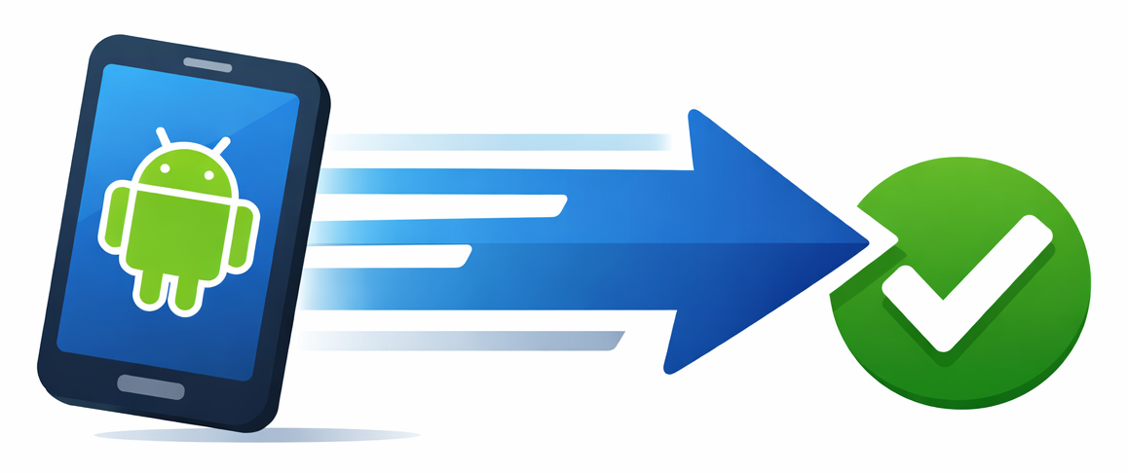
Google Mobile Services Enablement and Certification Optimization
Experience supporting Qualcomm Android programs to accelerate GMS certification for device platforms.
GMS Certification Readiness
Platform Stability Engineering
Performance Optimization
CTS, GTS, and XTS validation execution
Pre certification readiness validation prior to GMS submission
Debugging Google API compliance failures across framework and HAL layers
Failure triage using logcat, tombstones, kernel logs, and system traces
MTBF based stability validation across system services and device drivers
Stress scenarios including application switching, service load, memory pressure
Failure analysis for ANR events, service crashes, and kernel panics
Long duration reliability validation for production device readiness
Boot stage profiling across bootloader, kernel, and Android framework
Application launch performance validation for system and merchant apps
Memory map analysis and resource utilization optimization
Framework service initialization tuning
Impact for Android Device Programs
Reduced GMS certification cycles
Fewer certification iterations with Google
Faster Android platform readiness for production devices

Slide 32





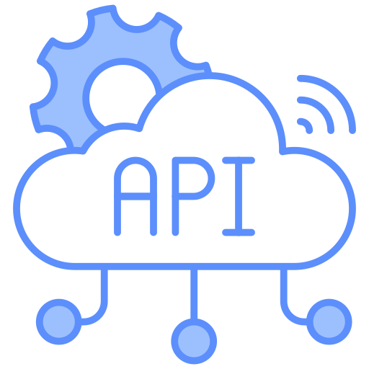



Benchmarking and Validation Framework for GMS Certification
Structured benchmarking and compatibility validation to ensure Android platforms meet GMS performance and API requirements.
System Performance Benchmarking
CPU and System Performance
Storage Performance
AnTuTu benchmarking for CPU, memory, and system performance
System benchmark suites for device level compute validation
AndroBench execution for sequential and random IO validation
Storage performance tuning impacting application launch
Graphics and UI Performance
Browser and WebView Validation
GFXBench validation for GPU and UI rendering performance
Frame latency analysis for smooth UI interactions
Browser benchmark execution for WebView performance
JavaScript execution performance for Android apps
Google API Compatibility and Continuous Validation
XTS Validation
Automated Certification Readiness
Failure Analysis and Debugging
Execution of XTS test suites to validate Google API coverage
Compatibility validation across Android framework services
Integration of CTS, XTS, and benchmarking workloads into automated pipelines
Continuous validation across Android platform builds
Cross layer debugging using logcat, kernel traces, and system profiling
Root cause analysis across framework, HAL, and BSP layers

Slide 33

Device Management & OTA Experience

Slide 34








Device Security & OTA Management
Secure Device Onboarding & Identity
Over-The-Air (OTA) Updates
Security Patch Management
Policy Management & Compliance
Threat & Vulnerability Management
Enterprise-grade IAM integration with Microsoft Azure Active Directory (Azure AD), OAuth2, and SAML for secure identity lifecycle management.
Zero-touch enrolment and policy-driven provisioning for Android/Linux-based devices.
Seamless integration with Azure DevOps pipelines and Intune/Endpoint Manager for policy-based update rollouts.
Custom OTA framework development for Linux and Android using Yocto, A/B partitioning, and delta updates.
CVE monitoring, patch integration, and binary signing workflows across BSP, middleware, and app layers.
Automated testing and deployment pipelines to meet compliance mandates.
Support for Intune-compatible models and Azure policy frameworks, adapted for embedded use cases.
Remote policy enforcement (password, VPN, app whitelist) via custom or third-party MDM.
Runtime integrity checks, secure boot, and rollback protection.
Integration with threat detection and audit tools for real-time device monitoring.

Slide 35








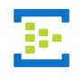

Device lifecycle Management platform – Services
Azure
Data security
Device management applications
Third party app integration
Identity and access
Management
Certificate
management
Device provisioning
Remote monitoring
OTA updates
Warranty /Ticket management
Enterprise apps
Service orchestration
Data ingestion
Data processing & Persistence
Data presentation
Database
Device statistics dashboards
API gateway
Business apps and reports
IoT Broker
Message Queue
Data processing &
Transformation
Rule's engine
Connectivity agent

Slide 36




Device Lifecycle Management Services
Common Features
Enrolment, Provisioning, Enforcing Security policies, Enforcing Configuration Policies, Self Help Portal, Policies to control apps, Authentication enforcement, Monitoring and Reporting
Ari Mobile Device Management (MDM) is a complete enterprise mobility management solution
Mobile Access Gateway
Critical mobile security, management & adaptation needs
Highlights
Policy based enrollment
Remote tracking and monitoring
Securely manage user activities - device, applications and content
Built-in Heartbeat
API Manager
Secure API Integration Management
System specific features - e.g., silent app push/removal, call/SMS related policies
Device level features
Activity monitoring & reporting
Call and data usage thresholds
User policies
Push notifications
Security & configuration policies
Remote distribution of apps
Application-level features
Policies to Control Access to apps
Authentication Enforcement
Manage access to Device Features
Fingerprint and IRIS recognition
Secure boot & secure execution
Remote Mobile Device Management, biometrics (Fingerprint and Iris recognition) authentication for access
Tightly integrated with Android OS
Trust Zone Soc
Pre-fused keys, Signed image storage, interface to biometric Sensors
Supports Android Linux

Slide 37
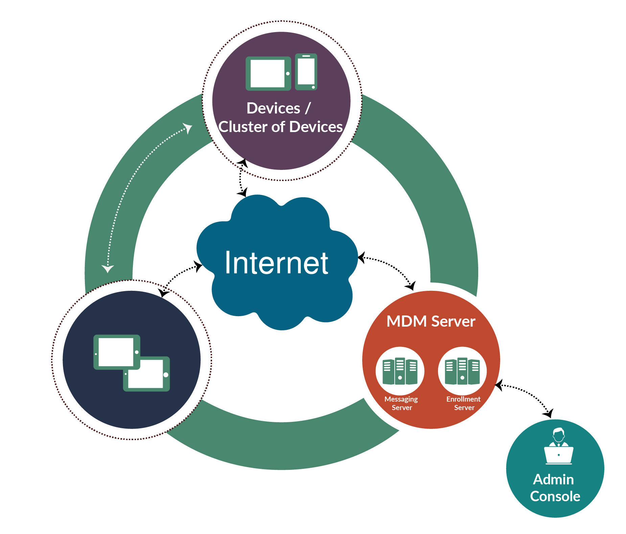
MDM Solution Overview
Ari MDM (Mobile Device Management) is a custom-built module for enterprises to secure and manage mobile devices, applications and content.
Functionalities
Security Driven
This includes policy admin, Identity and Access Management (IAM),
2. Data collection
- Device logs
- Usage statistics - No. of Apps installed, uninstalled
- Operational parameter of the devices - Battery health, Temperature
3. Device Administration
- App Install/Uninstall, Message Push, Content Push
Highlights
Can be upgraded over the air, targeting specific devices as necessary
Is compatible with all common handheld device operating platforms and applications
Can add or remove devices from the system as necessary to ensure optimum network efficiency and security
Ari MDM
Platform: Android L

Slide 38
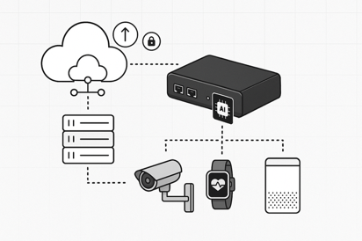
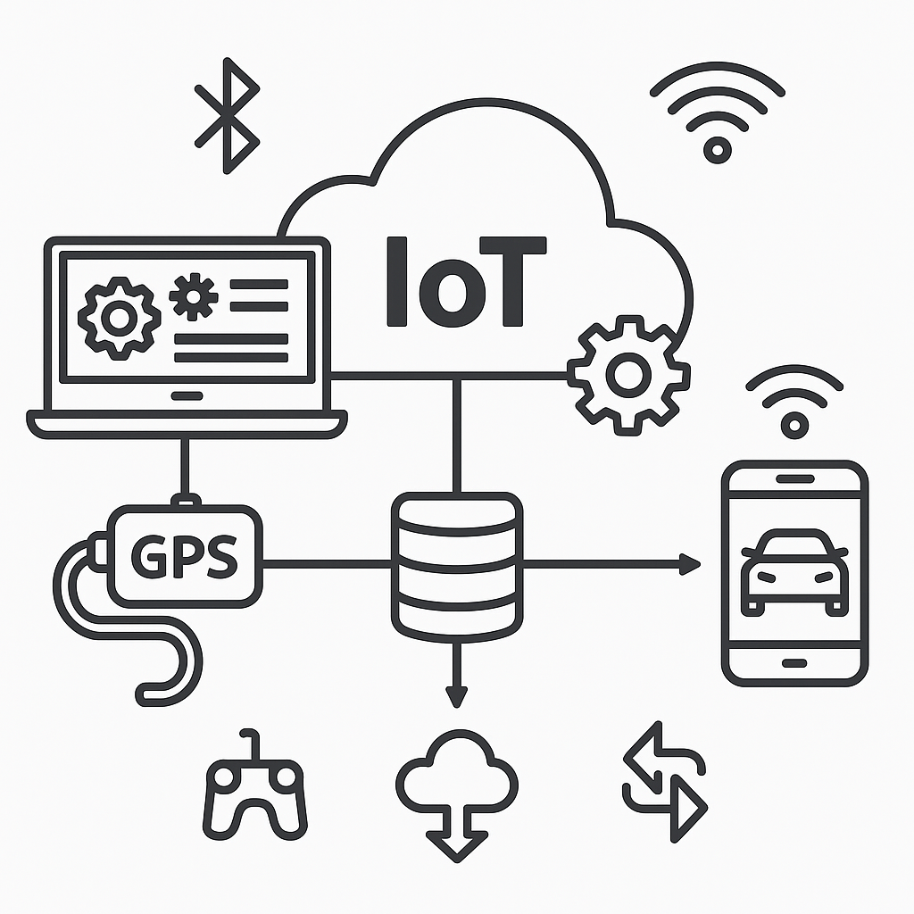
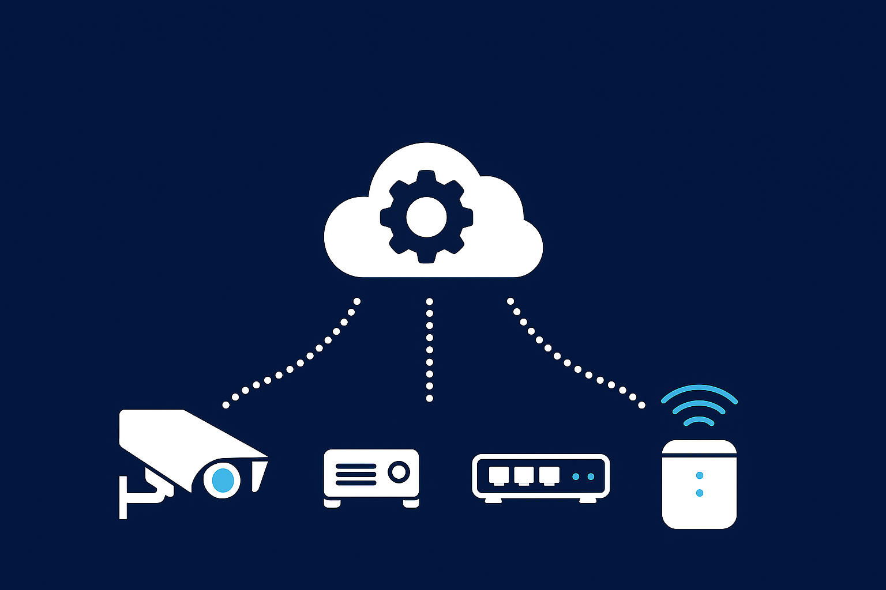
Device Lifecycle Management – Use Cases & Experience
OTA Updates & Firmware Management
Remote provisioning & Configuration
Remote Administration & Support
Credential Management, Device Health
Edge AI Deployment & Orchestration
IoT Device Lifecycle Management Platform | OOB Device Management via Cloud | Edge AI Workload Orchestration
Developed IoT device lifecycle management platform for a global tools manufacturer, enabling secure onboarding, OTA updates, and stateful device management. Features include robust identity management, seamless cloud-device sync, and optimized firmware rollout—enhancing operational efficiency, reducing downtime, and supporting future AI integration across complex tool ecosystems.. | Developed an IoT-based OOB (Out-of-Band) Service Agent framework for secure device onboarding, remote management, and telemetry. Enables periodic heartbeats, remote rebooting, and real-time positioning via Qualcomm Aware Services. Supports scalable, secure cloud-device interaction with publish/subscribe models—enhancing visibility, reliability, and centralized control of IoT edge devices. | Scalable, secure, and multi-tenant edge AI solution using NVIDIA Jetson and KubeEdge. Enabled automated AI model deployment, seamless integration, and high-scale workload management across 100k+ devices per vendor.

Slide 39


Observability, APM, and Telemetry Engineering

Slide 40








Innominds Observability and Telemetry Engineering Framework
Databricks Lakehouse on Google Cloud: A structured approach to building scalable observability platforms for cloud native and distributed systems.
Standardized instrumentation across application, platform, and infrastructure layers.
High throughput ingestion pipelines for large scale telemetry streams.
Real time processing and correlation of observability signals.
Unified telemetry Lakehouse for analytics and monitoring.
Telemetry Instrumentation
Telemetry Ingestion
Processing and Correlation
Observability Data Platform
Open Telemetry based instrumentation across services and APIs
Metrics collection through Prometheus exporters and service instrumentation
Centralized logging integration across application components
Telemetry capture from applications, backend services, and edge systems
Streaming ingestion using Pub/Sub or Kafka
Log ingestion pipelines using Cloud Logging
Telemetry normalization and schema standardization
Context enrichment for service and transaction level telemetry
Spark Structured Streaming pipelines on Databricks
Correlation of logs, metrics, and traces across service interactions
Aggregation of latency distributions and service level metrics
Identification of cross service dependencies and transaction flows
Delta Lake based storage for logs, metrics, and trace datasets
Time series optimized storage for large telemetry volumes
Historical telemetry retention for performance and reliability analysis
Unified analytics layer for operational and engineering teams

Slide 41

APM and Operational Intelligence Layer
End to end monitoring and performance intelligence built on unified telemetry data.
Deep visibility into service behavior and transaction performance
Distributed tracing across microservices and APIs
Monitoring request latency, throughput, and error rates
Transaction flow tracing across multiple services
Dependency mapping across distributed service architectures
Application Performance Monitoring
Observability Analytics and Monitoring
Operational monitoring across platform and service layers.
Real time dashboards built using Databricks SQL and Looker
Service health monitoring across environments
Monitoring service level objectives and operational KPIs
Historical telemetry analysis to identify performance trends
Intelligent monitoring for reliability and operational resilience.
Telemetry driven anomaly detection using ML models
Alerting for latency spikes, throughput drops, and service errors
Root cause analysis using cross signal telemetry correlation
Operational insights for reliability engineering teams
Incident Detection and Operational Intelligence

Slide 42
Innominds as - End-to-end MedTech Engineering Partner
Regulatory-aligned, data-driven, and AI-powered solutions — delivering connected devices, digital platforms, SaMD, and full lifecycle services
Digital Health & Connected Devices
AI/ML in Medical Devices
Regulatory-First Engineering
Cloud-First Platforms & Data Modernization
Expertise in IoMT engineering, companion app development, FHIR/HL7 integration, and EMR interoperability.
Secure cloud connectivity, real-time monitoring, and device-to-cloud data pipelines for renal care equipment.
AI models for diagnostics, predictive maintenance, and clinical decision support.
Regulatory-compliant V&V for SaMD and integration of real-world evidence to enhance product safety & performance.
ISO 13485, FDA, CE, HIPAA-aligned product engineering.
Automated verification /validation, cybersecurity risk assessments, and digital QMS platforms
Migration to scalable, secure multi-tenant SaaS and cloud-native platforms (AWS, Azure, GCP).
Digital twins and AI-enabled analytics for device performance and patient outcome optimization.
Accelerated NPI & Miniaturization
Cybersecurity & Long-Term Support (LTS)
Hospital & OT Digital Transformation
Sustainability & Cost Optimization
Virtual prototyping, edge AI integration, and multi-sensor architectures.
ODM partnerships to shorten regulatory cycles and reduce time-to-market.
Secure OTA firmware updates, SBOM management, and kernel/OS upgrades.
Threat detection and vulnerability management for connected medical devices.
Edge-cloud orchestration, zero-trust architectures, and AI-assisted workflows.
Network engineering for smart ORs and remote surgical support.
Energy-efficient and recyclable designs, lifecycle cost reduction, and supply chain optimization.
Device redesign and component engineering for extending product life.

Slide 43





Our Comprehensive Solutions for Med Device Engineering
SaMD Development
Data Security and Privacy
Cloud Enablement for SaMD
Rapid Prototyping and Development Diagnostics | Remote Monitoring | Therapeutics
Data Privacy, Security, and Compliance HIPAA | GDPR
Scalable, Secure, and Cost-Effective Cloud Deployments, and Support AWS | Azure | GCP
Regulatory Compliance
Clinical Workflow Integration
Interfacing with Wearables
Adherence to Regulatory Standards SaMD | Operate Services
Seamless integration with existing Clinical Workflows, EHR Systems and Interoperability between standards HL7 | FHIR
Integration of IoT-enabled Wearables Real-time Monitoring | Data Collection

Slide 44












Compliances & Certifications Experience
Quality-First Approach for Device Innovation
Innominds operates with strict adherence to international healthcare and medical device standards, ensuring compliance across the entire product lifecycle.
Compliances & Certifications
A Few of Our Clients
ISO 13485 QMS implementation
ISO 14971
IEC 60601
ISO 14001
UL
ICMED 13485
ICMED 9000
FCC/IC 50980
CE Certification
IEC 60601-1 Safety
RoHS
IEC 60601-1-2 EMC
IEC 60601-2-18
IEC 62304
FDA guidance for Cyber Security.

Slide 45



Integrated Talent Transition & Continuity Model
Rebadging Process / Approach
Innominds Talent Pool Leverage
New Hiring Process / Approach
Identify critical incumbent vendor resources based on skill fit, performance, and program dependency
Conduct joint technical and domain assessments with Convatec
Seamless rebadging into Innominds with role continuity and minimal disruption
Accelerated onboarding aligned to existing delivery workflows
Retention-first strategy to preserve domain knowledge and delivery velocity
Leverage pre-vetted Innominds resources from existing delivery pools and CoEs
Rapid deployment for short-term needs, scale-up scenarios, or niche skills
Plug-and-play integration into Convatec programs
Ensures speed, flexibility, and risk mitigation during transition and steady state
Targeted hiring for skill gaps across Quality, Data, Digital, and Cloud Engineering
Priority sourcing aligned to Convatec’s technology stack and compliance needs
Parallel hiring and onboarding to avoid delivery impact
Structured knowledge transfer and shadowing with rebadged/tenured resources
Rapid productivity enablement through standardized onboarding playbooks

Slide 46
Innominds Chrome OS Services
Enterprise Chrome OS Advisory and Managed Services
From adoption strategy through managed fleet operations — engineering depth at every stage of the Chrome OS lifecycle.
01
02
03
04
Advisory &
Readiness
Enterprise Integration
& Engineering
Deployment &
Modernization
Managed Services
& Optimization
Chrome OS adoption strategy & business case
App portfolio assessment & rationalization
Windows app gap analysis & remediation plan
Security & compliance readiness assessment
Persona-based device & licensing strategy
Google Admin Console architecture & OU design
Identity federation: Azure AD, Okta & SSO
Intune & Chrome Enterprise connector integration
VDI & Windows app delivery integration
PWA enablement & Android app validation
Custom policy automation & API-driven config
Zero-touch enrollment & large-scale rollout
Enterprise policy baseline configuration
Secure browser & endpoint hardening
Legacy Windows endpoint migration
Kiosk & frontline device configuration
Fleet monitoring, analytics & health dashboards
Policy drift detection & compliance reporting
OS lifecycle & update management
L2 & L3 enterprise support
Continuous cost & performance optimization
We don't provision Chrome OS. We engineer it into your enterprise — and operate it with accountability.

Slide 47


Our Experience with Audio Systems Quality (ASQ)
Audio customization and stack porting on Android/Linux
Mic/speaker audio tuning
DSP experience (QDSP4/5/6, TI DSP/OMAP)
Speech, audio, and Bluetooth codecs (A2DP/SBC)
Windows Media certifications
Multithreaded optimization and debugging
ASQ ensures a consistent, reliable, and high-quality audio experience across devices, operating systems, and the ecosystem by combining engineering validation, psychoacoustics, automation, and user-experience testing.
Overall Audio Expertise
ALSA and PulseAudio frameworks
Audio manager updates and DSP optimizations
Audio post-processing and fixed-point coding
OpenDSP program, release, and shim-layer abstraction work
Audio SW Stack Expertise
Audio Systems Quality (ASQ):​
Scope: Products testing HW/SW in robotic / automation fixtures to generate test results and measure KPIs. ​
​
Requires to set-up, deploy, and maintain test devices and fixtures for use in testing in connectivity automation and build models, disassemble, modify and re-assemble systems​
Develop test setups, execute tests, and perform analysis for validity of test data​
RCA from technically complex systems and create test reports and summaries​
Handle prototype/development hardware to protocols regarding handling of units​
VAD and keyword spotting (audio AI/ML for transcription)
Algorithm optimization for power and performance
Audio post-processing and filter chains (EQ, echo, Doppler, normalization)
Algorithms
Framework Expertise
Audio streaming via RTP/RTSP
Concurrent video stack using GStreamer
OpenCV porting and optimization (Intel/Snapdragon)
Video, camera, and MPEG codecs

Slide 48

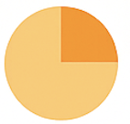



Kick-Off Dialogue with Dexcom
Current Priorities & Pain Points
Short-Term Needs
What are the immediate challenges you're facing with Stelo (or related initiatives)?
Are there specific areas where you'd like Innominds to step in right away?
Roadmap Alignment
Expectations from Innominds
What does the next 6-12 months look like for your mobility, embedded, and data strategy?
What capabilities, outcomes, or deliverables matter most to you?
Potential Collaboration Areas
Beyond the current scope, are there other initiatives (Other Apps & Areas) we can explore together?

Slide 49
Enhancing UX for Better Engagement & Outcomes
Recommended
UI/UX Enhancements
How Innominds Can Support
UI/UX Modernization
Few Suggestions/Observations
Simplify Navigation & Flow
Advanced Data Visualization
Personalization & Customization
Accessibility Improvements
Consistent Platform-Optimized Design
Onboarding & Help Features
Provide Custom Time Range for Historical Data Visualization
Critical Alerts (Out of Range) as Notifications.
Combined Data Visualization of Glucose Levels vs Food Intake
Material Design for Android & Human interface Guidelines (and Liquid Glass) for iOS.
Conduct UX audits and user research to identify pain points and prioritize improvements.
Create wireframes, prototypes, and high-fidelity designs incorporating accessibility best practices.
Implement UI/UX using modern native frameworks ensuring responsiveness and platform compliance.
Perform usability testing with real users to validate design decisions and refine the experience.
Integrate analytics to track user behavior and continuously optimize UX.
UI/UX Specific Insights & Recommendations for Dexcom Stelo App
Notes:
Recommended Enhancements to Elevate the UX/UI
Streamline navigation and overall flow to create a smoother user journey.
Enhance data visualization capabilities to help users easily interpret key metrics and trends.
Expand personalization and customization features to better engage individual user preferences.
Advance accessibility implementations, aligning with global best practices.
Ensure a consistent, platform-optimized design language for a cohesive experience.
Incorporate intuitive onboarding and contextual help to support user success.
How Innominds Can Support This Modernization Journey
Conduct in-depth UX audits and user research to uncover key improvement areas and prioritize initiatives.
Design wireframes, prototypes, and high-fidelity interfaces, embedding accessibility from the outset.
Implement modern, responsive UI/UX using native frameworks to ensure seamless cross-platform performance.
Facilitate usability testing with real users, validating design directions and refining experiences iteratively.
Integrate analytics to monitor user behaviour, enabling data-driven continuous optimization.

Slide 50
Dexcom Goals - Innominds Alignment Map
Dexcom Goal / Expectation
How Innominds Is Already Aligned
1
Fast, low-risk kickoff
Pre-assembled Agile PODs (Core/ Flex)
Onboarding & tools and source code ready
2
Seamless transition from Dexcom engineering
2 – 4 weeks shadowing & knowledge transfer plan
CI/CD & code hand-off playbook
3
Re-engineer legacy
Legacy Modernization Framework
Successful reengineering
4
Strict SaMD quality & compliance
End-to-end V&V with traceability (Figma → TestRail)
Functional equivalence, 70%+ automation
5
Clear productivity metrics & governance
KPI dashboards, telemetry instrumentation
MBR model + underperformance mitigation plan
6
Data / AI insights roadmap
AI-ready data platform team (Snowflake, Databricks)
Workshop planned for predictive insights

Slide 51
Kick Off Need - What we need to Jump Start ?
Requirements & Roadmap
What is Dexcom’s prioritized feature backlog and success KPIs?
Style Guide & Assets
Dexcom Style guide & Fonts for new UX Design development
Source code & Tools Access
Source code access, all tools, Environment Access for Development and V&V
Devices & Sensors
Ship ~5 Stelo sensor kits and reference phones (iOS + Android) for dev and QA.
Compliance Artifacts
Existing V&V documents (BRDs, PRDs, test cases, trace matrices) we should align to.
Stakeholders & Governance
Primary product, engineering, and release contacts, and what cadence works for check-ins (MBR).
Technical Document & Modernization
Migration plan for new technologies like Kotlin, Jetpack Compose, Swift UI
WebApp
There’s also a web app for Stelo. Do we need to consider a facelift or UI/UX improvements for that as well soon?
Notes:
Raghu

Slide 52
Regulatory Affairs Services & Software
Regulatory
Consulting
Regulatory
Submissions
Gap Assessment & Audit Support
Documentation and Report Writing
Regulatory Writing
& Labeling
Medical
Devices
MDR, IVDR, UDI process and strategy consulting
EUDAMED, PMS consulting
Business Process Definition & Optimization - UDI
Audit Services – Pharmacovigilance, Quality, Regulatory compliance readiness
Regulatory Intelligence Consulting
Strategic advisory consulting
EU Authorized Representative
Regulatory Intelligence
510(k), PMA, DeNovo and global regulatory submissions
US, EU, Australian, Chinese, and Canadian documentation and technical file development
Notified Body responses
Import and Export License applications
In country representation
Global Medical Device and IVD Registrations
BSI-certified mock audits
Assessment of equivalent devices
QMS audit support
Gap assessment and MDR / IVDR readiness plans
Technical file remediation
Compliance training for manufacturers
Literature search and review
CEP/CER, PEP/PER, PMS Report, and risk management, documentation development
CER/PER remediation from Rev 3 to Rev 4
PMCF Plans and Reports
PSUR, SSCP, FSCA, PMSR
Clinical Study Reports
Health Hazard Evaluation and Risk Assessment
Protocol & Amendment writing
Notes:
Raghu

Slide 53
Data Governance Automation Vision & Framework
Building Autonomous, Policy-Driven Governance Across the Data Lifecycle
Vision:
Enable enterprise vision through Smart Data + Smart Governance with a strong foundation of automated, AI-enabled data governance.
Goal:
Transform governance through end-to-end Information Lifecycle Management
(Acquire → Process → Store → Share → Archive)
Data Management
Enterprise data strategy
Information lifecycle management
Data standards & quality
2
Strategy
Maturity assessment & vision
Governance framework & org model
Technology selection
Implementation roadmap
Enablers
People & culture
Process & operating model
Tools & technology
DATA GOVERNANCE FRAMEWORK
1
Demo
3
Governance Principles
Clearly defined ownership & accountability across lifecycle
Governance embedded close to data sources (ERP/MDM/SAP)
Digital & AI-enabled enforcement vs manual oversight
Governance integrated into development & data lifecycle
4
Data Quality & Trust Foundation
Stewardship
Data stewardship model
Glossary & metadata
Lineage, quality, privacy & security
Complete
Consistent
Valid
Accurate
Timely
Secure

Slide 54





Governance Automation Operating Model
From Manual Governance to Continuous, Embedded Governance
Establish Governance Foundation
Automate Stewardship &
Policy Execution
Continuous Monitoring & Control
Community &
Collaboration Layer
Define vision, policies, standards & operating model
Assign data owners & stewards
Set up glossary, metadata & lineage foundation
Automated metadata ingestion & cataloging
AI-assisted data discovery & classification
Workflow-driven stewardship & approvals
Policy enforcement embedded into data lifecycle
Automated data quality & compliance checks
Real-time policy conformance monitoring
Usage, access & risk monitoring
Automated audit trails & reporting
Promote trusted data usage
Knowledge sharing & peer review
Continuous curation of critical data assets

Slide 55

Lineage & Provenance – Foundation for Trusted & AI-Ready Data
Establishing End-to-End Data Traceability Across Enterprise Lifecycle
Vision:
Enable trusted, explainable, and AI-ready data through end-to-end lineage and provenance visibility
Why It Matters
Governance Objectives
Traceability Across Information Lifecycle
Limited visibility into origin → transformation → consumption
Difficult to assess business impact of data issues
Increasing need for AI explainability & regulatory traceability
Need full traceability across enterprise value chain
(Source → ERP/MDM → Processing → Analytics → Business outcomes)
Establish single source of truth for data movement & ownership
Provide contextual understanding of data usage & transformations
Enable audit-ready and explainable data ecosystem
Strengthen trust for analytics, AI & decision-making
Capture lineage across:
Structured & unstructured data
ERP (SAP), MDM & enterprise applications
Data warehouses & data hubs
Reports, AI/analytics consumption
Outcome
Trusted data foundation enabling
Better decisions, compliance, and AI adoption

Slide 56

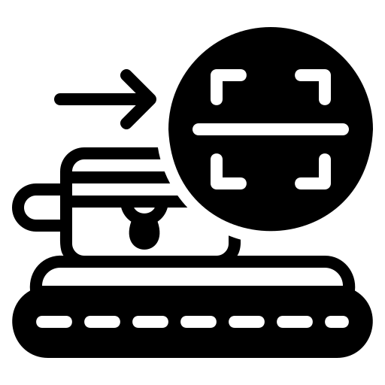



Automated Lineage & Provenance Framework
From Static Documentation to Continuous, Intelligent Traceability
Establish Lineage Foundation
Metadata ingestion across enterprise systems
Business glossary & data definitions alignment
Identify critical data elements & ownership
Map source-to-consumption data flows
Enable Automated Lineage Capture
Automated discovery of data flows & transformations
Column-level & business-process lineage
Provenance tracking (origin, changes, usage)
Integration with MDM, SAP & governance tools
Continuous Monitoring & Impact Analysis
Track data movement & transformation in real time
Identify downstream impact of data changes/issues
Root-cause analysis for quality & compliance issues
Support audit, risk & regulatory reporting
AI & Future-Ready Capabilities
AI-assisted lineage discovery & mapping
Explainability layer for AI/analytics outputs
Intelligent impact prediction
Integration into Data Fabric & governance automation
Outcome
End-to-end transparency & trust in enterprise data
Faster issue resolution & impact analysis
Strong compliance & audit readiness
Foundation for AI, knowledge graph & semantic layer initiatives

Slide 57



The Three Pillars Of Quality
The Three Pillars Of Quality
AUTONOMY
REASONING
TOOL-USE
Agents continuously monitor data streams without scheduled jobs.
LLMs interpret business context to distinguish valid outliers from errors.
Agents connect directly to SQL engines to execute fixes.

