Slide 1
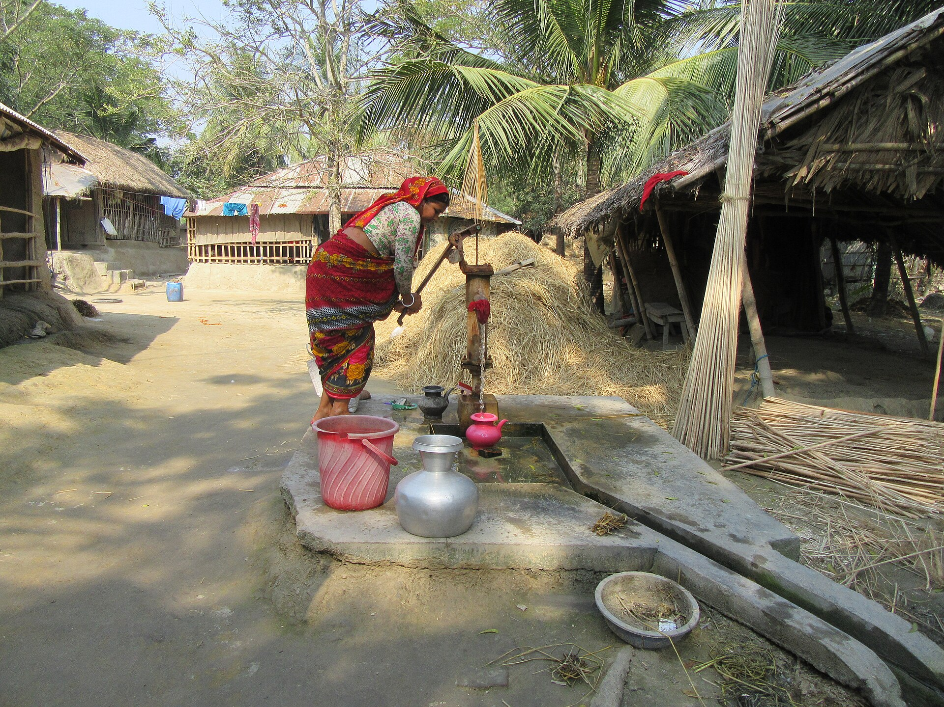




JolSetu
জলসেতু — “the water bridge”
AI reads a $1 arsenic test kit. Every tubewell gets a QR-stamped, tamper-proof spot on a live map. Every family gets a walking route to verified safe water — offline, in Bangla.
Xylem Global Student Innovation Challenge 2026
Water Quality problem statement · University track · Rudra Sarker
Photo: Wikimedia Commons (CC BY 2.0)
Notes:
Open slow: this is a real tubewell in Bangladesh. Twenty million people drink poison from wells exactly like it — invisibly.

Slide 2
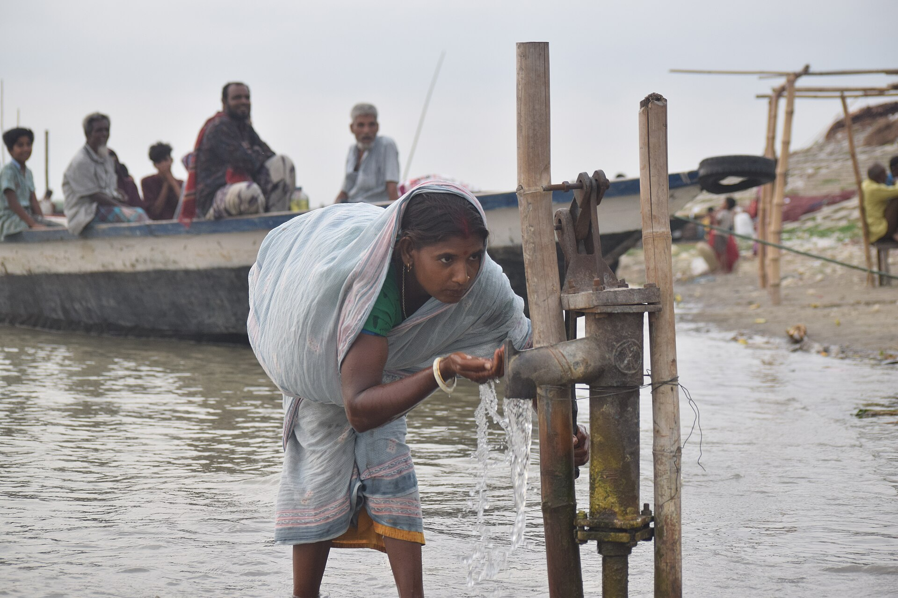


The largest poisoning of a population in history
WHO Bulletin, 2000 — on Bangladesh's groundwater arsenic
20M
Bangladeshis drink above the national standard (50 µg/L); 45M above the WHO guideline (10 µg/L)
24,000+
adult deaths a year from arsenic — plus up to 19,000 more from lower-level exposure
US$13B
lost productivity over 20 years — while the fix, well-switching, costs ≈$11 per person
Arsenic is invisible — no color, no taste, no smell
Sources: Flanagan et al., Bull WHO 2012 (2009 national survey); Smith et al., Bull WHO 2000. Photo: Wikimedia Commons (CC BY-SA 4.0).
Notes:
Numbers are from the WHO Bulletin — the strongest possible source. Emphasize invisibility: the water in the photo looks perfectly clean.

Slide 3


Tested once. Misread. And then… silence.
Tested once in decades
10M+ wells screened by national campaigns (2000–05, 2021–23). The result: a red or green paint mark — no live data, no follow-up.
37%
Read by eye, not instrument
of SAFE wells get condemned by human misreading — families abandon safe water
Field kits are read by matching a pad color to a chart. On 943 real kit-vs-lab comparisons, humans wrongly condemned 37% of safe wells.
No way to act
When your well fails, nothing tells you the nearest verified safe well. Families keep drinking — or walk blindly.
(943 real kit-vs-lab rows, this project)
Sources: UNICEF/DPHE national screening; kit-vs-lab analysis computed from HydroShare DOI 10.4211/hs.8e1373d87419447c945625af13f0a2ea.
Notes:
The problem is not testing — it is everything that should happen AFTER testing: interpretation, trust, action.

Slide 4
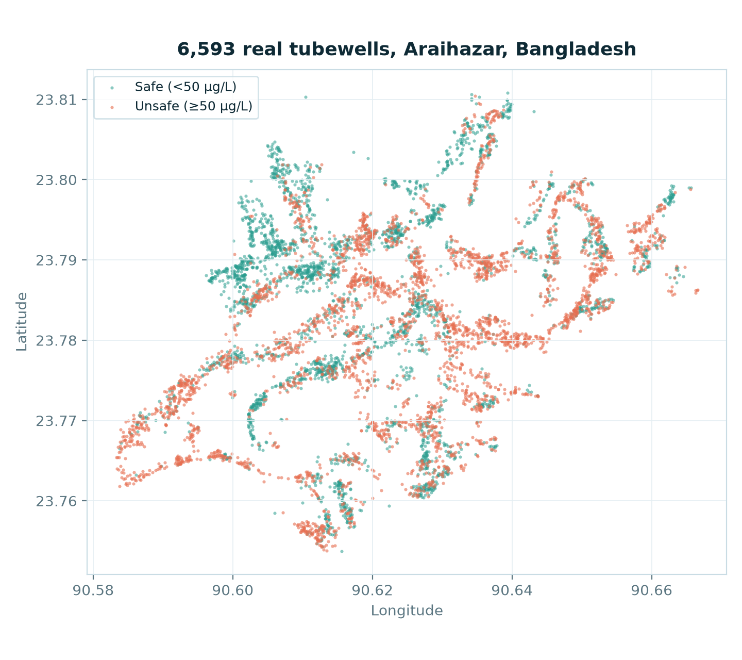
The data already knows where the poison is
Every dot below is a real, laboratory-measured tubewell from Columbia University's Araihazar survey
52.9%
of these 6,593 wells exceed the national standard — this is a hotspot upazila
76% → 11%
unsafe share drops from the 50–100 ft aquifer to below 150 ft — depth is destiny
DOI-cited
open dataset (HydroShare 10.4211/hs.8e1373d87419447c945625af13f0a2ea) — the pilot runs on truth, not mockups
Figure: scatter of the full dataset computed in this project (build/make_figures.py).
Notes:
You can literally see village roads and clusters in the data. Green vs red is life vs chronic disease.

Slide 5

Prediction apps and registries exist. None close the loop.
 | Reads the $1 kit | Live crowd map | Fraud-proof data | Routes to safe wells | Offline + Bangla voice
iArsenic Univ. of Portsmouth — static 3-input screen | — | partial | — | — | —
Nolkup DPHE-adjacent registry app (RCT 2025) | — | partial | — | partial | —
Arsenic 4M new cloud-connected test hardware | partial | partial | — | — | —
JolSetu the action layer on existing kits | ✓ | ✓ | ✓ | ✓ | ✓
JolSetu is the only system that digitizes the kit people already buy, keeps the map trustworthy, and walks families to safe water.
Sources: Univ. of Portsmouth iArsenic news (2025); Nolkup — ACS ES&T Water 2025 + AEA RCT 10.1257/rct.15469; arsenic-4m.org.
Notes:
Honest positioning: those teams do real work. JolSetu complements them — the action and trust layer.

Slide 6
Four moves, one bridge
1 · Read
2 · Stamp
3 · Learn
4 · Walk
→
→
→
Camera + color science reads any $1 Gutzeit kit: white-reference normalization, CIELAB chart matching, spoken Bangla verdict.
HMAC-signed QR well code + 30 m GPS geofence + duplicate detection. Cheaters are flagged or rejected — the map stays true.
A disclosed risk model (AUC 0.67) finds where the map and the model disagree; the crowd tests there next. Every test improves it.
Distance, compass bearing and walking time to the nearest verified safe wells — cached offline, voiced in Bangla.
Zero new hardware: the kit is already sold in every bazaar, the reader is any Android phone.
Notes:
Each move maps to a judging pillar: Read+Stamp = feasibility, Learn = innovation, Walk = impact.

Slide 7
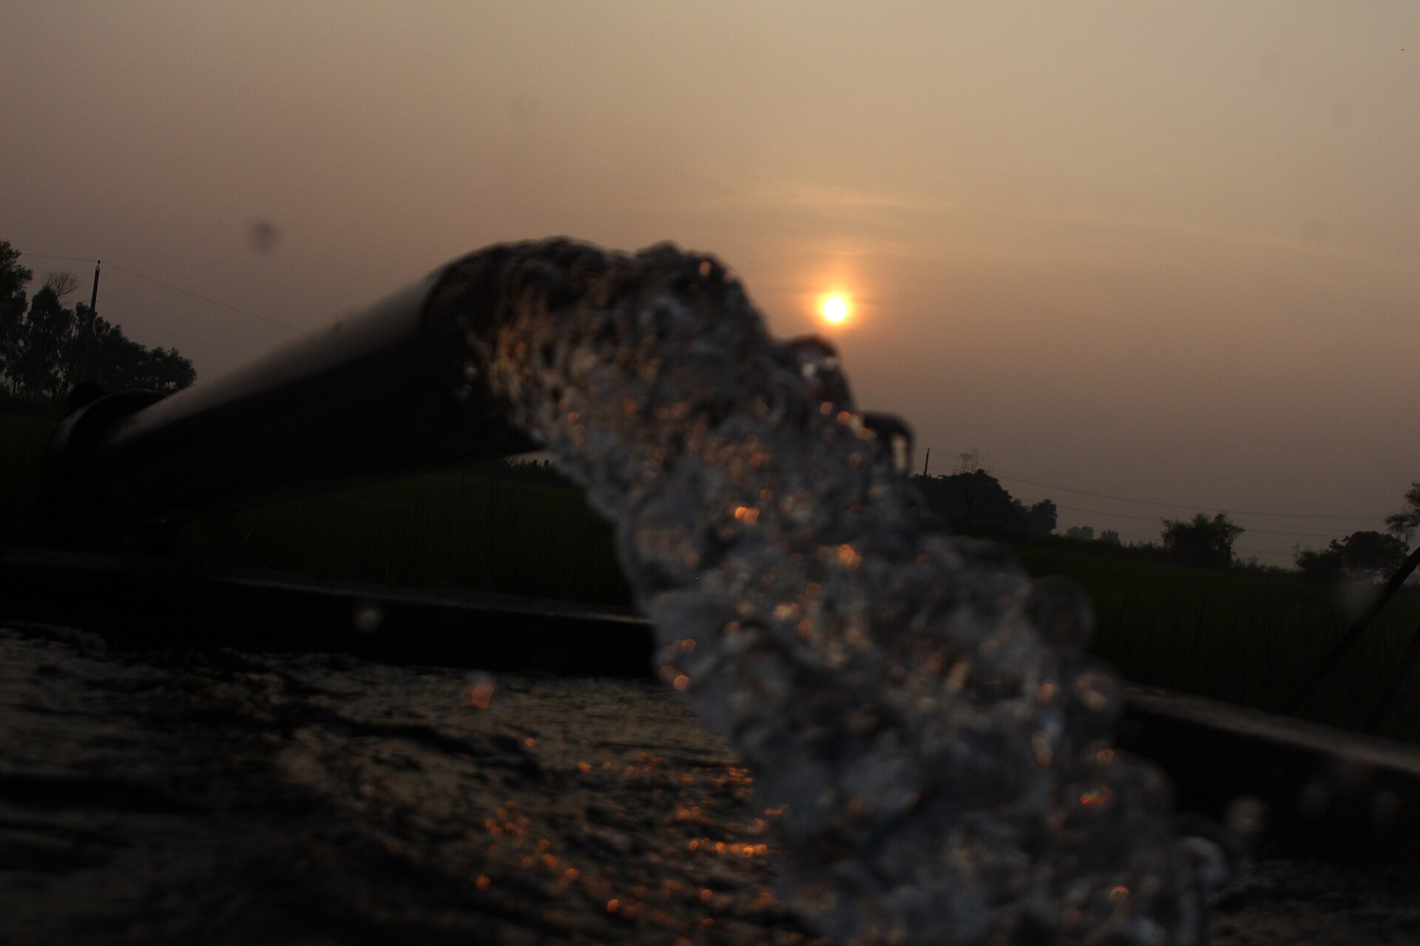
Amina's Tuesday — how one family gets safe water
A realistic walkthrough of the pilot experience
9:00
Buys a 30-taka kit at the bazaar, fills a vial from her tubewell
9:02
Photographs the pad — JolSetu reads 200 µg/L, speaks: “Unsafe” in Bangla
9:03
Scans the well's QR tag — result stamped to the public map, geofence-verified
9:10
Follows the app's bearing: 340 m to a verified safe well. Her kids drink safely that evening
Ten minutes from doubt to safe water
Illustrative journey composed from the pilot feature set; kit price ≈30 BDT ≈ US$0.25–1 depending on brand.
Notes:
Human story judges remember. Amina is illustrative — say so proudly; the features are all built.

Slide 8
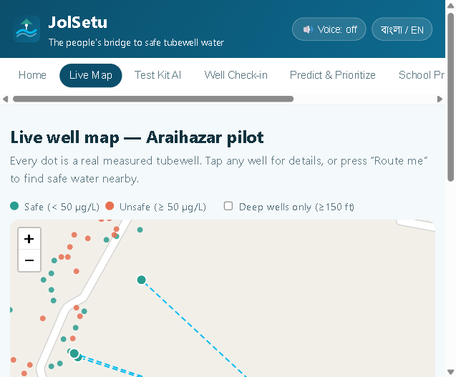
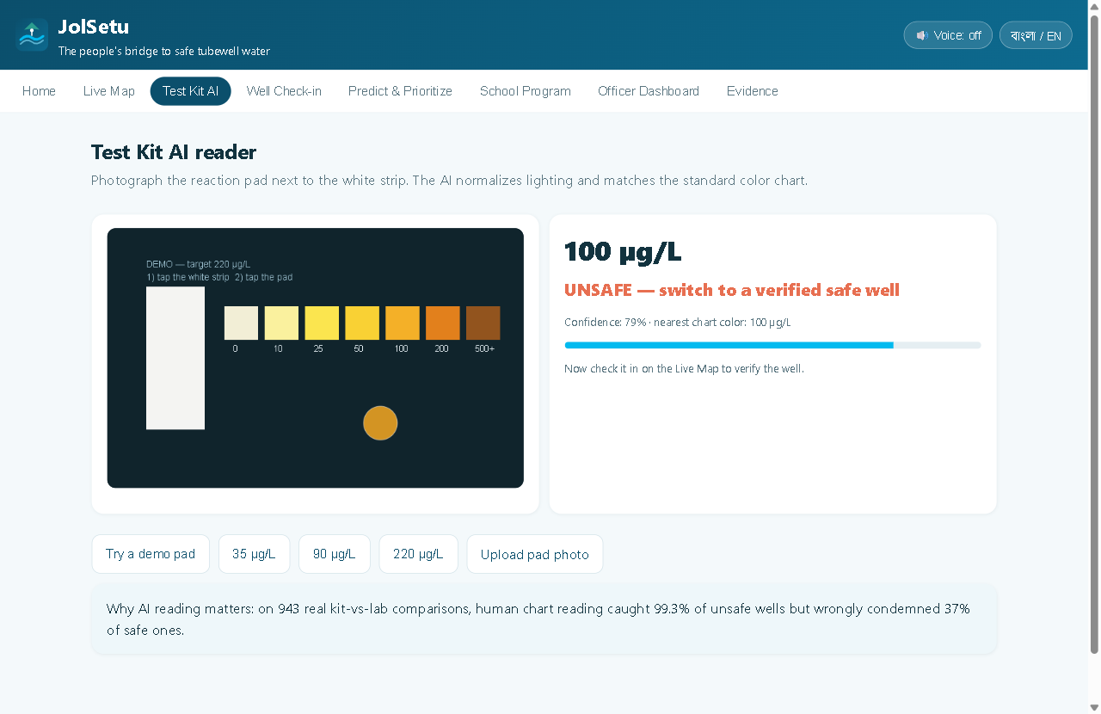
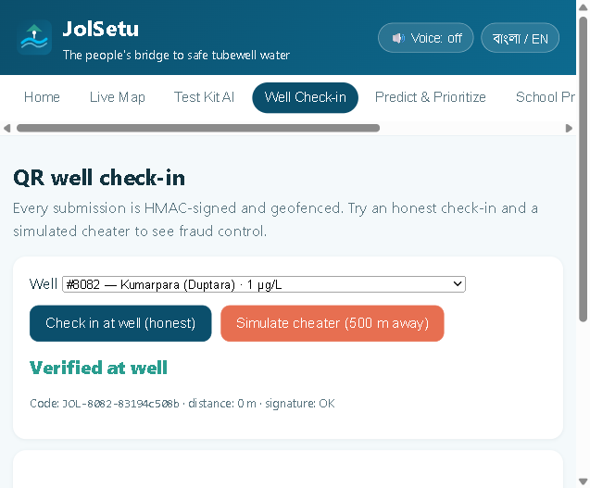
Not a concept — a running system on real data
Live map — 6,593 real wells + routing
Kit AI — demo pad → spoken UNSAFE verdict
Check-in — honest passes, cheater rejected
6,593
23 / 23
BN + EN
real wells loaded — Columbia University's Araihazar survey (DOI-cited)
automated tests passing: routing, color science, QR signatures, geofence
full bilingual UI with text-to-speech; installs as an offline app (PWA)
Live demo: https://rudra496.github.io/jolsetu/ · Code + evidence: https://github.com/rudra496/jolsetu
Notes:
All screenshots are the real running app. Every dot is a real measurement.

Slide 9
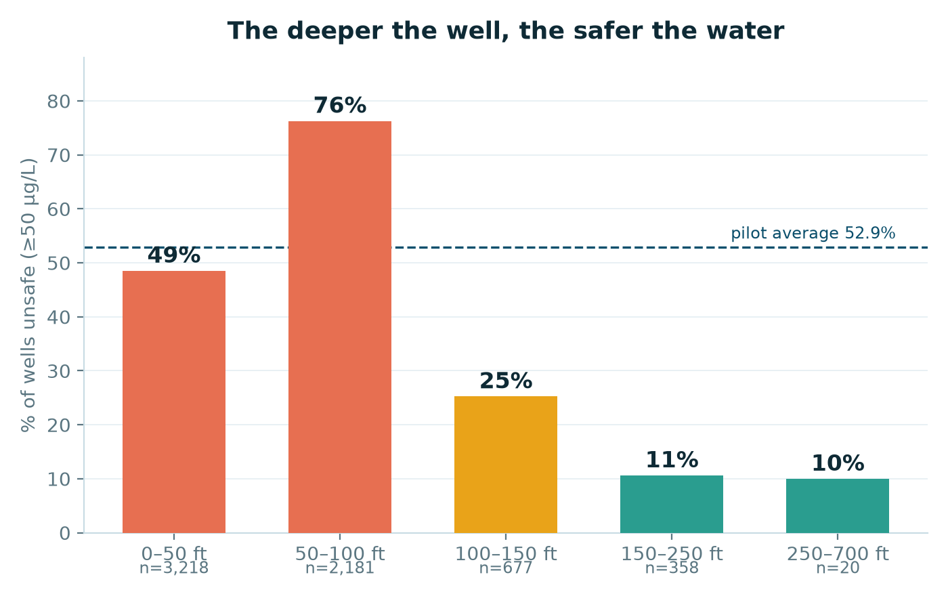
The data already knows: drill deep
One chart can save a life.
Wells in the 50–100 ft band are unsafe 76% of the time; below 150 ft, only ~11%. JolSetu teaches this before a family pays to drill.
Phone photometry is proven.
Quantitative arsenic measurement from phone photos of these exact field kits was validated in Bangladesh (Haque et al., Sci Total Environ 2018).
Computed from the 6,454 depth-tagged wells of the 6,593-well pilot dataset
Figure: this project's dataset (HydroShare DOI 10.4211/hs.8e1373d87419447c945625af13f0a2ea); Haque et al. doi 10.1016/j.scitotenv.2016.12.123.
Notes:
If a village remembers one number from this deck: 150 feet.

Slide 10
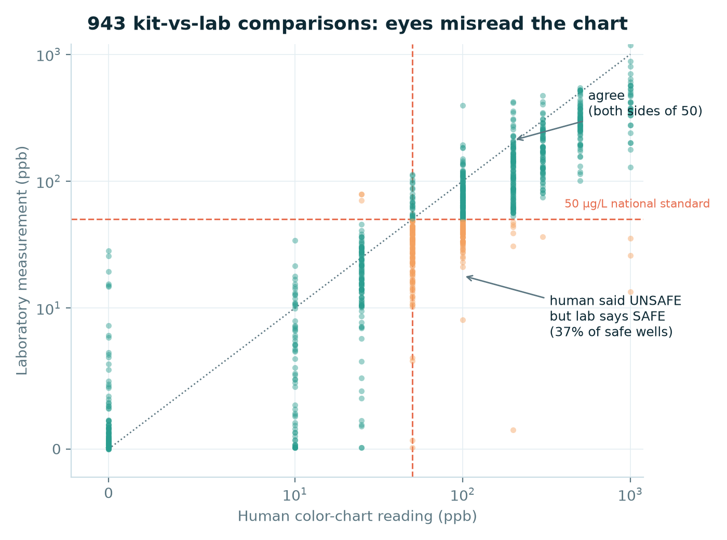
Human eyes are the weak link — AI reading fixes it
99.3%
sensitivity — humans rarely miss truly unsafe wells
63.0%
specificity — but 37% of safe wells get wrongly condemned
80.3%
overall agreement with the lab — standardized CV reading targets that 37%
943 real kit-vs-lab comparisons (orange = harmful misread)
Figure + stats computed from HydroShare DOI 10.4211/hs.8e1373d87419447c945625af13f0a2ea (Dataset1, n=943); kit accuracy context: Reddy et al., Water Research 2020.
Notes:
Orange dots = human said unsafe but lab says safe: families abandon working wells — a hidden cost nobody measures.

Slide 11

The map gets smarter with every test
Model
Disagreement
Priority queue
Verified tests
→
→
→
risk map P(As≥50)
AUC 0.67, disclosed
finds where model
and map differ most
tells clubs & officers
where to test next
QR check-ins update
the public map
every verified test re-trains the model — active learning, not a static score
Why it matters: static apps and 20-year-old hazard maps freeze in time; groundwater changes. JolSetu's evidence base compounds. Production roadmap: a gradient-boosted national model (Science 2020 approach) refreshed live — disclosed in-app via a model card.
Demo model: logistic on real Araihazar wells, AUC 0.672 on 1,319 held-out wells (docs/MODEL_CARD.md).
Notes:
If asked about iArsenic's 84%: ours is honest on local public data; architecture upgrades to the Science-2020 method as crowd data arrives.

Slide 12

Impact math, not impact vibes
$11
18 years
94M+
per person was enough for UNICEF's safe-water switch program (2006–11) — the intervention JolSetu industrializes
of Araihazar field evidence: labeled wells + switching cut exposure sustainably (Jamil et al., ES&T 2019)
people across the arsenic belt face the same crisis (Science 2020) — Bangladesh is the pilot, not the ceiling
KPI: person-days of arsenic exposure avoided = (verified unsafe wells) × (avg users) × (days since switch). Health endpoint: avoided exposure converts to avoided deaths via Bull WHO 2012 hazard ratios — the strongest impact claim a water project can make.
Sources: Flanagan et al., Bull WHO 2012; Jamil et al., ES&T 2019 (10.1021/acs.est.9b01375); Podgorski & Berg, Science 2020 (10.1126/science.aba1510).
Notes:
$220M reaches all 20M exposed Bangladeshis — under 2% of the $13B loss it prevents.

Slide 13

The last mile of water quality
Xylem's instruments measure world-class water data. JolSetu is the missing last mile: 20 million measurement points that measure themselves.
Instrument → data
Data services
Sustainability goals
Every $1 kit becomes a networked sensor; every phone, a reader for Xylem-grade water-quality intelligence.
Anonymized live contamination layers are what utilities, NGOs and DPHE buy — and what Xylem's analytics stack can serve.
Measurable progress on Xylem's water-security commitments — with public KPIs (exposure-days avoided).
Sustainability: NGO/DPHE SaaS tier + school program licensing; free forever for families.
Notes:
Answers 'market potential' in Xylem's own portfolio language: measurement, data, action.

Slide 14

Eight weeks from pilot to proof
W1–2
W5–6
W3–4
W7–8
Bamail pilot: 2 schools, 50 kits, per-batch chart calibration
Server ledger + officer review (geofenced check-ins at scale)
National risk model v1 + SMS fallback for feature phones
Impact audit: wells switched, exposure-days avoided — published
Already done today: dataset pipeline + model + kit-accuracy table, 23 automated tests, offline PWA (BN/EN + voice), live-verified evidence file.
Notes:
The risky parts (data, model, trust layer) already run. The 8 weeks are calibration, server, pilot audit.

Slide 15
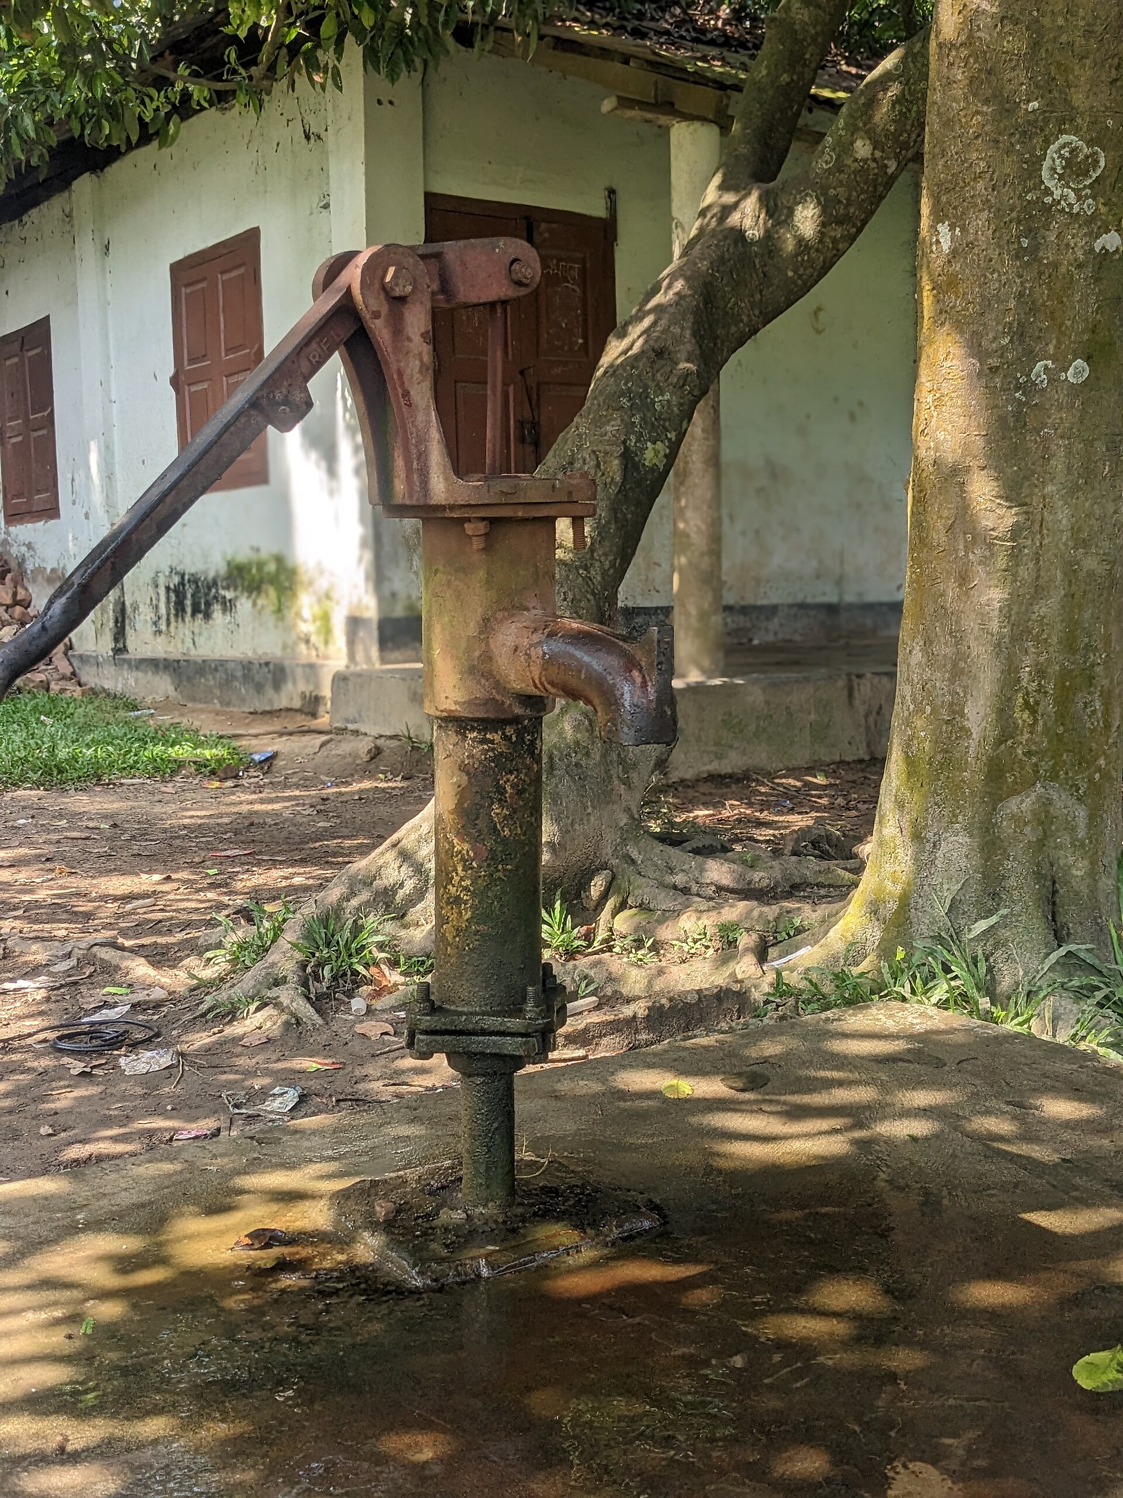
Join us on the bridge.
জলসেতু — নিরাপদ পানির সেতু
Twenty million people don't need another warning.
They need a bridge — built on data they can trust, in a language they speak.
Live demo · https://rudra496.github.io/jolsetu/
Code + evidence · https://github.com/rudra496/jolsetu
Rudra Sarker · Xylem Global Student Innovation Challenge 2026
Photos: Wikimedia Commons (CC BY 2.0 / CC BY-SA 4.0). Figures: this project's analysis of open data (HydroShare DOI 10.4211/hs.8e1373d87419447c945625af13f0a2ea).
Notes:
Pause on the quote. Thank the judges. Offer the live demo on their phone via the QR-free short URL.

