Slide 1
JolSetu
জলসেতু — “the water bridge”
AI reads a $1 arsenic test kit. Every tubewell gets a QR-stamped, tamper-proof spot on a live map. Every family gets a walking route to verified safe water — offline, in Bangla.
Xylem Global Student Innovation Challenge 2026
Water Quality problem statement · University track · Rudra Sarker
Notes:
Open with the quote on the next slide's context: largest poisoning of a population in history. One breath, then the promise: a bridge between 20 million people and safe water.

Slide 2
The largest poisoning of a population in history
— WHO Bulletin, 2000, on Bangladesh's groundwater arsenic
20M
Bangladeshis drink water above the national arsenic standard of 50 µg/L. 45 million drink above the WHO guideline of 10 µg/L.
24,000+
+19,000
US$13B
adult deaths a year from arsenic (>50 µg/L)
more likely from 10–50 µg/L exposure
productivity loss over 20 years
Sources: Flanagan et al., Bull WHO 2012 (2009 national survey); Smith et al., Bull WHO 2000.
Notes:
Anchor: arsenic is invisible — no color, taste, smell. These are the official WHO Bulletin numbers from the 2009 national survey.

Slide 3
Tested once. Misread. And then… silence.
1
Tested once in decades
10M+ wells screened by national campaigns (2000–05, 2021–23). Result: a red or green paint mark — no live data, no follow-up.
2
Read by eye, not by instrument
Field kits are read by matching a pad color to a chart. On 943 real kit-vs-lab comparisons, humans wrongly condemned 37% of safe wells.
3
No way to act
When your well fails, nothing tells you the nearest verified safe well. Families keep drinking — or walk blindly.
Sources: UNICEF/DPHE national screening programs; kit-vs-lab analysis in this project (HydroShare DOI 10.4211/hs.8e1373d87419447c945625af13f0a2ea).
Notes:
The problem is not testing — it is the missing live layer after testing: interpretation, trust, and action.

Slide 4
Prediction apps and registries exist. None close the loop.
 | Reads the $1 kit | Live crowd map | Fraud-proof data | Routes to safe wells | Offline + Bangla voice
iArsenic Univ. of Portsmouth — static 3-input screen | — | partial | — | — | —
Nolkup DPHE-adjacent registry app (RCT 2025) | — | partial | — | partial | —
Arsenic 4M new cloud-connected test hardware | partial | partial | — | — | —
JolSetu the action layer on existing kits | ✓ | ✓ | ✓ | ✓ | ✓
JolSetu is the only system that digitizes the kit people already buy, keeps the map trustworthy, and walks families to safe water.
Sources: University of Portsmouth iArsenic news (2025); Nolkup — ACS ES&T Water 2025 + AEA RCT 10.1257/rct.15469; Arsenic-4M project site.
Notes:
Position honestly: these teams do real work. JolSetu is complementary — the action and live-trust layer none of them build.

Slide 5
Four moves, one bridge
1
2
3
4
Read
Stamp
Learn
Walk
→
→
→
Camera + color science reads any $1 Gutzeit kit: white-reference normalization, CIELAB chart matching, spoken Bangla verdict.
HMAC-signed QR well code + 30 m GPS geofence + duplicate detection. Cheaters are flagged or rejected — the map stays true.
A disclosed risk model (AUC 0.67) finds where the map and the model disagree; the crowd tests there next. Every test improves it.
Distance, compass bearing and walking time to the nearest verified safe wells — cached offline, voiced in Bangla.
Hardware required: a test kit already sold in every bazaar, and any Android phone.
Notes:
Each move maps to a judging pillar: Read+Stamp = feasibility, Learn = innovation, Walk = impact. Zero new hardware is the feasibility story.

Slide 6
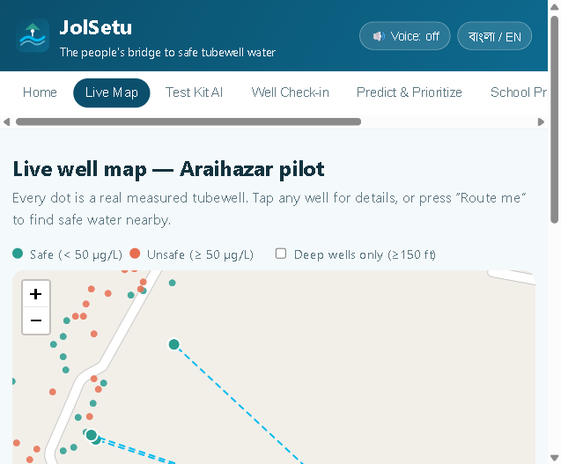
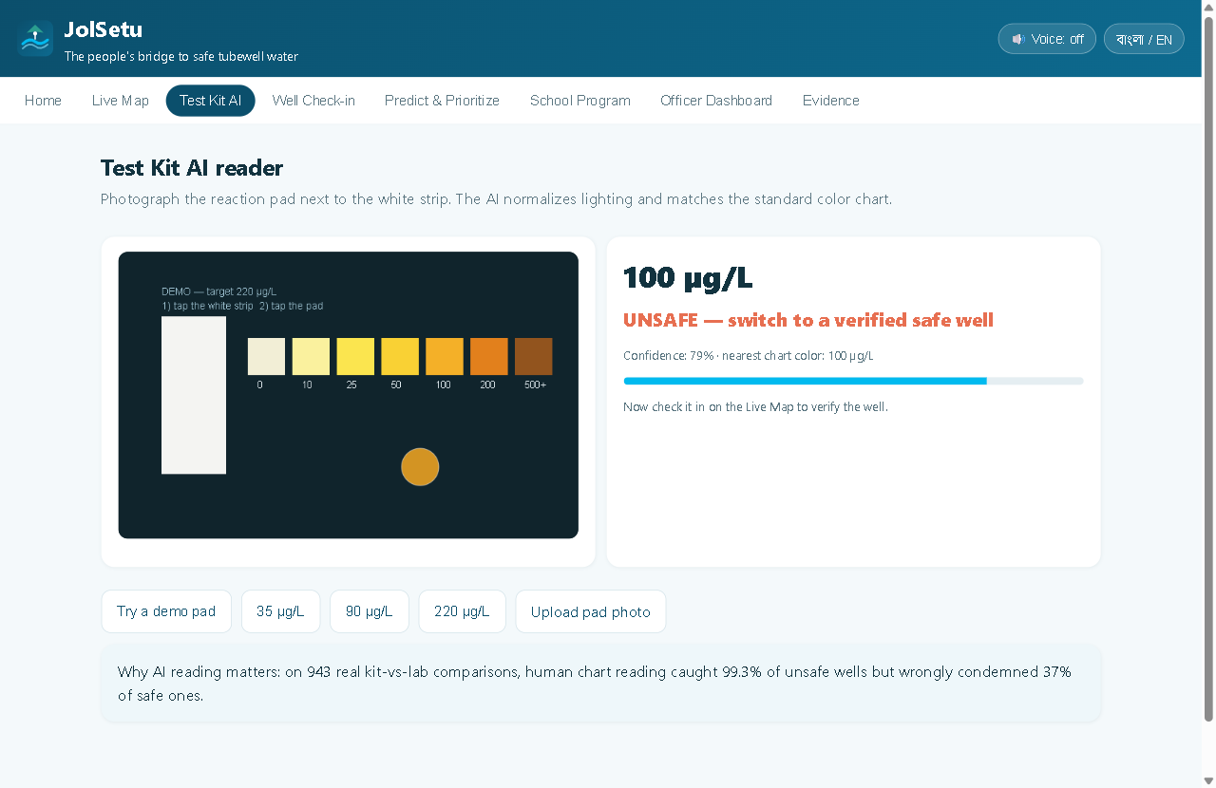
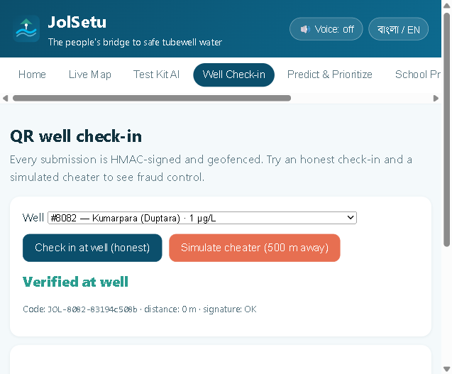
Not a concept — a running system on real data
Live map — 6,593 real wells, safe-well routing
Kit AI — 220 demo pad → UNSAFE verdict, spoken
Check-in — honest passes, cheater rejected
6,593
23 / 23
BN + EN
real wells loaded — Columbia University's Araihazar survey (DOI-cited)
automated tests passing (routing, color science, QR signatures, geofence)
full bilingual UI with text-to-speech; installs as an offline PWA
Live demo: https://rudra496.github.io/jolsetu/ · Code: https://github.com/rudra496/jolsetu
Notes:
All screenshots are the real running app. Emphasize: every dot is a real measurement, not simulated data.

Slide 7
The data already knows where the poison is
Phone photometry is proven.
Quantitative arsenic measurement from phone photos of field kits was validated in Bangladesh (Haque et al., Sci Total Environ 2018).
Human eyes are the weak link.
On 943 real kit-vs-lab comparisons: humans catch 99.3% of unsafe wells but wrongly condemn 37% of safe ones — well-switching chaos the AI reader prevents.
Drill deep.
Wells below 150 ft are ~7× safer. JolSetu teaches this before a family pays to drill.
Charts computed from HydroShare DOI 10.4211/hs.8e1373d87419447c945625af13f0a2ea; human baseline: same dataset, 943 kit-vs-lab rows.
Notes:
The depth gradient is the killer fact: 76% unsafe at 50-100 ft vs 11% below 150 ft. That single chart can change where villages drill next.

Slide 8
The map gets smarter with every test
Model
Disagreement
Priority queue
New verified tests
→
→
→
risk map P(As≥50)
AUC 0.67, disclosed
finds where model
and map differ most
tells clubs & officers
where to test next
QR check-ins update
the public map
every verified test re-trains the model — active learning, not a static score
Why it matters: static apps (iArsenic, national hazard maps) freeze in time. Groundwater and well usage change; JolSetu's evidence base compounds. Production roadmap: gradient-boosted national model (Science 2020 approach) refreshed live by verified tests — disclosed in-app via a model card.
Demo model: logistic on real Araihazar wells, AUC 0.672 on 1,319 held-out wells (see MODEL_CARD.md).
Notes:
If judges ask about the 84% claim of iArsenic: our AUC 0.67 is honest on local public data; the architecture upgrades to the Science-2020 method as crowd data arrives.

Slide 9
Impact math, not impact vibes
$11
18 years
94M+
per person was enough for UNICEF's safe-water switch program (2006–11) — the intervention JolSetu industrializes
of Araihazar field evidence: labeled wells + switching cut exposure sustainably (Jamil et al., ES&T 2019)
people across the arsenic belt face the same crisis (Science 2020) — Bangladesh is the pilot, not the ceiling
KPI: person-days of arsenic exposure avoided = (verified unsafe wells) × (average users) × (days since switch). Every feature exists to move this number.
Health endpoint: arsenic exposure carries measurable all-cause mortality risk (Bull WHO 2012 hazard ratios) — avoided exposure converts to avoided deaths, the strongest impact claim a water project can make.
Sources: Flanagan et al., Bull WHO 2012; Jamil et al., ES&T 2019 (DOI 10.1021/acs.est.9b01375); Podgorski & Berg, Science 2020.
Notes:
Judges score Impact on reach AND realism. The $11/capita number makes scale-up concrete: $220M reaches 20M people — less than 2% of the $13B loss it prevents.

Slide 10
The last mile of water quality
Xylem's instruments measure world-class water data. JolSetu is the missing last mile: 20 million measurement points that measure themselves.
Instrument → data
Data services
Sustainability goals
Every $1 kit becomes a networked sensor; every phone, a reader for Xylem-grade water-quality intelligence.
Anonymized live contamination layers are exactly what utilities, NGOs and DPHE buy — and what Xylem's analytics stack can serve.
Direct, measurable progress on Xylem's water-security commitments — with public KPIs (exposure-days avoided).
Sustainability: NGO/DPHE SaaS tier + school program licensing; free forever for families.
Notes:
This slide answers 'market potential' directly — align with Xylem's own portfolio language: measurement, data, action.

Slide 11
Eight weeks from pilot to proof
W1–2
W5–6
W3–4
W7–8
Bamail pilot: 2 schools, 50 kits, per-batch chart calibration
Server ledger + officer review (RippleUp-style geofence at scale)
National risk model v1 + SMS fallback for feature phones
Impact audit: wells switched, exposure-days avoided — published
Deliverable at kickoff (Sept 28): the working system you just saw — pilot-ready, tested, bilingual.
Already done: dataset pipeline + model + kit-accuracy table (build/prepare_data.py), 23 automated tests, PWA offline shell, full evidence file with live-verified DOIs.
Notes:
Feasibility pillar: the risky parts (data, model, trust layer) already run. The 8 weeks are for calibration, server, and the pilot audit.

Slide 12
Who is building the bridge
Rudra Sarker
The ask
University student (CSE), Bangladesh · full-stack + AI builder
Mentorship on arsenic chemistry calibration standards
Introduction for a DPHE / UNICEF / WaterAid field pilot
Review of the data-trust architecture for national scale
Prize funds → 1,000 test kits + 5 school clubs in pilot unions
Shipped production systems end-to-end: offline AI health worker PWA (49+ verified papers), court-domain trilingual classifier (F1 0.96 on a 1.28M-example corpus), QR-verified field platform with geofenced anti-fraud check-ins — the exact stack JolSetu composes.
Built JolSetu's dataset pipeline, risk model, kit-reader color science and 23-test suite for this challenge.
Notes:
Team slide can grow to 5 members if Rudra recruits classmates — the deck supports either version.

Slide 13
Join us on the bridge.
জলসেতু — নিরাপদ পানির সেতু
Live demo · https://rudra496.github.io/jolsetu/
Code + evidence · https://github.com/rudra496/jolsetu
Rudra Sarker · Xylem Global Student Innovation Challenge 2026
Notes:
Close: 'Twenty million people don't need another warning. They need a bridge.' Pause. Thank the judges.

