Slide 1

প
Porichoy (পরিচয়)
DPP-in-a-Box — every garment gets a verifiable identity before the EU’s 2027 wall.
≈4 million RMG workers, majority women (BGMEA)
THE PROBLEM
A dated regulatory wall
EU ESPR in force 18 Jul 2024; textiles in the 1st Working Plan (Apr 2025); textile DPP delegated act expected ~2027.
#2 exporter world RMG — Europe the biggest market
1
2027–30 EU DPP obligations phase in; customs auto-checks
2
Customs will auto-check passports
EU customs verify existence & authenticity of DPPs on imported garments — no passport data, no order.
3
The data is trapped in chaos
Factory records sit in mixed Bangla/English Excels, ERP exports and paper trim cards. Global platforms don’t climb onto the factory floor.
Live product, built & verified: rudra496.github.io/porichoy
RMG FACTORY FLOOR, CHATTOGRAM · PHOTO: S. BISWAS, CC BY-SA 4.0, WIKIMEDIA COMMONS
Porichoy (পরিচয়) · Needle Innovation Challenge 3.0 · Sources: European Commission (ESPR) · BGMEA
1 / 6

Slide 2
MARKET OPPORTUNITY
A compliance budget with a deadline — and an empty factory-floor square
18 Jul 2024
ESPR in force
Apr 2025
1st Working Plan — textiles
~2027
Textile delegated act (expected)
2027–30
DPP phase-in; customs auto-checks
W
$
✓
Brand-side DPP SaaS
TrusTrace · TextileGenesis · Reverse Resources
Enterprise-priced, English-first, consume clean data. They do NOT capture at the BD factory floor.
Consultancies & audits
Big-4 / compliance firms
Expensive, per-visit, no product. Cost recurs; nothing is learned or reused.
Porichoy’s square
The BD last-mile data engine
Sits at the factory, speaks Bangla, feeds ANY platform — partner to global players, not a rival.
Beachhead: mid-size exporters already facing buyer DPP requests → buying houses & certification bodies → integration partnerships with global DPP platforms.
Porichoy (পরিচয়) · Needle Innovation Challenge 3.0 · Sources: EC ESPR page (fetched 2026-09-12) · trustrace.com · competitor research verified 2026-08-26
2 / 6

Slide 3
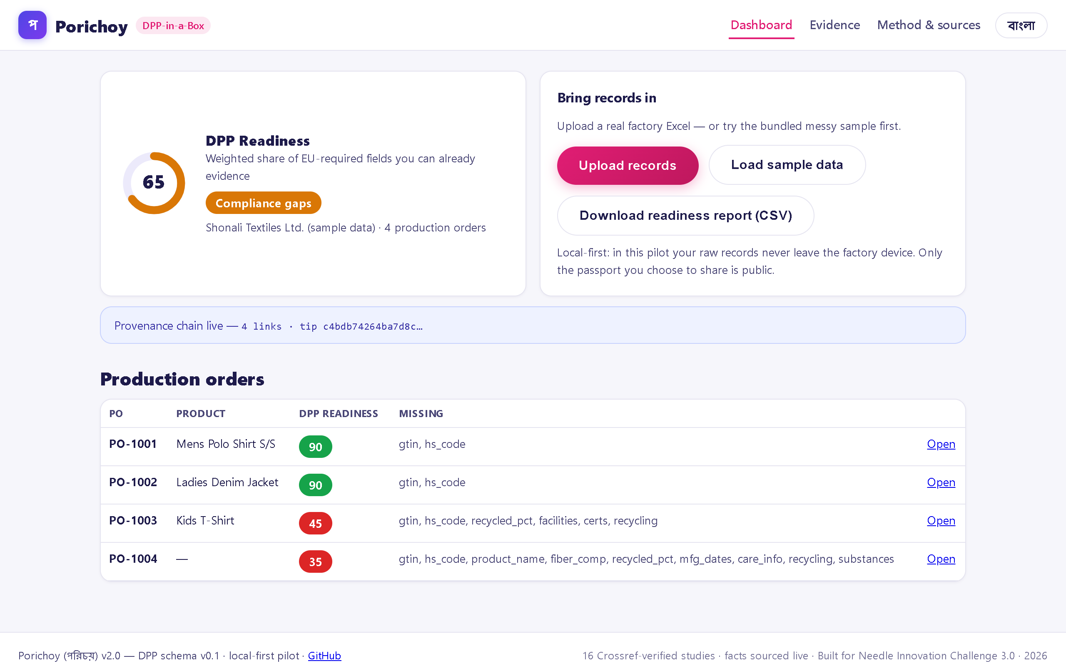
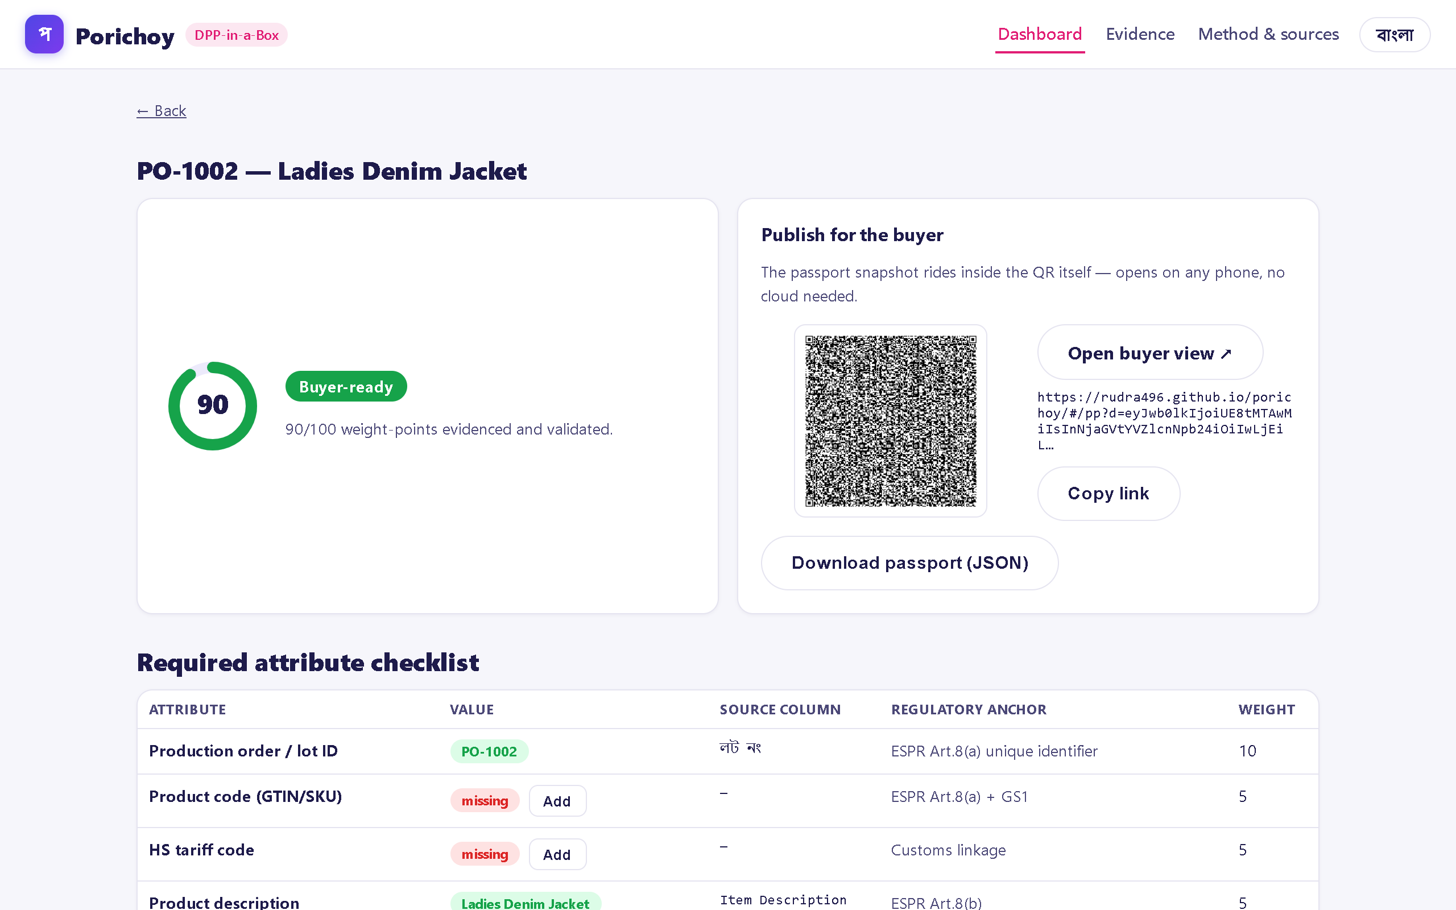
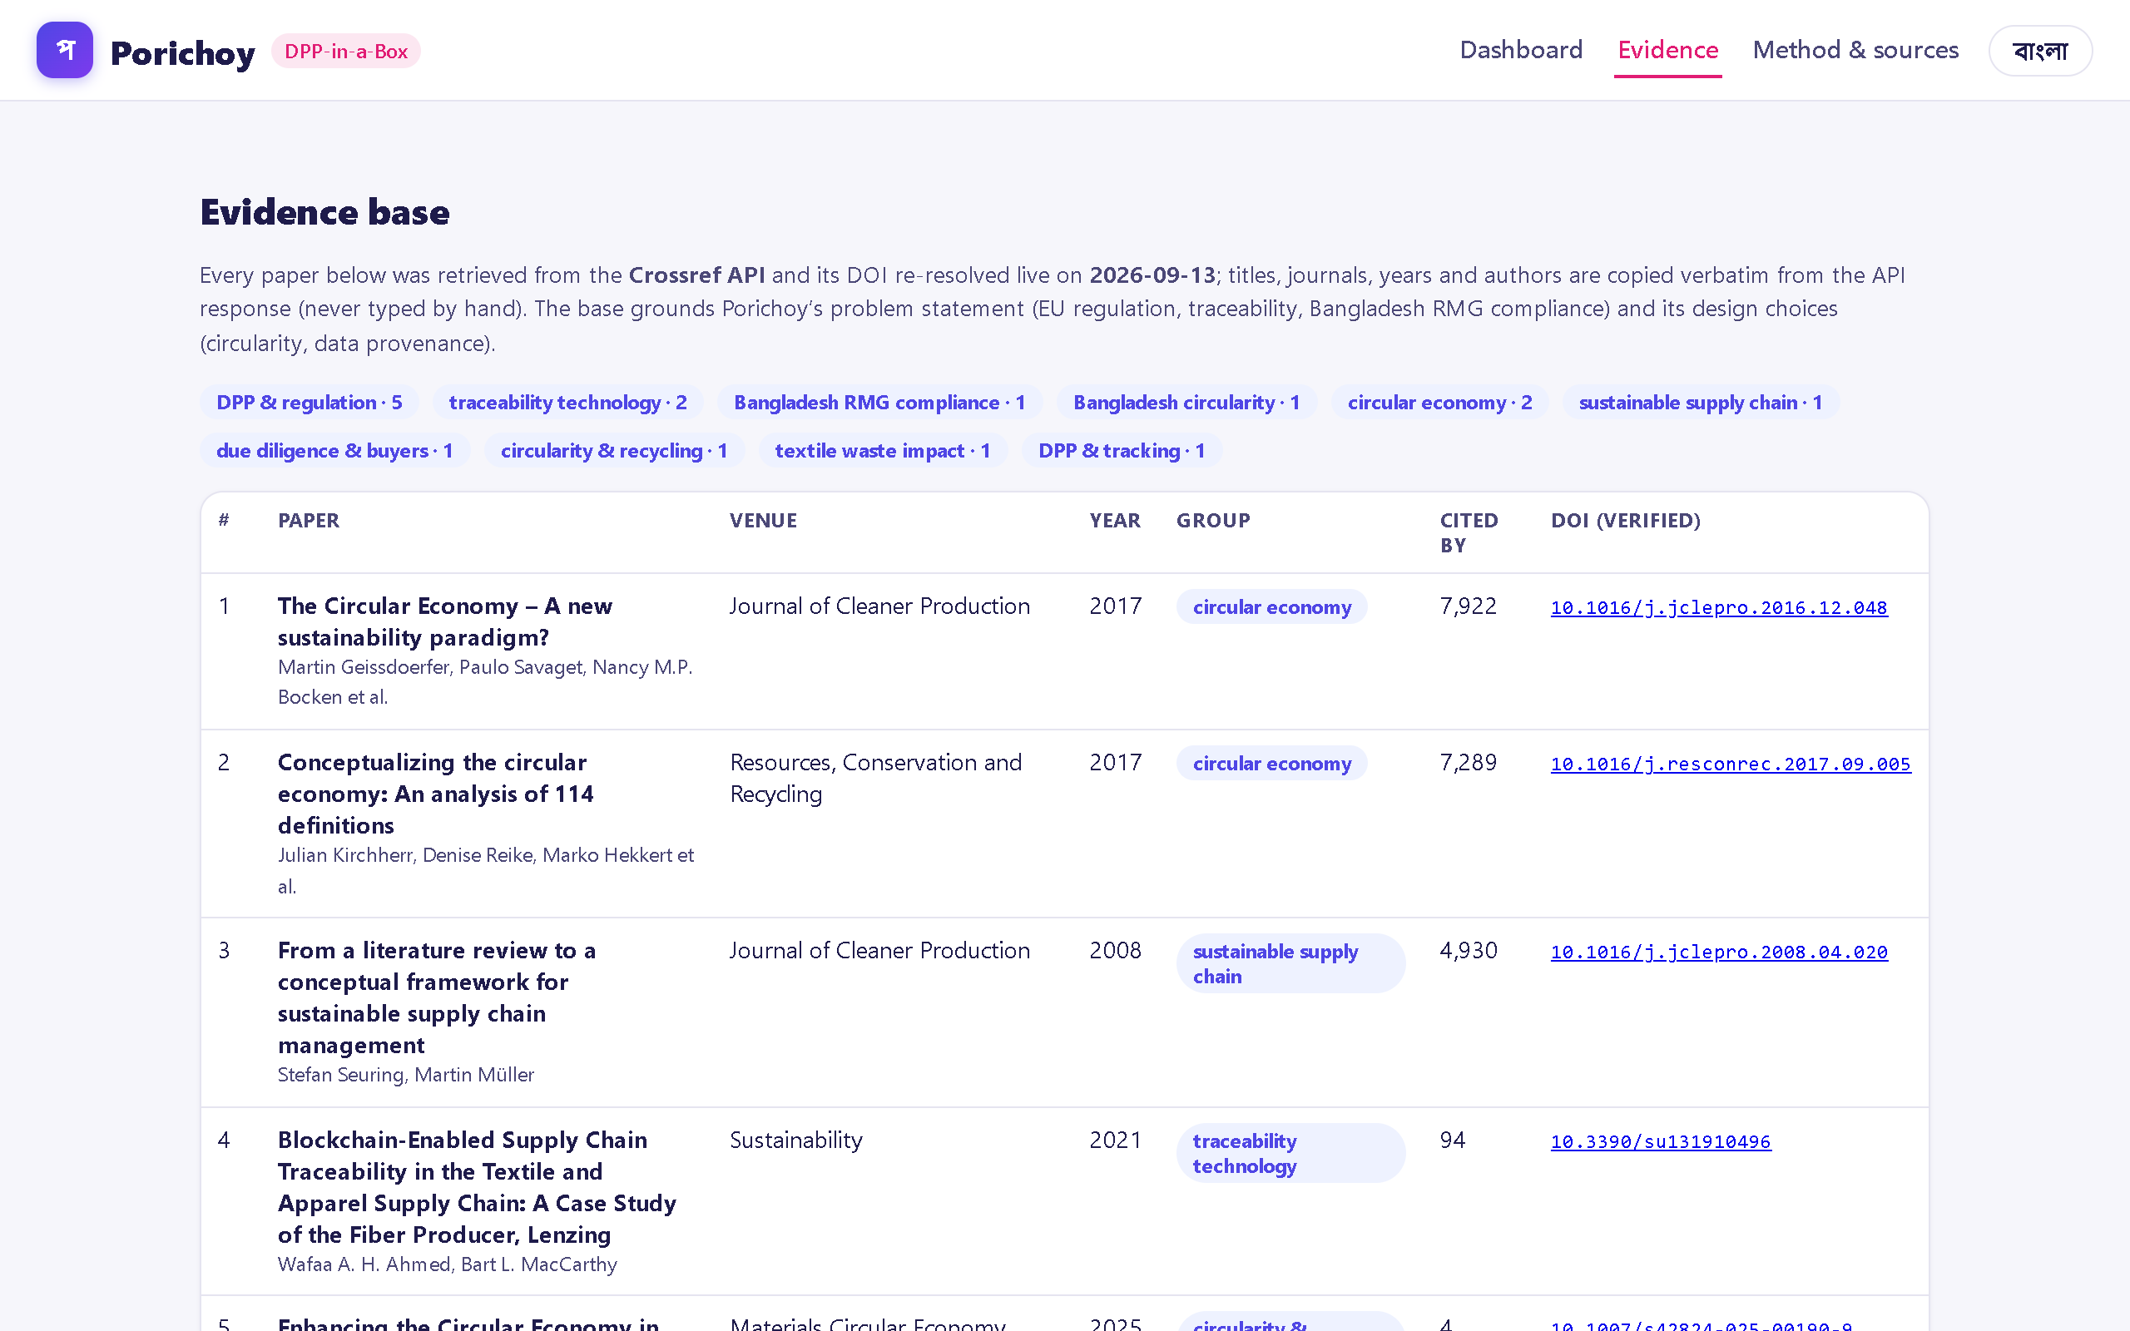
THE SOLUTION
Messy factory files in → buyer-ready passport out, in 90 seconds
1
INGEST Drop Excel/CSV — every sheet parsed on-device. Nothing leaves the factory (local-first).
2
MAP Engine reads chaotic Bangla/English headers with confidence scores; the steward confirms. Vocabulary is learned.
3
SCORE DPP Readiness 0–100 per order (weights = ESPR Art. 8 categories) + the exact gap list.
4
PASSPORT One click → QR whose link embeds the passport. Scan opens the buyer view on any phone. No backend.
Live dashboard — per-order readiness (sample data)
19 automated engine tests
SHA-256 provenance chain
বাংলা + English UI
Offline-tolerant PWA
Stewards fix gaps in-place — the score updates instantly and every value joins the hash chain.
PO passport & evidence base (16 Crossref-verified studies)
Porichoy (পরিচয়) · Needle Innovation Challenge 3.0 · All screenshots are the live production app (fetched 2026-09-13) · rudra496.github.io/porichoy
3 / 6

Slide 4
BUSINESS & REVENUE MODEL
Factories pay little; brands pay to make their suppliers compliant
Factory SaaS
BDT 2,000–8,000 / month by size — SME-priced, ~10× below enterprise platforms
◈
Onboarding & data-rescue
One-time fee: steward training + first ingest + mapping historic files
◆
Brand-funded onboarding
Buyers pay to onboard their supplier base before 2027 — CAC moves to the party with the money
◇
3-year path — targets
Y1
10 factories · 20 stewards
Y2
40 factories · buyer channel
Y3
100+ factories · platform integrations
Unit economics: onboarding ≈ 2 person-days per factory · software gross margin >80% · replication is a template, not a project.
Porichoy (পরিচয়) · Needle Innovation Challenge 3.0 · Grant allocation sums to BDT 650,000 (challenge maximum) · pricing benchmarks: verified competitor research
4 / 6

Slide 5

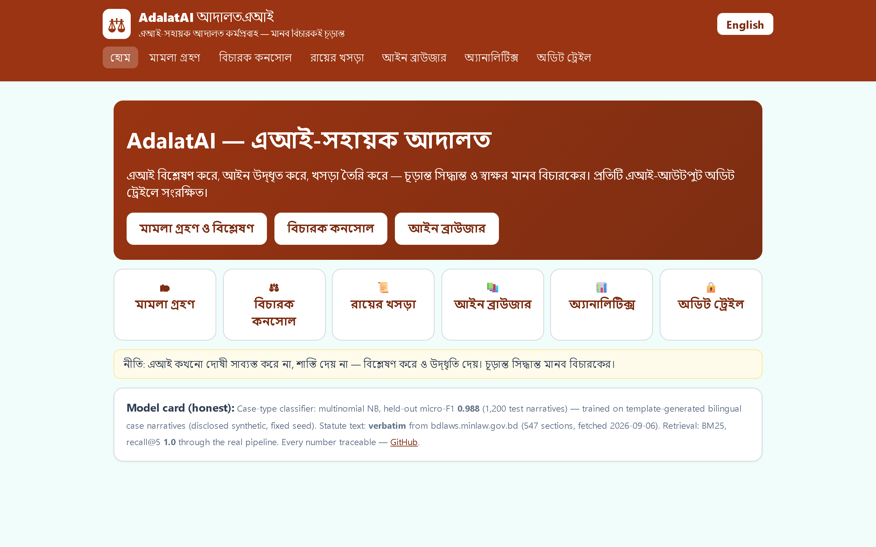
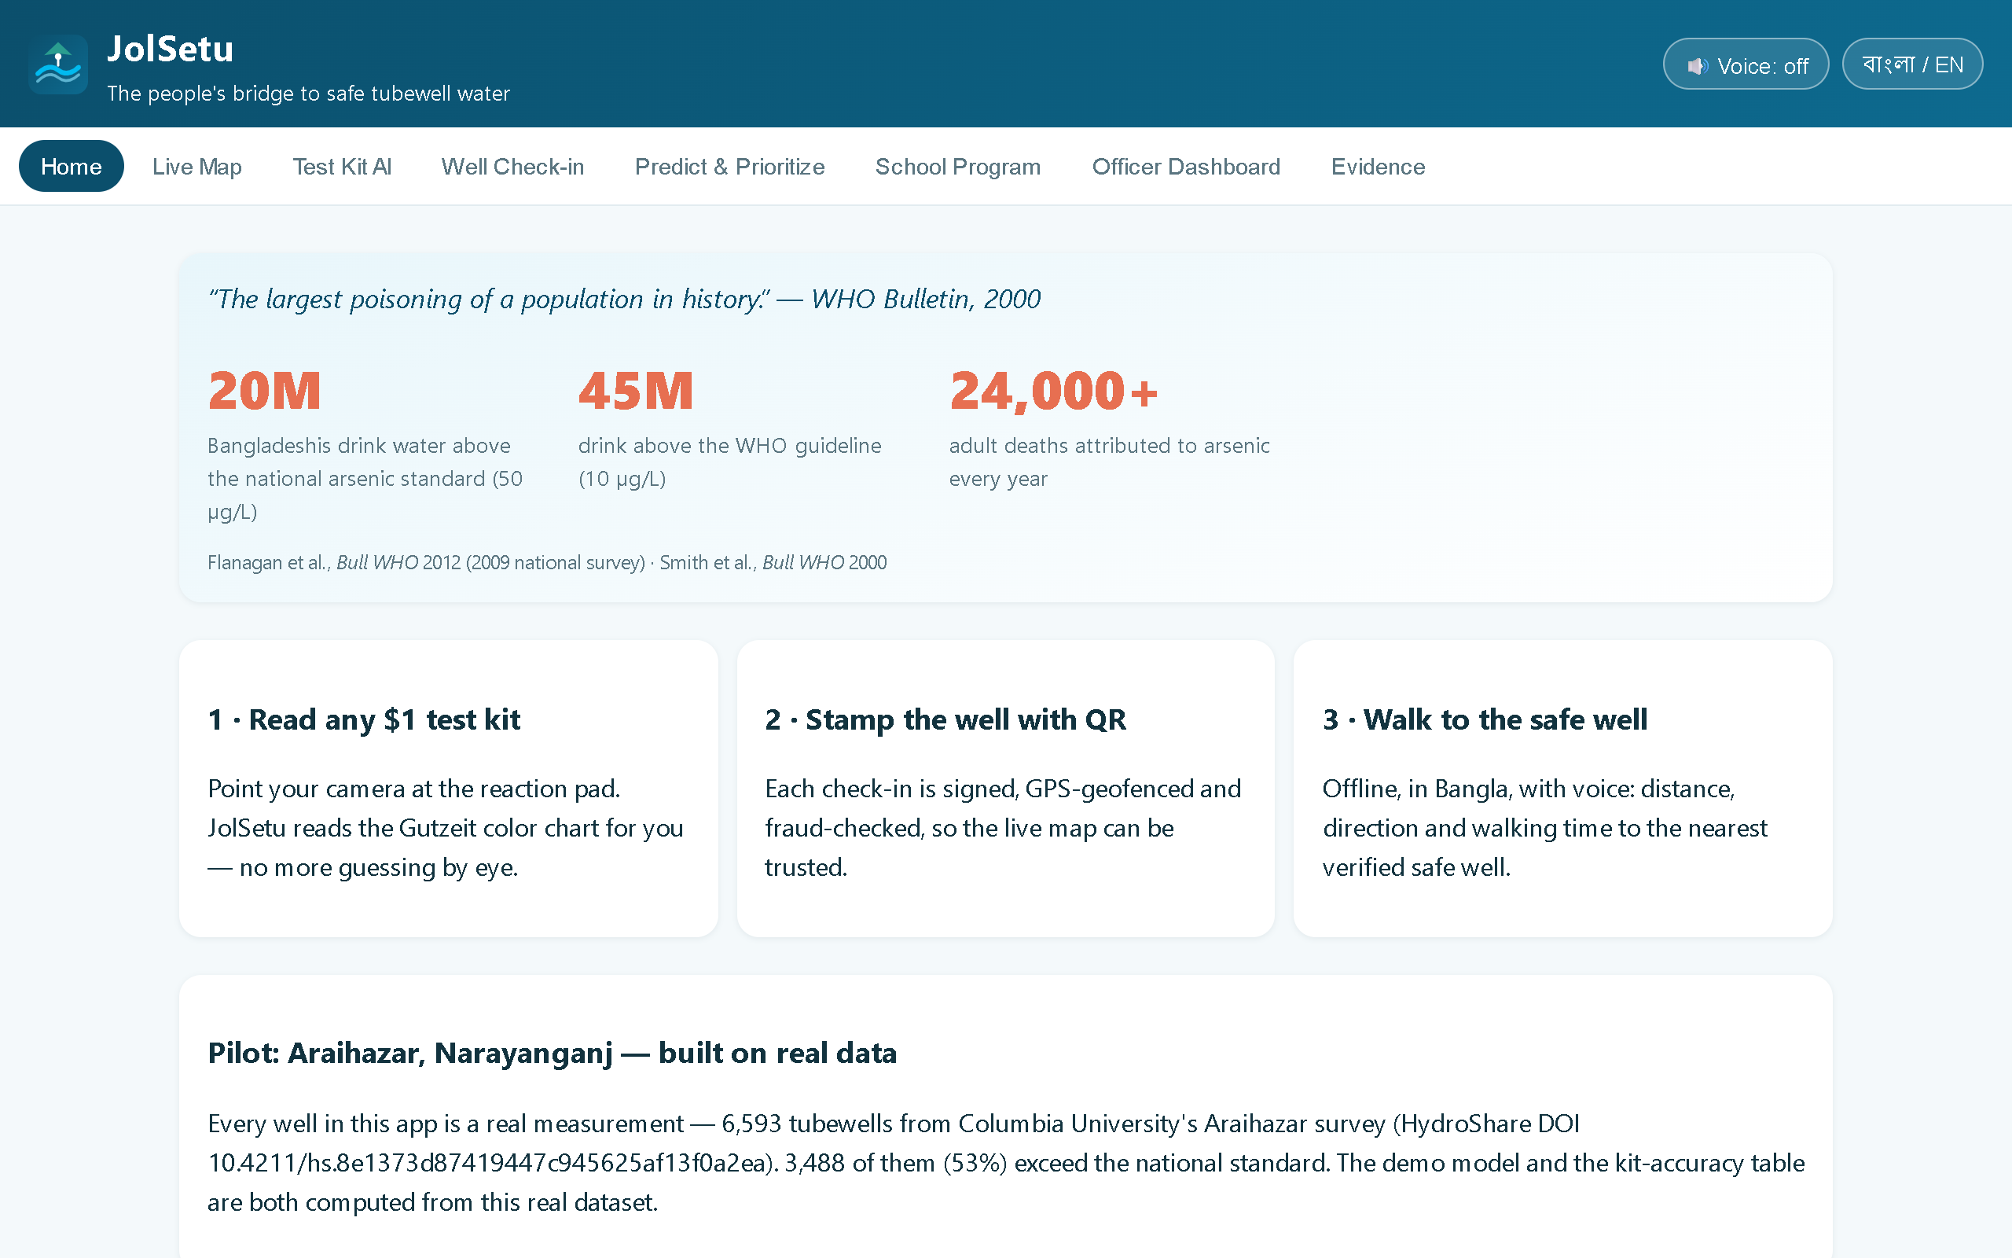
THE TEAM
A builder who ships production systems alone — with the right domain
Rudra Sarker
Founder & Engineer
Final-year B.Sc. Industrial & Production Engineering, SUST
Q1 journal article (J. Ethnopharmacology, 2026, 3rd author) · full-time on Porichoy · ready for both residential bootcamps
AdalatAI — court AI, F1 0.963
JolSetu — 6,593-well live map
RippleUp
Production Android + Windows desktop app (Compose), release v5.3.3
StealthHumanizer
Self-trained LLM system on a VPS, ~45s/request at production
Why me for THIS product: factory-process engineering (IPE) + production LLM pipelines + a proven 3-week ship velocity — exactly Porichoy’s stack.
Shipped systems (live screenshots, left to right)
WHAT WE ASK FROM NIC 3.0
The pollination grant to fund the 10-factory pilot · bootcamp mentoring on RMG business models & circularity
Warm intros: 2–3 pilot factories + one buyer sustainability team
Porichoy (পরিচয়) · Needle Innovation Challenge 3.0 · All listed systems are live productions · CV attached (FlowCV)
5 / 6

Slide 6
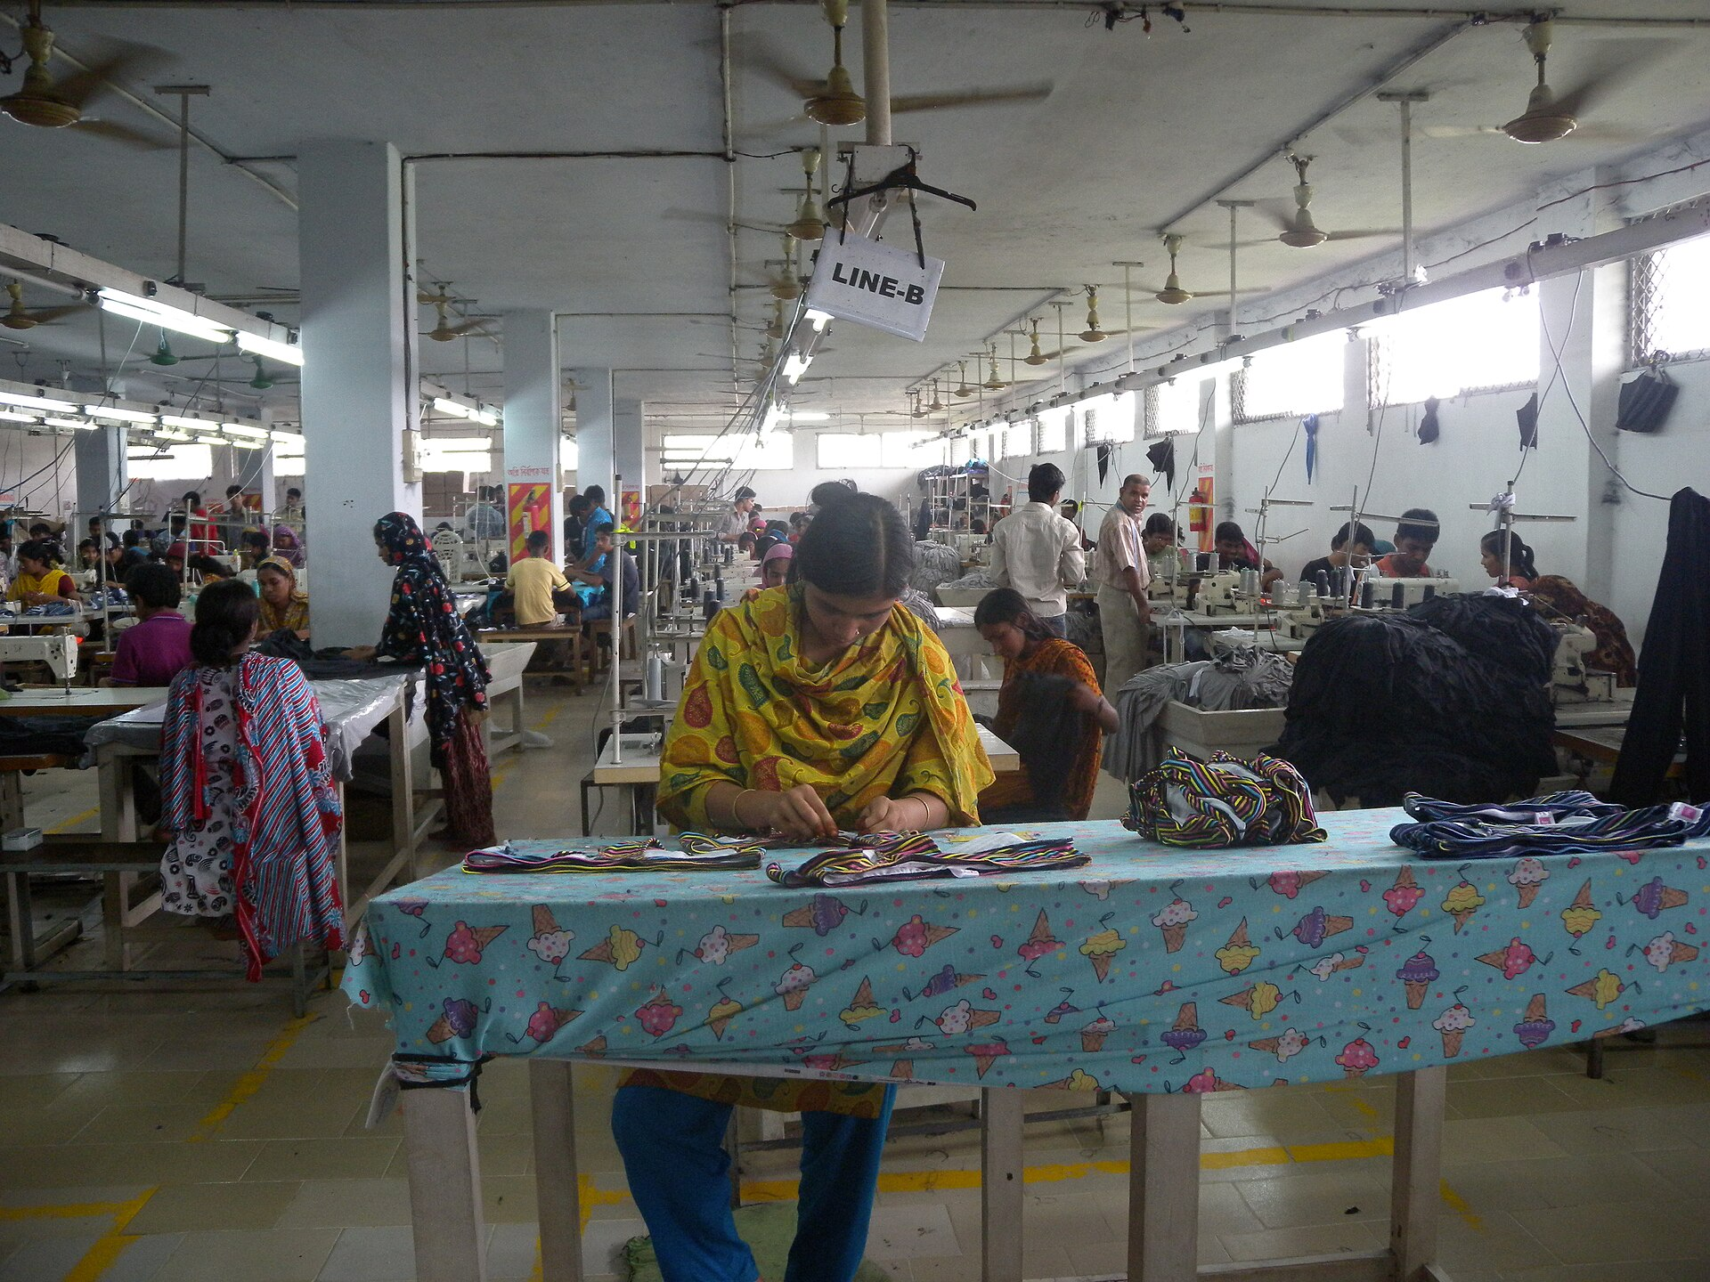
WOMEN AT THE CENTER
Designed in from the first commit — not bolted on.
NEW SKILLED JOBS
2 women operators per factory trained & certified as DPP Data Stewards — formal, higher-skilled back-office roles.
JOBS PROTECTED AT SCALE
Auto-checked EU customs mean non-compliant factories lose orders; compliance protects a majority-women workforce.
KEY REFERENCES — all Crossref-verified 2026-09-13 (full 16 in the accompanying report)
[1] EU Regulation 2024/1781 (ESPR), in force 18 Jul 2024 — European Commission, ESPR page.
[2] The Digital Product Passport of the Ecodesign Regulation — Business Law Review (2024). DOI 10.54648/bula2024009
[3] Digital Product Passport for Circular Economy: a review — Circular Economy & Sustainability (2026). DOI 10.1007/s43615-026-01000-3
[4] Blockchain-enabled supply-chain traceability in textile & apparel — Sustainability (2021). DOI 10.3390/su131910496
[5] Reclaiming waste: informal circularity in Bangladesh — Circ. Econ. & Sustainability (2026). DOI 10.1007/s43615-026-00844-z
[6] Open burning of polyester/cotton textile waste — Env. Science & Pollution Research (2026). DOI 10.1007/s11356-026-37563-9
[7] Social compliance in the RMG industry — Journal of Business Studies, SUST (2023). DOI 10.58753/jbspust.4.1.2023.21
[8] OECD — Due diligence in garments & footwear. DOI 10.1787/df7dc9d4-en · Photos: Wikimedia Commons, CC BY/BY-SA (artists credited in report).
BURDEN → CAREER
Ad-hoc clerical compliance work — often by women staff — becomes a titled, certified, visible career path.
“The last mile of the Digital Product Passport runs through Bangladesh’s factory floor — and it will be walked by its women.”
Live: rudra496.github.io/porichoy · repo rudra496/porichoy · 19/19 engine tests · evidence page with all 16 DOIs
PHOTO: CC BY 2.0, WIKIMEDIA COMMONS
Porichoy (পরিচয়) · Needle Innovation Challenge 3.0
6 / 6

