Slide 1



Porichoy (পরিচয়)
DPP-in-a-Box — every Bangladeshi garment gets a verifiable identity before the EU’s 2027 Digital Product Passport wall.
rudra496.github.io/porichoy · Sylhet, Bangladesh · Rudra Sarker & team, SUST IPE

Slide 2
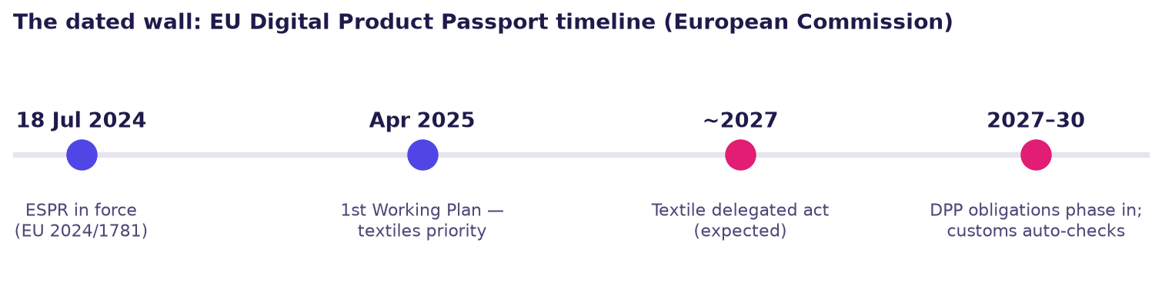
THE PROBLEM
EU customs will auto-check Digital Product Passports on imported garments: ESPR in force 18 Jul 2024 · textiles in the first Working Plan (Apr 2025) · textile delegated act expected ~2027. No passport data → no EU order.
The data already exists in every factory — trapped in mixed Bangla/English Excels, ERP exports and paper trim cards. Global traceability platforms are brand-side and enterprise-priced; nobody captures at the Bangladeshi factory floor.
Most affected: small & mid-size exporters without compliance teams — and, through them, the ≈4 million garment workers (BGMEA; majority women) whose livelihoods ride on Europe, the industry’s biggest market.

Slide 3
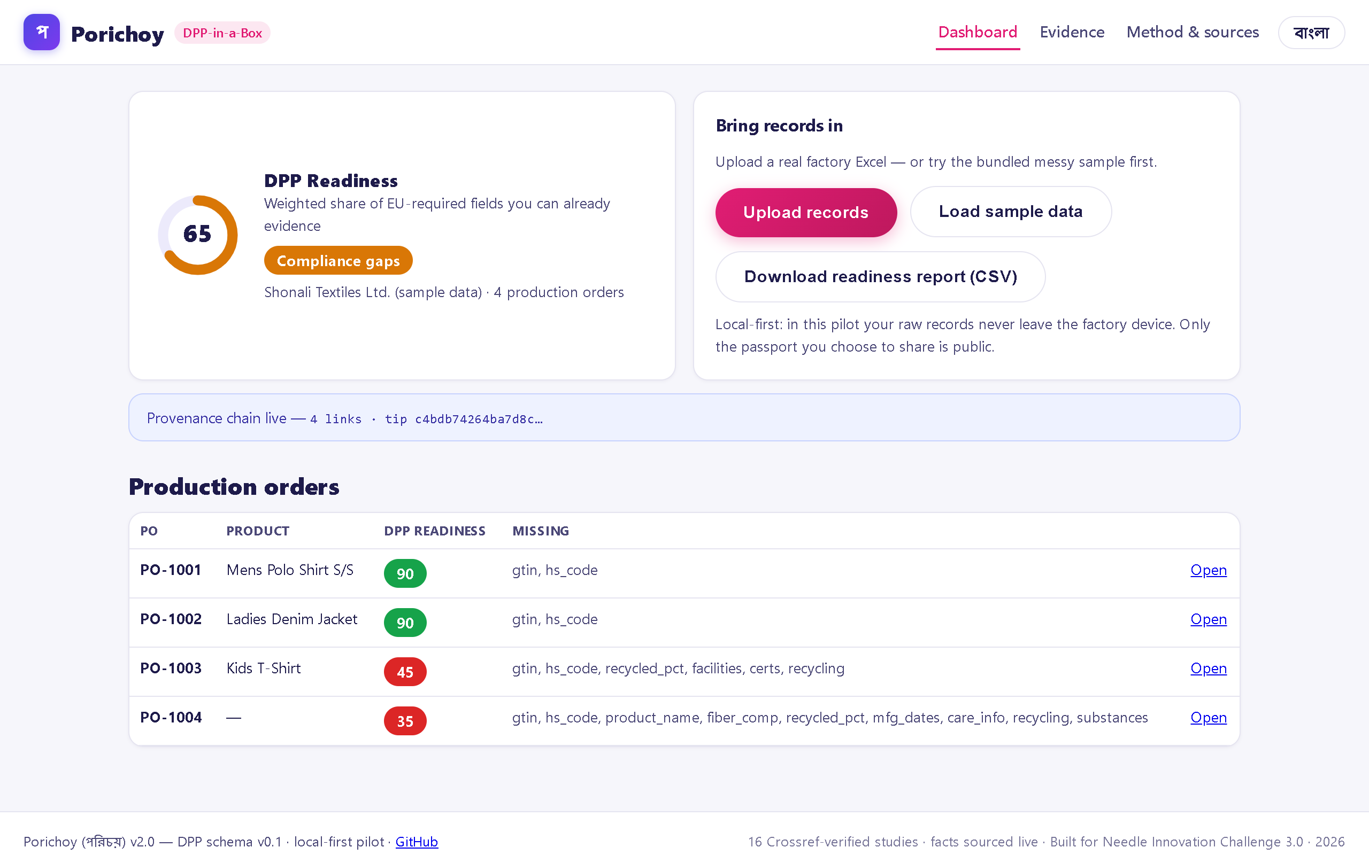
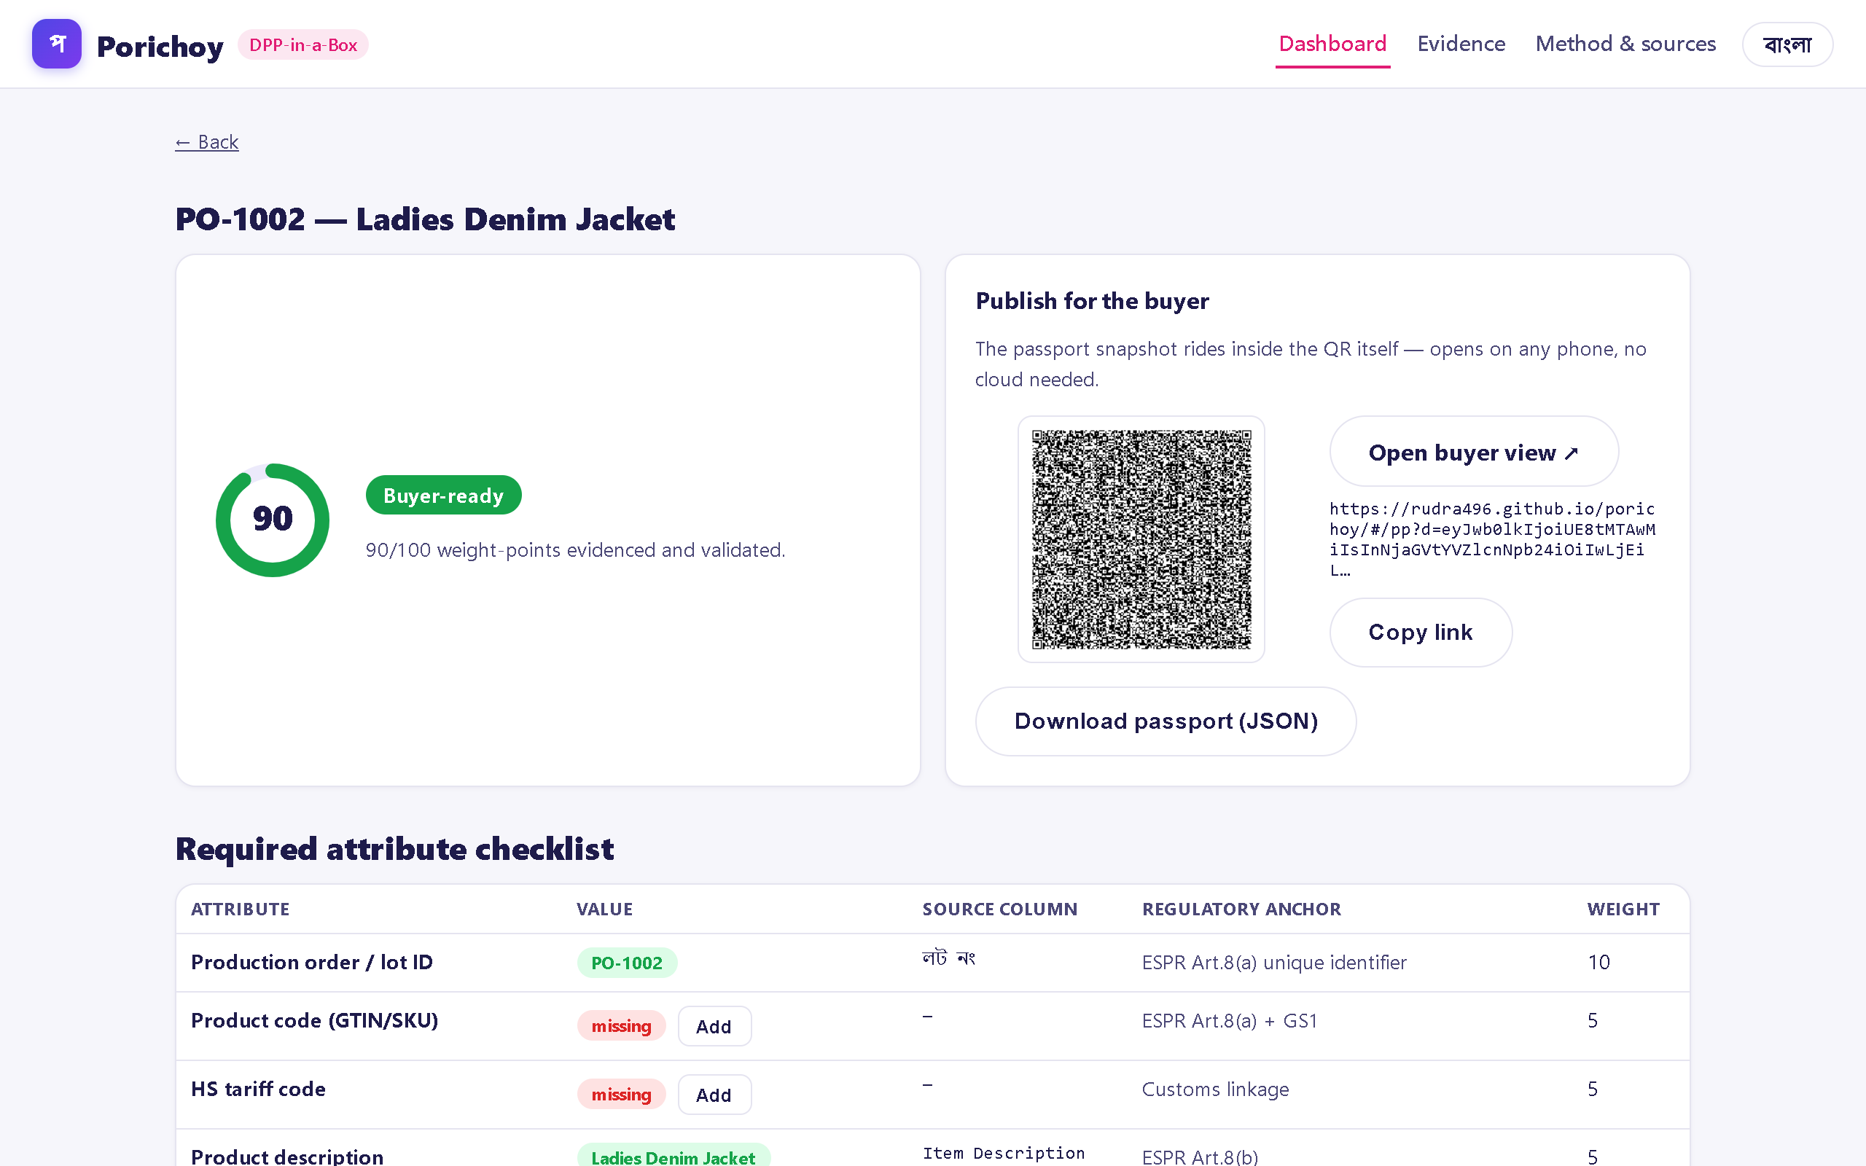
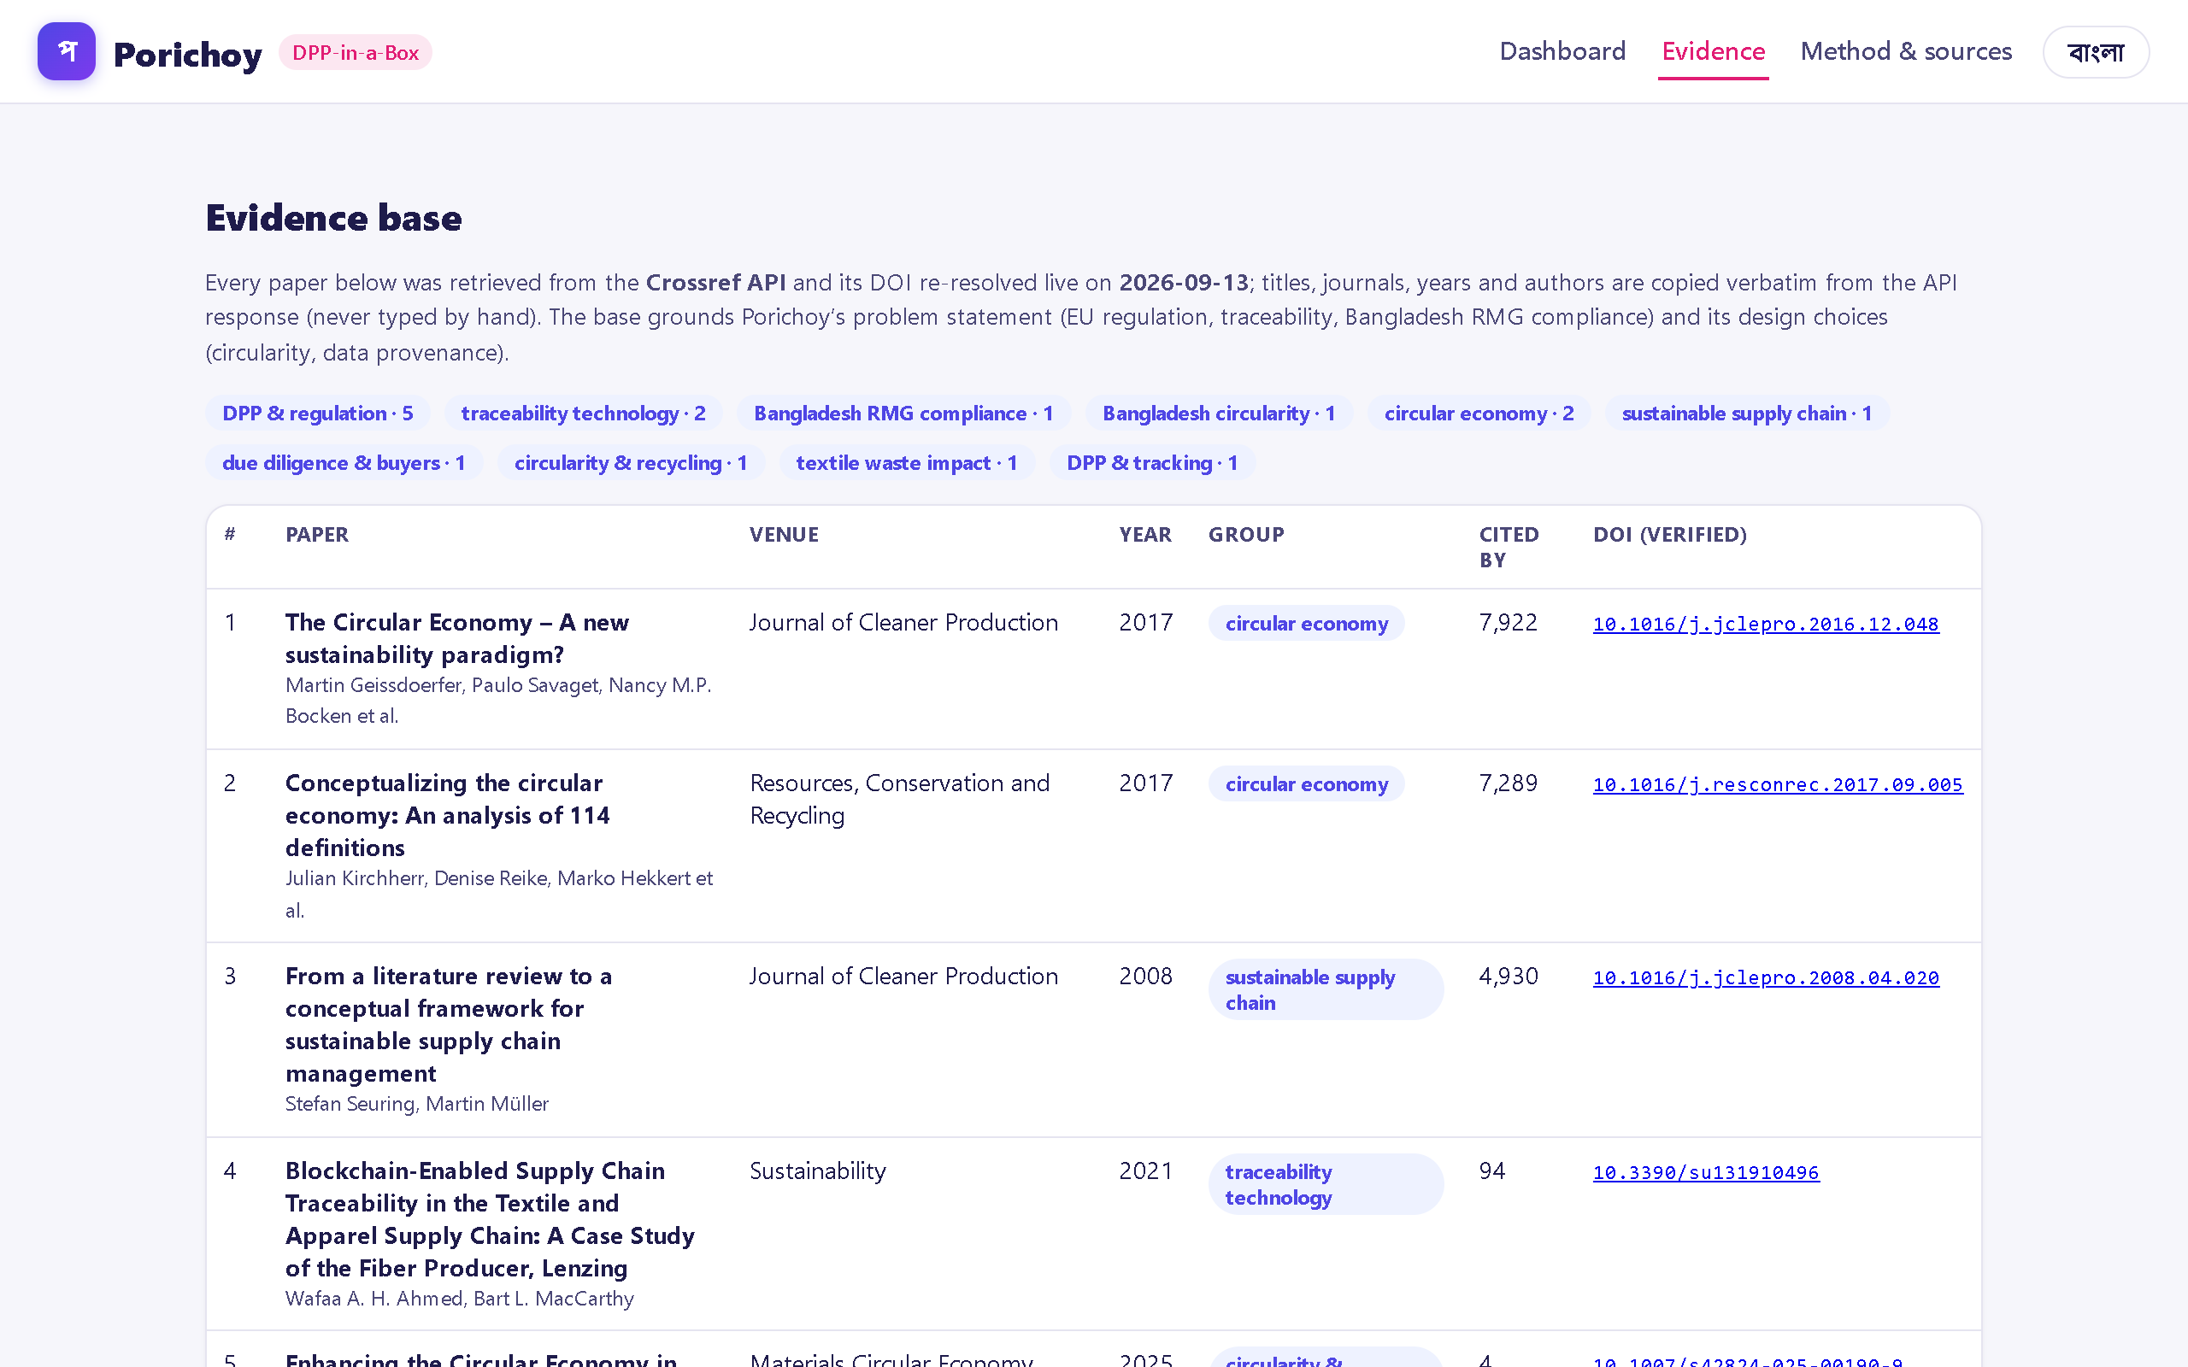
OUR SOLUTION
Porichoy turns a factory’s existing records into buyer-ready EU Digital Product Passports in four steps — all live today, offline-tolerant, Bangla + English:
1 · INGEST — drop the factory Excel/CSV; every sheet parsed on-device. Nothing leaves the factory (local-first).
2 · MAP — the engine reads chaotic Bangla/English headers with confidence scores; a trained steward confirms; the factory’s vocabulary is learned.
3 · SCORE — DPP Readiness 0–100 per production order (weights = ESPR Art. 8 categories) with the exact gap list.
4 · PASSPORT — one click → a QR whose link embeds the passport; scanning opens the buyer view on any phone. No backend.
19/19 automated engine tests · SHA-256 provenance chain · stewards fix gaps in-place and the score updates instantly.
Live production app — screenshots fetched 2026-09-13 · rudra496.github.io/porichoy

Slide 4
MARKET SIZE & OPPORTUNITY
A dated compliance wall creates a forced-adoption market:
≈ 4 million RMG workers (BGMEA) · world’s #2 ready-made garment exporter · Europe is the biggest market (NIC 3.0 call) · thousands of export factories in the BGMEA member base — every one shipping to the EU must be DPP-ready inside the 2027–30 window.
Illustrative revenue math on Porichoy’s own pricing (BDT 2,000–8,000/factory/month):
100 pilot-scale factories ≈ BDT 60 lakh/year · 1,000 factories ≈ BDT 6 crore/year — before brand-funded supplier-onboarding contracts, where buyers pay to bring their supplier base onto passports before the deadline.
≈4 million
RMG workers, majority women (BGMEA)
#2 exporter
world RMG — Europe the biggest market
2027–30
EU DPP phase-in; customs auto-checks
10→100+
factories: year-1 pilot → year-3 scale
Timing is the wedge: buyers already ask, budgets activate before the deadline, and no Bangladesh-built tool serves the factory floor today — the verified competitors are brand-side only.

Slide 5
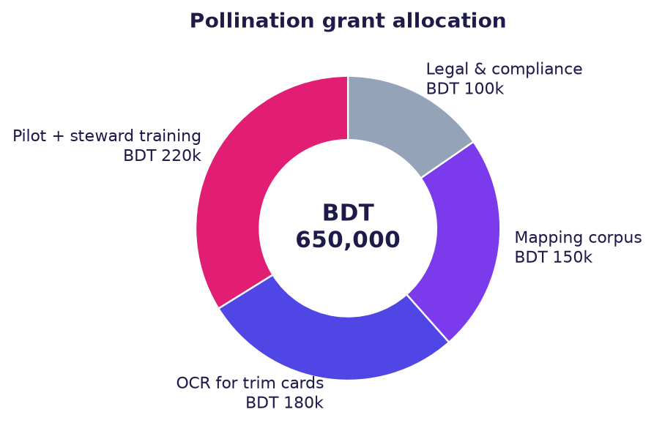
BUSINESS & REVENUE MODEL
Three simple revenue lines:
1. Factory subscriptions — BDT 2,000–8,000/month by size (SME-priced, ~10× below enterprise platforms).
2. Onboarding & data-rescue — one-time fee: steward training + first ingest + mapping historic files.
3. Brand-funded supplier onboarding — buyers pay to make their supplier base passport-ready before 2027–30.
Unit economics: onboarding ≈ 2 person-days/factory · software gross margin >80% · replication is a template, not a project.
Pollination grant (BDT 650,000) funds the 10-factory pilot:
BDT 220k pilot + steward training · 180k OCR for paper trim cards · 150k mapping corpus (Bangla + ERP formats) · 100k legal & compliance.

Slide 6
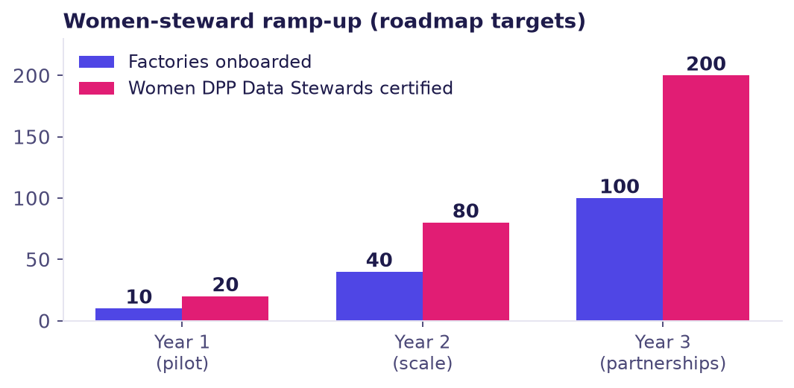
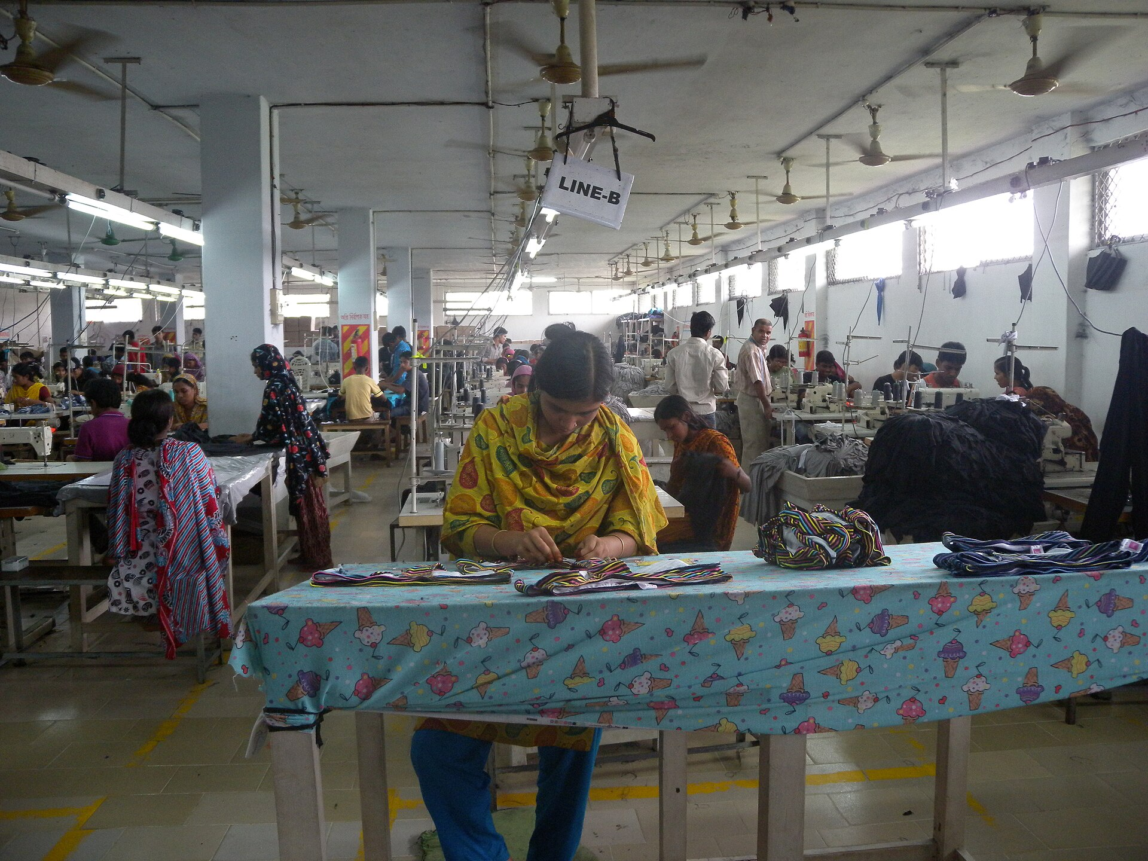
OUR IMPACT
Competitiveness: EU-order eligibility is protected (customs auto-checks), compliance prep per PO drops from days of file-hunting to under an hour, and readiness scores make factories the buyer-preferred choice.
Women: two women operators per factory are trained & certified as DPP Data Stewards — formal, higher-skilled roles (20 in year 1 → 200 by year 3, targets) — and keeping factories order-eligible protects a majority-women workforce (≈4M workers, BGMEA).
Circularity: DPP fields make recycled content, certificates and end-of-life routes verifiable — turning circularity claims into machine-checkable data that flows to buyers and recyclers.
Left: women-steward ramp (roadmap targets). Right: RMG factory floor — photo CC BY 2.0, Wikimedia Commons.

Slide 7

OUR TEAM
Rudra Sarker — Founder & full-time product engineer. Final-year B.Sc. Industrial & Production Engineering, SUST. Builds every part of Porichoy: the EU-aligned DPP schema, the Bangla/English mapping engine, readiness scoring and the provenance chain.
Awards & achievements (verified): Q1 journal publication — Journal of Ethnopharmacology (Elsevier, 2026), 3rd author · Z.AI Global Ambassador (since Nov 2025) · IEF Bangladesh Ambassador (since Apr 2026) · Secretary, RoboSUST (2025–26) · GaoTek industrial internship (2024–25).
Two IPE backgrounds ground us in how factories actually run; systems engineering makes the software ship. Women lead our steward program by design — the same people the product trains and employs. No big-name advisers: 19/19 passing tests, public code and a live product speak instead.
Lutfay Homayra Islam
SUST · IPE
Factory Operations & Pilot Lead
Process mapping, factory data collection, readiness audits across the pilot factories
Priom Sarker
BUET
Systems & Technology Lead
Systems architecture, ERP/API integrations, technical review of the ingestion pipeline
Shuvo Kundu
University of Asia Pacific
Data & Research Lead
Dataset curation, Bangla mapping-corpus growth, literature & research support
Samia Hossain
Steward Training & Outreach Lead
Runs the women DPP Data Steward training program and factory outreach
Live: rudra496.github.io/porichoy · code: github.com/rudra496/porichoy · 19/19 engine tests · launched Sep 2026
Everything we claim is checkable — that is the product’s whole point.

Slide 8
THANK YOU
Name: Rudra Sarker — Founder, Porichoy
Phone: +8801988223165
Email: rudrasarker125@gmail.com
Live product: rudra496.github.io/porichoy · Code: github.com/rudra496/porichoy

