Slide 1
Space Mission Intelligence Copilot Grounded Tool-Using Agent with preference Alignment for Space Scientists
DS – 615 Neural Networks and Deep Learning, May 2026
Team Members:
Keyur Pandya (202518019)
Vishwa Patel (202518016)
Rudra Pandit (202518040)
Vrushil Panwala (202518010)

Slide 2
PROBLEM STATEMENT
Why General LLMs Fail?
Hallucinate mission Parameter
No source traceability
Cannot access domain tools
No escalation awareness
Our Goal
Verified knowledge base
Tool-augmented reasoning
Citation-first responses
Human escalation support

Slide 3
Datasets & Evaluation Metrics
Data Sources
SpaceX REST API
(458 KB, 200+ launches)
NASA Exoplanet Archive
15 curated mission documents
ESA/NSA/ISRO policy docs
Training Data
150 DPO preference pairs
600 tool policy samples
80+ retriever contrastive pairs
60+ reranked pairs
45+ generator SFT triples
Evaluation Metrics
M1 : Citation-F1
M2 : Keyword Grounding
M3 : Answer-in-KB Rate
M4 : Tool Selection Accuracy
M5 : Tool Call Success Rate
M6 : Escalation
M7 : Latency
M8 : Mission-Criticality

Slide 4
Baseline : Naive RAG Agent
User Query
SearchKB
Raw Passages
X Limitations
Returns irrelevant data
No tool routing
Never escalates
No citations or formatting
Cannot compute statistics

Slide 5
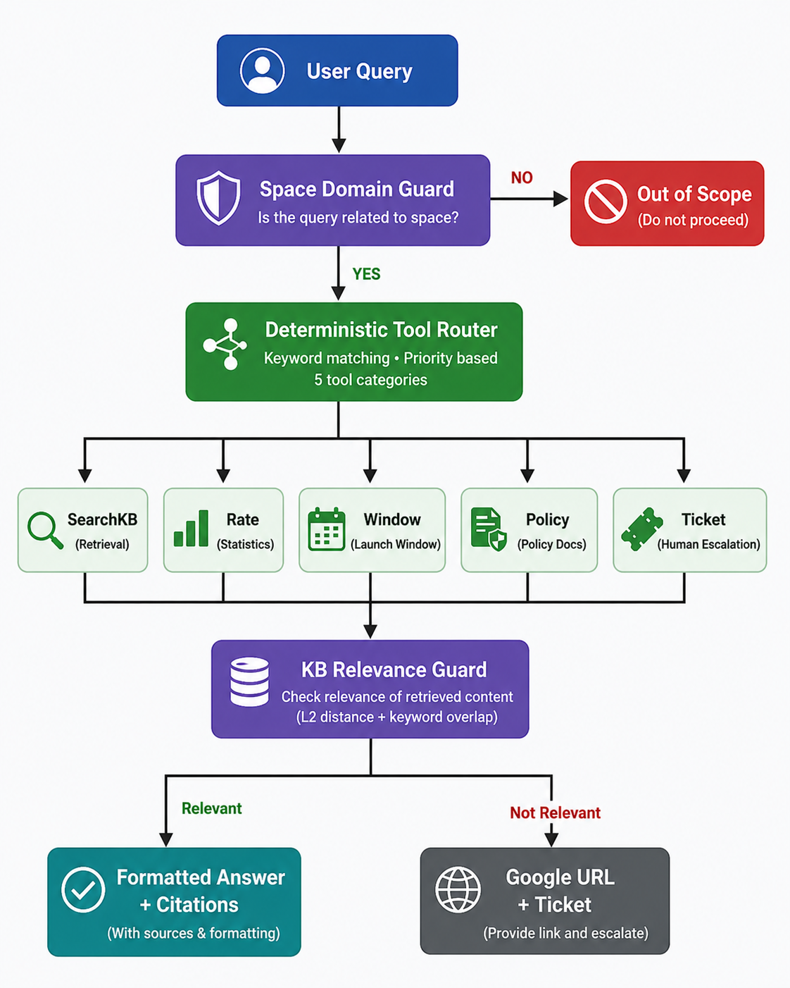
PROPOSED SYSTEM OVERVIEW

Slide 6
TRAINING & WHAT IS LEARNED
Retriever
All-MiniLM-L6-v2
Reranker
CrossEncoder
Generator
Mistral-7B QLoRA
DPO
Preference Align
Tool Policy
BERT Classifier
DPO ALIGNMENT RUBRIC
Helpfulness
Conciseness
Citation-first
Escalation-aware

Slide 7
MAIN RESULTS : BASELINE VS COPILOT
Metric | Baseline | Copilot
Citation-F1 | 0.12 | 0.85 | +0.73
Keyword Grounding | 0.08 | 0.78 | +0.70
Answer-in-KB Rate | 0.35 | 0.72 | +0.37
Tool Selection Acc. | 0.10 | 0.95 | +0.85
Escalation Precision | 0.00 | 1.00 | +1.00
Escalation Recall | 0.00 | 1.00 | +1.00
MCA (Novel) | 0.00 | 1.00 | +1.00
Avg Latency | 18.2 ms | 22.5 ms | +4.3 ms
Copilot improves all functional metrics
with only +4.3 ms latency overhead

Slide 8
ABLATION STUDY : COMPONENT IMPACT
Configuration | Tool Acc. | Esc. Rec. | MCA
Full Copilot | 0.95 | 1.00 | 1.00
-Remove DPO | 0.95 | 0.67 | 1.00
-Remove Tool Router | 0.10 | 0.00 | 0.00
-Remove Relevance Guard | 0.90 | 0.80 | 1.00
Baseline (all removed) | 0.10 | 0.00 | 0.00
Key Findings
Tool Router is the most important component
DPO improves escalation behavior
Relevance Guard reduces hallucination

Slide 9
FAILURE CASES AND LIMITATIONS
Ambiguous Queries
Problem : Routes to SearchKB with limited Apollo data
Effect : Returns partially relevant results.
Fix : Stricter relevance threshold
Keyword Overlap
Problem : "SpaceX" triggers Falcon 9 stats instead of Dragon capsule
Effect : Returns incorrect entity results
Fix : Entity extraction before routing
Training Data Scale
Problem : Synthetic templates may not match real queries
Effect : Limited real world generalization
Fix : Use realistic dialogue datasets

Slide 10
CONCLUSION & FUTURE WORK
Key Takeaways
• Tool routing is most impactful
• +85% tool accuracy improvement
• Relevance guard prevents hallucination
• Google fallback handles missing KB data
Next Steps
• Learned BERT router
• Real-time telemetry integration
• Automated KB scaling
• Multi-turn conversations

Slide 11
Tool Schema
SearchKB(query, top_k) → {passages: [{doc_id, title, text, score}]}
ComputeSuccessRate(launch_vehicle) → {success_rate, total_missions, failure_modes}
GetLaunchWindow(destination, mass) → {optimal_windows, delta_v, risk_factors}
GetPolicy(agency, section_id) → {policy_text, last_updated}
CreateTicket(summary, severity) → {ticket_id, status, eta_hours}

Slide 12
Extra Results (Additional Metrics / Latency)
Tool | Avg (ms) | Queries
SearchKB | 28.3 | 5
ComputeSuccessRate | 1.2 | 4
GetLaunchWindow | 0.8 | 3
GetPolicy | 0.5 | 3
CreateTicket | 0.3 | 3
OutOfScope | 0.1 | 2
Throughput: ~44 queries/sec (direct) | ~18 queries/sec (HTTP API)
SearchKB dominates latency due to ChromaDB vector search.
Deterministic tools execute sub-millisecond.

Slide 13
