Slide 1
IMPROVING DRINKING WATER ACCESS IN INDIA
IBM HACKATHON PROJECT
Presented By : Rudra Pratap Singh
Student Name: Rudra Pratap Singh
College Name - HARIDWAR UNIVERSITY
Department: CSE

Slide 2
OUTLINE
Problem Statement
Proposed System/Solution
System Development Approach
Algorithm & Deployment
Result
Conclusion
Future Scope
References

Slide 3
Problem Statement
Example: Problem Statement No.5 - Improved Source of Drinking Water The Challenge: Access to safe and improved sources of drinking water remains a critical issue in India, especially in rural and underdeveloped regions. Despite ongoing efforts under the Sustainable Development Goals (SDGs), inequalities persist in water accessibility across states and socio-economic groups. This project aims to analyze data from the 78th Round of the Multiple Indicator Survey (MIS) to assess the percentage of the population with access to improved drinking water sources. It will also explore related indicators such as use of clean cooking fuel and migration trends. By identifying patterns and disparities, the study will generate actionable insights to support evidence-based policymaking. The ultimate goal is to help ensure equitable access to clean water and contribute to India's progress on SDG targets.

Slide 4
Proposed Solution
The project analyzes data from the 78th Round of the Multiple Indicator Survey (MIS) to measure population access to improved drinking water sources.
It examines disparities across states, rural–urban regions, and socio-economic groups.
Related indicators such as clean cooking fuel usage and migration patterns are integrated for deeper insights.
Visual analytics and summaries are used to support evidence-based policymaking aligned with SDG goals.

Slide 5
System Approach
The "System Approach" section outlines the overall strategy and methodology for developing and implementing the rental bike prediction system. Here's a suggested structure for this section:
System requirements
Library required to build the model

Slide 6
Algorithm & Deployment
Use descriptive statistics to calculate percentages of access to improved drinking water.
Apply correlation analysis to study relationships with clean fuel usage and migration. Implement simple machine learning models for pattern detection where required.
Deploy results through visualization tools and reports for policymakers and planners.

Slide 7
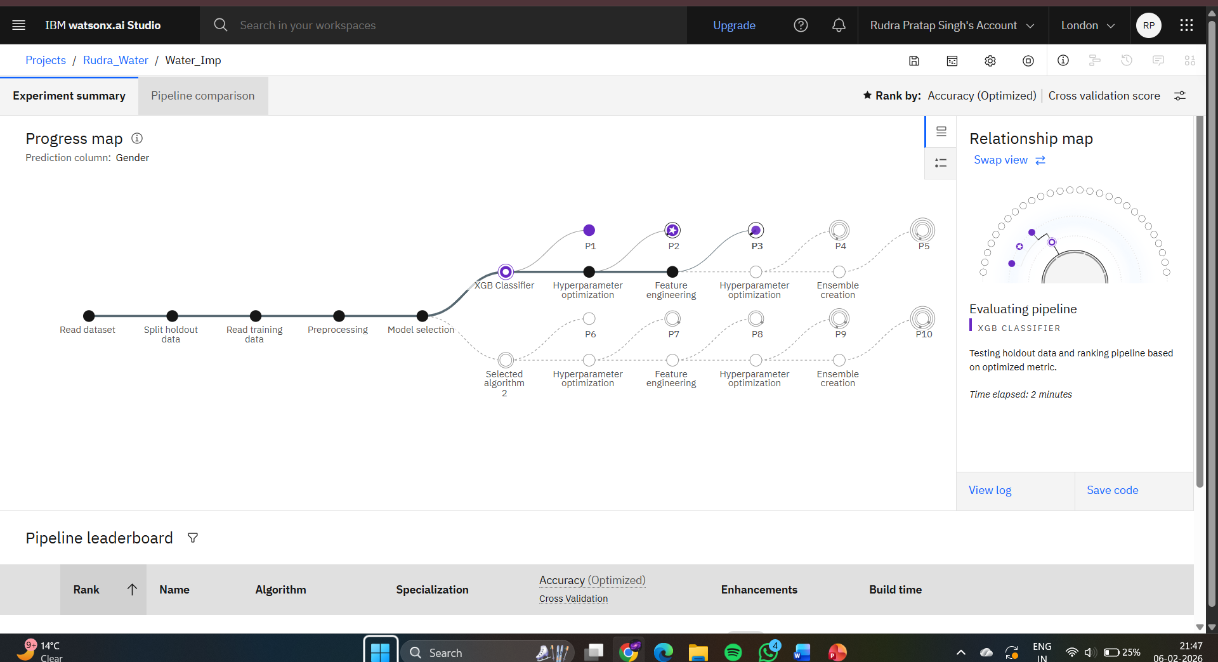

Slide 8
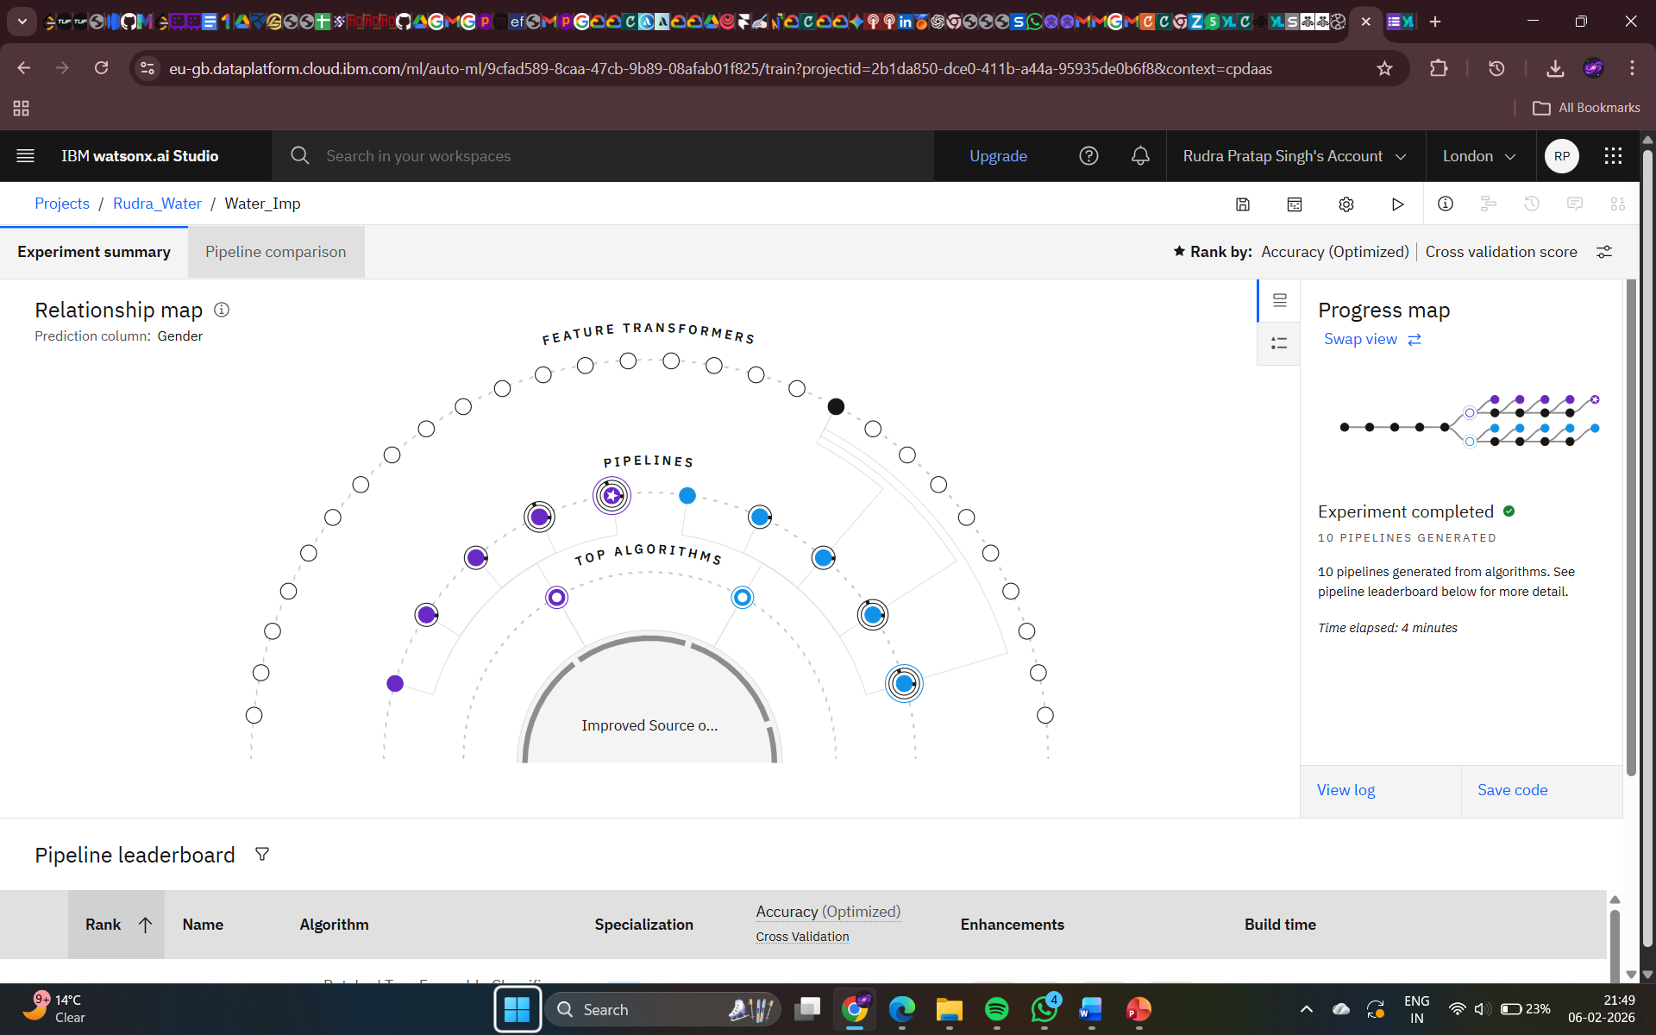
RESULT

Slide 9
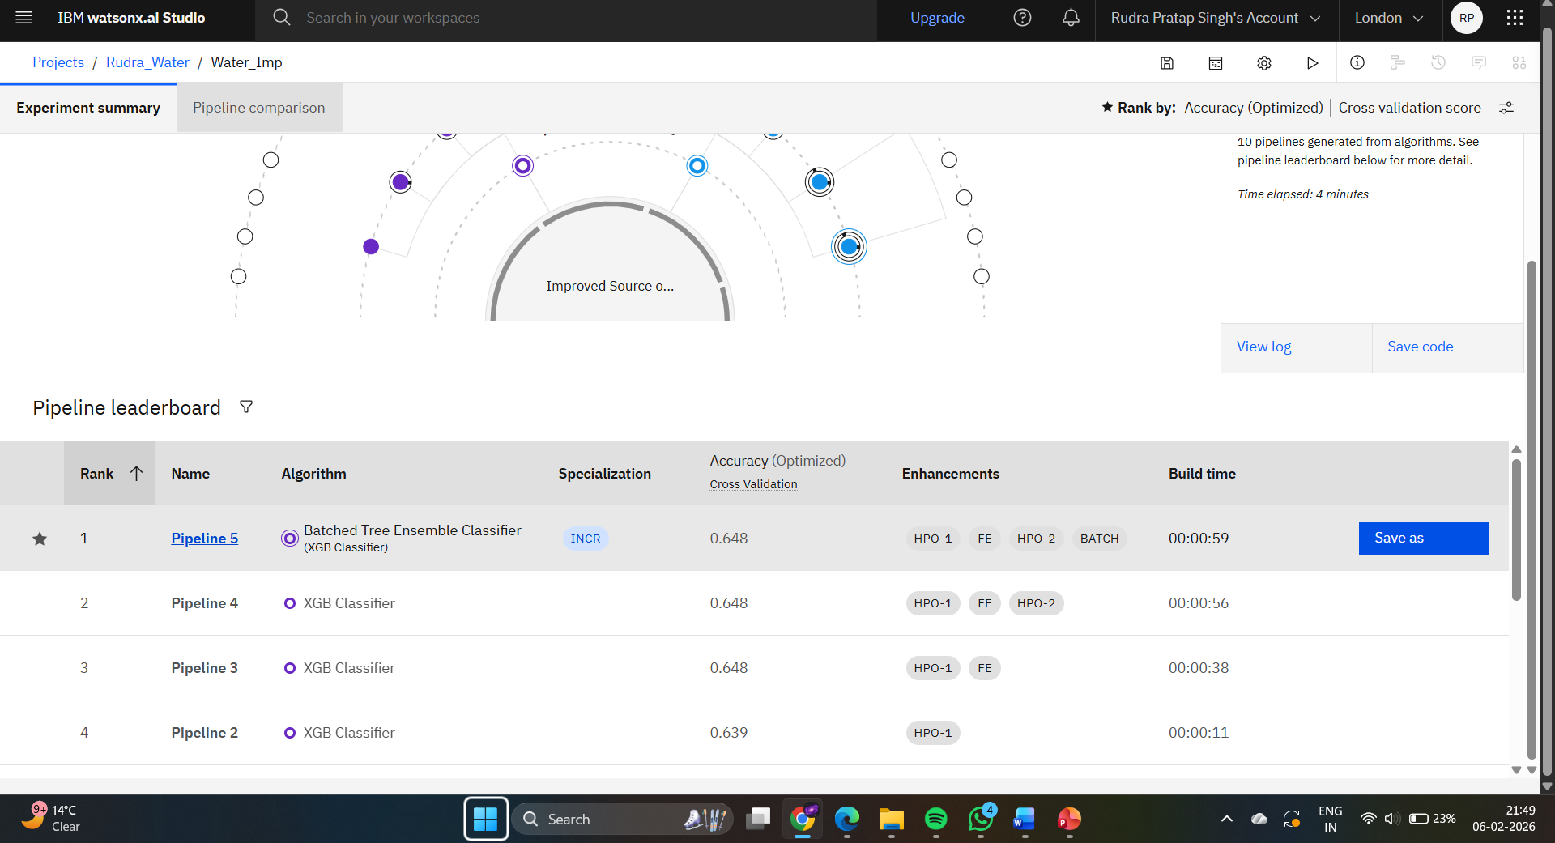
RESULT

Slide 10
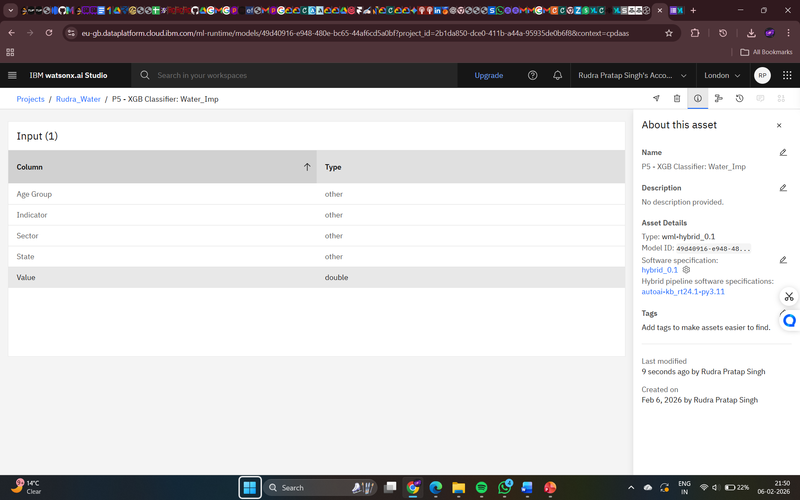
RESULT

Slide 11
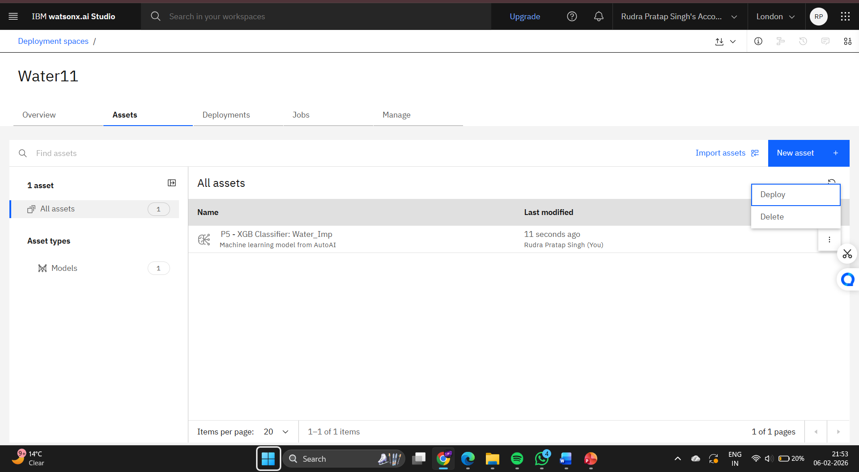
RESULT

Slide 12
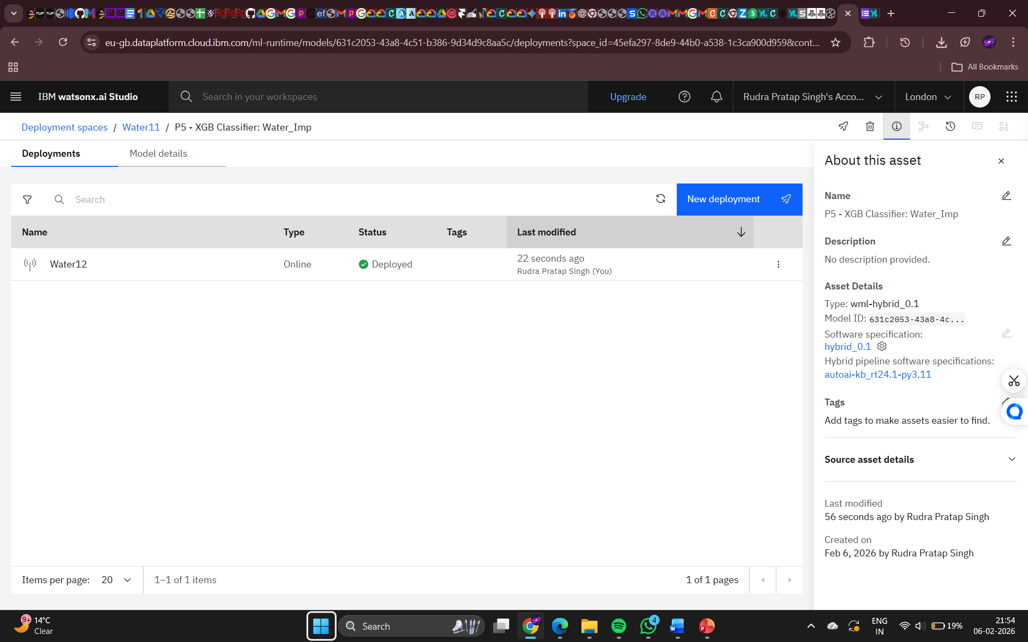
RESULT

Slide 13
Result
The analysis highlights significant regional and socio-economic disparities in access to improved drinking water across India. States with better infrastructure show higher coverage, while rural and underdeveloped regions lag behind. A positive relationship is observed between improved water access and clean cooking fuel usage. Migration trends indicate that lack of basic amenities influences population movement.

Slide 14
Conclusion
The study provides a data-driven assessment of drinking water accessibility in India. It identifies critical gaps and supports targeted interventions to improve equitable access. The findings contribute to monitoring progress toward Sustainable Development Goals.

Slide 15
Future scope
Inclusion of recent survey rounds for trend comparison.Integration of real-time data and GIS mapping.Advanced predictive modeling for policy impact assessment.Expansion to other SDG-related indicators such as sanitation and health.

Slide 16
References
List and cite relevant sources, research papers, and articles that were instrumental in developing the proposed solution. This could include academic papers on bike demand prediction, machine learning algorithms, and best practices in data preprocessing and model evaluation.

Slide 17
THANK YOU

