Slide 1

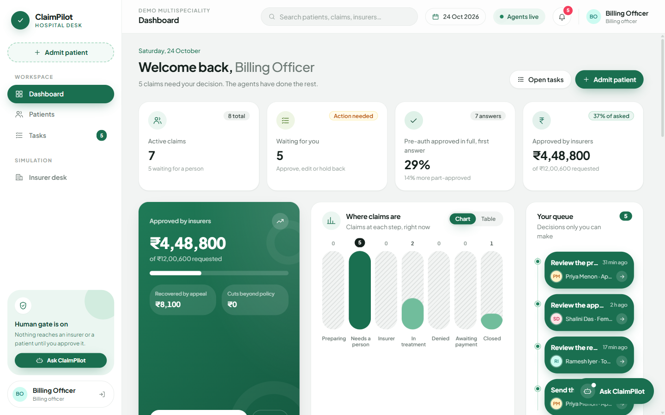
AgentOps 2026 · MIT Bengaluru × CGI
ClaimPilot
Cashless hospital insurance claims, checked before they are sent, with a person approving every step.
Rudra Solanki · Janhavi Bhattad
github.com/rudra995/claim-pilot

Slide 2




Hospitals find out a claim is wrong only when the insurer cuts it
Patient
ONE PATIENT, ONE ROOM CHOICE
Learns the bill at discharge, after the choices that drove it are made
₹47,200
Billing desk
extra paid by Ramesh, 58, for his knee replacement
Reads long policy wordings by hand and chases insurer queries
He took a ₹5,000-a-day room. His policy capped room rent at ₹3,000.
Above the cap, the insurer also cuts doctor, nursing and OT fees in the same ratio.
He paid ₹54,200 instead of ₹7,000. Nobody told him at admission.
Hospital finance
Deductions and denials leak revenue that is rarely recovered
Insurer / TPA
Incomplete claims cause rounds of queries and slow discharges
Ramesh is a synthetic case. His amounts are computed by ClaimPilot's rules engine from his policy wording (clause 4.2).

Slide 3









ClaimPilot runs the whole claim, from admission to the last rupee
1 Admission
2 Pre-auth
3 Enhancement
4 Discharge
5 Appeal
6 Reconcile
Read records, code the diagnosis
Price the stay, check risks, draft the request
Ask for more when the bill grows
Final claim with a deduction preview
Contest cuts only when evidence supports it
Payment vs what the policy allows
Catches problems before sending
Exact money, from code
A person approves every message
A denial-risk model and document checklist flag missing records, non-payables and room-cap breaches, each with its fix.
A rules engine prices every line against the policy clause by clause. The language model only writes prose.
Officers approve, edit or hold back each draft. Nothing reaches the insurer or patient without them.

Slide 4
Two agent teams that share no code and talk only through messages
Billing officer desk
Patient portal
Assistant (RAG chat)
FastAPI · sign-in · claim runner · live trace
HOSPITAL AGENTS · LangGraph orchestrator (state machine)
Human approval gate
Document reader
Clinical coder
Policy + cost
Denial-risk check
Drafts: pre-auth, query, appeal…
Claim exchange
append-only messages
DETERMINISTIC TOOLS
Rules engine · every rupee
XGBoost · cost, denial risk
ChromaDB policy search
LLM (optional) · prose only
Simulated insurer / TPA
fraud · medical review · adjudicator · queries
Rules enforced in code: no model arithmetic · every finding cites a source · state changes only through the orchestrator · hospital and insurer never import each other

Slide 5







12 hospital agents and a simulated 4-agent insurer, one job each
Document reader
Clinical coder
Policy agent
Cost estimator
SIMULATED INSURER
Fields with page references
ICD-10 code with reasoning
Limits and exclusions, by clause
Typical and high bill, stay length
Fraud screen
Medical reviewer
Adjudicator
Query writer
Pre-auth writer
Risk checker
Enhancement
Discharge
Package with justification
Denial risk, reasons, fixes
Top-up request as the bill grows
Final claim, deduction preview
Hidden strictness profiles per TPA, so outcomes come from real gaps in the claim, not a script.
Query responder
Appeal writer
Reconciliation
Patient agent
Answers with the right document
Clause-cited, evidence-checked
Valid vs recoverable cuts
Plain-language cost and room note
One output contract for all agents: decision, confidence, findings (each with a source such as "Policy clause 4.2" or "Bill line 3") and the next step. A finding without a source is rejected.

Slide 6
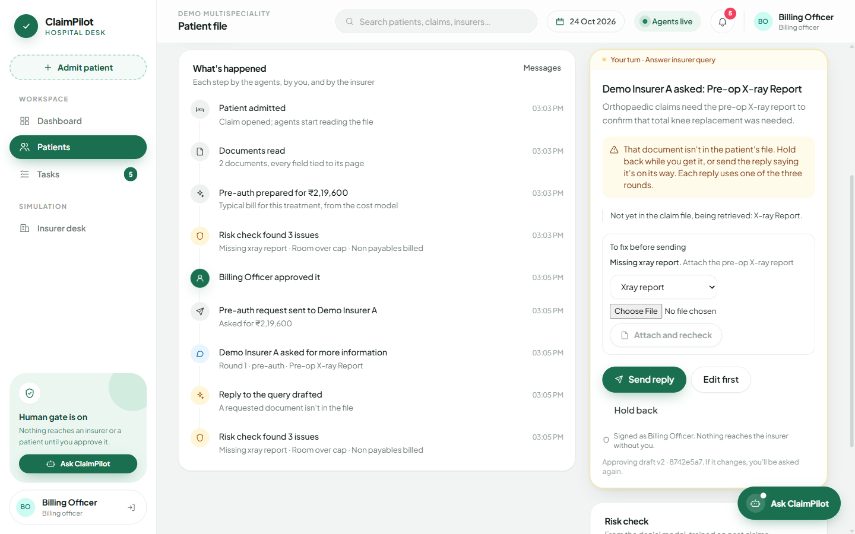





Nothing reaches the insurer or the patient until a person approves it
Approve, edit or hold back
every pre-auth, query reply, enhancement, discharge claim and appeal
Approvals bound to the draft
if the draft changes after review, the officer is asked again
Patients see reviewed updates only
judgement questions from patients go to the officer's queue
Agents escalate, never guess
low confidence or two failures send the claim to a person
Append-only audit log
every agent and human action, with inputs and outputs
Masked before any model call
names, phone and ID numbers are swapped for tokens

Slide 7
Every rupee comes from a rules engine, never from a language model
Final bill |  | ₹2,40,000
Consumables (gloves, admission kit) | Annexure II · non-payable | − ₹7,000
Single deluxe room, 4 days | 4.2 · room capped at ₹3,000/day | − ₹8,000
Surgeon and doctor fees | 4.2 · paid at 60% (proportionate) | − ₹24,000
Operation theatre charges | 4.2 · paid at 60% (proportionate) | − ₹12,000
Nursing charges | 4.2 · paid at 60% (proportionate) | − ₹3,200
Insurer pays |  | ₹1,85,800
Patient pays |  | ₹54,200
₹1,85,800
what the simulated insurer paid at settlement: exactly the engine's prediction at discharge
Room-rent caps, proportionate deduction, sub-limits, co-pay, waiting periods and non-payables are coded rules, each linked to its clause.
Tests scan agent code so no amount is ever computed outside the engine.
The same claim under another policy config pays ₹1,57,500, with no code change.

Slide 8
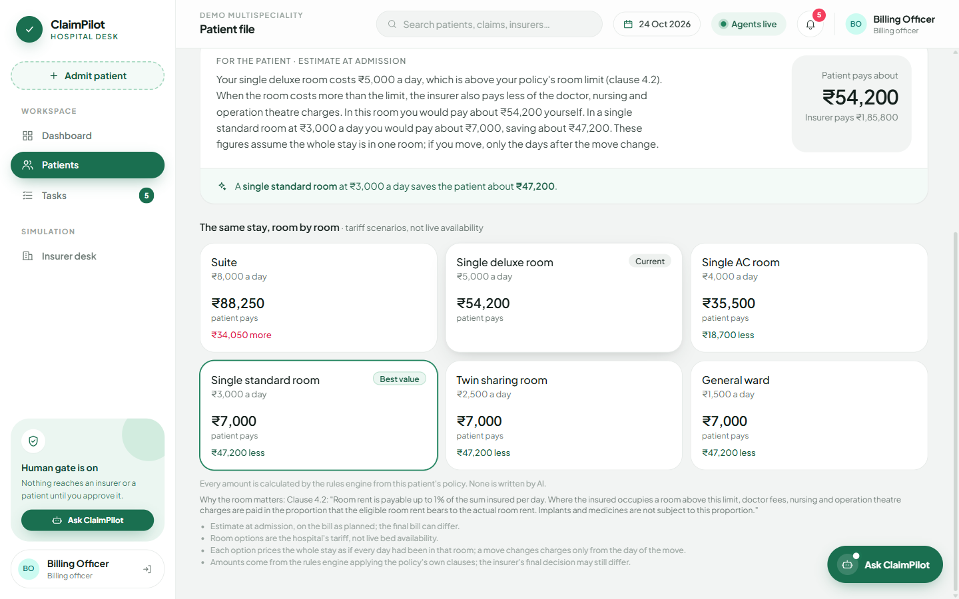
At admission, patients see what each room choice would cost them
Room advisor
Prices the same stay in every room on the hospital's tariff, using the patient's own policy.
Explains the room cap and proportionate deduction in plain words, quoting clause 4.2.
Ramesh's best choice: a single standard room saves him ₹47,200.
Reaches the patient only after the billing officer publishes it.

Slide 9

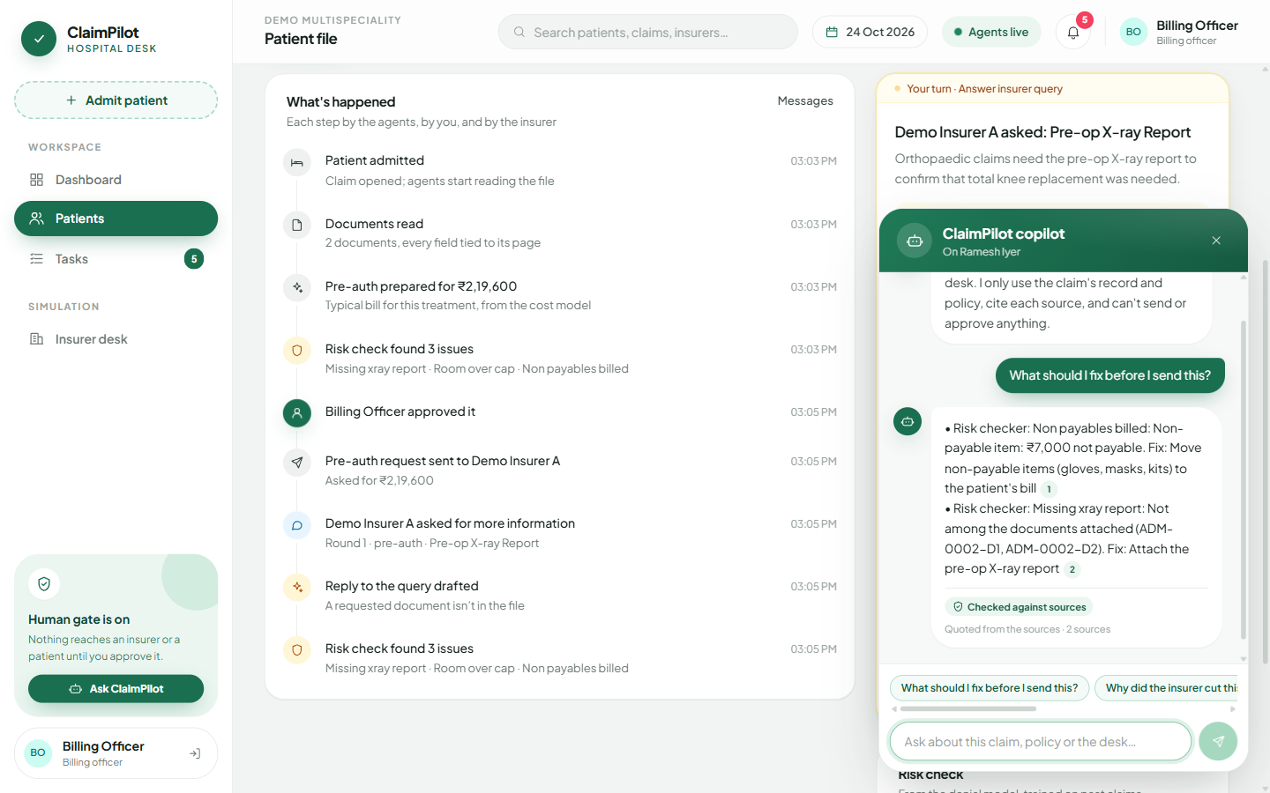



An assistant that cites its sources and knows when to hand off
Retrieve
Semantic search (MiniLM embeddings) over the claim record, agent findings, policy clauses and a ChromaDB index of policy wordings
Cite
The closest pieces become numbered sources [S1], [S2]; each chip opens the exact text
Verify
Rejected unless every citation exists, every number appears in a source, and nothing promises an outcome
Hand off
"Why was my claim cut?" goes to the billing officer; their reply returns to the patient's chat
Officer copilot is read-only: it cannot send, approve or change a claim. Patients only ever see figures an officer has published.

Slide 10
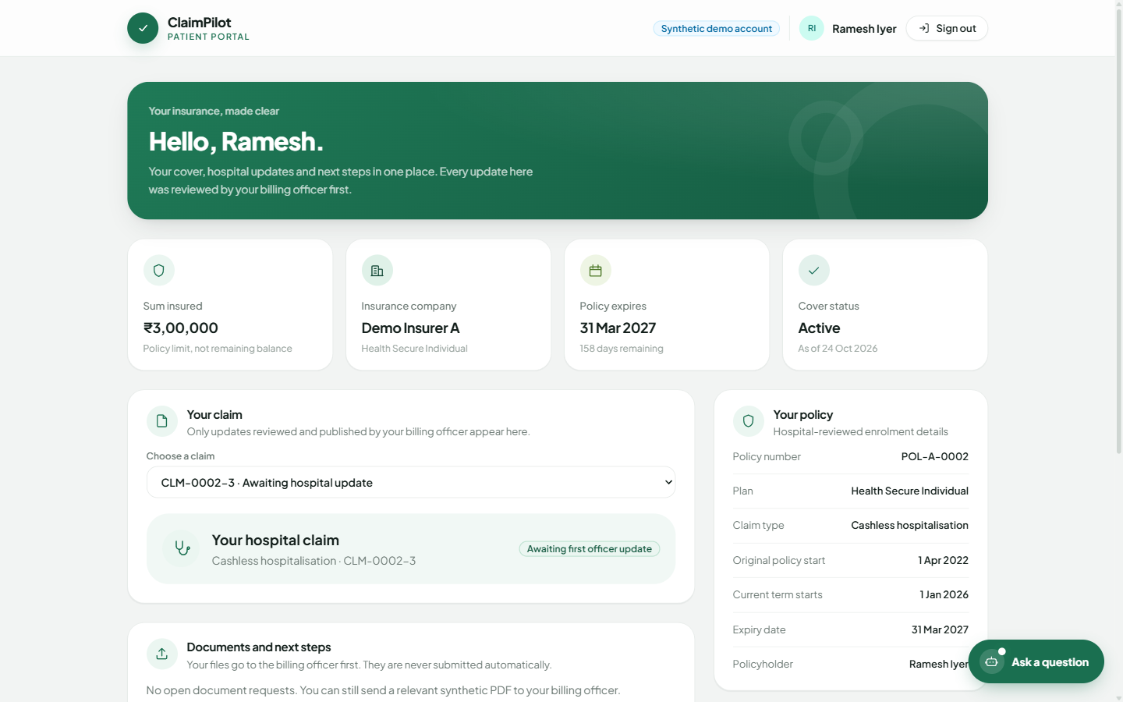




Patients follow their claim through updates the hospital has reviewed
Reviewed updates
Status, estimate and next steps, published by the officer
Send documents
Files go to the officer first, never straight to the insurer
Ask a question
Answers from their own policy, with sources
Own claims only
Patients cannot reach another claim or any staff tool

Slide 11
Every planted problem caught before sending, on 55 held-out cases
0.988
denial-risk model ROC-AUC on a later, held-out time split
₹20,690
recovered by evidence-checked appeals against a held-out insurer
0.79 days
average error of the length-of-stay estimate
287
automated tests, including the ₹1,85,800 reference claim
Same frozen cases, documents and approval gate in all three modes; labels never visible to the hospital side. The rules checklist matches ClaimPilot on catching problems; ClaimPilot adds the cost and risk models, evidence-checked appeals, room advice and reconciliation.
All measurements on synthetic data against a simulated insurer (reports/BENCHMARK.md, models/metrics.json). They are not evidence about real hospitals yet.

Slide 12




What is new here
Room advice priced by the engine
Self-checking appeals
Fix and recheck
Patients see the cost of each room at admission, with the clause that causes it.
Weak appeals are held back instead of sent; the appeal never invents a justification.
Attach the missing record, the risk check reruns, and a new draft version needs fresh approval.
Two organisations, one message log
A chatbot with a verifier
An honest baseline
Hospital and insurer agents share no memory or code, like a real claims exchange.
Answers that cite a missing source, state an unbacked number or promise an outcome are never shown.
A three-mode benchmark shows exactly which layer adds what, including where it adds nothing.

Slide 13
How ClaimPilot answers each judging criterion
Reusability | Policies are versioned configs: the same workflow pays ₹1,85,800 under one and ₹1,57,500 under another, no code change. Billing CSV/JSON import. Insurer habits switch by setting.
Governance & responsibility | Human gate with hash-bound approvals. Money only from the engine, enforced by tests. Cited findings, masking before model calls, append-only audit log, safe template fallback.
ROI / business value | Catches missing records and policy breaches before sending (47/47 vs 0/47), avoids query rounds, recovers money through appeals, tells patients their cost upfront.
MVP readiness | One-command Docker, setup scripts for Windows/macOS/Linux, readiness endpoint, resume after a crash, 287 tests, a demo check that runs twice from a clean state.
Originality | Engine-priced room advisor, evidence-checked appeals, fix-and-recheck drafts, a two-sided simulation, and a verified RAG assistant with human hand-off.

Slide 14







Built on open, well-understood tools, so it runs anywhere
Agents
Money
Python 3.11 · LangGraph · Pydantic v2
Hand-written rules engine · versioned policy configs
Models
Retrieval
XGBoost quantile cost model · denial classifier · SHAP
ChromaDB · all-MiniLM-L6-v2 embeddings
API
Frontend
FastAPI · WebSocket live trace · SQLite
React 18 · Vite · Tailwind CSS
Language model
Delivery
Optional: Ollama (local) or Gemini, for prose only
Docker Compose · nginx · setup scripts

Slide 15
What runs today, and what is simulated
Working end to end
Simulated or synthetic
Full claim lifecycle with every human gate
Rules engine, cost and denial-risk models
Policy search over four public policy wordings
Officer desk, patient portal, analytics dashboard
Grounded assistant for officers and patients
Benchmark, model report, 287 tests, Docker
Patients, bills and medical records are generated
The insurer/TPA is a simulation with hidden strictness profiles
No OCR yet: scanned pages go to a person
Demo sign-in uses fixed accounts
Benchmark numbers are synthetic, not field results

Slide 16
From a working MVP to a hospital pilot
NEXT 3 MONTHS
3 TO 9 MONTHS
9 MONTHS +
Pilot-ready
Connected
Learning
OCR for scanned records
Live model prose, reviewed by officers
Patient notes in Hindi and Kannada
Proper identity and hosting
Claims as FHIR resources for India's National Health Claims Exchange
Integration with hospital billing and HIS systems
PM-JAY mode: package rates instead of itemised bills
Learn each TPA's habits from its queries and denials
Retrain models on a hospital's own history
Fairness monitoring on real outcomes

Slide 17
Thank you
TRY IT
docker compose up --build
ClaimPilot checks every cashless claim before it is sent, prices every rupee from the policy, and keeps a person in charge of every message.
then open localhost:8080
BILLING OFFICER
officer@claimpilot.demo
OfficerDemo!2026
Rudra Solanki · Janhavi Bhattad
PATIENT
github.com/rudra995/claim-pilot
ramesh@claimpilot.demo
PatientDemo!2026
All data is synthetic.

